Slide 1
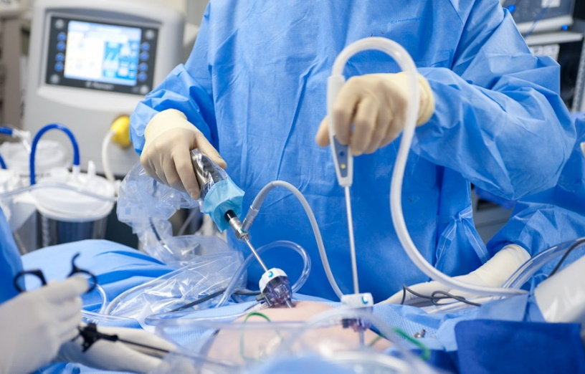
Modern equipment and techniques in laparoscopic surgery
Malynovskyi A.V., MD
Chair of Departmant of Robotic and Endoscopic Surgery

Slide 2
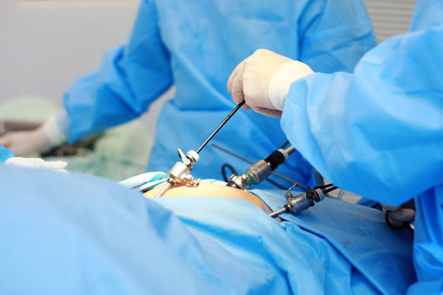
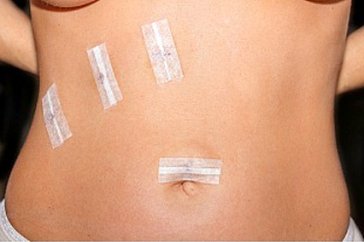

Advantages of minimally-invasive surgery
Lower postoperative pain
Lower blood loss and operative trauma
Early return to physical activity
Early renewal of function of alimentary tract, thus early return to oral food intake
Lower incidence of cardio-vascular, pulmonary and
thrombotic complications
Lower incidence of wound complications
Better cosmetic effect
Lower incidence of postoperative hernias and adhesions
Better functional results, better oncologic results of some procedures

Slide 3
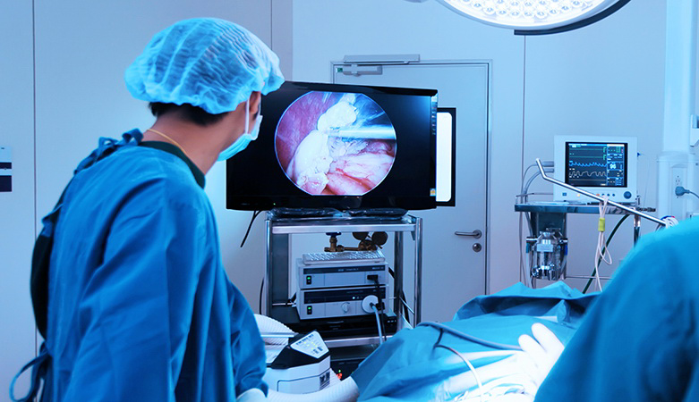
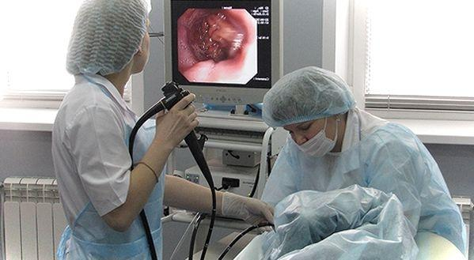
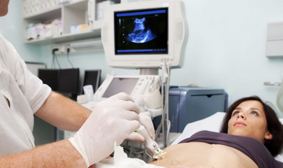
Chapters of minimally-invasive surgery
Laparoscopic surgery
Flexible therapeutic endoscopy
Interventional ultrasound (percutaneous interventions)
Endovascular surgery
Thoracoscopic surgery
Endourology
Rhinoscopic surgery
Arthroscopic surgery
Cranioscopic surgery and endoscopic operations on spinal cord and spine
Endoscopic thyroid surgery

Slide 4
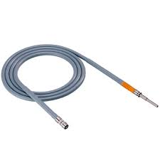
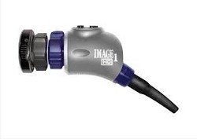
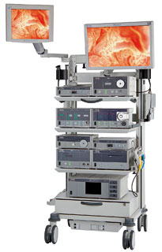
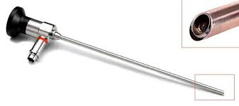
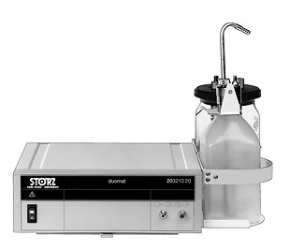
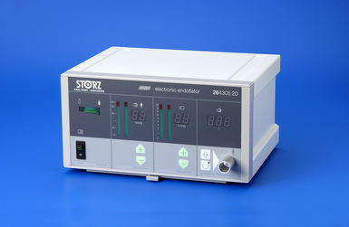
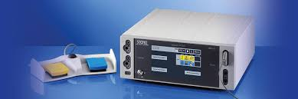
Laparoscopic equipment
Videosystem:
  Camera processor
  Camera and optics
  Monitors
  Light source and light cable
Insufflator
Aspirator-Irrigator
Multifunctional electrosurgery device
Additional electrosurgery devices (LigaSure, Harmonic, EnSeal)
Additional devices (morcellator, shaver, endopump, smoke evacuator, ect.)

Slide 5
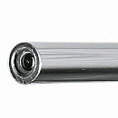
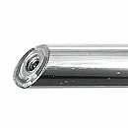
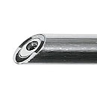
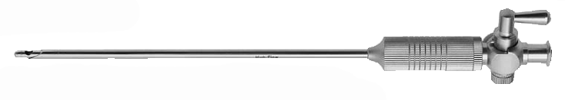
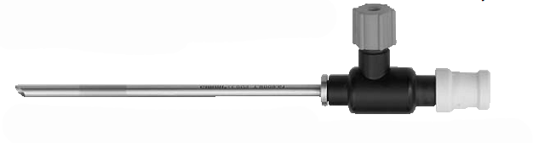
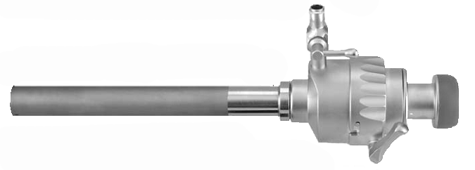
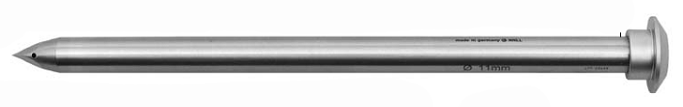
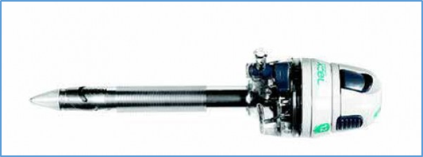
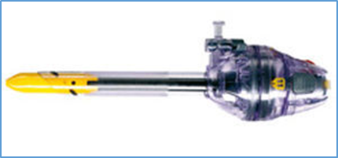
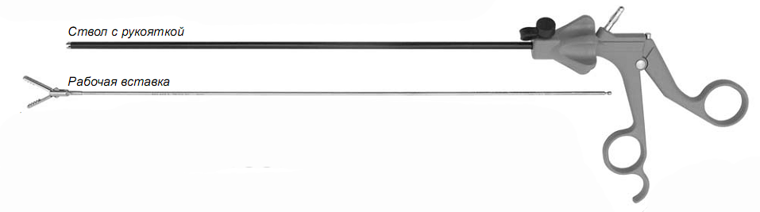
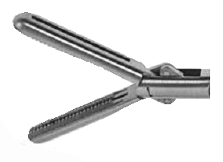
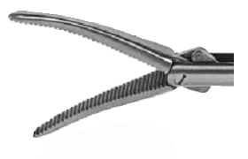
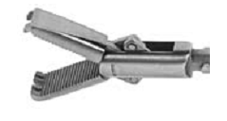
Laparoscopic instruments
Optics (3-, 5-, 10-мм; 0°, 30°, 45°)
Veresh needle
Trocars (3-, 5-, 10-, 15-mm; with silicone and flip valve; with protection hose; with transparent tip)
Clamps (3-, 5-, 10-mm) (with teeth, atraumatic, dissectors, bipolar, special)

Slide 6
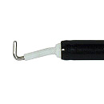
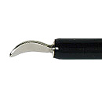
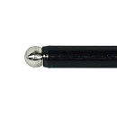
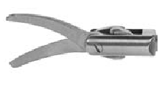
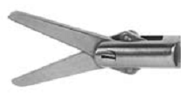
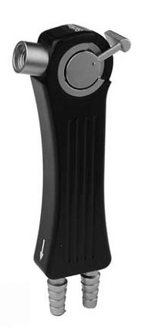
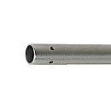
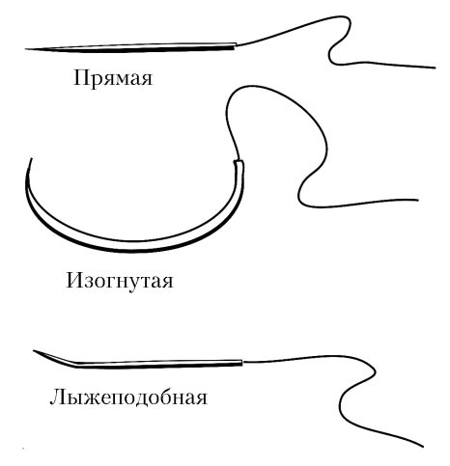
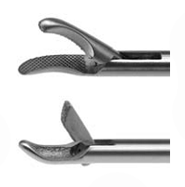
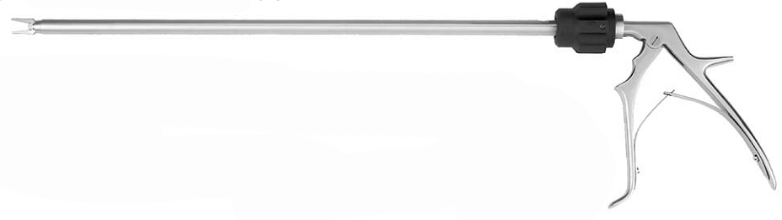
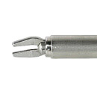
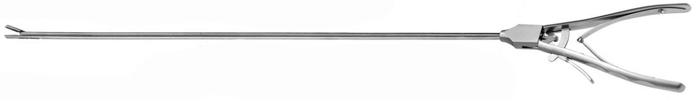
Laparoscopic instruments
Electrodes (L-type, spatula-type, ball-type)
Scissors (3-, 5-mm)
Aspiration-irrigation tube (3-, 5-mm)
Needle-holder (5-mm)
Clip-applier (5-mm)

Slide 7
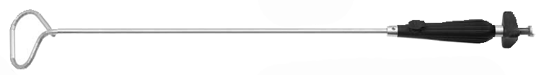
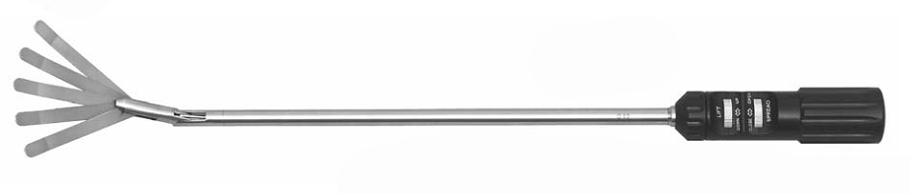
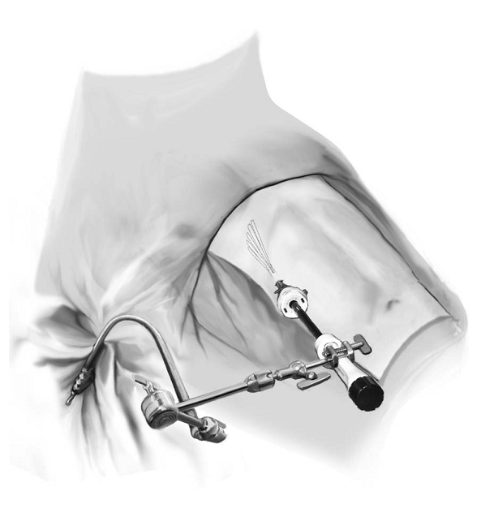
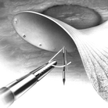
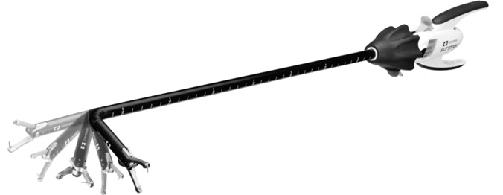
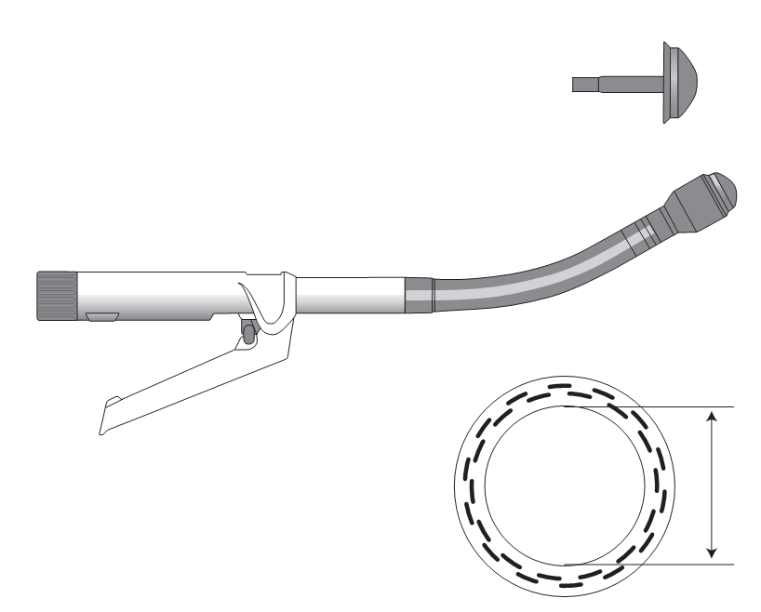
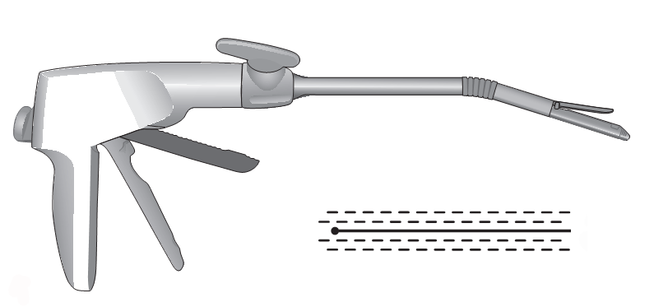
Laparoscopic instruments
Retractors (fan-like, ring-like, Nathanson), system of external fixation
Needle for transfascial sutures, tacker-applying stapler
Staplers (linear, circular, EndoStich)

Slide 8
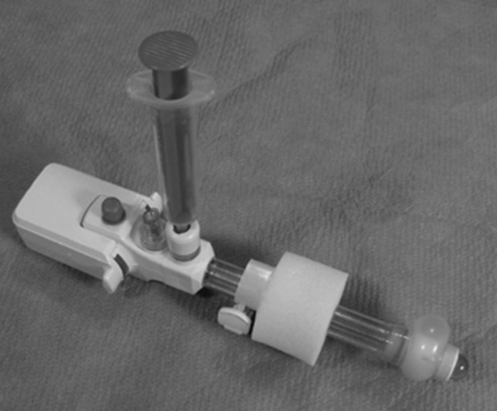
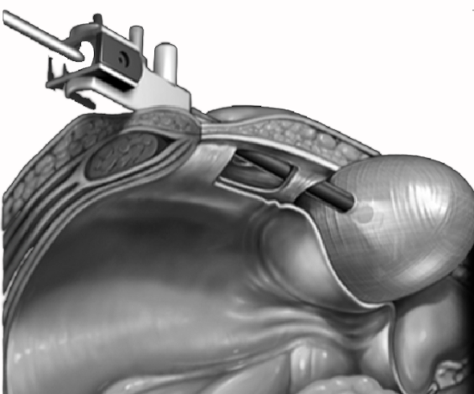
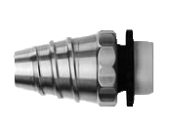
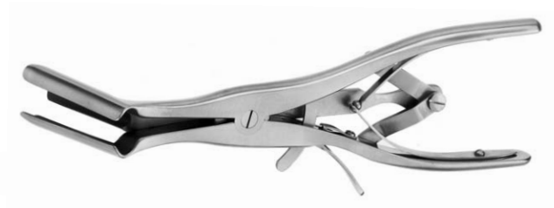
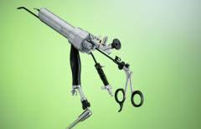



Laparoscopic instruments
Dissecting balloon
Hasson’s cannula
Wound retractors and retrieval bags
Cholangiography clamp
Stone retrieval baskets
Special kits (e.g., for single-port surgery, transanal endoscopic microsurgery)

Slide 9




Endoscopic equipment
Videosystem:
  Camera processor combined with insufflator, aspirator and light source
  Monitor
Endoscopes:
  Gastroscope
  Colonoscope
  Duodenoscope
  Bronchoscope
Aspirator
Electrosurgical unit
Additional units (e.g., carbon dioxide insufflator)

Slide 10







Endoscopic instruments
Biopsy forceps
Hot biopsy forceps
Polypectomy snare
Ligature applier
Irrigation tube
Injection needle
Coagulation probe (monopolar,
bipolar)
Argon probe
Distal cap
Variceal veins ligator
Clip-applier

Slide 11






Endoscopic instruments
Mucosal resection snare
Knifes for submucosal dissection
Guidewires
Balloon dilators for alimentary tract strictures
Self-expandable stents for alimentary tract
Percutaneous gastrostomy kit
ERCP catheters
Papillotomes
Balloon dilators for biliary tract strictures
Balloon extractors and Dormia baskets for biliary tract strictures
Self-expandable and plastic stents for biliary tract

Slide 12





Equipment and instruments for percutaneous interventions
Ultrasound device
Chiba puncture needles
Dilators
Drains (straight, «pig tail»)
Angiograph (C-arch)
Intraducers
Angiography catheters
Embols
Stents
Equipment and instruments for endovascular interventions

Slide 13




Principles of performance and safety in laparoscopic surgery
Applying of pneumoperitoneum
Safe insertion of trocars
Insertion of instruments
Use of traction, countertraction and gravitation
Rational use of optics
Visual control of the position of instruments
Safe use of energy devices

Slide 14
Limitations of laparoscopic procedures
Postoperative adhesions
Anatomical considerations (variations, anomalies)
High-grade cardiovascular and respiratory insufficiency
Advanced cases (e.g., perivesical mass, large tumors, tumors invading neighbouring structures)
No access to organ (e.g., state after Bilroth-2 hemigastrectomy)
Advanced cases (e.g., large sessile polyps with wide basis, large stones in common bile duct)
Specific limitations (e.g., periampulary diverticula)
Limitations of endoscopic procedures

Slide 15
Minimally-invasive procedures in abdominal surgery

Slide 16









Diseases of biliary tract
Chronic and acute calculous cholecystitis – laparoscopic cholecystectomy
Choledocholithiasis and calculous cholecystitis – endoscopic papillosphincterotomy, removal of the stones, with subsequent laparoscopic cholecystectomy or laparoscopic cholecystectomy, choledocholithotomy, choledochostomy

Slide 17




Diseases of biliary tract
Cancer of head of pancreas – endoscopic stenting or percutaneous cholangiostomy
Cancer of proximal parts of extrahepatic biliary ducts – percutaneous cholangiostomy
Early cancer or adenoma of papilla of Vater – endoscopic papillectomy, stenting of common bile duct
Scar stenosis of sphincter of Oddi - endoscopic papillosphincterotomy, stenting of common bile duct

Slide 18



Diseases of liver
Non-parasitic cysts of liver, large, located in anterior segments (3, 4б, 5, 6) – laparoscopic fenestration
Non-parasitic cysts of liver, large, located in posterior segments (6, 7, 8, 4а, 2) – percutaneous aspiration
Hydatid cysts of liver, large, located in anterior segments, superficially – laparoscopic cystectomy
Hydatid cysts of liver, large, located in anterior segments, in the depth of parenchyma – percutaneous drainage
Tumors of liver (e.g., metastatic lesions), located in anterior segments, superficially – laparoscopic resection
Liver abscesses – percutaneous drainage

Slide 19







Diseases of upper GI tract
Esophageal achalasia – laparoscopic cardiomyotomy, Dor fundoplication
Hiatal hernia, refractory GERD – laparoscopic crural repair, including mesh repair, Nissen fundoplication

Slide 20










Diseases of upper GI tract
Polyps of esophagus and stomach – endoscopic polypectomy
Esophageal varices – endoscopic ligation
Ulcer GI bleeding – endoscopic hemostasis (coagulation, clipping, injection)
Cancer of esophagus – endoscopiс stenting, percutaneous endoscopic gastrostomy
Stenosis of upper GI tract (duodenal ulcer, anastomotic) – endoscopic insertion of feeding tube, endoscopic balloon dilation
Early gastric cancer – endoscopic mucosal resection, endoscopic submucosal dissection

Slide 21










Diseases of colon, miscellaneous
Adenoma of colon – endoscopic polypectomy
Cancer of right half of colon – laparoscopic-assisted right hemicolectomy
Cancer of sigmoidal colon – laparoscopic sigmoidectomy
Adenoma and early cancer of rectum – transanal endoscopic microsurgery
Cancer of upper and mid- rectum – laparoscopic anterior and low anterior resection

Slide 22







Diseases of colon, miscellaneous
Acute appendicitis – laparoscopic appendectomy
Acute large bowel obstruction – endoscopic stenting
Inguinal hernia – laparoscopic mesh repair, TAPP (transabdominal preperitoneal) or TEP (totally extraperitoneal)
Umbilical, epigastric or incisional hernias – mesh repair, IPOM (intraperitoneal onlay mesh)
Adrenal gland adenoma – laparoscopic adrenalectomy

Slide 23




Bariatric surgery
BMI < 35 kg/m2 or > 50 kg/m2 with high risk – gastric balloon
BMI > 40 kg/m2 or > 35 kg/m2 with comorbidities (diabetes mellitus, joint pain, sleep apnea, ect.) – sleeve gastrectomy
BMI > 50-60 kg/m2 combined with diabetes mellitus – Roux-en-Y gastric bypass, mini-gastric bypass

Slide 24
Questions?

