Slide 1
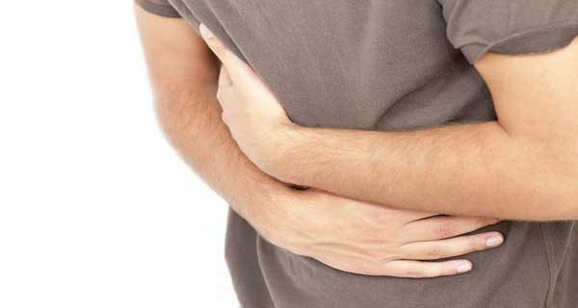
«Acute abdomen»
Dr. Malynovskyi A.V., Prof., DrMed,
Chair of Department of Robotic and Endoscopic Surgery

Slide 2
Minimal work-up for “acute abdomen”
CBC (anemia, leukocytosis, neutrophilic shift)
Urinalysis (hematuria, leukocyturia)
Additional tests (hyperglycemia, amylasemia, hyperbilirubinemia, thrombocytopenia, coagulopathy)
ECG (abdominal form of myocardial infarction)
Abdominal X-ray (horizontal fluid-gas levels, free gas under the diaphragm)
Ultrasound of abdomen, kidneys and pelvis (fluid in Morrison’s pouch, Douglas pouch, and flanks; gallstones; edema of pancreas; dilation of kidney pelvis)
Gynecologist examination, digital examination of rectum
CT-scan of abdominal cavity, kidneys and pelvis, chest X-ray, examination by urologist, cardiologist, infectionist (if necessary)

Slide 3
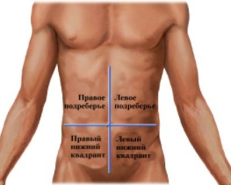
Causes of acute abdominal pain in different locations
Epigastric pain:
Acute pancreatitis
Peptic ulcer exacerbation
Strangulated hiatal hernia
Pain in the right hypochondrium:
Acute cholecystitis
Peptic ulcer exacerbation
Acute pancreatitis
Acute hepatitis
Intercostal neuralgia
Infected echinococcal liver cyst
Pain in the left hypochondrium:
Intercostal neuralgia
Strangulated hiatal hernia
Acute pancreatitis
Pain in the right iliac region:
Acute appendicitis
Right renal colic
Strangulated inguinal/femoral hernia
Apoplexy of right ovary
Acute right-sided adnexitis
Pain in the left iliac region:
Acute diverticulitis
Left-sided renal colic
Strangulated inguinal/femoral hernia
Apoplexy of left ovary
Acute left-side adnexitis
Pain in hypogastriс area:
Ovarian apoplexy
Tubal pregnancy
Acute adnexitis
Acute pelvioperitonitis
Torsion of ovarian cyst

Slide 4
Acute cholecystitis
Classification
Types:
  Calculous
  Acalculous
Forms:
  Catarrhal
  Phlegmonous
  Empyema
  Gangrenous
  Gangrenous with perforation
Complications:
  Perivesical mass
  Perivesical abscess
  Cholangitis
  Peritonitis

Slide 5
Acute cholecystitis
Clinical presentation
Pain in right hypochondrium, continious, may irradiate to shoulder
Nausea, non-frequent vomiting
Fever, usually subfebrile
Tenderness in right hypochondrium, moderate muscle guarding (Schetkin's sign is usually negative)
Positive Murphy's sign

Slide 6
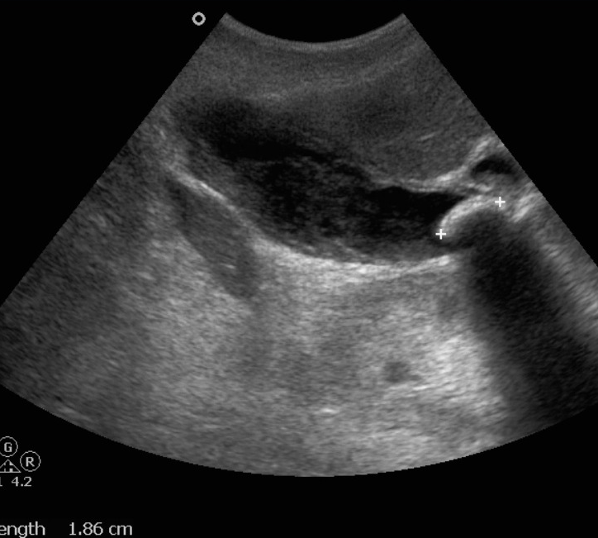

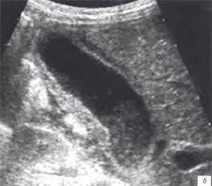
Acute cholecystitis
Diagnostics
Ultrasound:
  Calculi in gallbladder, usually in the infundibular part
  Thickening and duplication of gallbladder wall
  Enlargement of gallbladder
  Fluid and infiltration around gallbladder
Laboratory:
  Leukocytosis, neutrophilic shift, usually moderate

Slide 7
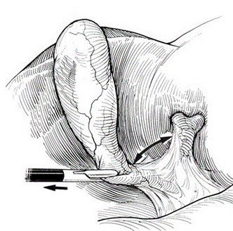
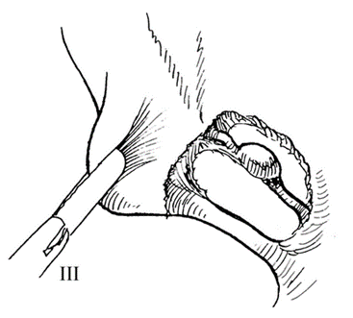
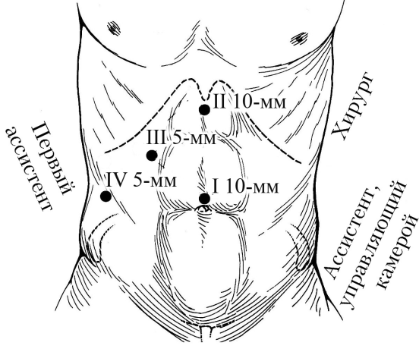
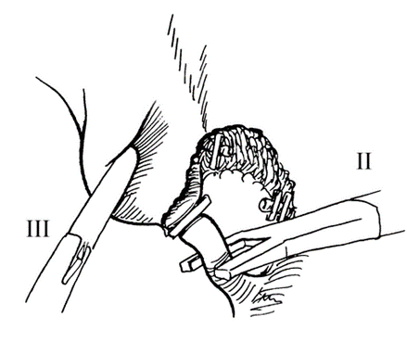
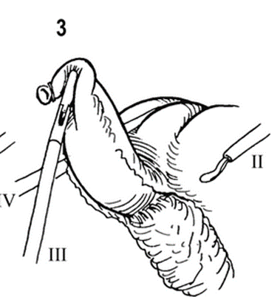
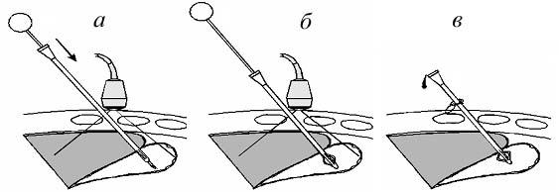
Acute cholecystitis
Surgical treatment
Laparoscopic cholecystectomy:
  Basic procedure
Open cholecystectomy, if:
  Technical difficulties with laparoscopic cholecystectomy
  Dense perivesical mass
  Peritonitis
Percutaneous cholecystostomy:
  High risk patients
  Acalculous cholecystitis

Slide 8
Acute pancreatitis
Classification
Types:
  Alcoholic, or alimentary
  Biliary
Forms:
  Acute edema
  Fatty pancreatic necrosis
  Hemorrhagic pancreatic necrosis
  Purulent pancreatic necrosis
  Fulminant
Stages:
  Hemodynamic disorders (pancreatogenic shock)
  Multiple organ failure
  Purulent complications
Complications:
  Pancreatogenic shock
  Enzymatic peritonitis
  Dynamic intestinal obstruction
  Abscess of the lesser sac
  Retroperitoneal phlegmone
  Left-sided subphrenic abscess
  Left-sided pleuritis
  Erosion bleeding
  Intestinal and biliary fistulas
  Portal vein thrombosis
  Obstructive jaundice
  Enzymatic (acalculous) cholecystitis

Slide 9
Acute pancreatitis
Clinical presentation
Epigastric pain, severe, continious, with irradiation to back
Repeated vomiting
Fatigue, weakness, thirst
Tachycardia, hypotension, oliguria
Fever, usually subfebrile
Tenderness in the epigastrium, moderate muscle guarding (Schetkin's sign is usually negative)
Palpable mass in the epigastrium
Abdominal distension

Slide 10
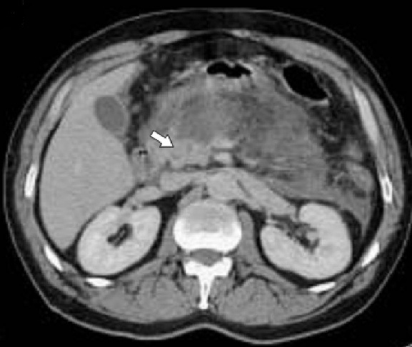
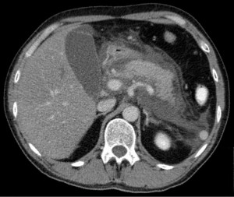
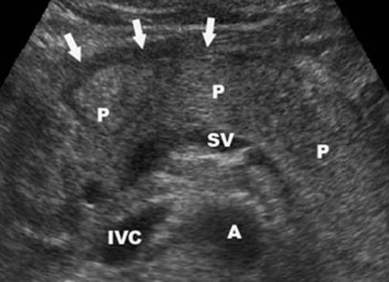
Acute pancreatitis
Diagnostics
CT-scan:
  Parenchyma destruction
  Gland enlargement
  Peripancreatic fluid collections
  Edema and infiltration retroperitoneal fat
Ultrasound scan:
  Parenchyma heterogenity
  Gland enlargement
  Peripancreatic fluid collection
Laboratory:
  Amylazemia
  Leukocytosis, neutrophyliс shift

Slide 11
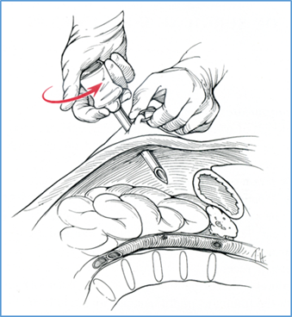
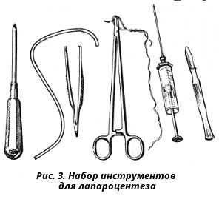
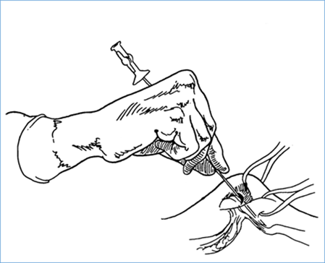
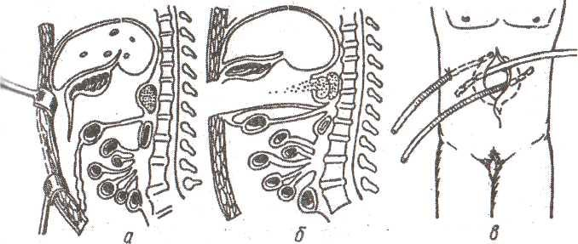
Acute pancreatitis
Surgical treatment
Diagnostic laparoscopy:
  Unclear diagnosis (e.g. susp. acute mesenteric thrombosis, or bowel obstruction, or hollow organ perforation)
Laparocentesis:
  Diagnostic laparoscopy is not possible
Laparotomy, necrosectomy, drainage of retroperitoneal space, laparostomy (optional):
  In the phase of purulent complications
  Revisional procedures are possible

Slide 12
Acute appendicitis
Classification
Forms:
  Catarrhal
  Phlegmonous
  Gangrenous
  Gangrenous perforated
Complications:
  Appendicular mass
  Appendicular abscess
  Diffuse peritonitis
  Pylephlebitis

Slide 13
Acute appendicitis
Clinical presentation
Pain in the right iliac region
Kocher`s sign: initially, diffuse pain is localized in the epigastrium, then moves to the right iliac region
Nausea, vomiting (not multiple)
Diarrhea (not multiple)
Fever, usually subfebrile
Tenderness in the right iliac region, muscle guarding, positive Schetkin-Blumberg`s sign
Other "appendicular" signs (Rovzing`s, Voskresensky`s, etc.)
Palpable mass in the right iliac region, moderately tender, in the case of appendicial mass or abscess

Slide 14
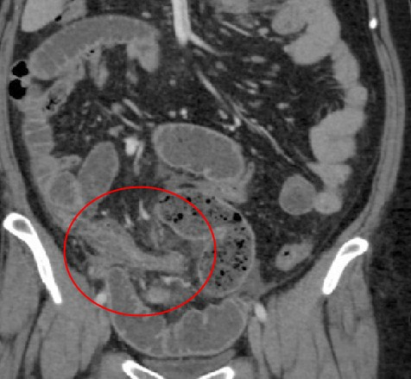
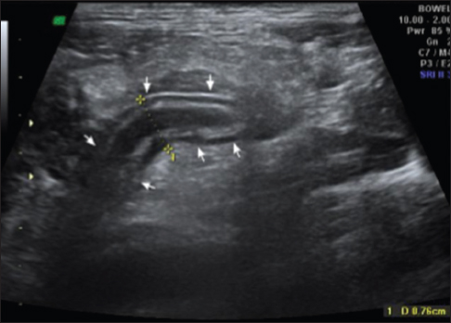
Acute appendicitis
Diagnostics
Ultrasound or CT-scan:
  Visualization of enlarged vermiform appendix, infiltrated fat around it (on CT)
  Small amount of fluid in the right iliac region
  Exclusion of renal colic, acute gynecological diseases
Laboratory:
  Leukocytosis, neutrophilia
Specialist consultation:
  Gynecologist
  Urologist
  Infectionist

Slide 15
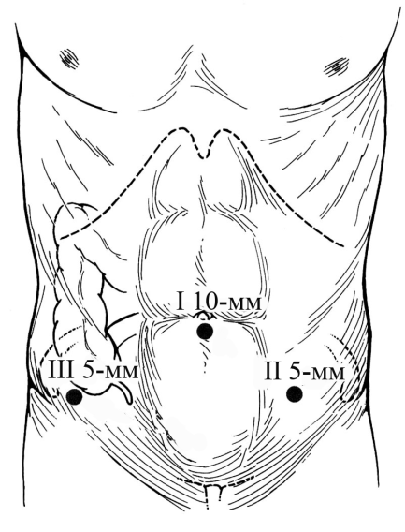
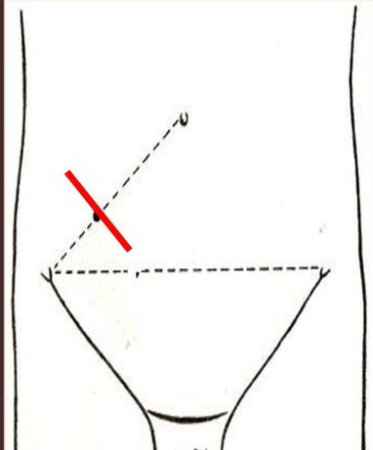
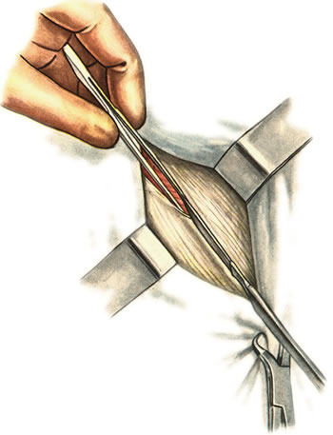
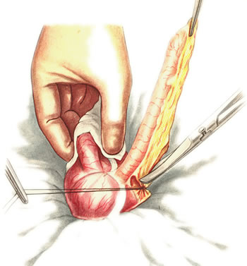
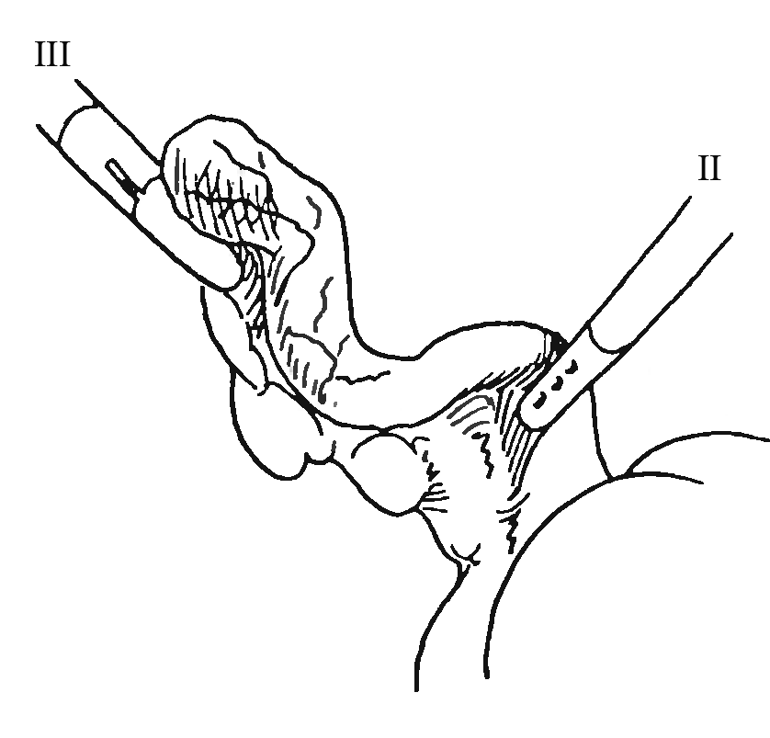
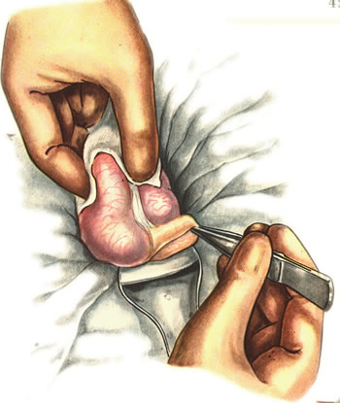
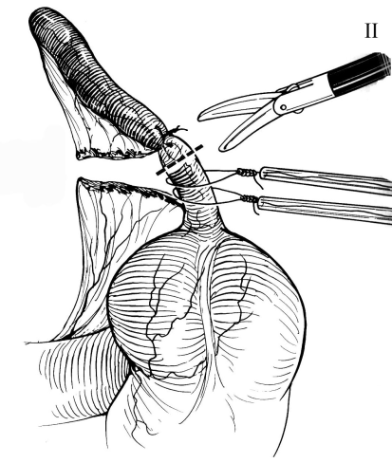
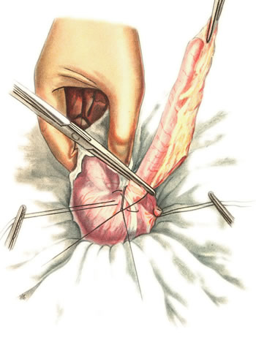
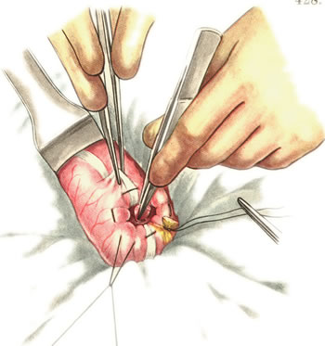
Acute appendicitis
Treatment
Appendectomy:
  Basic procedure
Laparoscopic appenectomy:
  Best in the case of unclear diagnosis
  Can be used for acute gynecological diseases
Conservative treatment:
  In the case of appendicular mass
Open drainage of abscess, appendectomy
  In case of appendicular abscess

Slide 16
Acute diverticulitis
Classification
Complications:
  Paracolic abscess
  Perforation, diffuse peritonitis
Clinical presentation
Pain in the left iliac region, continious
Fever
Tenderness in the right iliac region, moderate muscle guarding
Positive Schetkin’s sign in the case of perforation

Slide 17
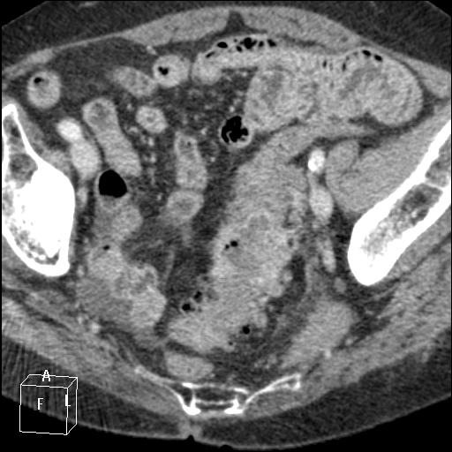
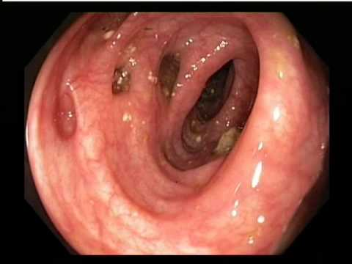
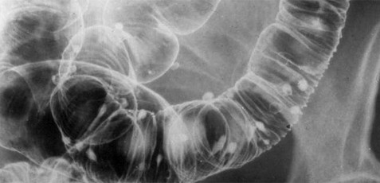
Acute diverticulitis
Diagnostics
CT (ultrasound):
  Infiltrated tissue around the sigmoid colon
  Paracolic fluid collection in the case of abscess formation
  Multiple diverticula (on CT)
Barium enema:
  If no suspected perforation
Colonoscopy:
  If no suspected perforation, useful for bleeding
Laboratory:
  Leukocytosis, neutrophyliс shift

Slide 18
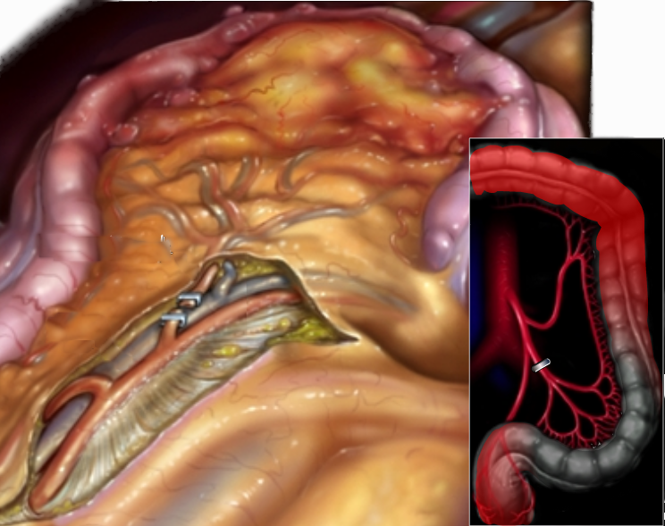
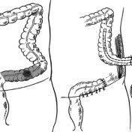
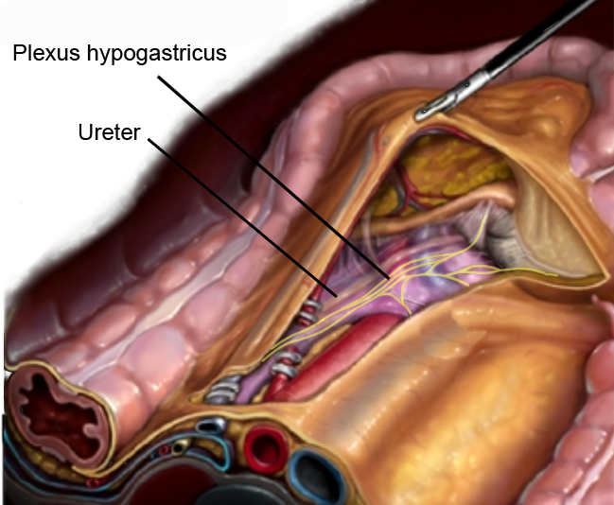
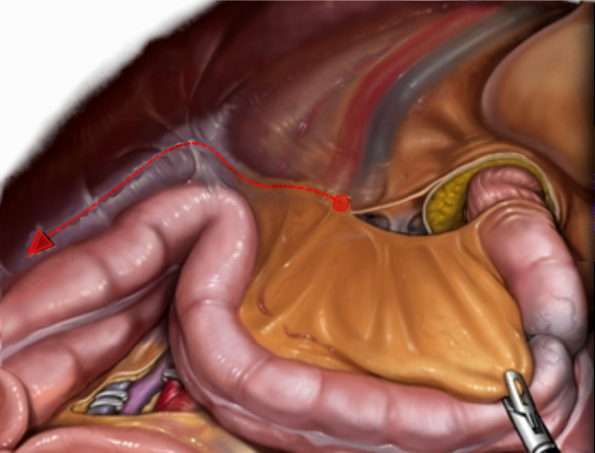
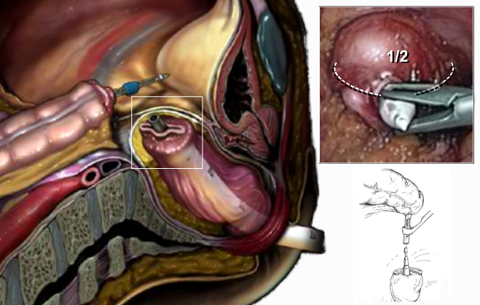
Acute diverticulitis
Treatment
Conservative
  Basic method
Laparotomy, drainage of paracolic abscess, sigmoidectomy, end colostomy (Hartmann type procedure)
    Abscess or perforation with diffuse peritonitis
Laparoscopy, drainage of peritoneal cavity
  Perforation with local peritonitis
Laparoscopic (open) elective sigmoidectomy with primary colorectal anastomosis
  Recurrent diverticulitis
  Bleeding

Slide 19
Peritonitis
Classification
Types:
  Reactive (serous, serous-fibrinous, fibrinous-purulent)
  Perforated (purulent, fecal, biliary)
  Enzymatic
  Primary (gonococcal pelvic peritonitis)
Forms:
  Local unlimited
  Local limited = abscess
  Diffuse
  Generalized

Slide 20
Peritonitis
Clinical presentation
Diffuse abdominal pain, continuous, intensive. Sudden (knife-stab like) in the case of hollow organ perforation
Severe weakness, thirst
Tachycardia, hypotension, decreased diuresis
Vomiting
Bloating, no flatus and stools
Localized or diffuse tenderness, muscle guarding (wooden-like abdomen in the case of perforated peptic ulcer), positive Schetkin-Blumberg`s sign

Slide 21
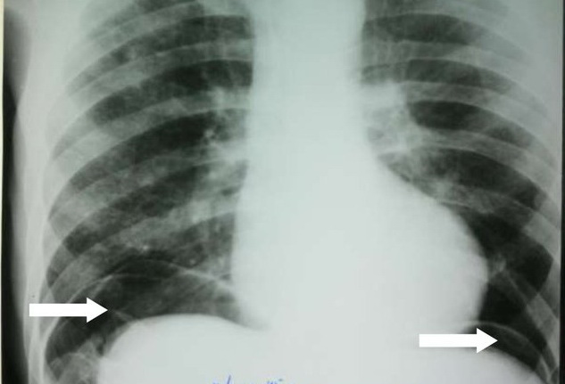
Peritonitis
Diagnostics
Abdominal X-ray:
  In case of perforated peritonitis - free gas under the diaphragm
Ultrasound:
  Liquid collections, bowel distention
  Calculi in the gallbladder, if caused by acute cholecystitis
CT scan:
  Liquid collections, bowel distention
  May show a source, e.g., colon diverticula, acute cholecystitis, acute pancreatitis, ect.
Laboratory:
  Leukocytosis, neutrophylic shift, amylasemia (in the case of acute pancreatitis)

Slide 22
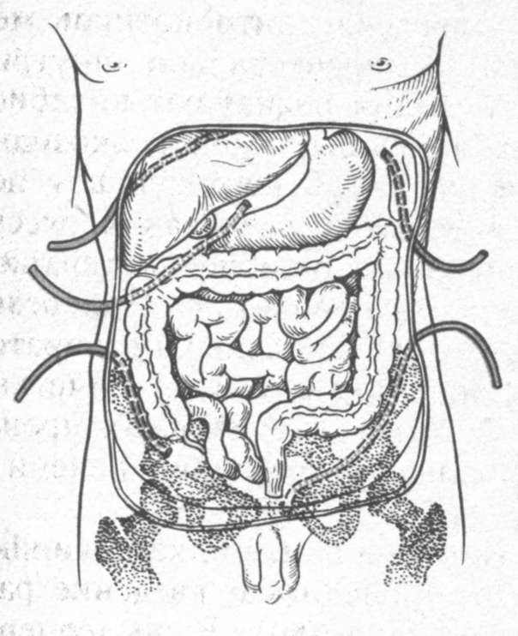
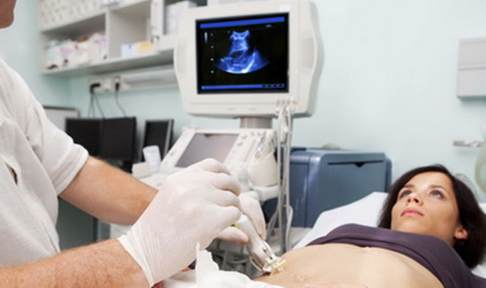
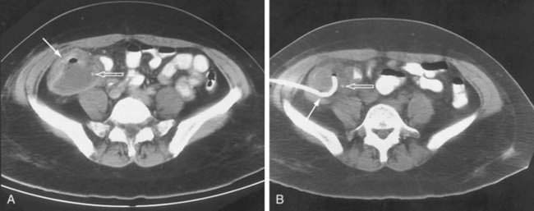
Peritonitis
Treatment
Laparotomy, elimination of primary source of infection (e.g., suturing of perforated peptic ulcer, Hartmann type procedure, cholecystectomy), lavage and wide drainage of the abdominal cavity:
  Basic procedure
Laparoscopy:
  For unclear diagnosis
Percutaneous abscess drainage
  Subphrenic abscess
  Retroperitoneal abscess

Slide 23
Acute mesenteric thrombosis
Clinical presentation
Diffuse or mesogastric abdominal pain, sudden, intensive, lasts usually for 1-2 days
Vomiting
Absence of flatus and stools (may be bloody stools)
Distension of abdomen, diffuse moderate tenderness, negative splash sign, negative peritoneal irritation signs
Toxic syndrome started from day 2-3 (tachycardia, hypotension, dyspnea, oliguria, encephalopathy)

Slide 24
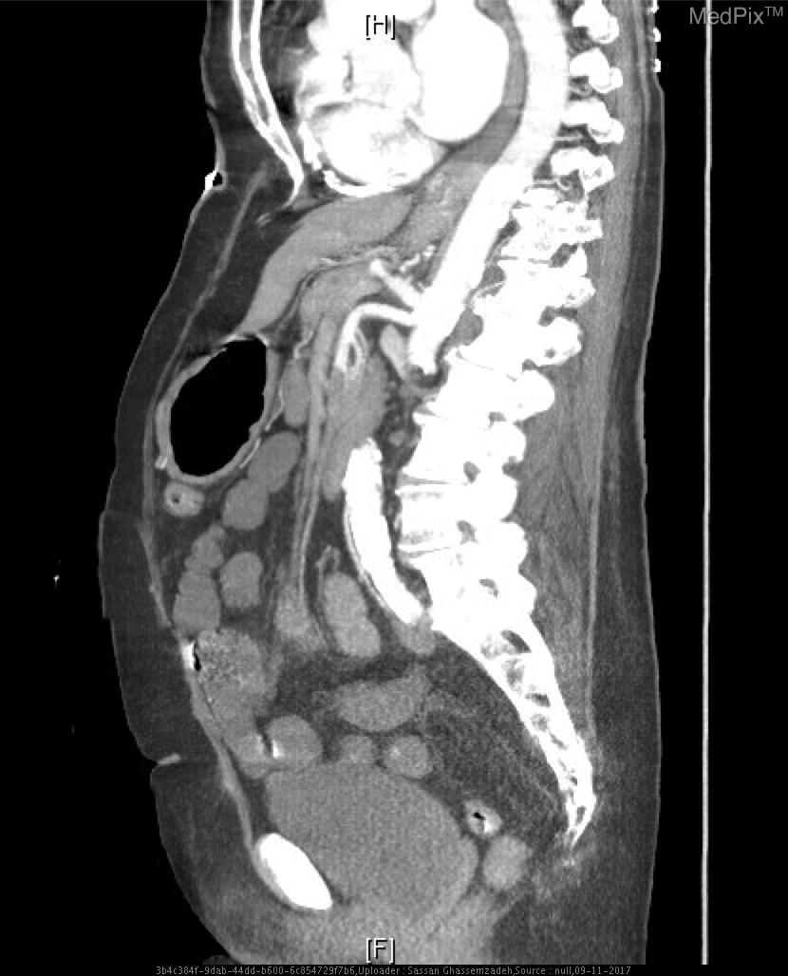
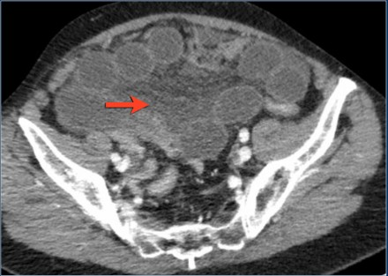
Acute mesenteric thrombosis
Diagnostics
  CT angiography:
    Interruption of contrast flow at the origin of superior mesenteric artery
    Distension of small bowel in the absence of mechanical obstruction, infiltration of the mesentery
  Laboratory:
    Leukocytosis, neutrophilic shift

Slide 25
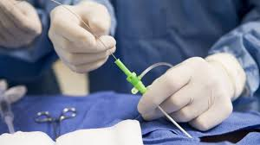
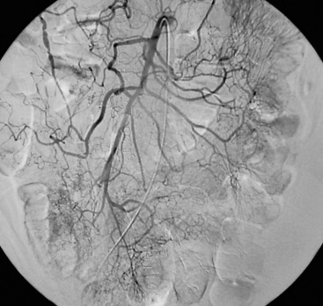
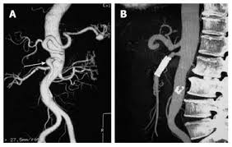
Acute mesenteric thrombosis
Treatment
  Diagnostic laparoscopy or minilaparotomy:
    For unclear diagnosis
  Endovascular thrombolysis:
    For segmental lesion and absence of gangrene of intestine
    Effective in first 2-4 hours
  Small bowel resection:
    For segmental gangrene of intestine

