Slide 1
Ministry of Health of Ukraine
Odesa National Medical University
Faculty of Pharmacy
LECTURE №2:
“Commodity and innovation policy of pharmaceutical enterprises.”
Odessa – 2019

Slide 2

The commodity policy is an exact firm’s activity which corresponds to marketing strategy;
it is directed on studying ways of the competitiveness
increase of let out production, first of all, its qualitative characteristics,
creation of new goods, making up the assortment and management,
the search of market segments, development and realization of the
packing strategy, trademarks, service of the goods.

Slide 3
To the decisions in the commodity policy, it is necessary to carry:
- the nomenclature of the made goods;
- width of assortment groups;
- a range of volumes of release of each goods;
- quality of the goods;
- updating;
- maintenance of goods the trade mark;
- an exception of manufacture of obsolescence goods;
- manufacture of new goods;
- standardization;
- the planned ageing of the former kinds of goods for the purpose of attraction of buyers’ attention to goods-novelty;
- quantity of each kind of goods which are let out

Slide 4
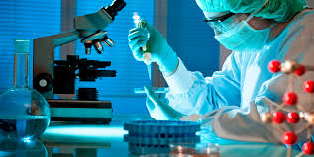
Pharmaceutical innovations are new drugs and new processes, as well as their significant technological changes. Pharmaceutical innovations are classified into two types: product (grocery) and process.

Slide 5
Pharmaceutical innovations
Products (Grocery) include:
creation and release of original drugs;
development and production of generic drugs;
introduction of new forms of drugs;
Improvement of the quality of already produced drugs;
identify new areas of application of known drugs.

Slide 6
Pharmaceutical innovations
Process are divided into:
technological (introduction of new or improvement of existing technologies);
organizational and managerial (development of new markets, use of new channels of promotion of medicines and forms of sales promotion, use of new economic, managerial, organizational mechanisms);
social (improving the quality of drugs already being produced; improving working conditions and improving the qualification and professional level of staff);
information (implementation of information technologies in management, streamlining of information flows).

Slide 7
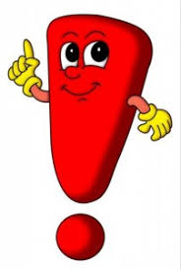
LEVELS OF NOVELTY OF MEDICINES
An original drug is a product that is owned only by the company that developed it or the company that holds the first license to sell it. The active substance of OD has a patent, until the expiration of which no other pharmaceutical company has the right to synthesize and use this active substance for commercial and non-commercial needs.
generic drug - a drug whose term of patent protection for an active substance has expired.
new
pharmacological group
existing pharmacological group

Slide 8
THE MAIN STAGES OF DRUG DEVELOPMENT
Stage | The name of the stage and its relevance for:
 | of the original medication | generic medication
I | Scientific idea and its rationale | Not done
II | Directed synthesis or screening of biologically active substances | Not done
III | Development of control technology and methods ; biopharmaceutical, preclinical and clinical studies | Development of technology and methods of control; biopharmaceutical simplified preclinical studies and limited clinical trials or demonstration of bioequivalence of medicinal products
IV | Commercial production, marketing and marketing

Slide 9
COMPETITIVENESS OF A MEDICINAL PRODUCT
is a set of consumer properties of a medicinal product provided during development and production, which contributes to its fastest realization on a specific market in a certain period of time in the case of differences from analogues:
by the degree of satisfaction of the needs of the consumer organization or the individual consumer and the level of costs for its purchase and use;
by the degree of awareness, accessibility and convenience of the consumer in making the purchase and use, provided with marketing and logistical measures.

Slide 10
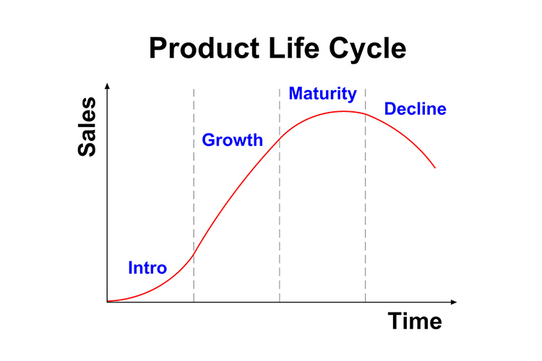
The product’s life cycle

Slide 11
A trademark is a name, a name, a symbol, a picture, or a combination thereof, intended to identify the products or services of a particular seller and differentiate them from the products of competitors.
Pharmaceutical companies manufacturing generic drugs often release them under an international, non-proprietary name or under a specially crafted name that must be different from the original drug's name.

Slide 12
Function of Trademark
The role and meaning of trademarks is that they are:
distinguish between medicines or medical products;
facilitate identification of the drug;
are the guarantor of the high quality of the medicinal product;
provide information about the drug and its manufacturer;

Slide 13
Function of Trademark
promote a medicinal product;
allow a company with lower costs to market new drugs;
enhance corporate spirit, uniting co workers, causing a sense of responsibility for the common cause - "corporate patriotism";
promote the prestige of a medicinal product;
provide legal protection for medicines.

Slide 14
Brand
A brand is a strong perception of the consumer about the brand, its image in the minds of consumers. In other words, a brand is called a well-known brand with a defined, formed position. A brand is a broad concept that, in addition to the brand, covers: the drug itself, its characteristics, expectations, consumer perceptions, consumer information and promises of certain benefits that the brand owner guarantees to consumers.

Slide 15
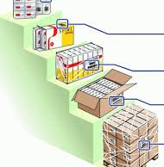
Packaging of medicines
Another element of a pharmaceutical enterprise's product policy is packaging, which, in a mature market, is becoming an increasingly effective marketing tool, an integral part of the company's image and the subject of innovative search.

Slide 16
STAGES OF THE DRUG PACKAGING PROCESS
Consumer
retail (individual) packaging
Grocery
(product) packaging
Transport
step 0
step 1
step 2
step 3
the pre-preparation phase of medicines and packaging materials
drugs are packaged in retail (protective, individual) packaging
Product (grocery) packaging
Transport
packaging

Slide 17

for attention!

