Slide 1
Ministry of Health of Ukraine
Odesa National Medical University
Faculty of Pharmacy
LECTURE №3:
“Price, pricing, price policy of pharmaceutical enterprises.”
Odessa – 2019

Slide 2
THEORETICAL BASES OF MARKET PRICING
The price − is an exchange equivalent of cost of the goods or services in money terms. In a broad sense for the price accept set of all values which exchange the buyer on possibility to use the goods or service.
The price – a unique component of marketing mix which makes profit, other components represent expenses. The price also is the most flexible component of marketing.

Slide 3
THEORETICAL BASES OF MARKET PRICING
The price factor in marketing is one of the main problems that speaks a number of circumstances:
the price is the major indicator for the enterprise as its basic function is maintenance of the income of realisation of the goods;
all enterprises are compelled to make decision on the prices. Prime value has an establishment of the prices in such cases: when the enterprise establishes the price for the first time (at release of the new goods, forma-tion of marketing channels, at an entry on new segments of the market); in connection with change of some circumstances (structure of expenses, market condition, character of competition, etc.); at change of the prices by competitors;
in a number of branches pricing plays a main role in the marketing program, and also is object of direct influence of the legislation and the state bodies.

Slide 4
Prices functions
1. Registration. The registration function of price is the means of the account of the cost indexes: the volume of the commodity circulation, the volume of the commodity stocks, arrival of goods, profitability.
2. Stimulating. This function is expressed in stimulating influence on manufacture and consumers.
3. Distributive. This function provides distribution of the national in-come between various branches of economy, regions of the country, differ-ent social groups.

Slide 5
Prices functions
4. The function of balancing the supply and demand. Through the prices communication between manufacture and consumption, supply and demand is carried out.
5. The function of price as criterion of the rational manufacture accommodation. This function shows that with the help of the mechanism of the prices transferring the capital from one sector of economy into another one, where the rate of return is higher, is carried out

Slide 6
Pricing process
Analysis of the factors that influence the pharmaceutical company's pricing policy
Selecting a pricing strategy selecting a pricing model and method
Price calculation.

Slide 7
Pricing factors
Internal
External
price targets, production and marketing costs, and the life cycle stage of the medicinal product
The level of demand,
The state of the competitive environment,
The participants of the product movement,
the state regulation of pricing for a medicinal product, etc.

Slide 8
Targets for drug pricing
1. Maximizing current profits;
2. Increasing market share;
3. Gaining leadership in the quality of medicines;
4. Ensuring the survival of a manufacturing company in a difficult market situation.

Slide 9
Lower price limit
It is impossible to make a profit at this price
FORMATION OF “POSSIBLE PRICES” ON MEDICINAL PRODUCTS
Upper price limit
Forming demand at such a price is impossible
THE PRICE IS POSSIBLE
Cost of medicines
(costs) Prices competitors Demand for medicines
S = V + F / N,
where V is the variable cost per unit of production;
F - fixed costs for a certain period of time;
N - the volume of production (sales) of products during this period.

Slide 10
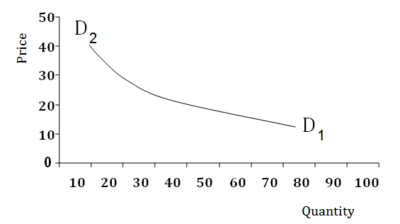
The demand law shows communication between the prices and quantity of the goods which can be got under each price

Slide 11
Analysis of price elasticity of demand for medicines
ELASTICITY OF DEMAND TO PRICE - is the ratio of change in demand (in percent) to the amount of change in price (in percent).
(N1 - N2) / (P1 - P2)
Edp = ------------------------------- · 100;
(N1 + N2) / (P1 + P2)
where:
P1- is the actual selling price;
P2 - projected reduced sales price;
N1- is the actual sales volume;
N2-is the expected volume of sales if the price is reduced.

Slide 12
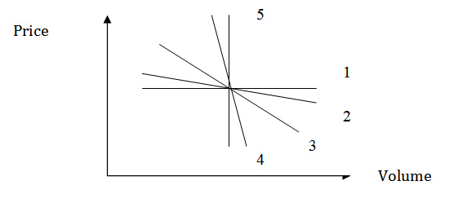
1 – Perfectly elastic demand;
2 – Elastic demand;
3 – Unitary elasticity of demand;
4 – Inelastic demand;
5 – Perfectly inelastic demand.

Slide 13
Demand
Elastic
Inelastic
is called demand, in which a percentage reduction in price causes the same percentage increase in sales of medicines.
is called demand in which a percentage decrease in price causes a slight percentage increase or decrease in sales of medicines.

Slide 14

for attention!

