Slide 1
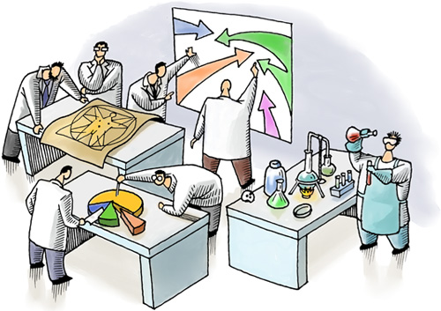
Ministry of Health of Ukraine
Odesa National Medical University
Faculty of Pharmacy
LECTURE №8:
“Marketing research and information”
Odessa – 2019

Slide 2

MARKETING RESEARCH is a system for collecting, processing and analyzing informative data on the market situation in order to reduce the risk of entrepreneurial activity and make appropriate marketing decisions.

Slide 3
Directions of marketing research
research of macro environment
research of the internal environment of the enterprise.
research of microenvironment
allow to define its strategy, to allocate perspective directions for work on the market.
study the market, competitors, consumers, goods, prices, distribution systems.
Manufacture, sale, management, marketing, the finance are analyzed

Slide 4
The objectives of marketing research may be:
search, i.e. providing for the collection of certain preliminary data on the basis of which a hypothesis can be developed;
descriptive, i.e. providing a description of a specific problem (phenomenon);
experimental, i.e. providing for the verification of the hypothesis of a certain causal relationship between the investigated phenomena.

Slide 5
PROCESS MODEL OF THE
MARKETING RESEARCH
The formulation of the research subject
Identification and study of the problem
Alignment of research objectives
Collection and analysis of secondary information
(“Desk” studies)
Internal sources of information
External sources of information
Collection of primary information
("field studies)
Analysis of primary information data by methods of statistics, logic, sociology
Preparation and submission of report
Development of a package of documents for improving the marketing activities of a pharmaceutical company

Slide 6


DESK research official sources of the information are used: the reporting, directories, the statistical data (secondary data).
Field research is used, as a rule, with the purpose of studying the reaction of consumers on a product (primary data). The main widespread methods are interrogation, supervision, experiment and panel.

Slide 7

Interrogation. It is necessary to understand finding-out of people’ positions or reception from them references on any question. Interrogation can be spent in the oral or written form. For working out of questions it is necessary to start from an information need and possibilities interrogated to give a right answer. If researcher wants to know agreement or disagreement, sufficient the type of questions «Yes − no». If it is necessary to draw a conclusion on opinions of interrogated might to use scale questions.

Slide 8
Supervision − is used as a way of information’s reception in market research much less often, than interrogation.
- independence of object desire to cooperation;
possibility to provide higher objectivity;
possibility of perception of not realized behavior (a choice of goods in pharmacy);
possibility of surrounding situation count, especially at supervision by means of devices.
it is difficult to provide representatively, because supervision has need, as a rule, special conditions (for example, behavior of visitors in pharmacy:
subjectivity of perception observing, selective supervision;
the behavior of objects can differ from natural if supervision is opened (effect of supervision).

Slide 9
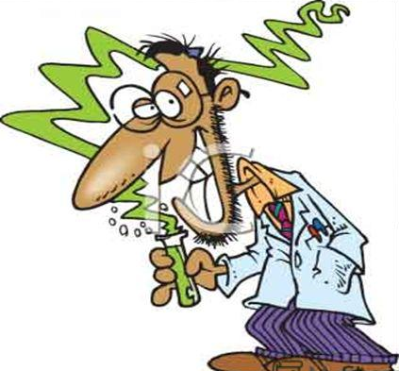
Experiment is research, at which should be established as change of one or several independent variables influences one or several dependent variables.
Essential signs of experiment:
the isolated changes (separate sizes vary the researcher, others should be, as far as possible, constants);
- the researcher actively interferes with process of data occurrence;
- the interconnection of cause and effect (for example, influence of color of packing on sales volume) is checked.

Slide 10
The panel. The necessary information can be received as a result of numerous interrogation of group of the interested buyers at regular intervals or by supervision over sale development in certain group of pharmacies.
The panel has such signs:
the subject and a research topic are constant;
data gathering repeats at regular intervals;
a constant (with certain conditionality) set of objects of research − trading enterprises, consumers.
Distinguish three kinds of the panel: trading, consumer, special forms.

Slide 11
CHARACTERISTIC OF
SECONDARY AND PRIMARY INFORMATION
Type of information | Advantages | Disadvantages
Secondary - information that is the result of other studies or collected for the implementation of some other tasks | ✓ low price; ✓ availability; ✓ promptness of receipt; ✓ the ability to compare data with data sources; ✓ availability of data that sometimes cannot be obtained independently. | ✓ incomplete data; ✓ unwarranted reliability of information from some sources; ✓ possible availability of outdated data; ✓ possible inconsistency of data from different sources; ✓ The methodology for collecting and processing data is often unknown.

Slide 12
CHARACTERISTIC OF
SECONDARY AND PRIMARY INFORMATION
Type of information | Advantages | Disadvantages
Primary - going specifically to achieve the specific objectives of the study | ✓ is collected for the specific purposes of this study; ✓ data is not outdated; ✓ the methodology of data collection is controlled by a pharmaceutical company; ✓ access to research results for competitors is limited. | ✓ data collection takes a lot of time; ✓ needs significant costs; ✓ not all information can be collected in this way; ✓ In case of insufficient qualification of researchers, the information may be inaccurate.

Slide 13
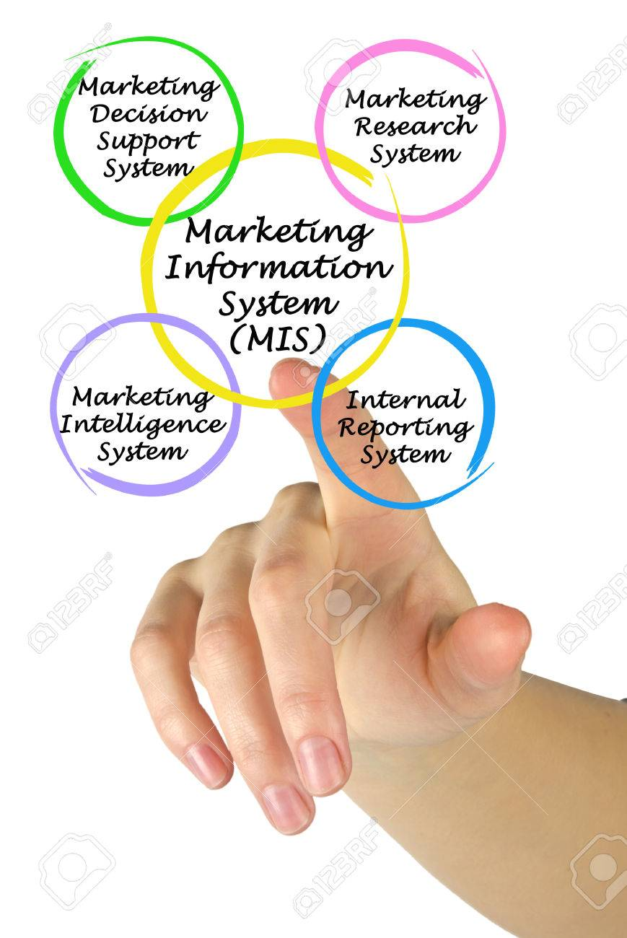
Marketing information system (MIS) is a set of procedures and methods designed to generate, analyze, disseminate, and store anticipated marketing decision information on a regular, continuous basis.

Slide 14

for attention!

