Slide 1

Ministry of Health of Ukraine
Odesa National Medical University
Faculty of Pharmacy
LECTURE №9:
“Marketing control”
Odessa – 2019

Slide 2

Control as one of the functions of management, completing the process of marketing activities and determine how effective work the firm.
Control (audit) of marketing is a deep the analytical work as the result of which the management of company fined new methods of marketing management, tools, and mechanisms of action or adaptation to the factors of internal and external environment.

Slide 3
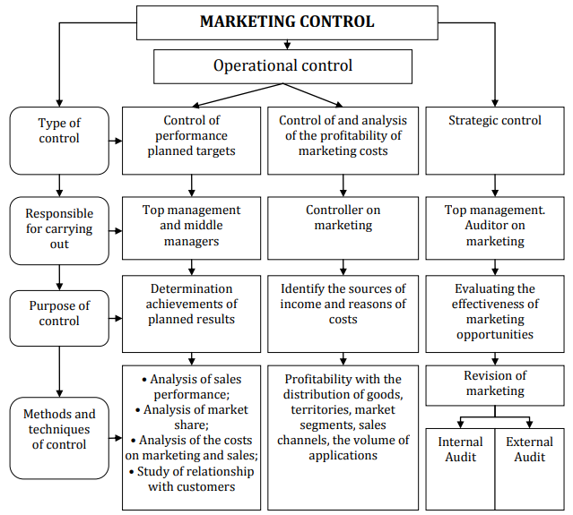

Slide 4

Management controls should be carried out in such directions:
1. Compliance with the planned indicators of actual results.
2. Control of profitability production and commercial enterprises activities.
3. Strategic control and auditing of marketing

Slide 5

Compliance with the planned indicators of actual data of production and commercial activity is aimed at establishing compliance or deviation from the planned indicators of sales of goods and services, income and profit, profitability both in general and for individual goods.

Slide 6

Monitoring and analysis of the profitability of marketing costs provides for control the profitability activity of the company on certain goods, their assortment groups, market segments, sales channels, advertising material, orders of different sizes.

Slide 7
Strategic control and auditing of marketing provide a regular, periodic or episodic inspection of marketing activities firm.
Strategic control (marketing audit and strategic control of the marketing system) includes an assessment of the main tasks, strategies, marketing activities, marketing organization in order to identify problems and positive outlook for the supply and the scientific and technical activities of the company and recommendations on the content of future plans to improve it.

Slide 8
Revision of marketing (marketing audit) is a complex, systematic and regular study of marketing environment the firm, its tasks strategies and operational and commercial activities in order to identify emerging problems and future opportunities for the development of recommendations for improving the marketing of the company.

Slide 9
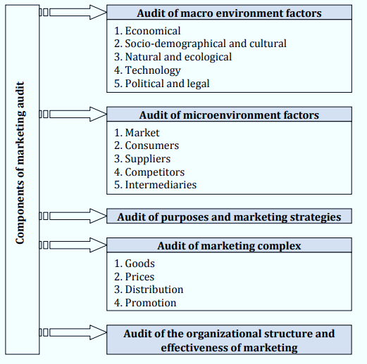

Slide 10

for attention!

