Slide 1
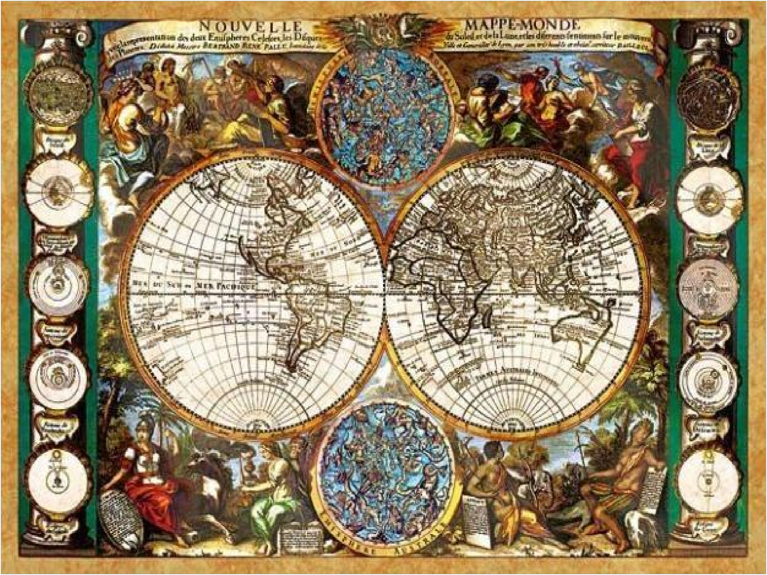
Lecture 1
“HISTORY
OF MEDICINE AND PHARMACY OF THE ANCIENT WORLD“
INTRODUCTION TO PHARMACY
ODESSA NATIONAL MEDICAL UNIVERCITY
DEPARTMENT OF ORGANIZATION AND ECONOMIC OF PHARMACY
ODESA 2022

Slide 2
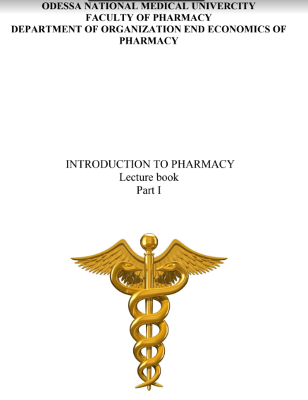
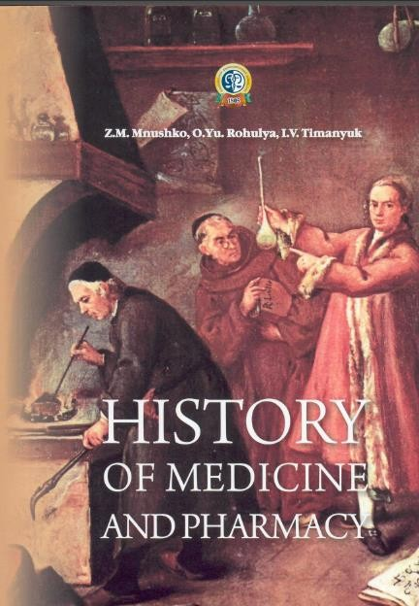
THE LIST OF RECOMMENDED LITERATURE
Texts of lectures on the discipline "Introduction to pharmacy" / IS Yashchuk, LM Unhurian, OI Bieliaieva etall. - Odessa: ONMedU, 2019. - 39 p
Mnushko Z.M. History of Medicine and Pharmacy: textbook for students of higher schools/ Z.M. Mnushko, O.Yu. Rohulya, I.V. Timanyuk. — Kharkiv: NUPh: Golden Pages, 2011. — 192 p.
Duffin, J. History of medicine: a scandalously short introduction /
J. Duffin. – Toronto : University of Toronto Press, 2016. – 480 p.
Fierke, К. К Teaching Resources in the History of Pharmacy: Teaching a Historical Perspective Using a Digital Resource / K. K. Fierke, P. L. Ranelli, R. C. Smith // Pharmacy in History. – 2012. – Vol. 54, № 4. – P. 112–114.
Higby, G. J. A Cornerstone of Modern Institutional Pharmacy Practice: Mirror to Hospital Pharmacy / G. J. A. Higby // Pharm. Hist. – 2014. – Vol. 56, № 3-4. – P. 59–65.
Magner, L. N. A History of Medicine / L. N. Magner, O. J Kim. – 3rd ed. – Boca Raton : CRC Press, 2017. – 446 p.
2

Slide 3
THEORETICAL QUESTIONS:
Periodization and chronology of the world historical process
Sources of studying the history of medicine and pharmacy
Medicine and pharmacy in Ancient Egypt
Medicine and pharmacy in Ancient Greece.
Medicine and pharmacy in Ancient Rome.
Outstanding physicians in the Ancient period.
3

Slide 4
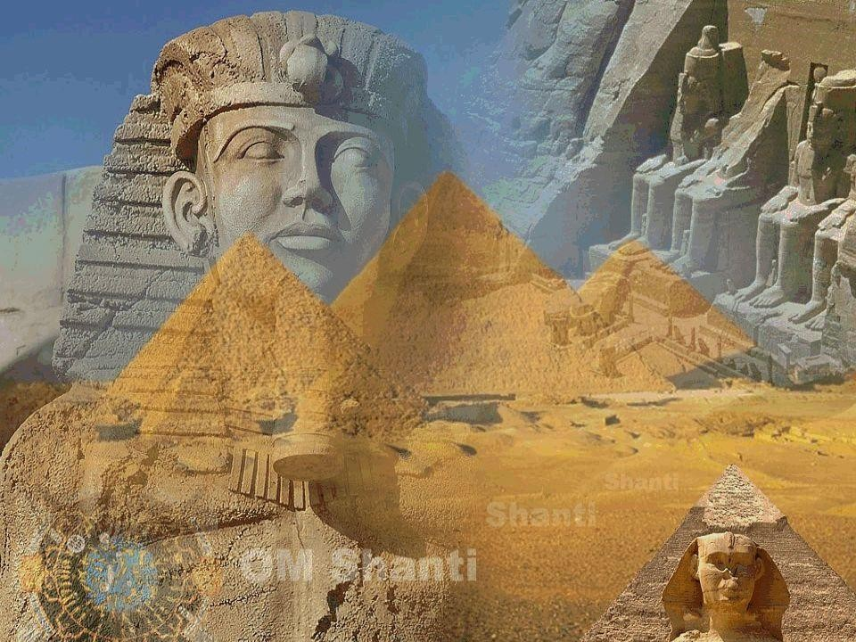
Periodization and chronology of the worlds historical process

Slide 5
MEDICINE IN ANCIENT EGYPT

Slide 6
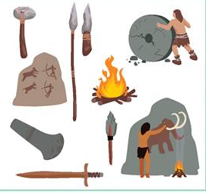
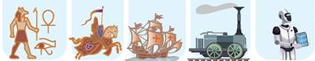
Periodization is an establishment in chronological order stages of social development.
Today, the periodization of world history is based on two principles: for the early periods of human development, their names are based on the material from which the main tools were made.
This is how the concepts of "Stone Age", "Copper-Stone Age", "Bronze Age", "Iron Age" appeared. With the advent of writing (about 5,000 years ago), the periodization was based on the existence of various civilizations and states in world history. Traditionally, the world historical process is divided into five main periods

Slide 7
Periods of the world historical process
The period of history | Chronological boundaries | Duration of the period
Primitive society | About 2 million years ago - V millennium BC. is. | About 2 million years (20 thousand centuries)
Ancient world | IV millennium BC. e. - 476 r.n. is. | About 4 thousand years (40 centuries)
Middle Ages | 476 - the middle of the seventeenth century. | About 1200 years (12 centuries)
New time | The middle of the seventeenth century. –Early twentieth century. | About 300 years
Recent history | 1918 - the beginning of the XXI century. | About 100 years (less than 1 century)

Slide 8
Sources of studying the history of medicine and pharmacy
is a carrier of historical information that has arsenals a
product of the development of nature and man and reflects one or another side of human activity.
When studying the history of medicine and pharmacy, basic information is provided by archeology, ethnography, paleontology, paleo botany, paleoanthropology, etc.
Historical sources
Material sources
Written sources
Art sources
Oral
sources
Linguistic
sources

Slide 9
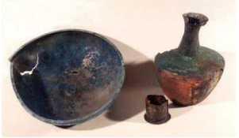
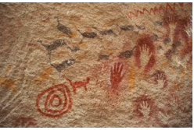
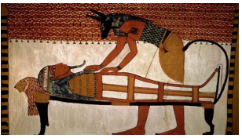
Art sources - contain information encoded in certain healthy images
(graphics, portraits, drawings, paintings, film, photo, video documents, cartographic
works).
Material sources store historical information about the past in the subject
form and reflect primarily the production and creative activities of people (clothing,
household items, architectural monuments), these sources include human remains.

Slide 10
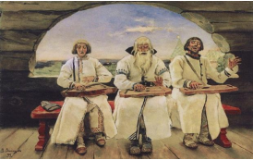
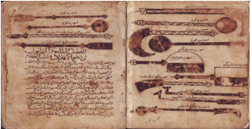
Linguistic
sources are linguistic monuments that contain valuable information, in particular, on the history of medicine and pharmacy (names of people, geographical names, names of peoples, tribes,
names of gods, names of animals, plants).
Oral sources provide information in the form of oral tradition, which is passed from
generation to generation, word of mouth and stored
in the memory of the people (myths, legends,
legends, songs, poems).
Written sources are considered the main in the study of the historical past,
their defining feature is the written record of information (chronicles, chronicles,
works of ancient authors, sources of personal origin and office documents, statistical
sources, periodicals, memoirs, diaries, biographies, correspondence, scientific
literature).

Slide 11


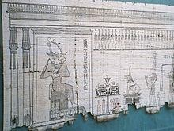





EGYPTIANS CONTRIBUTION to the HISTORY of MANKIND
the most ancient monuments of culture, citizenship, art
arithmetic to the world, fractions, calculated, even the millions
a calendar, counted that the number of days in a year was 365
geometry
a map of the sky - thus astronomy was originated
the written language in the form of signs, drawings-hieroglyphs
Papyrus is a thin paper-like material
made from the pith of the papyrus plant
Ancient Egyptians are thought to have used papyrus as a writing material, as well as employing it commonly in the construction of other artifacts such
as reed boats, mats, rope, sandals, and baskets ₅
A section of the Egyptian Book of the Dead written on papyrus

Slide 12









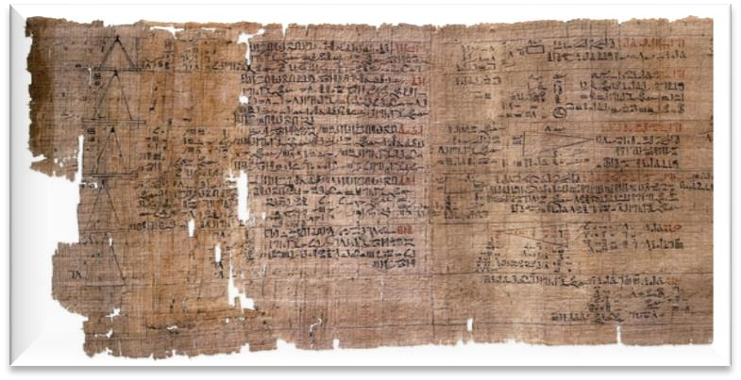
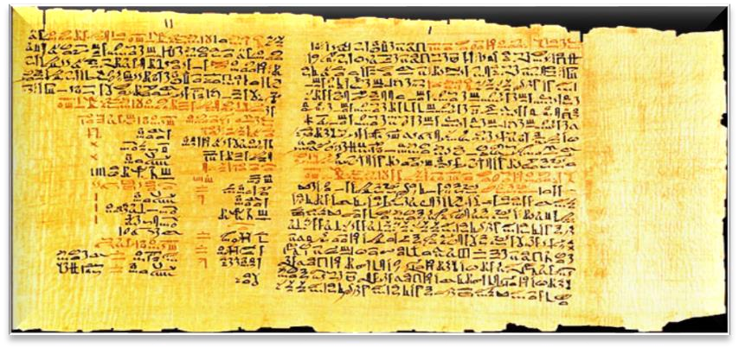
SOURCES FOR STUDY OF MEDICINE IN ANCIENT EGYPT
These books were constituted by different people at different times.
HERMETIC BOOKS
Hermes – God of the Writing.
342 books, 6 of them are related to medicine
Medical Papyruses
by the name after the first owner | by the place of discovery | by the name of the city where they store
Georg Ebers, Edwin Smith, Hurst, Ches-ter-Beatty, Carlsberg. | Cajun, from Ramsessum. | Berlin, London, Leiden.
6

Slide 13





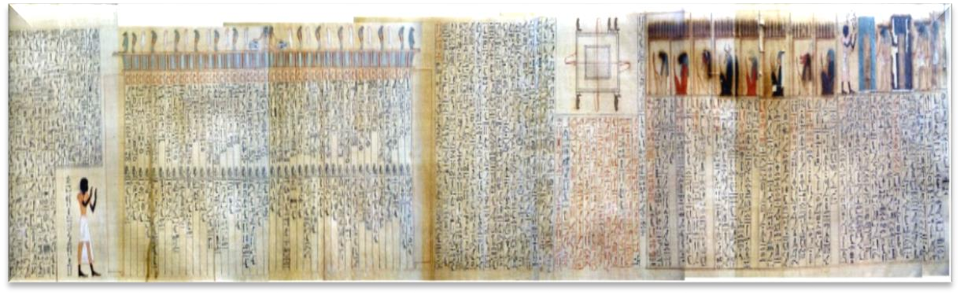
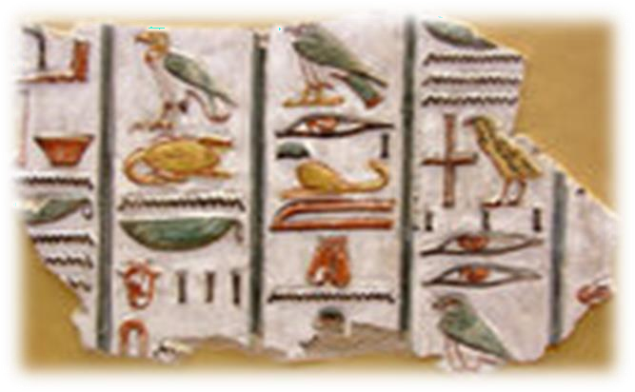
PAPYRUSES OF ANCIENT EGYPT
PAPYRUSES | CONTENTS
CAJUN (1950 BC) | Papyrus consists of 3 parts: medicine, veterinary medicine, mathematics Contains 17 gynecological prescriptions and 17 methods for determining the pregnancy and sex of the baby (beer, milk, figs are recommended as medicines)
BERLIN (1300 BC) | Sections about rheumatism and about the blood vessels, provides a way to determine the sex of the baby.
LEIDEN (1250 BC) | recipes and describes techniques of the magical and empirical treatment are contained
HURST | 260 cases of disease are described there is a chapter about bone diseases, treatment of fractures of the extremities and precautions for the bites of poisonous insects.
7

Slide 14
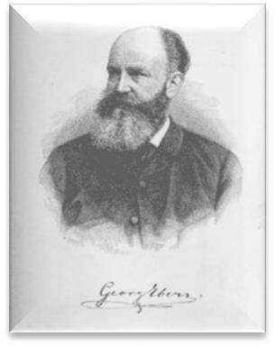
















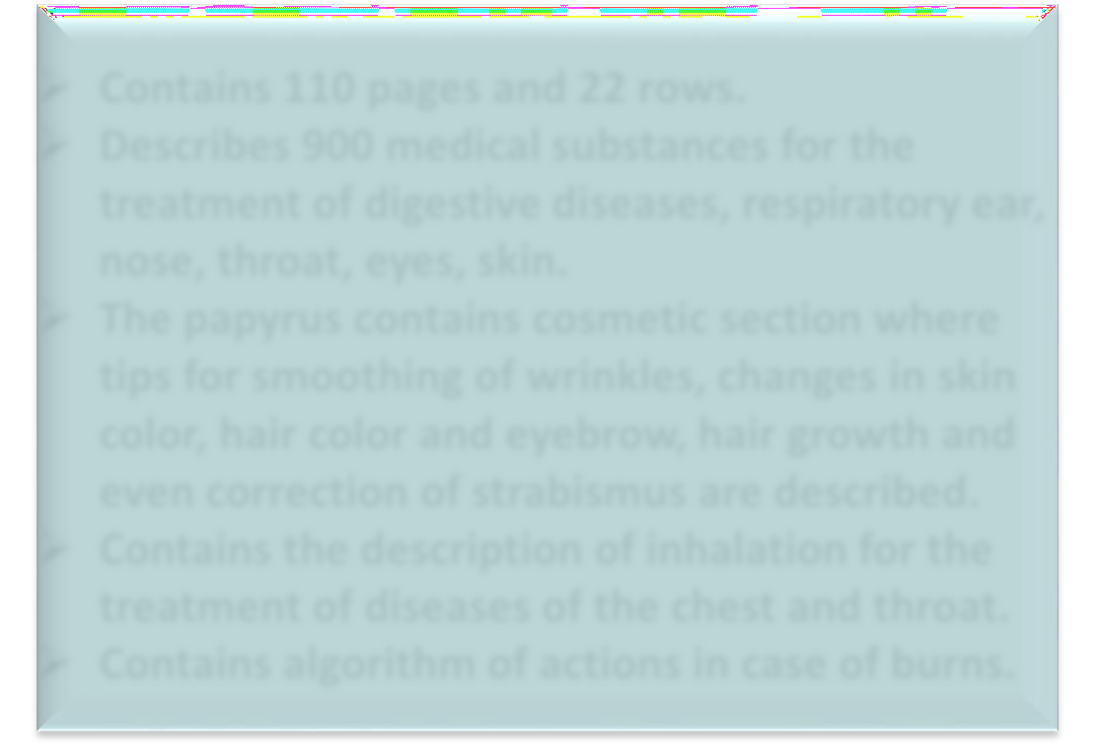
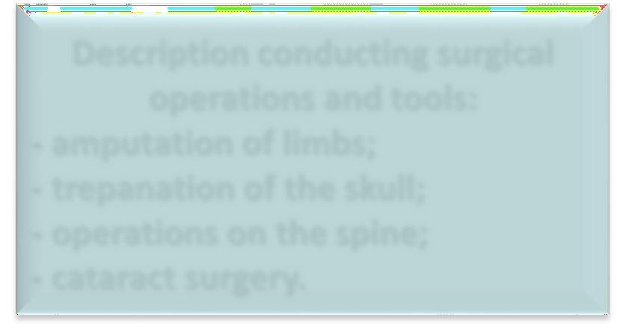








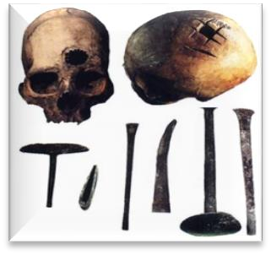
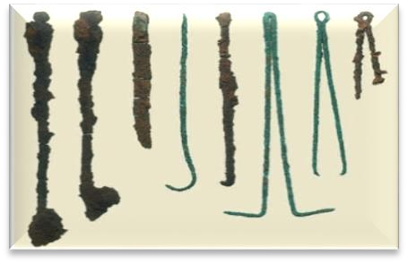
THE PAPYRUS OF EBERS AND SMITH
EBER’S PAPYRUS SMITH’S PAPYRUS
^{dates back to 1500 BC} until the end of XI century BC
BOOK OF DRUGS’ MANUFACTURING FOR ALL PARTS OF THE BODY
(was found in 1872 in Thebes)
ABOUT THE STRUCTURE OF THE HUMAN BODY AND SURGICAL TREATMENT
Contains 110 pages and 22 rows.
Describes 900 medical substances for the treatment of digestive diseases, respiratory ear, nose, throat, eyes, skin.
The papyrus contains cosmetic section where tips for smoothing of wrinkles, changes in skin color, hair color and eyebrow, hair growth and even correction of strabismus are described.
Contains the description of inhalation for the treatment of diseases of the chest and throat.
Contains algorithm of actions in case of burns.
Description conducting surgical operations and tools:
amputation of limbs;
trepanation of the skull;
operations on the spine;
cataract surgery.
8

Slide 15
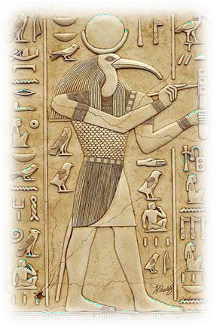
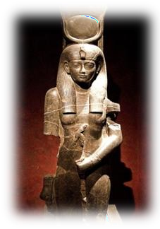
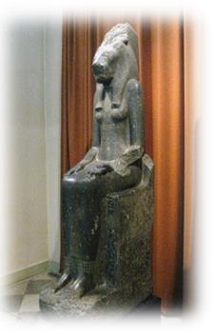
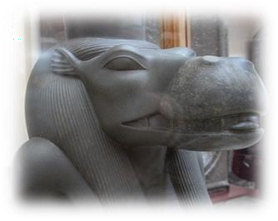
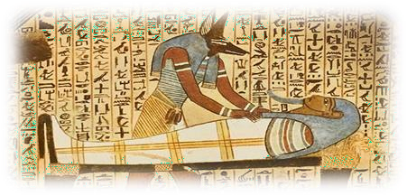




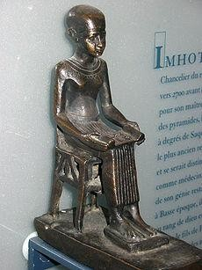
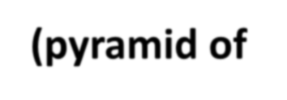










DEITIES OF ANCIENT EGYPT MEDICINE
GOD THOTH
god of science, laws and the sacred books
(writing, mathematics, astronomy, ceremonies, music, system
of treating diseases by natural remedies)
was depicted as a man with the head of ibis bird
ISIDA (ISIS)
goddess of motherhood and fertility
SEKBMET
patroness of women and women in childbirth
TAUERT (TAURT)
patroness of newborns
ANUBIS
god of death
IMHOTEP – the god of medicine
the defender of medicine and the author of the ancient medical texts, astrologer, architect (pyramid of Djoser).
The Egyptians called Thoth "pharmaco" or "pharmacy".
Hence, words with the root "pharma" arose: pharmacology, pharmacognosy, pharmacopoeia, pharmacy.
9

Slide 16







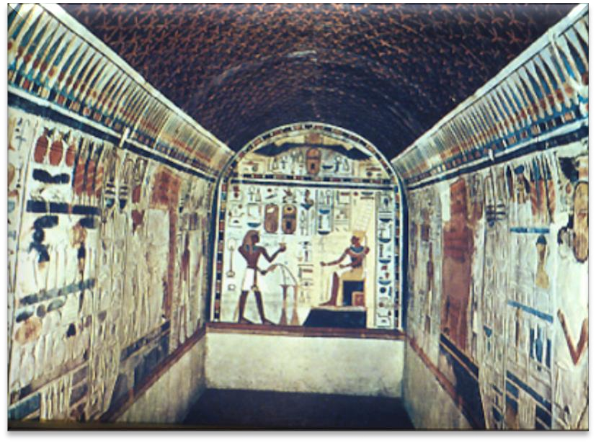





MEDICINE AND PHARMACY OF ANCIENT EGYPT
The causes of diseases – religious beliefs (a demon inside the body of the sick). The Egyptians associated causes of diseases both with natural phenomena (junk food, intestinal parasites, weather changes) and with supernatural ideas (occupancy of the spirit of the deceased person patient’s of the body).
Medicine of Egypt was “in the hands of priests” who preached to all the people to perform rituals of deprivation, temperance, extreme cleanliness, washing day and night. Health problems, according to priests, were brought by «the demons of diseases».
As a preventive measure healthy person every 10 days vomiting and laxative medicines was recommended to use
Thanks to preparation of mummies (embalming) the Egyptians studied well the structure of the human body.
Moderation in eating, orderly, compulsory part of the ablutions and body rub ointment was ordered
10

Slide 17





MEDICINE AND PHARMACY OF ANCIENT EGYPT
Doctors of Pharaohs advised no eating the fatty pork, and especially the raw
fish because «fever occurs in all internal organs and poor heart torn into pieces».
Physicians were trained in the Houses of life, which were located at temples in Sais and Heliopolis.
Egyptian surgeons were doing amputations, bandaged the festering
wounds; methods of bone fractures’ treatment were known.
Ophthalmology and stomatology have developed in Ancient Egypt.
Especially successful skin and cosmetic products were preparing, therefore Egypt is considered the birthplace of Dermatology.
Medicinal substances at that time: aloe, anise, henbane, flax seeds, plantain, onion, poppy seeds, dates, juniper, vinegar, honey.
11

Slide 18







PHARMACY OF ANCIENT EGYPT
poppy as a hypnotic, acanthus, resin, balsams, castor oil, incense, palm oil, wine, beer, brewer yeast, powder of rotten tree, wheat flour, turpentine, honey, dough
Medicines of vegetable origin
hair, bile, fat, teeth, woman’s
Medicines of
animal origin
milk, cow’s or donkey’s milk, sour milk, urine, liver
The Egyptians were able to prepare tablets, pills, infusions, decoctions, squeeze juice from plants, prepare ointments, adhesive bandages, plasters, smoking materials.
12

Slide 19
MEDICINE AND MEDICAL SCHOOLS OF ANCIENT GREECE
13

Slide 20

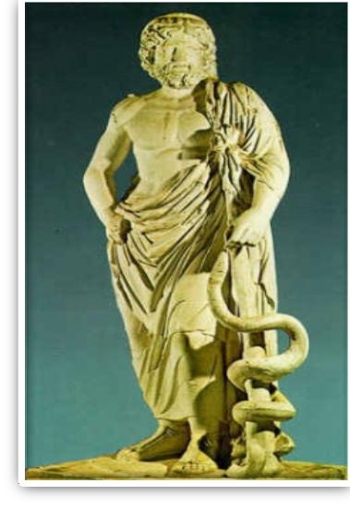











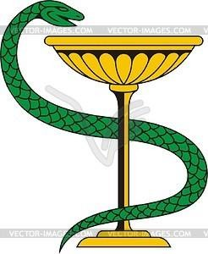



GOD OF THE MEDICAL ART - ASCLEPIUS
Asclepius was the son of Apollo
(the God of wisdom, poetry, music and beauty)
Apollo brought him to mount Pelion to herbalist Centaur Chiron.
Asclepius was depicted as an old man,
leaning on a staff entwined with a snake.
ASKLEPIUS’S SONS AND DAUGHTERS PERSONIFIED VARIOUS ASPECTS OF
MEDICAL ART
was depicted as a maiden holding in one hand a cup and snake drinking from it.
She became famous for her sound advice, that’s
why was revered as the goddess of health,
  the term «hygiene» was originated from her name.
MAHAON - surgery
HIGIEIA
(health / preventive medicine)
PODOLIRIY - internal diseases
TILESFOR - magical treatment
PANACEA
(who cures all)
is a patron of drug therapy, hence the term
«panacea» — a remedy for all illnesses.
Image of a bowl enlaced by a snake later became the emblem of medicine:
“A DOCTOR MUST BE WISE AS A SNAKE AND TO TAKE A WISDOM FROM THE BOWL OF THE NATURAL KNOWLEDGE."
1
4

Slide 21
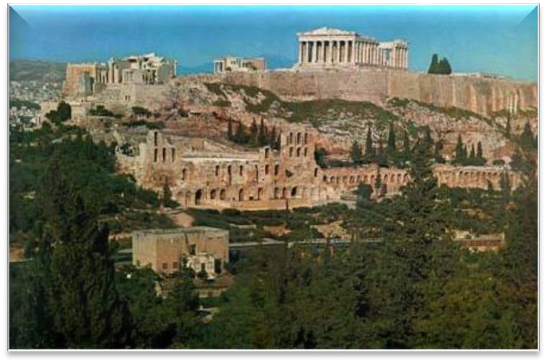
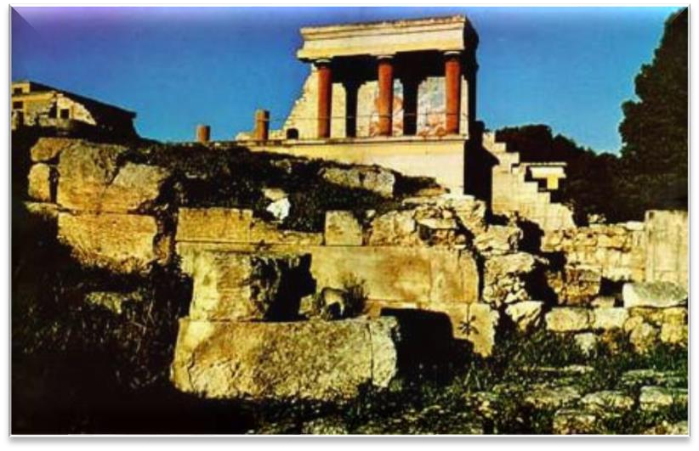



MEDICINE OF ANCIENT GREECE
TEMPLE MEDICINE
FAMILY MEDICINE
(PROFESSIONAL)
Asklepions
treatment was a family profession, and passed on from the father to the son
The main mean of the treatment
was incubation or sacred sleep at the feet of the deity
After recovery, patients brought into the temple organs’ casts of wood, ivory, marble, bronze, gold and silver, which were called votive gifts or "anatemata“
The Greek Name of
Drugs - “pharmakon"
15

Slide 22














MEDICAL SCHOOLS OF ANCIENT GREECE
CROTON
was founded by Alcmaeon Croton in Crotone (southern Italy, at that time being a Greek colony)
the body is a unity of opposites;
a healthy body is the result of the balance between opposing forces: dry, wet, hot and cold
the opposite is cured by the opposite (“contraria
contrariis curantur”).
Alcmaeon, mathematician Pythagoras
CNIDUS
laid the foundations of the humoral doctrine: “health is a favorable combination of four bodily fluids” (blood, phlegm, light bile and black bile), and unfavorable mixing of them is the cause of most diseases;
developed the doctrine about the signs of the
diseases (symptoms) and diagnostics.
Evrifon
KOS
considered the body in the close connection with the natural environment;
developed the principle of care and treatment at
the sick bed;
developed the foundations of the medical ethics.
the greatest physician of antiquity, rightly called the «father of medicine» —
Hippocrates
16

Slide 23
THE LIFE AND ACTIVITY OF HIPPOCRATES
17

Slide 24
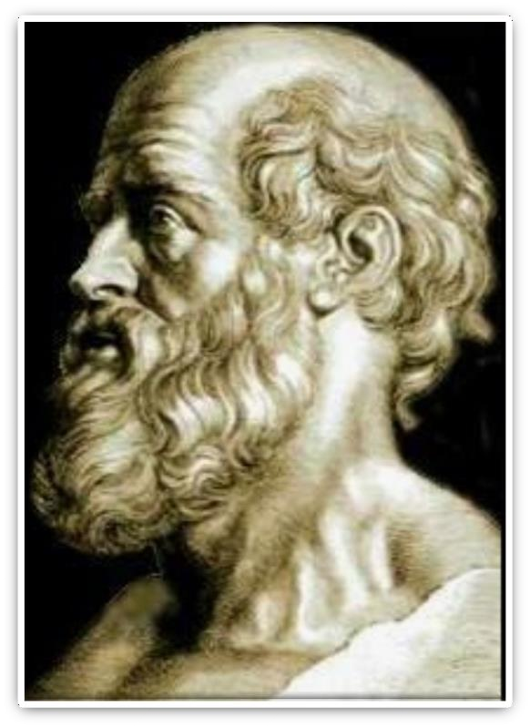


HIPPOCRATES’S VITAL ACTIVITY
born in the doctor’s family, his family practice medicine during 18 generations
attached great importance to the issues of health, welfare, regime and diet
“The social factors are influenced on the nature of man: the political system (freedom and democracy or slavery), lifestyle, customs”
The basic principle of Hippocrates’s treatment:
«Non nocere» – «Do not harm»
Physician could predict the course of disease observing enough cases.
(460 – 372 years BC)
«FATHER OF MEDICINE»
Hippocrates suggested a method of medical supervision near the patient's
bedside in various states: DURING SLEEP AND WAKEFULNESS.
18

Slide 25
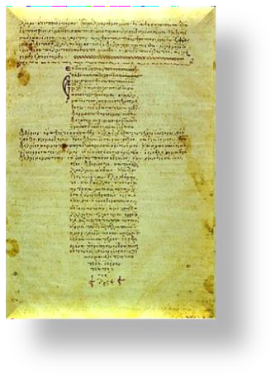


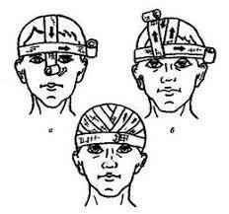







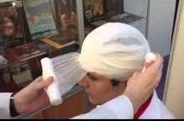
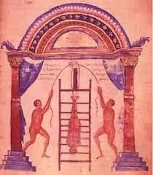
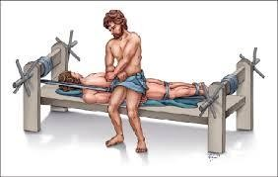


HIPPOCRATES’S SCIENTIFIC WORKS
TREATISE “ON EPIDEMICS"
described his observations of various epidemic
diseases in the cities of Greece;
led the first histories of the diseases;
developed disease diagnosis based on the localization of pain, appearance of sputum and urine.
TREATISES
“ON WOUNDS IN THE HEAD“, “ABOUT FRACTURES”
described a methods for applying bandages for fractures, sprains, dislocations;
nowadays in surgery used a bandage – “cap of
Hippocrates” and the machine tool to extract –
«bench of Hippocrates».
“The Code of Hippocrates"
Consisted of 17 books on internal illnesses: 8 books on surgery, 9 books on female illnesses;
Human body contains 4 juices: blood, mucus, black and yellow bile.
16

Slide 26








sanguine (the blood excess)
Depending on the predominance of one or another fluid four main types of the human constitution or temperament are distinguished:
IDENTIFIED FOUR MAIN TYPES OF TEMPERAMENT:
people of the East are plump, affable, calm,
but pampered and lazy;
they are not susceptible to diseases
choleric (the yellow bile excess)
the people of the North are lean, strong, energetic, active;
their stomach easily «opened» up, the bile was released into the lungs, brain and eyes, so cholerics are susceptible to pneumonia and «dry diseases» of eyes;
the humid climate is favorable for them
phlegmatic (the phlegm (mucus) predominates)
the people of the South are languid, drowsy, not hardworking, in most cases, with weak souls.
In a dry climate the mucus from the brain pours into the nose and the brain is cleared from moisture through cold - a dry, warm climate is recommended for phlegmatics;
melancholic (excess black bile)
the people of the West are gloomy, depressed, the prevailing moisture — is the residue after evaporation of the wet part of the ₂b₀ile;
they suffer the same diseases as cholerics and phlegmatics

Slide 27
MEDICINE IN THE ANCIENT ROME. ASCLEPIAD’S TEACHINGS.
WORKS OF GALEN.
21

Slide 28
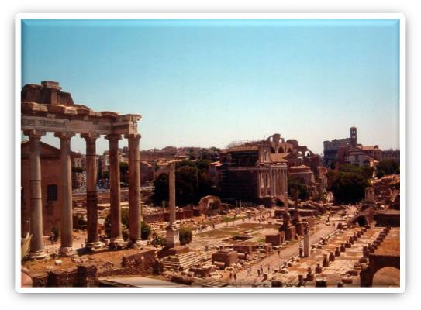










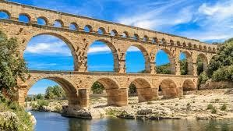

MEDICINE AND PHARMACY IN THE ANCIENT ROME
THE IMPERIAL
PERIOD
VIII - VI century BC
  the ancient Italy was a community of the city- states
THE PERIOD OF
REPUBLIC
509 - 31 years BC
  Rome conquered the cities in Italy and started wars of conquest beyond the Apennine peninsula
Every wealthy Roman citizen buys himself a slave doctor who treated free him, his family and other slaves.
For payment slave doctor treated other romans.
THE PERIOD OF THE EMPIRE
30 years BC - 476 years AD
  the rise and the crisis (collapse) of the slave state under the authority of Rome
Temple medicine, like the Greek medicine, appeared in Rome during the plague epidemic in the beginning of III century BC
"LAWS OF XII TABLES" - The first collection of
health-related laws
AQUEDUCT - Underground sources of clean drinking water
THERMO - Hot baths
18

Slide 29
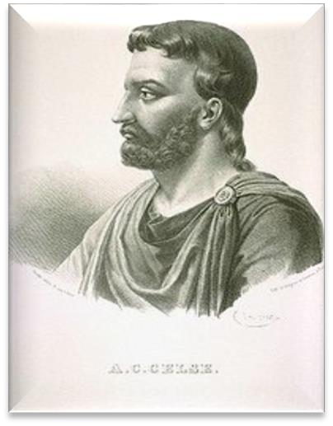






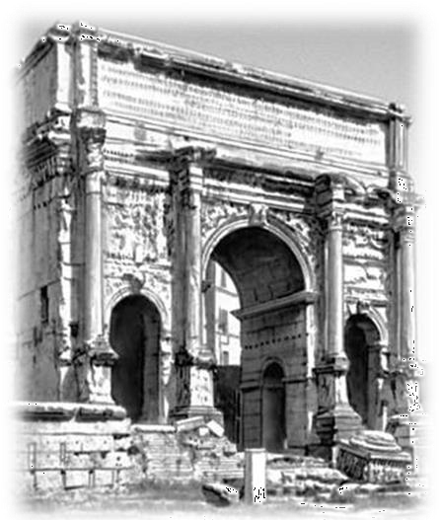
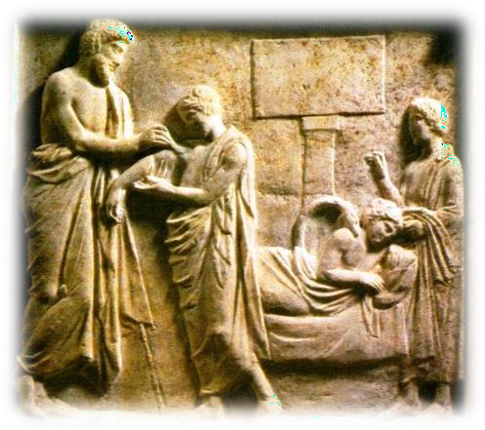
TEACHINGS OF ASCLEPIADES
ESSENCE OF TEACHING - the material basis of organisms are atoms
SLOGAN ASKLEPIAD -
"TREAT SAFER, FASTER AND ENJOYABLE"
For treatment of diseases Asclepiades recommended:
the correct nutrition,
massage,
fresh air (especially in the mountains)
physical exercise (walking, riding)
a thorough skin care.
(128 – 56 years BC)
GREEK BY ORIGIN, CAME TO ROME IN 90 BC
TYPES OF MEDICAL INSTITUTIONS
HOSPITALS
HOSPITALS, which belonged to
individual physicians
ASCLEPIUS - of educational institution type
VALETUDINARI - hospitals, witch created by wealthy Romans for their slaves and soldiers
23

Slide 30
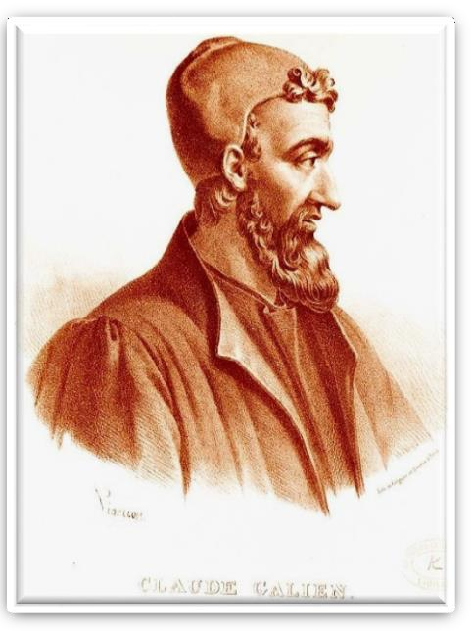

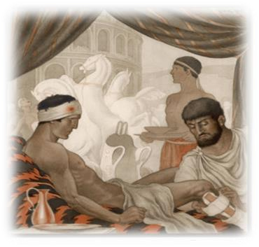
CLAUDIUS GALEN
Greek by origin, was born in Pergamum (Pergamos kingdom
became a Roman province) in the family of the famous architect, mathematician and philosopher
for 6 years practiced medicine in the school of gladiators
became famous for his art in the treatment of wounds, sprains and fractures
studied the anatomy and physiology of the best doctors in Alexandria, assuming that the treatment of disease based on the knowledge of these disciplines
complete mastery of necropsy technique
(129–199 AD)
AUTHOR OF MORE THAN 434 SCIENTIFIC WORKS, including 200 on medicine
One of his works - “About the appointment of the human body": the description of the parts of the body and organs.
Galen combined with the study of the fine structure named histology.
Galen classified medicines as
SIMPLE - there are basic qualities of cold, heat, humidity and dryness;
COMPLEX - are based on different combinations of main and side properties (bitter, sweet, sour);
SPECIFIC - those that acted as irritants, agents for emptying
24

Slide 31

Conclusions
Thanks to the preparation of mummies the Egyptians studied well the structure of the human body. They associated causes of diseases both with natural phenomena (junk food, intestinal parasites, weather changes) and with supernatural ideas (occupancy of the spirit of the deceased person patient’s of the body, attempts to expel it the unpleasant- tasting medicines, charms, spells, etc.). The Egyptian doctors were able not only to open the skull for removing the tumor in 3000 BC but also they did other surgical operations: removing of appendixes, amputation of hands and their replacement for the prosthesis.
The professional medicine in Greece was characterized by the appearance of the first in the history of medicine hospitals and the beginning of the organization of health care in urban areas. Hospitals were located in specially equipped premises, medical schools training every person who wanted to study for a fee were opened at them. The temple medicine included methods of treatment at the temples. Temples erected in honor of Asclepius and Apollo were located in areas with a favourable climate next to the healing springs. The treatment consisted of the developed system of hypnosis. Silence, rest, good nutrition acted on a patient beneficially, fasting, prayers and the appropriate music were preparing for the sacrament.
25

Slide 32
Conclusions
In the imperial period in Rome folk medicines were used for treatment. Fresh turnip reduced to powder with salt was applied to the patient’s bad legs. Nettle was recommended to eat in spring to prevent all diseases: a decoction of nettle was taken in a cough and cold, in nasal bleedings its root was powdered and the powder was inhaled, in running nose lotions of tincture of its seeds on the grape wine previously boiled to half volume were put on.
The name of the greatest physician of antiquity, rightly called the «father of medicine» — Hippocrates. The result of his observation was treatise the «About the air, waters and places» where he outlined the doctrine of four main types of human habitus and the temperament. In his opinion, the human body contained four cardinal fluids: blood, phlegm, yellow and black bile. The quantitative change of one of them led to a disease.
Claudius Galen was an outstanding physician of the ancient Rome. He had a medical practice in the school of gladiators for 6 years. He was famous for his art of healing wounds, sprains and fractures. He studied anatomy and physiology considering that the treatment of diseases was based on knowledge of these disciplines. He devoted one of his works — «About the purpose of a human body» to these sciences. Galen combined description of the body parts and organs with the study of their fine structure — histology. Galen laid the foundation of experimental physiology. He was the first to introduce the concept of active ingredients. Galen
became the founder of another science — pharmacology (about the effects of
medicines on the body).
26

Slide 33
Thank you for attention!

