Slide 1
Ministry of Health of Ukraine
Odesa National Medical University
Fаculty of Pharmacy
LECTURE №2:
«The development of medicine and pharmacy in Ukraine from ancient to present»
Odessa – 2019

Slide 2
Folk medicine
The history of medicine in Ukraine begins with the history of folk medicine.
The origin of Ukrainian medicine may be traced back to the folk medicine of the Kyiv Ukraine-Rus epoch. It developed as a monastery medicine and medicine of the Cossacks state.

Slide 3
Medical schools
The first medical hospitals in Kyiv Rus were founded in the 11-th century and were mostly in the form of alms houses attached to churches.
In 1653 in the city of Zamostya (near Lviv) Zamostya’s academy was organized under the initiative of graph Yan Zamoyskyi.
Yan Zamoyskyi graduated from the University of Padua. He desided to open a similar school in his motherland. The Pope of Rome Clement VIII confirmed the Academy status and gave it the right to adjudge the degree of the doctors of philosophy, low and medicine. Medical Faculty of the Academy was weaker than that of Cracow. Only 1-2 professors taught medicine there.
The academy was existing only for 190 years. But it played a positive role in the dissemination of scientific medical knowledge among the population.

Slide 4
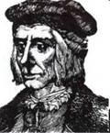
Medical schools
One of such doctors of medicine was Yuriy Drohobych-Kotermak (1450-1494).
Yuriy Drohobych-Kotermak was a philosopher, astrologist, writer, medical doctor, rector of the University of Bologna, professor of Krakow Academy, first publisher of a Ukrainian printed text. He is the author of “Iudicium Pronosticon Anni Currentis”, 1483.
In 1478 Drohobych received his doctorate in philosophy, but he continued his studies. This time he took up medicine.

Slide 5
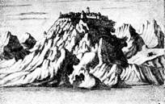
Medical assistance in the army of Bogdan Khmelnitsky
At the end of the XVI century the main Kossacks hospital was the hospital in Trahtemyrivskyi monastery below the Dnieper.
Military hospitals were in monasteries: Lebedinsky near Chyhyryn and Levkovsky near Ovruch. Monasteries willingly took care over the Cossacks.
In Cossack hospitals, opposed to civilians in towns and villages, the disabled found refuge as well as treatment the wounded was practiced. Those were the first military hospitals in Ukraine.

Slide 6
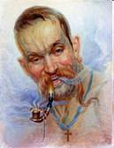
Cossacks medicine is very interesting too. Their practice off medicine is full of mysteries and legends.
Pauline, thyme, mint, borschivnyk were the main components of content of Kossack pipe. That is why Cossacks almost newer were sick with asthma and bronchitis.
Moreover smoking was able to reduce pressure, calm nerves, improve appetite, sleep and even eyesight.

Slide 7
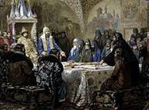
Epifany Slavinetsky
Among famous doctors of that time it is important to mention Epifany Slavinetsky.
In the 1620s, he attended the Kyiv Brotherhood School and later continued his education abroad.
Epifany was one of the most educated people of his period that came from Central and Eastern Europe. He came to master the Latin, Polish, Ancient Greek and Hebrew languages.
Epifany Slavinetsky translated into Slavic languages the book of anatomy by Andreas Vesalius.

Slide 8
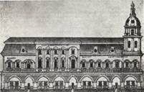
Kyiv-Mohyla academy
Kyiv-Mohyla academy played a significant role in the preparing of medical stuff, with organization of hospital’s medical schools. During 14 years (1784-1798) more than 300 persons who were studying at academy, entered medical schools. The Academy was first opened in 1615 as the Kyiv Brotherhood School. Among the famous graduates of the Kyiv-Mohyla Academy there are names of Peter Doroshenko, Philip Orlik, Yuri Khmelnitsky, Paul Teterya, Gregory Skovoroda, Ivan Skoropadskyi, Ivan Mazepa etc.

Slide 9
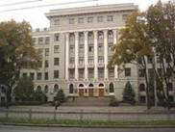
Kharkiv State Medical University
The Kharkiv State Medical University is one of the oldest higher educational establishments in Ukraine.
It was founded in 1805 as the Medical Faculty of the Kharkov University. At present, over 600 teachers work at the departments of this Medical University.

Slide 10
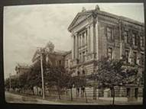
Odessa State Medical University
In year 2000 Odessa State Medical University has completed its 100 years of existence. Odessa State Medical University is the first university of Ukraine which started medical education in English medium in 1996.

Slide 11
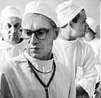
Mykola Amosov
Mykola Amosov was a Ukrainian doctor, heart surgeon, inventor, enthusiast, known for his inventions of several surgical procedures for treating heart defects.
In 1955 he was the first in Ukraine who began treatment for heart diseases surgically. In 1958, he was one of the first in the Soviet Union to introduce into the practice the method of artificial blood circulation (in 1963). Amosov was first in the Soviet Union to perform the mitral valve replacement, and in 1965 for the first time in the world he created and introduced into practice the antithrombotic heart valves prosthethesis. Amosov elaborated a number of new methods of surgical treatment of heart lesions, the original model of heart-lung machine.

Slide 12
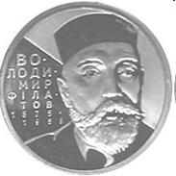
Volodymyr Petrovych Filatov
Volodymyr Filatov was a Ukrainian ophthalmologist and surgeon best known for his development of tissue therapy. He introduced the tube flap grafting method, corneal transplantation and preservation of grafts from cadaver eyes. He founded The Filatov Institute of Eye Diseases & Tissue Therapy in Odessa. Filatov is also credited for restoring Vasily Zaytsev’s sight when he suffered an injury to his eyes from a mortar attack during Battle of Stalingrad.

