Slide 1
Ministry of Health of Ukraine
Odesa National Medical University
Faculty of Pharmacy
LECTURE №5:
«Pharmacy – health care facilities
Odessa – 2019

Slide 2

Pharmacy - a healthcare institution that operates with the permission and under the control of public authorities, whose main task is to provide the population, health institutions, enterprises, institutions and organizations of the drug by retail trade.

Slide 3
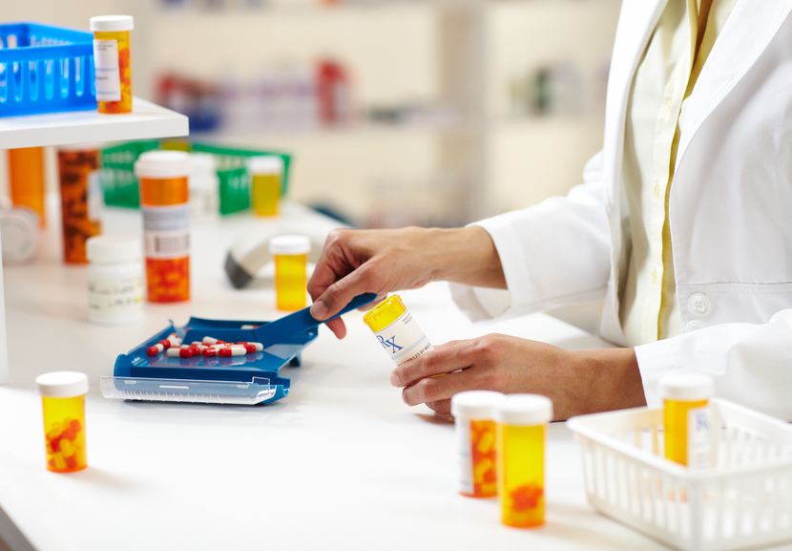
Functions of the pharmacy
1. Production:
preparation of medicines;
quality control of manufactured drugs
conducting laboratory and filling works;

Slide 4
Functions of the pharmacy
2. Trading:
purchase and taking medicines;
incoming quality control of medicines;
placement and storage of medicines;
realization of the public on prescription drugs and over the counter for cash;
implementation of treatment and prevention agencies and other organizations of drugs by bank transfer.

Slide 5

Functions of the pharmacy
3. Information:
disseminate public health and sanitation knowledge and conduct health education;
pharmaceutical care;
conducting outreach among medical and pharmaceutical professionals.

Slide 6
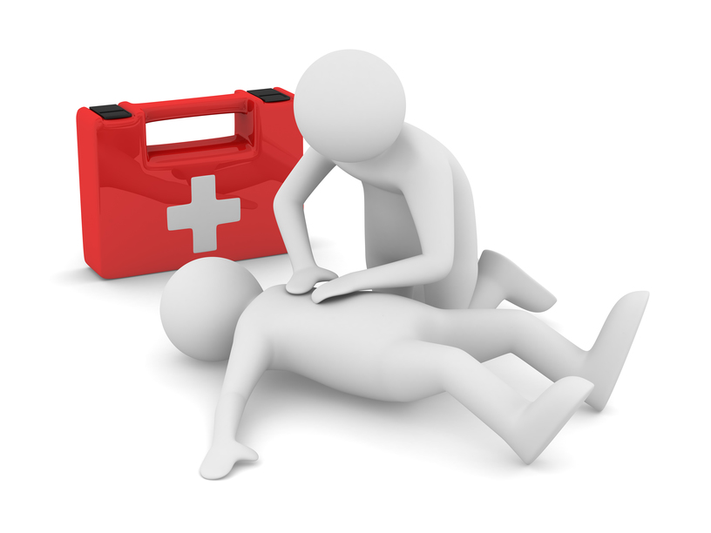
Functions of the pharmacy
4. Social:
✓ to provide emergency medical care to the population;

Slide 7
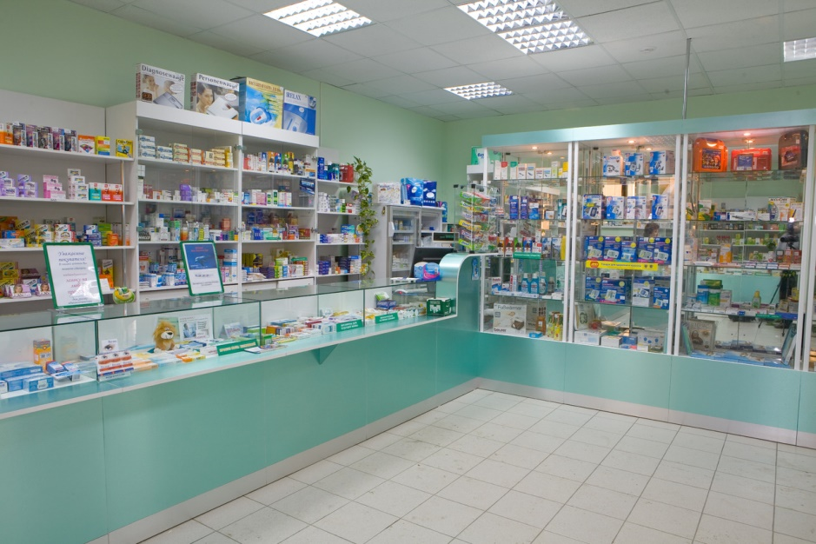
Pharmacy should be located in a separate building or in the built environment. In a residential house pharmacy is located on the ground floor; separate rooms pharmacies, except trading hall, can be placed in the basement.
The minimum area of ​​the pharmacy - 50 m; In vilagge – 30 m

Slide 8
Pharmacies rooms and their equipment
Pharmacy with right for making of non sterile medicines:
- room service population (minimum area of ​​18 sq m),
- assistant room – 20 m
- room for the receipt of cleared water – 8 m
- room of washing and sterilization – 8 m,
Pharmacy with right for making of sterile medicines:
- To obtain water for injection - an area of 8 square meters. m (possible to combine with room for water purification);
- Aseptic assistant gateway - 13 (10 + 3) is square. m;
- For sterilization manufactured drugs - from 10 square meters. m;
- Control room for labeling and hermetic sealing of drugs - from 10 square meters. m.

Slide 9

Staff of Pharmacy
Administrative: the Head of Pharmacy, the deputy head of the pharmacy, head of the Department, the deputy head of the department
Pharmaceautical: Pharmacist, Pharmacist analyst, the pharmacist intern, Junior pharmacist
Additional: Packer, cleaner ( container washer), Accountant, cashier, driver, cleaner.

Slide 10
Departments of pharmacies and their functions
The department reserves - pharmacy supplies, and health care institutions and other agencies and organizations of inventory values.
Functions
definition of current medical need,
timely submission of orders for them,
reception of goods in quantity and quality,
to ensure proper storage,
organization of subject-quantitative calculation,
conducting laboratory and filling works,
holiday goods other departments pharmacy, departments and health care agencies.

Slide 11
Departments of pharmacies and their functions
Prescription-production department - provides the population and medical institutions medicines pharmaceutical manufacturing.
Functions
receiving prescriptions for the manufacture of drugs for individual prescriptions,
manufacturing and design to the release of drugs,
manufacturing quality control of medicines in the pharmacy and they leave.

Slide 12
Departments of pharmacies and their functions
Department of finished drugs - serves a population of release drugs according to prescription.
Functions
receiving prescriptions for medications ready industrial production and release of drugs on them;

Slide 13
Departments of pharmacies and their functions
Department of non-prescription drugs and medical devices - serves a population of release of OTC drugs, medical devices, cosmetics, sanitary and hygienic products, mineral water, etc.
Functions
realization of medicines sold without prescription and medical products.

