Slide 1

Ministry of Health of Ukraine
Odesa National Medical University
Faculty of Pharmacy
LECTURE №8:
Organization of preparation and quality control of extemporaneous and finished medicines and other pharmaceutical products
Odessa – 2019

Slide 2
The concept of the quality of drugs
The quality of the drug - a combination of characteristics (efficiency, safety, storage stability, cost) that provide the drug's ability to meet consumers in accordance with its purpose.
Organization of intrapharmacy quality control of drugs in pharmacies is regulated by the order of Ministry of Health of Ukraine №677 from 29.09.2014.

Slide 3

Input ( intrapharmacy) quality control of medicines in pharmacies provide by an representative person who must have higher or secondary pharmaceutical education and at least 2 years work experience in the specialty.

Slide 4
The main duties of the representative person is:
Checking medicines, which come to the pharmacy, and the supporting documents - invoices (with the obligatory indication of the name, dosage, dosage form, batch number, quantity, manufacturer's name), manufacturer of quality certificates of the registration status of the drug data.
Design input output quality control of medicines.
Keeping the register of medicines, which came to the subject of economic activity.

Slide 5
The main duties of the representative person is:
To check if in the pharmacy are substandard and counterfeit medicines in series according to the information of the territorial inspection.
Provision of the territorial inspection reports to identify substandard and counterfeit medicines or those for which there is a suspicion of their quality. The suspension of trade with respect to such funds,
Harmonization of the internal order of trafficking drugs.

Slide 6
Methods of intrapharmacy control in the pharmacy
1. Purchasing and receiving medicines should only subjects who have valid licenses for the wholesale trade.
2. These pharmacy medicines should be visually inspected by an authorized person, the positive result of which is a written permission for the implementation of these drugs.
3. The authorized person checks the manufacture of a medicament supporting documents relative to the amount of dosage, a series of numbers, expiration dates, registration status, name, dosage form, manufacturer.

Slide 7
Methods of intrapharmacy control in the pharmacy
Group container, foreign (secondary) and internal (primary) packaging, labeling, package insert, appearance without revealing the package are checked for consistency, uniformity, damage, quality of packaging materials. If required, when there is suspicion of quality medicines are tested with respect to the disclosure of packaging size, shape, color, homogeneity, the number of units in the package, the presence of impurities.
5. If the result of the input control is positive authorized person transmits the series of medicines in the implementation.

Slide 8
Methods of intrapharmacy control in the pharmacy
6. With a negative result, the authorized person is an act of identified defects, which is the basis for the return of the party to the supplier. A copy is served to the territorial inspection, which after additional testing and sampling laboratory analysis takes measures regarding the information to other pharmacies on identified substandard or counterfeit medicines, and controls the actions of the supplier on their destruction, disposal or return (in the case of low-quality series) manufacturer.
7. In case of doubts about the quality of medicines in the performance of visual inspection the authorized person selects questionable drug samples and sends them to the territorial inspection for the passage of laboratory research. At the time of these studies, a final solution to the question about their quality, a series of dubious drugs are in quarantine, isolated from other drugs with the designation "Trade is not allowed to an individual order."

Slide 9
Intrapfarmacy control includes six types of control:
- Written,
- The questionnaire,
- Organoleptic,
- The physical
- chemical
- Control over realization.
Obligatory controls are written, organoleptic and Control over realization. The rest - selectively.

Slide 10

written control
Writing control is carried out after the production of any extemporaneous formulation and filling of passports of written control. In this case the pharmacist who made the dosage form from memory (without looking at the recipe) must write the name of the Latin language, and specify the amounts of all ingredients in the order in which they actually took to manufacture.
Passports of written control are stored in the pharmacy one month.

Slide 11

Questionnaire control (oral)
In carrying out its specialist calls the first of the ingredients manufactured dosage form and in complex dosage forms also indicate the amount. After that, the pharmacist calls all taken their ingredients and their amounts. In the case of the use of concentrates (semi-finished), a pharmacist must also name their composition and concentration.

Slide 12
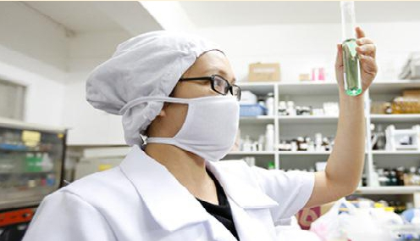
Sensory control (organoleptic)
a test of the appearance of the dosage form, its color, odor, mixing uniformity, absence of impurities in the rare dosage forms. Particular attention is drawn to medicine for children.

Slide 13
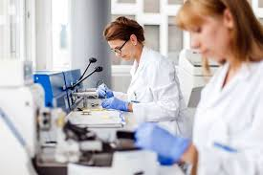
Physical control
- kind of control, which is to establish the total mass or volume of the dosage form, quantity and weight of the individual doses.

Slide 14

Chemical control
is to determine the identity (qualitative analysis) and quantitative drug content, which are part of the dosage form.
There are high-quality and full chemical control.

