Slide 1
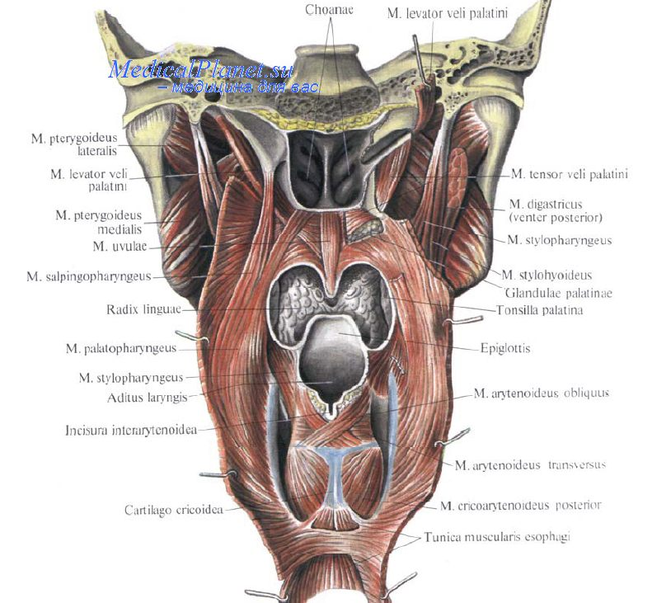
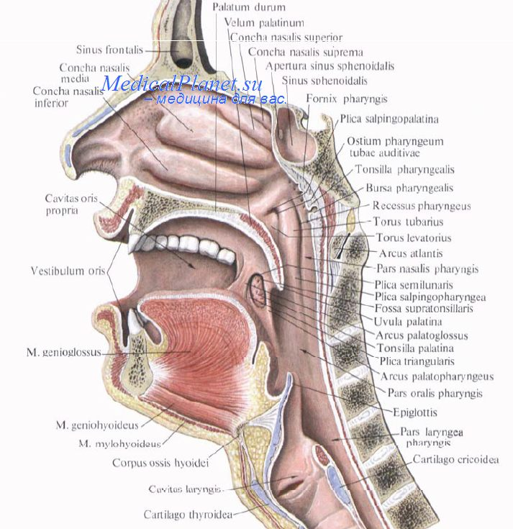
Diseases of the throat

Slide 2
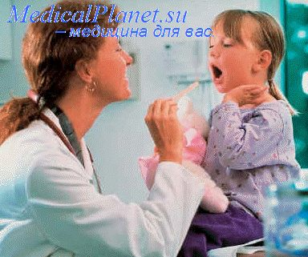
Acute tonsillitis is a general infectious disease in which the lymphoid tissue of the tonsils is affected by inflammation. In most cases the palatine tonsils are affected, while the other tonsils are involved less frequently.
Aetiology and pathogenesis: coccus, bacilli, viruses, spirochetae, fungi, beta-haemolytic
streptococcus of group A, Staphylococcus
aureus, adenoviruses.
Ocassional tonsillitis manifested as autoinfection
Epidemic form arising as a result of infection from a tonsillitis patient
Exacerbation of chronic tonsillitis.
The commonly used classification includes the following forms: I-catarrhal; II-follicular; III-lacunar; IV-fibrinous; V-herpetic; VI-phlegmonous (intratonsillar abscess); VII-necrotic (gangrenous); and VIII-mixed forms.

Slide 3
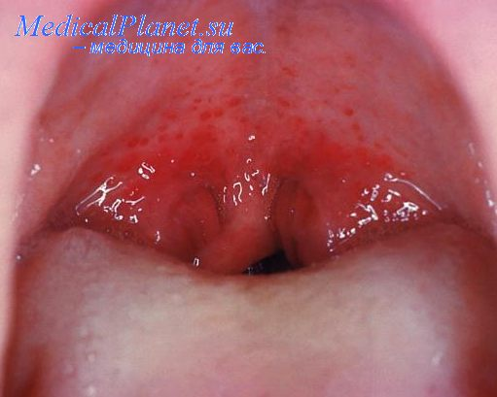
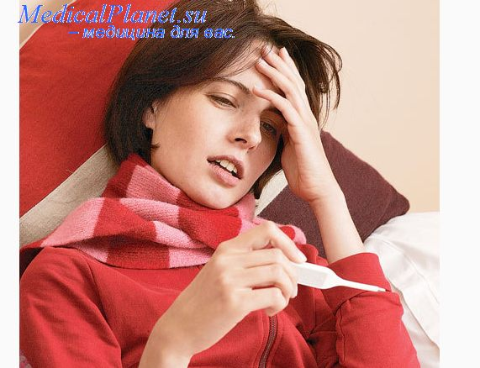

Acute catarrhal tonsillitis: dilatation of small blood and lymphatic vessels in the parenchyma of the tonsil.
The onset is acute and is marked by dryness, burning and tickling in the throat, painful swallowing,
general indisposition, subfebrile body temperature, insignificant inflammatory changes in the peripheral blood.
Pharyngoscopy reveals diffuse hyperemia of the tonsils and the margins of the palatine arches; the tonsils are somewhat enlarged. The regional lymph nodes are often slightly enlarged.
The disease must differentiate with ARVI.

Slide 4
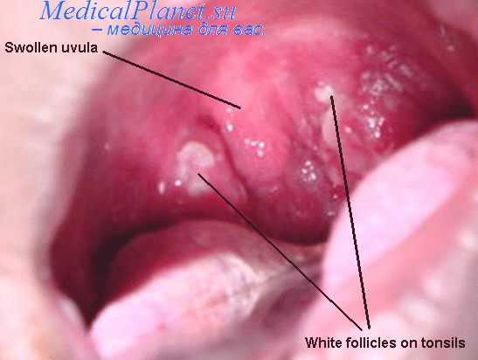
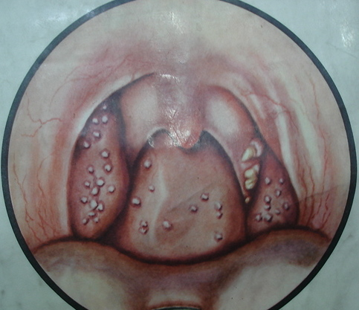
Follicular tonsillitis begins with elevation of temperature to 38-39° C, strong pain in swal­lowing, the changes in the blood are often pronounced: neutrophil leucocytosis, increasing of ESR, traces of protein in the urine.
Pharyngoscopy reveals diffuse hyperemia and infiltration of the soft palate and the arches; the tonsils are hyperemic and enlarged, with numerous yellowish or yellowish-white spots (1 -3 mm) elevated over the surface. These formations are suppurating follicles.
The regional lymph nodes are enlarged and painful.
Disease should to differentiated with leptotrichosis .

Slide 5
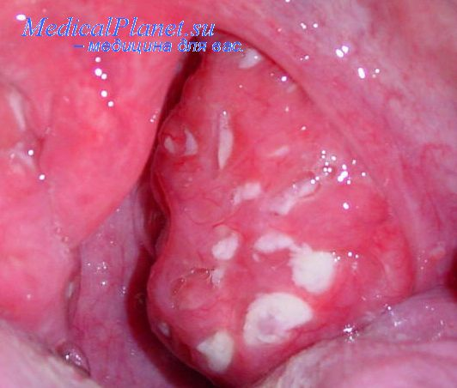
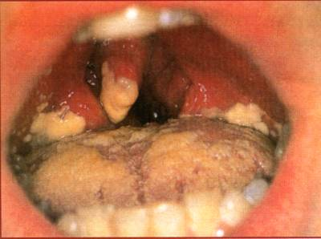
Lacunar tonsillitis: more severe course than follicular, toxaemia is severe.
Pharyngoscopic picture is characterized by enlargement of hyperaemic tonsils which are covered with islets of yellowish coat, first in lacunar orifices.
Disease should to differentiated with diphtheria.

Slide 6
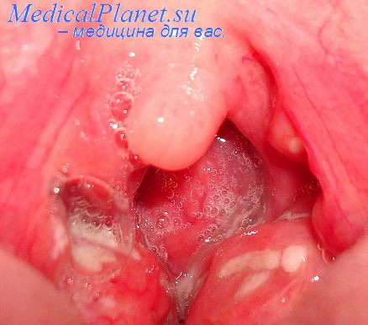

Treatment. The patient should be separated from the others. In very severe cases the patient should be hospitalized.
Food should be not irritating.
Gargling with a warm solution of antiseptics, a warming compress to the neck.
Nonspecific antiinflammative drags.
The antibiotic is administered usually for
5-10 days.
Desensitizing preparations.

Slide 7
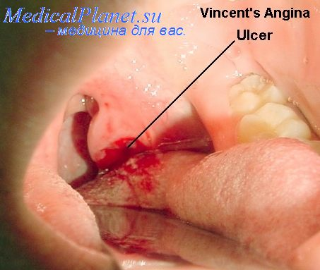
Necrotic (ulcerous-necrotic) tonsillitis of Simanovsky-Vensana: Symbiosis of Bacillus fusiformis and Spirochaeta buccalis.
The morphological changes: necrosis of the surface of one tonsil with formation of an ulcer whose floor is covered with a loose fibrinous membrane.
The patient complains of discomfort in the throat during swallowing, fetid breath and hypersali-vation. Swallowing is usually painless.
The body temperature is usually normal.

Slide 8

Peritonsillitis or Quinsy: Inflammation of the peritonsillar cellular tissue is a complication of acute tonsillitis, foreign body or odontogenic ethyology.
The development of the process has three stage: the oedema-infiltrative, purulent and reconvalescent stages.
A peritonsillar abscess can be in the anterior or antero-superior, posterior, inferior and the lateral parts.
Symptoms: severe pain during swallowing (it radiates into the ear, teeth, the patient refuses food and drinks),
headache and fatigue;
the body temperature rises to febrile,
trismus of the masticatory muscles develops
the speech becomes nasal
Inflammation of the cervical lymphnodes
The inflammative changes in the blood

Slide 9
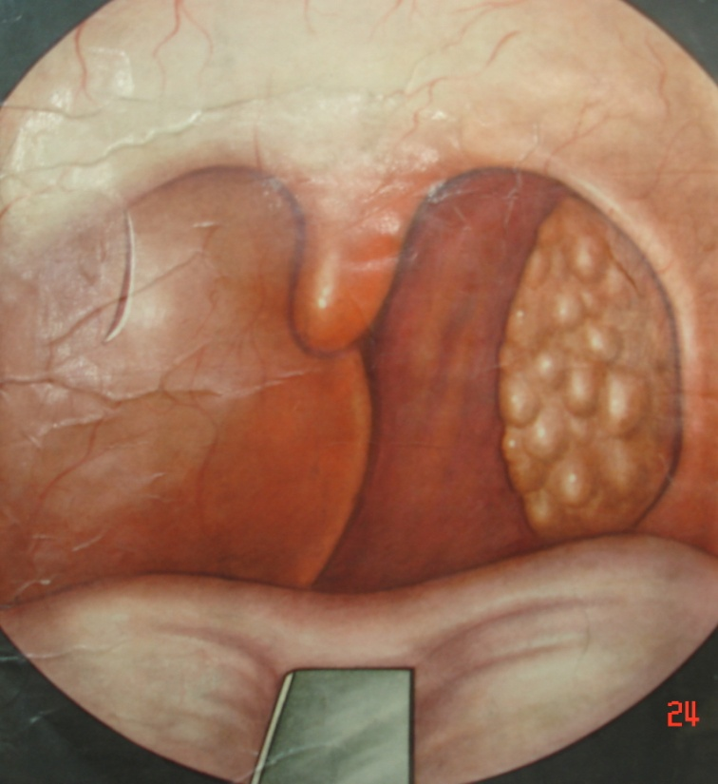
Pharyngoscopy is difficult due to trismus.
Peritonsillites are characterized by marked hyperaemia, protrusion of the tonsilla together with the palatine arches and the soft palate toward the median line. The uvula is moved to the opposite side. The tongue is covered with a thick coat, the
saliva is tenacious. Fluctuation
is observed in the region of the
strongest protrusion.

Slide 10
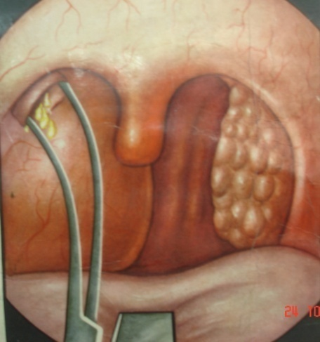
Treatment. The patient must be hospitalized.
Intramuscular antibiotic therapy is indicated for all stages.
The abscess is usually incised with local anesthesia with a 10 per cent lidocaine.
The incision should be done at the most prominent site.
Tonsillectomy is indicated in cases when the opening of abscess is impossible (lateral peritonsillitis), persistent course of the disease, and in the presence of signs of complications, such as sepsis, pharyngeal abscess, phlegmon of the neck, and mediastinitis.

Slide 11
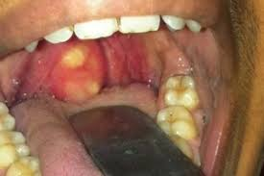
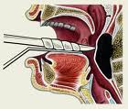
Retropharyngeal abscess - inflammation of the lymph nodes and loose connective tissue found between the fascia of the pharyngeal muscles and the prevertebral fascia. The disease occurs almost exclusively in children because presens the lymph nodes up to the age of 4.
Symptoms: pain in the throat during swallowing and impeded respiration. The child refuses food, becomes restless and often cries. The temperature
rises to 38-39° C. Respiration through the nose becomes difficult, speech is nasal, a laryngeal stridor can develop, the voice becomes hoarse and respiration noisy, asphyxia and cyanosis develop. The reaction of the regional lymph nodes is usually pronounced
Pharyngoscopy reveals protrusion and hyperaemia of mucosa only one half of the posterior pharyngeal wall.
The blood reacts to the inflammation.
When an abscess develops, it should immediately be opened; measures should be taken to prevent aspiration of pus. This can be attained by preliminary suction of pus during puncture; the abscess should preferably be opened on a half-lying patient .

Slide 12

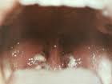

Infectious mononucleosis caused by a lymphotropic virus. The disease is characterized by a fever, different type of tonsillitis, adenosplenomegaly, and
changes in the blood (high counts of leukocytes and atypical monocytes).
The most characteristic symptom of the disease is a moderate leucocytosis with a predominance of mononuclear cells, which may number 50 to 90 per
cent of the total leukocytes, a great number of altered monocytes .
Blood examination to Epstein-Barr virus.
Treatment. Bed rest and high-calorie diet. Antibacterial preparations prevent secondary infection. Gargling with disinfectant or astringent solutions.

Slide 13


CHRONIC TONSILLITIS –
infectious-allergic diseases of human body.
Predisposing factors:
anatomo-topographic properties of the tonsils;
presence of pathological microflora in the lacunae;
disordered protective-adaptation mechanisms in the tonsil;
Chronic tonsillitis is usually secondary to acute tonsillitis.
Autoallergic mechanism of the onset of chronic tonsillitis.

Slide 14
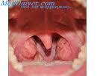
The patient complaints of recurring acute inflammation of the tonsils, unpleasant breath, discomfort and feeling of a foreign body in the throat during swallowing, dryness, fatigue, flaccidity, headache, decreased working capacity, the temperature is often subfebrile.
Examination of the tonsils reveals ridge-like thickening in the margins of the anterior and
posterior palatine arches, their edema, especially of the upper parts, hyperemia of the palatine arches, their adhesion to the tonsils and the triangular fold.

Slide 15
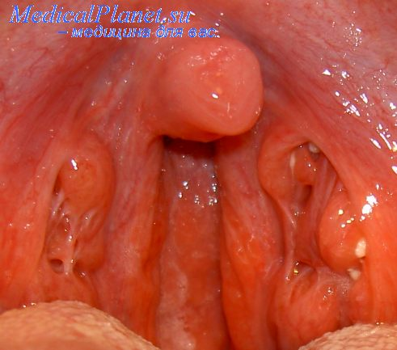
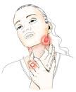
Hyperplasia of the palatine tonsils is not considered about chronic tonsillitis.
The lacunar contents are usually taken for diagnostic studies by expressing with a spatula.
A local sign of chronic tonsillitis is enlargement of the regional lymph nodes: upper deep
cervical, those located by the anterior edge of the sternocleidomastoid muscle.

Slide 16
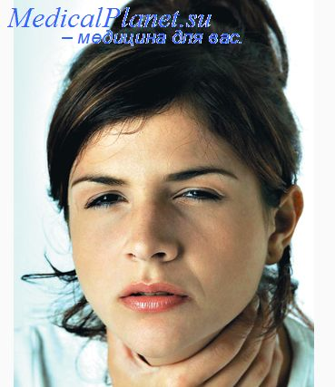
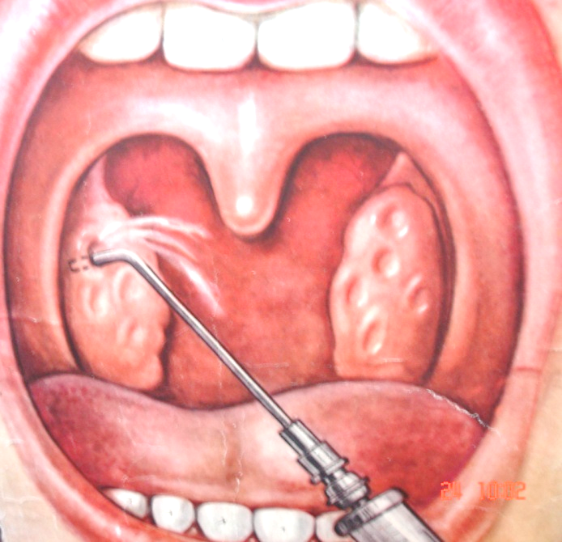
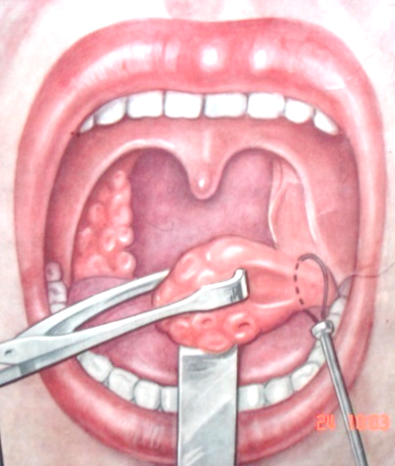
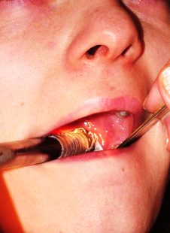
Classification of chronic tonsillitis:
Compensative - there are only local symptoms of chronic inflammation of tonsils;
Decompensative form is characterized , by recurrent acute tonsillitis, complications (peritonsillitis, rheumatism, sepsis etc).
Treatment
Conservative treatment: irrigation of the lacunae with various antiseptic solutions. A special syringe with a long curved cannula is used for the purpose.
Physiotherapy (ultrasound).
If treatment is not effective, tonsillectomy is indicated.
If this operation is contraindicated (e.g. in the presence of haemophilia), cryotherapy should be recommended.

Slide 17
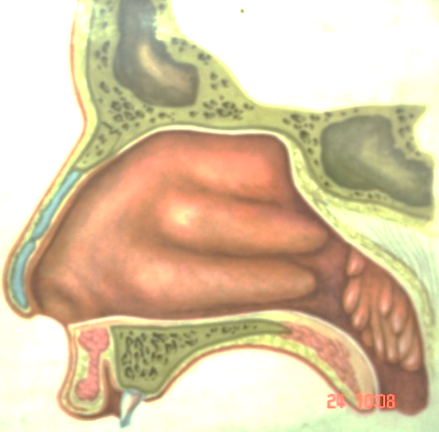
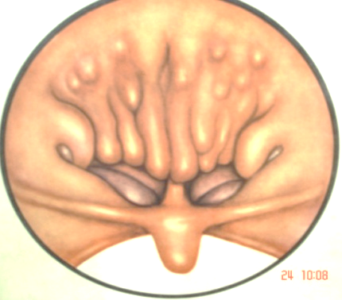
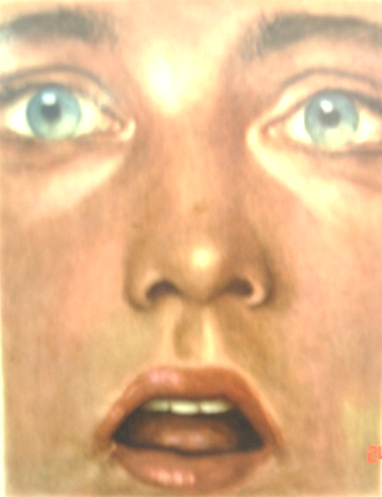
Hypertrophy of the pharyngeal tonsil (adenoids). Adenoids usually grow at the age from 3 to 15.
The symptoms: bad nasal respiration, constant nasal discharge, dysfunction of the auditory tubes, and recurrent inflammation of the nasopharynx and the nasal cavity, the inferior jaw becomes narrow and long, the hard palate undergoes malformations: it becomes high and narrow; incorrectly growing teeth cause malocclusion. These changes give a specific dull expression to the face of children with adenoid growths (adenoid face), can develop pigeon chest. Children are usually flaccid.
Endoscopy, palpation of nasopharynx confirm the diagnosis. The degrees: I-adenoids cover to one third of the vomer; II-about half of the vomer is covered; III-the vomer is covered to two thirds or almost completely.
Treatment of adenoids is commonly surgical. The operation is usually performed at the age from 5 to 7.

Slide 18
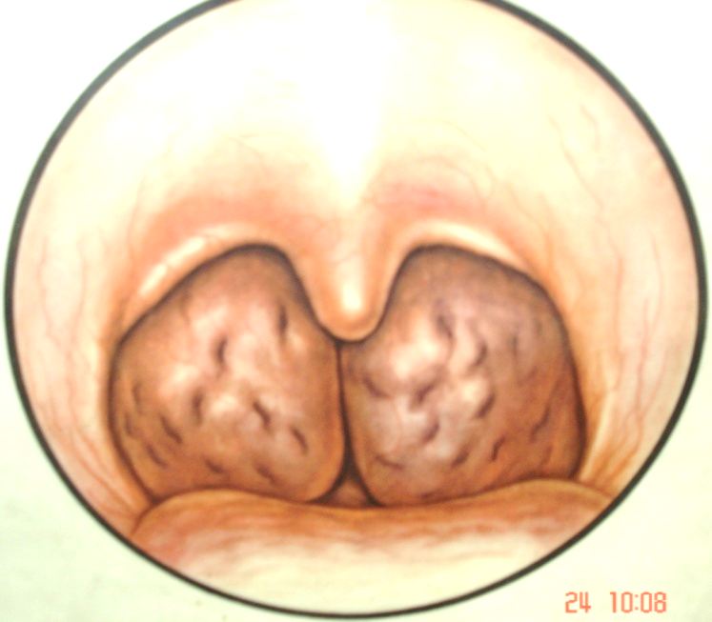
Hypertrophy of the palatine tonsils can interfere with normal respiration through the mouth, speech, and swallowing of food. If hypertrophy of the palatine tonsils concurs with adenoids, the respiratory function is severely upset. The child suffers from paroxysmal asphyxia during sleep, he is frequently wakes up during sleep.
Diagnosis is made during pharyhgoscopy. Simple hypertrophy of the palatine tonsils should be differentiated from chronic tonsillitis which is characterized by recurring acute tonsillitis and signs of chronic inflammation.
Treatment of pronounced forms of the disease is surgical. The tonsils are partly removed (tonsillotomy).

Slide 19
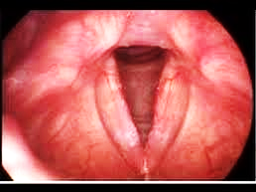
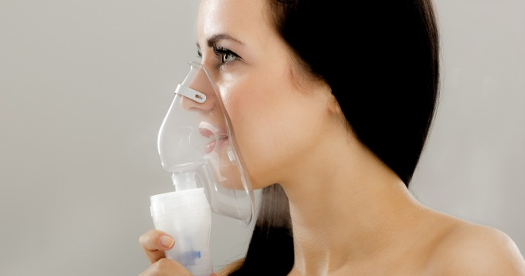
Acute laryngitis – inflammation of the of the larynx.
Catarrhal laryngitis
Ethiology: respiratory viruses, bacterial flora
Clinical signs:
Quick start at a satisfactory condition;
Normal body temperature;
Dryness, sore throat;
Dry damp coughing;
Hoarseness
Treatment
Voice regime.
Dry cough: Tusuprex, Falimint, Libexin.
Damp cough: ACC, Sinupret, Mukaltin, Bromhexin.
Inhalations with antiinflammative drug (Decasan, grases).
Aerosols : Kameton, Ingalipt, Kamofen.
Instillations in larynx: 1 % oil solution of menthol, antibiotics, Hydrocortison, 1% solution protargol or collargol.
Antibiotics, antihistamine drugs, calcium, Vitamin C.

Slide 20
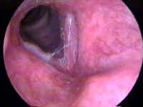
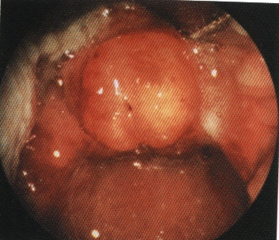
Flegmonous laryngitis
Acute purulent inflammation of the submucosal
layer, muscles and ligaments of the larynx.
Epiglotitis, abscesses can be formed.
Chondroperihondritis of the larynx
pain
painful swallowing
high body temperature
hoarseness
difficult breathing
smoothness of larynx contours
increase in volume of a neck
Complication - a cicatricle laryngeal stenosis.
Treatment:
Antibiotics;
Corticosteroids;
Detoxication;
Diuretics;
Opening of abscess.
In case of decompensated stenosis - tracheotomy.

Slide 21
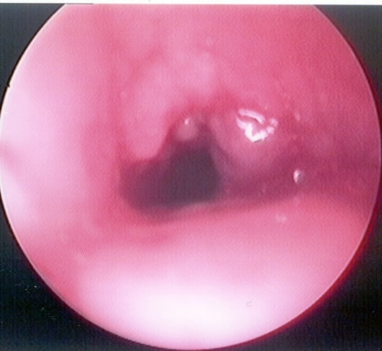
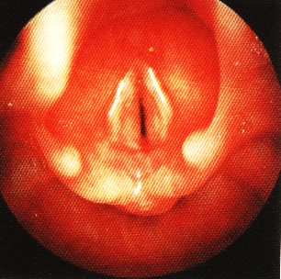
Acute stenosis laryngotracheobronchitis in children
Subglottic laryngitis (false croup)
Main symptoms:
Voice change;
“Barking” cough;
Difficult breathing due to swelling of submucus layer of subglottic spaces
Differential diagnosis
Diphtheria.
Retropharyngeal abscess.
Foreign body.
Bronchial asthma.
Papillomatosis of the larynx.

Slide 22
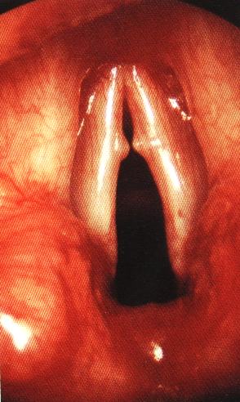
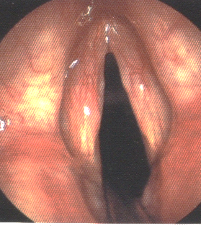
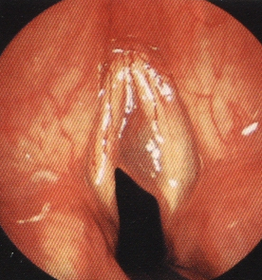
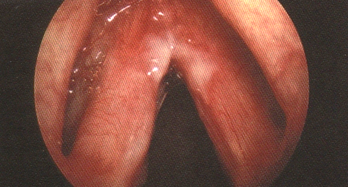
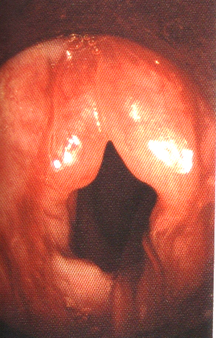
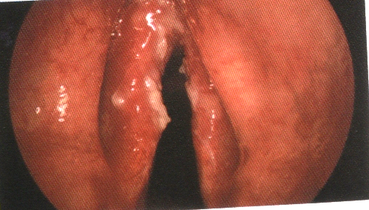
Chronic laryngitis
Catarrhal
Atrophic
Hypertrophic
Diffuse
Circumscribed
“single” nodules
of vocal cord
Chronic diffuse laryngitis
Polypus of the larynx
Luekoplakia and diskeratosis
Odema of the larynx

Slide 23
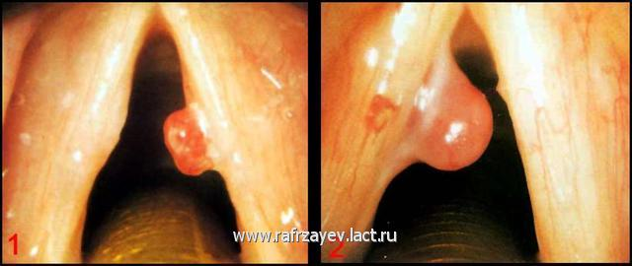
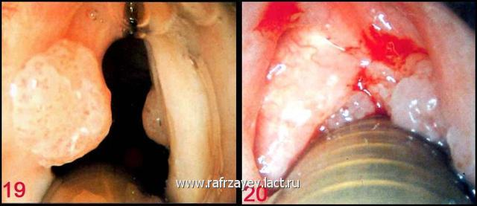
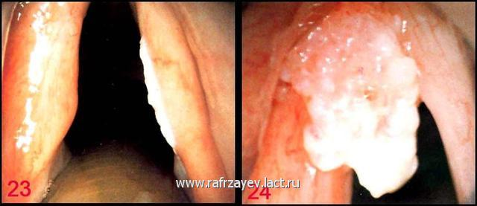
Benign tumors of the larynx
Epithelial - papilloma
Connective tissue - fibroma
Vascular - angioma
Mixed - angiofibroma
Rare - chondroma, teratoma
Symptoms: hoarseness of voice, dysphonia, aphonia.
Diagnostics: indirect or direct laryngoscopy, biopsy.
Treatment is surgical - endolaryngeal removal, in large tumors - laryngofissure, tracheostomy.

Slide 24
Morphological classification of the tumors of the ENT organs:
І type. Highly differentiated tumors - benign (osteoma, chondroma, lipoma, fibroma, angioma, adenoma, neurinoma, etc)
ІІ type. Malignant tumors - Cancer
1 grade. Highly differentiated cancer;
2 grade. Cancer of the moderate degree of maturity;
3 grade. Low-differentiate cancer.
4 grade. Undifferentiated cancer
International classification of cancer
The concept about the stage of the process in ENT oncology: the stage of the process can be I, II, III, IV; it is determined in the form the combinations of symbols T (tumor) (1-4), N (nodulus) (0-3), M (metastasis) (0,1).

Slide 25
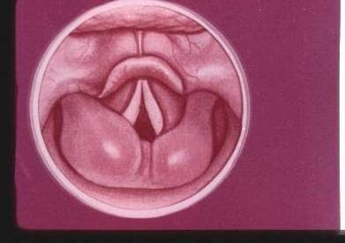
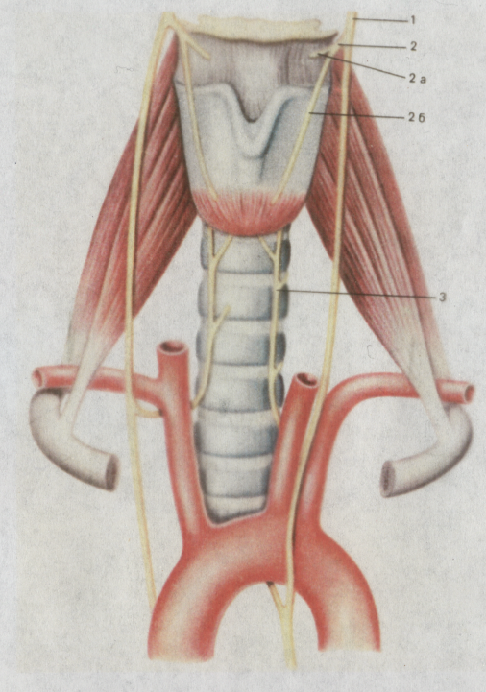
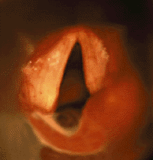
Laryngostenosis – narrowing of the larynx
Acute (seconds - days)
Swell (inflammation, allergic reaction)
Trauma.
Foreign bodies.
Acute laryngotracheitis in children.
Diphtheria of the throat.
Laryngospasm.
Chronic (weeks - years)
Tumours, cysts.
Infectious granulemas.
Scarifications.
In-born pathology.
Two-sided paralysis of the recurrent nerves.

Slide 26
Classification
The first stage of compensation. It is characterised by deepening and less frequent respiratory excursions, loss of a respiratory pause only during physical activity.
The second stage — a stage of subcompensation. At this stage additional muscles take part in the breathing act. One can clearly notice in patient retractions of over - and subclavia fossae, intercostal intervals, inflating (trembling) of wings of a nose . Breath is accompanied by noise (stridor), mucous membrane of lips becomes cyanotic.
In the third stage — decompensation — stridor more expressed, tension of respiratory muscles becomes maximal. The patient shows significant anxiety and disturbance. He becomes covered with cold sweat, cyanosis progresses, breathing becomes frequent, superficial, the arterial pressure decreased, pulse thread
Fourth stage – asphyxia - pupils extend, there comes loss of consciousness, involuntary urination and defecation, and the patient dies.

Slide 27
Aid in case of laryngostenosis
IN allergies immediate administration of adrenaline 0.5-1.0 ml of 0.1% solution of adrenaline, epinephrine, corticosteroids, antihistamines.
Intravenous:
Sol. Glucosae 40% 20,0
Sol. Calcii chloridi 10% 10,0
Sol. Acidi ascorbinici 5% 5,0
Sol. Euphyllini 2,4 % 5,0-10,0
Sol. Prednisoloni 60-90 mg
Antihistamines (Dimedrol 1%)
Diuretics (Lazix, Trifas).
Distracting procedures.
Inhalations of moisturized oxygen.
Dissection of the abscess.
Intubation.
Tracheostomy.
Conicotomy.

Slide 28
Indications for tracheostomia
Prophylactics of mechanical asphyxia.
Drainage of the respiratory pathways.
Long-term intubation.
Tracheostomy is divided into:
  upper;
  middle;
  lower.
  It depend of position of thyroid gland isthmus

Slide 29
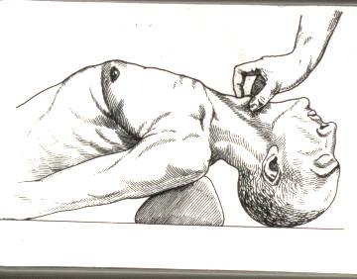
Position of the patient during tracheostomy

Slide 30

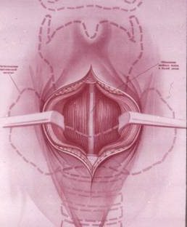
Tracheostomy

Slide 31
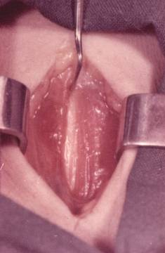
Tracheostomy

Slide 32
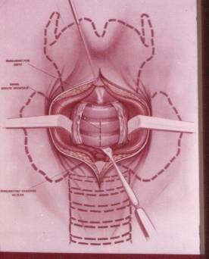
Tracheostomy

Slide 33

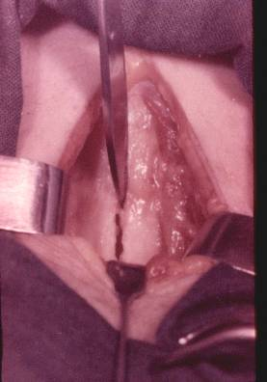
Tracheostomy

Slide 34

Tracheostomy

Slide 35


Tracheostomy

Slide 36


Tracheostomy

Slide 37



Tracheocanula

Slide 38


Tracheostomy complications
Bleeding.
Emphysema of subcutaneous fat tissue, pneumothorax,pneumomediastinum.
Respiratory standstill during a trachea cut.
Esophagus injury.
Purulent tracheobronchitis
in the postoperative period.

Slide 39
Injury of the rear wall of the trachea and of the esophagus during tracheostomia

Slide 40


Conicotomy
At extremely emergent interventions, in case of severe acute asphyxia, when there is no time for tracheotomy, and intubation is for whatever reasons impossible, conicotomy is recommended, i.e. dissection of the thyrocricoidea membranes (conic) ligament.

Slide 41


