Slide 1
Ministry of health of Ukraine
Odessa National Medical University
Department of Robotic and Endoscopic Surgery
Simulation medicine cycle
Topic2
Emergency care for anaphylaxis in adults and children of all ages. Emergency care for hypoglycemia in adults and children of all ages.

Slide 2
EMERGENCY CARE FOR
ANYPHYLAXIS IN ADULTS AND CHILDREN

Slide 3
WHAT IS ANAPHYLAXIS ?
◆ It’s a manifestation of immediate hypersensitivity type 1 reaction in which exposure of a sensitised individual to a specific antigen would results in life threatning respiratory distress, followed by vascular collapse , pruritus
,angioedema,urticaria .

Slide 4



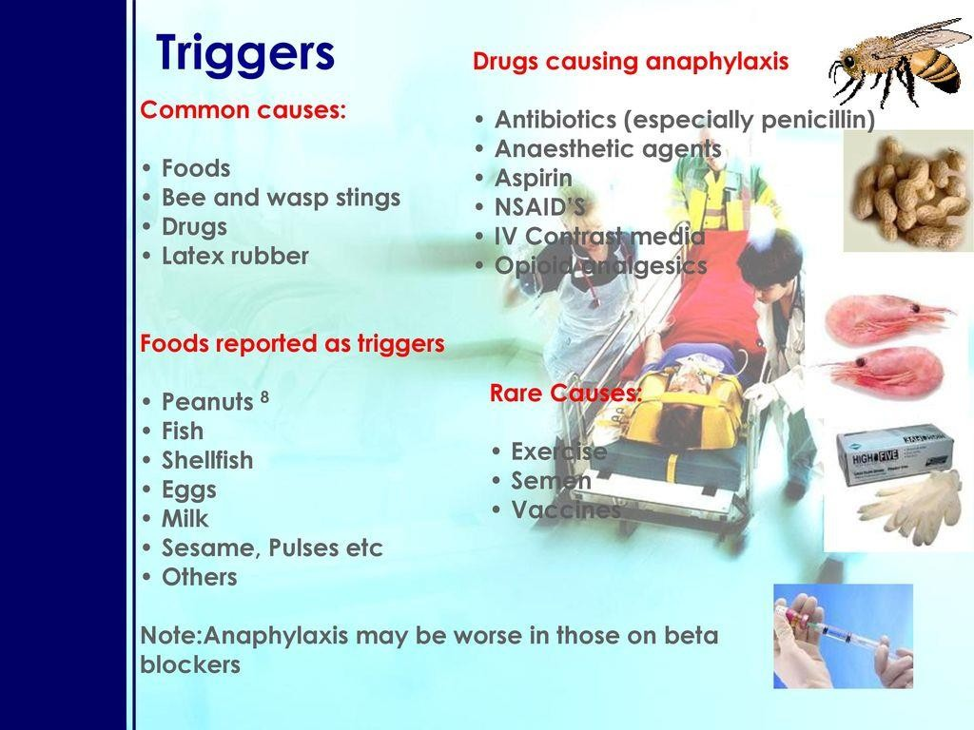




Slide 5


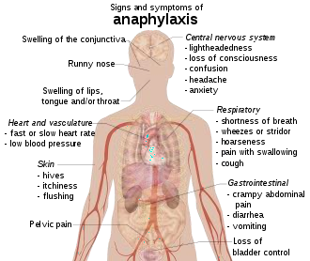

Slide 6
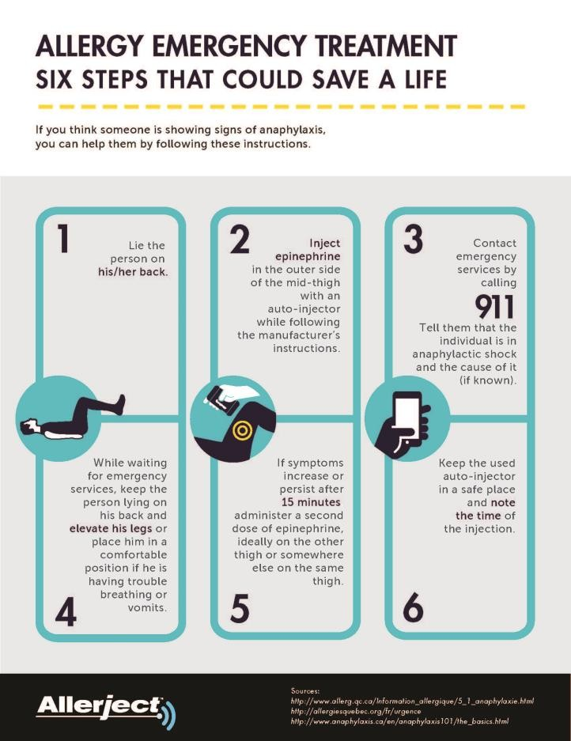
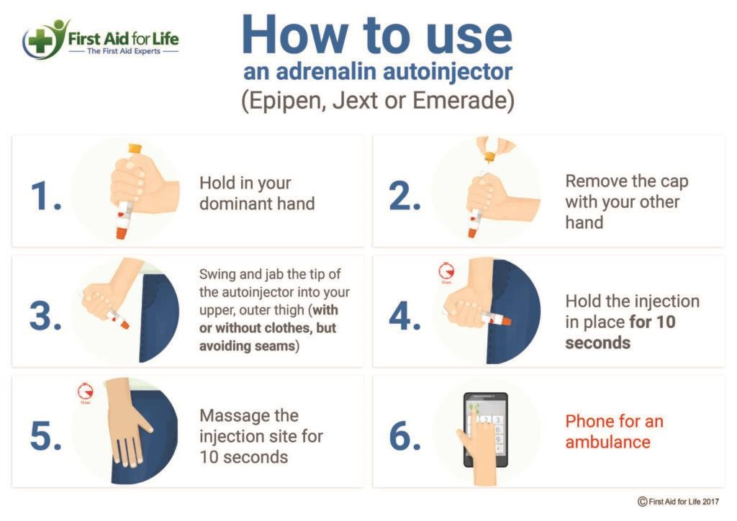

Slide 7

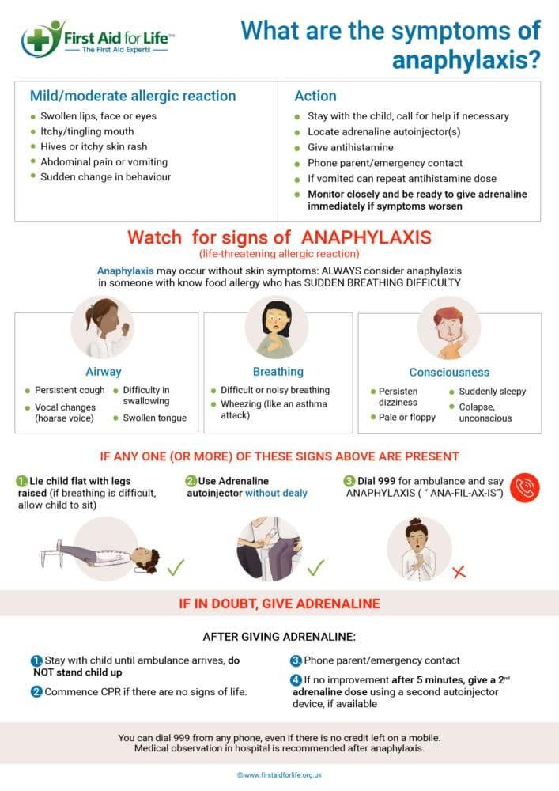

Slide 8
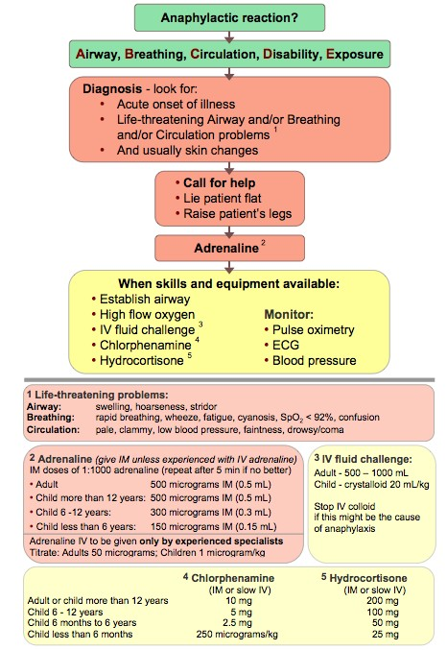

Slide 9






Pharmacological management of anaphylaxis
Drug and route of administration | Frequency of administration | Paediatric dosing (maximum dose)
Epinephrine (1:1000) IM | Immediately, then every 5–15 min as required | 0.01 mg/kg (0.5 mg)
Cetirizine PO | Single daily dose | 6 months to <2 years: 2.5 mg OD 2–5 years: 2.5–5 mg OD >5 years: 5–10 mg OD
Diphenhydramine IM/IV | Ev ery 4–6 h as required for cutaneous manifestations | 1 mg/kg/dose (50 mg)
Ranitidine PO/I V | Every 8 h as required for cutaneous manifestations | 1 mg/kg/dose (50 mg)
Corticosteroids: prednisone PO or methylprednisolone IV | Every 6 h as required | 1 mg/kg PO (75 mg) or 1 mg/kg IV (125 mg)
Salbutamol | Every 20 min or continuous for respiratory symptoms (wheezing or shortness of breath) | 5–10 puffs using MDI or 2.5–5 mg by nebulization
Nebulized epinephrine (1:1000) | Every 20 min to 1 h for symptoms of upper airw ay obstruction (stridor) | 2.5–5 mL by nebulization
Epinephrine IV (infusion) | Continuous infusion for hypotension – titrate to effect | 0.1–1 µg/kg/min (maximum 10 µg/min)
Glucagon IV | Bolus follow ed by continuous infusion – titrate to effect | 20–30 µg/kg bolus (maximum 1 mg), then infusion at 5–15 µg/min

Slide 10

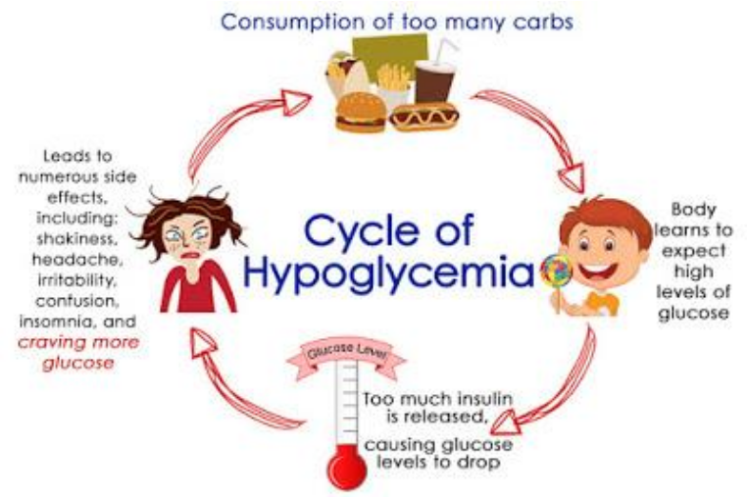
HYPOGLYCEMIA EMERGENCY CARE

Slide 11
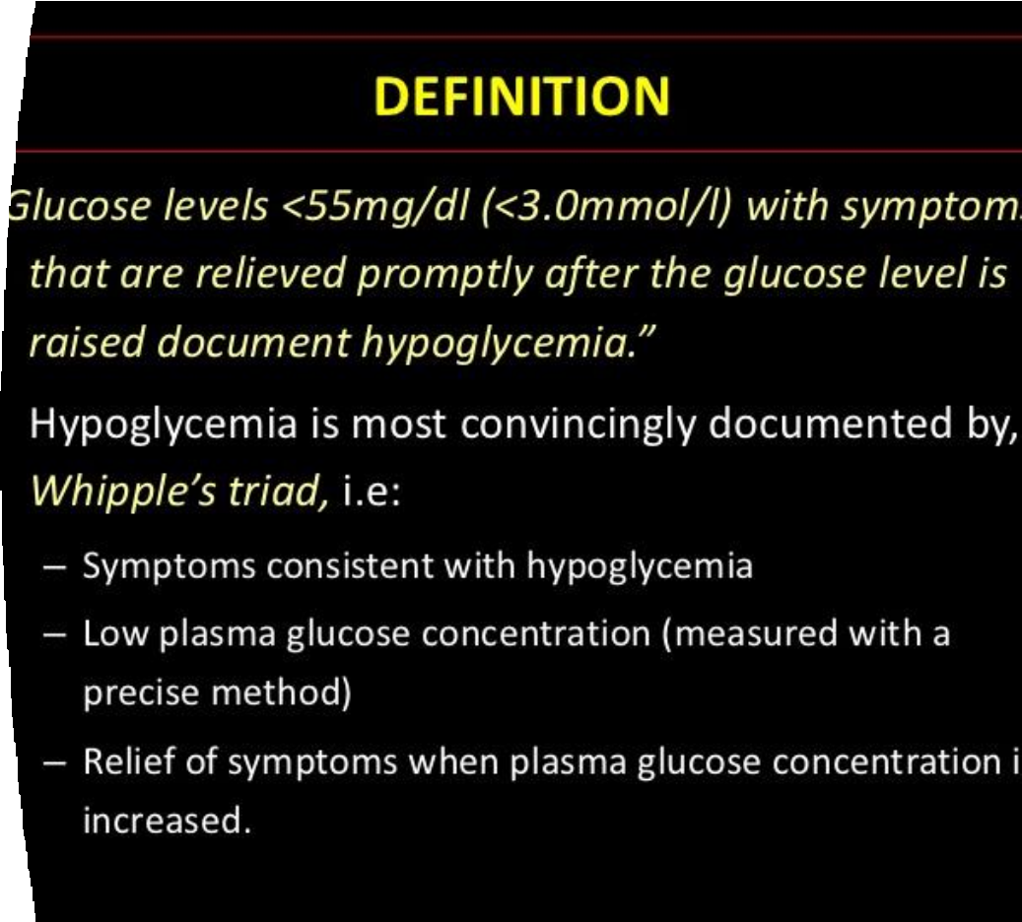
WHAT IS HYPOGLYC EMIA ?

Slide 12
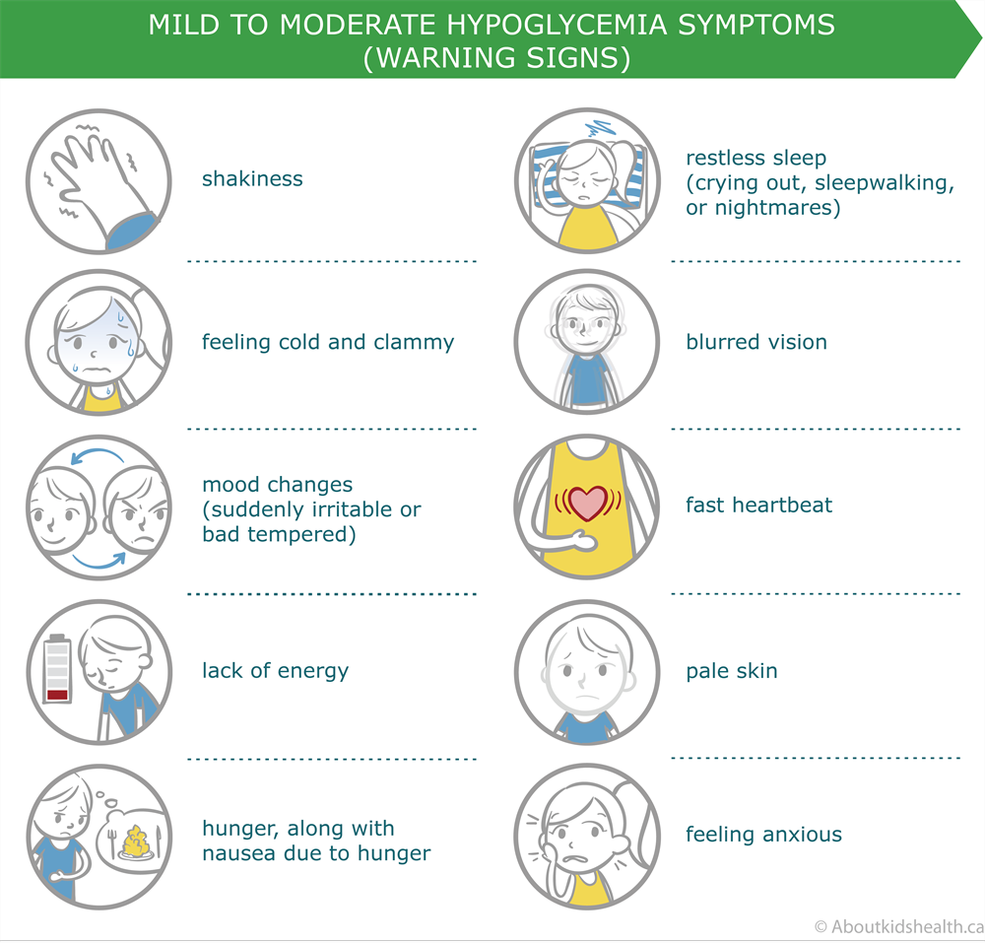
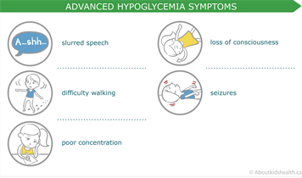

Slide 13
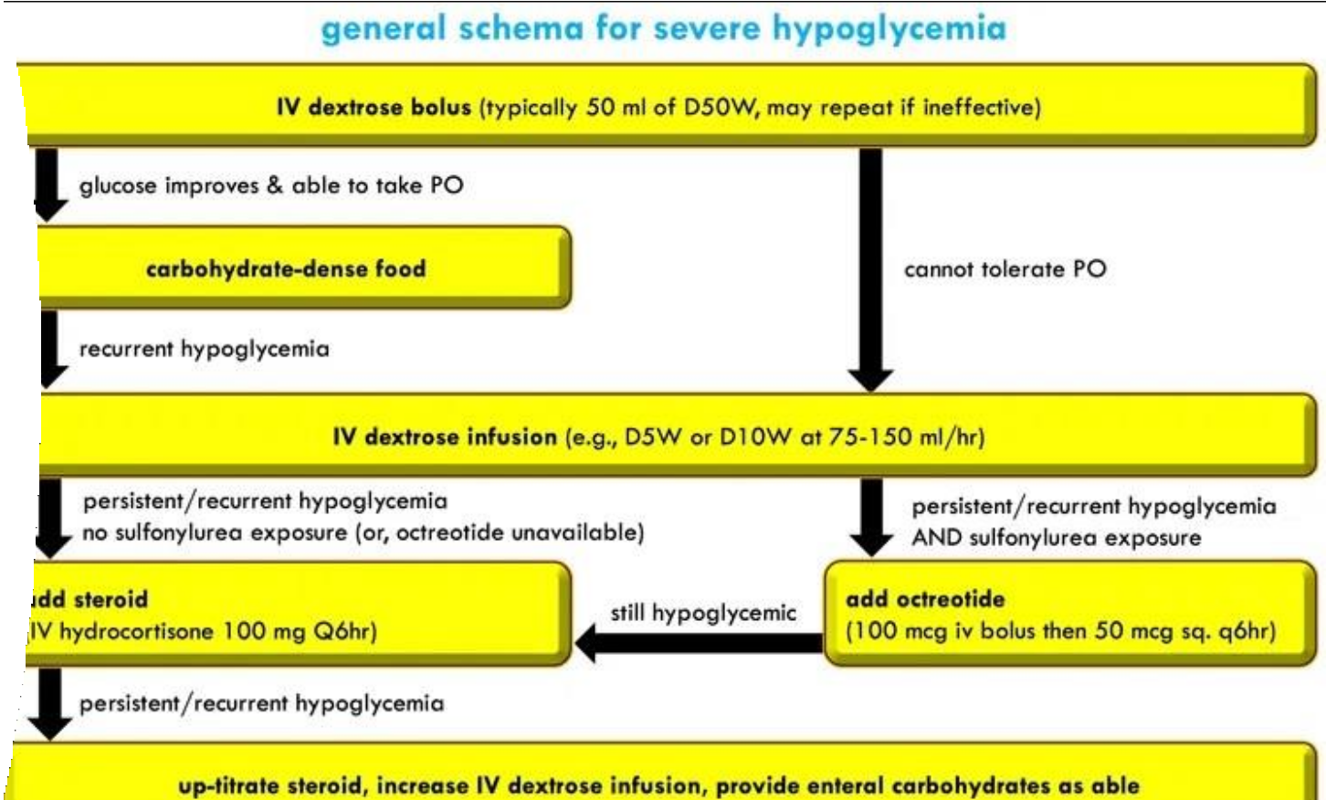

Slide 14
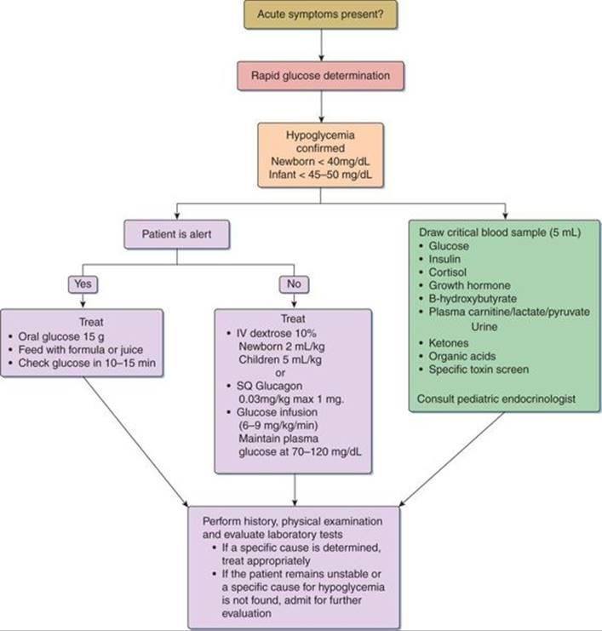
PEDIATRIC HYPOGLYCEMIA EMERGENCY CARE

Slide 15
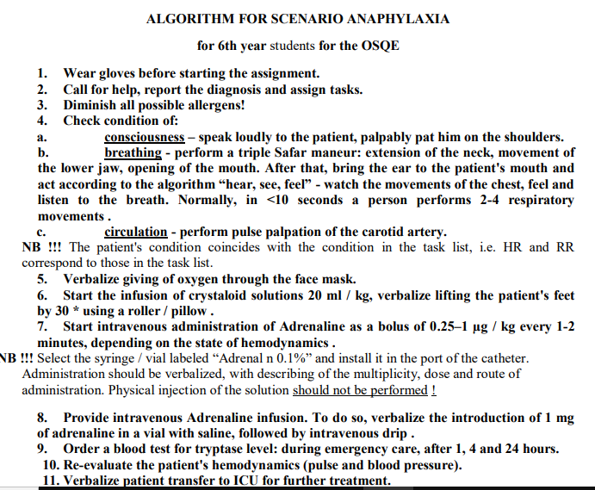
OSCE
FOR ADULTS

Slide 16
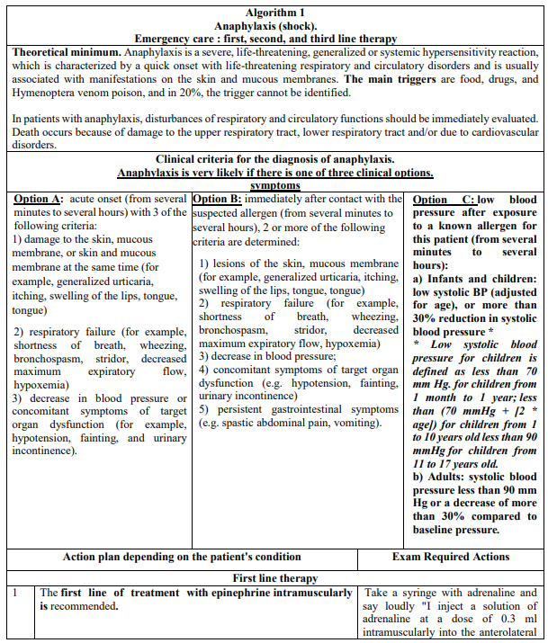
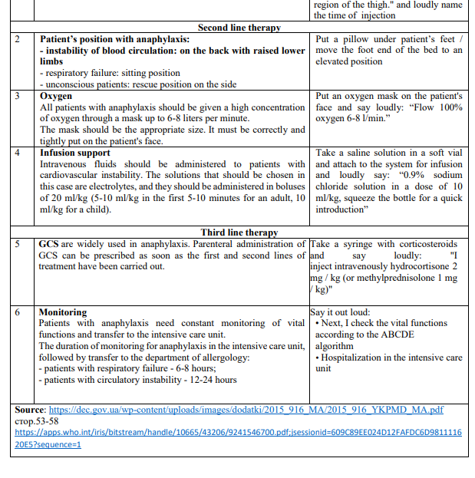
OSCE
FOR CHILDREN

Slide 17
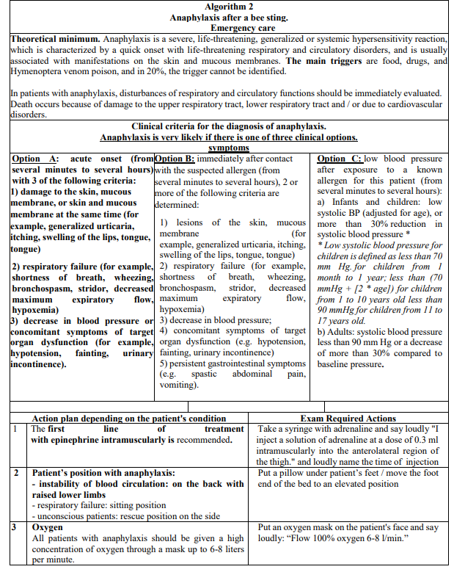
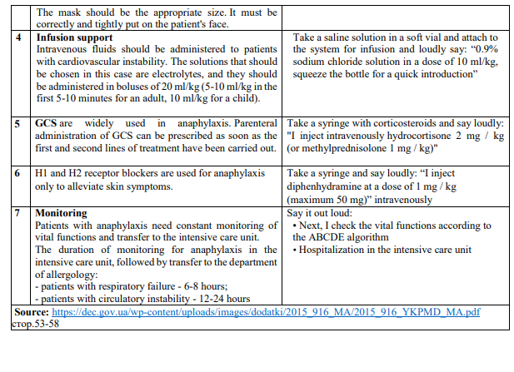
OSCE
FOR CHILDREN

Slide 18
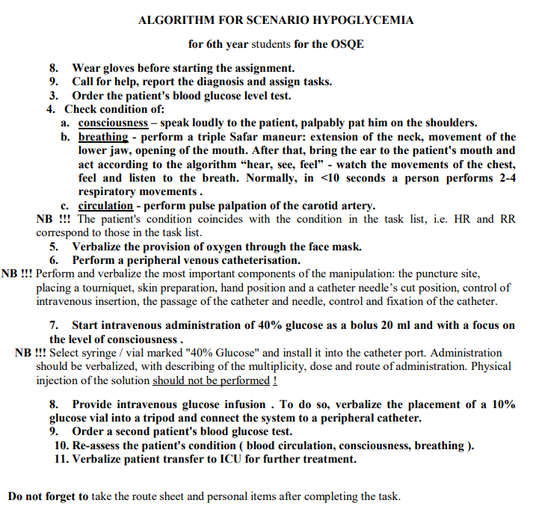
OSCE
FOR ADULTS

Slide 19
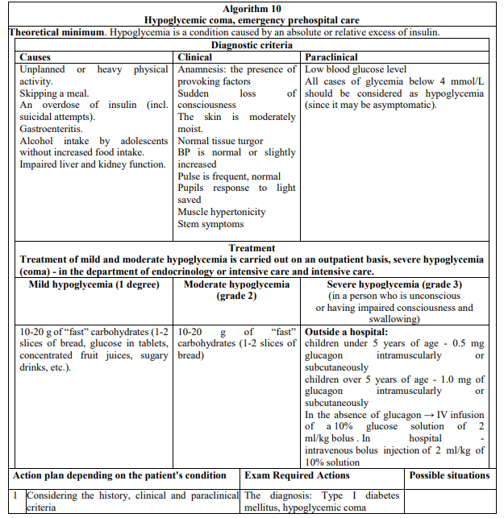
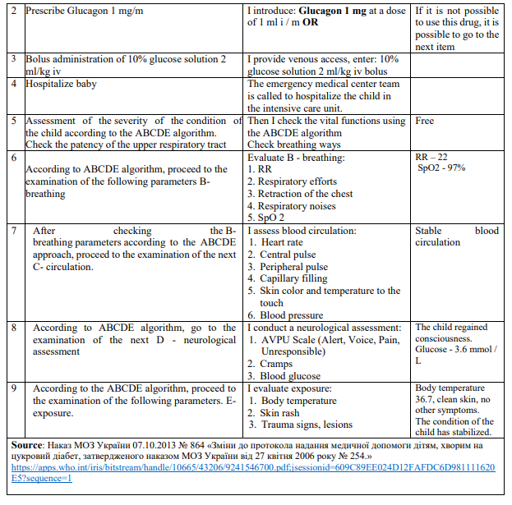
OSCE
FOR CHILDREN

Slide 20
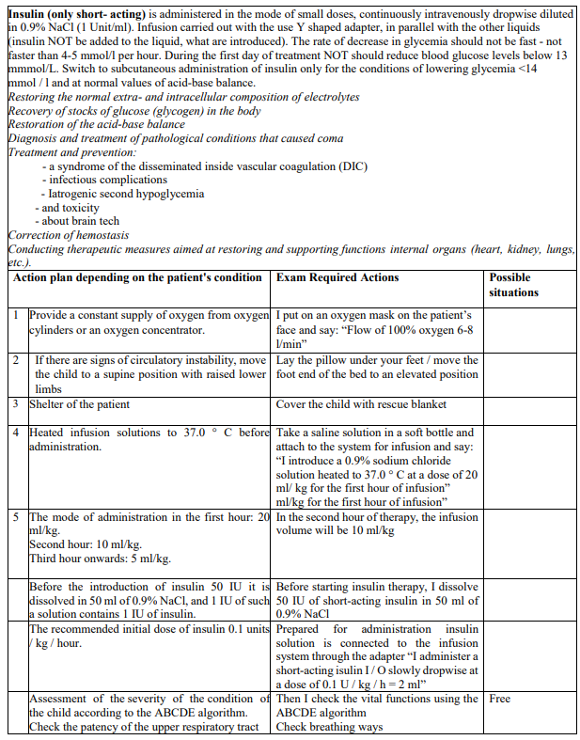
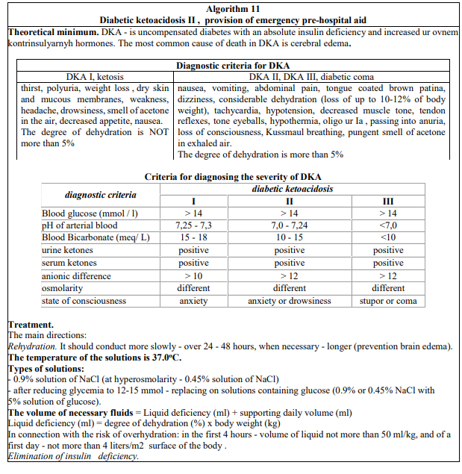
OSCE
FOR CHILDREN

Slide 21
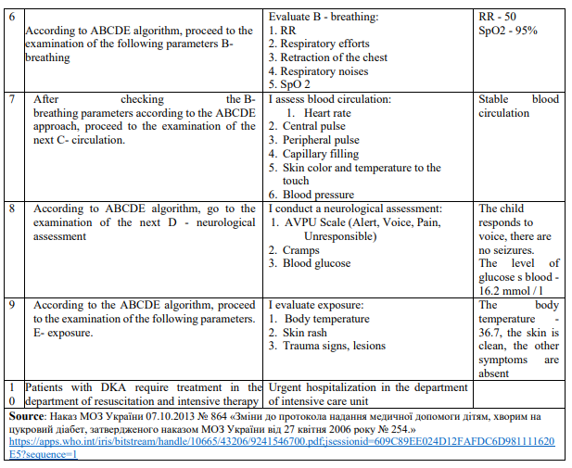
OSCE
FOR CHILDREN

