Slide 1
Ministry of health of Ukraine
Odessa National Medical University
Department of Robotic and Endoscopic Surgery
Simulation medicine cycle simulation medicine cycle
Topic 3
EMERGENCY CARE FOR PHOSPHORUS
POISONING,OPIOID POISONONG

Slide 2
EMERGENCY CARE FOR PHOSPHORUS
POISONING

Slide 3

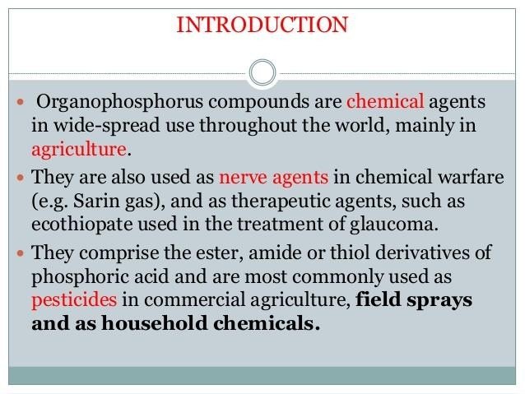

Slide 4
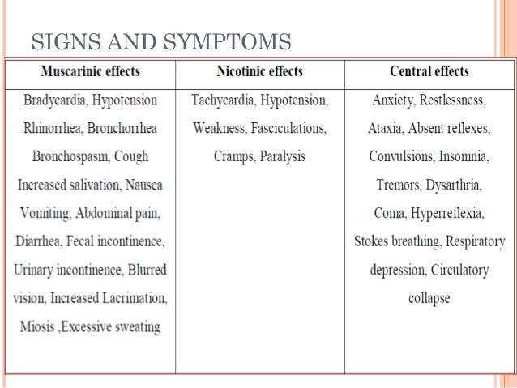

Slide 5
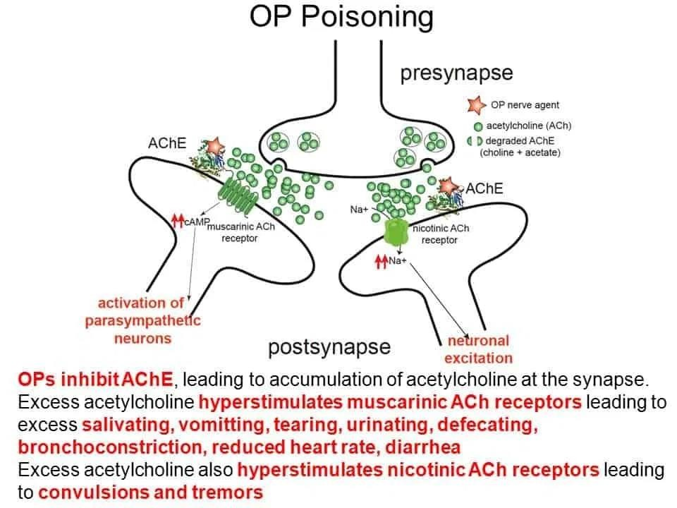

Slide 6


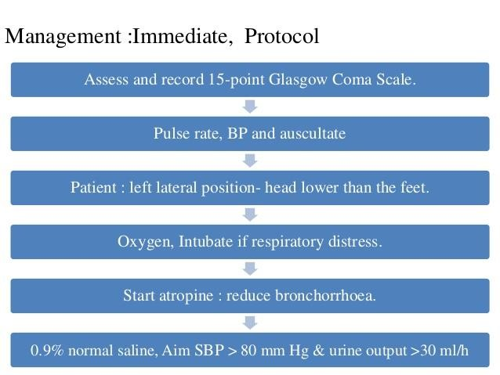

Slide 7


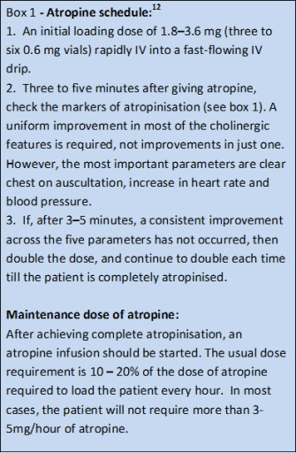
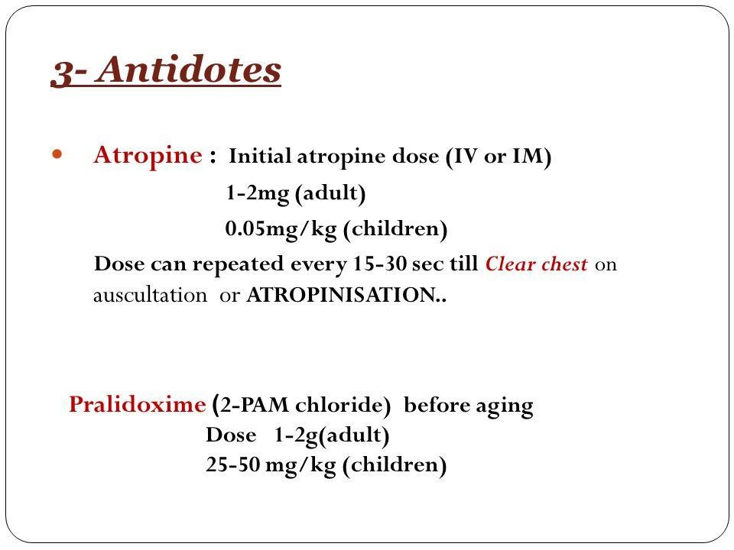

Slide 8



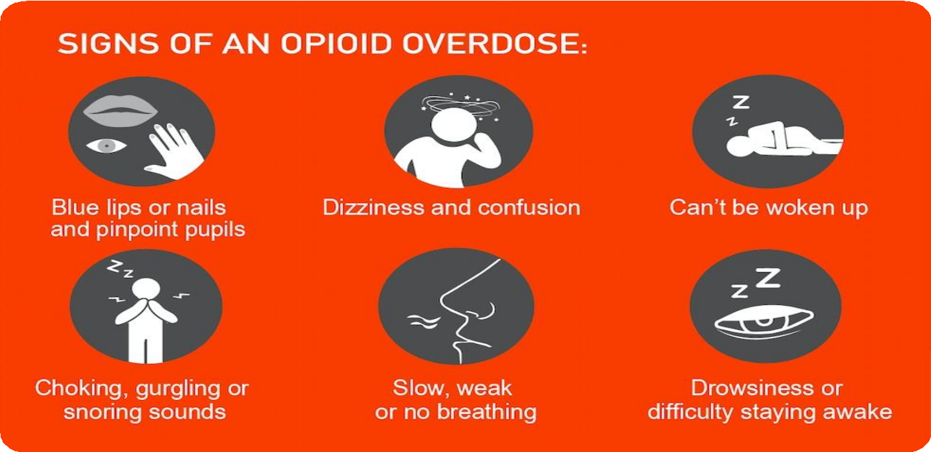
OPIOID POISONING

Slide 9
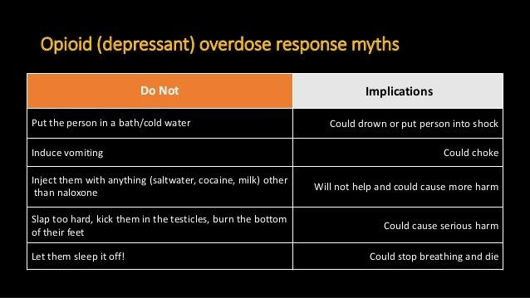

Slide 10
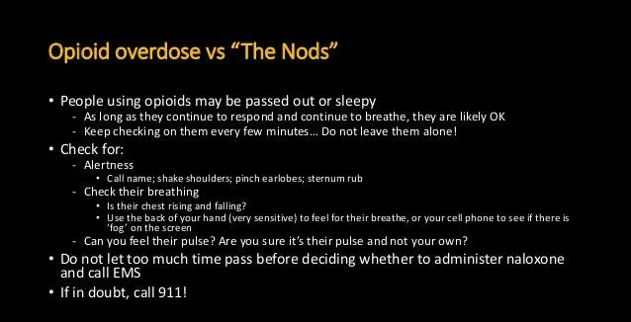

Slide 11
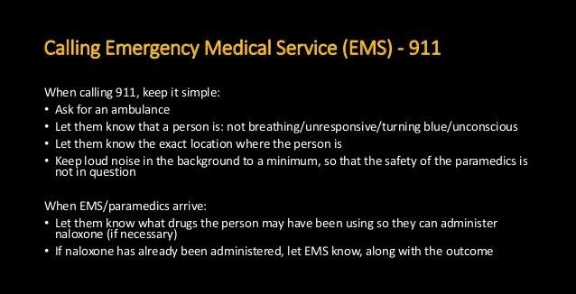

Slide 12
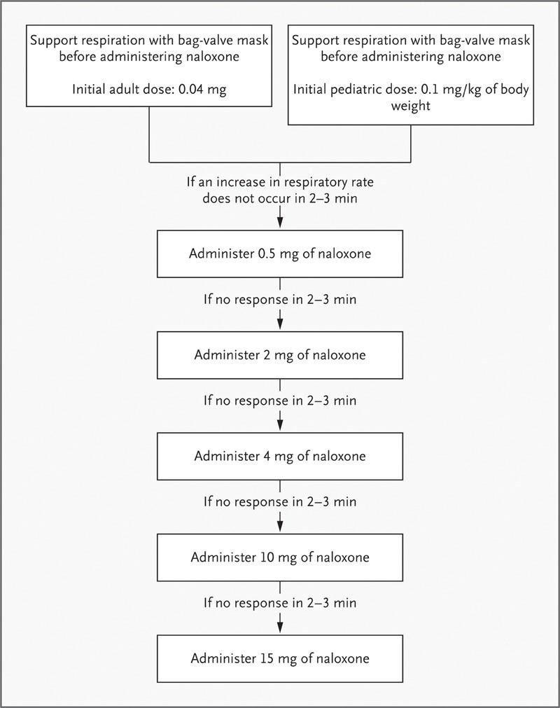

Slide 13
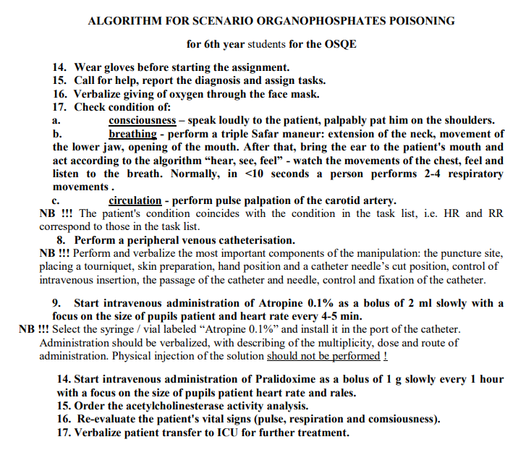
osce

Slide 14
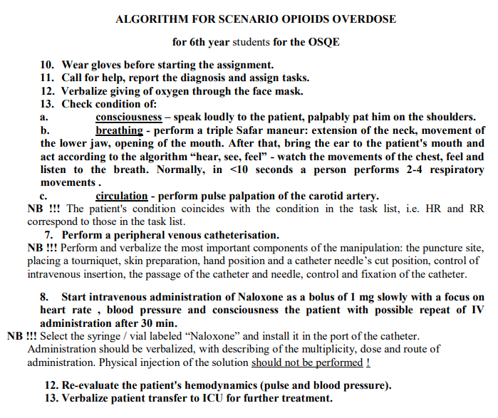
osce

