Slide 1
Ministry of health of Ukraine
Odessa National Medical University
Department of Robotic and Endoscopic Surgery
Simulation medicine cycle simulation medicine cycle
Topic 4
Emergency CARE FOR ASYSTOLE
VENTRICULAR FIBRILLATION

Slide 2
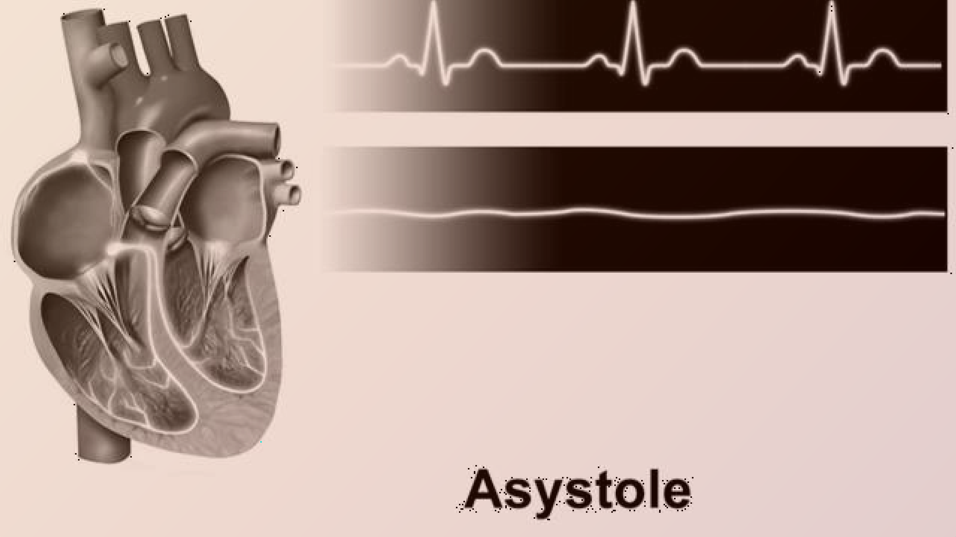
EMERGENCY CARE FOR ASYSTOLE
RAO PRAKSH MONIKA
GRP13
COURSE 6

Slide 3


WHAT IS ASYSTOLE ?
Asystole is a cardiac arrest rhythm with no discernible electrical activity on the EKG monitor. It is a flatline EKG, P Waves and QRS complexes are not present The heart is not functioning. It is a life-threatening condition that requires immediate action.

Slide 4



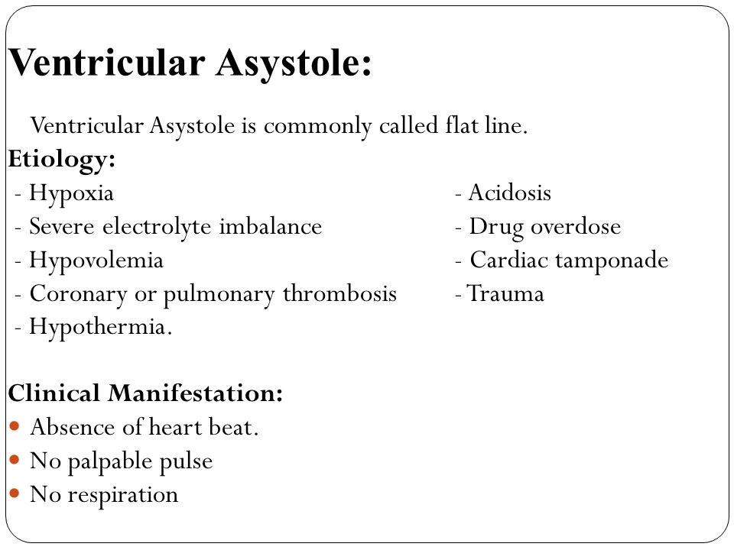
Etiology &
Clinical manifestation

Slide 5


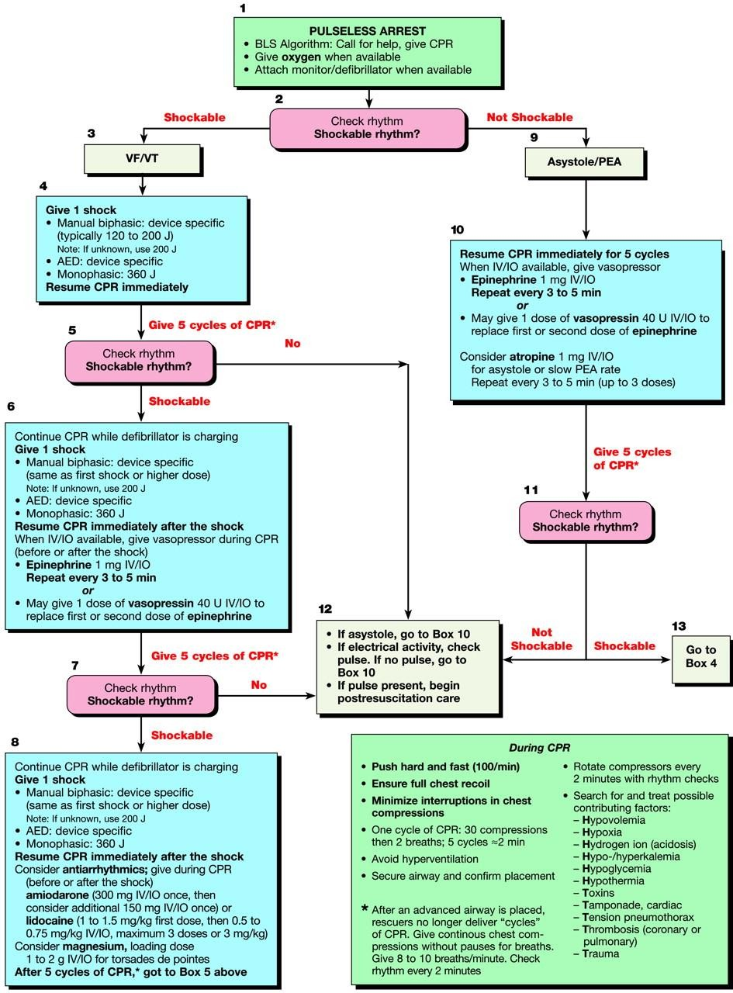
ASYSTOLE MANAGEMENT ALGORITHM

Slide 6
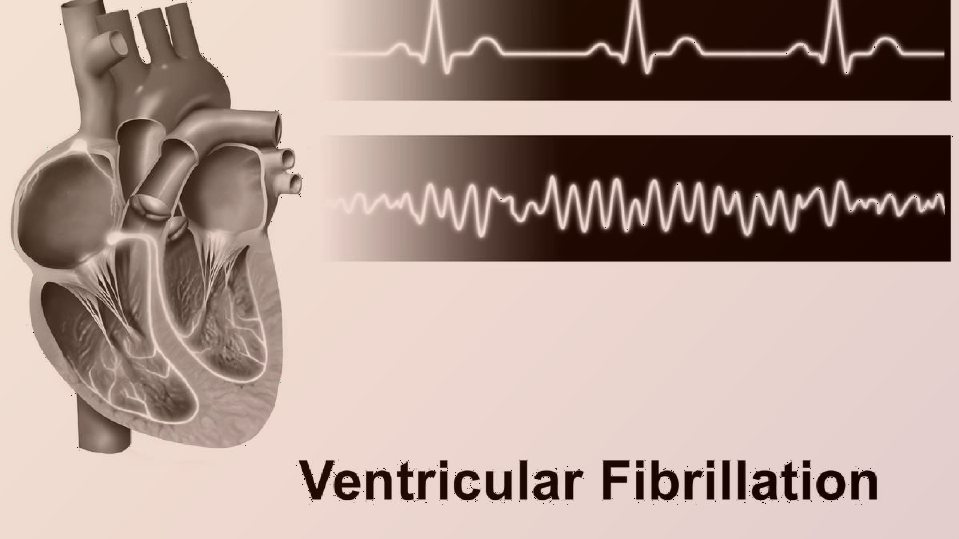
EMERGENCY CARE FOR

Slide 7


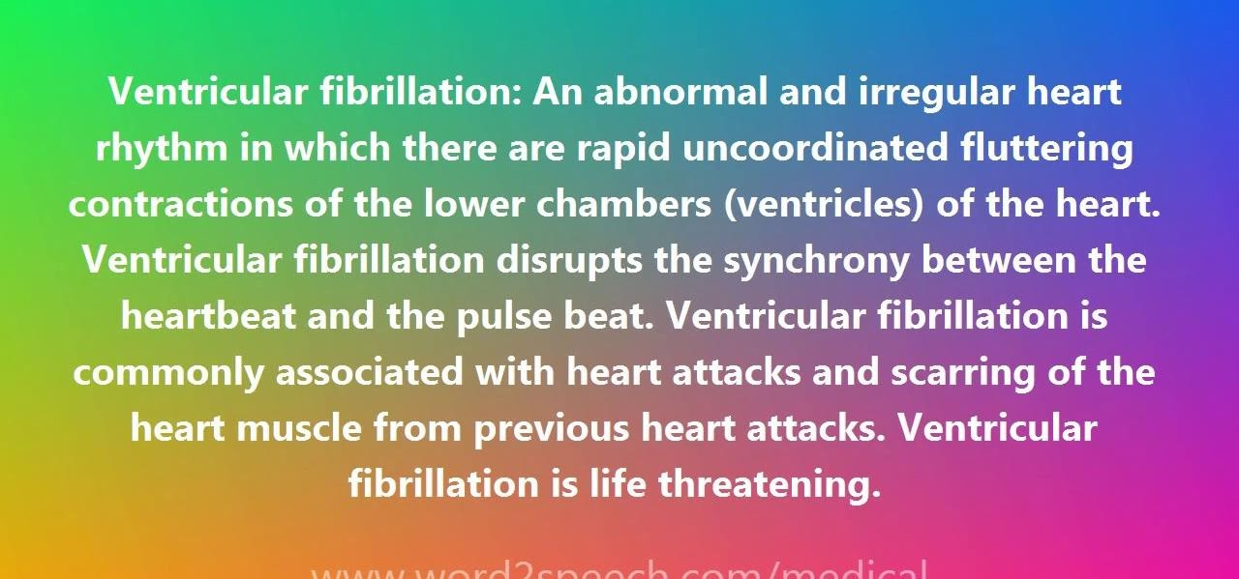
VENTRICULAR FIBRILLATION

Slide 8


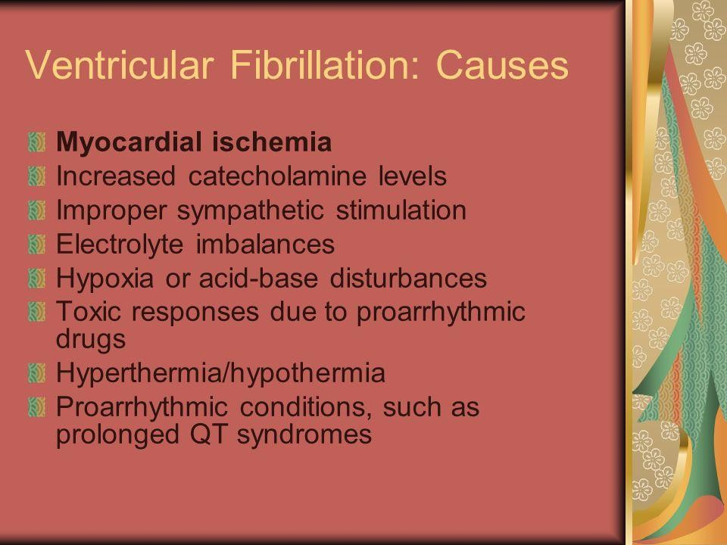
Causes

Slide 9

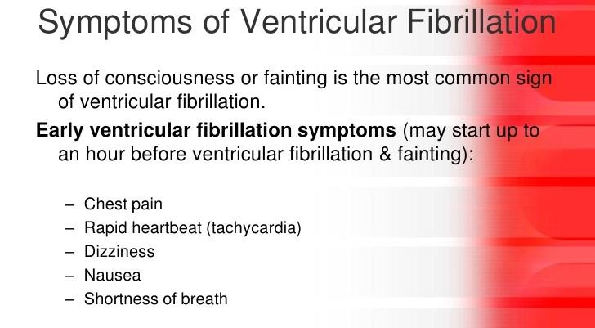

Slide 10

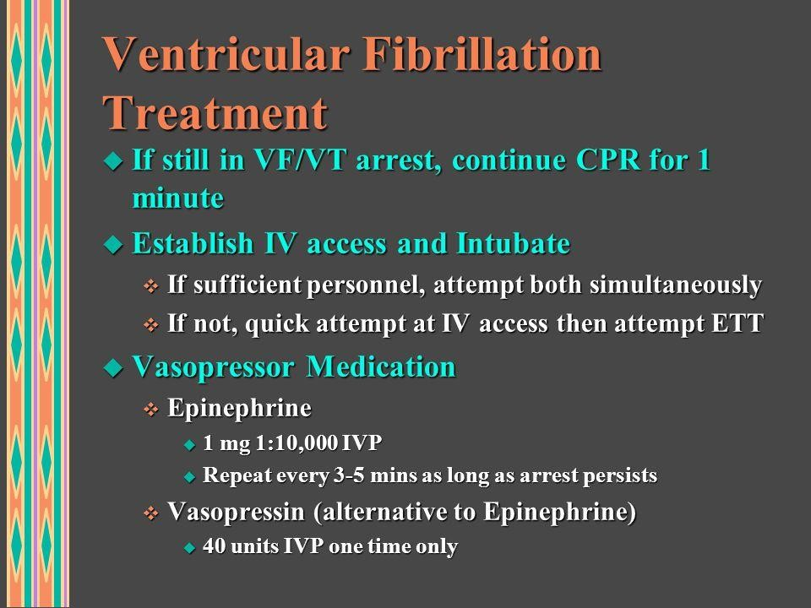

Slide 11
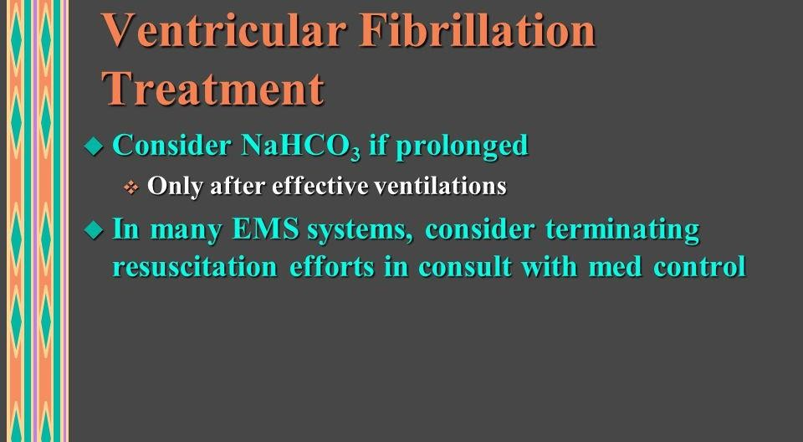

Slide 12

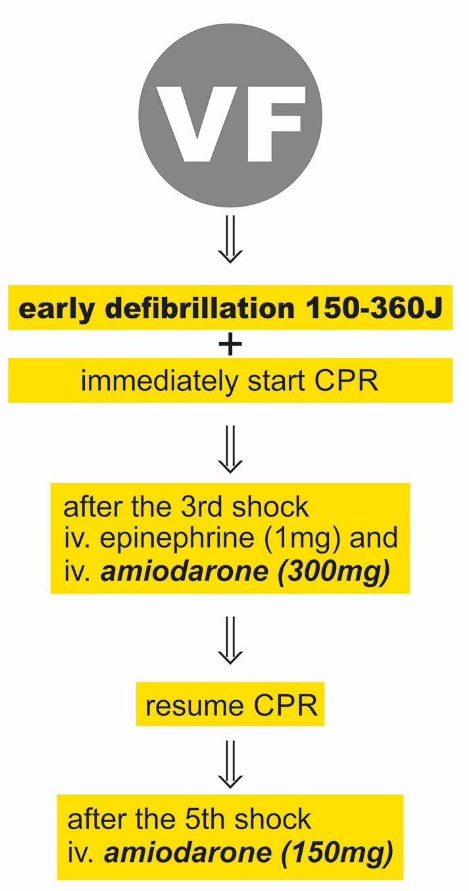

Slide 13
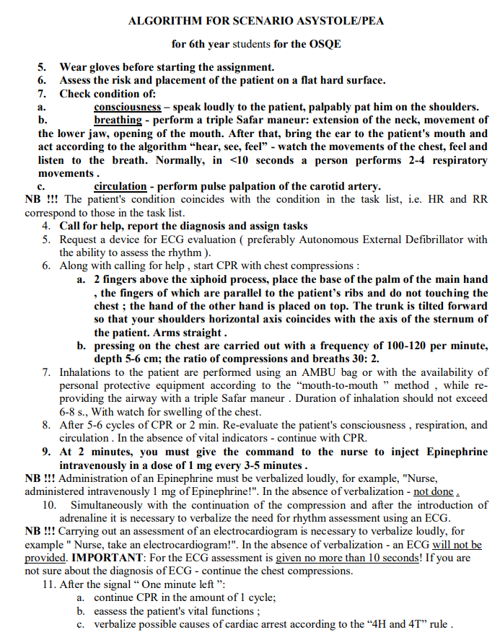
OSCE

Slide 14
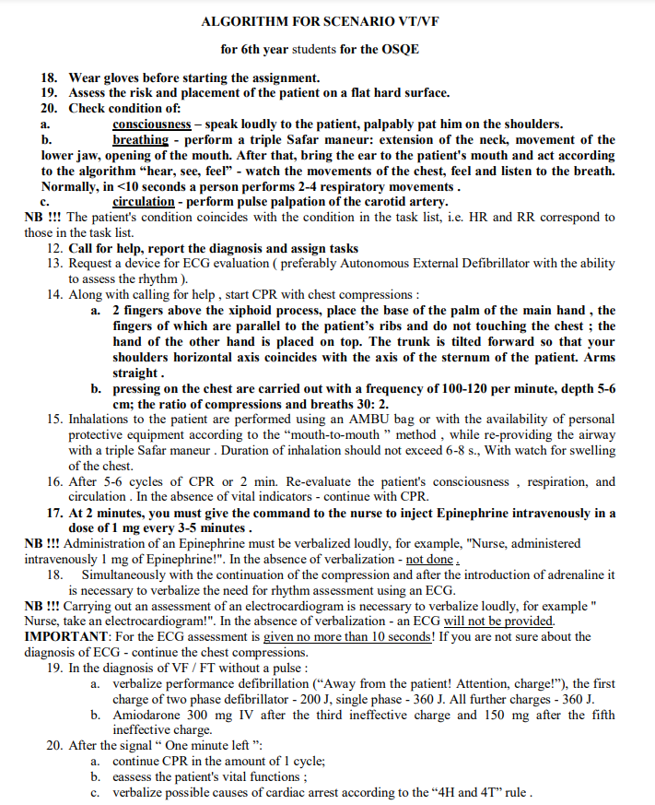
OSCE

