Slide 1
Ministry of health of Ukraine
Odessa National Medical University
Department of Robotic and Endoscopic Surgery
Simulation medicine cycle
Topic 9. Conicotomy: indications, contraindications, methods, complications. Anterior nasal tamponade. Examination of the fundus

Slide 2

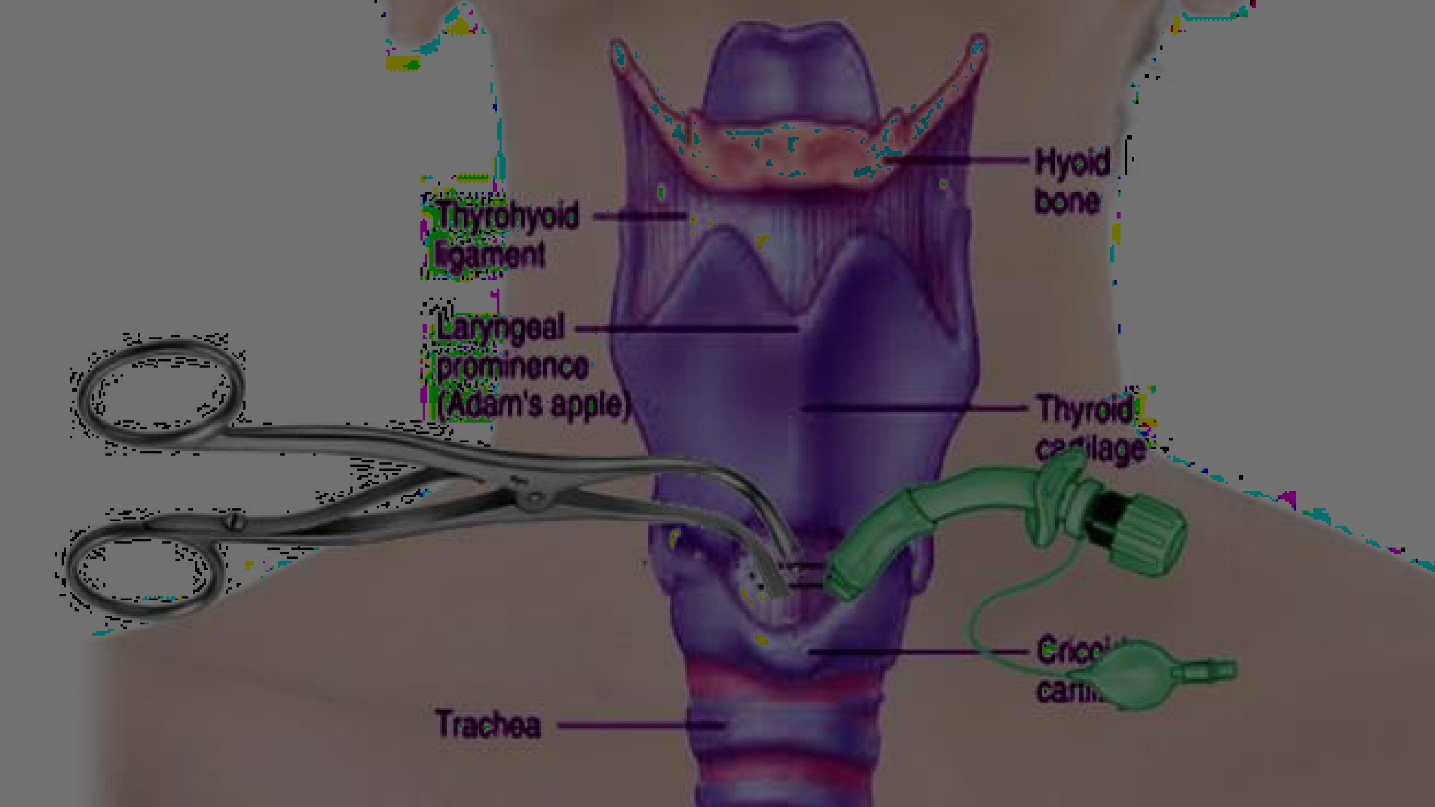


CONICOTOMY

Slide 3
What is cricothyroidotomy
/conicotomy ?
Cricothyroidotomy, also known as cricothyrotomy, is an important emergency procedure that is used to obtain an airway when other, more routine methods (eg, laryngeal mask airway [LMA] and endotracheal intubation) are ineffective or contraindicated.

Slide 4



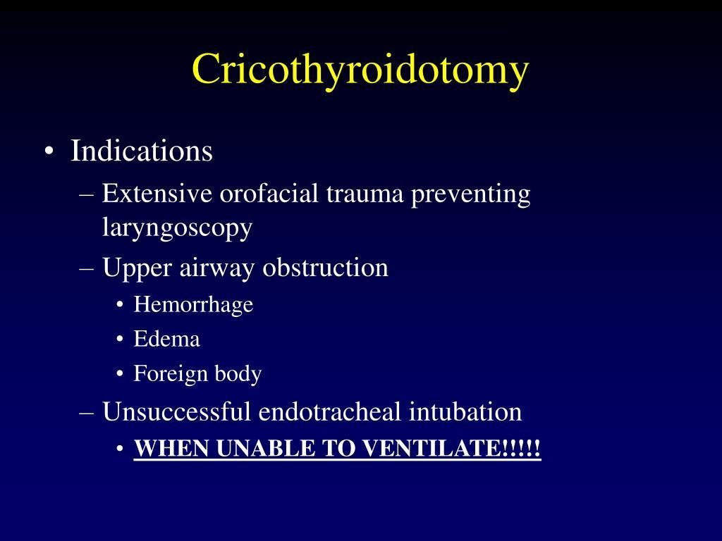
INDICATI ONS

Slide 5


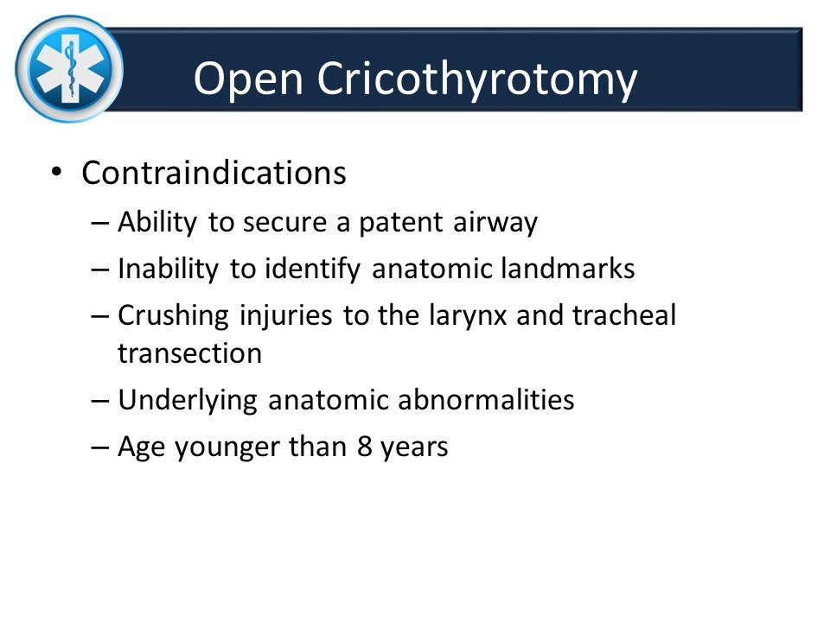
CONTRAINDIC ATIONS

Slide 6
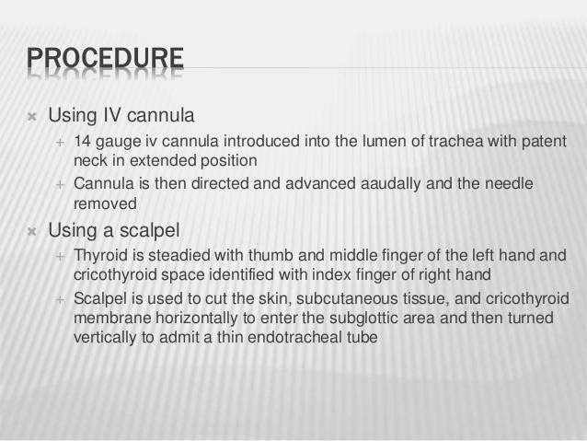

Slide 7
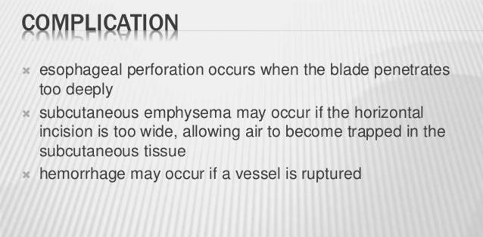

Slide 8
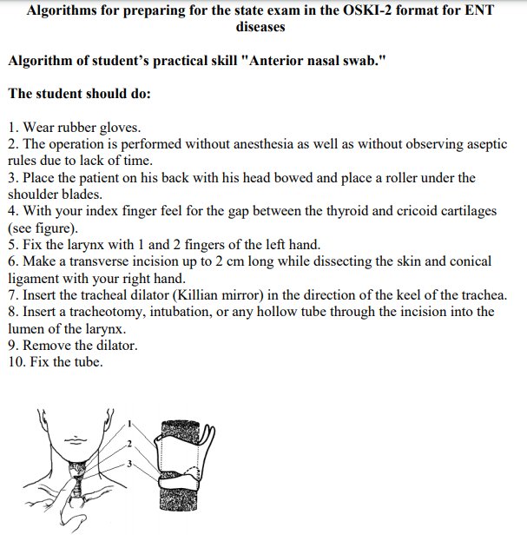
OSCE
Conicotomy

Slide 9
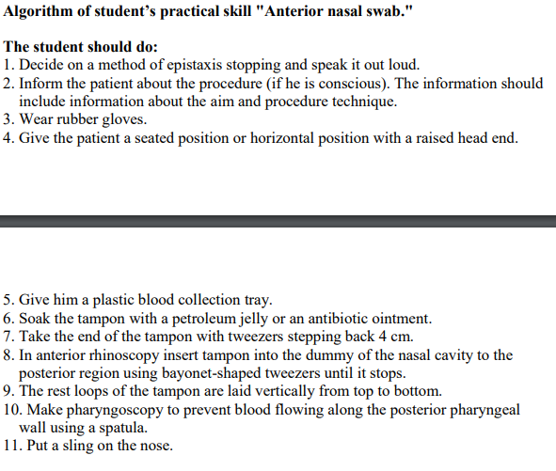
OSCE

Slide 10
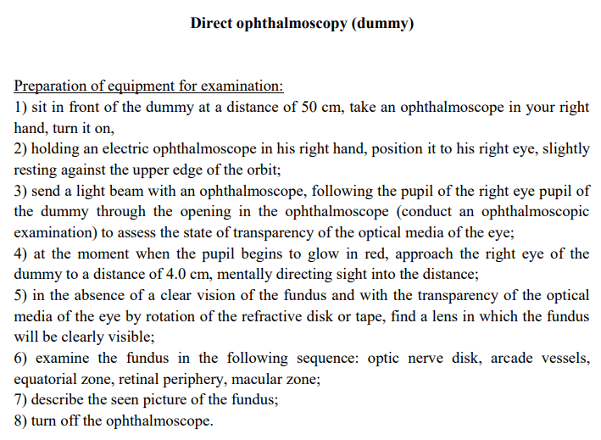
OSCE

