Slide 1
Topic 11 EMERGENCY
Ministry of health of Ukraine
Odessa National Medical University
Department of Robotic and Endoscopic Surgery
Simulation medicine cycle
CARE FOR MENINGOCOC CEMIA IN CHILDREN

Slide 2



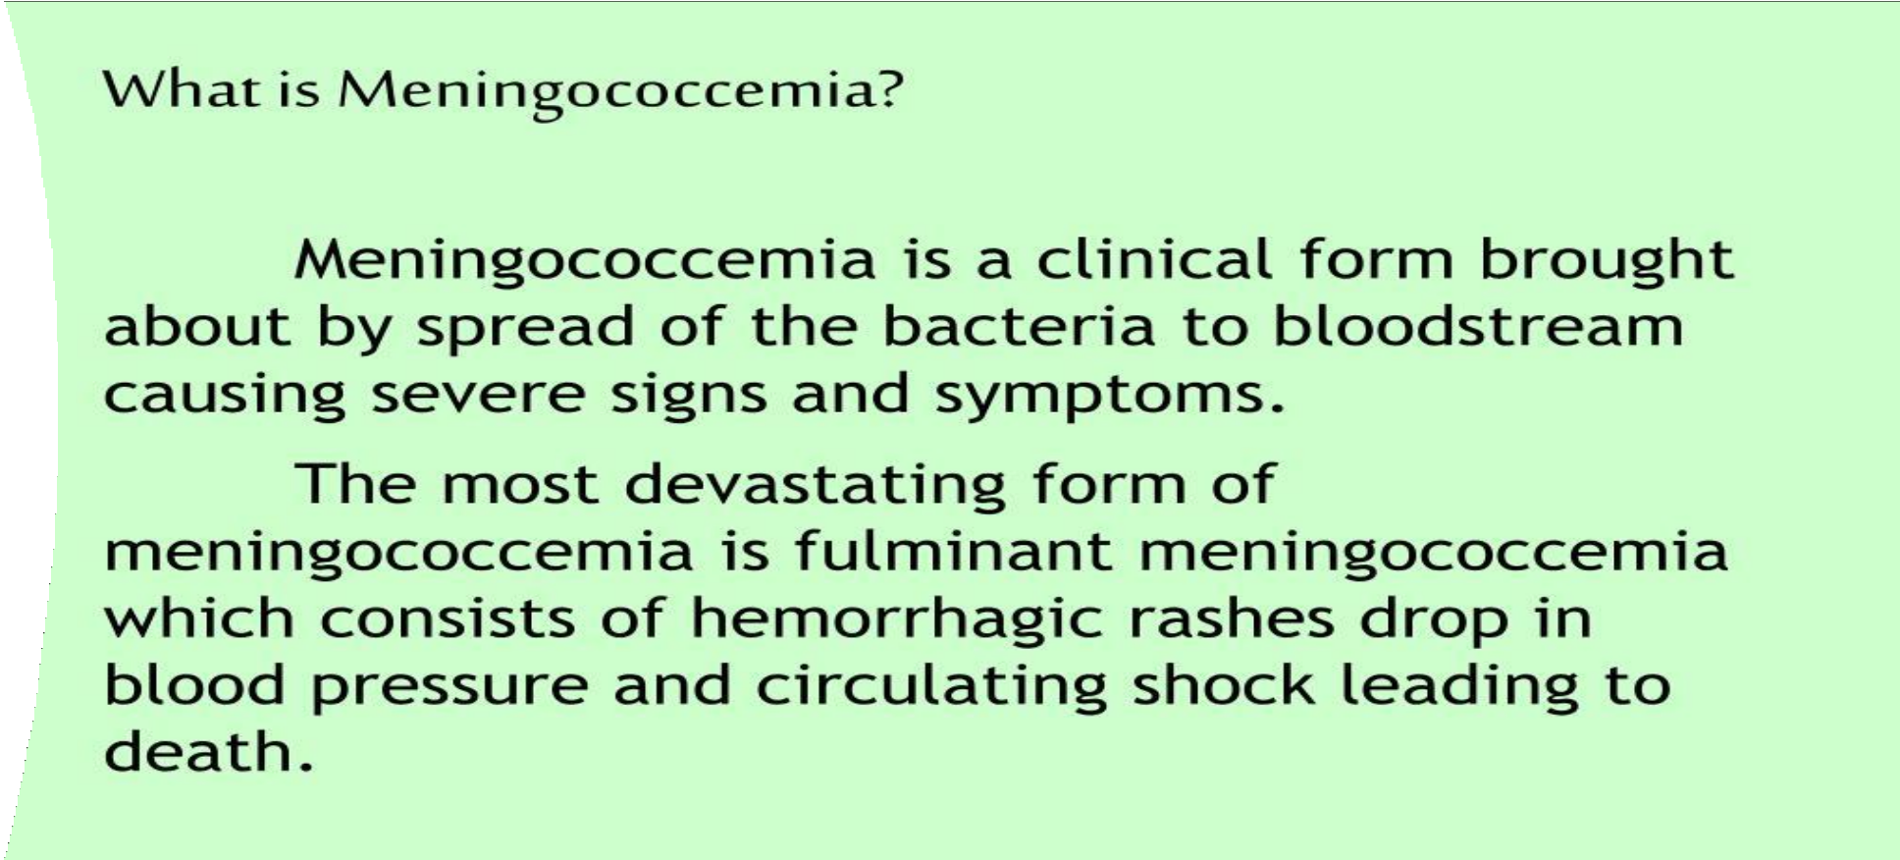

Slide 3

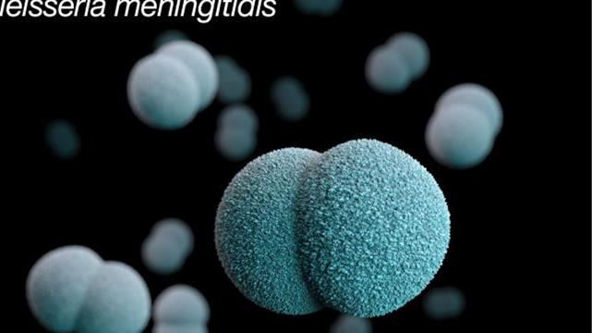





Etiology
NISSERIA MENINGITIDIS

Slide 4

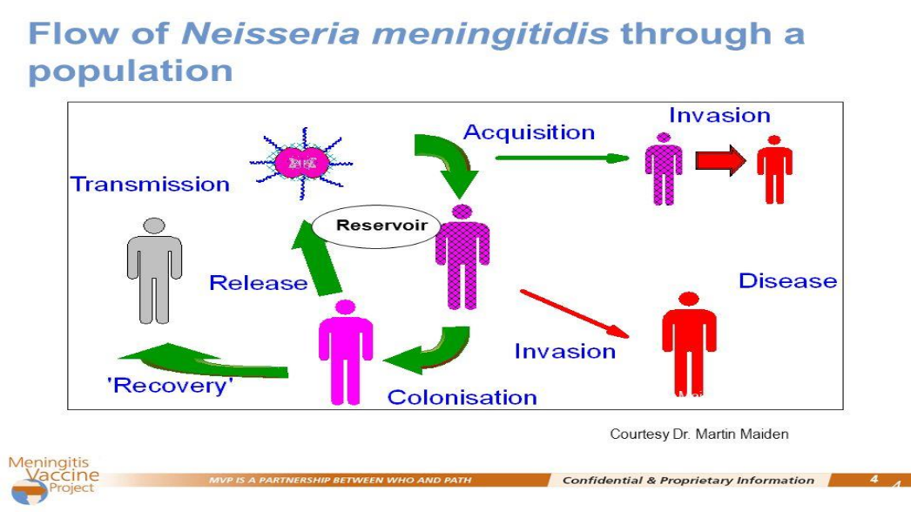
TRANSMISSION

Slide 5
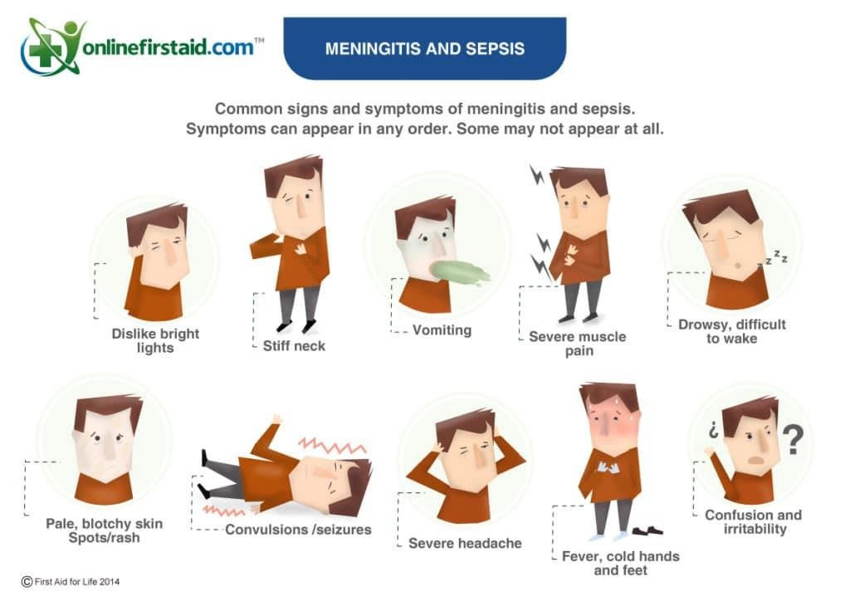

Slide 6
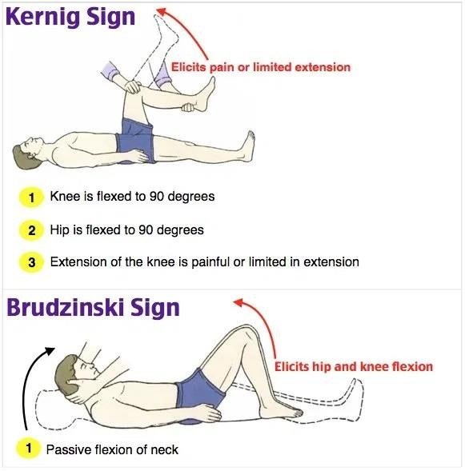
Signs in meningococcal infection

Slide 7
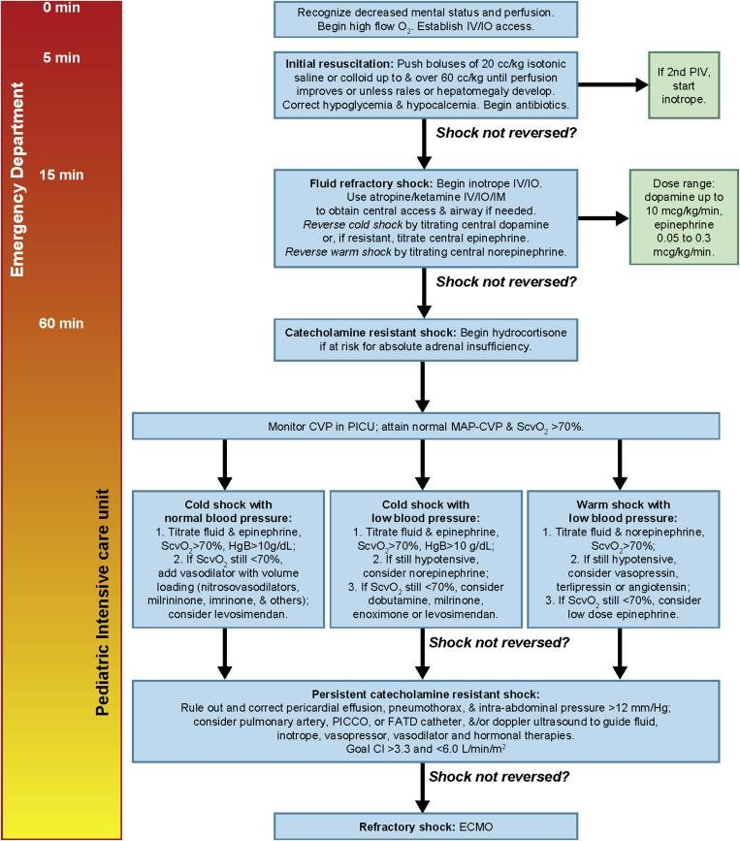
EMERGENCY
MANAGEMENT

Slide 8

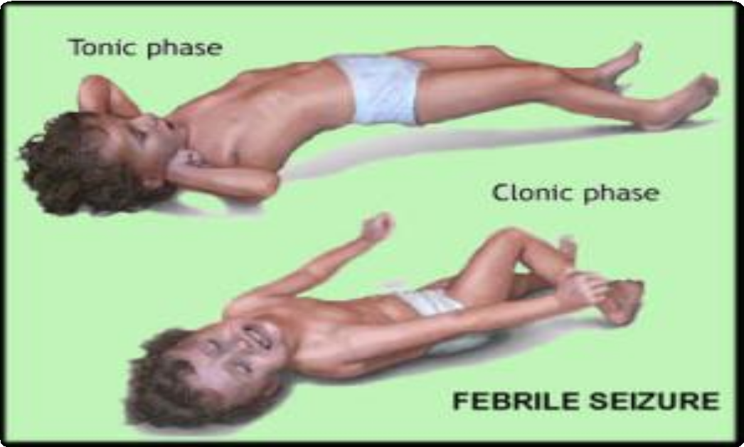
EMERGENCY CARE FOR FEBRILE SEIZURE IN CHILDREN

Slide 9
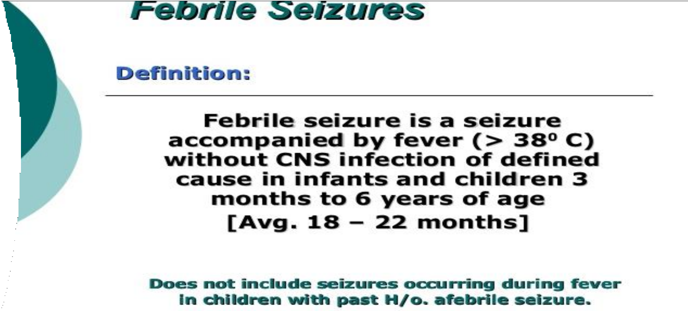

Slide 10
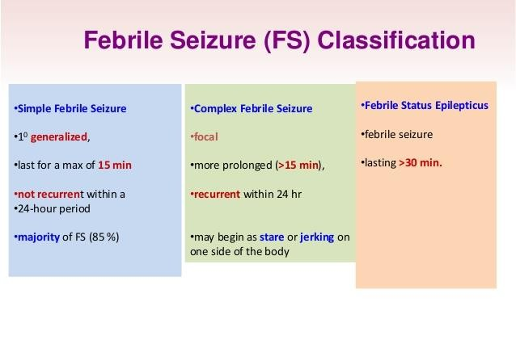

Slide 11
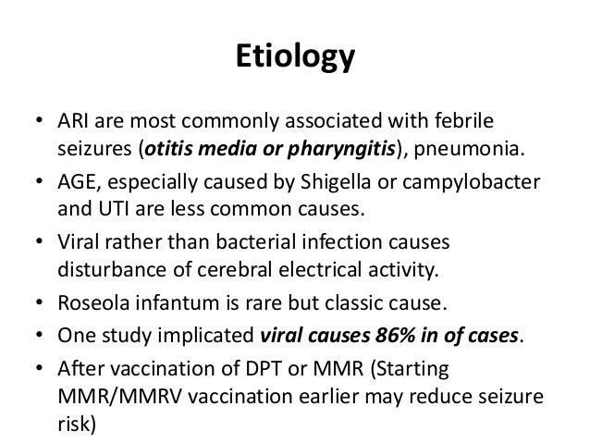
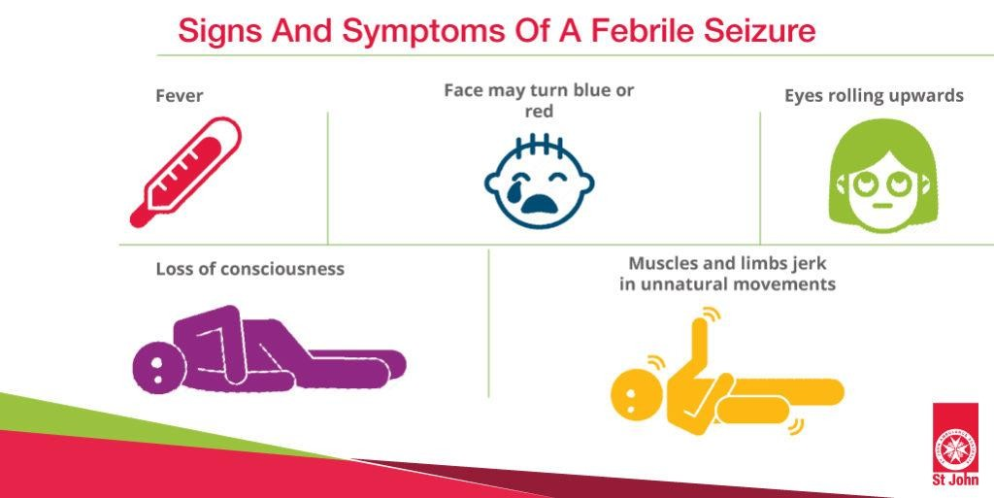

Slide 12
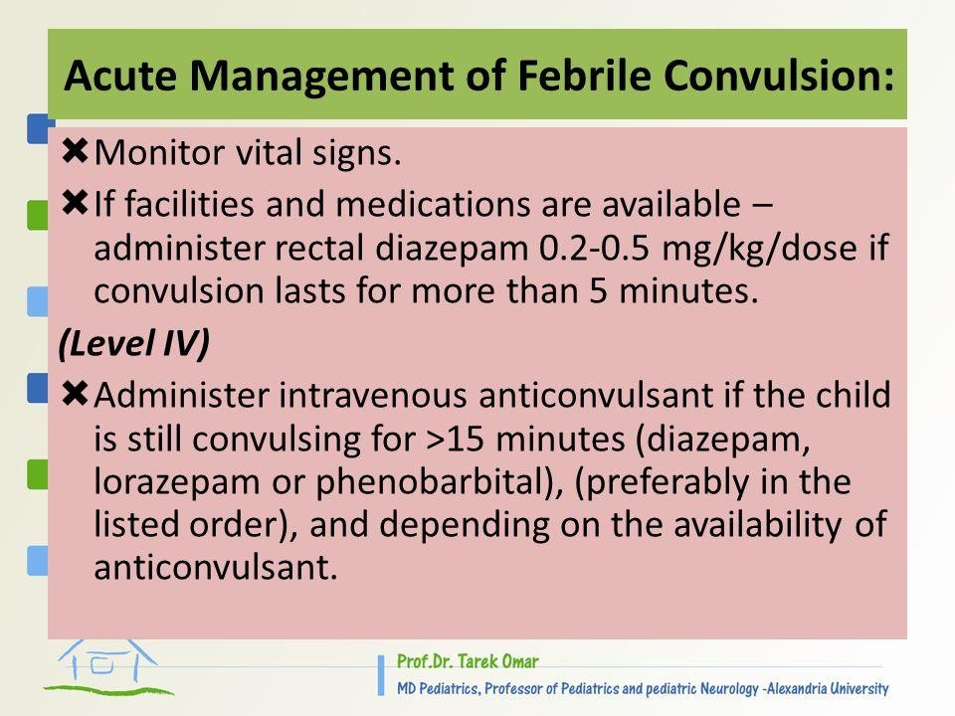
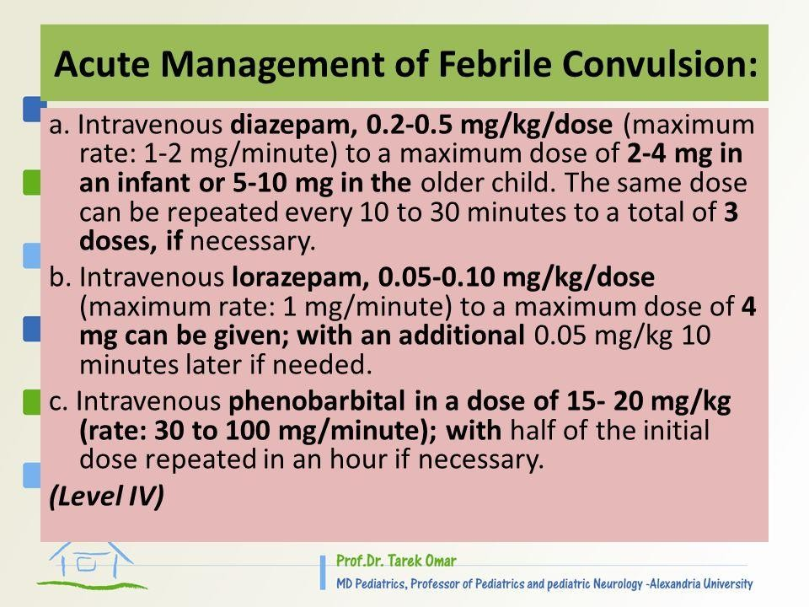

Slide 13
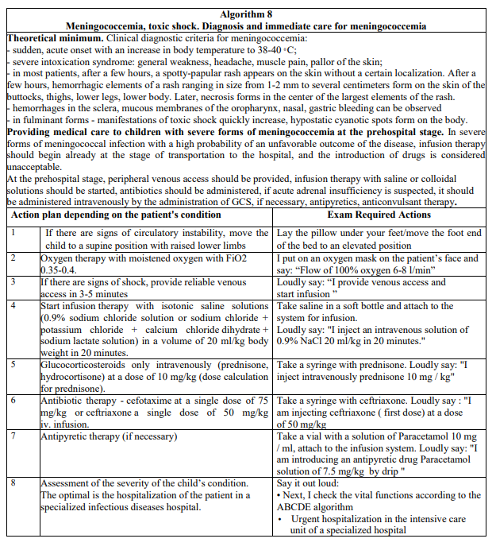
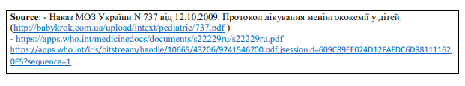
OSCE

Slide 14
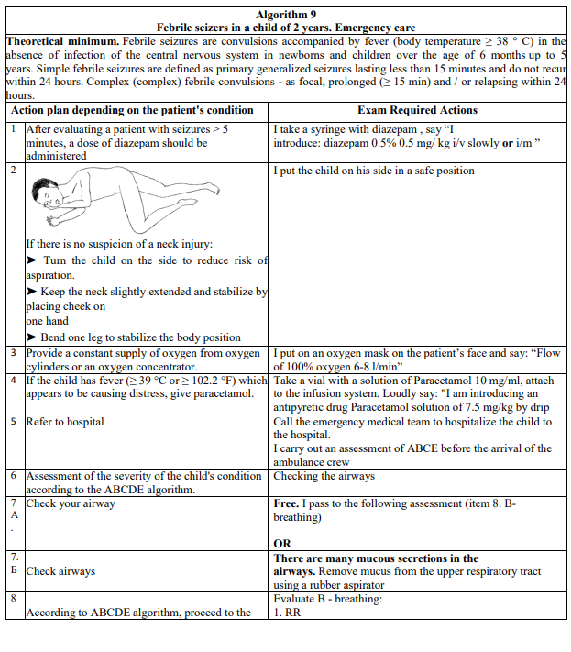
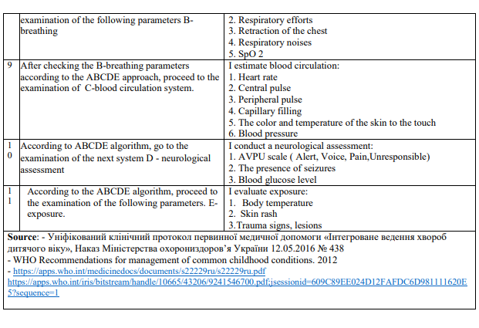
OSCE

