Slide 1
Topic 12. Emergency care for hypovolemic shock / severe dehydration. Emergency care for a full-term newborn. Assessment of the newborn on the APGAR scale.
Ministry of health of Ukraine
Odessa National Medical University
Department of Robotic and Endoscopic Surgery
Simulation medicine cycle

Slide 2
EMERGENCY CARE FOR HYPOVOLEMIC SHOCK / SEVERE DEHYDRATION

Slide 3



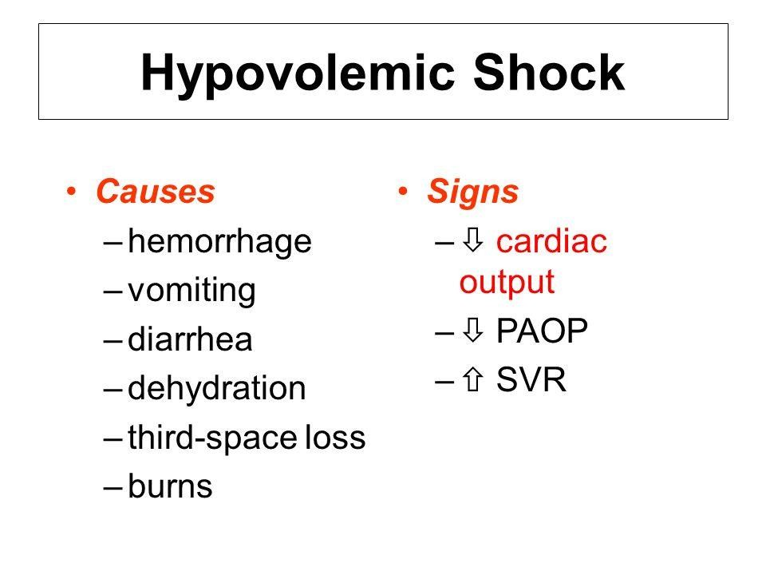

Slide 4


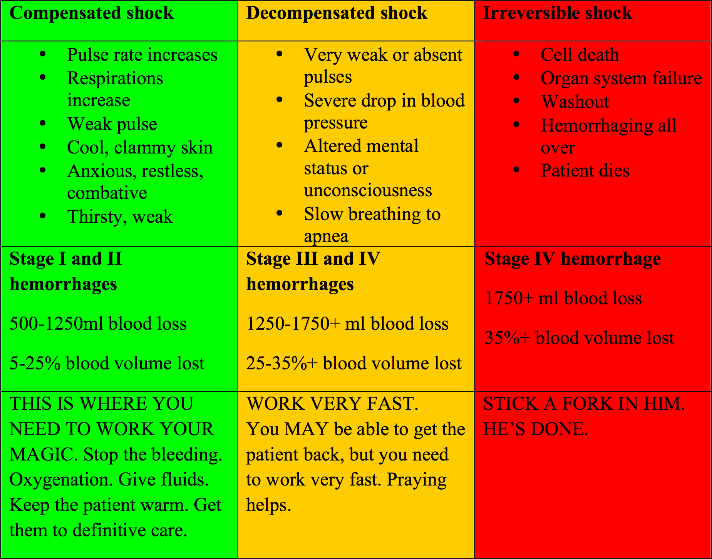

Slide 5

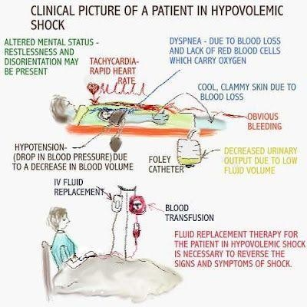

Slide 6
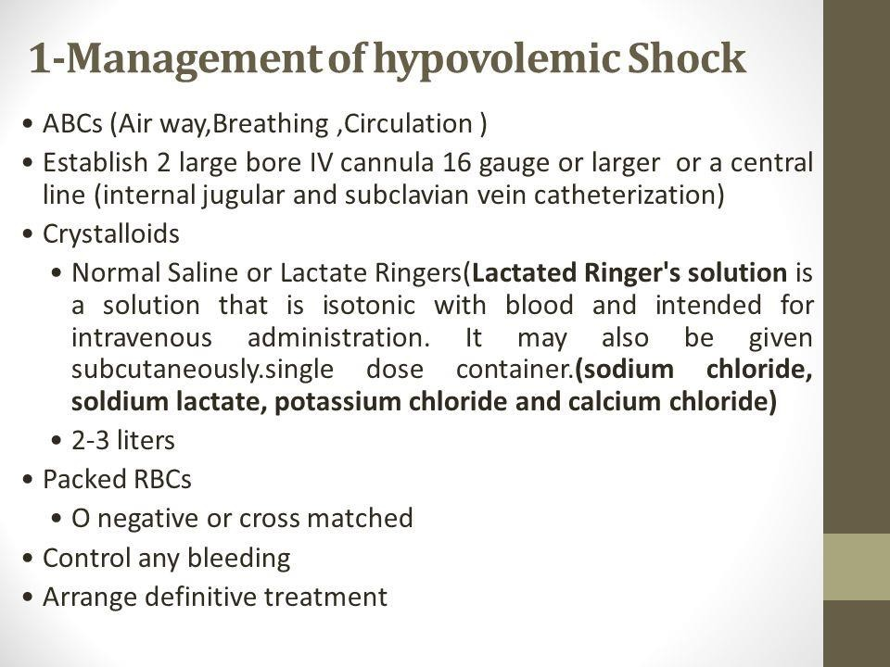

Slide 7





EMERGENCY CARE FOR A FULL TERM NEWBORN. ASSESSMENT OF THE NEWBORN BY APGAR SCALE.

Slide 8

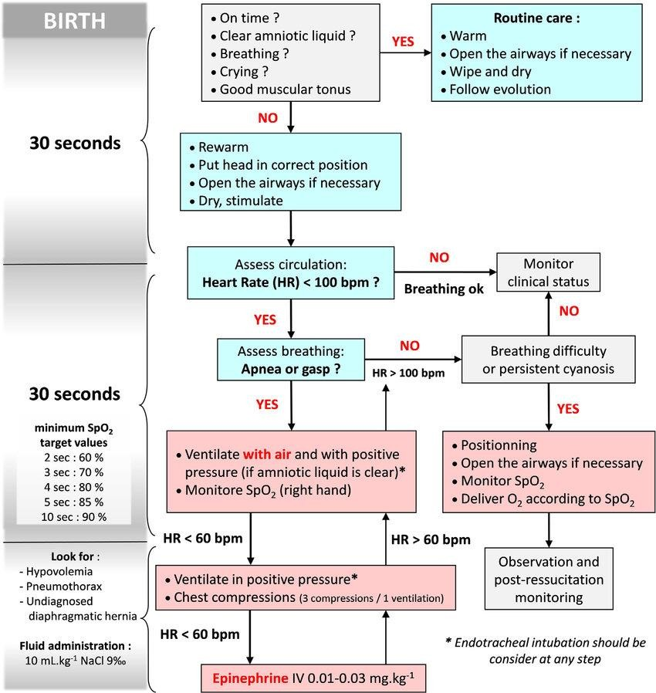
NEWBORN ASSESSMENT

Slide 9
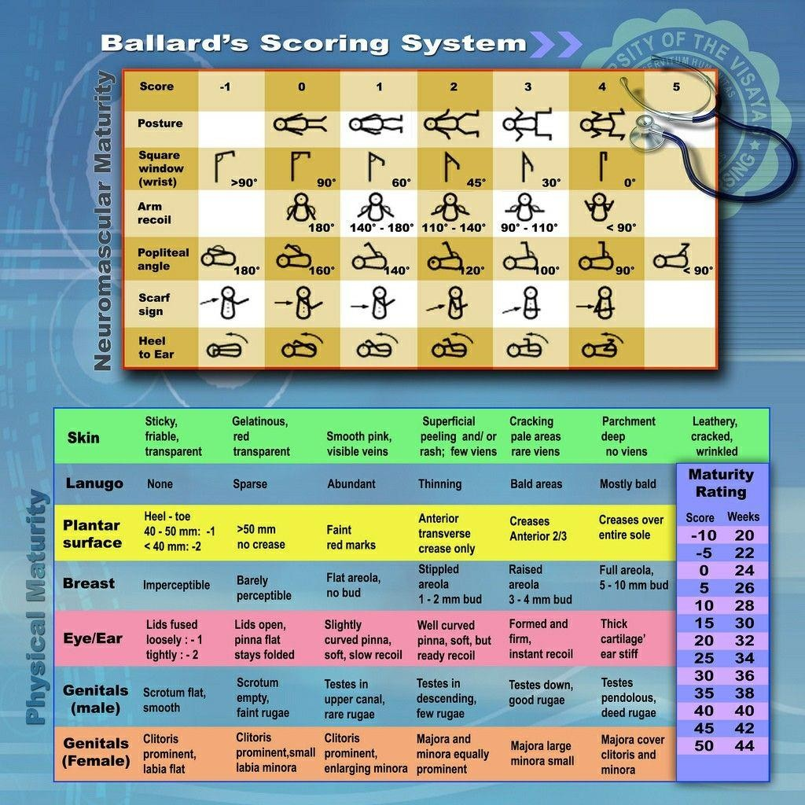

Slide 10
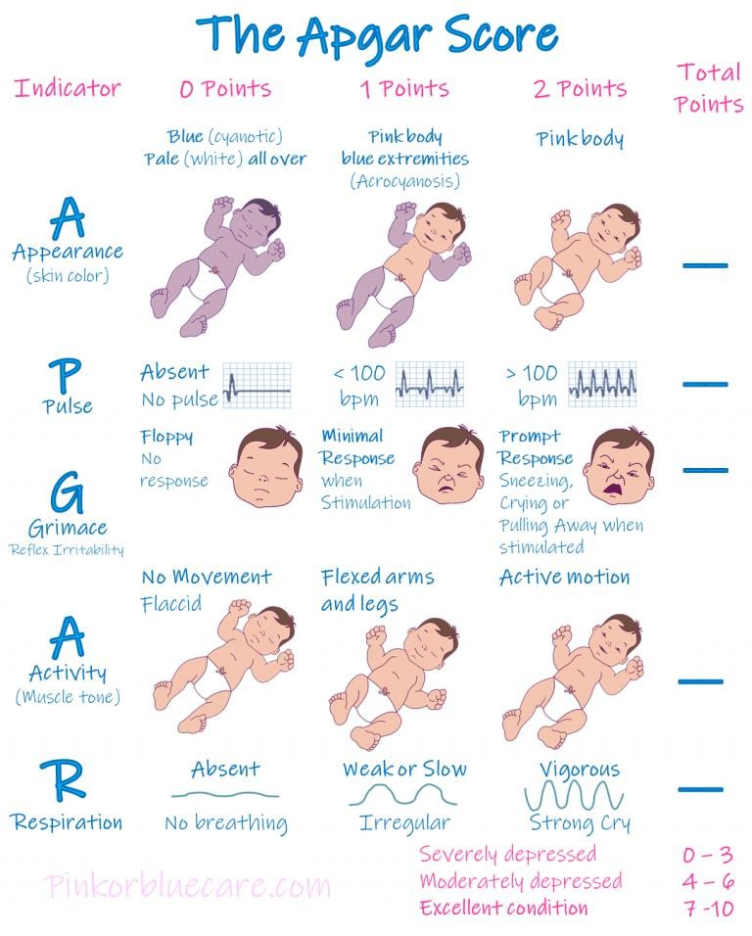

Slide 11
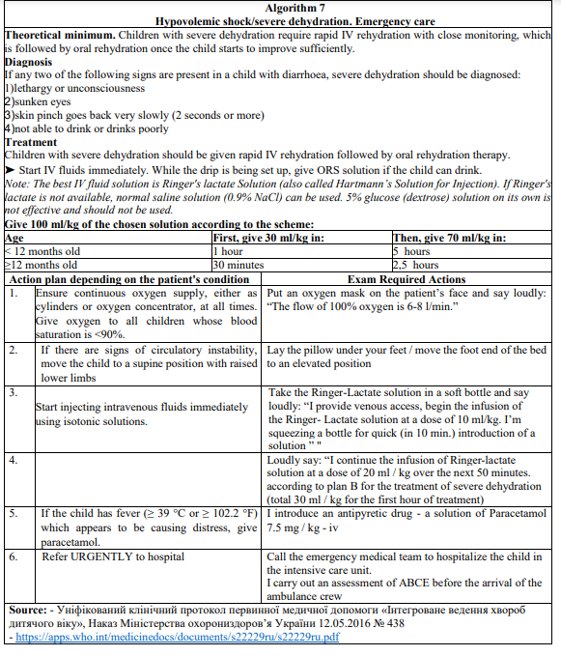

OSCE

Slide 12
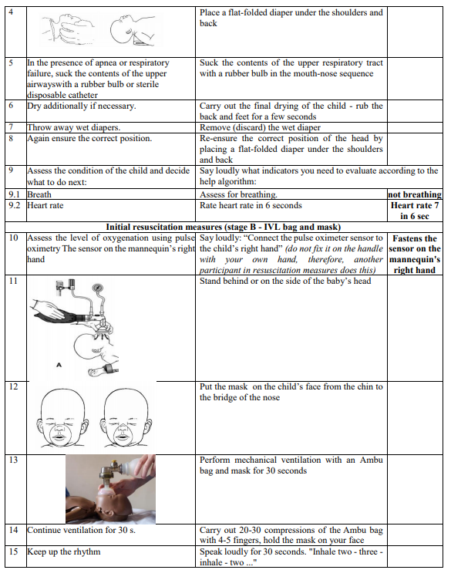
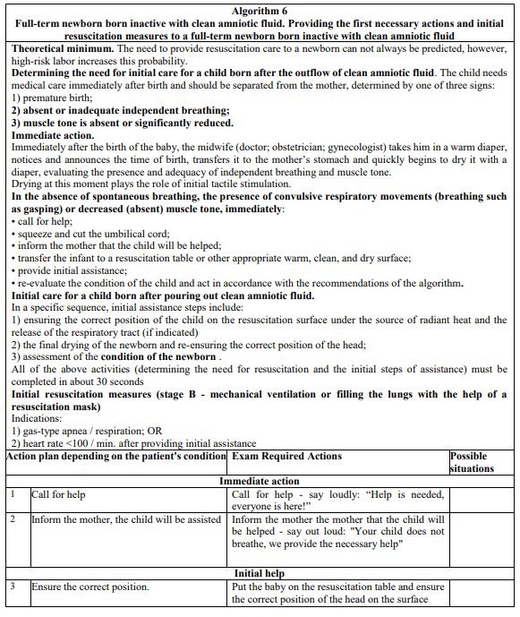
OSCE

Slide 13
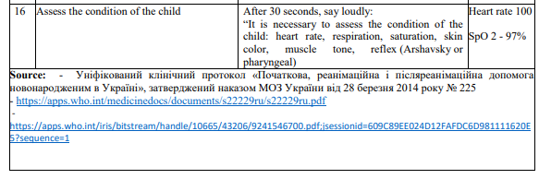
OSCE

Slide 14
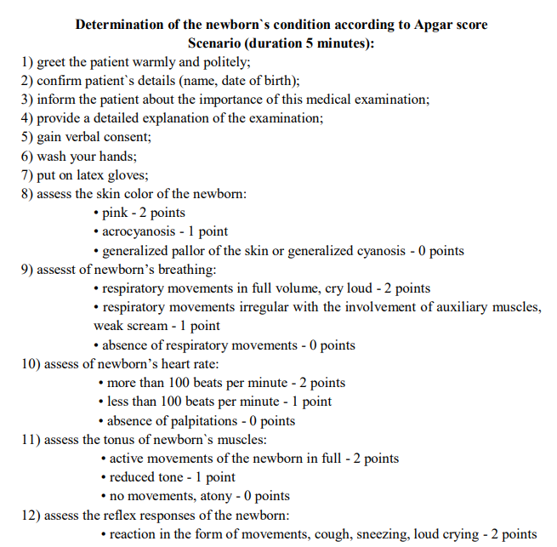
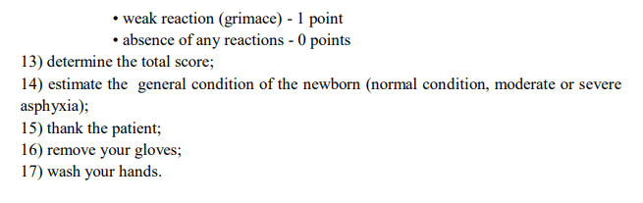
OSCE

