Slide 1






Ministry of health of Ukraine
Odessa National Medical University
Department of Robotic and Endoscopic Surgery
Simulation medicine cycle
TOPIC 13
EMERGENCY CARE FOR NEWBORN
WITH
ESOPHAGEAL ATRESIA

Slide 2
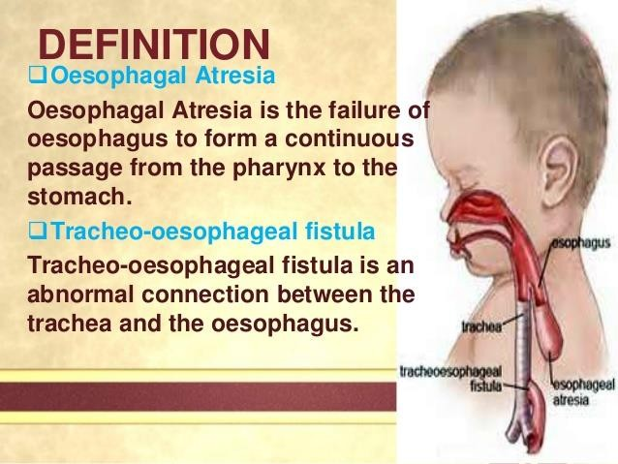

Slide 3
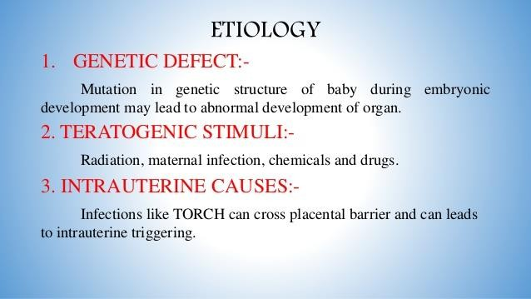
TYPES OF ESOPHAGEAL ATRESIA

Slide 4
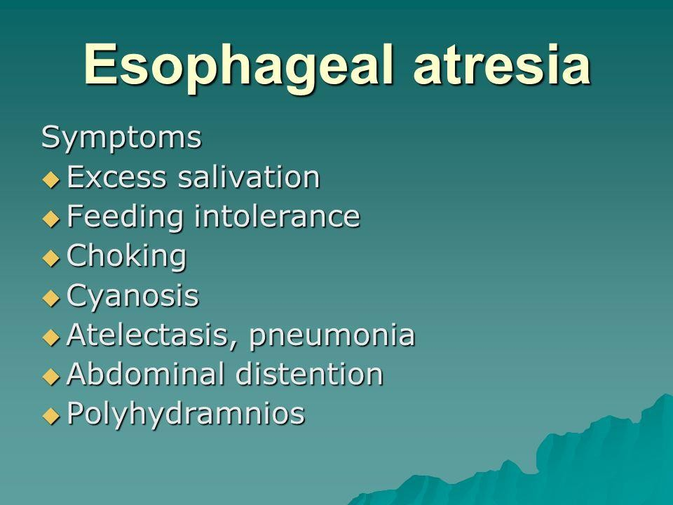

Slide 5




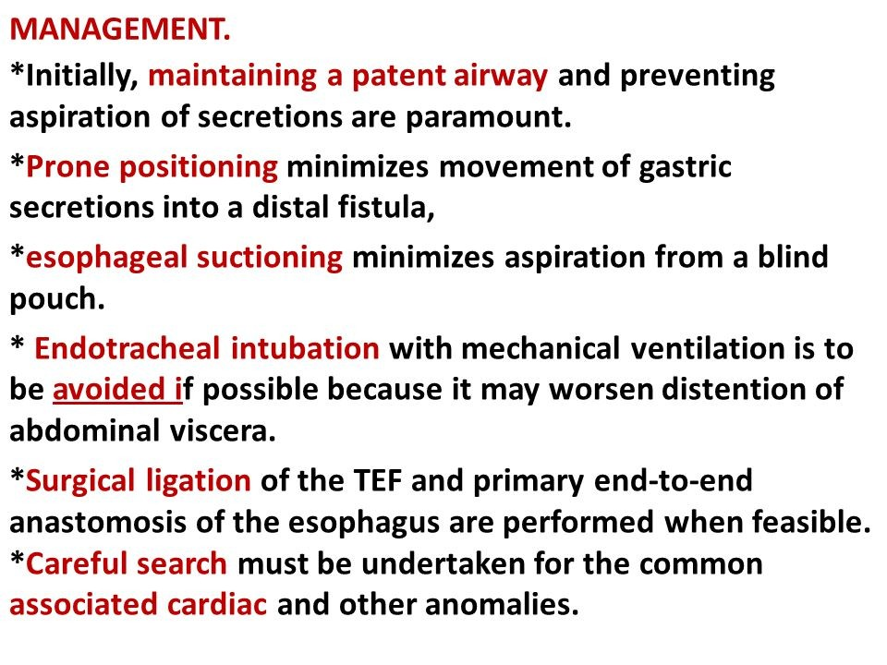

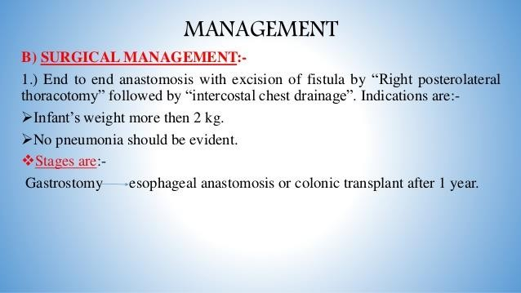


Slide 6
Emergency care for newborn with high congenital intestinal obstruction

Slide 7
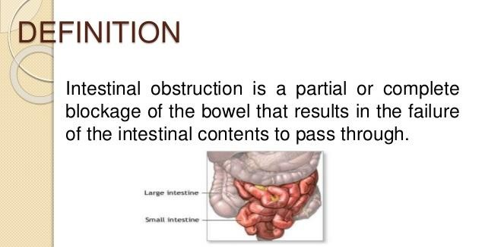

Slide 8
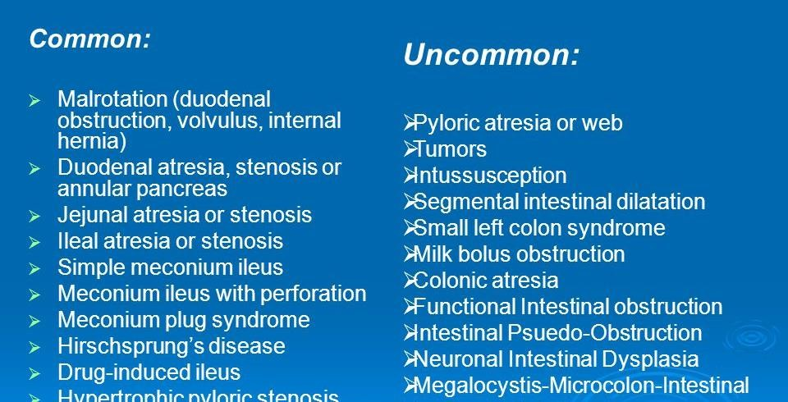

Slide 9
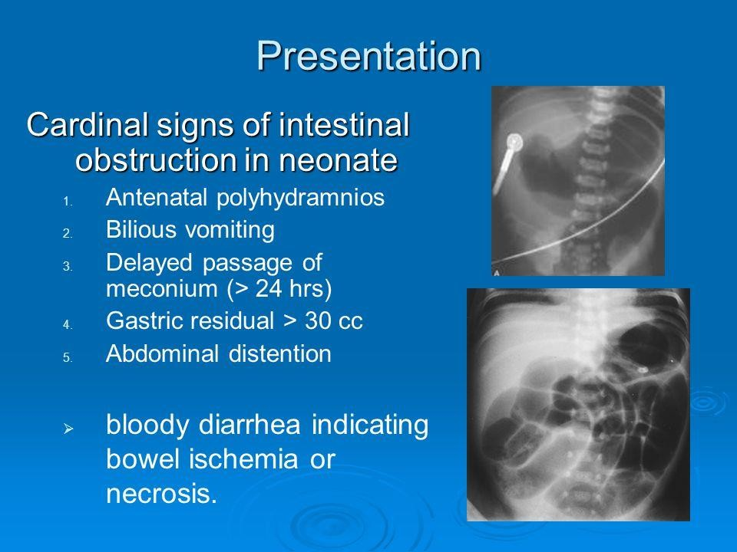

Slide 10
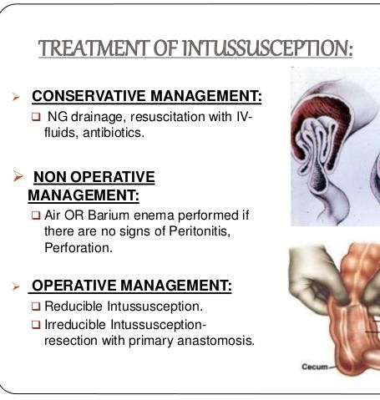
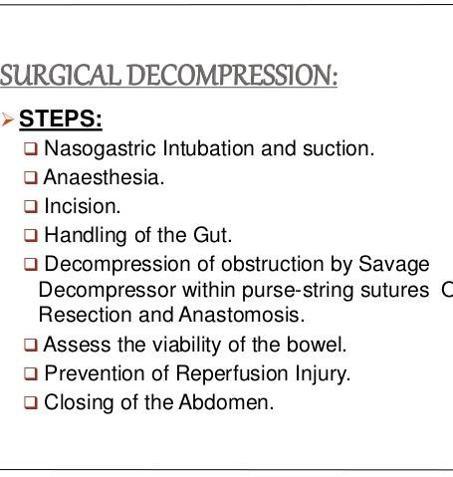

Slide 11
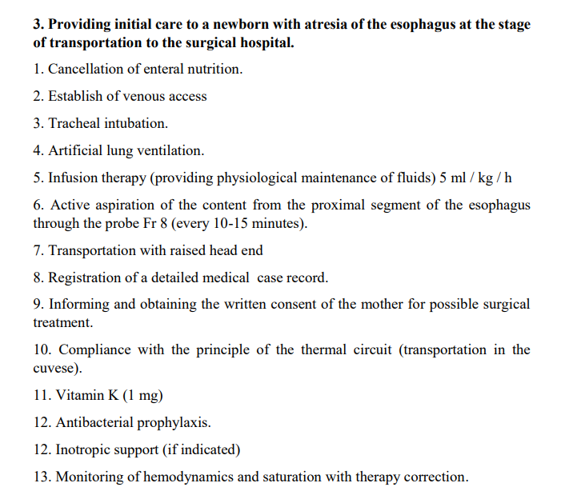
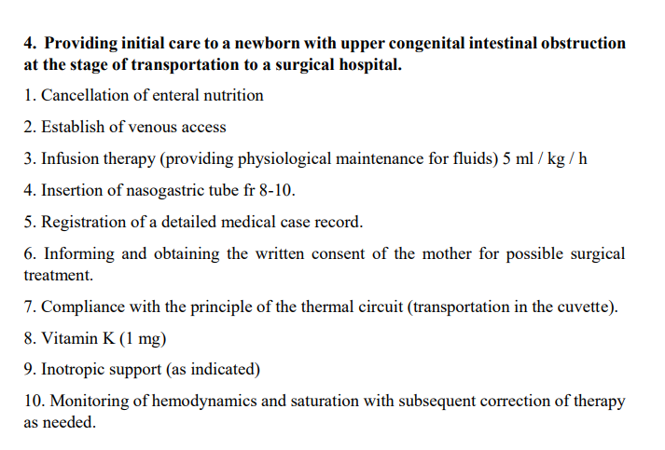
OSCE

