Slide 1
Ministry of health of Ukraine
Odessa National Medical University
Department of Robotic and Endoscopic Surgery
Simulation medicine cycle
Topic 14. Providing care for late adhesion intestinal obstruction.

Slide 2
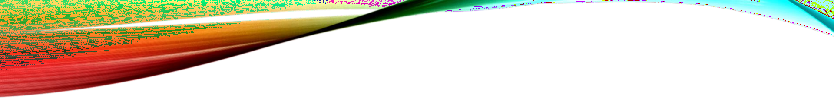

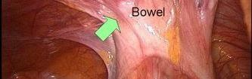
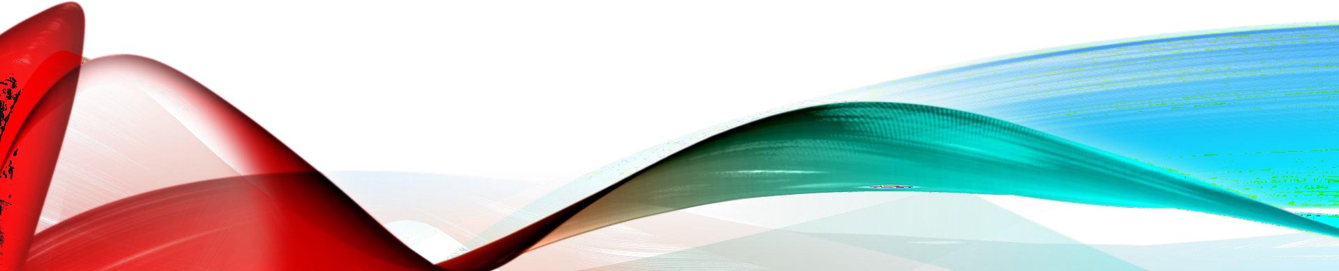
PROVIDING CARE FOR LATE ADHESIVE INTESTINAL OBSTRUCTION

Slide 3



ADHESIVE INTESTINAL
OBSTRUCTION
Adhesive small bowel obstruction (ASBO) is a common surgical emergency, causing high morbidity and even some mortality. The adhesions causing such bowel obstructions are typically the footprints of previous abdominal surgical procedures.

Slide 4


CAUSES
1. Post operative in most cases.
2. Post inflammatory with or without operation eg. Peritonitis ,appendicitis, acute pelvic infection
3.Foriegn body material used during surgery , gauze ,sutures talc powder from gloves
4.Radiation induced enteritis
5. Bowel ischemia
6. Inflammatory bowel disease
7 .certain conditions like eg. Malignancy , tuberculosis

Slide 5


TYPES OF ADHESIVE OBSTRUCTION
Type 1 fibrinious adhesion Occur during 5 To 10 th day of post surgical period ,basically it gets resolve completely ,its avascular.
Type 2 Fibrinious adhesion getS collagenised and vascularised.

Slide 6
SYMPTOMS
1. Abdominal pain like coliky type ,recurrent, episodic.
2.Abdominal distension, vomiting.
3.Constipation,fever, tachycardia, abdomen rebound tenderness.
4.Previous surgical scar most commonly seen
GILLROY BEVAN TRIAD OF PAIN :-
1.Pain gets aggravated or relieved on change of posture.
2.Pain in the region of old abdominal scar.
3.Tenderness of abdomen on previous scar.

Slide 7

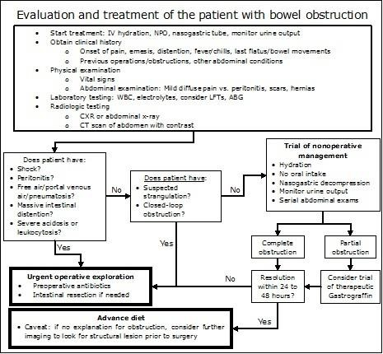
MANAGEMENT

Slide 8
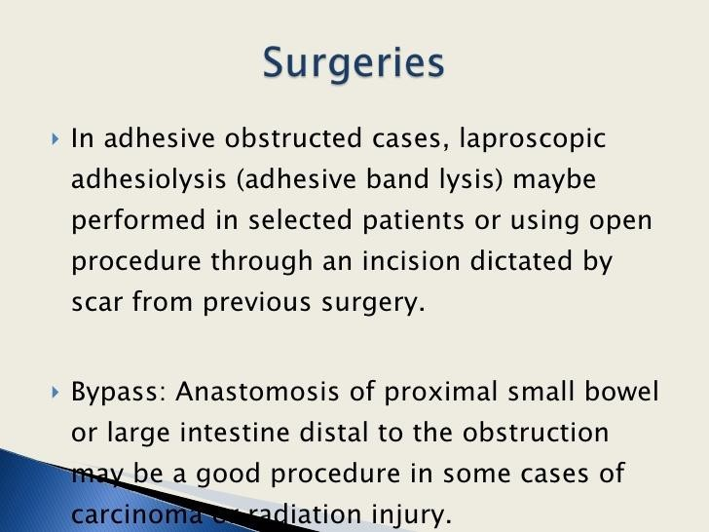
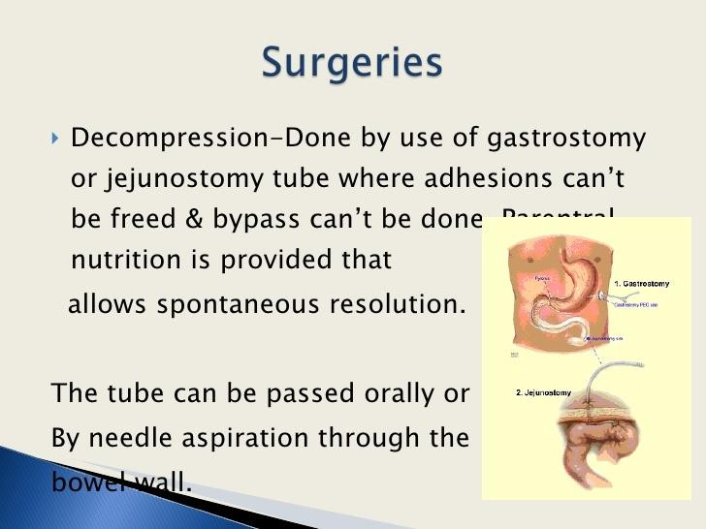
SURGICAL TREATMENT

Slide 9
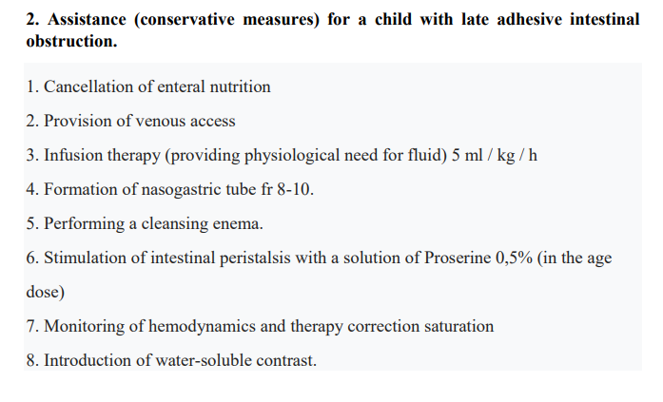
OSCE

