Slide 1
Odessa National Medical University
Faculty of Pharmacy
Department of Organization and Economics of Pharmacy
Lecture on
State Regulation of the Dispensing Prescription Drugs
Lecturer
Ass.prof., PhD in Pharmacy Oksana Bieliaieva

Slide 2
Lecture Plan
Classification of medicinal products: prescription and non-pres drugs
Drug prescription. Definition, functions, and forms of the prescriptions in Ukraine
General rules of writing out prescriptions
Procedure for dispensing medicines and medicinal products from pharmacies and their structural subdivisions
Storage, recording, and disposal of prescription forms
Dispensing narcotic and psychotropic drugs and precursors.
Medicines benefits and reimbursement policies for some groups of population. Part of charge and free of charge prescriptions.

Slide 3
Prescription: definition, functions
According to DIRECTIVE 2001/83/EC OF THE EUROPEAN PARLIAMENT AND OF THE COUNCIL of 6 November 2001on the Community code relating to medicinal products for human use:
Medicinal Prescription - any medicinal prescription issued by a professional person qualified to do so.
Prescription Functions
medical (prescription contains the information about the drug itself and route of administration)
legal (prescription helps the state and relevant controlling bodies regulate the circulation of narcotic, psychotropic, poisonous, potent drugs and precursors, provided the date of issue, and the patient’s and prescriber’s names)
technological (prescription contains data on active (sometimes auxiliary) substances and dosage form of extemporaneous drugs)
economic (prescription data are used in the economic analysis of the efficiency of the pharmacy, calculation of tariffs, costs of excipients and materials, reimbursements, etc.)
social (prescription must provide qualified, full, timely medical and pharmaceutical care to consumers regardless of their social and material status).

Slide 4
Types of the Prescription Payment
“full of charge” - if the patient pays for the drug at his own expense
“free of charge” - if the patient does not pay for the medicinal product
“with partial co-payment” - if the patient pays part of charge and the rest is paid from the state budget

Slide 5
Who can write out prescriptions to patients ?
medical doctors:
100% charge prescription
Free/Part charge (50%) prescriptions (when agreed with municipal healthcare authorities)
Free-of-charge and partial co-payment medicines, which are covered under the "Affordable Medicines" State Program (only by primary care physicians)
B) Feldsher (=clinical officer) (only for patients with chronic diseases in case of prolongation of the course of treatment by the physician)

Slide 6
Prescriptions must be written on :
prescription drugs
over-the-counter (OTC) medicines, medical devices in case of their release free of charge or with partial co-payment
medicines manufactured in a pharmacy for a certain patient (extemporaneous drugs)

Slide 7
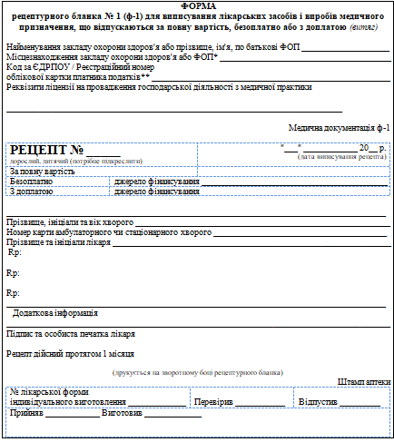
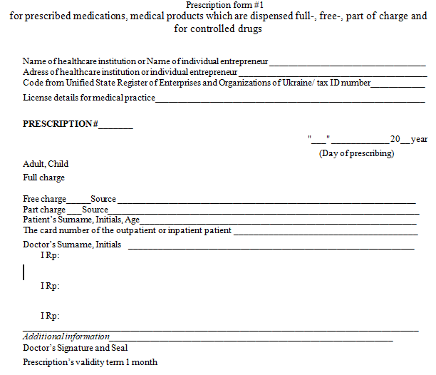
Prescription Forms
Ф-1
F-1
Prescription is certified by the doctor's signature and seal

Slide 8
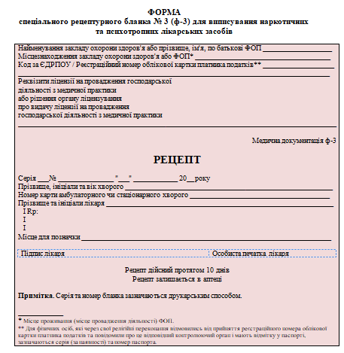
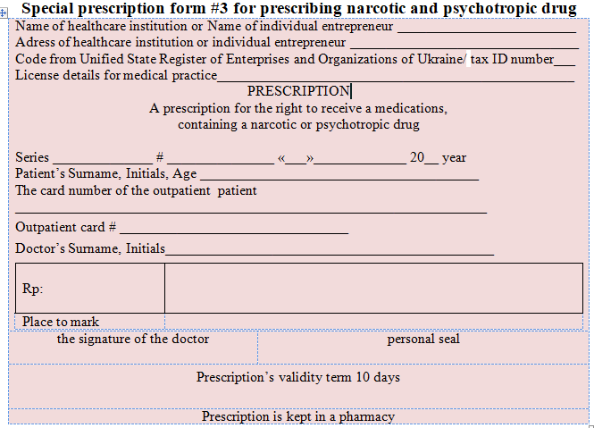
Prescription Forms
F-3
F-3
Prescription is certified by the doctor's signature and seal

Slide 9
Filling in prescription forms:
F-1 form (full of charge payment) - 3 items in one prescription form
F-1 form ( free of charge or part of charge) - 1 item in one prescription form
F-3 form 1 item only

Slide 10
A prescription for narcotic (psychotropic) medicines in a pure form (an active ingredient only) or mixed with indifferent substances
N.B. All other medicines are prescribed on the F- 1

Slide 11
Peculiarities of writing out free or part charge prescriptions
F-1 + F-1 (two copies)
it is required to write out two prescription forms F-1 for a controlled medicines that is dispensed free or part charge
F-3+F-1
it is required to write out two prescription forms
F-3+F-1 for narcotic and psychotropic drug that is dispensed free or part charge

Slide 12
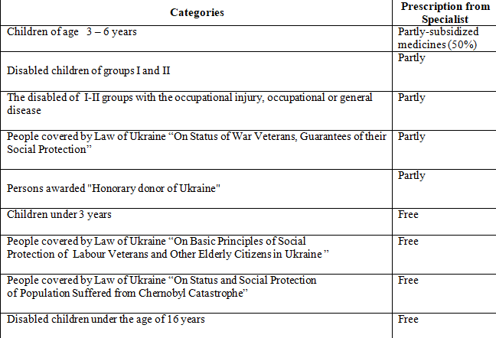
Exemption from Prescription Charges

Slide 13
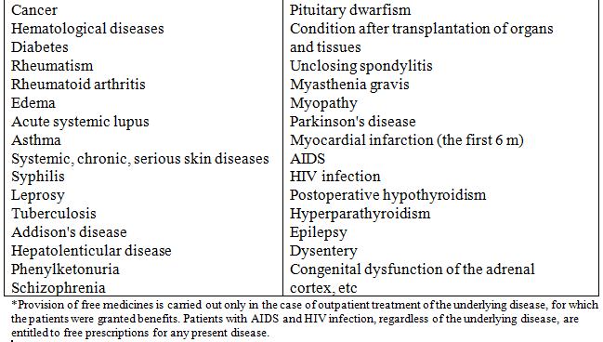
Medical conditions which are provided by free medications

Slide 14
Aspects of prescribing to particular patient groups
privileged categories of patients who make injections outside of health care facilities are allowed to prescribe up to 100 g of ethyl alcohol free of charge per month
With special mark by a doctor "For chronic patient"
Medications for three-month’s course of treatment (in case of vacation, business trip)
Palliative care - fifteen-day’s course
For patients with persisting and chronic diseases narcotic (psychotropic) drugs - ten-day’s course
With special mark by a doctor "Specific administration”:
For patients with persisting and chronic diseases prescription for Phenobarbital combined with other medications for the course of treatment up to 1 month.

Slide 15
List of the medication cannot be prescribed
It is forbidden to prescribe drugs used for all types of anesthesia (inhalation, non-inhalation, induction) during surgery and diagnostic procedures:
Nitrous oxide
Diethyl ether
Halothane
Ketamine
Droperidol
Diagnostic radiopharmaceuticals
Therapeutic radiopharmaceuticals
Tropicamide

Slide 16
Maximum amount of medication to be dispensed
Tramadol - 30 capsules, 10 ampoules, 20 suppositories
Eye drops (or Eye ointment) Aethylmorphini hydrochloridi – under 1 gr
Codeini 0,2 gr (in combination forms)
Phenobarbitali 1 gr (in combination forms)
Ephedrini Hydrochloridi 0,6 gr (in combination forms)

Slide 17
Special marks: design
1. Special marks «For chronic patient» and «Specific administration» are certified additionally by a doctor’s seal and signature
2. Special marks to prepare/dispense:
«cito» (Quick)
«statim» (Immediate)
3. Prescription is invalid :
with violation of requirements
prescription containing with incompatible medicines
incorrect dose of medicines
Prescription give back to patient with stamp “Prescription is invalid”
4. The stamp "Released" is put when dispensing drugs, and the prescription is returned to the patient. Dispensing of prescription drugs with the stamp "Released" is prohibited

Slide 18
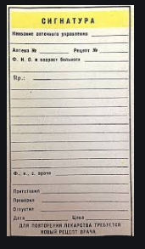
Extemporaneous medications dispensing
"Signature" is issued to patients instead of a prescription for extemporaneous
medications which contain poisons, narcotic (psychotropic) drugs
Precursors dispensing
Potassium Permanganate is dispensed without prescription only packaged in 3-5 gr for one time (in pharmacy with license). Dispensing other precursors is forbidden

Slide 19
Prescription Validity Term
F-1 – 1 month
F-3 – 10 days
E-prescription – the same

Slide 20
Prescriptions stored in pharmacy
F-3 - must be stored for 5 years expect the current year
F-1 (prescription drugs which are paid free/part charge) - must be stored for 3 years expect the current year
F-1 controlled drugs (combined narcotic, psychotropic, poisons, potent drugs) – prescriptions must be stored for 1 year expect the current year

Slide 21
Sources of receiving prescription form
F-1 – through municipal healthcare authorities
F-3 – through municipal healthcare authorities or pharmacy (chemist) warehouse (stock storage, pharmacy bases)
Storage of prescription forms in pharmacies
F-1 – in cabinets
F-3 – in locked cabinets and safes

Slide 22
Thank you
for your attention

