Slide 1

Principles
of clinico-pharmaceutical
approach to the selection of drugs
for the treatment of diseases
of blood system

Slide 2
Two forms of pathology of the erythrocyte system:
Anemia
Erythrocytosis
Anemia is a clinical-haematological syndrome characterized by ↓ count of erythrocytes
(N male 5.5 ± 0.9 · 1012 / L, women 4.8 ± 0.6 · 1012 / L) and / or hemoglobin concentration (N male 160 ± 20 g / L, female 140 ± 20 g / L) in units volume of blood.
The main pathophysiological essence of anemia is
↓ oxygen capacity of the blood, leading to a hemic type hypoxia.
With hypoxia, the main clinical symptoms and disorders of vital activity in patients with anemia are associated.
Poikilocytosis is a condition in which erythrocytes of unusual form occur.
Anisocytosis - a difference in the magnitude of cells in one tissue or cell population due to a violation of the function of bone marrow.

Slide 3
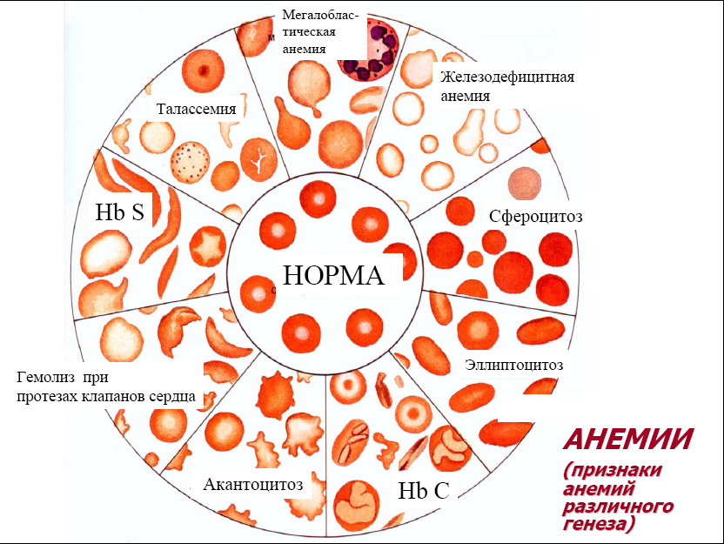

Slide 4
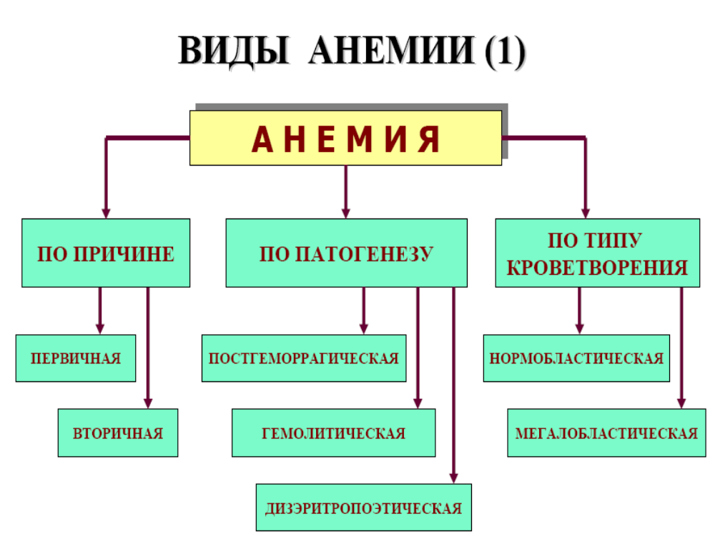

Slide 5
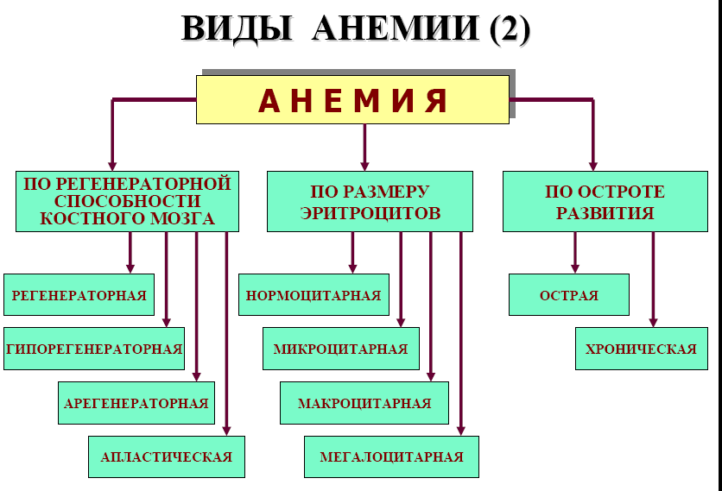

Slide 6
TYPES OF ANEMIA (3)
According to the color index
Normochromic (0.8-1.0)
Hyperchromic (>1,0)
Hypochromic (<0.8)
According to the concentration of HB, the degree of anemia:
80-100 g / l easy
60-80 g / l average
<60 g / l heavy

Slide 7
Posthemorrhagic anemia (PHA) is a chronic, acute
Chronic PHA.
Causes: repeated bleeding from the internal organs.
It is a private option for iron deficiency anemia.
Hematologic syndrome: hyporegenerative, hypochromic, microcytic.
Acute PHA.
Develop as a result of massive blood loss (external trauma, bleeding from the internal organs).
Leading pathogenetic link: ↓ volume blood circulation → hypoxia → violation of acid-equilibrium balance, imbalance of ions.

Slide 8
Severity of anemia from the degree of hemorrhage
With a loss of 15-25% of volume blood circulation, mild posthemorrhagic anemia develops (for children, a higher sensitivity to blood loss is characteristic);
The moderate severity of blood loss is -25-35%;
Severe form of anemia develops with blood loss of 35-50% of the blood volume;
More than 50% of blood loss - is lethal.

Slide 9
Phases of acute PHA
Reflex compensation phase. The picture of the blood does not differ from the norm (normocytemic hypovolemia). Ht, E, Hb is the norm. "Hidden anemia" is normochromic, normocytic.
Clinical manifestations are characteristic for collapse: ↓ AP, pallor, tachycardia, tachypnea.
Hydromic phase (consequence of stimulation of volumoreceptors) ► polydipsia ► ↑ fluid from outside, tissue fluid passes into vessels, vasospasm of the kidneys, ↓ diuresis, activation of RAAS, Na and water retarded). Emission of Er. from the depot. After the recovery of bcc, hematologic symptoms appear. Erythrocytes of blood and discarded from the depot contain a normal amount of hemoglobin (normochromic anemia). Hypoxia stimulates erythropoietin release by kidneys ↑ erythropoiesis.
The phase of bone marrow compensation. In the blood of reticulocytes up to 30-40% (hyperregenerative anemia). CP <0.85 (hypochromic anemia), the rate of Hb synthesis lags behind the rate of cell proliferation. In the bone marrow - signs of intensification of erythropoiesis - ↑ clinic of erythroblasts and reticulocytes. Lasts up to 14 days.

Slide 10
Hemolytic anemia
↓ average the lifespan of erythrocytes as a result of the predominance of the hemolysis process over their production.
The reasons for acquired of hemolytic anemias are:
factors of a physical nature. Artificial heart valves, multiple vascular prostheses, "marching" hemoglobinuria, with thrombus formation in small vessels (the erythrocyte membrane is compressed or "cut" by fibrin strands), etc .;
chemical factors are "hemolytic poisons". Compounds of lead, zinc, phosphorus, nitrobenzene, sulfonamides, phenacetin;
biological - fungal, snake, bee venom, exo-and endotoxins of bacteria, products of parasite metabolism (malarial plasmodium), autoantibodies to erythrocytes (the largest proportion among the causes of acquired of hemolytic anemias).

Slide 11
Повреждающий фактор
Повреждающий фактор
Повреждающий фактор
Повреждающий фактор
Повреждающий фактор
Повреждающий фактор
Повреждающий фактор
Повреждающий фактор
Повреждающий фактор
Повреждающий фактор
Damage factor
↑ проницаемости мембран эритроидных клеток
↑ проницаемости мембран эритроидных клеток
↑ проницаемости мембран эритроидных клеток
↑ проницаемости мембран эритроидных клеток
↑ проницаемости мембран эритроидных клеток
↑ проницаемости мембран эритроидных клеток
↑ проницаемости мембран эритроидных клеток
↑ проницаемости мембран эритроидных клеток
↑ проницаемости мембран эритроидных клеток
↑ проницаемости мембран эритроидных клеток
↑ permeability of erythroid cell membranes
Loss of K +, phosphates, enzymes, etc .; Excess Na +, Ca2 +
Утрата К⁺, фосфатов, ферментов и др.; Избыток Na⁺, Са²⁺
Утрата К⁺, фосфатов, ферментов и др.; Избыток Na⁺, Са²⁺
Утрата К⁺, фосфатов, ферментов и др.; Избыток Na⁺, Са²⁺
Утрата К⁺, фосфатов, ферментов и др.; Избыток Na⁺, Са²⁺
Утрата К⁺, фосфатов, ферментов и др.; Избыток Na⁺, Са²⁺
Утрата К⁺, фосфатов, ферментов и др.; Избыток Na⁺, Са²⁺
Утрата К⁺, фосфатов, ферментов и др.; Избыток Na⁺, Са²⁺
Утрата К⁺, фосфатов, ферментов и др.; Избыток Na⁺, Са²⁺
Гиперосмия цитозоля
Гиперосмия цитозоля
Гиперосмия цитозоля
Гиперосмия цитозоля
Гиперосмия цитозоля
Гиперосмия цитозоля
Hyperosmia of the cytosol
Гипергидратация и набухание эритр. клеток
Гипергидратация и набухание эритр. клеток
Hyperhydration and swelling of erythroid cells
Гипергидратация и набухание эритр. клеток
Гипергидратация и набухание эритр. клеток
HEMOLYSIS

Slide 12
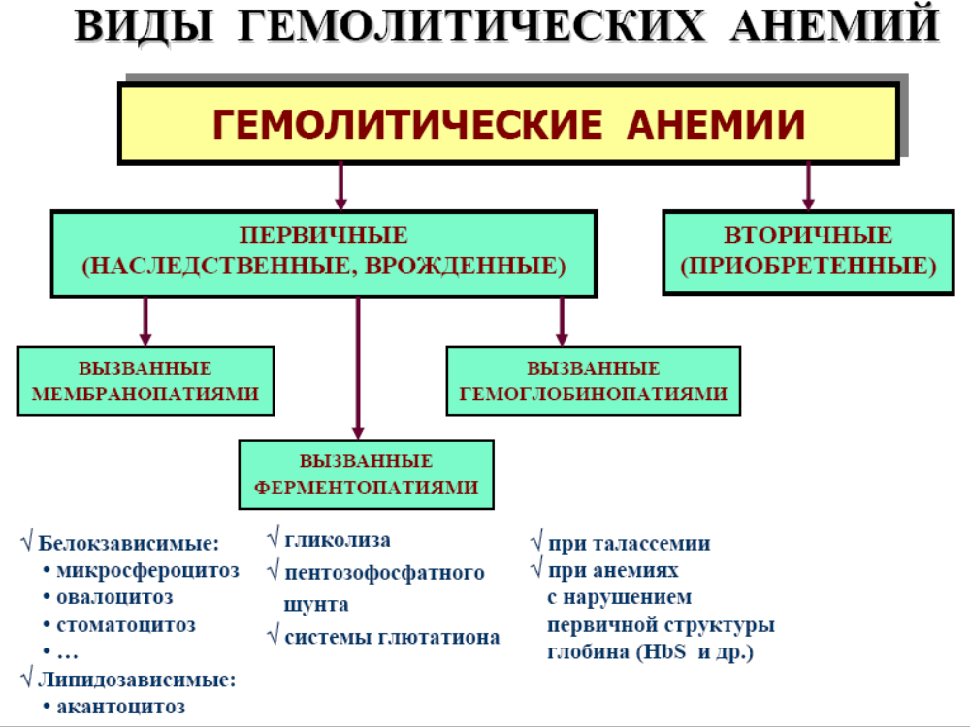

Slide 13
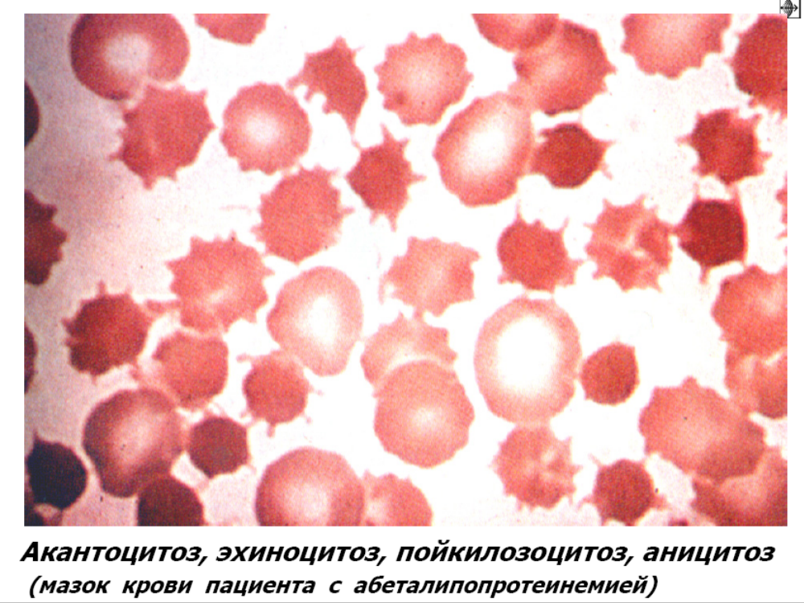

Slide 14
Membranopathy (erythrocytopathy)
Pathogenesis - congenital defects of the cell membrane. The synthesis of proteins (spectrin, ankerin, etc.)
Family hereditary microspherocytosis
(Minkowski-Schoffar disease).
It is inherited autosomal dominantly. Membranopathy is caused by a significant ↓ protein content of the spectrin, a violation of its binding to other membrane proteins. The structure of the spectrin itself in microspherocytosis is changed. All this causes ↑ the permeability of the erythrocyte membrane for Na +, Ca2 + ions and the accumulation of their excess, as well as fluid in the hyaloplasm. Hyperhydrated erythrocytes take on a spherical shape. This ↓ plasticity of erythrocyte membranes, their ability to deform in microvessels. Passing through the splenic sinuses, they can not deform, lose part of the surface and turn into small-sized spherocytes, drastically ↓ their life span (up to 6-8 days).
Characterized by a long latent course often with a single symptom of jaundice with microspherocytosis. Provoke an exacerbation of hypothermia, overwork, infection. In the acute period, splenomegaly and jaundice with urobilirubinemia and urobilinuria, as well as ↑ t °. Often there are trophic ulcers (a consequence of microthrombi in hemolysis).

Slide 15
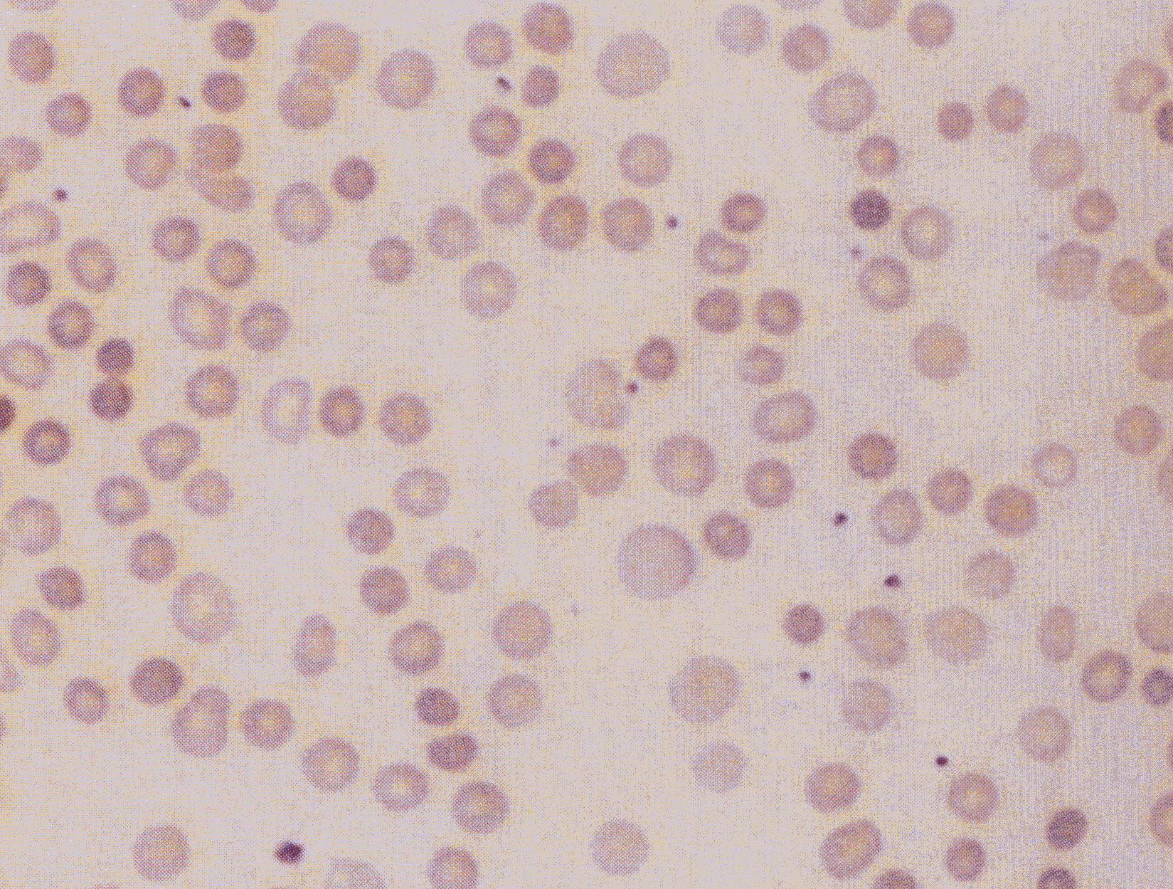
Hereditary spherocytosis

Slide 16
Hemoglobinopathies
Sickle-cell anemia.
Pathogenesis is a genetic defect in the structural gene ⇒ the structure of β-chains of globin is broken in connection with the replacement of one amino acid (more often glutamine) with another (valine).
The formation of sickle-shaped cells is based on the property of HbS to polymerize upon transition to the reduced form. The resulting polymers (long strands) are grouped into tactoids, they change the shape and appearance of red blood cells. The polymerization of reduced HbS is related to its low solubility (100 times the solubility of HbA). The formation of tactoids depends on the concentration of HbS in the erythrocyte and the partial pressure of oxygen in the blood.
↓ HB up to 30-50 g / l, reticulocytosis, ↑ content of iron in serum, hypochromia.

Slide 17
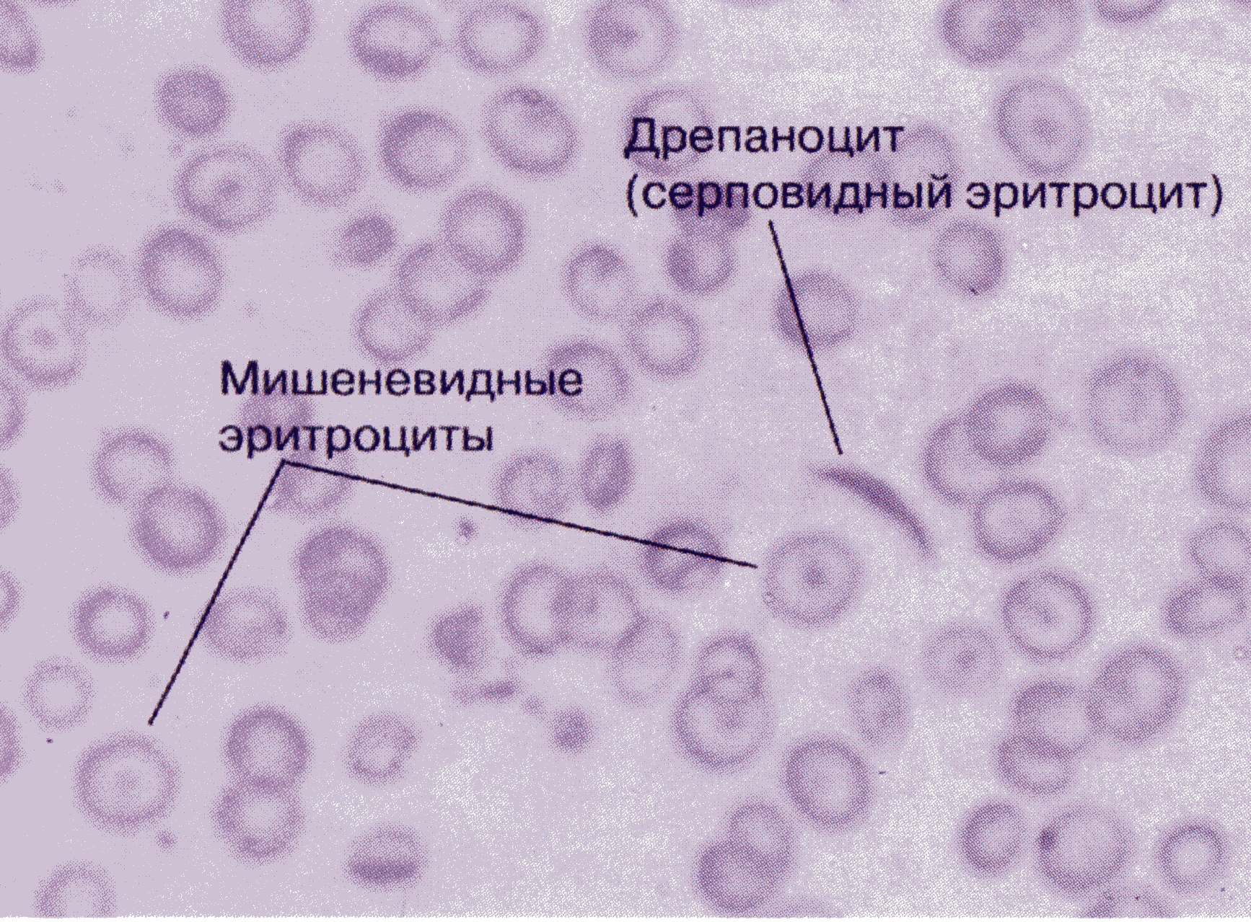
Sickle-cell anemia

Slide 18
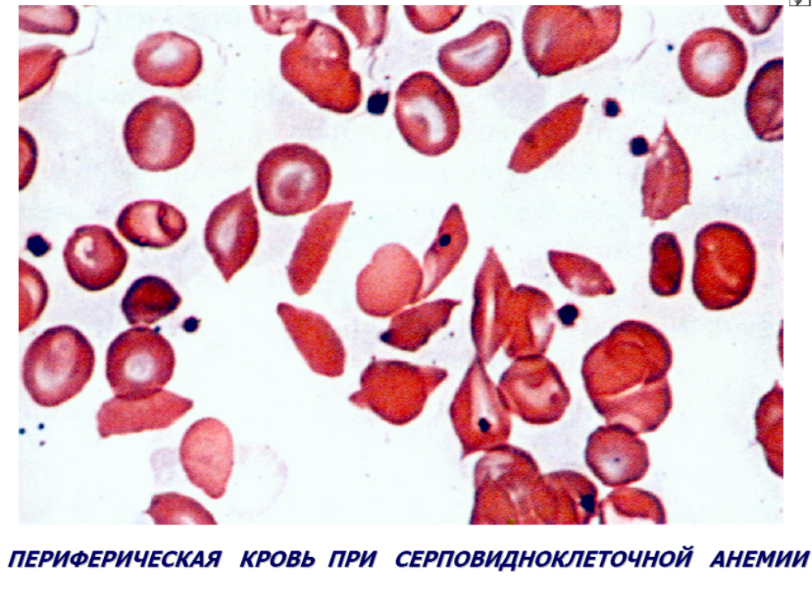

Slide 19
Thalassemia (Cooley-Cooley's disease)
Thalassemia (Greek talasia - sea) ⇒ Hb deficiency without qualitative disorders of its globin chains.
Pathology of regulatory genes ⇒ There is no norm in embryogenesis. switching of synthesis of globin chains, an abnormal Hb at the expense of HbA synthesis.
Two groups: α-thalassemia and β-thalassemia.
With α-thalassemia, a partial or complete deletion of α-globin gene regulators → ↓ synthesis of these chains. Their lack of comps in embryos. period by excess synthesis of α-glob. chains (HB Bart's). After birth, the deficiency of α-globin chains is compensated by the synthesis of β-globin chains (HbH). (HbBart's and HbH are the markers of α-thalassemia).
The clinical manifestation of α-thalassemia is hypoxia due to the high affinity of HbBart's and HbH to O2. Anemia is aggravated by ↑ destruction of red blood cells in the spleen.

Slide 20
β-thalassemia.
Β0 β + thalassemia.
Pathogenesis:
2 mechanisms: -He synthesized less, hypochromia.
- ↓ life of erythrocytes due to unbalanced synthesis of chains HB.
Outcome: inefficiency of erythropoiesis.

Slide 21
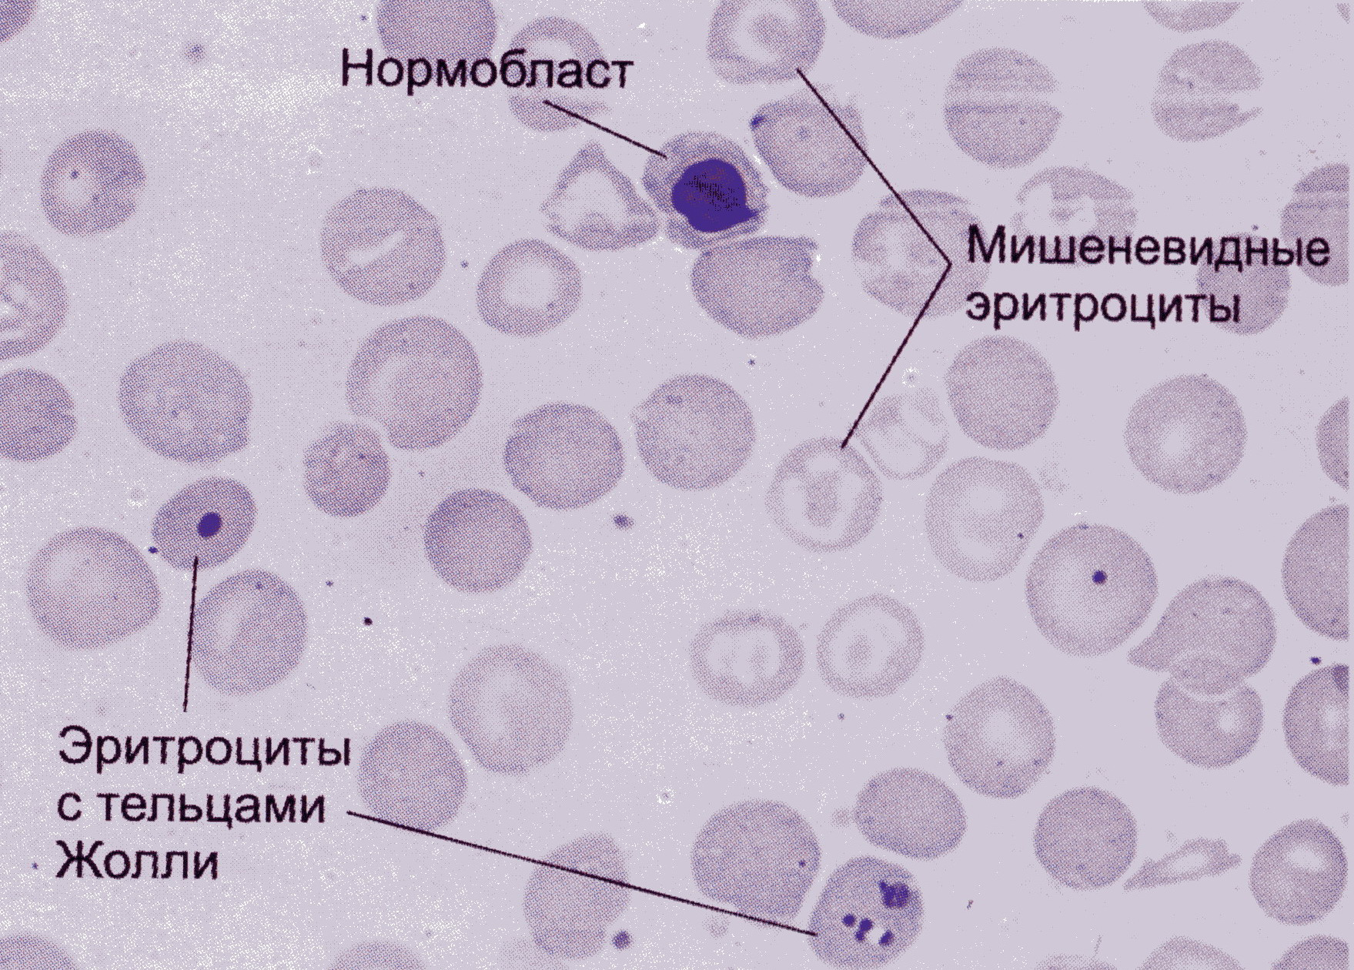
Thalassemia.

Slide 22
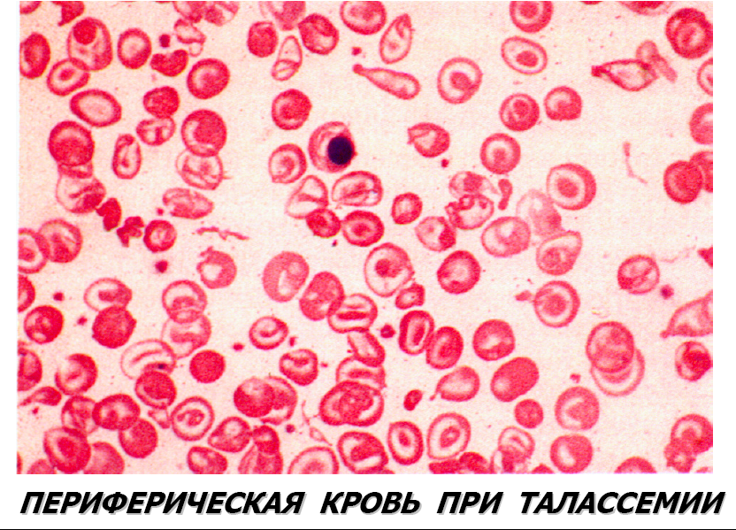

Slide 23
Enzymopathy
The most common defects are:
defects in the activity of glycolysis enzymes: pyruvate kinase, hexokinase, phosphofructokinase, etc. In erythrocytes the leading way of resynthesis of ATP is glycolysis. →→ lack of ATP energy causes a violation of transmembrane ion transport. Develop their imbalance ► hyperhydration and swelling of erythrocytes;
↓ activity of the enzymes of the pentose phosphate cycle. In the course of its implementation, a reduced form of NADPH, used to reduce glutathione, is formed. Recovered glutathione - a component of the antioxidant system of erythrocyte »with such enzymes there is destruction of lipoprotein complexes of membranes;
deficiency of glutathione system enzymes (glutathione synthetase, glutathione reductase, etc.).
Consequences: activation of lipo-peroxide reactions in erythrocytes, violation of the integrity of their membranes.
Example: hemolytic anemia associated with insufficiency in erythrocytes G-6-FD. Hemolysis is provoked by taking medications (sulfonamides, antipyretics, analgesics, etc.). At ↓ G-6-PD, erythrocytes quickly lose the minimum of the available reduced glutathione and rapidly age
Anemia: normochromic, normocytic, regenerative.

Slide 24
Acquired hemolytic anemia
Genesis is different. Anemia of this group combines intravascular hemolysis.
On the mechanism of destruction of erythrocytes: immune and non-immune.
Immune.
Caused by thermal (IgG) antibodies.
Caused by cold (IgM) antibodies.
Anemia with cold (IgG) hemolysins.
Anemia of non-immune origin.
Reason: infectious diseases, malaria, snake bites, burn disease, etc.
-------------------------------------------------- --------------------------------------
The picture of blood in hemolitic anemia: erythropenia, polychromatophilia, poikilocytosis, reticulocytosis, ↑ indirect bilirubin.
In bone marrow: ↑ cells of the erythroid germ.

Slide 25
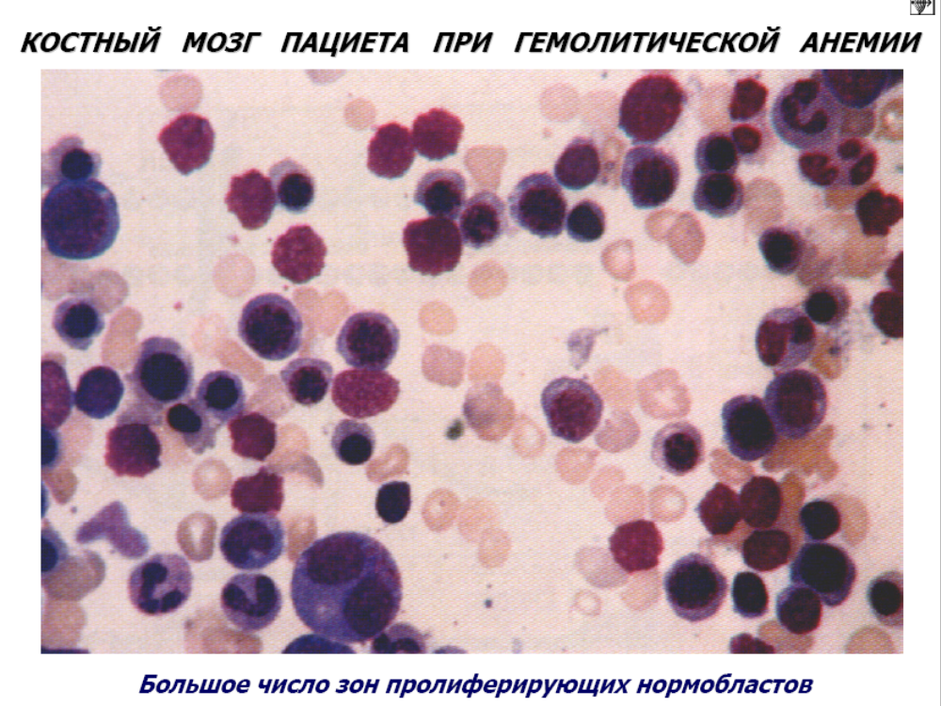

Slide 26
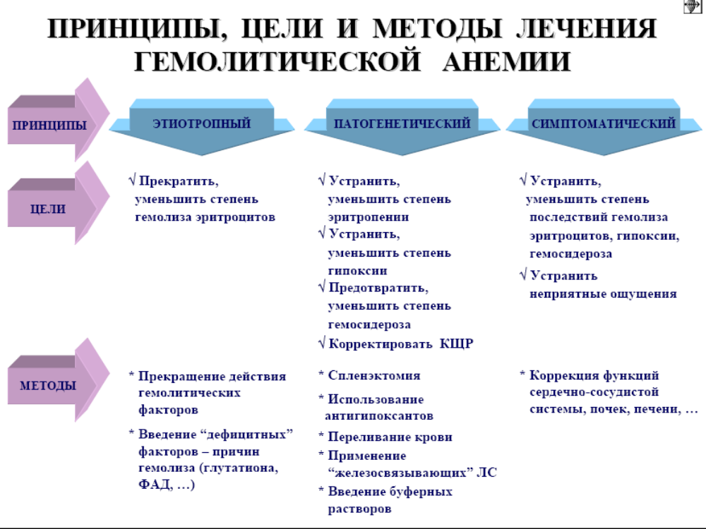

Slide 27
DYEREROTROPOEPTIC ANEMIA
1. Due to the violation of erythropoiesis due to the predominant damage to stem cells: hypo- and aplastic anemia.
2. Due to the violation of erythropoiesis in connection with the predominant damage of precursor cells of myelopoiesis and / or erythropoietin-sensitive cells:
due to a violation of the synthesis of nucleic acids of erythroplasmocytes (megaloblastic): vitamin B12 - (folic) deficiency anemia; folic deficiency anemia.
as a result of a violation of heme synthesis: iron deficiency anemia; porphyrin-deficient;
due to a violation of globin synthesis: thalassemia; with the primary structure of globin chains (sickle cell).
If the regulation of division and maturation of erythroid cells is disturbed.

Slide 28
Hypo- aplastic anemia
Are syndromes of other pathological processes.
By origin:
Acquired (secondary) under the action of agents of physical, chemical, biological nature.
Pathogenesis - a violation of proliferation and / or death of stem hemopoietic cells → anemia.
Manifestations - hypoxia, bleeding and hemorrhage (due to ↓ blood clotting), infection.
Inherited (primary).
Anemia Fanconi. (Autosomal recessive).
Pathogenesis is the process of repair of stem cell DNA, ↑ mutability. As a whole it is not clear, presumably – immunological supression, or anomalies of stem cells.
Manifestations: hypoxia, thrombocytopenia, leukopenia (infection).

Slide 29
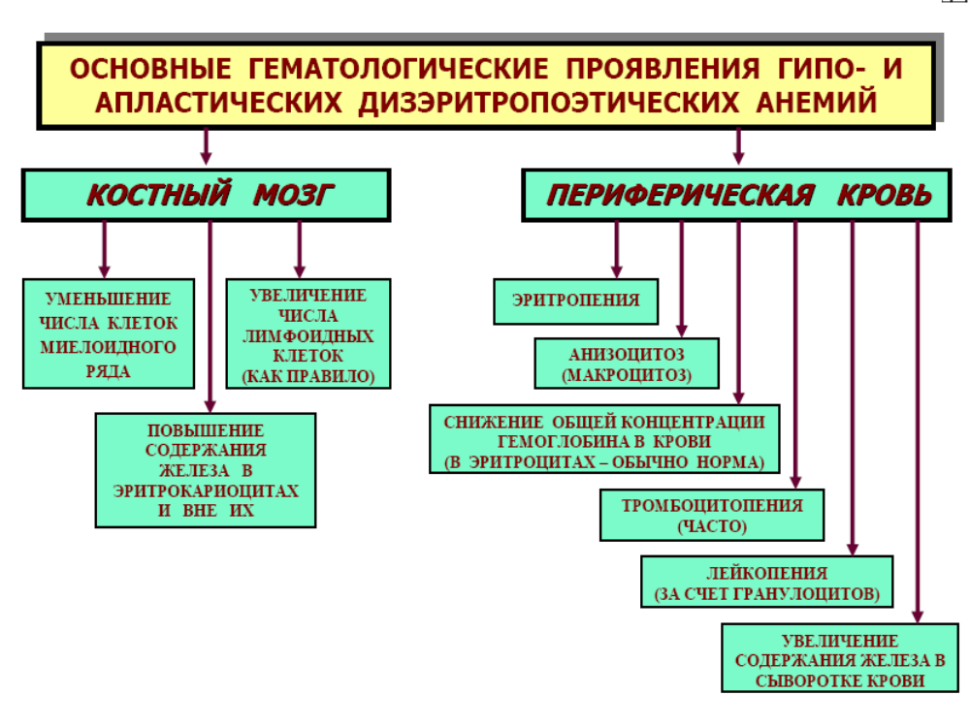

Slide 30
Anemia caused by impaired erythropoiesis due to the predominant damage to myelopoiesis precursor cells and / or erythropoietin-sensitive cells.
B12 - (folic) deficiency anemia and folic-deficient anemia (megaloblastic).
Deficiency of B12 and folic acid. The synthesis of DNA is broken. B12 (cobalamin) and folates - coenzymes in the process of DNA synthesis. Their lack → a defect in the maturation of the nucleus, a violation of the fission process. Asynchronous maturation of cytoplasm and nucleus. Abnormality of hematopoiesis.
For the absorption of B12, the Castle factor is required.
Two forms of B12:
methylcobalamin (with its help, the folic acid is converted to tetrahydrofolic, in its absence, it is not preceded by the precursor. DNA, the process terminates, the inhibition is called "methylphosphate trap").
adenosine cobalamin - deficiency leads to accumulation of methyl malonate and propionate → excess of abnormal fatty acids in lipids of nerve structures → neurological symptoms.

Slide 31
Clinical triad with B12 deficiency:
- Megaloblastic anemia;
- Glossitis Hunter;
- Funicular myelosis.
Pathogenesis of B12 - (folic) deficiency anemia:
Addison-Birmer anemia.
Autoimmune disease. Cytotoxic type of lesion of the gastric mucosa with loss of parietal cells of its fundus. Antibodies of 3 types: type I - blocking (block binding B12 with factor Kastla), type II - disruption of binding of the complex to the receptor, type III - against microvilli of parietal cells.
Manifestations of megaloblastic anemia:
Common for B12 (folic) and anemia in folate deficiency: associated with a violation of DNA synthesis (changes in the bone marrow, blood, GIT).
Differences: folate insufficiency is not associated with loss of adenosine-cobalamin function in the synthesis of fatty acids and disorders in the peripheral and central nervous system.

Slide 32
Manifestations of megaloblastic anemia:
In the bone marrow there are megaloblasts (d> 15 mm) "blue" bone marrow, as well as megalocaryocytes. The differentiation of other cells of the myeloid series is also disturbed.
In peripheral blood, ↓ is a significant number of red blood cells, sometimes up to 0.7-0.8 × 10¹² / l. They are larger, oval in shape, without central enlightenment. There are megaloblasts. In erythrocytes - the remains of nuclear matter (Jolly's body) and nucleolemmas (Kebot's rings). Characteristic anisocytosis and poikilocytosis. Color indexis = 1,1-1,3. Hb in the blood significantly ↓ (due to the ↓ number of red blood cells). The number of reticulocytes is more often ↓, as a rule, leukopenia (due to neutrophils) is observed. In connection with ↑ hemolysis - bilirubinemia.
Megaloblastic anemia is characterized as hyperchromic, macro-megalocitic, hypo- aregenerative.

Slide 33
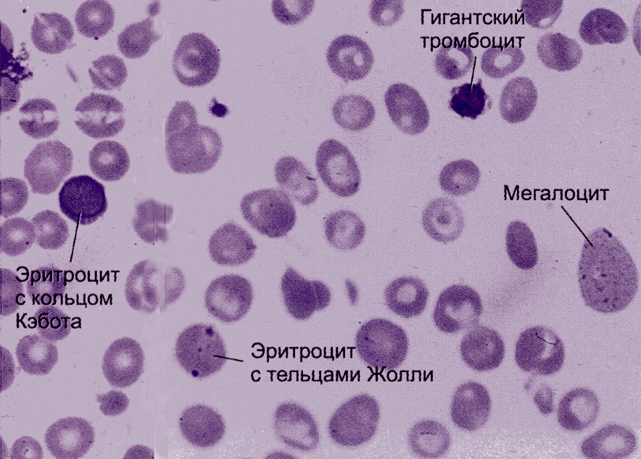
B12-deficiency anemia

Slide 34
Виды дизэритропоэтических анемий
в рез-те нар-ия синтеза гема
Виды дизэритропоэтических анемий
в рез-те нар-ия синтеза гема
Виды дизэритропоэтических анемий
в рез-те нар-ия синтеза гема
Виды дизэритропоэтических анемий
в рез-те нар-ия синтеза гема
Виды дизэритропоэтических анемий
в рез-те нар-ия синтеза гема
Виды дизэритропоэтических анемий
в рез-те нар-ия синтеза гема
Types of dyseritropoietic anemia
as a result of impaired heme synthesis
Железодефицитные
Железодефицитные
Железодефицитные
Железодефицитные
Железодефицитные
Железодефицитные
Iron deficiency
Порфириндефицитные
Порфириндефицитные
Порфириндефицитные
Porphyrin-deficient

Slide 35
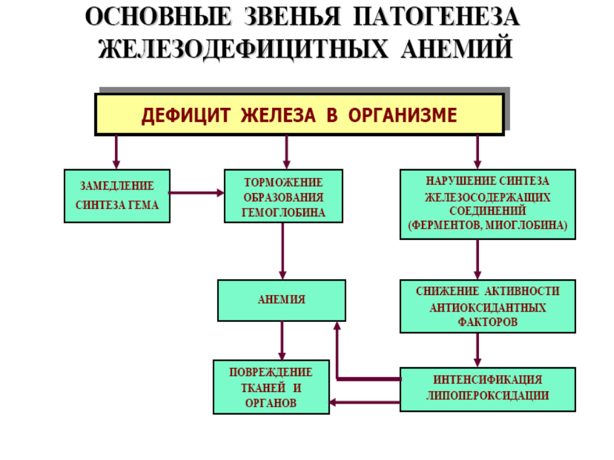

Slide 36
Iron deficiency anemia
¾ of all anemia. Maximum - pregnant and nursing mothers.
The body's iron is a functional (in HB) and a storage pool (hemosiderin and ferritin). Ferritin is a complex of iron with protein (in many tissues, many in macrophages). Part of ferritin in macrophages degrades with the formation of hemosiderin (granules).
Indicator of deficiency or excess iron - serum ferritin.
The main cause of IDA is chronic hemorrhage.
Stages of iron deficiency:
Hidden deficit.
Latent deficiency.
Constant deficit.
Expressed deficiency.

Slide 37
Manifestations of IDA:
Bone marrow: ↑ erythropoiesis, the disappearance of iron from macrophages and ↓ index of CM sideroblasts.
Peripheral blood: microcytomas, hypochromia, anulocytes (HB is located in the form of a ring on the periphery), poikilocytosis.
Changes in organs and tissues: glossitis, cracks in the corners of the lips, edema, perversion of taste, fragility of nails.

Slide 38
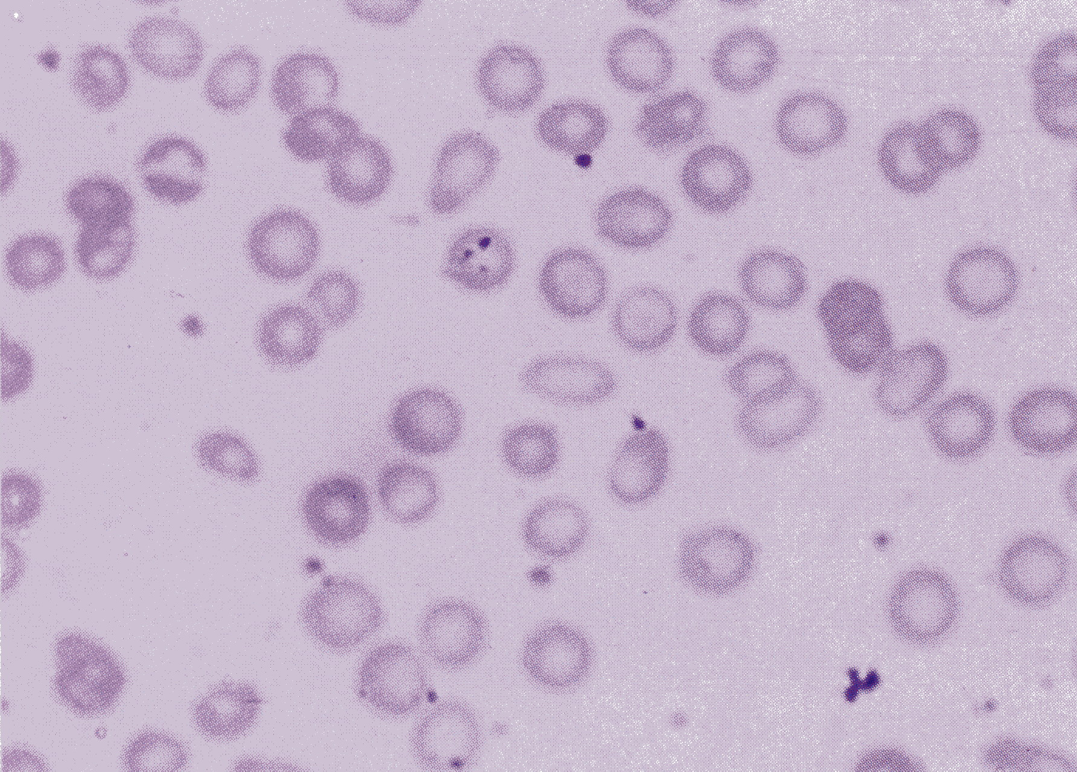
Iron-deficiency anemia
(Hypochromia of erythrocytes, microcytosis)

Slide 39
Children are sick by IDA before the year. The erythron kinetics differs in its intensity (the processes of natural loss of erythrocytes are not replenished by their formation). Erythropoietic stimulation of the bone marrow is imperfect, especially in prematurity. There is a physiological anemia of children of the first year of life. After the first year passive natural immunity weakens, which leads to infection → ↓ level of transferrin, the accumulation of iron in macrophages (hemosiderin).

Slide 40
In the heme molecule, iron is bound to protoporphyrin. Porphyrins are synthesized most of all in erythrocaryocytes and liver. Porphyrins are part of peroxidases, cytochromes, Hb, myoglobin.
Железорефрактерные анемии
Первичные
Вторичные
(приобретенные)

Slide 41
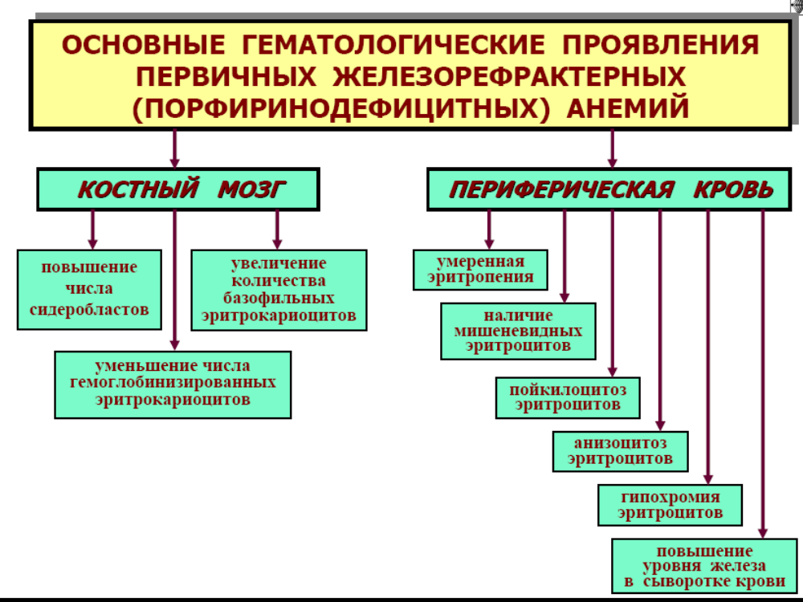

Slide 42
Principles and methods of therapy for deficiency anemia
elimination of the cause of the violation of the division of erythrocytes (cessation of damaging factors, introduction of scarce factors (substitutional treatment));
elimination of hypoxia;
prevention of hemosiderosis;
correction of acid-base balance;
elimination of the effects of hypoxia.

Slide 43
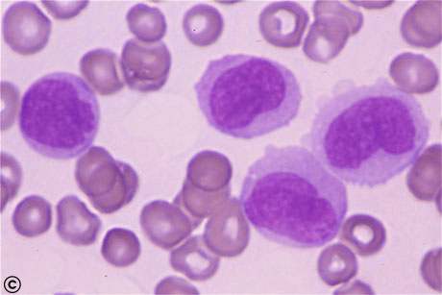
Pathology of white blood
Leukopenia
Leukocytosis, leukemoid reactions
Leukemia

Slide 44
Leukopenia - a decrease in the content of leukocytes in the peripheral blood below 4 * 10 / l.
Classification of leukopenia:
Physiological leukopenia (constitutional - 2-12% of practically healthy individuals of the Caucasoid race, more than 80% of Negroids).
does not reduce the adaptive capacity of individuals, there are no manifestations of immunodeficiency.
Pathological leukopenia is diverse in etiology, pathogenesis and occurs with different syndromes and diseases.

Slide 45
Classification of leukopenia
Redistribution leukopenia is a consequence of redistribution of leukocytes of circulating and parietal pools (enhanced emergency marginalization of leukocytes under stress, shock).
True leukopenia occur with an absolute decrease in the number of leukocytes in the body as a result of a significant and long prevalence of the death rate of leukocytes over the rate of their release into the blood (with bone marrow hypoplasia, radiation damage, vitamin B12 deficiency)

Slide 46
Classification of leukopenia
Neutropenia
Lymphopenia
Monocytopenia
Eosinopenia
Hereditary
Acquired

Slide 47
Mechanisms of development of leukopenia:
suppression of leukopoiesis in the bone marrow - proliferation and differentiation of myeloid germ cells (factors: drugs (salicylates, sulfonamides, antibiotics), radiation, cold, benzene, arsenic, deficiency of vitamin B12 and folic acid, iron, hereditary defects).
increased destruction of leukocytes in the vascular blood - under the influence of antibodies (blood transfusion, drug allergy, systemic lupus erythematosus), toxins - in the spleen, liver.
redistribution in the vascular blood, deposition - shock, collapse, neurosis, severe muscular work.
increased loss of leukocytes - with acute blood loss, loss of plasma.

Slide 48
Hereditary neutropenia
Kostmann's syndrome - is associated with an autosomal recessive mutation, which determines the insensitivity of promyelocytes to the further action of CSF.
hypoplasia of myeloid bone marrow elements, lack of myelocytes and more mature neutrophils;
microcephaly, retardation of psycho-motor development and short stature (may be both a manifestation of the primary systemic defect, and the consequences of severe purulent infections occurring in such patients at an early age);
the disease belongs to preleukemic and increases the risk of myeloid leukemia.

Slide 49
Hereditary neutropenia
Congenital cyclic neutropenia is inherited autosomal dominantly. Manifestations of neutropenia occur periodically, every 3-5 weeks. There is a cyclic fluctuation in the number of other leukocytes, blood platelets and reticulocytes. Pathogenesis is associated with a decreased sensitivity of progenitor cells to CSF, which necessitates the "accumulation" of a growth stimulus.
Symptoms are typical for the clinic consequences of agranulocytosis.

Slide 50
Hereditary neutropenia
Benign ethnic family neutropenia. It occurs in natives of the Near and Middle East (family neutropenia of Glassen). In Negroids, this autosomal dominant feature can be considered racial and inherent in most healthy individuals. It does not reduce anti-infectious immunity.
Syndrome Shvakhman-Diamond-Oskie. Pancytopenia is combined with pancreatic insufficiency, the syndrome is autosomal recessive and is preleukemic.

Slide 51
Acquired neutropenia
Infectious agents:
- viral (infectious mononucleosis, viral hepatitis, HIV infection, rubella, chicken pox, influenza, ARVI).
-particular bacterial infections: pertussis, salmonellosis, typhoid fever.
-ricksiosis, some protozoonoses (leishmaniasis).
Neutropenia depletion - develops in severe and generalized flow of certain bacterial infections (staphylococcal, tubercular, meningococcal) occurs again, after prolonged neutrophilia due to the depletion of the reserve pool of bone marrow.

Slide 52
Acquired neutropenia
Auto-allergy to neutrophilic antigens - with systemic lupus erythematosus, rheumatoid arthritis, Shenlein-Henoch disease and others.
Isoimmune conflict between mother and fetus in antigens. Isoimmune neutropenia is a disease fundamentally analogous to the hemolytic disease of the newborn, but occurs when there is a mismatch in the granulocyte antigens of the fetus and the mother. The mother gives antibodies against the paternal antigens of the fetus, which forced the placental barrier. The incidence of the disease among live births is 0.2%, in severe cases it contributes to the development of neonatal sepsis, and is usually stopped within 2-3 weeks.

Slide 53
Acquired neutropenia
Toxic neutrophilic lesion
Drug neutropenia often affects middle-aged and elderly patients who are constantly taking certain medications (mercazolil, aminoglycoside, macrolide antibiotics, sulfonamides (biseptol), novocainamide, pyrozolones (amidopyrine) and a number of other nonsteroidal anti-inflammatory drugs, phenothiazines (aminazine), preparations of digitalis).

Slide 54
Agranulocytosis
Agranulocytosis is called deep selective or nonselective neutropenia, most often in the absence of eosinophils and basophils.
Regardless of the origin, with severe acute pathological neutropenia, the same symptom complex is manifested, associated with a decrease in resistance to bacterial and fungal infections: sore throat, up to severe angina, fever, mucositis - that is, signs of inflammation of the mucous membranes of the mouth, nose , oropharynx, nasopharynx, sometimes - the eye, genitals. With prolonged neutropenia, pyoderma and superficial mycosis are possible.

Slide 55
Mechanisms of agranulocytosis
Immune - drug allergic reaction type 2 (cytolysis): sulfonamides, antibiotics, analgin, preparations of gold, bismuth; autoimmune damage of neutrophils in systemic lupus erythematosus, rheumatoid arthritis.
Myelotoxic - oppression of proliferation of granulocytes in the bone marrow - myelotoxic effect of cytostatics, ionizing radiation.

Slide 56
Other types of leukopenia
Eosinopenia - with stress, increased levels of glucocorticoids (Isenko-Cushing's disease)
Lymphopenia - a decrease in the synthesis of lymphocytes with thymic hypoplasia, protein deficiency in the body (starvation), the use of immunosuppressants, glucocorticoid drugs, hereditary immunodeficiencies, AIDS, stress, hypercortisy.

Slide 57
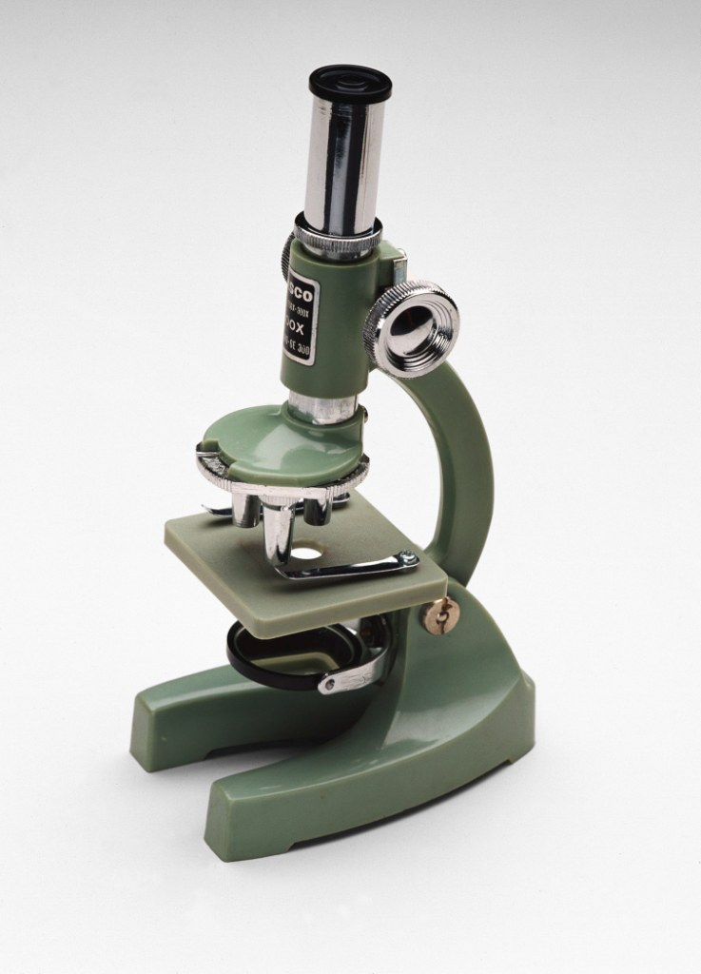
Leukocytosis
an increase in the total number of leukocytes in the peripheral blood above 9 * 10 cells / liter

Slide 58
Physiological leukocytosis
Myogenic (after exercise)
Psychogenic, emotional
Acclimatization
Digestive (2-3 hours after eating)
Have redistributive
character, are neutrophilic and proceed without sudden shifts of the leukocyte formula.
In healthy newborns, in pregnant women, after childbirth.
They have a mixed mechanism: stress regulation of redistribution of leukocytes and true stimulation of leukopoiesis.

Slide 59
Pathological leukocytosis
Reactive - under the influence of cytokines, stimulating leukopoiesis or redistribution of leukocytes:
- infectious-inflammatory (especially in purulent processes);
- aseptic inflammation - allergy, necrosis (myocardium infarction), burn;
- toxic (with chronic renal failure, poisoning with nitrobenzene, aniline, etc.);
- centrogenic (shock, epilepsy).
Neoplastic is leukemia.

Slide 60
Mechanisms of leukocytosis development
Enhancement of normal leukopoiesis (inflammation)
Redistribution of leukocytes in the vascular bed (eating, exercise, stress)
Enhancement of tumor leukopoiesis
Blood thickening

Slide 61
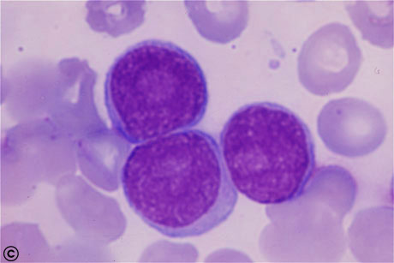
Lymphocytosis
Acute viral infections: chicken pox, rubella, measles;
Chronic bacterial infections: tuberculosis, syphilis, brucellosis;
Acute lymphoblastic leukemia, chronic lymphoblastic leukemia.

Slide 62
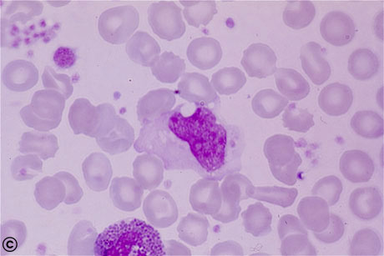
Monocytosis
Infectious mononucleosis
Rubella
Active tuberculosis
After splenectomy
Acute monocytic leukemia

Slide 63
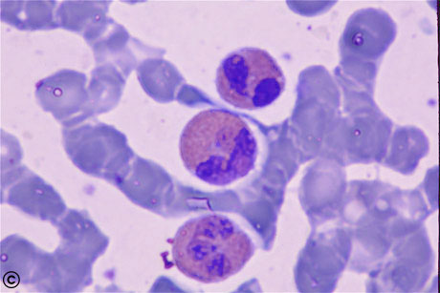
Eosinophilia -an increase in the number of eosinophils in the blood, occurring in response to some allergens, drugs, and parasites, and in some types of leukemia.
Allergic reactions
Glistular invasion
Taking medications (aspirin, sulfanilamides)
Chronic leukemia

Slide 64
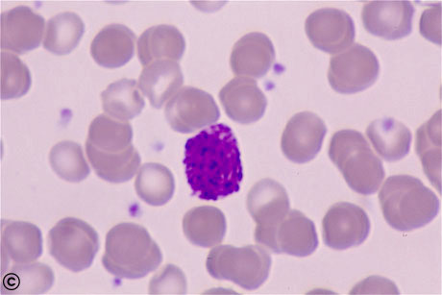
Basophilia - a condition of the blood marked by the formation and accumulation of an excess of basophil cells.
Myxedema
Chronic myeloblastic leukemia

Slide 65
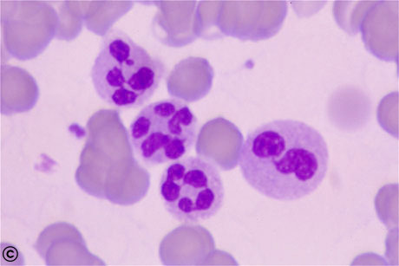
Neutrophilic leukocytosis
Acute infectious diseases (pyoinflammatory)
With myocardial infarction
After acute blood loss
Intoxication

Slide 66
Shifts of the neutrophilic formula
Bone
marrow
Myeloblasts
Promyelocytes
Myelocytes
metamyelocyte
Blood stick-nuclear
segment-nuclear

Slide 67
SHIFT LEFT
The increase in peripheral blood of immature forms of the neutrophil series (cell rejuvenation)
SHIFT RIGHT
Increase in peripheral blood of mature segment neutrophils

Slide 68
Shift left
1.Hyporegenerative (simple): an increase in stab-shaped forms - the initial stages of purulent infection, non-severe forms;
2.Regenerative: increased stab and metamyelocytes;
3.Hyperregenerative: increased stab and metamyelocytes, the appearance of myelocytes - a severe course of purulent-inflammatory diseases;
4.Leukemoid: the appearance in the blood of promyelocytes and myeloblasts - leukemia, leukemoid reactions;

Slide 69
Shift left
5.Regenerative-degenerative: increased stab, metamyelocytes, myelocytes, reduced segmented nuclear, degenerative changes in neutrophils - excessive stimulation of myelopoiesis with depletion of resources;
6.Degenerative: leukocytes at the lower limit of normal or decreased, segmented, degenerative changes in neutrophils are sharply reduced - supralental stimulation --- oppression of myelopoiesis

Slide 70
Shift Right
Increase in the blood of segmented neutrophils, degenerative changes in neutrophils - in the suppression of myelopoiesis, aplastic states.
Degenerative forms of leukocytes
Toxic granularity - in the cytoplasm and nuclei large grains of blue color - reflects the incomplete lysis of the pathogen;
Amato grains are oval blue formations in the cytoplasm with red inclusions - with scarlet fever;
Vacuolization of the cytoplasm ("shot through" leukocytes) - fatty degeneration, reflects a deep energy deficit, the onset of necrobiosis;
Pycnosis of nuclei

Slide 71
Types of leukocytosis
Neutrophilic-eosinopenic-an increase in the number of neutrophils, with a decrease in the content of eosinophils. It is characteristic for purulent infections.
Neutrophilic-eosinophilic - occurs in anaphylactic diseases and parasitosis, characterized by a combined increase in the number of neutrophilic and eosinophilic granulocytes.
Lymphocytic-neutropenic is characterized by a predominance of lymphocytes, typical of typhoid-paratyphoid diseases, viral infections.
Monocyte-lymphocytic - characterized by an increase in agranulocytes. It happens in autoimmune, allergic and infectious diseases, the causative agents of which are phagocytosed, mainly, by macrophages.

Slide 72
Leukemoid reactions
reactive hyperleukocytosis, pathological blood reaction, similar to leukemia. The term was first proposed in 1926 by Krumbhar to refer to changes in blood resembling leukemia, but of a reactive nature.
Classification: myeloid and lymphocytic monocyte type.
Myeloid type
neutrophilic myeloblastic - with severe, generalized purulent-septic and toxic conditions (sepsis, scarlet fever, purulent pneumonia, chronic renal failure, mercury poisoning, acute massive hemolysis, shock);
large eosinophilia - with severe allergies, helminthiases.
Lymphocytic-monocytic type - with infectious mononucleosis, severe rubella, measles, tuberculosis, herpetic infection.

Slide 73
Leukemia (leucosis) -a malignant progressive disease in which the bone marrow and other blood-forming organs produce increased numbers of immature or abnormal leukocytes. These suppress the production of normal blood cells, leading to anemia and other symptoms.
A blood disease characterized by rampant proliferation and rejuvenation of the hemopoietic elements without their maturation and metaplasia of the hemopoietic tissue
The frequency is 3-10 per 100 thousand of the population
Men get sick 1,5 times more often
The maximum incidence of acute leukemia is up to 10-18 years (peak: 2-5 years), chronic - over 50 years

Slide 74
Etiology of leukemia
Ionizing radiation
- after Hiroshima - the incidence of leukemia increased by 7.5 times
Chemical carcinogens
- proved in an experiment on animals
Viruses
- proved experimentally
Genetic predisposition
- Increased incidence of Down syndrome, Klinefelter, Sherashevsky-Turner syndromes

Slide 75
Classification of leukemia
Acute and chronic (criterion - morpho-functional features of leukemia cells)
Acute - the main substrate of the tumor - low-grade, immature cells (blasts). Bone marrow and blood are supersaturated with cells of 2, 3, 4 th grades;
Chronic - tumor substrate - maturing and mature elements.

Slide 76
Classification of leukemia
By type of leukemic cells:
- Myeloblast
- Lymphoblastic
- Monoblastic
- Erythromyoblast
- Promyelocytic
- Undifferentiated

Slide 77
Classification of leukemia
By the number of cells in the peripheral blood:
Leukemia variant - the number of leukocytes in peripheral blood - more than 100
Subleukemic-leukocytosis: 20-50-80
Aleukemic - the number of leukocytes within the normal range
Leukopenic - reduction of leukocytes in the blood

Slide 78
Pathogenesis of leukemia
A carcinogen causes a mutation in one of the hematopoietic progenitor cells
the information of division and differentiation is violated, the regulation of the division of hematopoietic cells
Division of a leukemic cell - formation of a pathological clone - monoclonal stage
The formation of a variety of different clones (due to the instability of the chromosomal apparatus of leukemic cells) - the polyclonal stage
Further expansion of clones, replacement (displacement) of normal hematopoietic elements of the bone marrow, spreading through the body with blood flow, metastasis to organs and tissues

Slide 79
Clinical manifestations of leukemia
Leukemia hyperplasia and bone marrow infiltration lead to the replacement of normal foci of hematopoiesis with leukemia, oppression of normal hemopoiesis, resulting in the development of anemia and thrombocytopenia.
Hemorrhagic syndrome - hemorrhages can be small-to-small or small-spotted single eruptions on the skin and mucous membranes, and can manifest themselves in the form of extensive hemorrhages and profuse bleeding.

Slide 80
Clinical manifestations of leukemia
Hyperplastic syndrome: mild and painless enlargement of lymph nodes, liver and spleen, hyperplasia of the tonsils, which often causes difficulty and pain in breathing and swallowing.
Intoxication syndrome is manifested by increasing weakness, increased fatigue, inhibition or, conversely, increased excitability, sleep disturbance, heaviness in the head, decreased appetite, tachycardia, increased body temperature.

Slide 81
Clinical manifestations of leukemia
Infectious syndrome is the main complication of leukemia, a frequent direct cause of death of patients.
Ulcerative necrotic tonsillitis, stomatitis, pneumonia and other infectious lesions, often taking a generalized character (sepsis) are associated with a sharp decrease in the functional qualities of inferior low-grade leukocytes (functional tumor atypism) -reduction of phagocytosis, motor, enzymatic activity of leukocytes.
Notes:
непосредственная

Slide 82
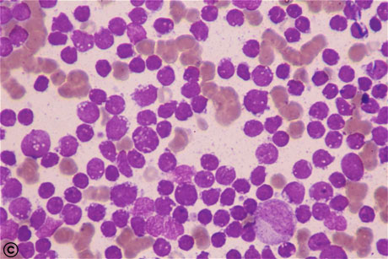
Acute lymphoblastic leukemia
type of leukemia, most commonly found in children.
It comes from a non-differentiating proliferating clone of lymphoblasts.
The peak incidence of ALL is at the age of 4-5 years, girls make up 1/3 of the patients.
Characteristic of anemia, thrombocytopenia, granulocytopenia and the corresponding clinical correlates (hemorrhagic, anemic and infectious-septic syndromes).

Slide 83
Chronic lymphatic leukemia
an incurable, slow-progressive neoplastic disease that originates from a B-cell clone.
Men are ill with CLL three times more often than women.
Specificity of CLL - in the pathological B-clone, in the presence of some signs of maturation, there is no ability to transition into plasmocytes. However, these mature cells seem to carry chromosomal abnormalities and are functionally inferior, which causes hypogammaglobulinemia, decreased immunity and a tendency to auto-allergy.
Hepatomegaly, splenomegaly, generalized lymphadenopathy.
Practically important late manifestations of CLL are autoimmune hemolytic anemia and autoimmune thrombocytopenia.

Slide 84
Chronic lymphoblastic leukemia
Blood picture: In the preparation of blood smears of CLL patients on the glass, some cells show instability to mechanical action and are destroyed. The result is the appearance on the smear (but not in the patient's blood in vivo!) Of the Klein-Humprecht-Botkin shadows. These data are pathognomonic for CLL and, in connection with the low-symptomateness of the early stages of this fatal disease, are of great diagnostic significance.
CLL is the only type of leukemia in which modern medicine is still completely powerless. The early onset of therapy does not improve, as with other neoplasms, but significantly worsens the prognosis, because of side effects, so it is customary to begin to treat a patient who has a blood cell level of at least 150 g / l.

Slide 85
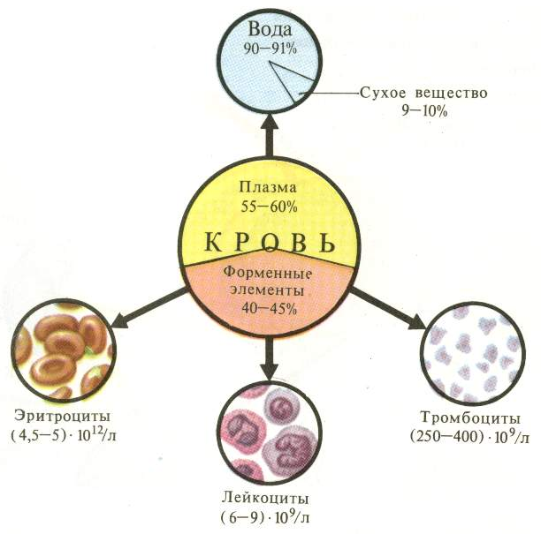
BLOOD PATHOLOGY OF ANEMIA PATHOLOGY OF LEAKON

Slide 86




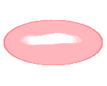







Blood as a liquid medium
. The blood system is represented by shaped elements (erythrocytes, leukocytes, platelets) and the liquid part - by plasma.
In healthy men, the number of erythrocytes in 1 liter of blood is 4.5-5.5 × 1012, in women 4.0-4.5 × 1012 with a hemoglobin content of 120-180 g / l

Slide 87
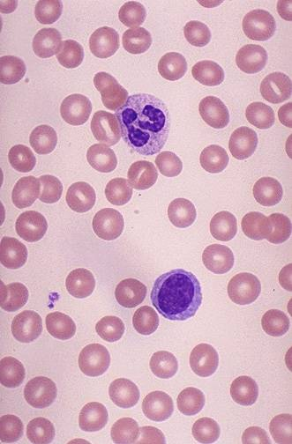

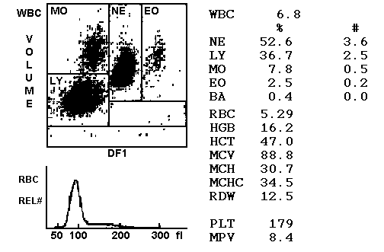
NORMAL BLOOD
Microscopy Hemogram

Slide 88
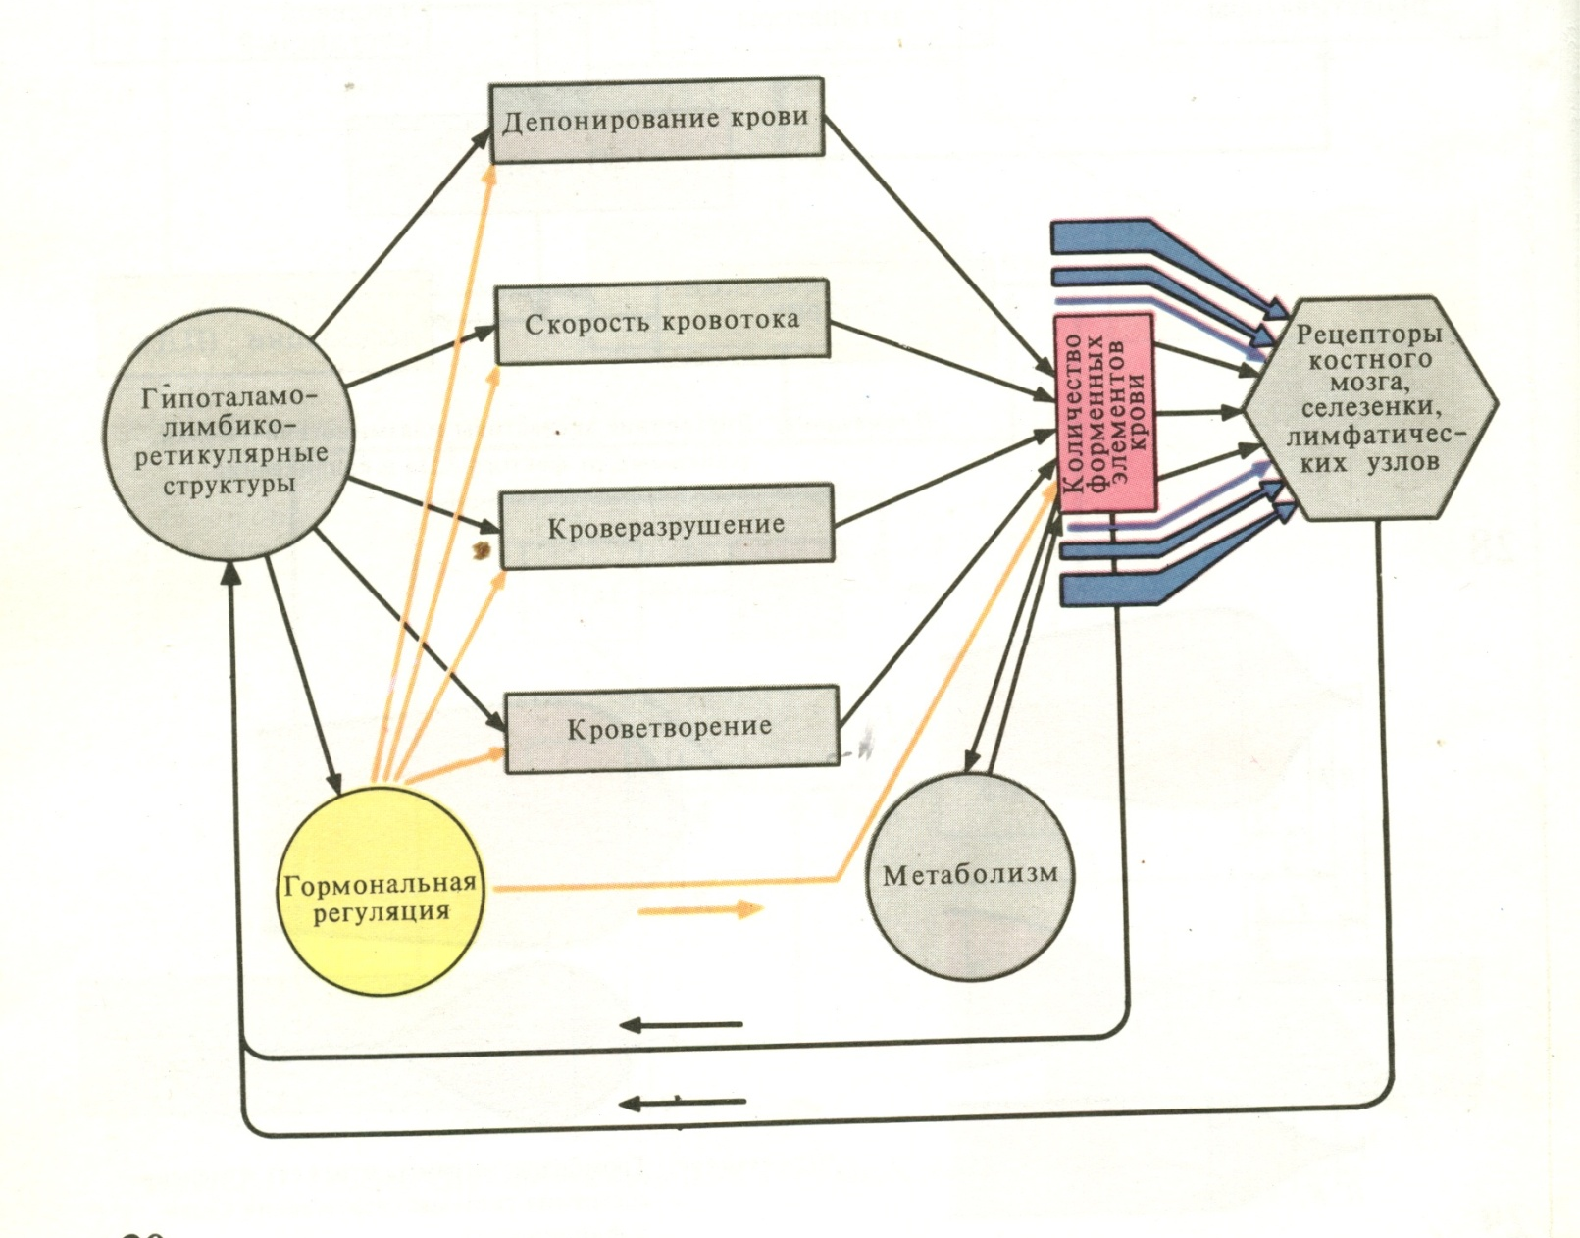
Functional hematopoiesis system

Slide 89
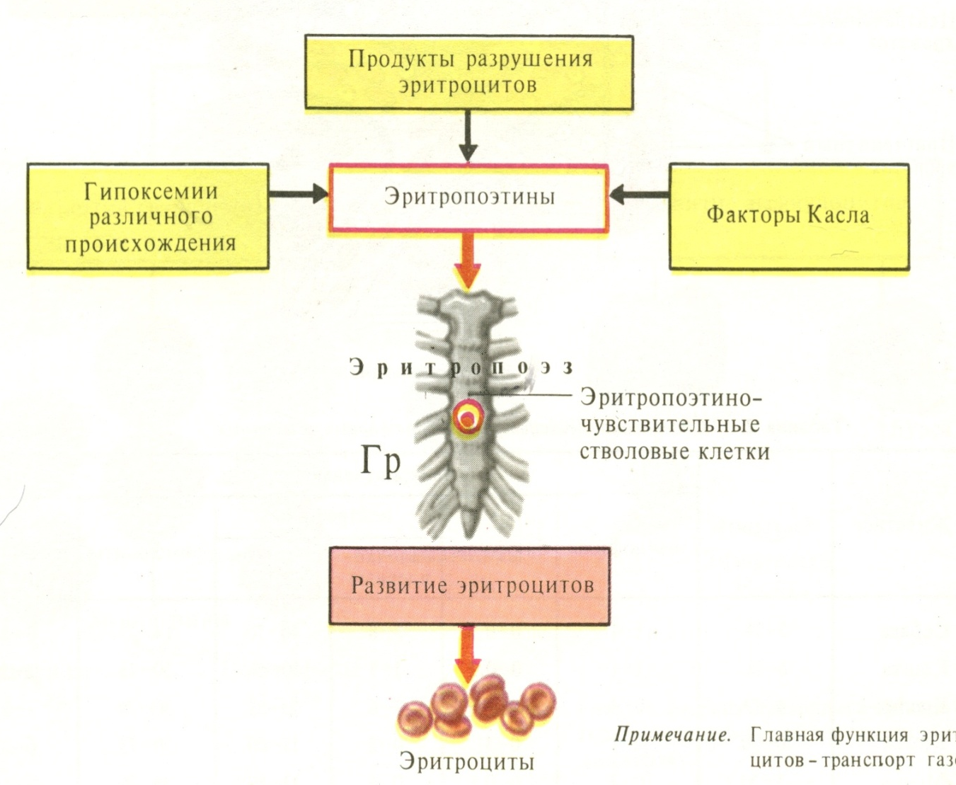
Erythron is a system of erythrocytes circulating in the peripheral blood and organs that perform their production (erythropoiesis) and destruction (erythrodirosis), which functions under the influence of the system of neurohumoral regulation.

Slide 90
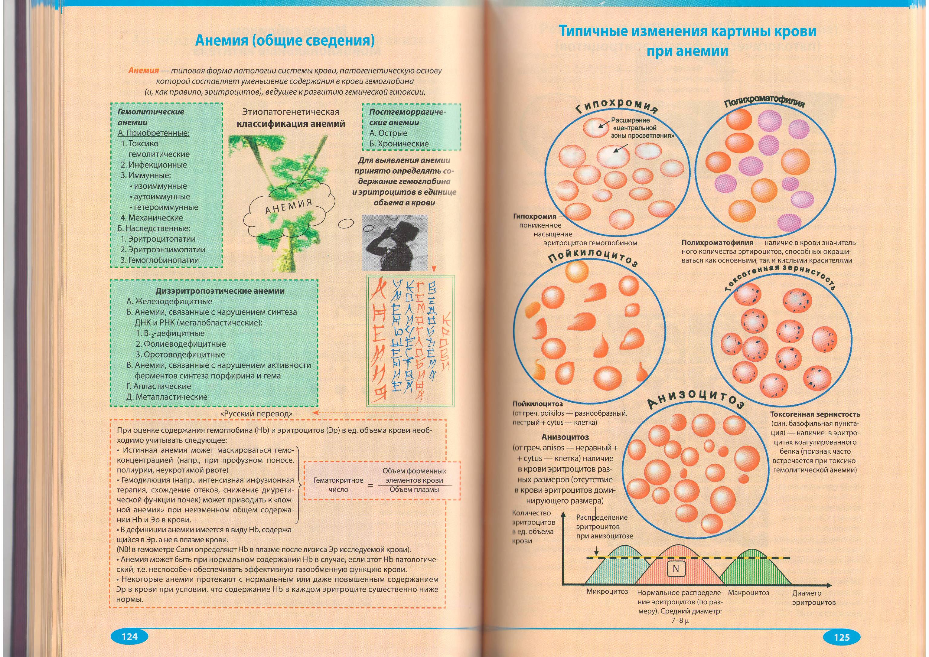
Anemia
a group of diseases and conditions characterized by a decrease in the content of red blood cells and / or hemoglobin per unit volume of blood.

Slide 91
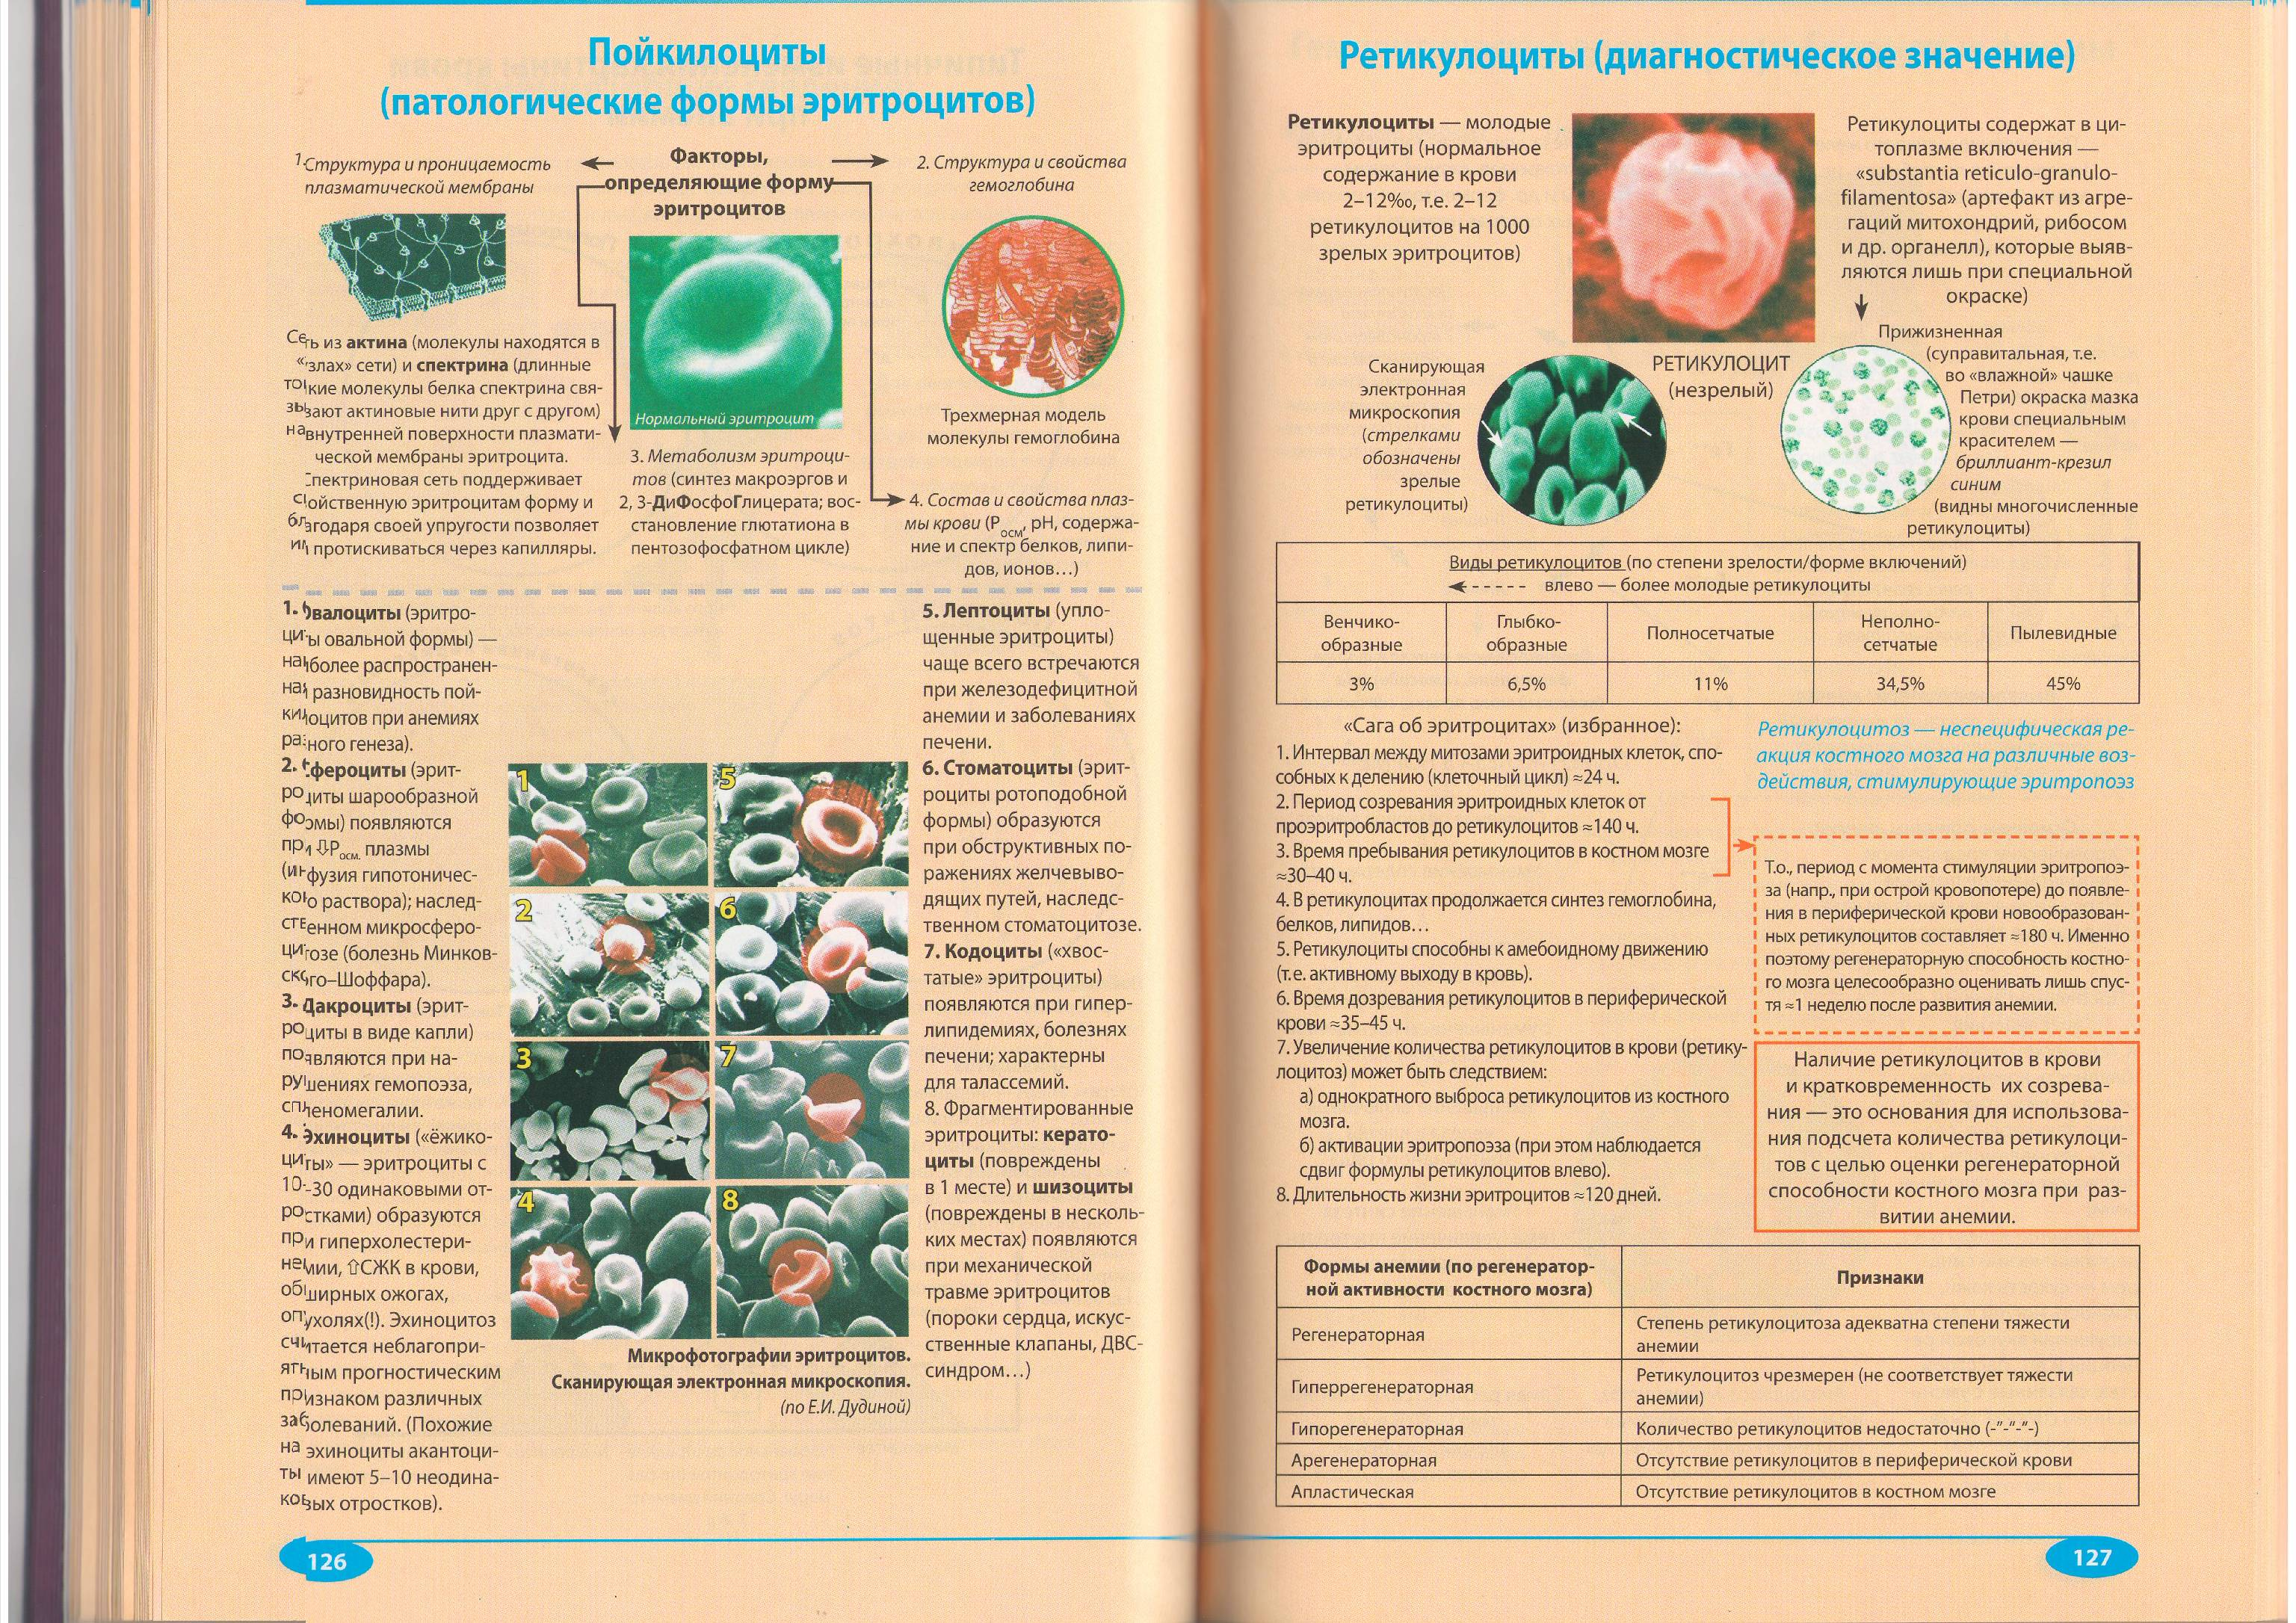
Shape and size of red blood cells
Normally, red blood cells have a diameter of 7.5 mkm.
decrease in diameter - microcytosis,
increase in diameter - macrocytosis), with even larger sizes - megalocytosis).
without changes in the size of cells - normocytosis, dissimilar in diameter Er - anisocytosis.
the shape of erythrocytes can vary: spherocytosis, ovalocytosis, sickle cell. Different forms - poikilocytosis.

Slide 92
The main types of poikilocytes
1 . Ovalocytes
2. Spherocytes
3. Dacrocytes
4. Echinocytes
5. Leptocytes
6. Stomatocytes
7. Codocytes
8. Keratocytes
and schizocytes

Slide 93
The hemoglobin content and the regeneration of erythrocytes
elevated hemoglobin in erythrocytes - hyperchromia, normal - normochromia, reduced - hypochromia. Some anemia is caused by anisochromia. (polychromatophilia).
The activity of erythropoiesis (the regeneration of erythrocytes in the blood) changes. Define anemia hypo-, normo- and hyperregeneratory.

Slide 95
Classification of anemia
Anemia due to loss of blood (posthemorrhagic).
- acute;
- chronic (variant of iron deficiency anemia)
Anemia due to impaired hematopoiesis:
- Deficient (protein-, iron-, B12-folic deficiency anemia);
- Achestic (inability and use of factors when they enter the blood;
- hypoplastic as a result of reduction or cessation
erythropoiesis (radiation, toxic, immune damage to the bone marrow).
Anemia due to increased destruction of erythrocytes (hemolytic).
- hereditary;
- acquired.

Slide 96
Acute posthemorrhagic anemia
after massive bleeding with peptic ulcer, with a fallopian tube in the case of an ectopic pregnancy, erosion of the pulmonary artery branch in pulmonary tuberculosis, rupture of the aortic aneurysm or injury of its wall and departing from the aorta of large branches.

Slide 97
Chronic posthemorrhagic anemia
with repeated mild or moderate blood loss: small bleeding from a decomposing tumor of the gastrointestinal tract, stomach ulcers, hemorrhoids, from the uterine cavity, with hemorrhagic syndrome, hemophilia, etc.

Slide 98
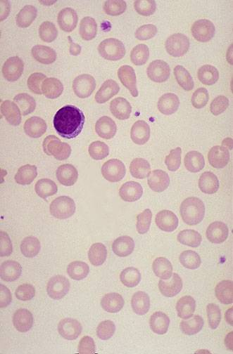
Chronic posthemorrhagic anemia
Microscopy Hemogram

Slide 99
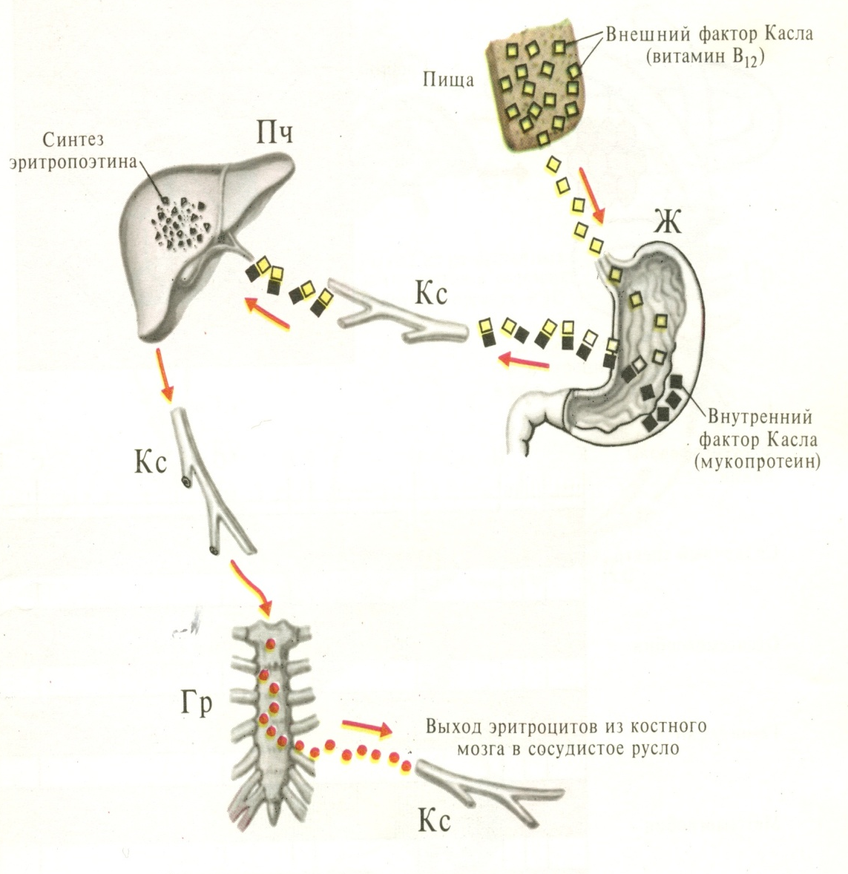
Iron-deficiency anemia
with insufficient intake of iron from food;
exogenous iron deficiency in connection with the increased demands of the body in pregnant and lactating women;
with some infections;
the basis may lie resorption iron deficiency, which occurs in diseases of the gastrointestinal tract, as well as after resection of the stomach or intestine.

Slide 100
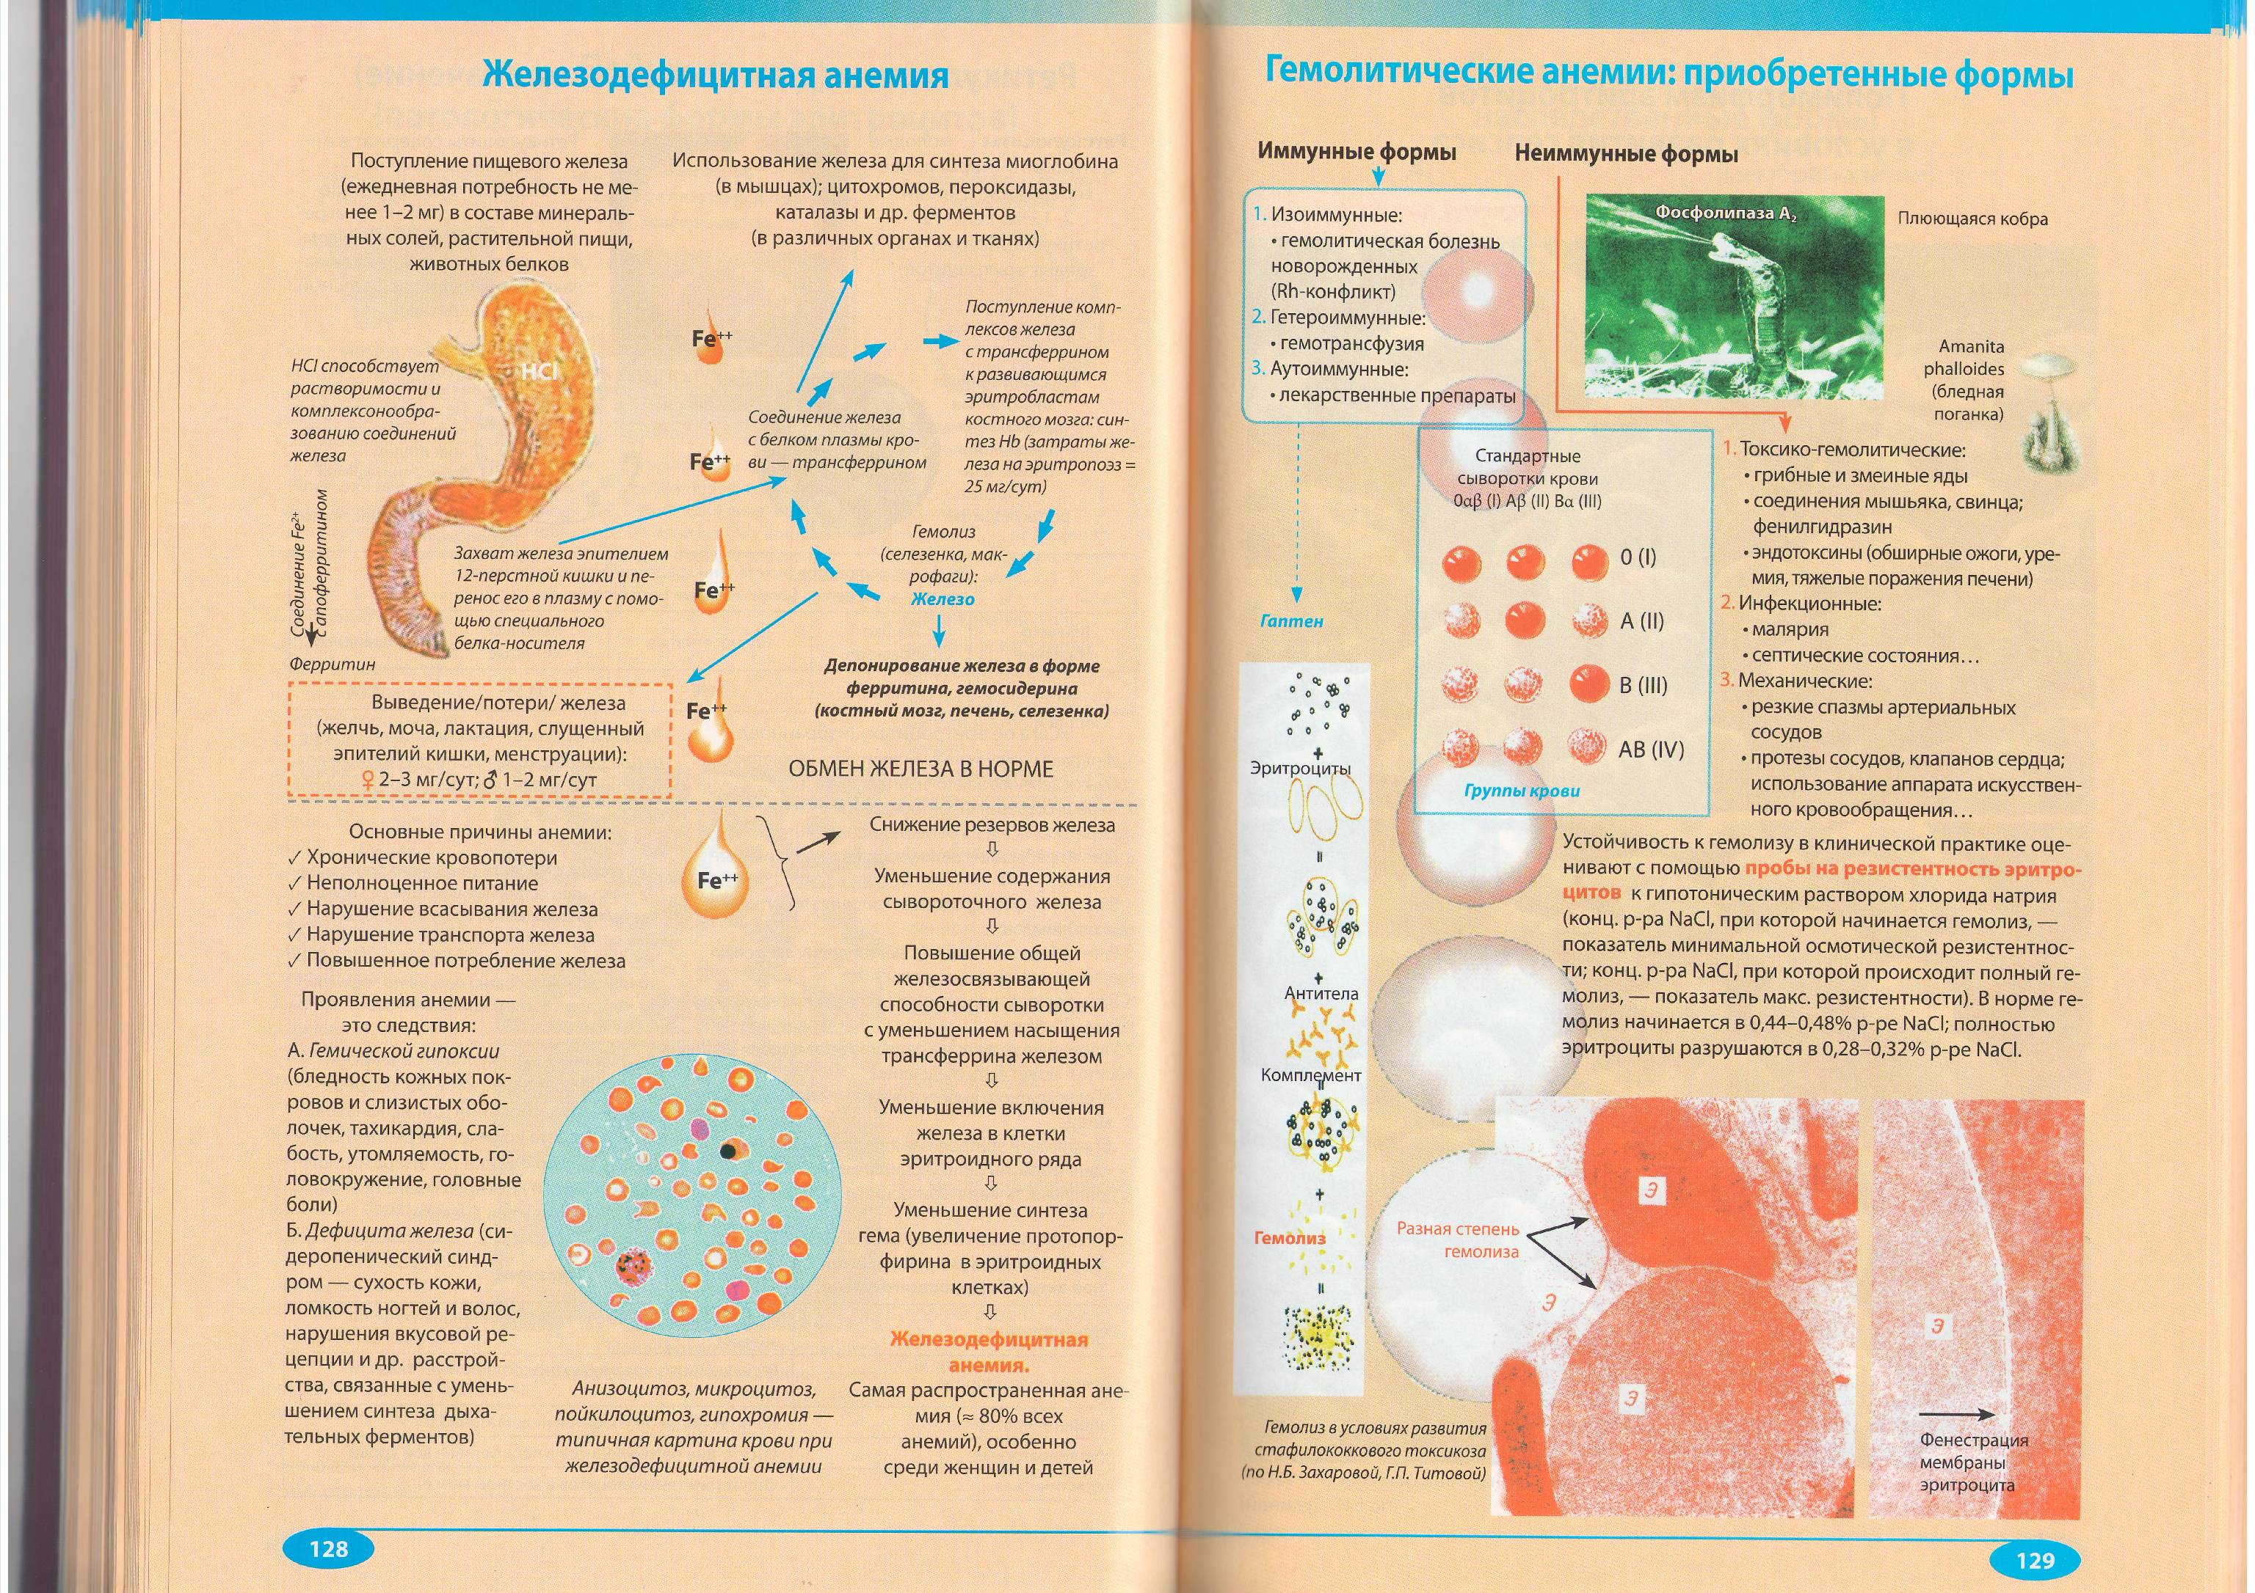
Iron-deficiency anemia

Slide 101
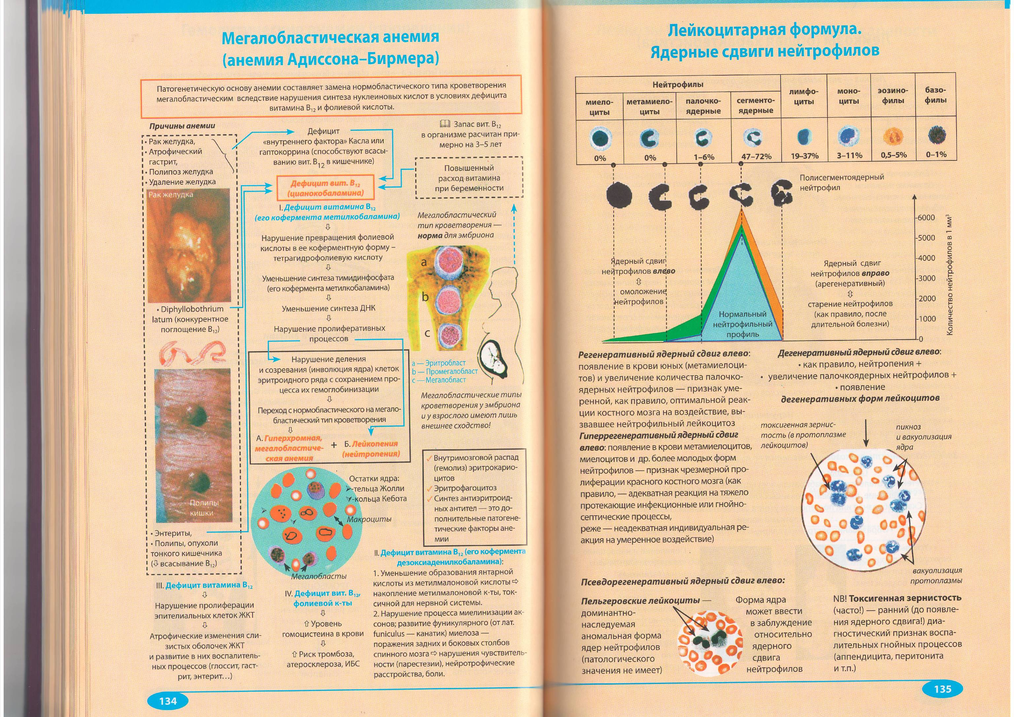
B12-deficiency anemia
occurs in adulthood (after 40 years).
The development of the disease is caused by the loss of secretion of the gastromucoprotein in connection with the hereditary inferiority of the stomach's own glands, culminating in their premature involution.
Of great importance are autoimmune processes.

Slide 102
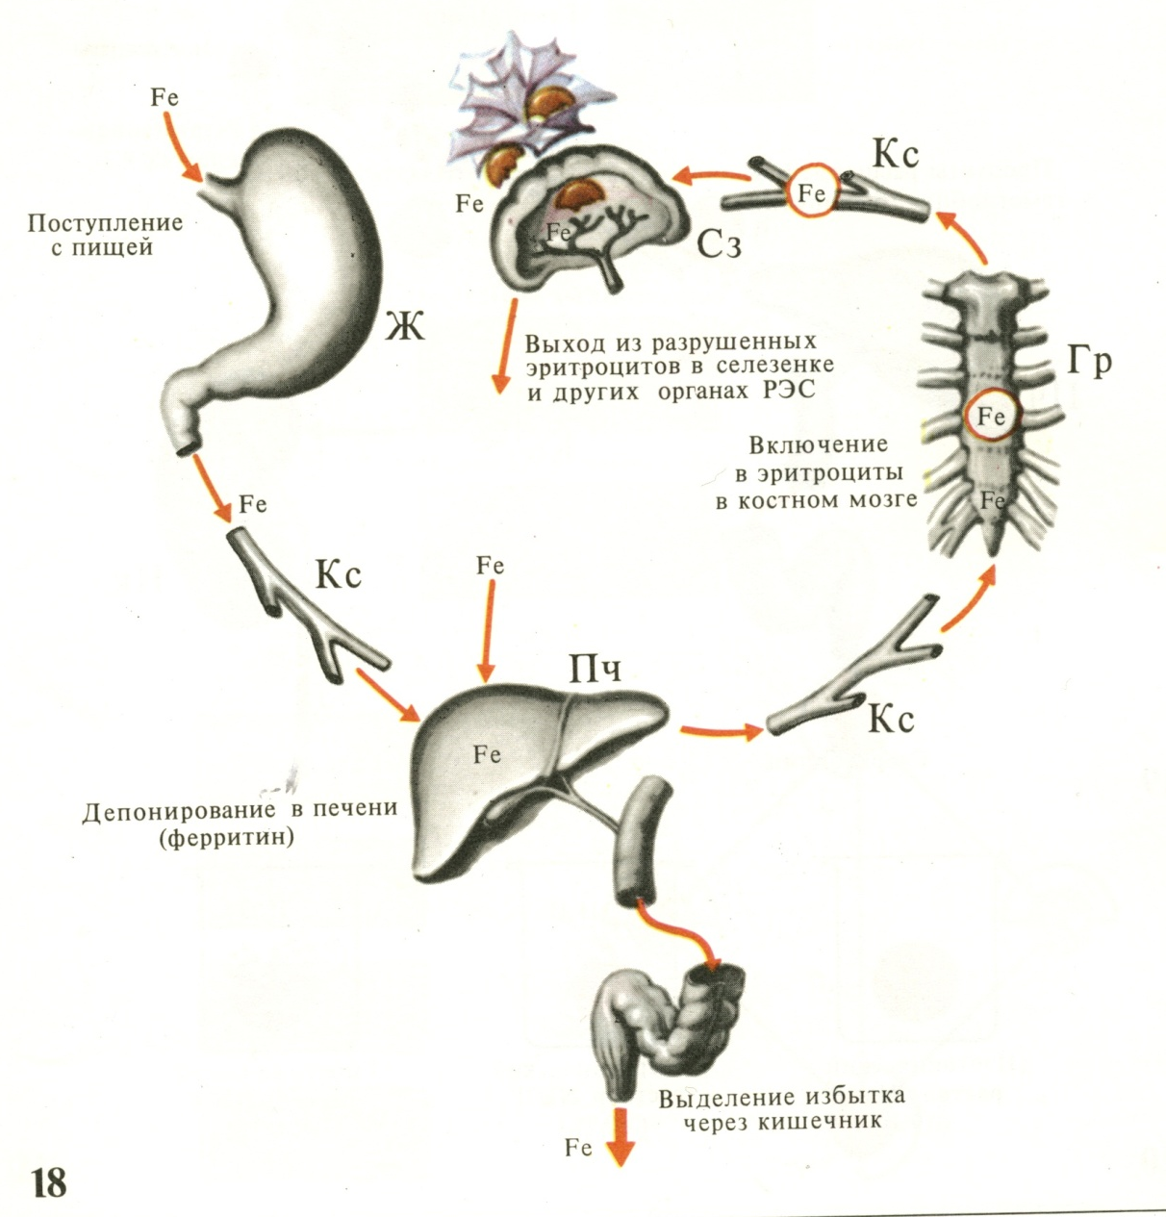
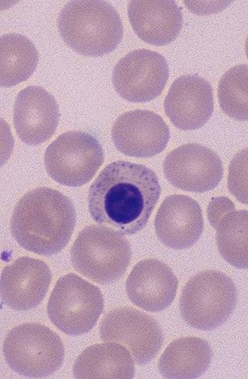
B12-deficiency anemia

Slide 103
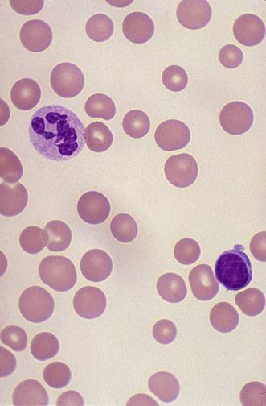
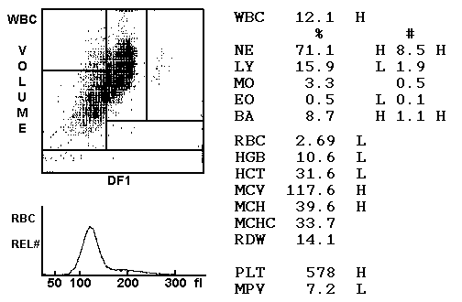
B12-deficiency anemia

Slide 104
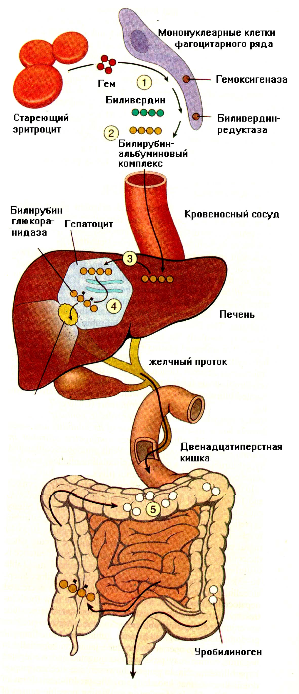
Hemolytic anemia
Hemolytic anemia caused mainly by intravascular hemolysis occur when exposed to hemolytic poisons, with severe burns, malaria, sepsis, transfusion incompatible with the group and the Rh factor of blood. Immunopathological processes play an important role.
Hemolytic anemia caused mainly by extravascular (intracellular) hemolysis have a hereditary character. Disintegration of erythrocytes occurs mainly in macrophages of the spleen, to a lesser extent bone marrow, liver and lymph nodes. A triad is typical: anemia, splenomegaly and jaundice. These anemias are divided into erythrocytopathy, erythrocytophermmentopathy and hemoglobinopathy.

Slide 105
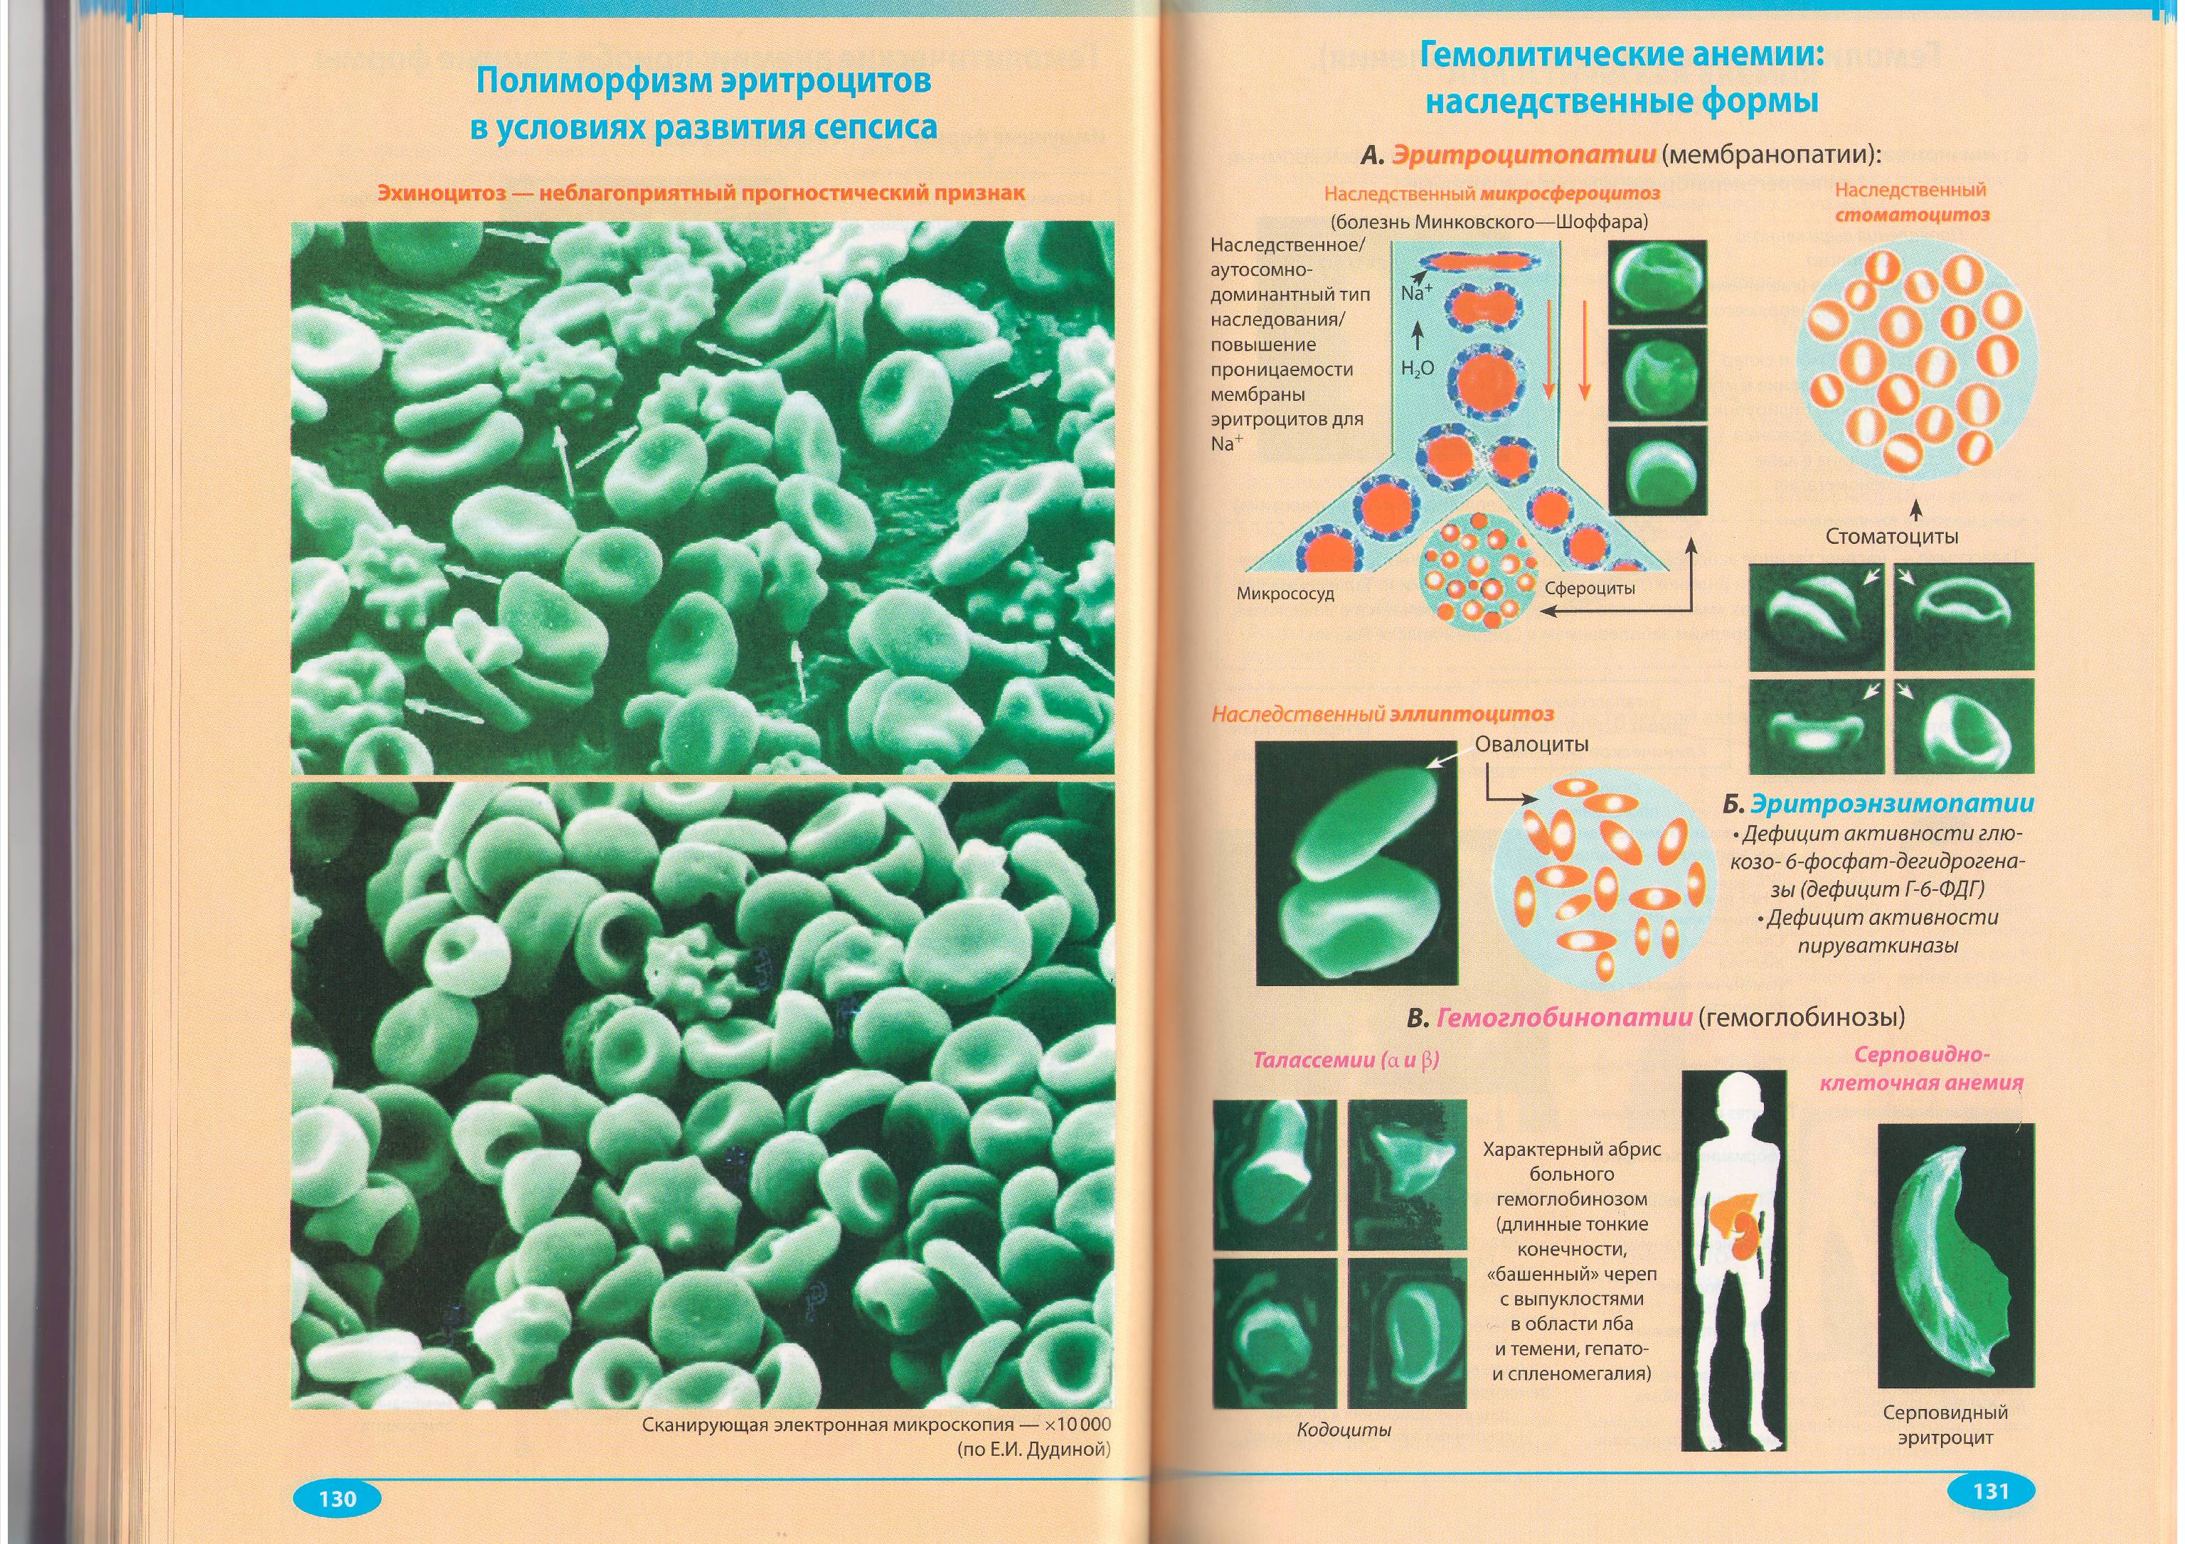
Hereditary forms of hemolytic anemia

Slide 106
Hereditary forms of hemolytic anemia

Slide 107
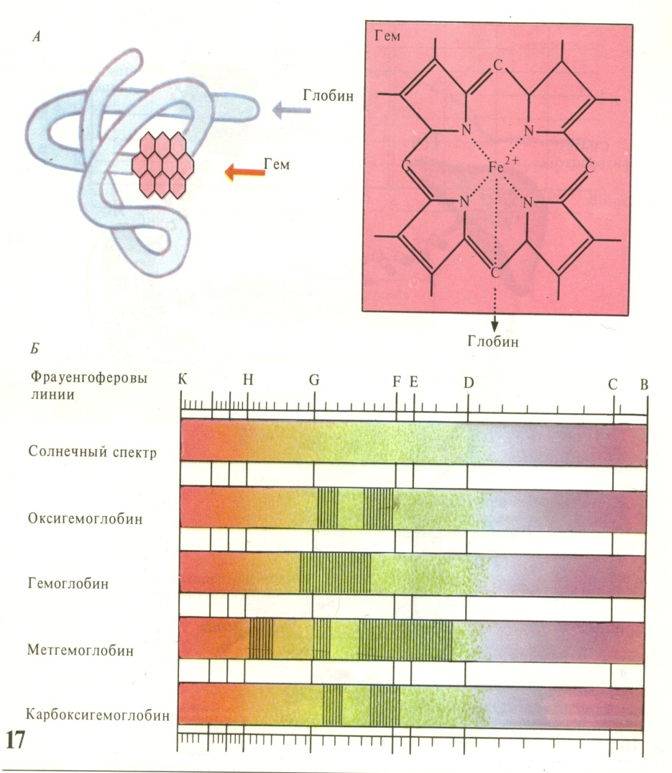
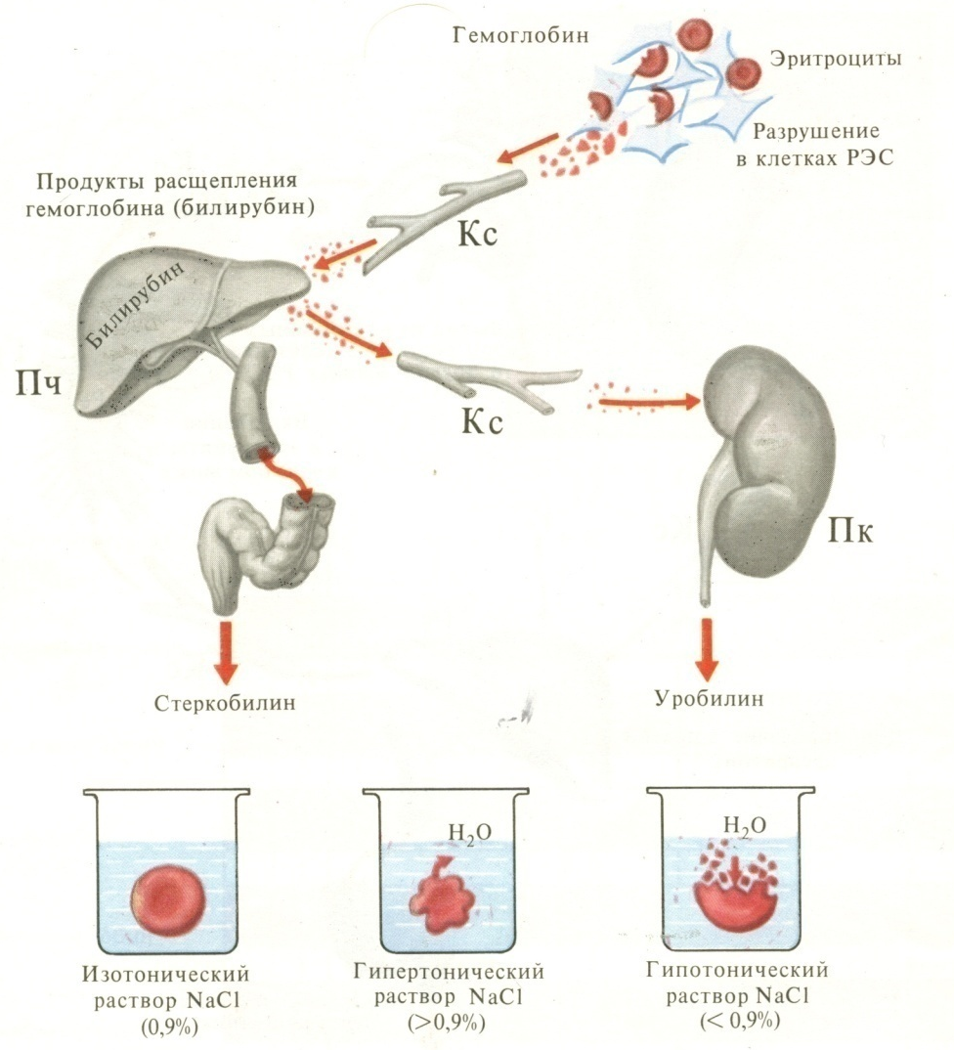
Hemolytic anemia

Slide 108
Acquired forms of hemolytic anemia

Slide 109
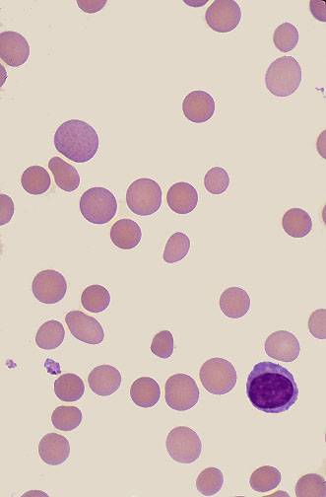
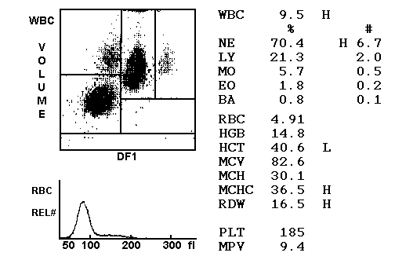
Hemolytic anemia

Slide 110
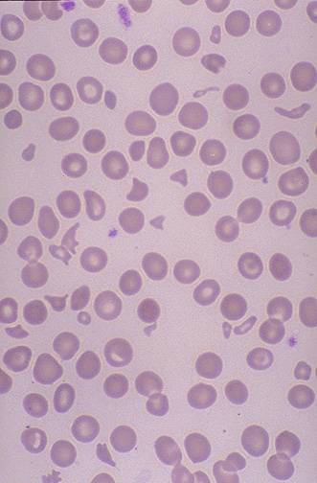
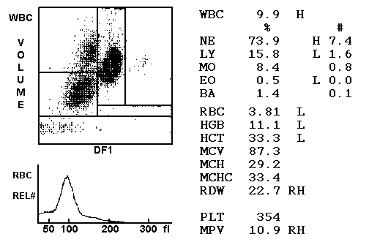
Hemolytic anemia

Slide 111
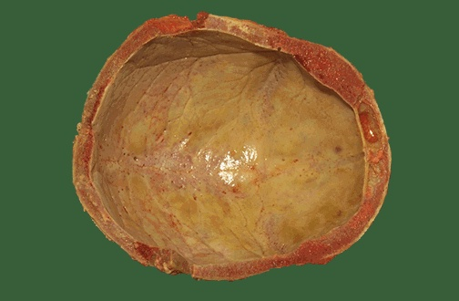



Sickle cell anemia-a severe hereditary form of anemia in which a mutated form of hemoglobin distorts the red blood cells into a crescent shape at low oxygen levels. It is most common among those of African descent.

Slide 112


Morphology of bone marrow

Slide 113

Aplastic anemia-deficiency of all types of blood cells caused by failure of bone marrow development.
are a result of oppression of hematopoesis, especially of young elements of hemopoesis. The cause of development can be both endogenous and exogenous factors. Among the endogenous factors, hereditary occupy a large place. Endogenous anemia is characterized by damage to the erythroblastic blood sprout with the loss of the ability of the bone marrow to regenerate.

Slide 114
Aplastic anemia
Exogenous factors that cause the development of hypoplastic anemia may include radiation energy, toxic substances, drugs (cytostatics, amidopyrine, atopan, barbiturates, etc.). With exogenous anemia, complete suppression of hemopoiesis does not occur, only inhibition of the regenerative capacity of the bone marrow is noted. Hemolysis joins, multiple hemorrhages occur in the serous and mucous membranes, the phenomena of general hemosiderosis, fatty degeneration of the myocardium, liver, kidneys, ulcerative necrotic and purulent processes, especially in the gastrointestinal tract.

Slide 115

Aplastic anemia

Slide 116

Leukon
a system of leukocytes circulating in the peripheral blood and organs carrying out their production (leukopoiesis) and destruction (leukodiases), functioning under the influence of the system of neurohumoral regulation.

Slide 117
Leukocytosis and leukopenia
Leukocytosis - an increase in the content of leukocytes in peripheral blood (the norm is 4.0-8.0 ∙ 109 in 1L). By type of cells, leukocytosis is divided into neutrophilic, lymphocytic and mixed.
Leukopenia - a decrease in the content of leukocytes in peripheral blood (less than 4,0 ∙ 109 in 1L). Leukopenia is also neutrophilic, lymphocytic and mixed.

Slide 118
Changes in the leukocyte formula

Slide 119


Leukemia, leucosis
Leukemia is a neoplasm from the hematopoietic cells with bone marrow lesions in the form of generalized, unregulated hyperplasia with the admission (or lack thereof) of the shaped elements into the bloodstream

Slide 120


Slide 121
Clinic of leukemia

Slide 123
Types of leukemia

Slide 124
Theory of leukemia
It is estimated that one leukemia cell, on average over 3 months, gives a huge number of cells (10x12) with a mass of about 1 kg. It is assumed that this is the number of leukemia cells that is the boundary from which the clinical manifestations of acute leukemia begin.

Slide 125
ACUTE LEUCOSIS
make up about a third of their total number of leukemias, and acute lymphoblastic leukemia is one of the most common childhood cancer. There are 2 peaks of incidence: at the age of 3-4 years and 60-69 years, men suffer more often than women.
There are a number of factors that contribute to the development of acute leukemia: 1) chromosomal abnormalities; 2) exposure; 3) toxic effects of environmental pollution, drug therapy; 4) previous diseases of hematopoiesis (myelodysplasia, refractory anemia, paroxysmal nocturnal hemoglobinuria, etc.). In families of patients with acute leukemia, the risk of the disease increases almost 3-4 times. The incidence of acute leukemia increases with certain genetic disorders and developmental anomalies (Down's disease, Klinefelter's syndrome, Fanconi anemia, etc.

Slide 126

Acute lymphoblastic leukemia
anemia, thrombocytopenia;
dispersal of leukemia cells through the bone marrow and spleen, liver, lymph nodes and parenchymal organs;
hemorrhagic syndrome;
intoxication syndrome

Slide 127

Acute lymphoblastic leukemia

Slide 128


Acute myeloblastic leukemia

Slide 129
Acute myeloblastic leukemia

Slide 130
Acute leukemia: causes of death
Progression of leukemia;
Infectious complications (pneumonia, sepsis, gram-negative flora, herpes virus, Pseudomonas aeruginosa, etc.);
Hemorrhagic complications (disseminated manifestations, hemorrhages in the brain);
Liver failure

Slide 131

Chronic lymphoblastic leukemia
more often in persons older than 40, in old age, rarely ends in a blast crisis. It is characterized by the proliferation of lymphoid cells (mainly B-lymphocytes).
The bone marrow, lymph nodes, spleen, liver, and other organs are involved in the process. In the peripheral blood - leukocytosis and lymphocytosis, increasing with the progression of the disease.
Infectious complications are frequent. Patients suffer from autoimmune hemolytic anemia - the main cause of death.

Slide 132

Chronic lymphatic leukemia
described in 1854 by R. Virchow. It occurs in persons 30-70 years old. The life expectancy of patients is 3-12 years. Harktern deletion of the long arm of the 22nd chromosome - the so-called Philadelphia chromosome.
Depending on the duration and severity of the disease, there is an increase in the spleen, liver, content of blood elements (mature forms), purulent-necrotic changes, hemorrhagic syndrome, hepatic insufficiency, pyoid bone marrow. Myelofibrosis often develops. There is a resorption of bone tissue. With a blast crisis, blast cells predominate, sometimes giant multi-nuclear forms.

Slide 133


Chronic myelogenous leukemia
Hemogram Blood smear

Slide 134




Chronic myelogenous leukemia

Slide 135
Polycythemia - an abnormally increased concentration of hemoglobin in the blood, through either reduction of plasma volume or increase in red cell numbers. It may be a primary disease of unknown cause, or a secondary condition linked to respiratory or circulatory disorder or cancer.
(erythrocytosis, Vakez-Osler disease) will occur in people older than 50 years. Erythrocytosis, color index increase, thrombocytosis (increase of blood coagulability), leukocytosis are determined in the blood. Spleno- and hepatomegaly appear in the expanded stage. The course is benign. The most dangerous thrombus formation: it is possible to develop a heart attack, stroke.

Slide 136

Lymphogranulomatosis
malignant neoplasm of lymphoid tissue, is characterized by its granulomatous structure with the presence of giant cells of Berezonovsky-Steinberg. The disease occurs with the involvement of lymph nodes and internal organs. About 50% of patients younger than 40 years.
The disease begins with lesions of the lymph nodes of the neck (70%), supraclavicular (25%), axillary (13%), inguinal (1%). It is difficult to diagnose the disease with lesions of mediastinal (25%) and retroperitoneal (10%) lymph nodes.

Slide 137
Classification of lymphogranulomatosis
- Lymphoid-histiocytic variant (lymphoid prevalence).
- Mixed-cell variant.
- Nodular sclerotic variant (nodular sclerosis).
- Lymphoid depletion.

Slide 138




Lymphogranulomatosis

Slide 139




Lymphomas - cancer of the lymph nodes.
At this point the differential diagnosis included thymoma, teratoma and lymphoma .

