Slide 1
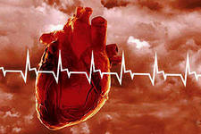
Principles
of clinico-pharmaceutical
approach to the selection of drugs
for the treatment of ischemic heart disease

Slide 2
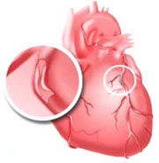
ISCHEMIC HEART DISEASE (IHD)
IHD – is a myocardial lesion caused by a coronary artery disorder that occurs as a result of imbalance between the coronary blood flow and the metabolic needs of the cardiac muscle

Slide 3
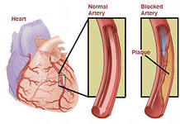
The prevalence and significance of IHD
IHD —
a common disease, one of the main
reasons mortality, and
temporary and persistent loss of
working capacity of the population
in the developed countries of the world.
In connection with this, the problem of IHD occupies one of the leading places among the most important medical problems of the 21st century.
The ratio of dead men and women in this is approximately 5: 1.
According to statistics in Europe, IHD and brain stroke account for 90% of all diseases of the cardiovascular system, which characterizes IHD as one of the most widespread diseases.

Slide 4
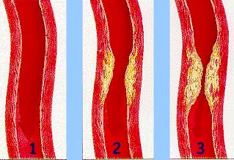
Classification of IHD in clinical forms
Each of form has an independent meaning
1. Sudden coronary death
-Sudden coronary death with successful resuscitation
-Sudden coronary death
2. Angina pectoris
-Angina of Stress
-The first occurrence of angina pectoris
-Stable exertional angina with indication of functional class
-Unstable angina
-Vasospastic angina pectoris
3. Myocardial infarction
4. Postinfarction cardiosclerosis
5. Heart rate disorders
6. Heart failure

Slide 5

Risk factors of IHD
Risk indicators can be classified as follows:
1. Biological determinants or factors:
-elderly age;
-male;
-genetic factors that contribute to the
genesis of dyslipidemia,
hypertension, glucose tolerance, diabetes and obesity.
2. Anatomical, physiological and metabolic factors:
-dyslipidemia;
-arterial hypertension;
-obesity and the nature of the distribution of fat in the body;
-diabetes.

Slide 6

Risk factors of IHD
3. Behavioral factors that may lead to IHD:
- eating habits;
- obesity, as a factor in the development of IHD;
- smoking;
inadequate motor activity, or physical loads
exceeding the adaptive capacity of the organism;
- alcohol consumption;
behavior that contributes to the development of coronary artery disease.
The likelihood of developing coronary heart disease and other cardiovascular diseases increases with the increase in the number and "power" of these risk factors.

Slide 7
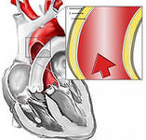
PATHOGENESIS OF IHD
According to modern ideas, IHD is a pathology based on myocardial damage caused by insufficient blood supply.
Violation of the balance between the actual blood supply of the myocardium and its blood supply needs can occur due to the following reasons:
Reasons inside the vessel:
- atherosclerotic narrowing of the lumen of the coronary arteries;
- thrombosis and thromboembolism of coronary arteries;
- spasm of coronary arteries.
Reasons outside the vessel:
- tachycardia;
- hypertrophy of the myocardium;
- arterial hypertension.

Slide 8
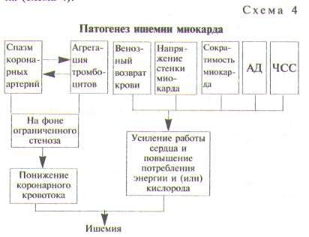
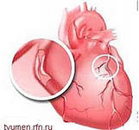
PATHOGENESIS OF IHD

Slide 9
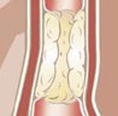
PATHOGENESIS OF IHD
The leading cause is atherosclerosis - densification of blood vessels by depositing fatty substances (cholesterol) in the inner wall.

Slide 10
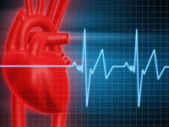
Clinical forms of ischemic heart disease
Sudden coronary death
Sudden coronary death allegedly
related with electrical instability
myocardium.
To an independent form of ischemic
heart disease sudden death is
if there is no reason to diagnose another form of ischemic heart disease or another disease: for example, death that occurred in the early phase of myocardial infarction is not included in this class and should be considered as a death from myocardial infarction.
If resuscitation measures were not performed or were unsuccessful, then the primary cardiac arrest is classified as sudden coronary death.
The latter is defined as the death occurring in the presence of witnesses instantly or within 6 hours of the onset of a heart attack.

Slide 11
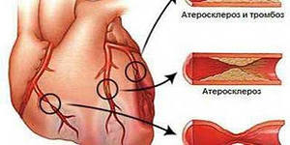
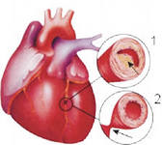
Clinical forms of ischemic heart disease
Stenocardia (angina pectoris) - in translation from Greek - chest pain -
a clinical syndrome associated with acute transient short-term myocardial ischemia arising on the background of coronary artery insufficiency and manifested by characteristic pains.

Slide 12
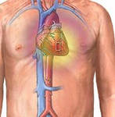
Classification of angina pectoris
I. Angina of Stress
1.The first occurrence of angina pectoris
2.Stable angina:
-Class I is latent. Stenocardia occurs only with intense and prolonged physical exertion;
-Class II is an easy degree. Attacks occur when climbing stairs, uphill, cold wind, frosty weather, walking for distances longer than two kilometers and climbing more than one floor;
-Class III is of medium severity. Attacks occur when walking for distances greater than 1 kilometer and climbing one floor. Occasionally, there are seizures at rest;
-Class IV is heavy. Inability to perform any physical activity, seizures occur regularly at rest.
3.Progressive angina (unstable)
4.Spontaneous (variant, vasospastic) angina pectoris.

Slide 13
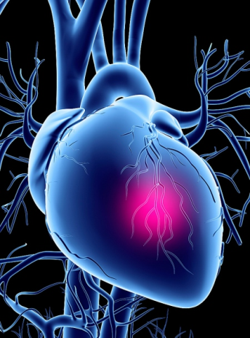
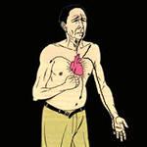
Classification of angina pectoris
Classification of progressive angina pectoris according to the severity of the onset
Class I. Severe or progressive angina pectoris. Recently, the history of an exacerbation of ischemic heart disease less than 2 months;
Class II. Stenocardia of tension and rest subacute. Patients had anginal attacks during the previous month, but no later than 48 hours;
Class III. Acute angina pectoris. Patients had angina attacks at rest for the last 48 hours.

Slide 14

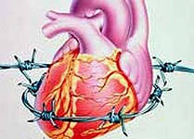
Classification of angina pectoris
Classification of unstable angina pectoris (UAP), depending on the conditions of its occurrence
Class A. Secondary UAP: The development of unstable angina occurs under the influence of factors that aggravate ischemia (fever, anemia, hypotension, infection, tachyarrhythmia, uncontrolled hypertension,
respiratory insufficiency, thyrotoxicosis);
Class B. Primary UAP: develops without
Influence the above factors;
Class C. Early postinfarction UAP: develops
for two weeks after extensive myocardial
infarction

Slide 15
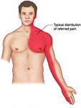
Symptoms of stenocardia
Pain - or discomfort, localized in the
chest, retrosternal area.
Nature of pain:
compressive, pressing or burning.
Irradiation:
- in the left shoulder;
in the inner surface of left arm and
neck;
- less often in the teeth on the left side,
- In the right shoulder or arm;
- interscapular area;
- In epigastric region (the latter may be accompanied by dyspeptic disorders);
- very rarely the pain is localized exclusively in the epigastric region or in the region of the head, in this case the diagnosis is significantly hampered.

Slide 16
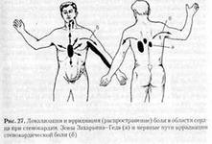
Symptoms of stenocardia
As a rule, attacks of angina arise:
- with physical activity;
- increased emotional stress;
- at overeating;
- in case of hypothermia;
- increased blood pressure.
In all of the above cases, the need for cardiac muscle in oxygen increases, and the narrowed coronary arteries can not satisfy it.
In the absence of stenosis of the coronary arteries -
pain in the chest can be a consequence of severe left ventricular hypertrophy, which may be due to:
- stenosis of the aortic valve;
- aortic regurgitation;
- hypertrophic cardiomyopathy or dilated cardiomyopathy

Slide 17
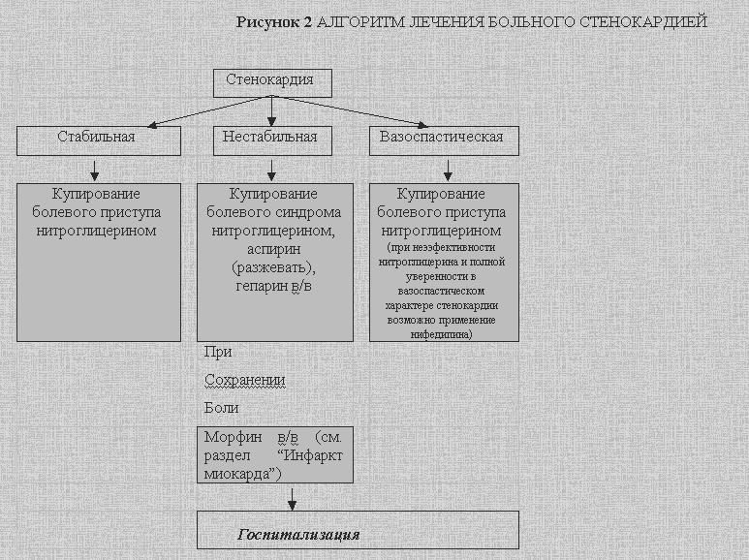
Algorithm for treating a patient with angina pectoris

Slide 18
ANTIANGINAL DRUGS
Antianginal drugs - drugs that have a curative effect in IHD
Classification of antianginal drugs:
I. Drugs that reduce the need for myocardium in oxygen:
Nitrates: nitroglycerin, trinitrolong, sustac, nitrosorbide.
Calcium antagonists: Corinfar (nifedipine).
Beta-adrenoblockers: anaprilin (obzidan), metoprolol.
II. Coronary dilatation drugs: molsidomine (Corvatone).
III. Preparations that improve the transport of oxygen to the myocardium:
Inhibitors of phosphodiesterase: ralofect (pentoxifillin), euphyllin (aminophylline)
Inhibitors of adenosine deaminase: dipyridamole (curantyl)

Slide 19
ANTIANGINAL DRUGS
Classification of antianginal drugs
IV. Inhibitors of aggregation of trombocytes:
acid acetylsalicylic (aspirin), acelazine, raloekt (pentoxifylline), ticlopidine (ticlid)
V. Preparations that increase myocardial resistance to hypoxia:
Energy-supplying: ATP (phosphobion), phosphadene, creatine phosphate (neoton).
Antioxidants: tocopherol acetate, nicotinic acid.
Anabolic agents: inosine (riboxin), retabolil, potassium orotate.
Regulating the exchange of electrolytes: asparkam (panangin), maklukord.
Electronoacceptors: cytochrome-C, riboflavin.

Slide 20
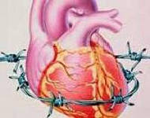
ANTIANGINAL DRUGS
The main groups of antianginal drugs in the treatment of IHD:
There are the following groups of antianginal agents:
1) Nitrates and the group of Sydnonimins close to them.
2) Blockers of β-adrenergic receptors.
3) Calcium antagonists.
Rational combinations of basic antianginal drugs:
beta-adrenoblockers + nifedipine,
beta-blockers + nitrates,
calcium antagonists + nitrates

Slide 21
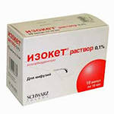
ANTIANGINAL DRUGS
Nitrates.
Organic nitrates
from the second half of the past
centuries are used:
- for cupping of attack of angina
pectoris
for prevention of attack of angina pectoris
Due to differences in the chemical structure of nitrates and the peculiarities of their pharmacological action (the rate of onset of the antianginal effect, its duration) nitrates have a different application.

Slide 22
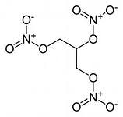
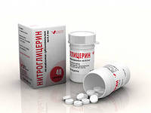
ANTIANGINAL DRUGS
Nitroglycerin -
- colorless oily liquid;
- poorly soluble in water;
- it is soluble in alcohol;
- quickly absorbed by mucous
membranes and skin.
It is effective for sublingual administration in the form of a solution, tablets or capsules.
The effect occurs in 1-2 minutes and
lasts 20-30 minutes.
With intravenous administration
the effect develops even faster.

Slide 23
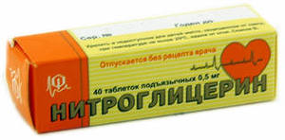
ANTIANGINAL DRUGS
Nitroglycerin -
- stimulates the formation of NO
in the wall of the vessels;
- stimulates synthesis of
prostacyclin in the vessel wall;
- stimulates beta2-adrenoreceptors of the central nervous system and increases the influence of coronary dilatation pulses on the vasomotor center (clonidine similar mechanism).
- increases the activity of guanylate cyclase;
- increases the amount of cyclic guanylate phosphate;
- activates the function of the vascular relaxation system;
- reduces the penetration of calcium ions into blood vessels and cardiomyocytes.

Slide 24
ANTIANGINAL DRUGS
Nitroglycerin -
- reduces blood pressure and afterload on the heart;
- relaxes the veins wall and reduces preload on the heart;
- expands coronary vessels (coronary vasodilative agent);
- reduces the output volume of blood, the final diastolic pressure, improves the blood supply of subendocardial layers of the myocardium;
- reduces heart function and myocardial oxygen demand;
- normalizes the exchange (especially energy) of substances in the myocardium and vessels.

Slide 25
ANTIANGINAL DRUGS
Nitroglycerin -
- reduces the venous flow of blood to the heart;
- reduces pressure in the right atrium, in the pulmonary artery system, and also decreases peripheral resistance of blood vessels.
As a result, the myocardium is discharged, its voltage is reduced to overcome the resistance to blood ejection, its oxygen demand and energy costs are reduced. Reduction of cardiac tension contributes to the restoration of blood flow in small vessels of the myocardium. Along with the reduction of ischemia, the pain impulse from the ischemic focus disappears and the pain syndrome ceases.
These properties of nitroglycerin give the basis to apply it as not only an antianginal agent, but also a drugs for treating acute and chronic heart failure

Slide 26
ANTIANGINAL DRUGS
Nitroglycerin -
In addition to coronary vessels, nitrates dilate the vessels of the brain, the abdominal cavity, and also have an antispasmodic effect on the muscles of the biliary tract, digestive canal, ureters, uterus and bronchi.
Continuous and long-term use of nitroglycerin leads to the development of tolerance,
when an increase in dose and frequency of receptions is required to achieve antianginal and hemodynamic effects.
The development of tolerance to organic nitrates is associated with a gradual decrease in cGMP activity and a decrease in NO production. When nitrates are prescribed, it is necessary to constantly monitor the effectiveness of therapy, carefully adjust the dose.

Slide 27
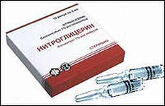
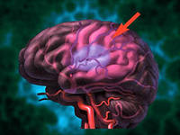
ANTIANGINAL DRUGS
Nitroglycerin -
Side effects:
When using nitroglycerin preparations often occurs:
- headache;
- dizziness;
- lowering of blood pressure;
and with an overdose –
orthostatic collapse.
Contraindications:
- hemorrhage in the brain;
- increased intracranial pressure;
- severe hypotension;
- closed angle form of glaucoma with high intraocular pressure.

Slide 28
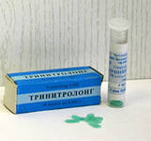
ANTIANGINAL DRUGS
Prolonged nitrates :
Trinitrolong - is released in the form of polymer films, acts when applied to the mucous membrane of the gums relatively quickly and for a long time.
Polymer films contain 0.001 and 0.002 grams of nitroglycerin and are used for both prevention and relief of angina attacks.
The antianginal effect develops in 1-2 minutes and lasts 3-4 hours.
Sustak-mite, Sustak-forte - a microencapsulated form of sustained-release nitroglycerin, containing 0.0026 g or 0.0064 mg of nitroglycerin.
Applied for warning angina attacks with
chronic coronary insufficiency.

Slide 29
ANTIANGINAL DRUGS
Prolonged nitrates :
Isosorbide dinitrate is sublingually, in a vein and inhalation.
When administered orally in the form of tablets:
the beginning of the action - in 30-50 minutes,
the maximum effect - after 1,5-2 hours,
the total duration of action is 4-6 hours.
Take pills before meals 3-4 times a day for chronic ischemic heart disease to prevent attacks.
Nitrosorbide - administered sublingually can quit angina attacks, although the action develops more slowly than nitroglycerin.
Isomak Spray is an aerosol form of nitrosorbide for relief of angina attacks.
Isodinite is a dosage form for intravenous use.

Slide 30
ANTIANGINAL DRUGS
Antianginal remedy from the group of sydnonimins
Molsidomine (Corvatone, Sidnofarm) -
has a peripheral venodilating effect, which leads to a decrease in venous return to the heart, reduces pre- and post-loading on the heart, reduces the need for myocardium in oxygen, improves circulatory conditions in the subendocardial layer of the myocardium, improves collateral circulation in coronary atherosclerosis.
Pharmacokinetics.
- Quickly absorbed in the digestive canal.
- Metabolised in the liver.
- Half-life is about 3.5 hours.
- It is excreted mainly with urine.
- The onset time is about 10 minutes after sublingual use.
- The drug lasts several hours.
Applied for cupping and prevention of angina attacks, with chronic heart failure

Slide 31
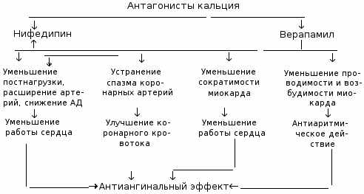
CLINICAL FORMS OF IHD

Slide 32
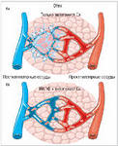
ANTIANGINAL DRUGS
Calcium antagonists or calcium channel blockers
Classification:
1. Cardiotropic - Phenylalkylamines:
verapamil (phinoptin, isoptin).
2. Vasotropic - Digdropyridines: fenygidine (nifedipine, corinfar), amlodipine, felodipine.
3. Mixed action - Benzothiazines: diltiazem.
The transport of calcium ions through the slow calcium channels of the cell membranes is inhibited inside the cardiomyocytes and smooth muscle cells of the coronary and peripheral vessels.
Reducing myocardial contractility and heart function, directly reduces myocardial oxygen consumption, and also indirectly reduces myocardial oxygen demand by decreasing peripheral vascular resistance and associated optimization of heart function.

Slide 33
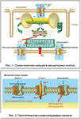
ANTIANGINAL DRUGS
Calcium channel blockers
Nifedipine Prolonged
Moderately prolonged:
Adalat-SL, Cordaflex Retard,
Corinfar retard 30-100 mg / day
Significantly prolonged:
Osmo-Adalat, Cordipine-XL,
Nifecard-XL 30-120 mg / day
Amlodipine Norvasc, Cardilopin, Normodipine, Calchek, Amlonas, Vero-amlodipine 5-10 mg / day
Felodipine Plendil, Felodip 5-10 mg / day
Isradipine Lomir 2.5-10 mg twice daily
Lacidipine Latsipil 2-4 mg / day
Diltiazem Cardisem, Diltiazem TEVA, Diltiazem Lannacher, Altiazem PP, Cardil, Diazem 120-320 mg
Verapamil Isoptin, Finoptin, Lekoptin, Verapamil 120-480 mg / day

Slide 34
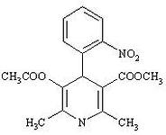
ANTIANGINAL DRUGS
Fenygidine –
- expands (dilates) spasmodic coronary arteries;
- improves poststenotic coronary circulation in atherosclerotic obstructions.
Pharmacokinetics - The effect of the drug with sublingual application begins to manifest after 5-15 minutes, and when administered orally - after 10-30 minutes.
The maximum effect develops after 30-90 minutes after ingestion and persists for 4-6 hours.
Side effects:
- headache, dizziness, fatigue;
- tides of blood to the face;
- reflex tachycardia;
- hypotension, edema of the shins;
- nausea, feeling full of stomach;
- itching, hives;
- gingival hyperplasia;
- temporary hyperglycemia.

Slide 35
ANTIANGINAL DRUGS
Beta-adrenoblockers:
Classification:
Non-selective
Pindolol (Visken) 2,5-7,5 mg 3 times a day
Propranolol (Inderal, Оbsidane, Anaprilinum) 20-80 mg 2 t/d
Selective
Metoprolol – (Betalok-zok, Egilok, Мetocard, Corvitol) 50-100 mg 2 times a day
Аtenolol (Теnormin, Аtenosan) 50-100 mg 1-2 times a day
Bisoprolol (Concor, Concor Cor) 2,5-10 mg/day
Betaxolol (Lokren, Betoptik, Betak) 10-20 mg/day
Аcebutolol (Sectral) 200-400 mg 2 times a day
Beta-blockers with additional vasodilating properties
- Nebivolol (Nebilet) 2,5-5 mg/day
- Carvedilol (Dilatrend, Coriol) 25-50 mg 2 times a day

Slide 36
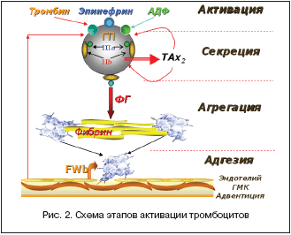
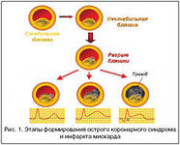
Medications that improve the prognosis in patients with angina pectoris
Аntiaggregative (antiplatelet) drugs
АSA -the basis of the prevention of arterial thrombosis. The optimal dose of ASA is 75-150 mg/day, the use of ASA in patients with angina pectoris, especially those with MI, reduces the risk of recurrent MI, on average, by 23%.
Ticlopidine is a non-competitive blocker of ADP receptors and is comparable to antiplatelet activity with ASA.
Clopidogrel is an alternative
antiplatelet preparation –
75 mg/day

Slide 37
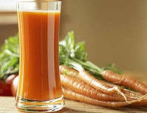
Medications that improve the prognosis in patients with angina pectoris
Lipid-lowering drugs
Classification:
• Statins: lovastatin, simvastatin, atorvastatin, rosuvastatin
• Bile acid sequestrants (anion exchange resins): cholestyramine, colestipol.
• Fibrates: gemfibrozil, fenofibrate.
• A nicotinic acid.
• Different (probucol, unsaturated fatty
acids, fat-soluble vitamins).
Lipid-lowering therapy is indicated for patients with hyperlipoproteinemia at a concentration of:
Cholesterol in the blood above 6.5 mmol/l and
trigcycerides is above 2.3 mmol/l.

Slide 38
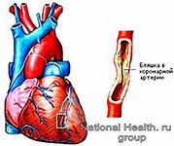
Drug therapy for ischemic heart disease
Drug therapy for IHD is carried out stepwise:
I step - monotherapy with a drug of one of 3 groups of choice:
-nitrates
-beta blockers
-calcium antagonists
II step - a combination of 2 drugs of the choice group:
-nitrates + beta blockers
-nitrates + calcium antagonists
III step - a combination of drugs of choice
with auxiliary antianginal agents.

Slide 39
Recommendations for pharmacotherapy, improving the prognosis in patients with stable angina pectoris
Class I:
- Aspirin 75 mg/day in all patients in the absence of contraindications (active gastrointestinal bleeding, allergy to aspirin or its intolerance)
- Statins in all patients with coronary heart disease
- ACE inhibitors in the presence of arterial hypertension, heart failure, left ventricular dysfunction, suffered myocardial infarction with left ventricular dysfunction or diabetes mellitus
- Beta-blockers in patients after a history of myocardial infarction or with heart failure

Slide 40
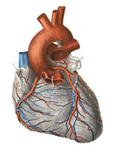
Recommendations for pharmacotherapy, improving the prognosis in patients with stable angina pectoris
Class II а:
- ACE inhibitors in all patients
with angina and confirmed
diagnosis of coronary heart disease
- Clopidogrel as an alternative of
aspirin in patients with stable
angina that can not take aspirin,
for example, because of allergies
- Statins in high doses in the presence of high risk (cardiovascular mortality - more than 2% per year) in patients with proven coronary heart disease

Slide 41
Recommendations for pharmacotherapy, improving the prognosis in patients with stable angina pectoris
Class II b:
- Fibrates with low HDL or high triglycerides in patients with diabetes mellitus or metabolic syndrome
- Drug therapy aimed at relief of symptoms
- Antianginal drugs (drugs that prevent attacks of angina pectoris): 3 main groups of antianginal drugs: beta-blockers, nitrates and prolonged calcium chanel blockers.
Until now, it is not clear whether the therapy with antianginal drugs affects the prognosis of the life of patients with uncomplicated course of ischemic heart disease (without MI in the anamnesis).

Slide 42
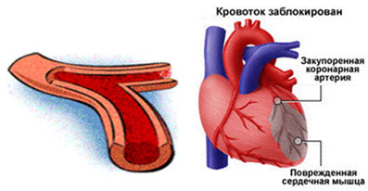
Myocardial infarction
characterized by the formation of a necrotic focus in the heart muscle as a result of a violation of the coronary circulation.

Slide 43
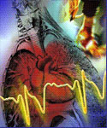
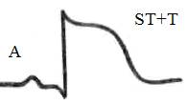
Myocardial infarction (MI)
Symptomatology
The main symptom of MI prolonged
painful attack in the heart and behind
the breastbone.
Pain occurs suddenly and rather
quickly reaches high severity,
can irradiate to the left hand, scapula,
lower jaw, interscapular space.
Unlike pain in angina pectoris with myocardial infarction, the pain is much more intense and is not stopped by the intake of nitroglycerin.
Such a variant of the onset of a heart attack
is typical (the so-called anginal status).

Slide 44
Treatment of myocardial infarction
For the treatment of a patient with acute infarction a number of measures are used:
relief of a pain attack;
2) anticoagulant and fibrinolytic therapy;
3) oxygen therapy;
4) prevention and management of heart rhythm disturbances;
5) treatment of complications.

Slide 45
Treatment of myocardial infarction
1. Pain relief
- Introduction of narcotic analgesics (morphine, omnopon, promedol)
- Neuroleptanalgesia (droperidol - neuroleptic and fentanyl - narcotic analgesic).
2. Anticoagulant and fibrinolytic therapy
is performed to stop the beginning of coronary artery thrombosis, prevent new thrombosis, prevent thromboembolic complications.
Intravenously drip aktilise in combination with heparin for 3-7 days, and then the patient is transferred to the reception of indirect anticoagulants (fenilin, warfarin). Heparin is administered under the control of blood clotting (activated partial thromboplastin time), indirect anticoagulants are dosed taking into account prothrombin time (international normalized ratio).

Slide 46
Treatment of myocardial infarction
2. Thrombolysis
- all thrombolytics convert plasminogen to the active enzyme plasmin responsible for cleavage of the fibrin component of thrombus
- differences between drugs are reduced to the degree of generalized fibrinolysis they cause (which determines the need for heparin therapy), side effects and cost.

Slide 47
Treatment of myocardial infarction
2. Thrombolysis
Thrombolytics
Streptokinase. The cheapest drug; the lowest probability of intracranial hemorrhage.
Urokinase. It costs expensive. Advantages over streptokinase are not proven.
Anistreplase. It costs expensive. Advantages over streptokinase are not proven.
Alteplase. It costs expensive. The greatest risk of intracranial hemorrhage. With accelerated administration, the use of heparin IV and early (4 h) initiation of therapy - some improvement in survival compared with streptokinase. To maintain patency of the coronary artery, immediate intravenous administration of heparin is necessary. Therapy with heparin is continued for 3-7 days.

Slide 48
Treatment of myocardial infarction
2. Thrombolysis
Streptokinase preparations (streptase, streptoliasis) - the product of vital activity 7b 0-hemolytic streptococcus, and urokinase, the product of the vital activity of the human body.
Interacts with the profibrinolysin and, the resulting complex acquires proteolytic activity and activates the transition of profibrinolysin (plasminogen) to fibrinolysin (plasmin). The latter, being a proteolytic enzyme, dissolves fibrin.
Streptoliasis is administered intravenously droplly, usually starting at 250,000 units, at a rate of 30 drops per minute. The subsequent treatment is carried out with heparin and indirect anticoagulants.

Slide 49
Treatment of myocardial infarction
3. Anticoagulants are divided:
- anticoagulants of direct action (heparin)
- indirect action:
--derivatives of 4-hydroxycoumarin (neodicumarin, syncumar)
--derivatives of indandione (phenylin)
Heparin -
-activates the co-factor of antithrombin III, accelerating its anticoagulant action
-neutralizes a number of activating factors of blood coagulation (kallikrein, IX, X, XI, XII, XIII)
-violates the transition of prothrombin to thrombin
-inhibits thrombin (IIa)
-lowers blood lipids
Heparin is administered intravenously at 10 000-15 000-25 000 units and subcutaneously at 10 000 units. Starting from the second day, the dose is 30 000-50000 units. The administration of heparin continues for 4-8 days, 1-2 days before its cancellation, the daily dose is gradually reduced by 2500-5000 units

Slide 50
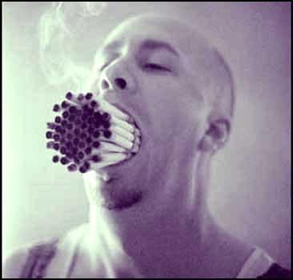
Prophylaxis of ischemic heart disease
а) smoking.
Smokers, in comparison with non-smokers, are 2 times more likely to die from heart attacks.

Slide 51

Prophylaxis of ischemic heart disease
b) overweight.
People who consume fats above average (especially animal origin) are at increased risk of atherosclerotic plaques.

Slide 52

Prophylaxis of ischemic heart disease
c) low
motor
activity
(hypodynamia).
Regular
the physical
exercises
increase the efficiency
work of the heart, while reducing the need for oxygen.

Slide 53

Prophylaxis of ischemic heart disease
d) caffeine in large doses.
- It is desirable that the total intake of caffeine per day does not exceed 400 mg.
- A cup of natural coffee contains about 200 mg of caffeine.
- The same cup of instant coffee - 80-100 mg.
- The same cup of tea - 50 mg.

Slide 54
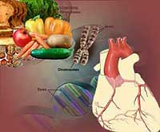
Prophylaxis of ischemic heart disease
e) food,
nutrition.

