Slide 1
Principles of clinical-pharmaceutical approach
to the selection of drugs for the treatment
of bronchial asthma and chronic
obstructive pulmonary disease

Slide 2
COPD
The term "chronic obstructive pulmonary disease" (COPD)
appeared about 30 years ago and was proposed to refer to slowly progressing and irreversible airway obstruction, usually in smokers.
There are usually two main reasons for this obstruction:
- narrowing of the bronchi due to inflammation, sclerosis (chronic bronchitis)
loss of the elastic framework of the lungs due to the destruction of peripheral airborne spaces (emphysema)
In most cases it is almost impossible to determine the specific contribution of bronchitis and emphysema to the development of airway obstruction in this patient, therefore the terms "chronic bronchitis" and "emphysema" are often replaced by the term COPD

Slide 3
Chronic
obstructive
bronchitis is included in the concept
COPD -
chronic obstructive pulmonary
disease

Slide 4
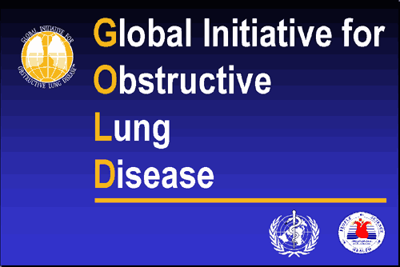
2001, 2003, 2006

Slide 5
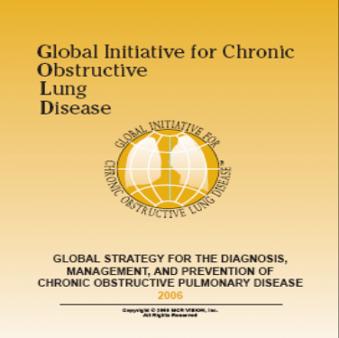
Recommendations GOLD edition 2006 year
Have appeared on November, 20th 2006
The first complete revision of the GOLD document
The general structure of 2001-2005 saved
New evidence is included
2 new items on tiotropium bromide
New chapter on primary care
Notes:
В наших силах сделать больше, существует больше способов решения проблемы, больше способов борьбы.

Slide 6
Recommendations GOLD 2006
Main changes
Subject | Change | Соntent
Definition | Uploaded | Preventable and treatable
Classification | removed | Stage 0
Prevalence | uploaded | Research data PLATINO, BOLD
Pathology | uploaded | Comparison COLD with bronchial asthma
Bronchodilators | removed | Long-acting expensive
Tiotropium | uploaded | Reducing the frequency of exacerbations
Tiotropium | uploaded | Increases the effectiveness of rehabilitation programs
Inhalation corticosteroids | uploaded | Decrease in mortality associated with any causes, requires prospective studies
Inhalation corticosteroids/beta2-long-acting agonists | removed | Advantage over beta2-short-acting agonists/ anticholinergic drugs
Exacerbations | uploaded | Impact on quality of life, impairment of lung function, socio-economic significance
Primary care | uploaded | A new chapter, a link to IPAG
Notes:
В наших силах сделать больше, существует больше способов решения проблемы, больше способов борьбы.

Slide 7





Prevalence of COPD in Europe
Clinically confirmed diagnosis of COPD has 4-6% of adults
  1.8 million in Spain
  3.0 million in England
  2.7 million in Germany
  2.6 million in Italy
  2.6 million in France
  More than 10% of adults have signs of airflow restriction (bronchial obstruction)
Notes:
Данные Европейского Респираторного Общества (European Respiratory Society) и Европейского Фонда Легких (European Lung Foundation). European Lung White Book (2003)

Slide 8
Mortality
Every year, 200,000 to 300,000 people die from COPD in Europe
By 2020, COPD will be the third largest cause of death in the world and will cause 6 million deaths per year
From 1968 to 1999 in the US, mortality from COPD among men increased by 27%, while among women, mortality from COPD increased by 38%
The mortality from COPD among women is now approaching COPD mortality among men

Slide 9
Mortality from COPD
Causes of death in patients with COPD:
COPD I - III stages - the frequency of deaths is the same and can be associated with diseases of the cardiovascular system
COPD III – IV - the cause of death can be cancer
acute respiratory failure (38%)
pulmonary heart (13%)
pulmonary infections (including hospital pneumonia - 11%)
embolism of the pulmonary artery and its branches (10%)
cardiac arrhythmias (8%)

Slide 10
Genetic factors involved in the pathogenesis of COPD
α1-antitrypsin
α1-antichymotrypsin
Transmembrane regulatory protein (TRB)
Vitamin D-binding protein
α2-macroglobulin
Cytochrome P 4501A1
Blood group antigens (patients with blood group II (A) had lower FVD values than group I (0)
The HLA system (<allele frequencies of HLA-Bw16 in individuals with low FEV1 and> HLA-B7 allele frequencies)
Immunodeficiency conditions

Slide 11
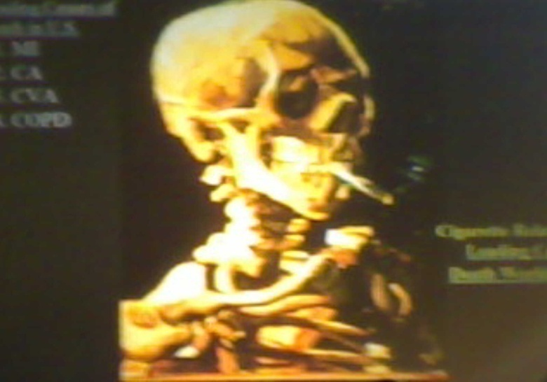
Распространенность курения

Slide 12
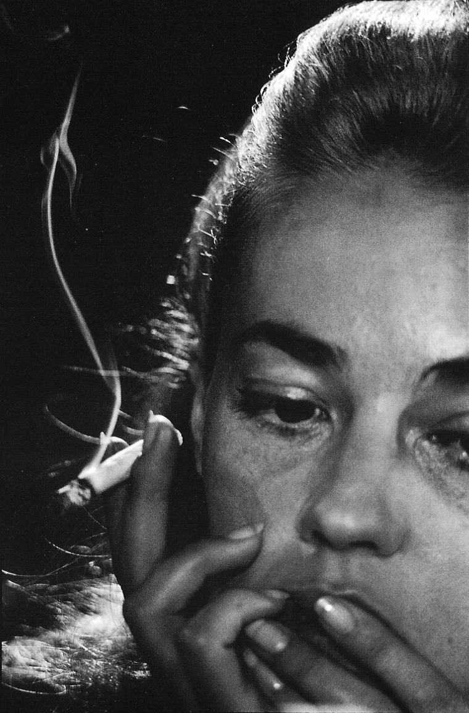
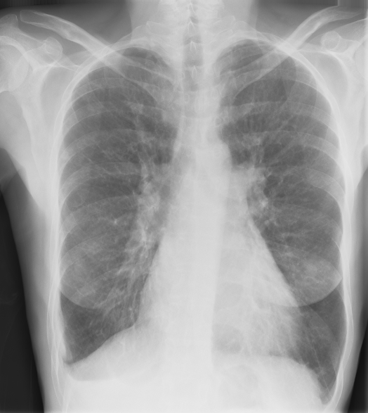
Women are more susceptible
to the effects of tobacco
Smoke than men

Slide 13


Slide 14
Index of a smoking person (IS)
IS (pack of cigarettes/ years) = n smoked cigarettes per day Х smoking experience (years)
IS > 10 pack/ years -
a significant risk factor for the development of COPD

Slide 15
Smoking and life expectancy
  Smoking - in 90% of cases is cause of COPD
  Smoking-abstinent people have reduced COPD mortality, reduced respiratory symptoms (cough, sputum production, wheezing), as well as the frequency of lower respiratory infections

Slide 16
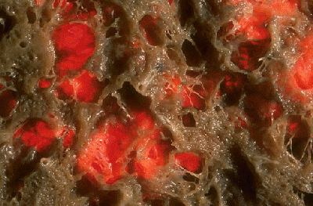
Human lungs – smoking experience 10 years

Slide 17
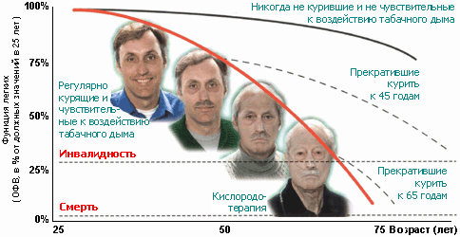
Deterioration of lung function as a addiction of smoking
The risk group of COPD is, as a rule, smokers with experience, smoking one pack of cigarettes a day for 20 years.
The median age at onset of the disease is 40 years
Women are more susceptible to adverse effects of tobacco smoke than men

Slide 18
Professional factors,
causing intense and prolonged exposure of dust, chemicals, vapors, etc., can cause the development of COPD, regardless of smoking, or increase the risk of diseases in smokers

Slide 19
Costs for COPD and asthma in the US, mln
Total cost
Direct medical costs
Indirect
costs
COPD
23.900
14.700
9.200
ASTHMA
12.600
9.800
2.800
Cost per 1 COPD patient is THREE times
exceed costs for 1 patient of asthma and
amounted to 1522 USD per 1 patient / year

Slide 20
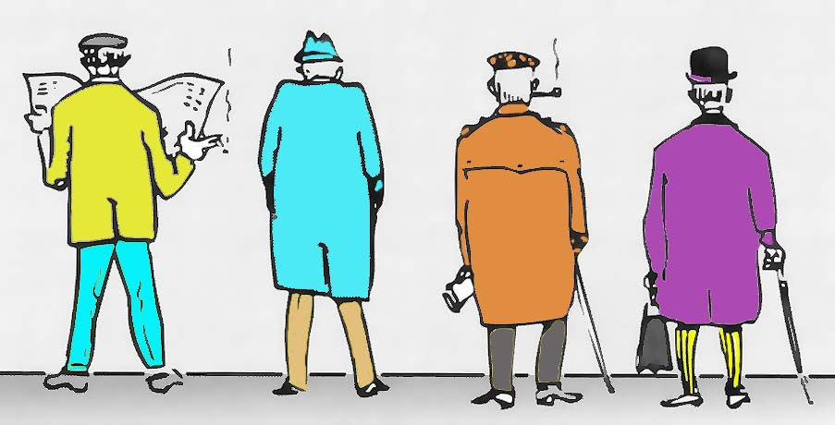
Which of these men suffer from COPD?
А
B
C
D

Slide 21
DEFINITION
CHRONIC OBSTRUCTIVE PULMONARY DISEASE (COPD)–
a chronic inflammatory disease that occurs in people over 35 years of age under the influence of various risk factors (harmful particles or gases), most often smoking, which occurs with a primary lesion of the distal parts of the respiratory tract and lung parenchyma and the formation of emphysema.
COPD is associated not only with lung damage, but also with systemic manifestations.

Slide 22
DEFINITION (continued)
COPD is characterized by an airflow restriction that is not completely reversible, which is caused by an inflammatory response other than bronchial asthma and is present regardless of the severity of the disease
COPD is a preventable and treatable disease (GOLD, 2006)
COPD - the disease develops in predisposed individuals and is manifested by coughing, sputum separation and increasing dyspnea, has a steadily progressive nature with the outcome of chronic respiratory failure and pulmonary heart disease

Slide 23
Definition of COPD
Chronic obstructive pulmonary disease is a disease that can be prevented and treated, and which is accompanied by extrapulmonary manifestations that increase the severity of the disease
characterized by the limitation of the air flow, which is not reversible completely
airflow restriction usually progresses and is associated with an inflammatory response of the lungs to pathogenic particles or gases

Slide 24
The Evolution of COPD
Lung function
Progression
РаО₂ 60 mm Hg
CRF
РаО₂ 30 mm Hg
Exacerbation
Death
годы
Notes:
ХОБЛ - заболевание, характеризуемое ограничением скорости воздушного потока, которое обратимо не полностью. Ограничение скорости воздушного потока при ХОБЛ, в отличие от БА, является прогрессирующим и связано с патологическим воспалительным ответом легких на действие ингалируемых патогенных частиц или газов.

Slide 25
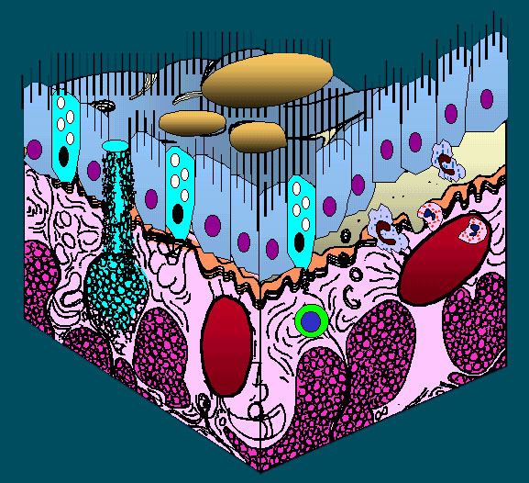
COPD: a basic model of inflammation
Cell of
inflammation
Inflammation
reactions
Degranulation
CD8+
Adhesion
Neutrophils
Eosinophils
Macrophages
Activation
Chemotaxis
Broncho-
constriction
Imbalance:
proteolysis-
antiproteolysis,
oxidant-antioxidants
Myeloperoxidase
IL8

Slide 26
COPD: cells of inflammation
SPUTUM
Exacerbation
Remission
COPD
Eosinophils
Neutrophils
ASTHMA
Neutrophils
Eosinophils

Slide 27
COPD: cells of inflammation
BIOPSY
Exacerbation
Remission
COPD
Eosinophils, T-cell Neutrophils
T-cell, macrophages
ASTHMA
Eosinophils, T-cell
Eosinophils, T-cell

Slide 28
DIAGNOSTICS of COPD
Risk factors
Symptoms
smoking
cough
sputum
occupational hazards
dyspnea
pollution of environment
è
Spirometry
Notes:
A diagnosis of COPD should be considered in any patient who has cough, sputum production, or dyspnea and/or a history of exposure to risk factors. The diagnosis is confirmed by spirometry.
To help identify individuals earlier in the course of disease, spirometry should be performed for patients who have chronic cough and sputum production even if they do not have dyspnea.
Spirometry is the best way to diagnose COPD and to monitor its progression and health care workers to care for COPD patients should have assess to spirometry.

Slide 29
Diagnostics of COPD
Clinical and anamnestic signs of COPD are the following symptoms:
- cough with sputum;
- dyspnea;
- risk factors (smoking, occupational hazards, pollutants, rarely inherited deficiency of alpha-1-antitrypsin).
The most important diagnostic feature of COPD is not a completely reversible airflow restriction.

Slide 30
Diagnosis and monitoring (key provisions)
Diagnosis of COPD should be suspected in all patients with chronic cough, sputum and/or dyspnea and risk factors in the history.
The diagnosis is confirmed by spirometry.
Patients with risk factors in a history should be tested to detect airflow limitation, even if they do not have shortness of breath.

Slide 31
METHODS OF RESEARCH
X-ray (radiography)
Perfusion scintigraphy
- COMPUTER TOMOGRAPHY
(with the use of functional and high-resolution methods)

Slide 32
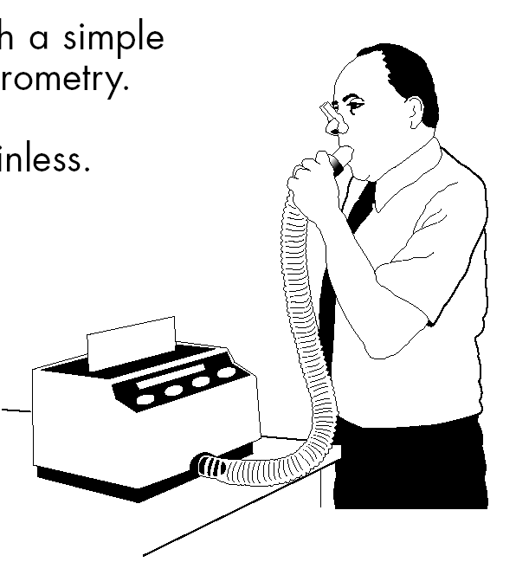
SPIROMETRY
The main sign that allows to speak about the presence of COPD
is determined by the spirometry index:
FEV1 / FVC <70%
FEV1 / FVC <70%
Postbrioncho-
lytic
FEV1 <80%

Slide 33
Obstruction is considered chronic, if it is registered, at least 3 times within one year, despite ongoing therapy
Postbronchodilator ratio
VFE₁/ FVCL < 70%
indicates a violation of bronchial patency in COPD

Slide 34
Clinics of COPD
Prolonged cough;
Sputum production;
Dyspnea;
Respiratory insufficiency;
Pulmonary heart.

Slide 35
System effects of COPD
Weight loss
Effects
Weakness of
skeletal muscles,
loss of muscle
mass,
osteoporosis
Neuropsychiatric
disorders,
depression,
memory disorders,
sleep disorders
Heart failure,
endothelial
dysfunction,
erythrocytosis

Slide 36
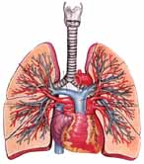
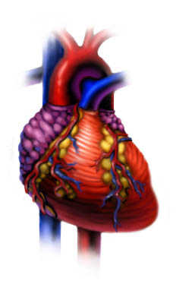
Target organs
Pulmonary system
Systemic
inflammation

Slide 37
Characteristics of COPD
In the clinical picture of COPD, in addition to bronchial obstruction, has the meaning of pulmonary hyperinflation (PHI).
At the heart of PGI lies the air trap, which develops due to incomplete emptying of the alveoli during expiration due to loss of elastic traction of the lungs or due to insufficient expiration time in conditions of pronounced restriction of the expiratory air flow.

Slide 38
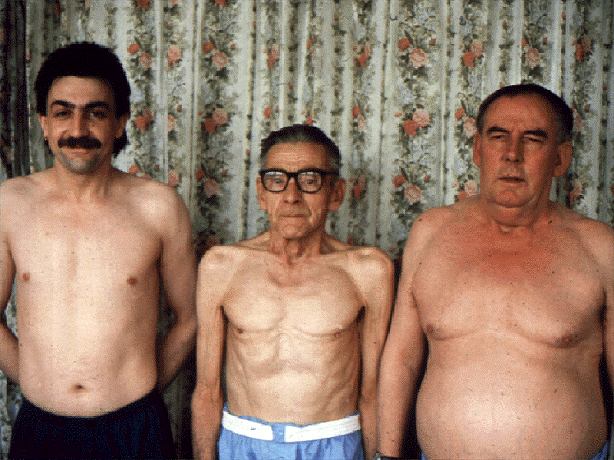
AIRWAY OBSTRUCTION
auscultatory: dry wheezing with forced breathing
Elongation of forced exhalation time
Hyperinflation

Slide 39
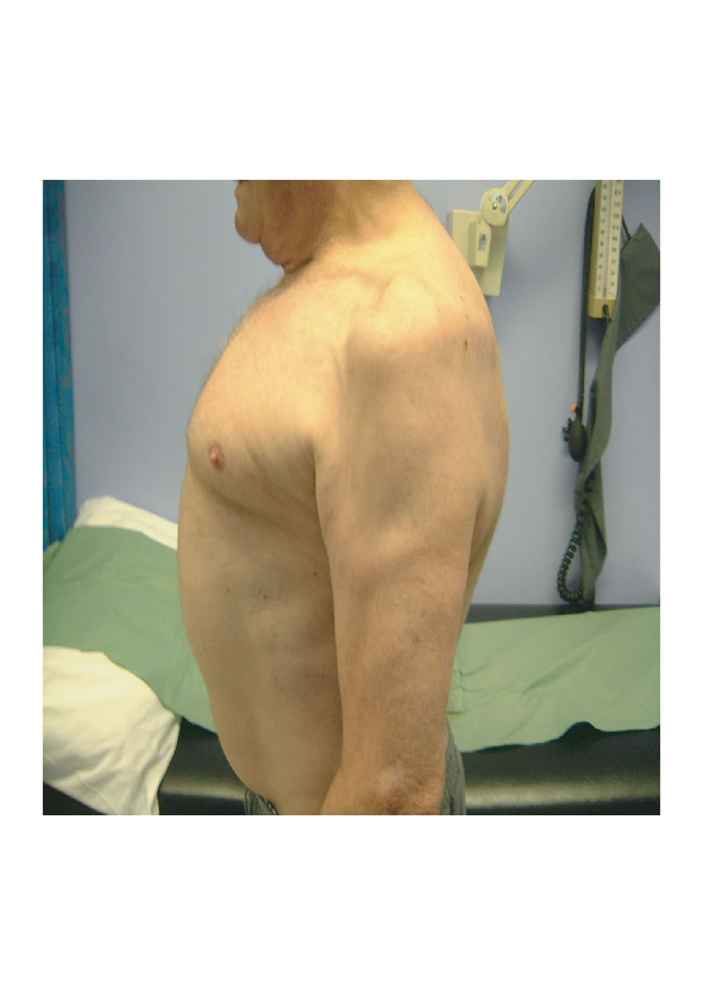
Symptom of Campbell -
shortening of the extrathoracic part of trachea <4 cm

Slide 40
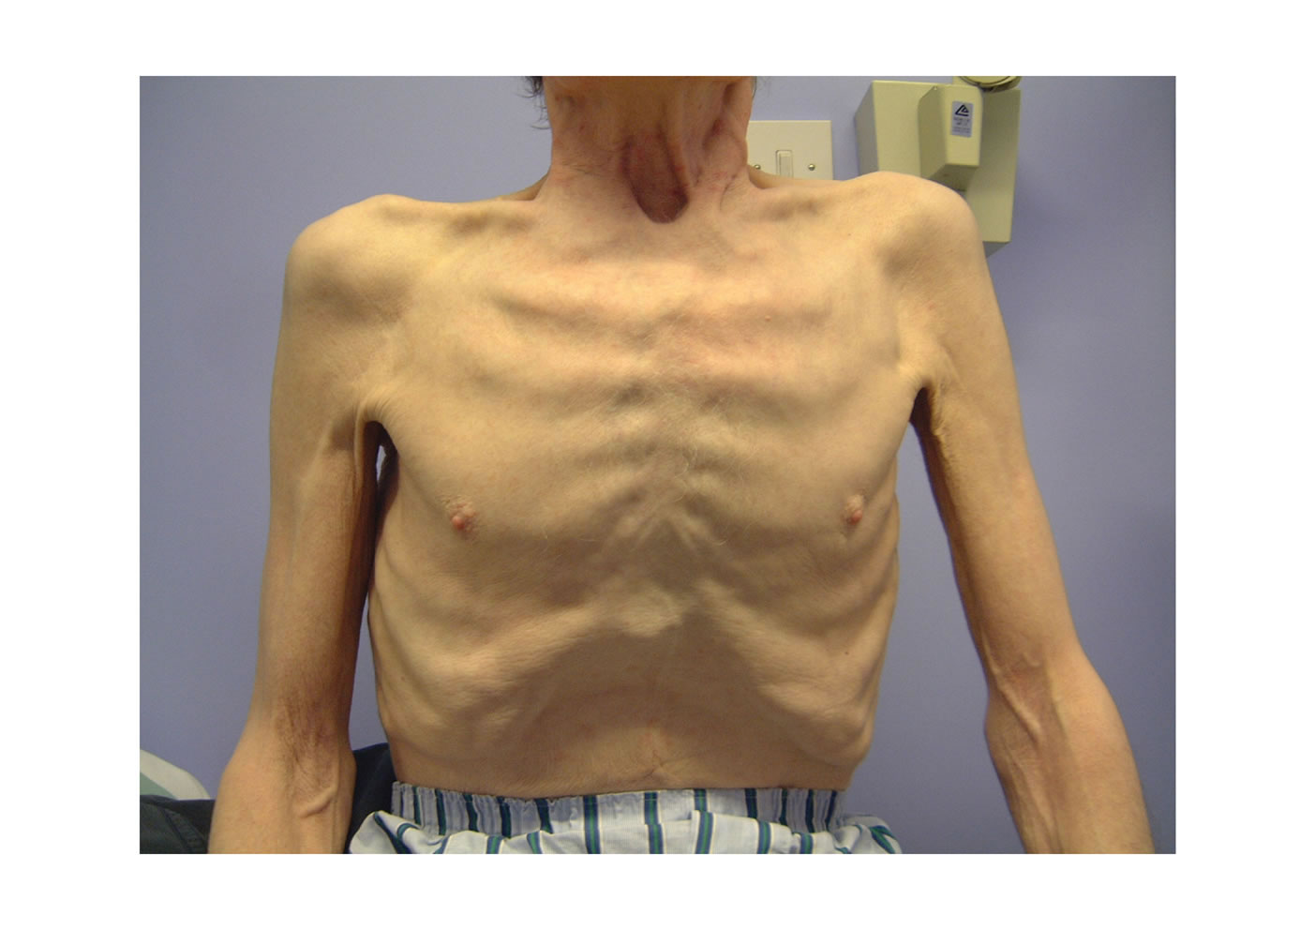
Symptom of Hoover
Lower parts of the thorax
during the inhalation move not outward, but inside

Slide 41
Structure of lungs volumes in norm and in patients with COPD
TLC
TLC
IRV
IC
Vt
IC
IRV
ERV
FRC
Vt
FRC
RV
ERV
FRC – функциональная
остаточная емкость
IC – инспираторная емкость
TLC – общая емкость легких
RV

Slide 42
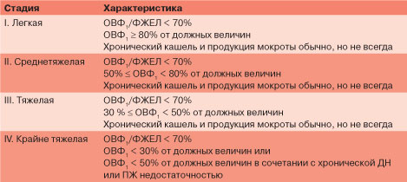
Classification of COPD by severity
Stage 0 indicates an increased risk of COPD

Slide 43
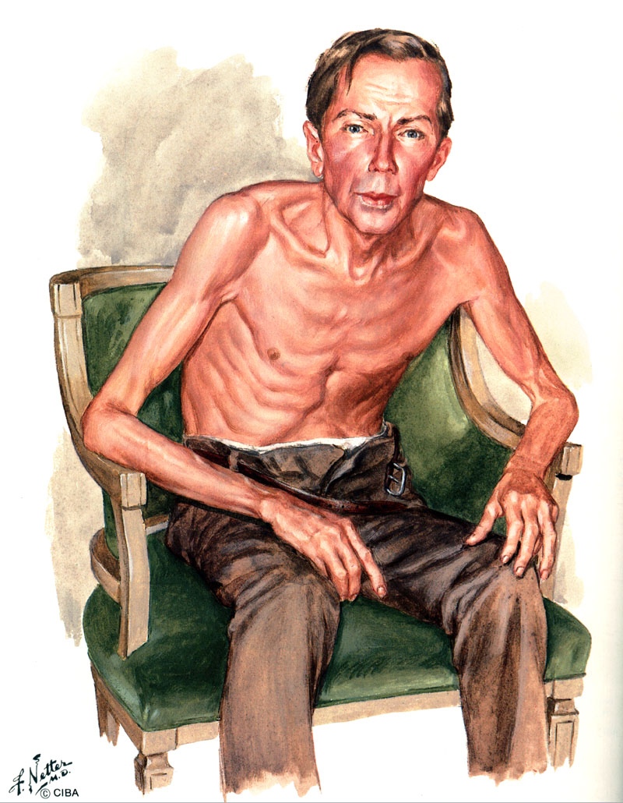
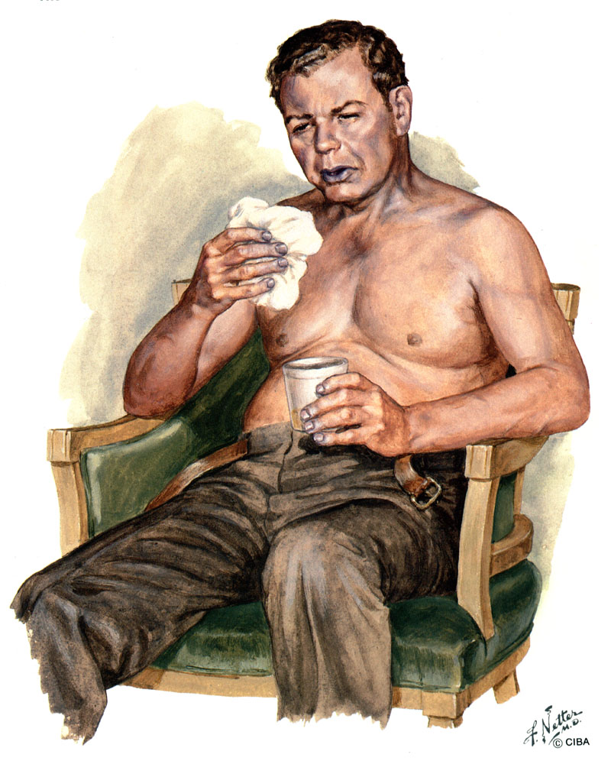
Emphysematous type of
patient with COPD
Bronchotic type of patient
with COPD
«Pink puffers»
«Blue with dyspnea»

Slide 44
TREATMENT OF COPD
The purpose of treatment:
decrease in the rate of progression of diffuse bronchial damage leading to an increasing respiratory failure
reduction in the frequency of exacerbations
lengthening remission
increased exercise tolerance
improving the quality of life
This purpose is achieved in the following areas:
- reduction in the impact of risk factors
- implementation of educational programs
- treatment of COPD in a stable condition
- treatment of exacerbation of the disease

Slide 45
TREATMENT OF COPD
The treatment programs for COPD are determined by:
stage of the disease
severity of symptoms
severity of bronchial obstruction
frequency and severity of exacerbations
presence of respiratory insufficiency and other complications
concomitant diseases
In all stages of COPD special attention is paid to:
- elimination of risk factors
- training of patients
- preventive and rehabilitation measures

Slide 46
TREATMENT OF COPD
Cessation of smoking - is the first and mandatory step in the program of treatment of COPD
This is the most effective and economically feasible way to reduce the risk of COPD and prevent the progression of the disease.
Along with this, it is necessary to carry out primary preventive measures to reduce the adverse effects of atmospheric, industrial and domestic pollutants.

Slide 47
Drug therapy - pharmacotherapy
The basic principles of managing patients with stable course of COPD are as follows:
- stepwise increase in the volume of therapy, depending on the severity of the course;
- training of patients, elimination of risk factors;
- use of pharmacotherapy to improve symptoms and/or reduce complications;
- bronchodilators occupy a central place in the therapy of COPD;
- Inhaled glucocorticoids are used only in patients with a proven clinical or spirometric response, or with FEV1 <50% of due or with repeated exacerbations;
- prolonged use of systemic corticosteroids is not recommended;
- programs for physical training are shown to all patients;
- тo prevent infectious exacerbations, vaccine therapy is advisable;
- with severe respiratory failure, long-term oxygen therapy is used.

Slide 48
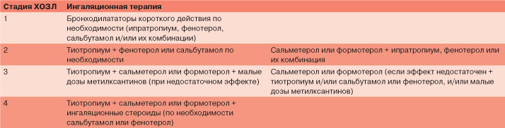
Bronchodilator therapy
-Bronchodilators are the basis of symptomatic therapy in the stable course of COPD.
-Preferably their inhalation use.
-The choice between sympathomimetics, anticholinergics, theophylline or combination therapy depends on availability, individual effectiveness and side effect

Slide 49
Anticholinergic drugs
Inhalation anticholinergics are the first choice drugs in the treatment of COPD:
1. Ipratropium bromide - (duration of action is 6-8 h).
2. Tiotropium bromide is a new anticholinergic agent of prolonged action - it is applied once a day, the anticholinergic action of tiotropium is approximately 10 times greater than that of ipratropium, the important property is the property of tiotropium to slow down the rates of progressive decline in bronchial patency.
3. Berodual - a combined drug (ipratropium bromide + fenoterol).
Cholinolytics provide competitive inhibition of M-cholinergic receptors and a decrease in the parasympathetic tone of the bronchi.
- The effect after inhalation of cholinolytics occurs later than when using sympathomimetics.
- It lasts longer than with sympathomimetics.
- There are no systemic effects.
- As the aging of receptors to the anticholinergics remain sensitive.

Slide 50
Selective β₂-аgonists
Short action:
Salbutamol (Salamol, Ventolin, Ascoryl)
Fenoterol (Berotec)
Long-acting:
Formoterol (Foradyl)
Salmeterol (Salmeter)
β₂₋аgonists have a less pronounced bronchodilator effect in COPD than in bronchial asthma.
They are recommended to be prescribed to patients with intermittent symptoms to reduce clinical manifestations.
These drugs are recommended to use no more than 3-4 times a day, or as a prophylaxis before physical exercise.
Beta-agonists are preferred in inhalations, but they can be administered orally or parenterally.
According to the indications, the use of spacers for better drug delivery and reduction of side effects.

Slide 51
Selective β₂-аgonists
The mechanism of action of b₂-аgonists
increase the concentration of intracellular cAMP, which leads to a relaxation of the smooth muscles of the bronchi and an increase in bronchial patency;
stimulate mucociliary transport due to an increase in the frequency of ciliary effusions of epithelial cells;
have an effect on the cardiovascular system: they
- can improve the systolic function of the myocardium
- to reduce vascular resistance in the large and small circle of blood circulation, leading to a decrease in biventricular afterload;
act on the function of the respiratory musculature:
- increase the global strength and endurance of the respiratory muscles;
reduce the manifestation of fatigue of the diaphragm.
In COPD, the bronchodilator effect is not as pronounced as with bronchial asthma, but even a small bronchodilation can lead to a decrease in airway resistance and a decrease in the work of breathing

Slide 52
Selective β₂-аgonists
Doses and duration of action of the main sympathomimetics
Drug | Dose, mg | Duration, h
Salbutamol (albuterol) | 0,12,5 - 54 | 6
Metaproterenol (аlupent) | 0,6510 - 151 | 3
Terbutalin (bricanil) | 0,20,25 - 0,53 | 6
Fenoterol (berotec) | 0,21 - 24 | 6
Bitolterol (tornalat) | 0,370,5 - 25 | 8
Pyrbuterol (maxair) | 0,2-3 | 6

Slide 53
Selective β₂-аgonists
The basis of inhalation technique for exacerbation of COPD is the use of nebulizers
Their advantages become especially valuable in severe patients with a pronounced decrease in the functional reserves of respiration:
- provides a good coordination of inspiration of the patient with the release of the drug;
- it is not necessary to perform forced inspirational maneuvers;
- guaranteed adequate deposition of drug substance in the respiratory tract.
An alternative to nebulizers is the use of volumetric nozzles for metered-dose inhalers – spacers:
they also significantly improve the coordination of inspiration;
much cheaper than nebulizers and spend less money on drugs.
Studies comparing inhalation techniques using spacers and nebulizers show that nebulizer use of b2-agonists is more effective in exacerbating COPD

Slide 54
Methylxanthines
The bronchodilating effect of theophylline is lower than that of cholinergic and adrenomimetic drugs
- They increase cardiac output
- Reduce the resistance of the vessels of the lungs
- Have immunomodulatory and anti-inflammatory properties
- Affect the activation and redistribution of lymphocytes
- Reduce the number of activated eosinophils and their degranulation in the airways
Cause a decrease in the release of cytokines IL-1b, IL-4, IL-5, tumor necrosis factor
Theophyllines are administered orally, intravenously, in suppositories, and may be used in patients who find it difficult to use inhalers.
The use of prolonged theophyllines, which are prescribed 1-2 times a day, has become widespread.
Caution is needed when prescribing theophyllines to patients with heart rhythm disorders

Slide 55
Treatment of COPD
Pharmacotherapy of COPD is divided into:
- stable course therapy (remission stage)
- therapy of exacerbations
Steady flow therapy is stepwise, with a gradual increase, long, takes into account the stage and severity of COPD
At all stages of COPD it is recommended:
- smoking cessation
- limiting exposure to risk factors
If necessary: exacerbation, contact with provoking factors, excessive physical exertion, and others are prescribed short-acting bronchodilators

Slide 56
Treatment of II stage of COPD
As a basic therapy appoint:
- prolonged-action bronchodilator
- program of necessary rehabilitation
Bronchodilators (M-cholinolytics, β2-agonists, methylxanthines) are key in the treatment of COPD. They are prescribed for preventive and curative purposes for a long time and/or according to need (for relief of symptoms).
The main principles of their use are:
- individual selection
- preference of inhaled and prolonged forms
- preference of combined preparations.

Slide 57
Treatment of III and IV stages of COPD
To therapy attach:
Inhaled glucocorticosteroids in high doses (on average - 1000 mcg) after conducting a sensitivity test for 3 weeks to 6 months.
At IV stage also shows prolonged (up to 15 hours per day) oxygen therapy up to increase of the target parameters of gas exchange PaO2 up to 60 mm. Hg at rest and/or SаО2 at least up to 90%.

Slide 58
Treatment of COPD
Other groups of drugs that are used in COPD therapy include:
- Mucolytics
- Antioxidants
- Antitussive
Mucolytics and antioxidants are usually used for exacerbations
N-acetylcysteine (flumucil, mucosolvin, ACC)
- Has a mucolytic effect associated with the depolymerization of intermolecular disulfide bonds of sputum glycoproteins;
- It has pronounced antioxidant properties, since it is a precursor of glutathione - one of the most important components of the body's antioxidant defense;
Inhibits production of proinflammatory cytokines TNF-a and IL-1b.
The drug is given in a dose of 600 to 1200 mg/day in the form of tablets or powders or is introduced with a nebulizer at a dose of 300 to 400 mg twice a day

Slide 59
Treatment of COPD
Ambroxol (lasolvan):
- Affects the production of mucus in the respiratory tract;
- Has anti-inflammatory and antioxidant properties;
- Has a stimulating effect on alveolocytes of the second type, which leads to an increase in the formation of surfactant.
Ambroxol can be given orally, intravenously and with the help of a nebulizer, the average therapeutic dose is 30 mg 3 times a day.
DNase - mucolytic enzyme preparation of recombinant deoxyribonuclease
It is able to reduce the viscosity of purulent sputum by depolymerizing DNA - the product of destruction of leukocytes
DNase is an effective drug in the treatment of cystic fibrosis both in the stable course and in exacerbations of the bronchopulmonary process
The drug is administered with a nebulizer at a dose of 2.5 mg 2 times a day.

Slide 60
Аntibacterial drugs
Infection of the tracheobronchial tree is the most common cause of exacerbation of COPD
The most common pathogens are three types of microorganisms:
Haemophilus influanzae,
Streptococcus pneumoniae,
Moraxella catarrhalis.
In most cases, with exacerbation of COPD, bacteriological and serological methods reveal untypable strains of Haemophilus influanzae
More rarely, the cause of the infectious process can be other pyogenic bacteria: streptococci, staphylococci, gram-negative microorganisms
Also possible causal factors may be:
Mycoplasma pneumoniae
Viruses
Chlamydia pneumoniae

Slide 61
BRONCHIAL ASTHMA
Bronchial asthma -
this is a chronic inflammatory disease of the respiratory tract characterized by hyperreactivity of the bronchi and manifested by attacks of suffocation or, in the absence of such, respiratory discomfort (paroxysmal cough, shortness of breath (dyspnea), wheezing).
The prevalence - from 4 to 10% of the world's population suffer from bronchial asthma
Classification:
I. On the etiology:
-Allergic (atopic, exogenous).
-Non-allergic (endogenous).
According to ICD-10, mixed and unspecified forms are also distinguished.

Slide 62
Bronchial asthma
Classification:
II. By severity (based on the number of seizures and external respiration rates):
Degree 1 - mild episodic (intermittent) asthma. Symptoms are noted less often 1 time per week. Nocturnal seizures are more than 2 times a month. In the interattack period, symptoms are absent, the function of the lungs is normal. Daily fluctuations of peak expiratory flow (PEF) are less than 20%.
Degree 2 - mild persistent asthma. Symptoms occur more than once a week, but not daily. Night attacks are more than 2 times a month. PEF and FEI1 beyond the seizure of more than 80% of the expected values. Daily fluctuations of PEF 20-30% indicate an increasing reactivity of the bronchi.
Degree 3 - persistent asthma of moderate severity. Symptoms occur daily. Nocturnal seizures occur more than once a week. PEF and FEI1 are 60-80% of the required values. The PEF fluctuations exceed 30%.
Degree 4 - severe persistent asthma. Constant symptoms throughout the day. PEF and FEI1 are below 60% of the expected values. Daily fluctuations of PEF exceed 30%.

Slide 63
Bronchial asthma
Etiology
- Heredity. Increased production of IgE.
- Contact with allergens - the products of livelihoods of house dust mites, plant pollen, dandruff, bird fluff, food and medicinal allergens.
- Triggers (provokers) - an infection of the respiratory tract, cold air, physical stress, psychological, environmental and occupational factors, sharp smells, smoking.
- Asthma of physical effort - because the physical activity can contribute to the degranulation of mast cells.

Slide 64
Bronchial asthma
PATHOGENESIS
- Under the influence of various causes, the reactivity of the bronchi changes.
- Then, under the influence of various triggers, the inflamed hyperreactive bronchi respond with a spasm of the smooth muscles of the respiratory tract, edema, hypersecretion of mucus, cellular infiltration of the respiratory tract, leading to the development of obstructive syndrome.
Because of this, the early asthmatic reaction is distinguished (which is caused by the release of histamine, leukotrienes, prostaglandins and characterized by a spasm of the smooth muscles of the respiratory tract, their edema and mucus hyperproduction) and late asthmatic reaction (due to infiltration by neutrophils, lymphocytes, eosinophils).
Beta2-adrenomimetics block only the early reaction, inhalation preparations of glucocorticoids - only late. Cromons (nedocromil, ketotifen, cromolin) act on both phases of the asthmatic response.

Slide 65
Bronchial asthma
Clinics
- The most characteristic symptoms are episodic attacks of expiratory dyspnea and/or cough, the appearance of distant wheezing, a feeling of heaviness in the chest.
- Objective examination: outside the attack there are no characteristic signs of the disease. When exacerbation is characterized by expiratory dyspnea, participation in the act of respiration of the auxiliary muscles, dry wheezing intensifying on exhalation and being heard at a distance (distal wheezing). In a mild course of the disease, the patient maintains normal activity and sleeps in the usual position.
- Percussion of the lungs - with the development of emphysema of the lungs mark the box percussion sound.
- Auscultation of the lungs - dry wheezing are most often heard

Slide 66
Basic treatment of patients with asthma
(step approach)
is determined by the order No. 499 of the Ministry of Health of Ukraine and the guidance for doctors of Ukraine on the treatment of bronchial asthma (formular system) based on the Global Strategy for the Treatment and Prevention of Asthma, recommended by WHO (1995), as well as the provisions of the Global Initiative for the Prevention and Treatment of AD (GINA 2002 -2006 years).

Slide 67
GENERAL PROVISIONS:
Treatment of patients with asthma is complex, it includes medication and non-drug treatment with antiallergic regimen.
Patients with severe asthma require the preparation of an individual treatment program.
3. Mandatory detection of the causative factor and, if possible, its elimination: cessation of smoking, control of triggers, identification of causally important allergens, prevention of infections, sanation of the paranasal sinuses, normalization of sleep, struggle with reflux, etc .; determination of the phenotype of the disease.

Slide 68
Control of bronchial asthma - means control over the clinical manifestations of the disease, the criteria of which are defined in the international document "Global strategy for the treatment and prevention of bronchial asthma" (GINA, 2006) as:
1. absence of daily symptoms of bronchial asthma (or <2 episodes a week)
2. absence of nocturnal symptoms
3. no restrictions on daily activities (including exercise)
4. no need for emergency medicine (or <2 times a week)
5. absence of exacerbations
6. normal function of external respiration.

Slide 69
Stepwise approach of therapy of bronchial asthma
The purpose of this approach is to achieve asthma control with the use of the least amount of drugs:
1. the number and frequency of medication increases (step up) if the course of asthma worsens, and
2. decrease (step down) if the course of asthma is well controlled.

Slide 70
Level 1. Patients with mild intermittent (episodic) asthma course.
1. Long-term therapy with anti-inflammatory drugs, as a rule, is not shown in these patients.
2. Treatment includes prophylactic medication before physical exertion if necessary (short-acting inhaled β2-agonists, or cromoglycate, or nedocromil).

Slide 71
Level 1. Patients with mild intermittent (episodic) asthma course.
3. As an alternative to short-acting inhaled β2-agonists, anticholinergic drugs, short-acting oral β2-agonists or short-acting theophyllines may be suggested, although these drugs begin to act later and / or have a higher risk of side effects.
Note: go to step 2 if the need for bronchodilators is more than 1 time per week, but not more than 1 time per day; check compliance, inhalation equipment.

Slide 72
Level 2. Patients with mild persistent asthma need a daily long-term prophylactic using of drugs.
Daily - or inhaled corticosteroids 200-500 mcg, or cromoglycate sodium, or nedocromil.
2. With ongoing symptoms - check the inhalation technique!

Slide 73
Level 2.
3. Any inhaled corticosteroid in a standard dose:
- (beclomethasone dipropionate or budesonide 100-400 mcg twice daily, or fluticasone propionate 50-300 mcg twice daily, or flunisolide 250-500 mcg twice daily);
- or regular intake of cromoglicate or nedocromil;
- but if control is not achieved - on switching to inhaled corticosteroids + inhalation of short-acting β2-agonists or alternative drugs "on demand", but not more often 3-4 times a day.

Slide 74
Level 3. Patients with moderate severity of asthma:
1. Require daily intake of prophylactic anti-inflammatory drugs to establish and maintain control of asthma.
2. Shows the use of high doses of inhaled corticosteroids or standard doses of inhaled corticosteroids in combination with inhaled prolonged β2-agonists
3. Inhalation of short-acting β2-agonists or alternative drugs "on demand", but not more often 3-4 times a day + any inhaled corticosteroid in a high dose or ...

Slide 75
Level 3. Patients with moderate severity of asthma:
4. or standard doses of inhaled corticosteroids in combination with inhaled prolonged β2-agonists (salmeterol 50 mcg twice daily or 12 mcg formoterol twice daily for people over 18 years of age)

Slide 76
Level 4. In patients with severe bronchial asthma, there is no way to completely control asthma.
1. The purpose of the treatment is to achieve the best possible results, the minimum number of symptoms, the minimum requirement for short-acting β2-agonists, the best possible PEF, the minimum spread of PEF, and the minimal side effects of taking drugs.
2. Treatment is usually performed with a large number of asthma-controlling drugs. Primary treatment includes inhaled corticosteroids in high doses (800 to 2,000 mcg per day of beclomethasone dipropionate or its equivalent).

Slide 77
Level 4. In patients with severe bronchial asthma, there is no way to completely control asthma.
3. In addition to inhaled corticosteroids, prolonged bronchodilators are recommended:
- To achieve the effect, you can also use short-acting β2-agonists once a day.
- You can try to use an anticholinergic drug (ipratropium bromide), especially patients who notice side effects when taking β2-agonists.
- Short-acting inhaled β2-agonists can be used if necessary to relieve symptoms, but their frequency should not exceed 3-4 times per day.

Slide 78
Level 4. In patients with severe bronchial asthma, there is no way to completely control asthma.
4. A more severe exacerbation may require a course of oral (systemic) corticosteroids.
5. If the stepped tactic allows to achieve a clinical effect, then a decrease in the doses of the drugs is possible.

