Slide 1

Principles
of clinico-pharmaceutical
approach to the selection of drugs
for the treatment of diseases
urinary organs

Slide 2
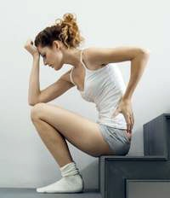
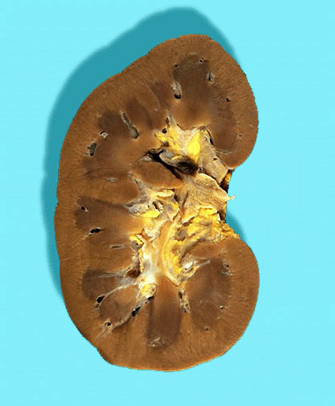
Pyelonephritis is a nonspecific infectious and inflammatory process in the interstitial tissue and tubule of the kidney, simultaneously or sequentially damaging the parenchyma and the renal pelvis.
Pyelonephritis - inflammation of the substance of the kidney as a result of bacterial infection.

Slide 3
Relevance of the problem
Pyelonephritis is the most frequent disease of the genito-urinary organs.
He is the reason for hospitalization of 4-5% of all children and is observed in 3-5% of pregnant women.
According to pathoanatomical statistics, it is found in 8-20% of autopsies.
However, this diagnosis during life is established only in ¼ of the patients.
In Ukraine, the incidence of pyelonephritis is 100 cases per 100 000 population.
The predominant sex is female (5: 1).
The predominant age is 30-40 years.

Slide 4
Predisposing factors
anatomical features of the urethra in women;
gynecological diseases and pregnancy;
urological diseases leading to a violation of uro- and hemodynamics (developmental anomalies, stone formation, hyperplasia of prostate, prostatitis);
concomitant diseases (diabetes mellitus);
vesicoureteral reflux;
instrumental studies of the kidneys and urinary tract.

Slide 5
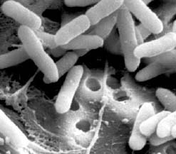
Etiology -
Specific pathogens do not exist, the most significant are: E. coli, Proteus spp., P. aeruginosa, Enterobacter spp., Staphylococcus spp., Enterococcus faecalis.
As a rule, these are microbial-viral associations. In recent years, the role of hospital strains of microorganisms as causative agents of pyelonephritis has increased.

Slide 6
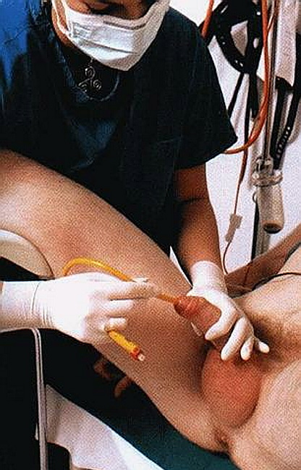
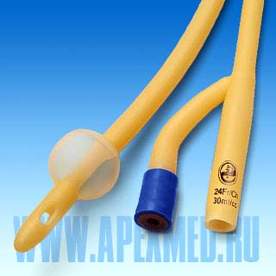
The change in the etiological structure of pathogens is associated with the introduction into clinical practice of endoscopic methods of diagnosis and treatment, resulting in the abandonment of drainage in the organs of the urinary system, which become the gateway to infection.

Slide 7
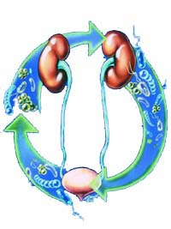
Pathogenesis
Infection can penetrate the kidney in three ways:
hematogenous;
urinogenic;
ascending (along the wall of the urinary tract).
The most frequent way of penetrating the microbial flora into the kidney parenchyma is hematogenous.

Slide 8
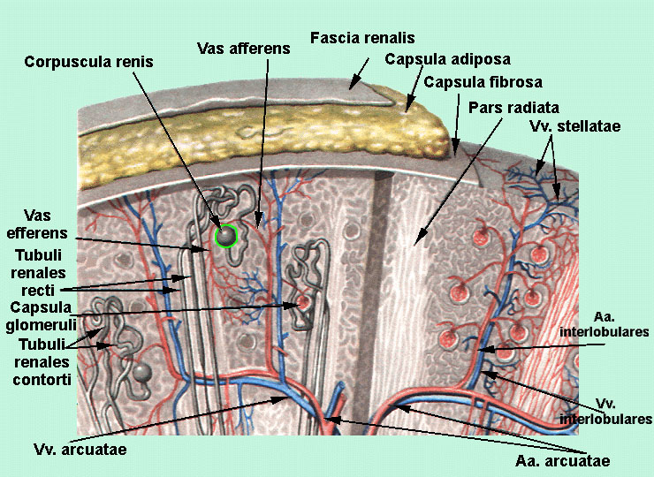
Microbes with blood flow enter the vascular loops of the renal glomeruli, where they cause inflammatory-degenerative changes in the endothelium and penetrate the lumen of the tubules. Around the bacterial thrombi, a leukocyte infiltrate is formed in the interstitial tissue, the further fate of which depends on the treatment and the general condition of the organism.

Slide 9
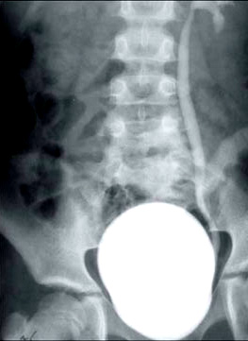
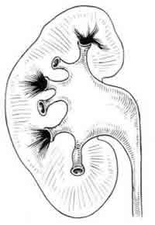
An ascending pathway of infection of the kidney is possible in the presence of vesicoureteral reflux. With the return current of urine, the microflora from the bladder gets into the pelvis, from where, when the pressure rises, it penetrates into the total blood flow.

Slide 10
Classification
Pyelonephritis unilateral or bilateral
Primary
Secondary
Acute
Serous
Purulent
Necrotic papillitis
Apostematous pyelonephritis
Carbuncle of the kidney
Kidney abscess
Chronic
Active inflammation phase
Wrinkling of the kidney or pyonerophosis
Phase of latent inflammation
The phase of remission

Slide 11
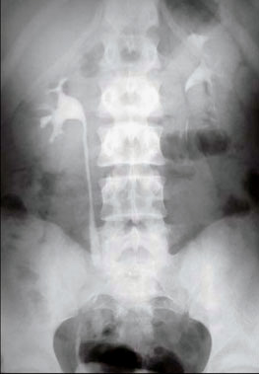
Primary acute pyelonephritis
Primarily conditionally called pyelonephritis, which occurs without a previous disease of the kidneys or urinary tract. Infection of the kidney occurs by hematogenous way.

Slide 12
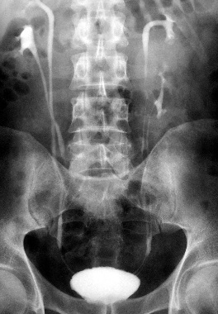
Secondary acute pyelonephritis
Secondary acute pyelonephritis differs from the primary by more pronounced local symptoms of the disease and a violation of urodynamics.

Slide 13

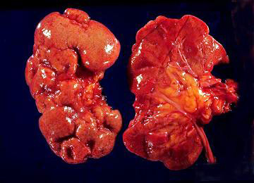
Symptoms of acute pyelonephritis

Slide 14


Suddenly, the temperature rises to 39-40 ° C, weakness, headache, nausea and vomiting. Simultaneously there are pains in the lumbar region. The pain is blunt, but the intensity may be different. If the disease develops against the background of the stone disease, the attack of pyelonephritis is preceded by an attack of renal colic.

Slide 15
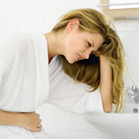
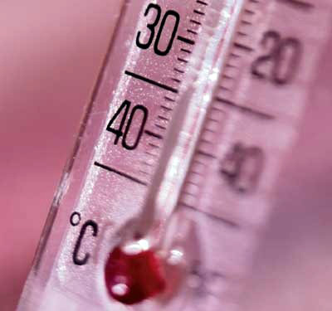
General symptoms
The clinical picture is characterized by a combination of general and local signs of the disease. At the beginning, general symptoms predominate (severe general condition, extremely strong chills, high body temperature, severe sweating, changes in blood, signs of general intoxication).

Slide 16

Local symptoms
Pain in the lumbar region, spontaneous and provoked by palpation of the patient.
Muscle tension in the kidney projection.
Changes in urine.
Sometimes there is a rapid and painful urination.

Slide 17
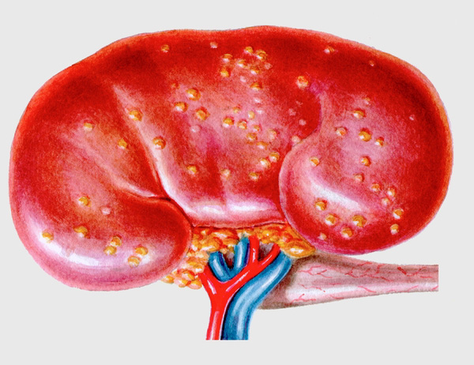
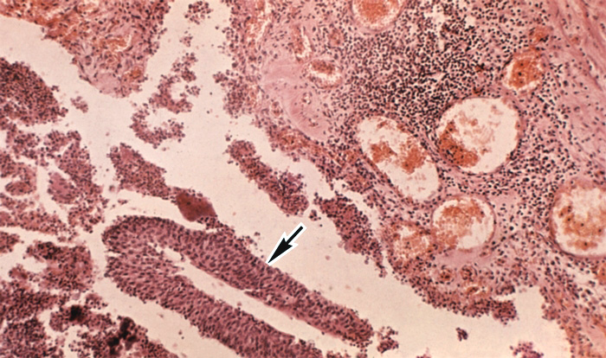
Strengthening pains forces the doctor to assume the transition of the inflammatory process from the serous form to purulent. The hectic increase in body temperature that arises in patients at definite intervals of time can also be associated with the development of multiple purulent foci in the kidney.

Slide 18

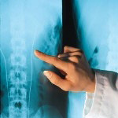
Diagnosis of acute pyelonephritis

Slide 19
Bimanual palpation of the kidneys
Ultrasonography
Survey urography
Excretory urography
Retrograde pyelography
CT scan
Dynamic renascintigraphy
Laboratory research

Slide 20
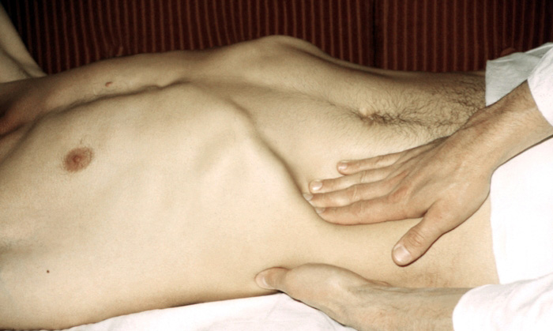
Bimanual palpation of the kidneys
With bimanual palpation of the kidney on the side of the lesion, tenderness, muscle tension of the anterior abdominal wall is noted. There are phenomena of scoliosis and a positive symptom of Pasternatsky.

Slide 21
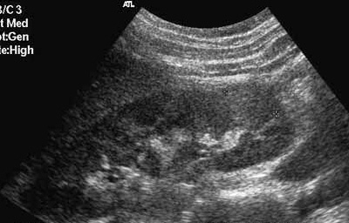
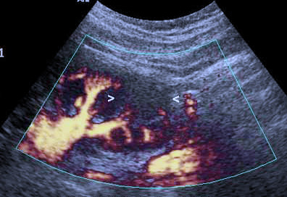
Ultrasonography
It allows to determine the increase in the size of the kidney, the compaction of the parenchyma, the deformation of the calyx and the pelvis.
With carbuncle of the kidney - cavity formation in the parenchyma.

Slide 22
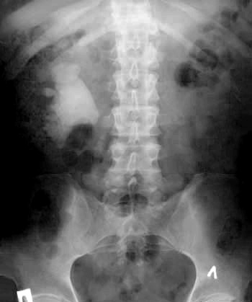
Survey urography
Detects shadows suspicious for concrements, enlarged sizes of the affected kidney, fuzziness of the contour of the lumbar muscle.

Slide 23
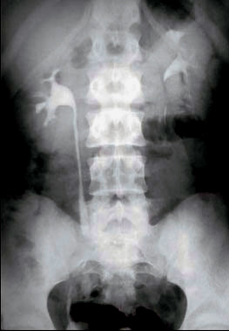
Excretory urography
On excretory urograms, the primary acute pyelonephritis is manifested by a decrease in the function of the affected kidney or hypertension and hyperkinesia of the calyces, which in later stages are replaced by their hypotension.

Slide 24
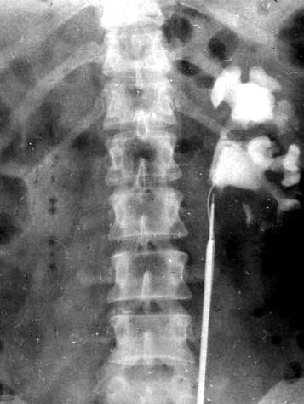
Retrograde pyelography
The study is performed according to strict indications, with X-ray negative stones or other causes of urinary passage disorders, when it is necessary to solve the question of surgical intervention.

Slide 25
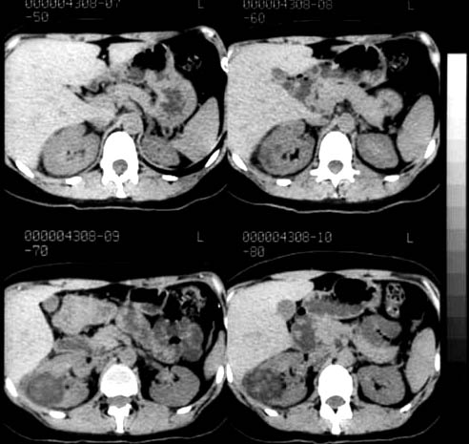
CT scan
It is used in differential diagnosis between serous and purulent forms of acute pyelonephritis (by difference in the density of the kidney parenchyma and pathologically altered tissues).

Slide 26
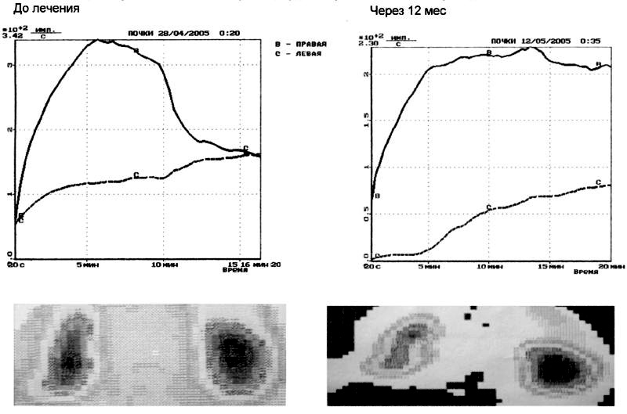
Dynamic renascintigraphy
It is used when it is impossible to perform excretory urography due to renal failure. The size of the kidneys is ordinary or reduced, the accumulation of the isotope is reduced.

Slide 27
Laboratory research
1. General blood analysis. Neutrophilic leukocytosis. Sometimes, when the condition worsens, leukocytosis is replaced by leukopenia, which indicates a worsening of the patient's condition.
2. General urine analysis. Pyuria is the most important sign of pyelonephritis. Bacteriuria (95% of patients have more than 100 000 bacteria in 1 ml of urine). To clarify the type of microflora and determine its sensitivity to antibiotics, a bacteriological study is carried out. Hematuria, in most cases, microscopic, but can be a macrohematuria (for example, with necrosis of the renal papillae).

Slide 28
Differential diagnosis of serous and purulent stages of acute pyelonephritis
Serous pyelonephritis | Purulent pyelonephritis
Hyperthermia | Hyperthermia with tremendous chills.
Soreness in the kidney | Tension of the muscles of the anterior abdominal wall. Palpated enlarged painful kidney.
Leucocyturia | Leukocyturia. Bacteriuria.
Excretory urography - the contours of the lumbar muscles are clear. The mobility of the kidney is preserved. | EU - the absence of a contour of the lumbar muscles on the side of the lesion. Kidney mobility is limited or absent.
Ultrasound - the parenchyma is not thickened, homogeneous, the mobility of the kidney is preserved. | US - diffuse or focal compaction of the parenchyma, its heterogeneity.

Slide 29
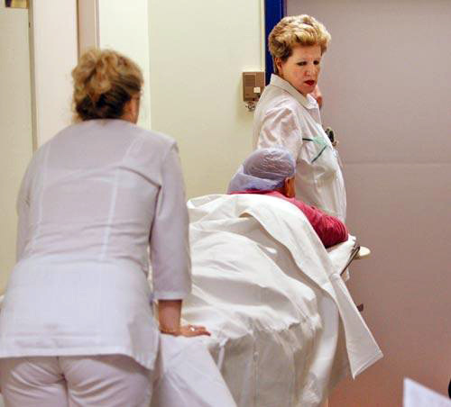
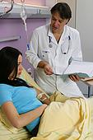
Treatment of acute pyelonephritis

Slide 30
Conservative treatment of acute pyelonephritis should be complex and include the following: elimination of the cause of urodynamic disturbances, antibacterial, detoxification, imunocorrective and symptomatic therapy.
Operative treatment is performed in the case of unsuccessful conservative therapy.

Slide 31
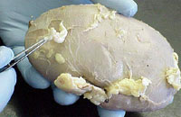
The purpose of the treatment is preservation of the kidney, prevention of urosepsis and relapse of the disease.

Slide 32
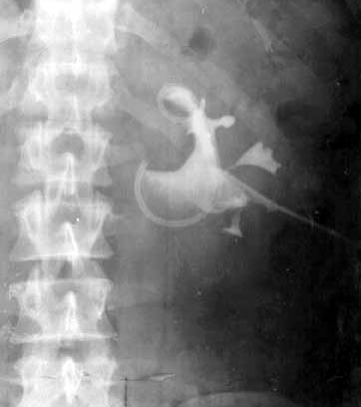
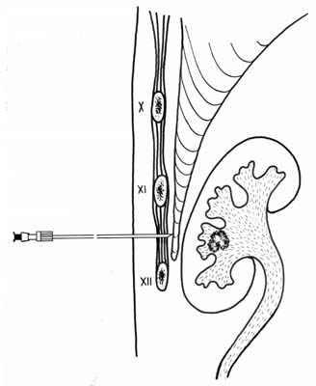
Urodynamics recovery
In any form of acute obstructive pyelonephritis, the outflow of urine from the affected kidney must be urgently restored, and this must precede all other medical measures.

Slide 33
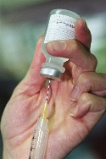
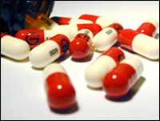
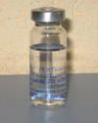
Antibacterial therapy
In acute pyelonephritis at the beginning of treatment antibacterial therapy is always empirical, it is necessary to choose the right antibiotic or a rational combination of drugs, the dose and method of administration.

Slide 34
Empirical antibacterial therapy
Diagnosis | The most frequent pathogen | Antibacterial therapy | Duration
Pyelonephritis acute uncomplicated | E. Coli Proteus Klebsiella Others: Enterobacter Staphilococcus | Fluoroquinolones Cephalosporins II-III generation Alternative: Aminopenicillins + inhibitors of β-lactomases Aminoglycosides | 7 -10 days
Pyelonephritis acute complicated | Enterobacter Pseudomonas Candida | Fluoroquinolones Cephalosporins II-III generation Antipseudomonal Carbapenem + aminoglycoside | 3-5 days after elimination of pathogens or complicating factors

Slide 35
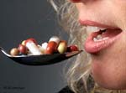

In all stages and forms of acute pyelonephritis, only the parenteral way of administration of antibiotics is adequate, preference should be given to the intravenous route of administration. Evaluation of the effectiveness of the therapy should be carried out after 48-72 hours, correction - after receiving the results of bacteriological research.

Slide 36
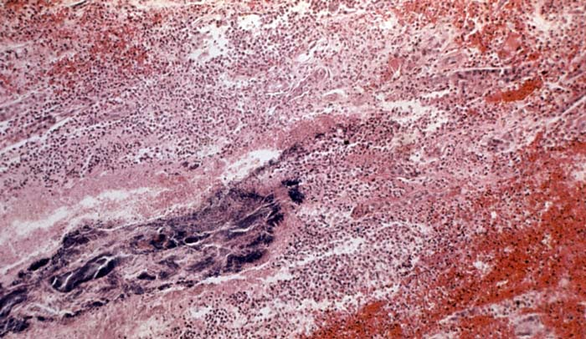
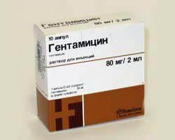
Adhering to the rational tactics of antibiotic therapy, it is possible to avoid many undesirable consequences arising from an incorrect approach to treatment: the spread of antibiotic-resistant strains of pathogens, the manifestation of toxicity of drugs.

Slide 37


The criterion for resolving the question of stopping antibacterial therapy is the normalization of the clinical picture, blood and urine tests.

Slide 38

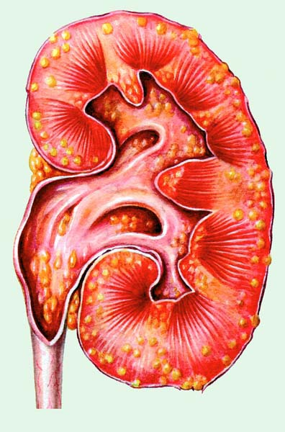
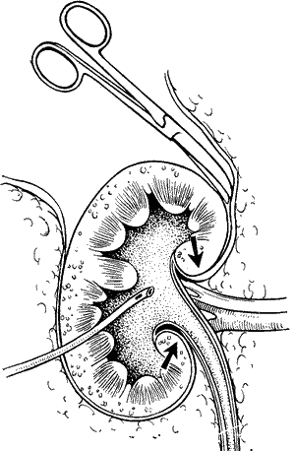
Operative treatment
It is performed when there is a purulent inflammation in the kidney. The operation of choice - kidney decapsulation and drainage of the renal pelvis.

Slide 39
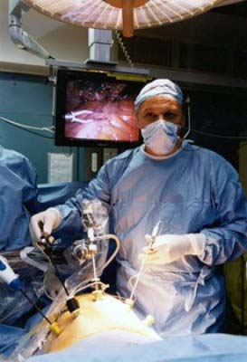
With multiple carbuncles of the kidney, purulent fusion of her parenchyma, pyonephrosis and good function of the contralateral kidney resort to nephrectomy.

Slide 40
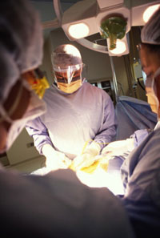
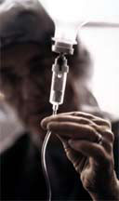
In patients operated on for acute purulent pyelonephritis, antibiotic therapy continues until the closure of the nephrostomy fistula. In the future, the outpatient appointment of antibacterial drugs taking into account the results of antibioticograms.

Slide 41
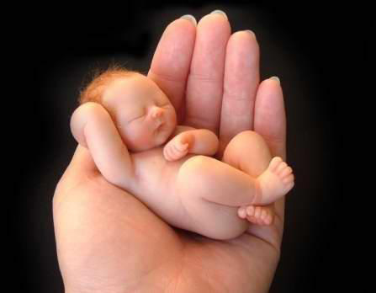
Acute pyelonephritis of pregnant women

Slide 42
Relevance of the problem
Pyelonephritis - the most frequent kidney disease in pregnant women, occurs in 12% of women, more often with the first pregnancy, usually in the second half (at the 20-26th week).
Pyelonephritis adversely affects the course of pregnancy and the condition of the fetus.
Non-pregnancy in this category is 30% due to premature birth.
Perinatal mortality is 25-50%.

Slide 43
Predisposing factors
a decrease in the tone of the upper urinary tract due to neurohumoral shifts (excess estrogens, progesterone and glucocorticoids);
mechanical pressure of the enlarged uterus on the ureters, especially the right one;
the presence of asymptomatic bacteriuria in 5-10% of women, which is explained by a decrease in the protective properties of urine in relation to pathogenic flora;
colds, constipation, eating disorders and sexual intercourse.

Slide 44

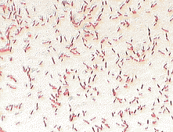
ETIOLOGY
The causative agents of pyelonephritis in pregnant women are conditionally pathogenic microorganisms: E. coli, Proteus spp., and also Candida, Mycoplasma hominis, Ureaplasma urealyticum, Trichomonas vaginalis, anaerobic bacteria.

Slide 45
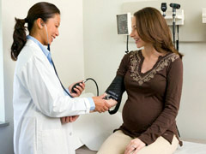
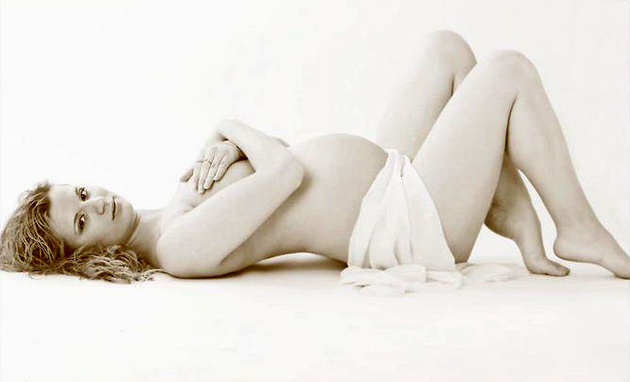
Clinic
The disease begins with fever, chills and headache. Expressed signs of intoxication are accompanied by pain in the lower back, intensifying with breathing, with irradiation along the ureter, into the inguinal region, thigh and labia. There is a positive symptom of Pasternatsky. There is a rapid painful urination.

Slide 46
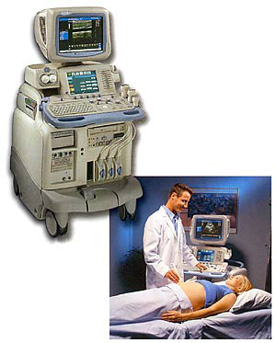
Diagnostics
Palpation of the kidneys is poorly informative, X-ray and radionuclide research methods are contraindicated, therefore, when a patient enters the clinic, it is necessary to perform ultrasound examination of the kidneys or chromocystoscopy.

Slide 47
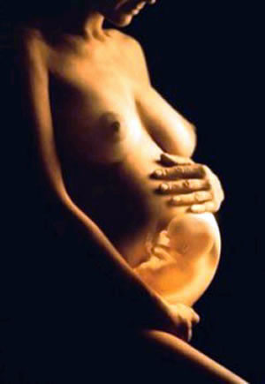
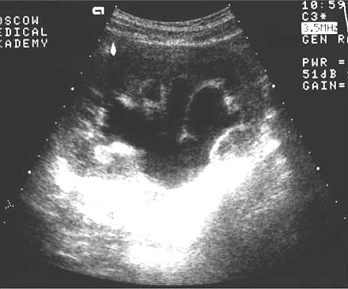
Ultrasonography
This method allows you to identify the expansion of the renal cavity system, urinary tract concretions and changes in peri- kidney tissue. In addition, it makes it possible to assess the condition of the fetus in a pregnant woman.

Slide 48
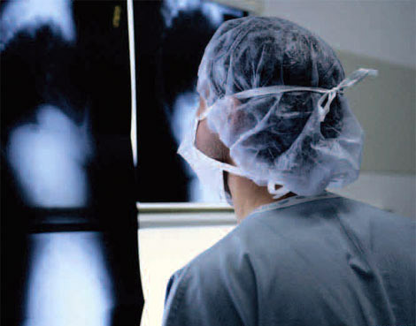
Excretory urography
It is used in extreme situations: bilateral renal damage, unclear anatomical and functional state of the opposite kidney and in those cases when the question of a woman's life is being decided.

Slide 49
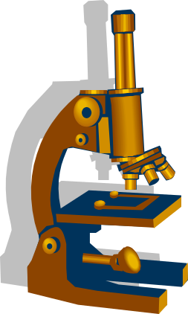
Laboratory research
General blood analysis. There is a leukocytosis with a shift of the leukocyte formula to the left, the appearance of young forms of neutrophils, toxic granularity, aneosinophilia, there is a moderate decrease in hemoglobin, a significant increase in ESR.
General urine analysis. Determined bacteriuria and leukocyturia. Proteinuria is insignificant, microhematuria and cylinduria are possible. Macrogematuria is a poor prognostic sign and often indicates necrotic papillitis.

Slide 50

Treatment
The peculiarities of treatment of pregnant women with pyelonephritis are determined by the fact that in this disease almost always there are violations of urodynamics and the possibility of toxic effects of drugs on the fetus, therefore modern approaches to treatment include:
Restoration of the passage of urine with the study of its microflora and sensitivity to antibiotics.
Intensive antibacterial, infusion and detoxication therapy, taking into account possible adverse effects on the fetus.
Dynamic monitoring by urologist and obstetrician - gynecologist.

Slide 51

In those cases when the pregnant women with acute pyelonephritis do not violate the passage of urine, it is enough to recommend the patient to the knee-elbow position or to lay on a healthy side with the raised leg of the bed and carry out antibacterial therapy.

Slide 52


Restoration of the passage of urine
In the absence of indigo carmine release from the ureteral cavity on the side of the disease, restoration of the passage of urine by means of a catheter is shown prior to arresting the attack of pyelonephritis (usually for 2-3 days).

Slide 53

With frequent exacerbations of pyelonephritis, instead of usual catheterization, a self-retaining catheter (stent) is used, which is inserted into the pelvis for 1-2 months.
For drainage of the kidney in pregnant women, also use a transcutaneous puncture nephrostomy.

Slide 54


Antibacterial therapy
In the first trimester of pregnancy, the administration of tetracyclines is contra-indicated, possibly teratogenic. The appointment of aminoglycosides is undesirable in connection with their ototoxicity.

Slide 55


Currently, starting therapy is carried out using semi-synthetic penicillins. Treatment begins with intramuscular injection, and then the drug is administered orally. For prolonged therapy, drugs of the nitrofuran series are used.

Slide 56
NEPHRITIS
Immune mechanisms play a leading role in the development of nephritis.
The source of damage to the renal glomeruli is the formation of antibodies and the deposition of immune complexes.
Cellular immune responses also have a definite value.
Primary immune mechanisms in themselves usually do not lead to pronounced changes in the kidney tissue, but they cause a cascade of reactions accompanied by the production of various inflammatory mediators.
The latter make a significant contribution to the development and progression of renal pathology.
Below are some mediators that can play a role in the pathogenesis of nephritis:

Slide 57
NEPHRITIS
oxygen radicals;
metabolites of arachidonic acid (prostaglandins and thromboxane A2, leukotrienes);
metalloproteinases (collagenase, elastase), plasminogen activators;
proteinase inhibitors;
modulators of cell growth (fibroblast growth factor, transforming growth factor 1);
coagulation factors produced by monocytes-macrophages and glomerular cells;
cytokines (interleukin-1, tumor necrosis factor, etc.);
vasoactive substances formed in the kidneys (angiotensin II, endothelin, endothelial relaxing factor).

Slide 58
NEPHRITIS
The choice of method of treatment depends on the nature of the nephritis (primary or secondary), the clinical variant, the morphological changes in the tissue of the kidneys.
In primary nephritis, immunosuppressive agents are most often used in the rapidly progressive and nephrotic variants, much less frequently in other clinical forms. At the same time with Wegener's granulomatosis or nodular periarteritis even minor changes in urine are the basis for more active therapy.
Means of choice in the treatment of nephritis remain:
- glucocorticoids
- cytostatics

Slide 59
NEPHRITIS
Glucocorticoid hormones are most often used in edematous or mixed forms of chronic glomerulonephritis, if the duration of the disease does not exceed two years, as well as in hypertensive form without pronounced increase in blood pressure.
There are several scheme of treatments for corticosteroids:
10-15 mg / day of prednisolone, followed by increasing the dose to 60-80 mg / day (1 mg / kg of body weight), upon reaching the therapeutic effect, the dose is reduced (2.5 mg per week)
when the disease worsens, large doses of prednisolone are used - 60-70 mg / day, followed by a decrease in the dose to 10-15 mg / day
pulse therapy: 1000 mg of methylprednisolone is injected into the vein at a time, sometimes in combination with cytostatics - or cyclophosphamide., for three days

Slide 60
NEPHRITIS
Immunosuppressants -
azathioprine (imuran) or chlorobutin (leukeran)
are most often used in the hypertensive form of the disease, when corticosteroids are either contraindicated, or they can be used in combination with immunosuppressants, but in a small dose (10-20 mg / day).
Usually, immunosuppressant therapy is used in a pronounced autoimmune reaction with a histologically confirmed exacerbation of a chronic disease. The dose of azathioprine is 100-200 mg / day (2-4 mg / kg body weight), leukeran - 10-20 mg (0.2-0.4 mg / kg body weight). At the stage of a wrinkled kidney with high hypertension due to sclerosis and atrophy of the renal glomeruli, the use of cytostatics is contraindicated.

Slide 61
NEPHRITIS
A new generation of selective immunosuppressive agents
Cyclosporin A (sandimmune, sandimmune neoral)
Anticoagulants
prescribe as independently, and in combination with other drugs, more often cytostatics
Assign heparin at a dose of 10 000-40 000 units / day intravenously or 2-3 times a day under the skin of the stomach for 2-3 months.
Antiaggregants
(trental, dipyridamole, reopolyglucin) - used in combination with heparin.
Supportive therapy -
in chronic glomerulonephritis latent flow without pronounced activity of the process use quinoline derivatives (delagil and plakvenil).

Slide 62
NEPHRITIS
Criteria for the effectiveness of pharmacotherapy for chronic glomerulonephritis include:
Decreased expression of proteinuria
Reduction of hematuria
Increase the glomerular filtration rate by 30-50%
Increased maximum osmolarity of urine

Slide 63
NEPHRITIS
Non-immune mechanisms of nephropathy progression and treatment
Non-immune mechanisms of nephritis progression can be divided into 4 large groups:
- changes in hemodynamics;
- metabolic disorders;
- urinary tract infections;
- exposure to drugs.
This list can include changes in the microcirculatory bed, the system of thrombosis and fibrinolysis, hormonal disorders.

Slide 64
NEPHRITIS
The main mechanism of the damaging effect of arterial hypertension on the kidneys -
changes in intrarenal hemodynamics (intraglomerular hypertension and hyperfiltration).
The sharp increase in the overall peripheral vascular resistance, which is associated with an increase in the sensitivity of the walls of the vessels to pressor factors, the activation of the renin-angiotensin system (both general and local inside the kidney itself), and a decrease in the secretion of depressor substances (kinins, prostaglandins) is of primary importance.
Renal hypertension often occurs severely and does not respond well to therapy, which forces the use of drugs in high doses or uses combinations of antihypertensive medications.

Slide 65
NEPHRITIS
Considering the role of increased total peripheral vascular resistance in the pathogenesis of arterial hypertension, vasodilators are used in patients with nephritis.
Angiotensin-converting enzyme inhibitors (enalapril, lisinopril, ramipril, etc.)
Angiotensin-II- receptor blockers (telmisartan, valsartan, kandesartan, etc.)
which:
decrease blood pressure
reduce intraglomerular pressure and thus eliminate both factors contributing to the progression of renal pathology
Calcium antagonists - vasotropic (amlodipine, etc.)
they have:
Severe vasodilating effect
Nephroprotective action

Slide 66



Urolithiasis is a metabolic disease whose main feature is the formation and presence of single or multiple stones in the urinary tract system - calyx, pelvis, ureter, bladder or urethra.
Definition of urolithiasis

Slide 67
Relevance of the problem
According to the world data, urolithiasis affects 1 - 3% of the population.
12% of men and 5% of women suffer renal colic at least once during a lifetime.
Patients with nephrolithiasis account for 30-40% in the urological hospital.
In the United States, more than 1 million Americans are hospitalized each year for kidney stones and urinary tract.
In Russia, the incidence of nephrolithiasis is 460 cases per 100,000 population.
The predominant gender is male (2: 1).
The predominant age is 30 to 50 years.

Slide 68

The increase in the incidence of nephrolithiasis is explained by the following reasons:
an increase in life expectancy;
Hypodynamia;
increased consumption of protein products and alcohol;
increasing psychoemotional tension of life;
use of some medications;
adverse environmental conditions.

Slide 69

The theory of stone formation
The microbial theory (Meckel, 1856).
Physicochemical theory (Ulzman, 1890).
The theory of the coloidal-crystalloid equilibrium (Lichvitz and Shade, 1889).
Theory of the matrix (Randal, 1936).

Slide 70
Factors of stone formation
(for urinary stones)
- taking a small amount of fluid and releasing a small amount of urine;
- urine supersaturation due to excessive release of urine in the presence of metabolic disturbances and small diuresis, if the urine reaction promotes crystallization;
- work in hot shops and hot climates;
- urinary tract infection;
- alimentary factors;
- deficiency of stone formation inhibitors that bind ions to maintain them in a dissolved state;
- hyperuricosuria, hyperuricemia (gout, nutritional factors, myeloproliferative diseases, psoriasis);
- constantly sharply acidic urine reaction with pH less than 5.5 (diseases of the gastrointestinal tract, accompanied by diarrhea, tubular dysfunction).

Slide 71
Factors of stone formation
  (for calcium stones)
  - idiopathic hypercalciuria;
  - hyperparathyroidism;
  - intoxication with vitamins of group D;
  - distal tubular acidosis;
  - sarcoidosis;
  - myeloma;
  - metastases of tumors;
  - milk-alkaline syndrome with a combination of a dairy diet with iatrogenic alkalosis in the treatment of gastric and duodenal ulcer.

Slide 72
Factors of stone formation
  (for oxalate stones)
  - primary hyperoxaluria, including those caused by a deficiency of pyridoxine;
  - increased consumption of plant foods with food;
  - excess of substances that enhance metabolism in oxalates (ascorbic acid);
  - an increase in absorption of free oxalates in violation of absorption of fats that bind calcium in the intestine (Crohn's disease, malabsorption, resected small intestine resection).

Slide 73
Factors of stone formation
  (for phosphate stones)
abruptly alkaline urine at pH more than 7.0;
infection of the lower urinary tract with pathogens, alkalinizing urine and releasing urease, capable of cleavage urea (Proteus, Pseudomonas aeruginosa);
obstructive processes of the upper urinary tract.

Slide 74



The cause of stone formation can be endogenous factors leading to stagnation of urine and disturbance of urodynamics. In this situation, stone formation is considered secondary, and is a complication of pathological processes.

Slide 75

It has now been established that the basis for the formation of a calculus is a protein-mucopolysaccharide matrix, which is produced by the kidney and can be excreted in the urine.

Slide 76
Reasons for matrix formation
metabolic disorders in the distal sections of the nephron, due to hereditary (enzyme and tubulopathies), metabolic (distal tubular acidosis) disorders;
the release of poorly soluble compounds (ketoform of uric acid in the purine crisis, sulfonamides in conditions of relative ohiguria, etc.);
disorders of intrarenal hemodynamics;
disorders urodynamics creates a nucleus of crystallization, contributing to the formation of concrement;
the nucleus of crystallization, in addition to the matrix, can be accumulations of urothelial cells, microorganisms and cellular detritus against inflammation and urodynamic disturbances.

Slide 77

Thus, the nature of this disease is polyethiologic, a crystallization nucleus or matrix is needed to form a calculus.

Slide 78

Chemical composition of stones
Phosphates are white, formed in alkaline urine, X-ray positive.
Oxalates - dense with spines, X-ray positive. These are the hardest, hardest crushing stones.
Urates - yellow-brown color, solid, X-ray negative. Formed with overeating and excess uric acid.
Cystine stones - yellow-white, soft, X-ray negative.
Carbonate stones - are formed from calcium salts of carbonic acid, X-ray negative.
Protein stones - are formed mainly from fibrin with an admixture of salts and bacteria. They are white, x-ray negative, soft.

Slide 79

Often there are mixed stones, which contain various chemicals, the layers of which alternate concentric layers on the main core of the stone.

Slide 80

Dimensions, number, location
Dimensions of stones are very diverse, as well as their number. In the clinic prof. S.P. Fedorova in one case in a remote kidney there were 3000 stones.
Multiple stones are very common, they cause significant morphological changes in the kidneys.
It is almost easier to divide stones:
Lohan
Parenchymal
Roach and parenchyma
Stones of the ureter (always the displaced kidney stones)

Slide 81

Symptoms of urolithiasis

Slide 82
Renal colic.
Hematuria.
Piuria.
Dysuria.
Departure of stones with urine.
Anuria.
Acute urination retention.

Slide 83

Renal colic
The main cause of renal colic ─ acute violation of the passage of urine through the urinary tract.
The initial moment is the local spasm of the ureter, which leads to intralovenum hypertension and pyeloectasia.
There is a violation of the hemodynamics of the kidney (spasm of the arteries and venous stasis). Venous stasis in the kidney helps to stretch the fibrous capsule and irritate the pain receptors.

Slide 84


The pain is very strong, localized in the lumbar region and in the abdomen, have a sharp intolerable character.
Accompanied by a certain irradiation, the nature of which depends on the location of the occlusion.
Patients are concerned about nausea, vomiting, intestinal paresis, bradycardia, moderate increase in blood pressure.

Slide 85

Hematuria - the presence of blood in urine.
The causes of hematuria in nephrolithiasis are different: nephritis, pyelitis, congestive kidney disease, direct trauma to the renal parenchyma and pelvis with calculus.
In a state of rest, the hematuria decreases or temporarily ceases altogether, but appears again and increases with movement, any physical strain.

Slide 86

PYURIA - the presence of pus in the urine, typically from bacterial infection.
With urolithiasis, it occurs frequently and is an important symptom indicative of complication of nephrolithiasis by infection.

Slide 87

Dizuria
Depends on the location of the stone: the lower the stone in the ureter, the sharper it is expressed.

Slide 88


Departure of stones in the urine
The most demonstrative symptom of urolithiasis (kidney stones up to 0.6 cm leave on their own in 96% of cases).

Slide 89

Anuria - failure of the kidneys to produce urine.
Calculous anuria is a rare, but the most serious complication, threatening the life of the patient. It is especially dangerous with a single kidney.
The mechanism of the formation of calculable anuria is mainly obturation, but reflex effects also play a role when the second, healthy kidney in the normal state of its ureter ceases to excrete urine as a result of reflex effects emanating from the diseased kidney or ureter containing the calculus.

Slide 90

Acute urination retention
Occurs when the concrement is stuck in the urethra.

Slide 91
Complications of urolithiasis
Hydronephrosis.
Ureterohydronephrosis.
Acute pyelonephritis.
Bacteriotic shock.
Urosepsis.
Chronic pyelonephritis.
Wrinkling of the kidney.
Pionerophosis.
Chronic renal failure.

Slide 92

Diagnosis of urolithiasis

Slide 93
In order to avoid medical error and correctly establish the diagnosis, the patient must perform the following instrumental and laboratory methods of investigation:
Chromocystoscopy.
Ultrasonography.
Excretory urography.
General analysis of blood and urine.

Slide 94
Chromocystoscopy

Slide 95


ULTRASONOGRAPHY
Currently, it is the most harmless and priority method, especially in pregnant women and children.
It allows to diagnose concrements in the lumbar system of the kidney, to determine the thickness of the parenchyma, the foci of destruction, and also the degree of expansion of the cup-and-pelvic system.

Slide 96

Excretory urography
The first reports in Ukraine on the X-ray diagnosis of urolithiasis with the help of a survey snapshot were made by A.N. Gagman (1899) and N.S. Overwriting (1905).
The excretory urogram in almost 96% of cases allows to see the shadow of the calculus in the projection of the urinary system.

Slide 97

Excretory urography
Excretory urography was performed for the first time in the clinic SP. Fedorova (1929).
This study gives a clear idea of the anatomical state of the kidneys and the location of the stone, indicating the functional state of the upper and lower urinary tract.

Slide 98

General analysis of blood and urine
In an emergency situation, a blood test can identify leukocytosis, a stab shift, increased ESR, indicating the development of an inflammatory process in the kidney.
Color and transparency are signs of a qualitative composition of urine.
The urine of a healthy person is transparent and has a straw-yellow color. Urine turbidity can depend on the admixture of salts, bacteria, mucus, pus or blood.

Slide 99

Modern methods of treatment

Slide 100
Treatment of patients with urolithiasis is usually complex and involves a combination of the following methods:
Conservative treatment.
Operative treatment.
Remote lithotripsy.
X-ray endoscopy methods.

Slide 101

This is a relief of renal colic and therapy aimed at self-detachment of the calculus.
Conservative treatment

Slide 102

Cupping a renal colic
Thermal procedures (hot bath, heating pad).
Introduction of spasmolytic (baralgin) and analgesics (ketanov).
Introduction of inhibitors of prostaglandin synthesis (NSAID).
Use drotaverine in combination with β-adrenomimetics (ginipral).
Use of physiotherapy methods (inductothermy, vacuum devices).

Slide 103

Therapy aimed at the independent retreatment of the calculus (used in patients with clinical manifestations of ureteral stones up to 0.5 cm, which tends to self-separate).
Drinking regime (water strikes).
Myotropic antispasmodics (drotaverine).
Beta-adrenomimetics (ginipral, partusisten) if necessary with phinoptin.
Inhibitors of prostaglandin synthesis (indomethacin, voltaren) in the absence of contraindications to plant remedies (cystone, prolith).
Active motor mode.
If necessary, antibacterial and anti-inflammatory therapy.
Physiotherapeutic treatment (intraphone, low-frequency ultrasound).
Mineral water, sanatorium treatment.

Slide 104

Operative treatment
Any surgical intervention is not an etiological method of treatment of urolithiasis, since it does not eliminate the main causes of stone formation, but is aimed at getting rid of the patient from the stone.

Slide 105
Indications for open surgical interventions:
Large coral stones, secondary stones, which require reconstructive surgery of the urinary tract.
Urolithiasis complicated by purulent-destructive pyelonephritis, kidney failure.
When remote lithotripsy or endosurgery is contraindicated.

Slide 106

Types of operations:
Organ saving:
Pyelolithotomy.
Nephrolithotomy.
Ureterolithotomy.
Pyelonephrotomy and others.
Organizing:
Nephrectomy.

Slide 107


Remote lithotripsy
Specialists of the German airline Dernier during the test of the supersonic aircraft found that when moving various objects in the atmosphere shock waves can arise, which destroy solid bodies.
An unexpected application of the device was remote lithotripsy (RLT).

Slide 108


The first successful use of remote lithotripsy was carried out on February 7, 1980 at the university clinic in Munich, Germany.
Throughout the world, thousands of remote lithotriptors function, with the help of which millions of patients with urolithiasis have been cured.

Slide 109

The remote lithotriptor consists of a wave source, an impact medium for energy transfer inside the body and a visualization system of the X-ray unit, an ultrasonic device.
RLT is optimal for stones of the upper urinary tract with a diameter of less than 2.0-2.5 cm.
RLT is by far the only method that can be used on an outpatient basis.

Slide 110
Indications for RLT:
Stone of the kidney or ureter.
The ability to focus the stone radiological or ultrasound.
Absence of a violation of the outflow of urine below the stone.

Slide 111
Contraindications for RLT:
Technical:
- X-rays are negative stones.
- Deformation of the patient's skeleton.
- The patient's weight is more than 130 kg.
- Growth is more than 2 meters and less than 1 meter.
Common:
- Violation of the blood coagulation system.
- Pregnancy.
- Stones of the lower third of ureter in women of childbearing age.
- Violation of the rhythm of the heart.
- Aneurysm of the abdominal aorta.

Slide 112
Contraindications for RLT:
Urological:
- Acute inflammatory process.
- Non-functioning kidney.
- Obstruction of the urinary tract below the stone.
- Anomalies in the development of the urinary system.
- Stones that overlay the bone system.
Relative:
- Large coral stones.
- Stones of a single kidney.

Slide 113

Complications of RLT:
Heart rhythm disturbances.
Changes in blood pressure.
Acute pyelonephritis.
Formation of a stone path with obturation of the ureter.
Acute pancreatitis (with RLT of the left kidney).

Slide 114
X-ray Endoscopy methods
A. Transurethral
Endosurgery X-ray endosurgery.
Ureterolithotripsy.
Ureteroliteextraction.
B. Percutaneous
X-ray endoscopic surgery.
Nephrolithotripsy.
Nephrolithoextraction.

Slide 115

Transurethral X-ray endoscopy endosurgery
Ureterolitoextraction is performed under epidural or intravenous anesthesia using rigid or flexible ureteropileoscopes to extract mobile stones, up to a size of 0.6 to 0.8 cm.

Slide 116

The ureteropyeloscope is transurethral transposed to the stone, a litho extractor (flexible 2 and 3 lobed forceps or Dormia's basket) is inserted through its instrumental channel. The stone is captured from the ureter to the outside.

Slide 117

Ureterolithotripsy is used for mobile and large stones (more than 0.8 cm) or with pinned ureteral stones.The lithotriptor probe is brought close to the stone, the latter is destroyed electrohydraulically or with the help of a laser.

Slide 118

Percutaneous X-ray endoscopic surgery
Modern percutaneous treatment of nephroureterolithiasis is performed using rigid nephroscopes. With a stone size of up to 1.5 cm, endoscopic lithoextraction is performed.

Slide 119


Percutaneous nephrolithoextraction
Introduction of a radiopaque tube with an extractor into the renal pelvis.
"Washing out" with a concrement catheter from the lower cup of the kidney.

Slide 120



The grip of the concrement by the loop of Dormia.
X-ray control.
Delete the stone.

Slide 121

Percutaneous crushing and aspiration of stone (litholapaxy)
When the size of the stones is more than 1.5 cm (down to the coral), the stone is crushed.
The lithotriptor probe is guided along the instrumental canal of the nephroscope to the stone.

Slide 122


Crushing and simultaneous aspiration of small fragments of stone (litholapaxy) is performed.
The operation ends with the establishment in the pelvis of the kidney nephrostomy drainage.
The remaining fragments of the stone are destroyed by remote lithotripsy on the background of the drained kidney.

Slide 123

The main tasks in the treatment of patients with urinary tract infection: elimination or reduction of the inflammatory process in the kidney tissue and bladder
When choosing a drug, it is necessary to be guided by the following information:
about an infectious agent
on the spectrum of antimicrobial activity of the drug.
An antibiotic can be safe, capable of creating high concentrations in the parenchyma of the kidneys and urine, but if its spectrum is not active against a particular pathogen, the purpose of such a drug is meaningless.

Slide 124
Basic principles of antibiotic therapy
Identification of pathogens of diseases, the study of their antibioticograms.
The choice of the most active and least toxic drug.
Determination of optimal doses and methods of antibiotic administration.
Timely initiation of treatment and the provision of chemotherapy (antibiotic therapy) courses of the required duration.
Knowledge of the nature and frequency of side effects when prescribing drugs.
Combination of antibacterial drugs in order to enhance the antibacterial effect, improve their pharmacokinetics and reduce the incidence of side effects.

Slide 125
General principles of antibiotic therapy:
In the febrile course of a urinary tract infection, therapy should begin with a broad parenteral antibiotic (inhibitor-protected penicillins, cephalosporins II, III generations, aminoglycosides).
The sensitivity of the urine microflora must be considered.
The duration of treatment of pyelonephritis is 14 days, cystitis - 7 days.
In children with vesicoureteral reflux, antimicrobial prophylaxis should be prolonged.
With asymptomatic bacteriuria, antibiotic therapy is not indicated (there are exceptions)

Slide 126



In the treatment of urinary tract infections today are used:
inhibitor-protected penicillins,
cephalosporins,
aminoglycosides,
carbapenems,
fluoroquinolones (limited in pediatrics),
uroantiseptics (derivatives of nitrofurans).

Slide 127



With infection of the lower urinary tract
Inhibitor-protected aminopenicillins: amoxicillin + clavulanic acid (Amoxiclav, Augmentin, Flemoclav Solutab), ampicillin + sulbactam (Sulbacin, Unazin).
Cephalosporins of the second generation: cefuroxime, cefaclor.
Fosfomycin.
Derivatives of nitrofuran: furamag, furagin, furadonin.

Slide 128



With infection of the upper urinary tract
1.Inhibitor-protected aminopenicillins: amoxicillin + clavulanic acid, ampicillin + sulbactam.
2.Cephalosporins of the second generation: cefuroxime, cefamandol.
3.Cephalosporins of the third generation: cefotaxime, ceftazidime, ceftriaxone.
4.Cephalosporins of the fourth generation: cefepime.
5.Aminoglycosides: netilmicin, amikacin.
6.Carbapenems: imipenem, meropenem.

Slide 129


The principle of minimum sufficiency is the strategic principle of antibiotic therapy in outpatient settings.
Preparations of the first row are:
inhibitor-protected aminopenicillins: amoxicillin + clavulanic acid (Amoxiclav);
cephalosporins: oral cephalosporins of II and III generations;
derivatives of the nitrofuran series: nitrofurantoin

Slide 130
In the application of antibiotic therapy in the hospital should adhere to another principle - from simple to powerful (minimum use, maximum intensity).
The spectrum of the groups of antibacterial drugs used here is significantly expanded:
inhibitor-protected aminopenicillins;
cephalosporins III and IV generations;
aminoglycosides;
carbapenems;
fluoroquinolones.

Slide 131
Treatment of recurrences of urinary tract infection is a rather complex task, this is due to:
increased resistance of microorganisms, especially when applying repeated courses;
side effects of drugs;
the ability of antibiotics to cause immunosuppression of the body;
decreased compliance in connection with long-term courses of taking the drug.

Slide 132
Acute cystitis
Cause: E. coli is caused in 80% of cases, S. saprophyticus - in 10-15% of cases, klebsiella and proteus - in 5-10% of cases.
Treatment is done with antibiotics for 3 days.
In persons with aggravating factors - within 7 days.
It is necessary to remember:
one-third of bacterial strains causing cystitis are resistant to amoxicillin, about 15-20% to nitrofurans, 5-15% to biseptol, but less than 5% to fluoroquinolones.
trimethoprim / sulfamethoxazole (biseptol) is not recommended for the treatment and prevention of urinary tract infections due to the high level of antibiotic resistance to it of the main uropathogens.
phosphomycin trometamol (monural) is effective in the treatment of acute cystitis in a single dose: 3.0 gr orally.

Slide 133
Antibiotic therapy for acute uncomplicated cystitis
Antibiotic | Dose | Duration of prescribtion
In adults (antibiotics of choice)
fosfomycin trometamol | 3 gr orallyy | Once
Co-trimoxasole | 480 mg orally twice a day | 3 days
Оfloxacine | 200 mg orally twice a day | 3 days
Pefloxacine | 400 mg orally once a day | 3 days
Ciprofloxacine | 250 mg orally twice a day | 3 days
Levofloxacine | 250 mg orally once a day | 3 days
In adults (antibiotic reserve)
Аmoxicillin|clavulanat | 500 mg /125 mg orally 3 times | 5 days
Cefuroxim axetile | 250 mg orally twice a day | 5 days

Slide 134
In pregnant women
Monural (fosfomicin) | 3 gr orally | Once
Cefuroxim axetile | 250 mg orally twice a day | 5 days
Аmoxicillin | 500 mg orally 3 times a day | 7 days
Nitrofurantoin | 100 mg orally 3 times a day | 7 days
In children
Аmoxicillin|clavulanat | 45 mg/kg/day 2-3- times a day orally | 6-8 days
Monural (children over 5 years) | 2 gr orally | Once
Cefuroxim axetile | 10-15 mg / kg orally twice a day | 6-8 days
Co-trimoxasole(children over 3 months) | 3-4 mg/kg (by trimethoprim) orally twice a day | 6-8 days
Cefixim (children over 6 months) | 4 mg / kg orally twice a day | 6-8 days

Slide 135
Asymptomatic bacteriuria
All pregnant women and persons with burdened diseases are subject to treatment.
Principles of treatment:
When detecting bacteriuria, treatment begins with a 3-day course of antibiotic therapy followed by a monthly culture of urine to monitor the possible recurrence of the disease.
In case of repeated detection of bacteriuria (16-33%) it is necessary to prescribe maintenance therapy before the end of pregnancy and 2 more weeks after delivery: a single dose of the drug in the evening after a meal.
It is recommended to prescribe supportive treatment based on the sensitivity of microorganisms detected in urine to antibiotics.

Slide 136
Acute pyelonephritis
Caused E. coli in more than 80% of cases.
Treatment begins with intravenous administration of antibiotics (cephalosporins or fluoroquinolones), which continues until the body temperature normalizes (48-72 hours). Then go to oral intake - 14 days, and with the allocation of enterococcus or Pseudomonas aeruginosa - up to 21 days.
20-30% of the pathogens of pyelonephritis are resistant to amoxicillin and cephalosporins of the first generation, which should not be used to treat acute pyelonephritis without microbiological confirmation of its effectiveness.
If pain and fever last more than 72 hours, it is necessary to repeat the culture examination of urine, assess the possibility of a paraneural or intra-venous abscess, urinary tract abnormalities or their obstruction.
Control culture examination of urine is carried out 2 weeks after the end of treatment.

Slide 137
Antibiotic therapy for acute pyelonephritis
Аntibiotic | Dose | Duration of prescribtion
In adults, an easy course (antibiotic choice)
Norfloxacin | 400 mg orally twice a day | 7-14 days
Оfloxacin | 400 mg orally twice a day | 7-14 days
Ciprofloxacin | 500 mg orally twice a day | 7-14 days
Pefloxacin | 400 mg orally once a day | 7-14 days
Levofloxacin | 400 mg orally once a day | 7-14 days
Cefuroxim axetile | 500 mg orally twice a day | 7-14 days
Co-trimoxasol | 480 mg orally twice a day | 7-14 days
Аmoxicillin|clavulanat | 500 mg /125 mg orally 3 times a day | 7-14 days
Cefixim | 400 mg orally once a day | 7-14 days

Slide 138
In adults, moderate and severe course (antibiotics of choice)
Cefuroxim | 0,75 g i.v. or i.m. 3 times a day | 14 days
Cefamandol | 1- 2 g i.v. or i.m. 4 times a day | 14 days
Cefotaxim | 1-2 g i.v. or i.m. 2-3- times a day | 14 days
Ceftriaxon | 1-2 g i.v. or i.m. 1-2- times a day | 14 days
Ceftazidim | 1-2 g i.v. or i.m. 2030 times a day | 14 days
Cefepim | 1 g i.v. or i.m. twice a day | 14 days
Fosfomicin | 2 g i.v. or i.m. 3 times a day | 14 days
Аmoxicillin|clavulanat | 1,2 g i.v. 3 times a day | 14 days

Slide 139
Levofloxacin | 500 mg i.v. once a day | 14 days
Оfloxacin | 200-400 mg i.v. twice a day | 14 days
Pefloxacin | 400 mg i.v. twice a day (step therapy is recommended; after the parenteral course 400 mg per os 2 p / day) | 14 days
Ciprofloxacin | 400 mg i.v. twice a day (step therapy is recommended; after the parenteral course 500 mg per os 2 p / day) | 14 days

Slide 140
In adults, an moderate and severe course (reserve drugs)
Аztreonam | 1 g i.v. or i.m. 3 times a day | 14 days
Meropenem | 0,5- 1 g i.v. 3 times a day | 10-14 days
Cefoperason|sulbactam | 2 g i.v. or i.m. twice a day | 10-14 days
Аmpicillin+gentamicin | 1 g i.v. or i.m. 4 times a day | 14 days

Slide 141
The use of fluoroquinolones is contraindicated in all trimesters of pregnancy (risk of involvement of the fetal connective tissue)
At pregnant women (drugs of choice)
Аmoxicillin|clavulanat | 1,2 g i.v. 3 times a day (step therapy is possible; after a parenteral course of 250 mg / 125 mg per os 3 time / day) | 14 days
Cefuroxim | 0,75 g i.v. or i.m. 3 times a day | 14 days
Cefotaxim | 1-2 g i.v. or i.m. 2-3- times a day | 14 days
Ceftriaxon | 1-2 g i.v. or i.m. once a day | 14 days
At pregnant women (preparations of a reserve)
Аztreonam | 1 g i.v. or i.m. 2-3- times a day | 14 days
Fosfomicin | 2 g i.v. or i.m. 2-3- times a day | 14 days

Slide 142
At children should not use tetracyclines (staining teeth) and fluoroquinolones (inhibition of growth of cartilage tissue)
At children (drugs of choice)
Cefuroxim | 50-100 mg/kg | day i.v. or i.m. 3 times a day (step therapy is possible, after a parenteral course of 15 mg / kg per os 2 r / day during meals) | 14 days
Cefamandol | 50-100 mg/kg/ day i.v. or i.m. 3 times a day | 14 days
Cefotaxim | 30-50 mg|kg i.v. or i.m. 3 times a day | 14 days
Ceftriaxon | 50 mg/kg i.v. or i.m. once a day | 14 days
Cefoperazon | 30-50 mg/kg i.v. or i.m twice a day | 14 days
Cefepim | 25-30 mg/kg i.v. or i.m. twice a day | 14 days
Fosfomicin | 100-200 mg/kg/day i.v. or i.m. 3 times a day | 14 days
Аmoxicillin|clavulanat | 30-40 mg/kg i.v. 3 times a day (step therapy is possible, after a parenteral course of 45 mg / kg / day for 3 doses per os) | 14 days

Slide 143
General principles of treatment of a complicated urinary tract infection (UTI)
The main principles of treatment are adequate antimicrobial therapy and elimination of the factors that led to the development of infection (primarily, elimination of obstruction of the MVP).
Patients with a complicated infection are in most cases hospitalized. The choice of starting antimicrobial therapy, mostly empirical.
The basis of therapy are fluoroquinolones, which are excreted mainly by the kidneys, have a wide spectrum of antimicrobial activity and reach a high concentration in both urine and in the tissues of the urogenital system.
Among the drugs of choice - cephalosporins II-IV generations, inhibitor-protected aminopenicillins.
In severe and urosepsis, carbapenem or cefepime therapy is required.
Among the reserve antibiotics are monobactams (aztreonam), aminoglycosides in combination with aminopenicillins, phosphomycin.
The duration of antimicrobial treatment of complicated UTI usually varies from 7 to 14 days (sometimes up to 21 days).

