Slide 1
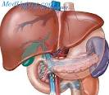

Principles
of clinico-pharmaceutical
approach to the selection of drugs
for the treatment of diseases
of liver and gallbladder

Slide 2

Methods of investigation of the liver
and biliary tract
Complaints
The following groups of complaints are encountered:
1. Hepatic dyspepsia (bile dyspepsia):
1.1 This symptom complex is caused by a violation of the motility of the gallbladder, bile ducts, duodenum, stomach and esophagus. Includes: decreased appetite, a feeling of heaviness, dull pain in the right upper quadrant intensifying after eating, nausea, bitterness in the mouth, frequent headaches.
1.2 Insufficient intake of bile in the intestine leads to a violation of emulsification, hydrolysis and absorption of fat, as well as fat-soluble vitamins A, D, E and K, which is accompanied by: pain, flatulence, rumbling in the stomach, diarrhea.
2. Symptomatic complex of "hepatic laziness." It is caused by hepatic insufficiency (hepatodepression)
It manifests itself: weakness, lethargy, rapid mental exhaustion, increased irritability, unmotivated decrease in working capacity, frequent headache, sweating, slight dizziness, a feeling of heaviness in the epigastrium and in the right hypochondrium, unstable appetite, metallic or bitter taste in the mouth.

Slide 3

Methods of investigation of the liver
and biliary tract
3. Jaundice
Yellow coloration of the skin and conjunctiva of the eye
bilirubin in the blood (more than 34.2 mmol / l)
4. Itching
Associated with the delay of bile acids and their deposition in the skin
Itchy, persistent, worse at night
5. Feeling of heaviness, pressure and pain in the right hypochondrium
arise from the dilatation of the fibrous capsule of the liver
are with acute and chronic hepatitis
6. Biliary colic
The attack of severe pain in the right hypochondrium is a characteristic symptom of cholelithiasis and occurs as a result of blockage of the vesicle or common bile duct by concrement
Usually provoked by abundant food intake, especially oily
The pain spreads to the epigastrium and radiates into the interlateral region, the right shoulder blade and the shoulder
The attack develops as a rule suddenly, often accompanied by nausea and vomiting and lasts 1-4 hours.
After the stifling of acute pain, the feeling of severity of the same localization during the day is usually maintained.
The fever, chills that occur with biliary colic, indicate the development of complications (cholecystitis, pancreatitis, cholangitis)

Slide 4
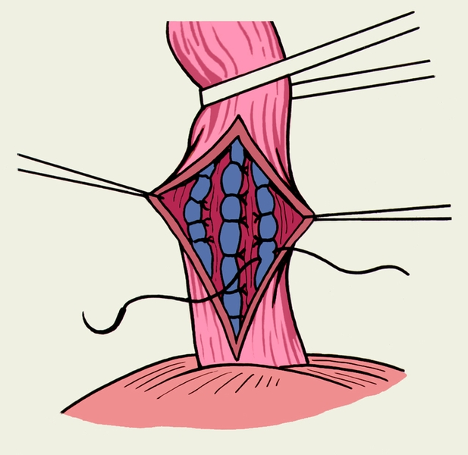
Methods of investigation of the liver
and biliary tract
7. Bleeding from esophageal varices (with portal hypertension)
Bleeding occurs usually without any obvious provoking factors and proceeds painlessly with abundant bloody vomiting and the presence or absence of melena.
Related symptoms - from mild postural tachycardia to deep shock - depend on the severity of hemorrhage and the degree of hypovolemia.
8. Fever
9. Hepatic smell -
sweet aromatic, sensible when breathing patients
Due to the violation of the exchange of amino acids and aromatic compounds with the accumulation of the product of the conversion of methionine - methyl mercaptan

Slide 5
Methods of investigation of the liver
and biliary tract
Anamnesis
1. Acquaintance with the profession and way of life of the patient helps to identify hepatotoxic factors and to suspect such infections and infestations as leptospirosis, echinococcosis.
2. Alcohol consumption - liver damage occurs with prolonged abuse of alcohol (the likelihood of developing cirrhosis of the liver is high with a daily intake of more than 60 grams of alcohol in men and more than 20 g in women).
3. The use of drugs entails a variety of liver damage, the diagnosis of which is impossible without an accurate knowledge of the drugs taken and their possible hepatotoxicity.
4. Family history allows you to suspect hereditary liver disease - benign hyperbilirubinemia, etc.
5. Epidemiological anamnesis - it is important to establish whether there was contact with patients with viral hepatitis,
blood transfusion, dental interventions, surgery, chronic hemodialysis, etc.
Belonging to "high risk" groups for serum hepatitis - personnel of blood transfusion stations, hemodialysis centers, drug addicts and prostitutes

Slide 6
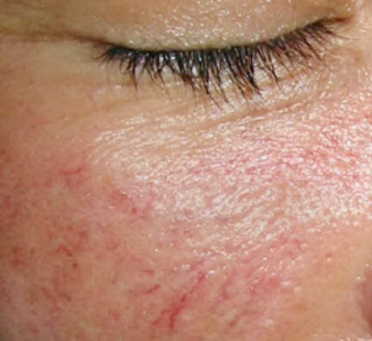
Methods of investigation of the liver
and biliary tract
General inspection
Weight loss, sometimes reaching cachexia,
possibly with liver cirrhosis and liver tumor.
2. Jaundice staining of the skin and mucous membranes is an important sign of liver disease
3. Vascular asterisks (spiders, telangiectasias, stellate angiomas):
They consist of a pulsating central part and ray-like branches of vessels resembling the legs of a spider.
The central artery of stellate angioma under the epidermis expands ampoule-like, protrudes above the skin and spreads in the form of a star.
Spider veins located in the neck, face, arms, hands, back, on the upper palate mucosa shell cavity, the pharynx.
Dimensions from 1 mm to 1-2 cm.
Pulsation of large stars is visible to the eye, and in small stars it is possible to reveal pressure.
Vascular sprocket detected during active liver damage, acute and chronic active hepatitis, cirrhosis, cirrhosis, cancer.

Slide 7
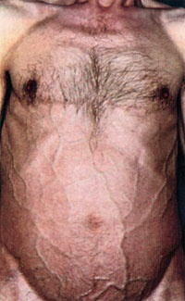

Methods of investigation of the liver
and biliary tract
General inspection
4. Hepatic palms (palmar erythema) -
symmetrical patchy redness of the palms and soles,
expressed in the field of tenar and hypotenar
stains pale under pressure
with chronic diffuse liver disease
5. Hair loss in the axillary regions
with chronic liver disease
6. Crimson tongue - bright red color of the tongue,
having a smooth, like a varnished surface
is caused by a violation of the exchange of vitamins
7. Skin and bruises on the skin are caused by skin pruritus
Cutaneous hemorrhages and pinpoint hemorrhages are due to a decrease in the synthesis of prothrombin (and other coagulation factors), as well as thrombocytopenia
8. The dilated veins on the front wall of the abdomen (the head of Medusa) are anastomoses between the portal portal systems and the lower and upper hollow veins
Develops with portal hypertension

Slide 8
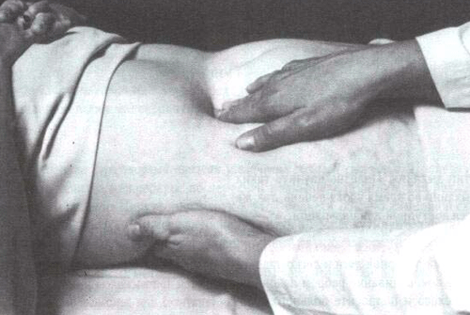
Methods of investigation of the liver
and biliary tract
Palpation
1. Determination of liver edge properties
Localization of the edge with respect to the costal arch
norm at the level of the costal arch
2. The consistency of the edge
norm - soft consistency
3. Shape of the edge
round (with stagnation, amyloidosis)
Acute (more often with cirrhosis)
4. Outline of the edge
The margin of the liver is normally even
5. Soreness
Soreness is characteristic of stagnant and inflammatory processes
6. The surface of the liver
Normally smooth
Low location of the lower edge of the liver
indicates its increase or lag of the liver

Slide 9
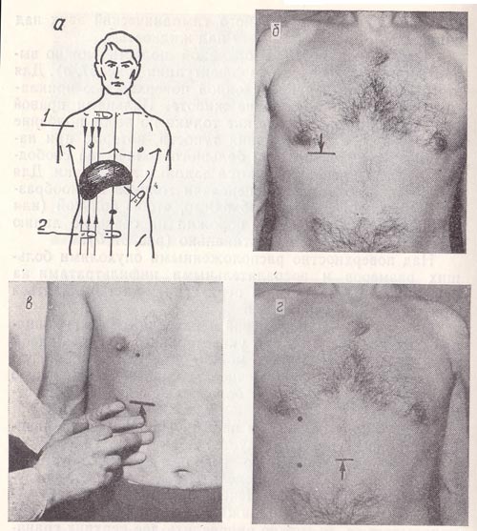
Methods of investigation of the liver
and biliary tract
Percussion
Percussion of the liver
Allows to tentatively establish the boundaries of the liver (according to Kurlov)
1. The distance between the upper and lower boundaries of the liver along the mid-succinic line is 9-11 cm
2. The distance between the upper and lower boundaries of the liver along the anterior median line is 8-9 cm
3. Distance from the lower border of the liver along the left costal arch (this boundary is determined by gently perculating along the edge of the left costal arch upward from the level of VIII-IX ribs) to the upper border of the liver along the anterior median line (normally this distance is 7-8 cm. ).

Slide 10
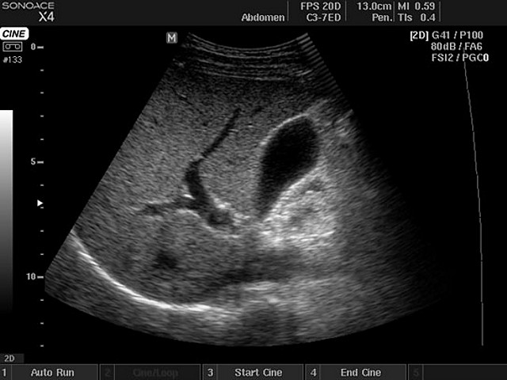
Methods of investigation of the liver
and biliary tract
Ultrasound of the abdominal cavity -
ultrasound examination of the liver, pancreas, spleen, kidney, adrenal, bladder,
allowing to determine them:
sizes and condition
presence of a tumor
hemorrhage
foreign bodies
stones, etc.
evaluate moving objects.
Ultrasound of the gallbladder function -
determination of its motor disorders.
The method is based on dynamic observation of the rhythm of contraction of the gallbladder in standardized intervals of time - reveals:
the presence of stones
allows you to determine the size of the body and the thickness of its walls.
Presence of a perianous infiltrate and consistency of the contents of the gallbladder
helps to establish the form of dyskinesia.

Slide 11
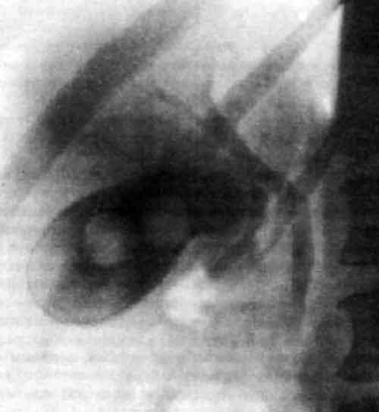
Methods of investigation of the liver
and biliary tract
Cholegraphy (cholecystocholangiography)
X-ray examination of the biliary tract after administration (intravenously or orally) of radiocontrast substances and excreted from the body together with bile
The method is used to assess the state of the biliary tract and is the only way to study the concentration ability of the gallbladder.
Cholegraphy helps:
establish a position
form
contours
the size and structure of the bile duct and gallbladder
detect the presence of stones
to study the motor function of the gallbladder

Slide 12
Chronic hepatitis
Chronic hepatitis - polyetiological chronic (duration more than 6 months) liver inflammation-dystrophic lesion with moderately expressed fibrosis and preserved lobular liver structure
Etiology
- Most often, chronic hepatitis is the outcome of acute hepatitis B, C, B + D
- Alcohol, drugs (tubazid, sulfonamides, tetracycline, etc.)
- Idiopathic (autoimmune) chronic hepatitis
Pathogenesis
1. The defeat of hepatocytes in viral hepatitis B is a consequence of the reaction of cytotoxic lymphocytes to the B virus antigens (immune cytolysis). In the development of CG, the partial elimination of the virus (an insufficient immune response) in acute hepatitis plays a decisive role.
2. Alcohol, medicines and chemicals have a direct damaging effect on the liver cells.
3. The development of autoimmune hepatitis is associated with the suppression of the T-suppressor population of lymphocytes and the appearance of antibodies to the nucleus, mitochondria, smooth muscles and specific lipoprotein of hepatocytes in the blood. The latter stimulate their cytolysis with lymphocytes - killers.

Slide 13
Chronic hepatitis
Classification of chronic hepatitis (CH)
1.Autoimmune hepatitis (AIh) -with hypergammaglobulinemia and the production of antibodies to liver tissue, the heaviest predicted
2.CH-B-called hepatitis B virus, with transition to cirrhosis of the liver
3.CH-D-called the hepatitis D virus, combined with viral hepatitis B, since the replication of the virus D requires HBS-Ag,
4.CH-C-caused by the hepatitis C virus, with the transition to cirrhosis of the liver - "affectionate killer"
5.Chronic nonspecific hepatitis
6.CH of unknown etiology
7.CH, unclassified as viral or autoimmune-called a virus or having an autoimmune origin
8.CH- drug - caused by the side effect of drugs
9.Primary biliary cirrhosis - chronic cholestatic granulomatous destructive process in interlobular bile ducts of autoimmune etiology with development of cirrhosis of the liver
10.Primary sclerosing cholangitis is a chronic progressive fibrotic inflammatory disease that affects both the extrahepatic and intrahepatic bile duct system leading to secondary biliary cirrhosis.

Slide 14
Chronic hepatitis
Classification of HG (clinico-morphological)
1. Chronic persistent hepatitis (CPH)
2. Chronic active hepatitis (CAH)
2.1 with high activity;
2.2 with moderate activity;
2.3 with minimal activity;
2.4. Autoimmune (lipoid) hepatitis (LH);
2.5 chronic cholestatic hepatitis.
3. Chronic lobular hepatitis ("congealed acute hepatitis")
4. Nonspecific reactive hepatitis (clinic against ulcer disease, cholecystitis, pancreatitis, enteritis, collagenosis, etc.)

Slide 15
Chronic hepatitis
Chronic persistent hepatitis
Relatively benign chronic inflammatory liver disease without a pronounced tendency to spontaneous progression.
Clinic
Leading syndromes:
- Dyspeptic (nausea, eructation, bitterness in the mouth)
- asthenovegetative (fatigue, irritability, sleep disturbance)
- feeling of heaviness or dull pain in the right hypochondrium
Without exacerbation of CH no complaints.
On examination:
- ictoric sclera in 1/5 of patients,
- palmar erythema,
- minor hepatomegaly (the liver is compacted with an even surface and a rounded edge),
- splenomegaly percutaneously in 1/4 of patients.

Slide 16
Chronic hepatitis
Chronic persistent hepatitis
Diagnostic tests
Biochemical studies
1. Changes in biochemical parameters are insignificant
and impermanent
1.1. increased activity of aminotransferases
(cytolytic syndrome)
1.2. albumin disproteinemia
(hepatodepressive and inflammatory syndromes)
1.3. increase in thymol test
(inflammatory syndrome)
1.4. small hyperbilirubinemia or normal indices of total bilirubin
2. Markers of viral hepatitis
3. When ultrasound is observed moderate hepatomegaly, sometimes a slight increase in the spleen
4. Histological examination of liver biopsy specimens:
the pathological process is concentrated in the portal tracts
border tissue is intact

Slide 17
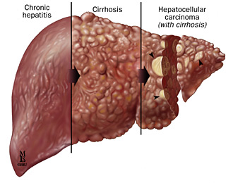
Chronic hepatitis
Chronic active hepatitis
Relatively infrequent systemic inflammatory disease with pronounced liver damage, significant immune disorders and spontaneously not abating activity of the pathological process in the liver; often transformed into cirrhosis of the liver
Clinic
Leading syndromes:
mesenchymal-inflammatory,
hepatodepressive,
cytolytic, cholestatic,
asteno-vegetative,
dyspeptic, hemorrhagic,
hypersplenism syndrome,
systemic manifestations.

Slide 18
Chronic hepatitis
Chronic active hepatitis
Complaints:
Asthenovegetative syndrome:
weakness, severe fatigue, decreased efficiency, rapid weight loss (by 5-10 kg.)
Pain in the liver:
constant, aching, very intense, sharply increased after a little physical exertion
Symptoms of hemorrhagic syndrome:
Gum bleeding, nasal bleeding, hemorrhages
Itching.
Jaundiceous color of the skin.
Fever, right up to the febrile.
Dyspeptic syndrome:
persistent, painful nausea, worse when eating
Extra-hepatic complaints:
pain in the joints and muscles, amenorrhea, decreased libido, gynecomastia

Slide 19
Chronic hepatitis
Chronic active hepatitis
Objective research
Inspection:
-weight loss
-gynecomastia in men
-palmar erythema
-telangiectasia
-icteric sclera
-icterus
-cutaneous hemorrhage
Palpation:
Liver: significant hepatomegaly;
the liver is painful, moderately dense, with a smooth surface, with a pointed scalloped edge.
Spleen: splenomegaly (percussion and palpation)
Systemic manifestations are erythema nodosum, pleurisy, pericarditis, hemorrhagic vasculitis.

Slide 20
Chronic hepatitis
Chronic active hepatitis
Laboratory and instrumental research
1. Biochemical blood tests:
1.1 5-10-fold and more increase in the activity of transaminases (cytolytic syndrome)
1.2 Increase in blood IgA, M, G, thymol and sulemic samples (mesenchymal inflammatory syndrome)
1.3 hypoalbuminemia, decreased cholinesterase activity, hepatic-cell insufficiency - hepatodepression
1.4 Hyperbilirubinemia
1.5 UV. indicators of cholestasis - activity of alkaline phosphatase, cholesterol, beta-lipoproteins, bile acids
2. Markers of viral hepatitis
3. Ultrasound -
enlarged liver with pointed edge
acoustic heterogeneity of the liver
splenomegaly
initial signs of portal hypertension
4. Histological examination of liver biopsy specimens: step, bridge and multilobular necrosis

Slide 21
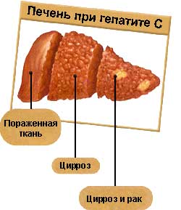
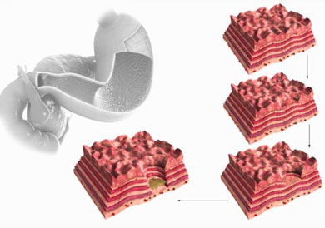
Chronic hepatitis
Chronic hepatitis - polyethological chronic (duration more than 6 months) liver inflammation-dystrophic lesion with moderately expressed fibrosis and preserved lobular liver structure

Slide 22
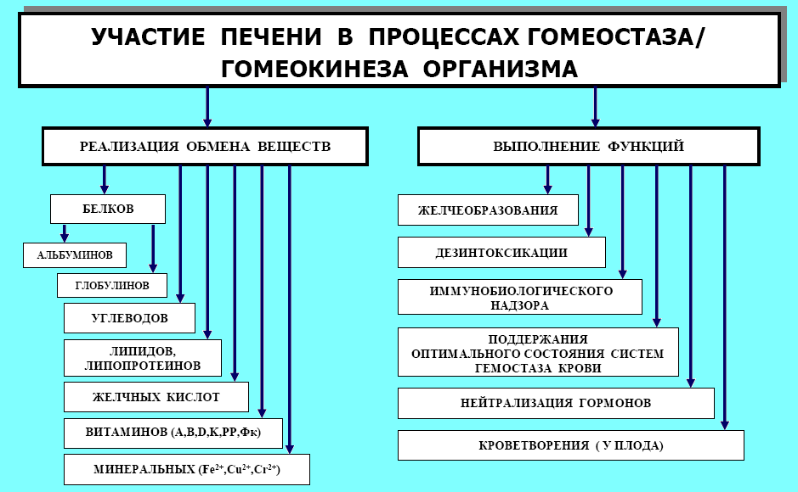

Slide 23
Etiology of liver diseases
Infection of the liver - viruses, protozoa, bacteria, helminths,
mushrooms.
Toxic liver damage - the effect of hepatotoxic substances
(polycyclic aromatic hydrocarbons, chlorine and organophosphorus
pesticides, ethanol and its surrogates, phenols, phosphorus compounds, salts of heavy
ferrous metals, СCl4, toxins of plant origin (pale toadstool),
many hepatotoxic drugs: drugs for anesthesia (chloroform), psychotropic-
(aminazine), non-narcotic analgesics (indomethacin, paracetamol),
AB, anti-TB drugs.
Physical effects - radiation, mechanical damage.
Alimentary factors - increase in animal fat consumption, deficit
lipotropic factors and proteins.
Violation of the hepatic blood flow - local (thrombosis of the hepatic artery,
portal vein, cirrhosis) and systemic.
Endocrine disorders - are accompanied by a metabolic disorder
(diabetes mellitus, thyrotoxicosis, etc.)
Tumors are primary and metastases.
Congenital defects - anomalies of the development of the liver (cavernomatosis of the portal vein).
metabolic disorders (glycogenoses), hereditary enzymopathies.
Autoimmune processes in the liver.

Slide 24
Immune reactions in liver pathology
Immune mechanisms
☞ In chronic and acute forms of hepatitis in the blood, an increased content of CD8 + T-lymphocytes, serving as suppressors and possessing cytolytic properties, is revealed.
☞ Antibodies, autoantigens and haptens act as antigenic determinants that cause the formation of activated T-lymphocytes. When hepatitis B virus is affected, foci of immune cytolysis of hepatocytes appear, in which the virus persists.
☞ Induction of cytolysis is provided by circulating immune complexes as heterologous, containing the antigen of the virus, and autologous, formed with the inclusion of the liver autoantigen - lipoprotein, to which AT (IgG) is produced.
☞ Antibodies are fixed on the surface of hepatocytes, and also induce cytotoxicity of normal lymphocytes against hepatic cells. Depending on the patient's immune status and the nature of the pathogen, cytotoxic reactions prevail or tolerance towards foreign antigens is manifested.
☞ The number of cells that interact with the virus determines the clinical course of hepatitis.
О Переводчике GoogleСообществаМобильная версияО GoogleПравила и принципыСправка

Slide 25
JAUNDICE
Symptom characterized by the appearance of yellow skin color, sclera and
mucous membranes as a result of deposition of bile pigments with their
increase in blood> 30-35 mmol / l.
PURCHASED
HEREDITARY
Superhepatic
Gilbert
Subhepatic
Kriegler-Nayyar
Hepatic
Dabin-Johnson

Slide 26
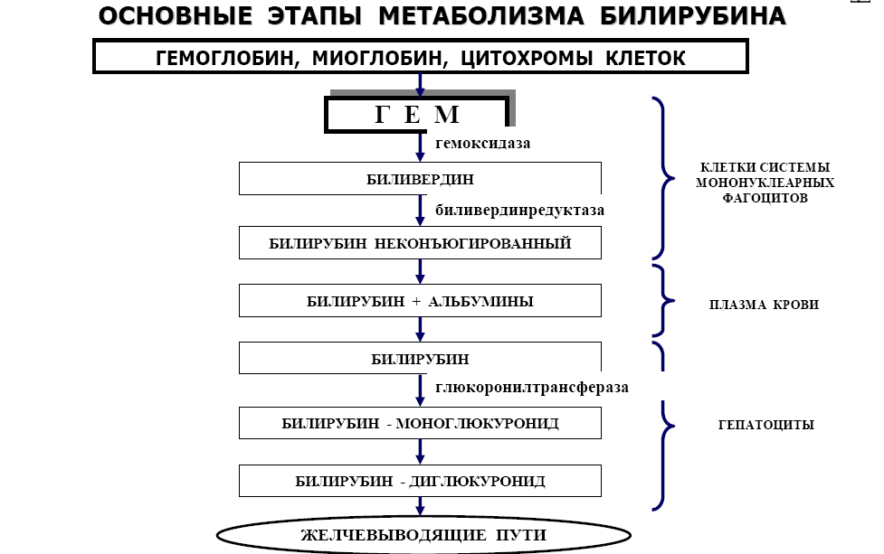

Slide 27
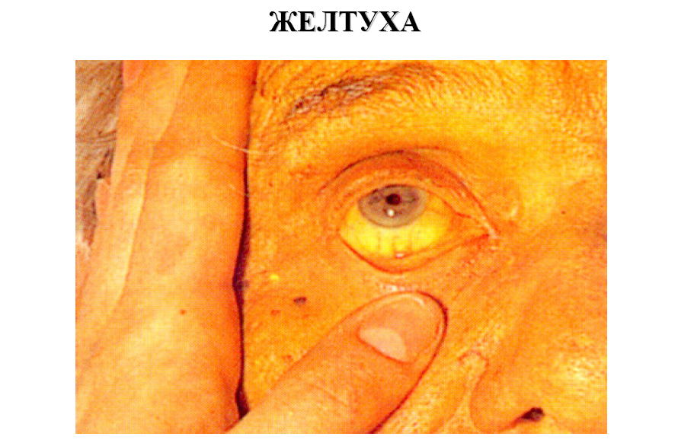

Slide 28
Hepatic jaundice
☞ Allocate the hepatic-cell (parenchymal) and enzymopathic varieties of hepatic jaundice.
☞ Liver-cell jaundice develops due to the defeat of hepatocytes (more often with viral hepatitis or toxic liver damage), accompanied by impairment of all functions of the hepatic cells.
☞ Depending on the degree of destruction of hepatic cells and the severity of liver function abnormality, three stages of parenchymal jaundice (pre-arthritic, icteric and stage of outcome) are distinguished.

Slide 29
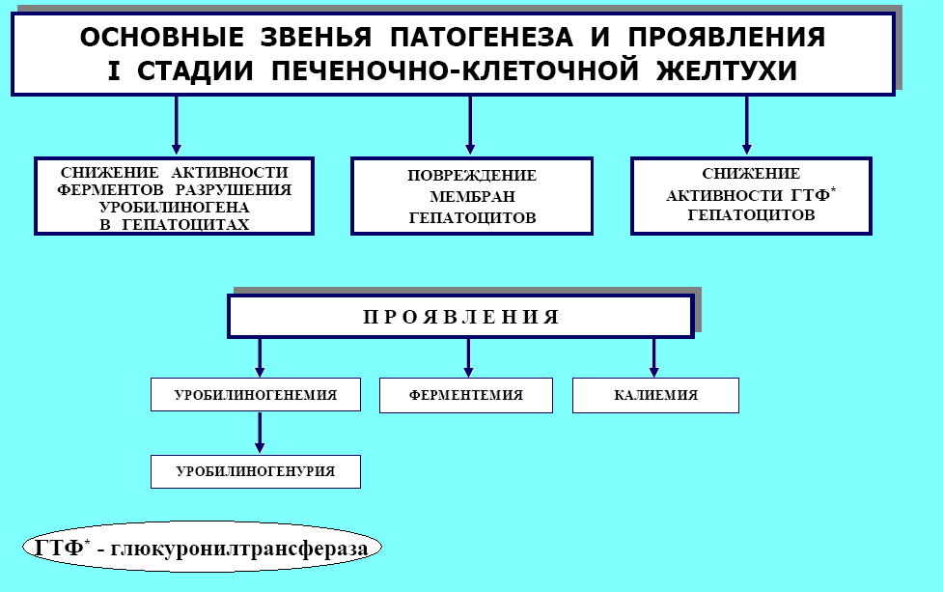

Slide 30
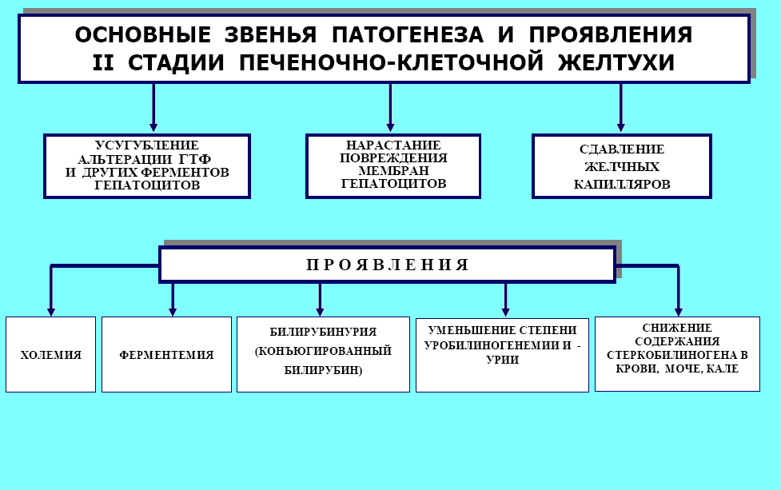

Slide 31
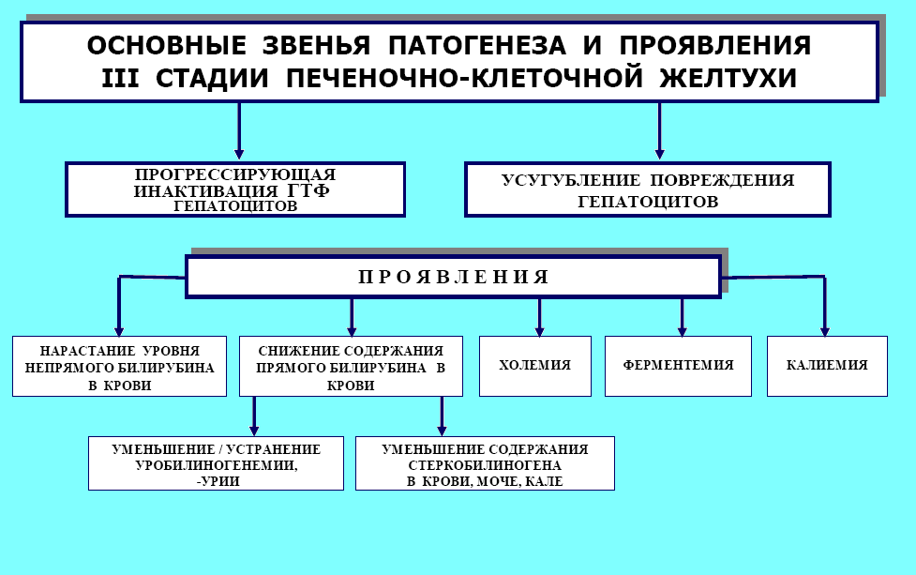

Slide 32
Enzymopathic form of parenchymal jaundice
☞ It is caused by metabolic disorders of bilirubin in the hepatic cells themselves due to a decrease in the activity of enzymes responsible for seizure, transport, binding to glucuronic acid, and excretion of bilirubin from hepatocytes.
☞ On the etiology, these jaundices are usually hereditary, but can develop with prolonged starvation, after the introduction of radiopaque, radionuclide preparations and other substances that compete with bilirubin for the capture of hepatocytes.

Slide 33
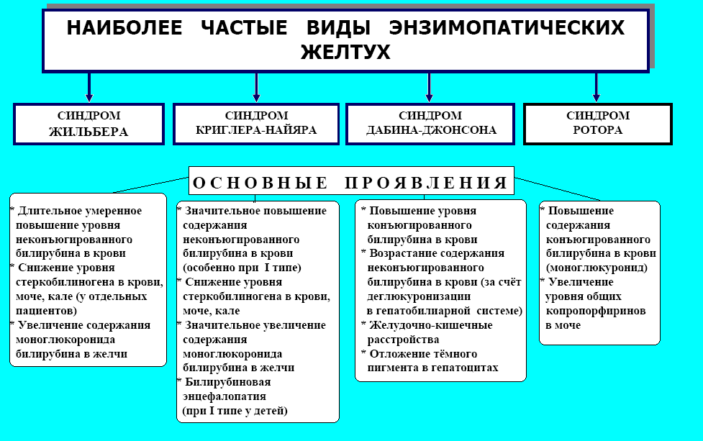

Slide 34
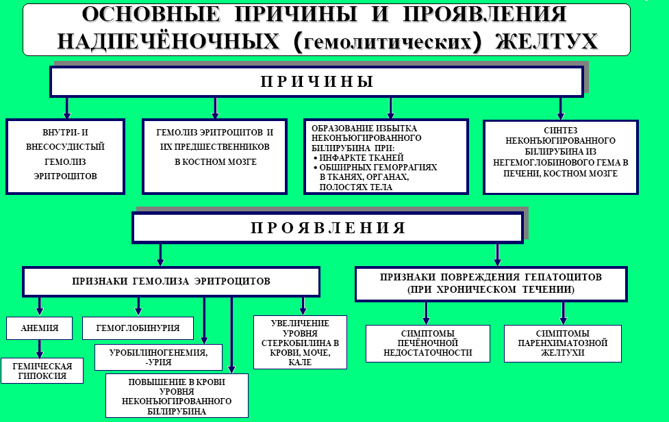

Slide 35
Subhepatic jaundice
☞ It develops when it is difficult to remove bile from the bile capillaries, the gall bladder or its duct in the PDK.
☞ Violation of the outflow of bile is accompanied by ↑ pressure in the bile capillaries, their hyperextension, ↑ permeability of the walls and diffusion of bile components into the blood capillaries. With complete obturation of the bile ducts,  the rupture of the bile capillaries and the release of bile out of the latter. Bile, coming into contact with the tissue, causes its damage, manifested in the form of biliary hepatitis.
☞ For obstructive jaundice, a manifestation of two syndromes is typical: cholemia and acholia.

Slide 36
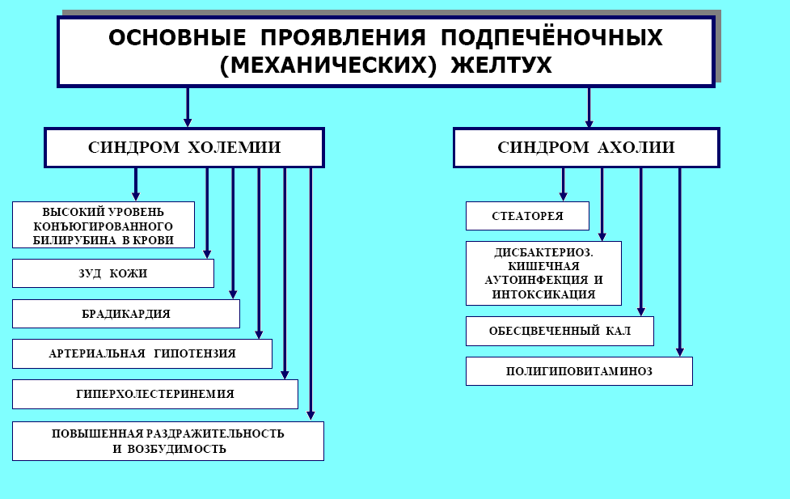

Slide 37
Bl-blood; Ur-urine; Fe-feces Jaundices
Indicators | Norm |  |  | Super-hepatic |  |  | Sub-hepatic |  |  | Hepatic-cellular
 |  |  |  |  |  |  |  |  |  | 1 stage |  |  | 2 stage |  |  | 3 stage
 | B l | U r | F e | B l | U r | F e | B l | U r | Fe | B l | U r | F e | B l | U r | F e | B l | U r | F e
Indirect bilirubin | + | - | - | ↑ | - | - | N | - | - | N | - | - | N | - | - | ↑ | - | -
Direct bilirubin | + | + | - | N | - | - | ↑ | + | - | - | - | - | ↑ | + | - | - | - | -
Urobilinogen | - | - | - | + | + | - | - | - | - | + | + | - | + | + | - | - | - | -
Stercibilinogen | + | + | + | ↑ | ↑ | ↑ | - | - | - | N | N | N | ↓ | ↓ | ↓ | - | - | -
Bile acids | - | - | - | - | - | - | ↑ | + | - | - | - | - | + | + | - | + | + | -
Liver enzimes |  |  |  |  |  |  |  |  |  |  |  |  | + | + | - | + | + | -

Slide 38
ACUTE HEPATITIS
diffuse infiltrative-necrotic changes in the liver parenchyma.
Etiology
infectious
toxic
drugs
Transmission ways
Hepatitis А,Е
Hepatitis B,С,D
Feces, saliva
Blood, sperm, saliva,
perinatal.

Slide 39
CAUSES OF HEPATITIS
Most frequent
Less frequent
Rare
hepatitis A virus
hepatitis B virus
hepatitis C virus
alcohol
-Virus of hepatitis E
-virus
Epstein-Barra
-Drugs
-hepatitis D virus
-cytomegalovirus
Coxsackie A and B virus
-leptospirosis
-chemical compounds
-toxins of fungi

Slide 40
Diagnosis of viral hepatitis

Slide 41
HEPATITIS А
in most cases it is easy
the reverse development of the disease is favorable
1. The incubation period (2-4 weeks)
2. Pre-jaundice period (5-7 days)
begins suddenly; symptoms of intoxication
in peripheral blood: leukopenia, ↓ activity of ALT, ASAT,
violation of pigmental metabolism.
3. Jaundice period (5-7 days)
appears icteric sclera
jaundice reaches a maximum
at palpation the liver is smooth, dense.
in peripheral blood: leukopenia, lymphocytosis, ESR up to 18-24 mm / h
4. The phase of reverse development
rapid disappearance of biochemical and clinical signs of hepatitis

Slide 42
HEPATITIS В
Patients of biochemical laboratories, blood transfusion units, hemodialysis units, patients with immunosuppressive diseases are particularly at risk of infection.
- feature: autoimmune liver damage
Serological tests for hepatitis B:
Hbs Ag
Hbe Ag
Hbc Ag class Ig M, later Ig
HBV DNA
DNA polymerase HBV

Slide 43
Clinical course of acute hepatitis В
The incubation period (2-4 months)
Pre-jaundice period (from 1 to several days)
- begins gradually with dyspeptic disorders and asthenovegetative syndrome;
- in peripheral blood: leukopenia, ↑ ESR, sorbitol and lactate DG,
aldolase.
3. Jaundice period - the height of the disease
- jaundice 12-16 days
- arthralgia
- dyspeptic disorders
- splenomegaly
- pain syndrome
- extrahepatic symptoms
- skin itch and hemorrhagic phenomena
- bradycardia, hypotension
- enlargement of the liver
- dystrophic changes of myocardial and central nervous system
- fever
- in peripheral blood: leukopenia, lymphocytosis, sometimes monocytosis, ESR, hyperbilirubinemia, cytolysis markers.
4. Reconvalescence 3-4 weeks

Slide 44
ALCOHOLIC HEPATITIS
at systemic use of alcohol
has a wide range of clinical manifestations
Clinic:
anorexia, nausea, vomiting, diarrhea
fever
hepatomegaly (80-100%)
ascites (30-60%)
"vascular asterisks"
palmar erytema
Dupuytren's contracture
The course and prognosis of alcoholic hepatitis (complications):
- encephalopathy
- ascites
-renal insufficiency
But unfortunately, in the late stages of alcoholic hepatitis can progress even with abstinence from drinking alcohol.

Slide 45
The data of laboratory analyzes,
characteristic for alcoholic hepatitis.
In peripheral blood:
neutrophilic leukocytosis with n / a shift
increased ESR
leukemoid reactions
bilirubin
aminotransferases
gamma-glutamine transferase - "potential marker of alcoholism"
(80-90%)
albumin
Criteria for the reliability of the diagnosis: Liver biopsy DATA
alcoholic hyaline (Mallory's calf)
coagulation necrosis of hepatocytes with infiltrates from the leukocytes.
centrolobular necrosis, often with steatosis

Slide 46
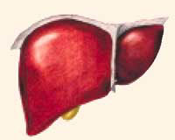
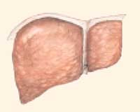
Cirrhosis of the liver
The chronic progressive disease characterized by increasing hepatic insufficiency caused by dystrophy of the hepatic cells, scarring and restructuring of normal liver architectonics, leading to the formation of structural abnormalities.
Classification by morphological picture:
postnecrotic
biliary
portal
Etiology:
consequence of viral hepatitis
- chronic alcoholism
- autoimmune hepatitis
- metabolic disorder (hemochromatosis, alpha-1-antitrypsin deficiency, glycogenase)
- diseases of intra- and extrahepatic biliary tract (primary and secondary
biliary cirrhosis)
So it looks like a healthy liver. So it looks like a liver at cirrhosis.

Slide 47
Pathogenesis of cirrhosis - "Chain Reaction"
Repeated different length of necrosis of hepatic cells
Scar formation
Disturbance of blood supply to adjacent areas of the surviving liver parenchyma
The surviving hepatocytes intensively proliferate
Node formation
The compression of the surrounding tissue with the vessels passing through it up to
ischemic necrosis
Violation of the outflow of blood
Formation of new vascular anastomoses between the portal and hepatic veins
Blood goes around the surviving parenchyma
Blood supply sharply worsens and leads to new ischemic necrosis
The mechanism of "self-progression" is the action of the primary pathological
factor is no longer necessary.

Slide 48
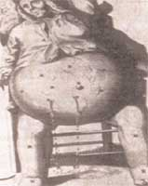
Manifestations of liver cirrhosis
☞ Portal hypertension. For a long duration - varicose veins of the esophagus, cardiac part of the stomach, anterior abdominal wall (jellyfish head) and hemorrhoidal veins.
☞ Hepatomegaly and splenomegaly (result of difficulty in outflow of blood and regional hypoxia). There is a violation of the function of the spleen for elimination from the blood and destruction of old blood elements (anemia, leukopenia, thrombocytopenia).
☞ Ascites.
The origin connect:
- with hemodynamic, stagnant phenomena
in the portal system;
- with the hormonal factor (the deposition of blood in the organs of the abdominal cavity leads to the activation of the RAAS and the retention of sodium and water in the body);
- with a possible deficiency of natriuretic hormone produced by the liver.

Slide 49
Manifestations of liver cirrhosis
☞ Parenchymal jaundice and hemorrhagic diathesis (bleeding of the nasal mucosa and gums, subcutaneous petechiae and hemorrhages).
☞ Dysproteinemia (hypoalbuminemia, hyper-γ-globulinemia), increased activity of hepatic transaminases and direct bilirubin concentration in the blood, ↑ ESR.
☞ Hyponatremia, hypokalemic alkalosis.
☞ Pain syndrome (dyskinesia of the biliary tract or necrosis of the liver).
☞ Liver failure (expressed in varying degrees) with hepatocerebral syndrome.

Slide 50
Liver failure
это состояние, при котором происходит снижение одной или нескольких функций печени ниже уровня, необходимого для обеспечения нормальной жизнедеятельности организма.
Types of liver failure (LF):
absolute and relative (against the background of functional overloads);
total (reduced all liver function) and partial;
small LF (without encephalopathy) and large LF (with encephalopathy).
Pathogenetic forms of hepatic insufficiency:
Excretory (cholestatic)
Hepatocellular (with inflammation, dystrophy, necrosis of the liver)
Vascular (with violation of local or general circulation)
Mixed
Clinical forms:
- acute and chronic
with diffuse liver damage or focal

Slide 51
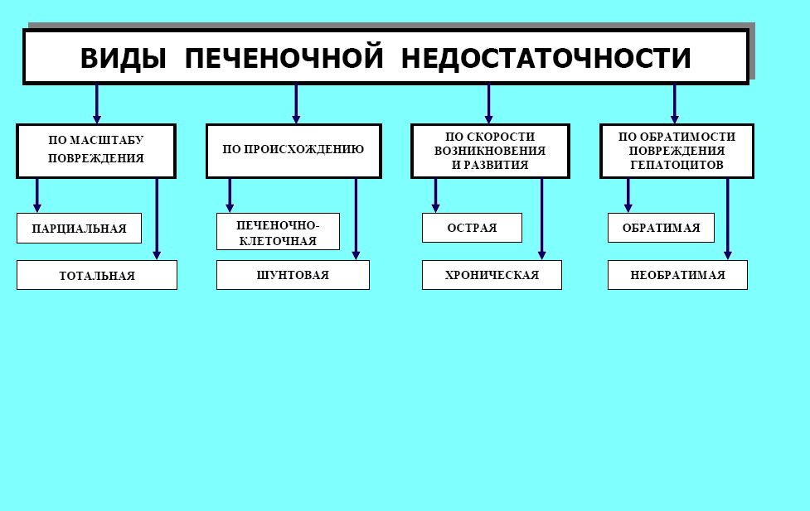

Slide 52
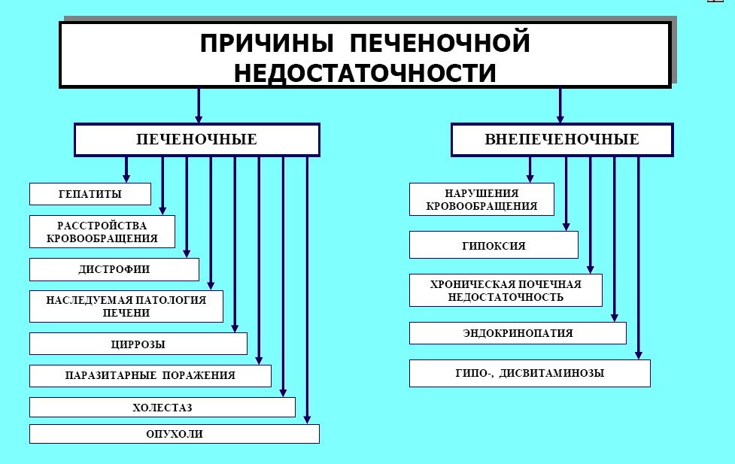

Slide 53
Hepatic cell insufficiency
syndrome, which is characterized by
weakening of metabolic,
detoxification and barrier function of the liver.
Metabolic disorders of the liver
with hepatic-cell failure:
protein metabolism
carbohydrate metabolism
imbalance of hormones
fat metabolism
weakening of liver's antitoxic function
weakening of the barrier function
toxemia

Slide 54
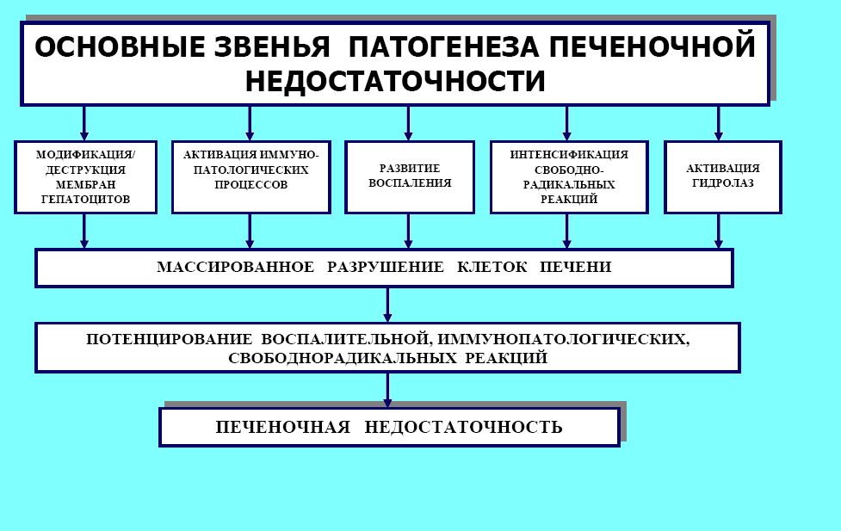

Slide 55
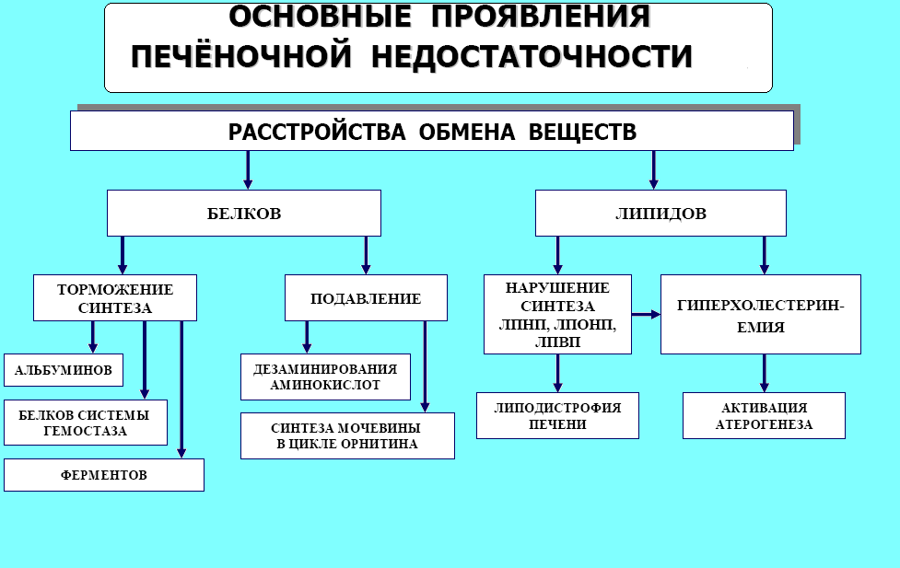

Slide 56
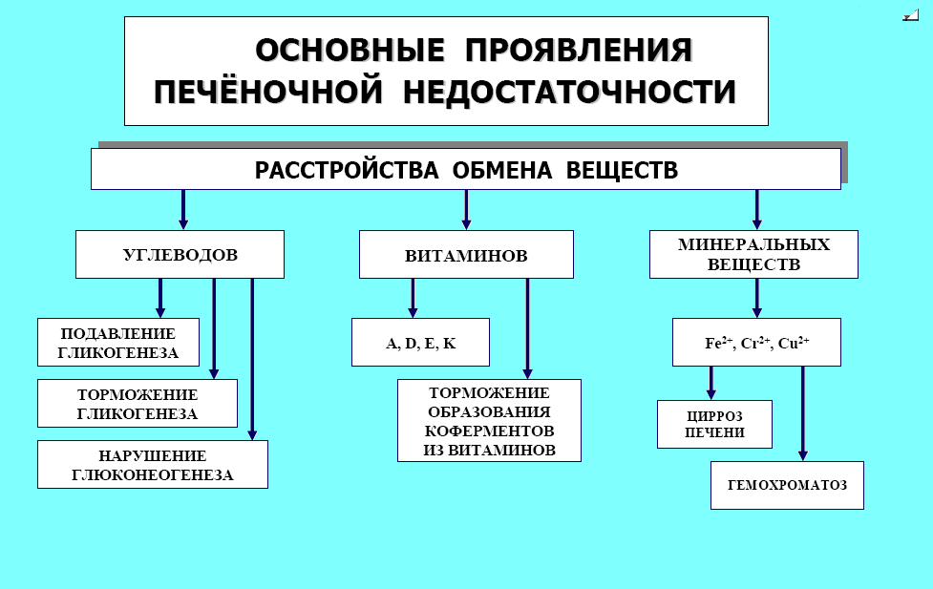

Slide 57
Carbohydrate metabolism
propensity to hypoglycemia (⇓ processes of glycogenolysis and gluconeogenesis)
Weakness
Dizziness
Vegetative disorders
Weakening of liver detoxification function
Neutralization of the NCB
Fat metabolism
- disruption of synthesis and oxidation of triglycerides, PL, LP, СH, LC and CT.
In blood
Reduction of cholesterol content of antiatherogenic forms of lipoprotein
In the intestine
Deficiency of bile acids

Slide 58
Protein metabolism
- a decrease in albumin blood
the appearance of hyperhydration and edema
development of ascites
-dysproteinemia
decrease in albumin-globulin coefficient
increased ESR
hyperaminoacidemia
аminoaciduria
increase in blood ammonia
decrease urea in blood
violation of the synthesis of important clotting factors 1, 2, 5, 7, 9, 10, 13.
Hemorrhagic syndrome
a decrease in the synthesis in the liver of transferrin and transcobalamin,
vitamin B6 and A.

Slide 59
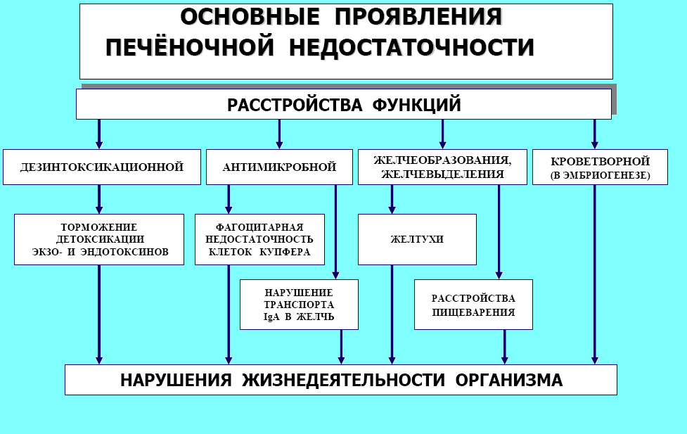

Slide 60
Weakening the barrier function
As a result:
- reduced resistance to infection
- development of allergic, immune diseases
Toxemia
Clinical manifestations and changes in peripheral blood:
leukocytosis
fever
hemolysis of erythrocytes
erosion of the intestine
renal insufficiency
toxemic collapse
Weakening of liver's antitoxic function
disinfection of ammonia and indirect bilirubin
the appearance of endogenous carcinogens

Slide 61
Hepatic coma
Hepatic coma is the final stage in the development of progressive hepatic insufficiency, when signs of severe damage to the central nervous system (hepatocerebral syndrome), as well as other organs and tissues, are revealed against the background of an organism intoxication.
"There is no hepatic coma without a liver" (if uraemic syndrome can be induced in an experiment with bilateral nephrectomy, then partial preservation of hepatocyte functions is necessary for the development of the hepatic coma).
There are three variants of the development of the hepatic coma: shunt, hepatic-cellular and mixed.

Slide 62
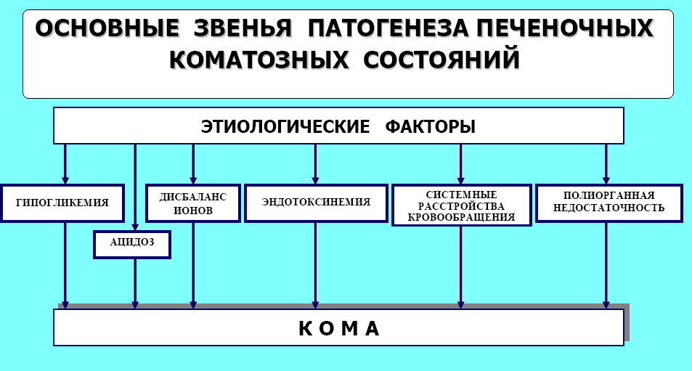

Slide 63
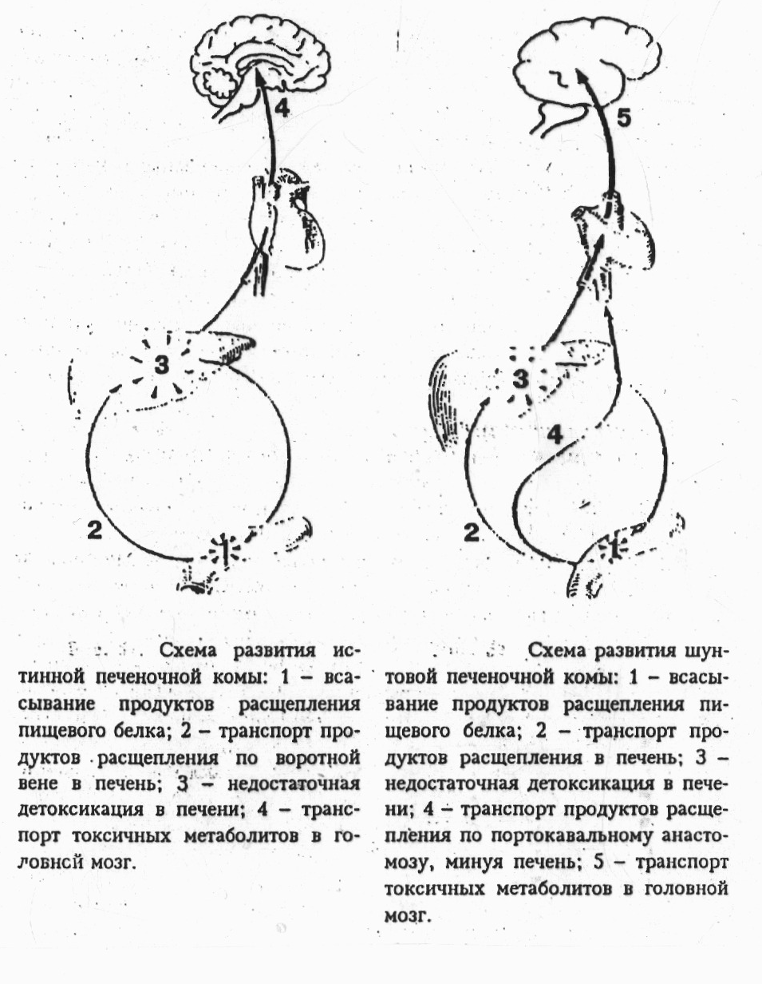

Slide 64
The development of encephalopathy is explained by the appearance in the blood of a large amount of CEREBROTOXINS:
ammonia
protein metabolites
fatty acid
derivatives of pyruvic and lactic acid
amino acids
false neurotransmitters
Causes of coma development
can develop on the background :
severe viral hepatitis
toxic dystrophy
cirrhosis of the liver
with acute disturbance of the hepatic circulation
with liver injuries

Slide 65
Laboratory indicators of liver damage
Cytolysis: ⇑ activity of ALT and AST, glutamate dehydrogenase, LDH, an increase in iron and vitamin B12 in the blood.
Cholestasis: ⇑ level of direct bilirubin, cholesterol, increased activity of alkaline phosphatase, γ-glutamyltranspeptidase (GGT), 5-nucleotidase.
Hepatic (production) hyperazotemia: ⇑ serum ammonia, total amine nitrogen, aromatic amino acids (phenylalanine, tyrosine, tryptophan), phenols, indicator.
Insufficiency of the synthetic function of the liver: ⇓ level of albumins, cholesterol, procoagulant prothrombin complex, ⇓ cholinesterase activity.
Polyclonal Gammopathy: ⇑ the content of total protein in the serum, β and γ-globulins, IgA, G, M, positive sedimentary colloidal samples.

