Slide 1
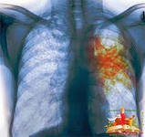

Principles
Of clinico-pharmaceutical
approach to the selection of drugs
for the treatment of respiratory diseases
(bronchitis, pneumonia, tuberculosis)

Slide 2
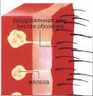
ACUTE BRONCHITIS
Acute diffuse inflammation of the mucous membrane and other layers of the bronchi, characterized by an increase in the volume of bronchial secretion with cough, separation of sputum, and in the defeat of small bronchi by the development of dyspnea
Acute bronchitis accounts for 1.5% of all diseases and
35% of acute nonspecific respiratory diseases
Etiology
- Infectious agents (viruses, mycoplasma, bacteria)
- Physical factors (excessive cooling, dust)
- Chemical agents (vapors of alkali and acids)
- Toxic substances
Predisposing factors:
- Smoking, alcohol, cardiovascular diseases
- high humidity of atmospheric air
- foci of chronic infection in the nasopharynx, tonsils
Pathogenesis
Decrease in the effectiveness of physical factors protecting the bronchial tree, especially the ability to filter the inhaled air and clean it of coarse mechanical particles, as well as mucociliary transport in the respiratory tract

Slide 3

Acute bronchitis
Classification
1. On etiology:
1.1 Infectious: viral, mycoplasmic, bacterial
1.2 Mixed: viral-bacterial,
due to the impact of non-infection
1.3 Unspecified genesis
2. On pathogenesis:
2.1 Primary
2.2 Secondary: as a consequence of acute
respiratory disease, with exacerbation of foci of chronic infection with upper RT, with acute pneumonia
3. By primary localization:
3.1 Proximal
3.2 Distal or obstructive
3.3 Bronchiolitis (bronchi d < 1 mm)
4. By the nature of inflammation: catarrhal, edematic, purulent
5. In the course of the disease:
5.1Acute phase of the disease (up to 2 - 3 weeks)
5.2 Acute bronchitis with prolonged course (up to 1 month or more)

Slide 4

ACUTE BRONCHITIS
Complaints
Cough — paroxysmal, initially dry, later with mucous, less often mucopurulent sputum.
With the involvement of small bronchi - expiratory dyspnea
Intoxication syndrome (duration 1-7 days) -
chills, fever, headache, a sense of weakness
Body temperature, as a rule, normal, less often briefly raised to subfebrile digits, and in severe cases, when a bacterial infection joins, the temperature rises to febrile digits
Аnamnesis of the disease
Acute bronchitis usually occurs after the acute respiratory disease, less often at the same time, the incubation period lasts 3-5 days.
Аnamnesis of life
Allows to identify predisposing factors
Status prаesens
Chest examination - pathological changes, as a rule, no.
The frequency of respiratory movements can be increased with severe intoxication, lesion of small bronchi and bronchioles

Slide 5
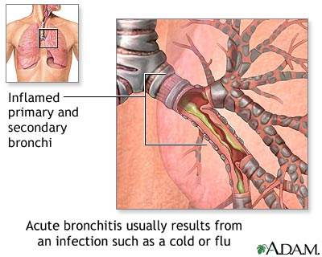
ACUTE BRONCHITIS
Palpation of the chest -
may be tenderness in the intercostal spaces
Percutary sound -
over the lungs usually does not change
Auscultatory - enhanced vesicular (called hard) breathing
- The wheezing is dry, less damp, the caliber of which depends on the level of the affected bronchi: when the large bronchi are involved in the process, wheezing are dry bass and wet large bubbles, small bronchi are discrete dry and finely bubbly moist wheezing
A blood test - may not reveal changes at all, or there is a mild leukocytosis and a slight increase in ESR
Biochemical blood test - possibly the appearance of C-reactive protein, an increase in the content of sialic acids
Sputum - has a mucous or mucopurulent nature, sometimes with blood; sputum is found in the cylindrical epithelium, macrophages and other cellular elements
X-ray of the lungs - one can identify the increase in pulmonary
pattern due to peribronchial edema

Slide 6
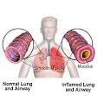
ACUTE BRONCHITIS
Principles of treatment
- Bed conditions
- Hospitalization is not indicated
- A plentiful warm drink with honey,
raspberry, lime color, heated alkaline mineral water
- Anti-inflammatory drugs
- Mucolitics and expectorants (bromhexine, tincture of thermopsis, mucaltin)
- Immunocorrectors (echinocin, interferon)
- Ascorbic acid
- Inhalation of sodium hydrogencarbonate
- If the symptomatic therapy is ineffective for 2-3 days, as well as the severe course of the disease, antimicrobial drugs are prescribed

Slide 7

CHRONIC BRONCHITIS
Diffuse progressive lesion of the bronchial tree -
- with a reorganization of the secretory apparatus
of mucous membrane;
development of the inflammatory process and sclerotic
changes in the deeper layers of the bronchi, accompanied
by a violation of the purifying and protective function of
bronchi and hypersecretion of mucus;
- is clinically manifested by a productive cough -
within 3 months of the year for 2 subsequent years
About 20% of the male population suffer from chronic bronchitis.
In recent years, the growth of tobacco smoking in women leads to an increase in the incidence of chronic bronchitis among them.
The most common - in the UK, in connection with which
was called the "English disease". The total number of patients in this country is more than 10 million.

Slide 8

CHRONIC BRONCHITIS
Etiology
1. Toxic-chemical agents (pollutants)
1.1 Smoking - tobacco smoke contains more than 2,000 toxic components. Passive smoking is very important.
1.2 Inorganic dust - cement, coal.
1.3 Toxic vapors and gases-chlorine, ammonia, acids.
2. Broncho-pulmonary infection
2.1 Viral infection
2.2 Bacterial infection
3. Predisposing factors: climatic factor (moist and cold weather), hereditary predisposition to chronic bronchitis
Pathogenesis - The damaging effect of various factors on the bronchial epithelium and the suppression of local defense factors are of paramount importance. Expressed anatomical changes arise and accumulate: hypertrophy of bronchial glands, an increase in the number of goblet cells and a sharp decrease in ciliate cells, an excessive amount of viscous glue secret.
Ultimately, there is an irreversible obstruction of the bronchial tree, ventilation is disrupted and alveolar hypoxia occurs.

Slide 9
CHRONIC BRONCHITIS
Classification
1. Basic forms
1.1 Chronic simple (non-obstructive) bronchitis, without
ventilation disorders.
1.2 Chronic purulent (non-obstructive) bronchitis, with a constant or periodic discharge of purulent sputum and without ventilation disorders.
1.3 Chronic obstructive bronchitis, with discharge of mucous sputum and persistent obstructive disorders.
1.4 Chronic purulent-obstructive bronchitis, with discharge of purulent sputum and persistent obstructive disorders.
2. Special forms
2.1Hemorrhagic chronic bronchitis.
2.2 Fibrinous chronic bronchitis.
In the course of the disease: latent, with rare exacerbations, with frequent exacerbations, continuously recurring.
In phase: exacerbation, remission
Complications: emphysema, hemoptysis, respiratory failure, pulmonary hypertension

Slide 10
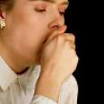
CHRONIC BRONCHITIS
Clinics
Complaints:
Cough —
- at the beginning of the disease - in the morning, accompanied by the separation of a small amount of sputum, intensified in the cold and damp season
- in the future - cough gradually increases, is noted throughout the day and at night, as well as in all seasons.
Spitting —
- in the early stages of sparse sputum mucous character
- in the future appears mucopurulent and purulent sputum, the progression of chronic bronchitis leads to a constant secretion of purulent sputum
- sputum is deteriorating in wet weather or after drinking alcohol and gradually the amount of sputum increases and usually does not exceed 50 ml/day.
Dyspnea —
at the beginning - dyspnea occurs only with considerable physical exertion
gradually increases over a number of years

Slide 11
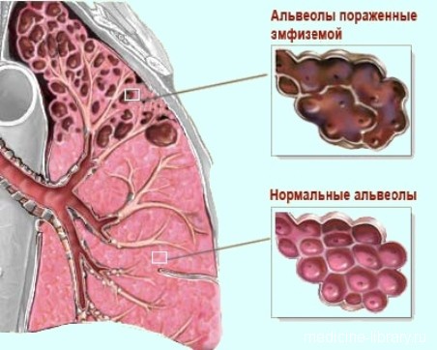

CHRONIC BRONCHITIS
Status presens
It is noted: pallor of the skin, acrocyanosis, in far-gone cases - swelling of the lower limbs
the shape of the chest - barrel (emphysematous)
chest excursion is limited
voice jitter evenly - weakened
percussion sound - box shade
the lower borders of the lungs are omitted, the mobility of the lower edge
with auscultation of the lungs - prolonged exhalation
breathing is hard, and when developing
emphysema, respiration is a weakened vesicular
adverse respiratory wheezing - dry wheezing
When examining the cardiovascular system: sinus
tachycardia, heart tones muffled, accent of
2nd tone on pulmonary artery
Examination of external respiratory function –
obstructive type
X-ray of the lungs - deformation of the
pulmonary picture, diffuse pneumofibrosis, emphysema

Slide 12

CHRONIC BRONCHITIS
Principles of treatment
1. Treatment during an exacerbation:
1.1 Elimination of causative factors (smoking)
1.2 A diet rich in vitamins with a restriction of carbohydrates
1.3. Endobronchial sanation and inhalation therapy with bronchodilators
1.4 Antibiotic therapy
1.5 Mucolytics and expectorants
1.6 Physiotherapy exercises
2. Treatment during remission:
2.1 General strengthening therapy
2.2 Physiotherapy exercises
2.3 Spa treatment

Slide 13
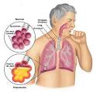
PNEUMONIA
Pneumonia (greek πνευμονία от πνεύμων — «lungs») (inflammation of lungs) — acute inflammation of the pulmonary tissue of infectious origin with predominant alveolar involvement (development of inflammatory exudation
in them) and interstitial lung tissue
Etiology
The most frequent pathogens of community-acquired pneumonia are:
pneumococci (30-40%), mycoplasma (20%), viruses (10%)
With nosocomial pneumonia -
Pseudomonas aeruginosa, Proteus, Legionella, Aspiriglia, Mycoplasma and Pneumocystis
With aspiration pneumonia -
association of Gram-positive and Gram-negative bacteria with anaerobic microorganisms.
Such pneumonias are found in diseases of the gastrointestinal tract, nervous system, in patients with multiple injuries

Slide 14
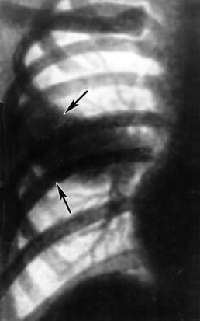
PNEUMONIA - classification
- Community pneumonia
(home, аmbulatory)
light pneumonia in patients under the age of 60 years without concomitant diseases
light pneumonia in people over 60 years of age, as well as people of any age with concomitant diseases
severe pneumonia in patients regardless of age,
the presence or absence of concomitant diseases
– Hospital pneumonia
(intrahospital, nosocomial)
- pneumonia in patients without previous antibiotic treatment in general and ventilation departments less than 5-7 days
- pneumonia in patients on the background of antibiotic therapy in general hospitals and on artificial ventilation for more than 5-7 days
Aspiration pneumonia,
both community-based and hospital
Pneumonia in persons with severe immunity defects,
including neutropenia

Slide 15
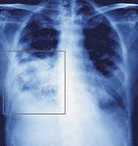
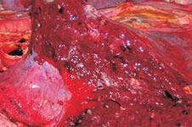
Community-acquired pneumonia
Community-acquired pneumonia (CAP) –
acute disease that originated in out-of-hospital conditions and is accompanied by lower respiratory tract infection symptoms (fever, cough, sputum, possibly purulent, chest pain, dyspnea) and radiographic signs of new focal-infiltrative changes
In the lungs, in the absence of an obvious diagnostic alternative

Slide 16
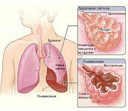
ETIOLOGY OF CAP
The etiology of the CAP is directly related to the normal microflora colonizing the upper respiratory tract.
A typical causative agent of CAP is:
S. pneumoniae (30-50% of cases).
Atypical microorganisms, whose share in total accounts for 8% to 30% of cases:
• Chlamydophila pneumoniae;
• Mycoplasma pneumoniae;
• Legionella pneumophila.
Rare (3-5%) pathogens of CAP:
• Haemophilus influenzae;
• Staphylococcus aureus;
• Klebsiella pneumoniae,
even less often - other enterobacteria.

Slide 17
PATHOGENESIS OF CAP
Anti-infective protection of the lower respiratory tract is performed by:
- mechanical factors
- aerodynamic filtration
- branching of the bronchi
- epiglottis
- coughing and sneezing
- ciliary epithelial cilia
mechanisms of nonspecific and specific immunity
The causes of the inflammatory reaction can be:
- Decreased the effectiveness of the protective mechanisms of the macroorganism
- Massiveness of the dose of microorganisms and/or their increased virulence

Slide 18
PATHOGENESIS OF CAP
It is possible to distinguish four pathogenetic mechanisms, with different frequency causing the development of CAP:
- aspiration of the secretion of the oropharynx;
- inhalation of an aerosol containing microorganisms;
hematogenous distribution of microorganisms from the extrapulmonary focus of infection (endocarditis with tricuspid valve injury, septic thrombophlebitis);
direct spread of infection from neighboring affected organs (for example, with liver abscess) or as a result of infection with penetrating chest wounds.

Slide 19

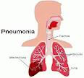
PNEUMONIA
Clinics
Complaints:
- cough at first dry, then moist;
- production of sputum mucous, mucopurulent nature;
- dyspnea; - fever of the wrong type.
Anamnesis morbi
Acute onset with high fever, often chills, lasting from
3 to 10 days
Anamnesis vitae
Chronic diseases of the lungs, cardiovascular system
Status praesens
Objective signs depend on the prevalence and location of inflammatory changes in the lungs.
Small pockets of inflammation are not accompanied by a change in the voice jitter, or a distinct change in percussion sound
General examination: in 1/3 of patients -
pallor of the skin and acrocyanosis;
hyperemia of the cheeks, sometimes herpetic eruptions

Slide 20
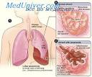
PNEUMONIA
Respiratory system
- Lag in the act of chest respiration on the side of the lesion
- Limitation of mobility of the lower edge of the lung
Shortening of percussion soun
Auscultative phenomena: hard breathing above the affected
area, wet fine and medium bubbling wheezing in a limited area of the lesion
Сardio-vascular system —
- muffled I tone, systolic murmur at the top of heart,
lability of pulse;
- a decrease in ABP is observed only with the prevalence of the inflammatory process, pronounced intoxication, in the elderly
Blood analysis:
- shift of leukoformula to the left, increase of ESR
X-ray of lungs:
lobular infiltration alternates with patches
unaffected or compensatory bloated lung tissue

Slide 21
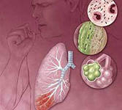
Diagnostic criteria for CAP
The diagnosis of СAP is established with:
- presence of X-ray confirmed focal infiltration of pulmonary tissue
- at least two clinical signs from the following:
-acute onset of the disease with a body temperature above 38°C;
-cough with sputum;
-physical signs (short or dull percussion sound, weakened or rigid bronchial breathing, focus of sonorous small bubbling wheezing and/or crepitus;
-leukocytosis (more than 10000) and/or stab shift (more than 10%).

Slide 22
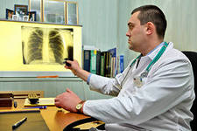
Assessment of the severity of the course of CAP and the choice of the place of treatment of the patient
For an objective assessment of the severity of the course and the prognosis of the CAP, several groups of unfavorable prognostic risk factors for the lethal outcome in patients with CAP have been identified:
- impaired consciousness;
- respiratory rate 30 or more per 1 minute;
- arterial hypotension;
- urea nitrogen> 7 mmol/l.
The next group of risk factors are additional and occurred before the onset of the disease:
- bilateral or multilobar pneumonic infiltration;
- hypoxemia (saturation O2 <90% or PaO2 <60 mmHg);
- age 50 years and older;
- presence of concomitant diseases.

Slide 23
Assessment of the severity of the course of CAP and the choice of the place of treatment of the patient
Patients in the absence of any adverse prognostic factors have a low risk of death.
These patients do not have medical indications for hospitalization - they are treated out-patient.
However, patients can be hospitalized for social reasons - the inability to adequately monitor the patient and fulfill all appointments of the doctor at home.
Should be hospitalized:
Patients with the presence of one of the main adverse prognostic factors.
The presence of two or more major adverse risk factors in patients should be immediately hospitalized in the intensive care department.

Slide 24
Groups of patients with community pneumonia
It is recommended that all adult patients be assigned in four groups.
With CAP of a mild course, which do not require hospitalization, without concomitant diseases and other modifying factors. The most common pathogens in these patients are S. pneumoniae, M. pneumoniae, C. pneumoniae, H. influenzae (usually smokers), and respiratory viruses. In 30-50% of patients, the causative agent is not found.
With CAP of a mild course not requiring hospitalization, with the presence of concomitant pathology (chronic obstructive pulmonary disease, renal and heart failure, cerebrovascular disease, tumor, diabetes mellitus, chronic liver disease of various etiologies, alcoholism) and/or other modifying factors. The causative agents of these patients are S. pneumoniae (including antibiotic-resistant strains), H. influenzae, S. aureus, M. catarrhalis, representatives of the Enterobacteriaceae family (E. coli, Klebsiella spp.) It should also be anticipated the possibility of anaerobic infection in the presence of CAP in patients with unsanitary oral cavity, clinical and anamnestic data on neurological diseases and/or violations of the swallowing act.

Slide 25
Groups of patients with community pneumonia
with the CAP of a mild course, which requires hospitalization in the therapeutic department for medical (the presence of unfavorable prognostic factors) indications. In patients of this group, the development of CAP can be caused by S. pneumoniae, H. influenzae, atypical pathogens, Gram-negative enterobacteria. In 10-40% of patients in group III, a "mixed" infection is identified (a combination of typical and atypical pathogens).
with severe course of CAP, who require hospitalization in the intensive care department. The spectrum of microbial flora in such patients includes S. pneumoniae, Legionella spp., H. influenzae, S. aureus. In the presence of appropriate modifying factors, the causative agent of the CAP may be
P. aeruginosa.

Slide 26
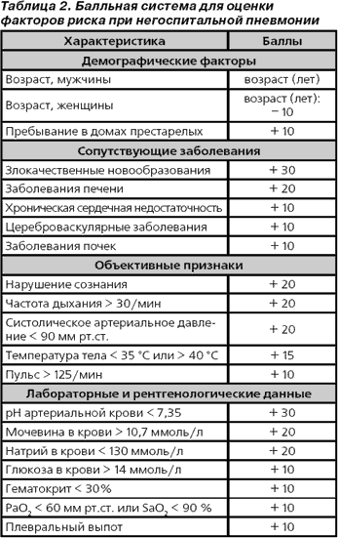
Groups of patients with community pneumonia

Slide 27
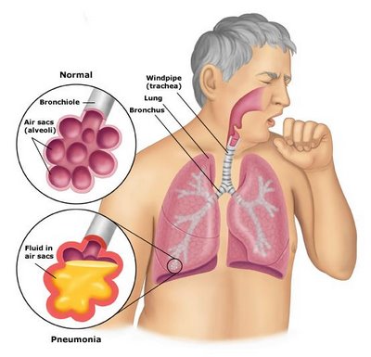
PNEUMONIA
Principles of treatment
Treatment should be :
early
rational
individual
complex
At the first place :
etiotropic
antibacterial therapy
In second place :
- symptomatic therapy
- detoxification
- antipyretic
- mucolytic and expectorant
- immunocorrecting
On the third place:
- physiotherapy
- exercise therapy

Slide 28
Treatment of patients with community-acquired pneumonia
Аntibiotics
appointed for the empirical treatment of patients with CAP, divided into drugs:
first line (drugs of choice and alternative drugs)
second line
They begin treatment with drugs of choice, and if they can not be prescribed (absence, intolerance or use during the last three months for any reason)
alternative drugs.
In the case of inefficiency of first-line drugs, after 48-72 hours of treatment, second-line drugs are prescribed, in which alternative drugs can be used

Slide 29
Treatment of patients with CAP
In patients with CAP of I group, an adequate clinical effect is possible with oral administration of an antibacterial drug (monotherapy).
As a drugss of choice, amoxicillin is recommended (prescribing ampicillin per os is inadvisable because of its low bioavailability) or macrolide (azithromycin, clarithromycin, spiramycin).
If it is not possible for patients to take the drug, an alternative drug is prescribed - respiratory fluoroquinolone (levofloxacin, moxifloxacin).
In case of ineffectiveness of amoxicillin after 48-72 hours of treatment, as a second-line preparation, macrolide or doxycycline is prescribed.

Slide 30
Treatment of patients with CAP
In patients of the second group, a pronounced clinical effect is also possible in the case of oral antibiotic administration.
However, as the likelihood of the etiological role of Gram-negative microorganisms (including those that have some mechanisms of resistance to antibiotics) increases, it is recommended as a means of choice:
protected aminopenicillin (amoxicillin/clavulanic acid) or cephalosporin of II generation (cefuroxime axetil).
Alternative therapy may be the use of respiratory fluoroquinolone.
When oral administration of the drug is impossible or low compliance, a parenteral antibiotic is administrated -
(ceftriaxone intramuscularly once daily).

Slide 31
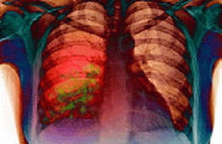
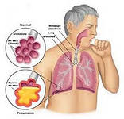
Treatment of patients with CAP
Hospitalized in therapeutical department patients of the 3rd
group should be conducted:
parenteral therapy using aminopenicillin, mainly protected (amoxicillin/clavulonic acid, ampicillin/sulbactam)
or cephalosporin II-III generations (cefuroxime, cefotaxime, ceftriaxone).
In case of inefficiency drug
selection in 48 hours should be
added to it:
macrolide (combination therapy)
or replace it with fluoroquinolone III-IV generations (monotherapy).

Slide 32
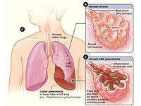
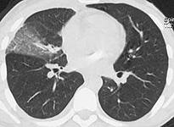

Criteria for the effectiveness of antibiotic therapy in patients with pneumonia
body temperature below 37.5 ° C;
absence of symptoms of intoxication;
absence of signs of respiratory insufficiency;
absence of purulent sputum;
the number of leukocytes in the blood is less than 10000, the neutrophilic granulocyte count is less than 80%, the young forms less than 6%;
absence of negative dynamics of X-ray changes.

Slide 33
HOSPITAL PNEUMONIA (HP)
Hospital (intrahospital, nosocomial) pneumonia (HP)
- it is a pneumonia that developed after 48 or more hours of hospitalization of a patient in a hospital, provided there are no signs of inflammation at the time of hospitalization
The incidence of HP varies from 13 to 18% in the overall structure of nosocomial infections.
On the level of mortality, this complication stably takes first place.
Especially acute is the problem of HP in critical patients in intensive care departments, where the frequency of development of HP is 5-10 times higher than in other departments of hospitals.
Mortality with HP in patients in intensive care department remains extremely high - from 10 to 80%

Slide 34
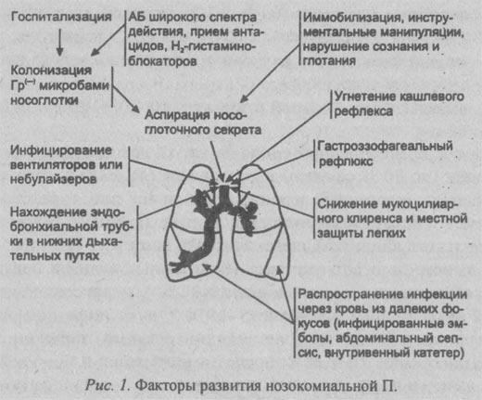
HOSPITAL PNEUMONIA (HP)
PATHOGENESIS OF HOSPITAL PNEUMONIA

Slide 35
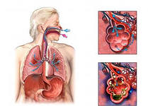
structure of hospital pneumonia
Ventilator-associated pneumonia (VAP) -
develops in patients who are on prolonged mechanical ventilation (IVL). In patients who are on prolonged ventilation, pneumonia occurs 20 times more often.
Postoperative pneumonia (PP)
Its frequency reaches - 18.6%.
Lethality according to different authors varies from 9 to 46% and on average is 21%.
Aspiration pneumonia (AP) -
has no clear definition.
Develops due to aspiration of gastric
contents in respiratory tract.
Some authors believe that at the
heart of any HP lies aspiration.

Slide 36
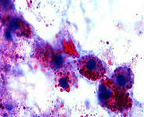
ETIOLOGY OF HOSPITAL PNEUMONIA
Hospital pneumonia is most often caused by bacteria, often in associations;
Streptococcus pneumoniae and Haemophylus influenzae may act as pathogens of HP;
Staphylococci are more likely to cause HP in patients with burns and patients with wound infection;
Fungi, especially the genus Candida, are more common in the ICD for newborns;
In patients with depressed immunity, probable etiological agents of HP may be Aspergillius, Legionella, Pneumocystis carinii, and cytomegalovirus;
HP viral etiology occur, as a rule, in the winter season.
The main difference between hospital and non-hospital
pneumonia is that the former develops against the background of the use of antibiotics and
its pathogens are more likely to have
resistance to antibacterial drugs.

Slide 37
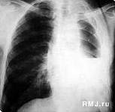
TREATMENT OF HOSPITAL PNEUMONIA
Antibacterial therapy:
clindamycin in combination with an inhibitor-protected beta-lactam (cefoperazone / sulbactam, ampicillin / sulbactam)
or beta-lactam antibiotic in combination with metronidazole.
De-escalation antibacterial therapy:
cefepime (Maxycef) in combination
with metronidazole,
ceftazidime (Vitsef) in combination
with metronidazole or clindamycin,
piperacillin/tazobactam
or ticarcillin/clavulanate.
Combination: aztreonam with clindamycin, glycopeptides, for example vancomycin or teicoplanin.
Preparations of the reserve:
Fluoroquinolones - levofloxacin, gatifloxacin and moxifloxacin.

Slide 38
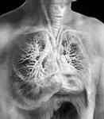
Tuberculosis
TUBERCULOSIS (from the Latin tuberculum «tubercle») — a widespread worldwide infection of human and animal diseases caused by various types of mycobacteria, usually Mycobacterium tuberculosis (Koch's stick).
As the name of tuberculosis of the kidneys and some other internal parenchymatosis organs (liver, spleen), as well as glands (for example, salivary), the word "tubercle" was previously used.
External tuberculosis (skin, mucous membranes, lymph nodes) was called scrofula.
Tuberculosis usually affects the lungs, less
often affecting other organs and systems
Mycobacterium tuberculosis is transmitted
by airborne droplets, with infection in 9 of 10 is asymptomatic (tubinfication)

Slide 39
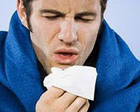
TUBERCULOSIS
Classic symptoms of pulmonary tuberculosis:
- a prolonged cough with phlegm, sometimes with hemoptysis in later stages;
- fever;
- weakness;
- night sweats;
- significant weight loss.
There are: open and closed forms of tuberculosis.
When the form is open in sputum or in other natural discharges of the patient (urine, fistulous discharge, rarely - feces), mycobacterium tuberculosis is detected.
Open forms also include those types of tuberculosis of the respiratory organs, in which, even in the absence of bacterial excretion, there are clear signs of a lesion with the external environment: a cavern (decay) in the lung, bronchus tuberculosis (especially ulcerous form), bronchial or thoracic fistula, tuberculosis of the upper respiratory ways.

Slide 40
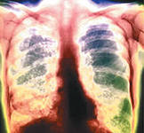
Diagnosis of tuberculosis
Diagnosis of tuberculosis is based on:
- fluorography and radiography of the affected organs and systems
- microbiological examination of different biological material
- cutaneous tuberculin test (Mantoux reaction)
- molecular-genetic analysis (PCR method)
In 2007 there were:
-registered cases of chronic active tuberculosis - 13.7 million
-new cases of disease 93 million
-deaths of 1.8 million
M. tuberculosis infected about a third of the world's population, and about every second there is a new case of infection

Slide 41
Choice of treatment regimen for tuberculosis
All patients with tuberculosis are divided into four groups:
I. with newly diagnosed pulmonary tuberculosis (new cases);
II. with recurrence of the disease and those who did not receive the expected effect (positive smear) or were interrupted. At the end of the initial phase of chemotherapy and with a negative smear, the sputum begins the continuation phase. However, when detecting mycobacteria in sputum, the initial phase should be extended for another 4 weeks;
III. suffering from pulmonary tuberculosis with limited parenchyma lesions and having negative sputum smears, as well as patients with non-severe extrapulmonary tuberculosis;
IV. patients with chronic tuberculosis. The effectiveness of chemotherapy in this category is low. It is necessary to use reserve drugs, the duration of treatment increase.

Slide 42
Choice of the regimen of tuberculosis
Group of patients | Definition
The newly diagnosed tuberculosis patient (a "new case") | A patient who has never been treated with anti-TB drugs or who has been treated for less than a month
Relapse, recurrence | A patient who had previously undergone an effective chemotherapy course and who again showed signs of active tuberculosis
Treatment after an ineffective chemotherapy course | A patient whose previous course of treatment was ineffective (bacteriovenous infection, determined by any method at the 5th month or later, or the ineffectiveness of the course was confirmed clinico-radiological)
Treatment after discontinuation of chemotherapy | A patient who resumed the course of chemotherapy after the interruption of treatment for a period of 2 months or more
Transferred patient to continue treatment | A patient who came from another administrative territory or other department where he started a course of chemotherapy registered for the continuation of treatment and for which there is relevant information
Other | Patients on whom a decision is made to conduct a course of chemotherapy, but which do not meet the definitions for other groups of patients

Slide 43
Regimen of chemotherapy/group of patients
Regimen | Group of patients
Regimen 1, 3 | Regimen 1 appoint: newly diagnosed patient with pulmonary TB: - with positive sputum microscopy; with a negative result of sputum microscopy, but with a common process attributed by the doctor to "severe cases of the disease"; extrapulmonary tuberculosis attributable to "serious diseases". Regimen 3 appoint: patients with newly diagnosed limited, uncomplicated pulmonary tuberculosis with negative sputum microscopy; patients with newly diagnosed uncomplicated extrapulmonary tuberculosis.
Regimen 2А | Patients with a second course of chemotherapy ("relapse," "treatment after an ineffective course of chemotherapy," "treatment after discontinuation of chemotherapy," "others"), when the patient retains sensitivity to the drugs of the main series or at low risk of drug resistance MT.
Regimen 2Б | Assign with a high risk of drug resistance of mycobacterium tuberculosis before receiving the results of a microbiological study.
Regimen 4 | Assign TB patients with tuberculosis mycobacteria, resistant to at least isoniazid and rifampicin at the same time (multiple drug resistance).

Slide 44
Basic antituberculous drugs
Basic antituberculous drugs | Type of action | Recommended dose (mg/kg)
 |  | Daily | Three times a week
Isoniazide (H) 100 mg, 300 mg | Bactericidal | 5-10 | 10 (8--12)
Rifampicin (R) 50 mg, 300 mg | Bactericidal | 10 (8--12) | 10 (8--12)
Pyrazinamide (Z) 400 mg | Bactericidal | 25 (20–30) | 35 (30–40)
Streptomycin (S) 1,0 g | Bactericidal | 15 (12–18) | 15 (12–18)
Ethambutol (E) 100 mg, 400 mg | Bacteriostatic | 15 (15–20) | 30 (25–35)

Slide 45
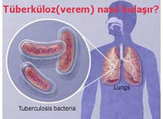
Противотуберкулезные препараты
2-го ряда
менее эффективны и дороже, чем ПТП 1-го ряда
большее количество ПТП необходимо на более длительное время
они вызывают много побочных реакций
К препаратам второго ряда относят –
Этионамид,
Капреомицин,
Протионамид,
Канамицин,
ПАСК
Виомицин,
Циклосерин,
Амикацин,
Офлоксацин,
Ципрофлоксацин.

Slide 46
Antituberculosis drugs of 1 range
Isoniazide (Isoniazidum) – isonicotinic acid derivative.
The preparations of this group include metazide, ftivazide, saluside.
Mechanism of action - Suppresses the synthesis of mycolic acids, disrupts the structure and functions of the cell membrane of mycobacterium tuberculosis.
Side effects
Headache, irritability, sleep disturbances, paresthesia, polyneuritis, psychosis, convulsive syndrome, palpitation, angina, hypertension, toxic hepatitis, allergic reaction.
Dosing and Administration
Inside orally, after eating, at a rate of 15 mg/kg/day in 1-3 divided doses. For prophylaxis - 5-10 mg/kg/day for 2 months.

Slide 47
Antituberculosis drugs of 1 range
Rifampicin -
Antibiotic of a wide spectrum of action. It is active against mycobacteria tuberculosis and leprosy, acts on Gr + (especially staphylococcus) and Gr- (meningococcus, gonococcus) cocci, less active against Gr-bacteria.
Pharmacokinetics -
well absorbed from the gastrointestinal tract. The maximum concentration in the blood is reached after 2 hours after ingestion.
Rifampicin penetrates well into the tissues and body fluids and is found in therapeutic concentrations in pleural exudate (accumulating between the membranes surrounding the lungs, a protein-rich fluid), sputum, cavern contents (cavities in the lungs resulting from necrosis of tissue), bone tissue. The greatest concentration of the drug is created in the tissues of the liver and kidneys.
It is excreted from the body with bile and urine.

Slide 48
Antituberculosis drugs of 1 range
Rifampicin –
Rifampiain is taken orally on an empty stomach (for 1 / 2-1 h before meals) at 0.45-0.9 or injected intravenously
Side effects:
allergic reactions (varying degrees of severity),
dyspeptic phenomena
dysfunction (impaired function) of the liver and pancreas
leukopenia
can lower blood pressure
phlebitis
Interaction
Rifampicin is the inducer of microsomal liver enzymes - with simultaneous administration of anticoagulants and with the cancellation of the last - dose of anticoagulants should be reduced.
The preparation has a bright brownish-red color. It stains (especially at the beginning of treatment) urine, sputum, teardrop in an orange-reddish color.

Slide 49
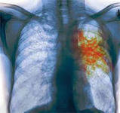
Antituberculosis drugs of the 2nd range
Streptomycin –
The broad-spectrum antibiotic is bactericidal against a wide range of Grams positive and Gram negative microorganisms.
Ethambutol – appointed inside orally.
Synthetic drug with an active effect only in respect of mycobacterium tuberculosis, bacteriostatic.
Adverse reactions:
-loss of vision - retrobulbar neuritis
-hepatotoxicity
-anorexia,
-mild fever
-can develop gout
-neurological disorders
(headache, epi-seizures)
-anaphylactic reactions
-bronchospastic reactions

