Slide 1

Principles
clinico-pharmaceutical
approach to the selection of drugs
for the treatment of diseases
thyroid gland

Slide 2
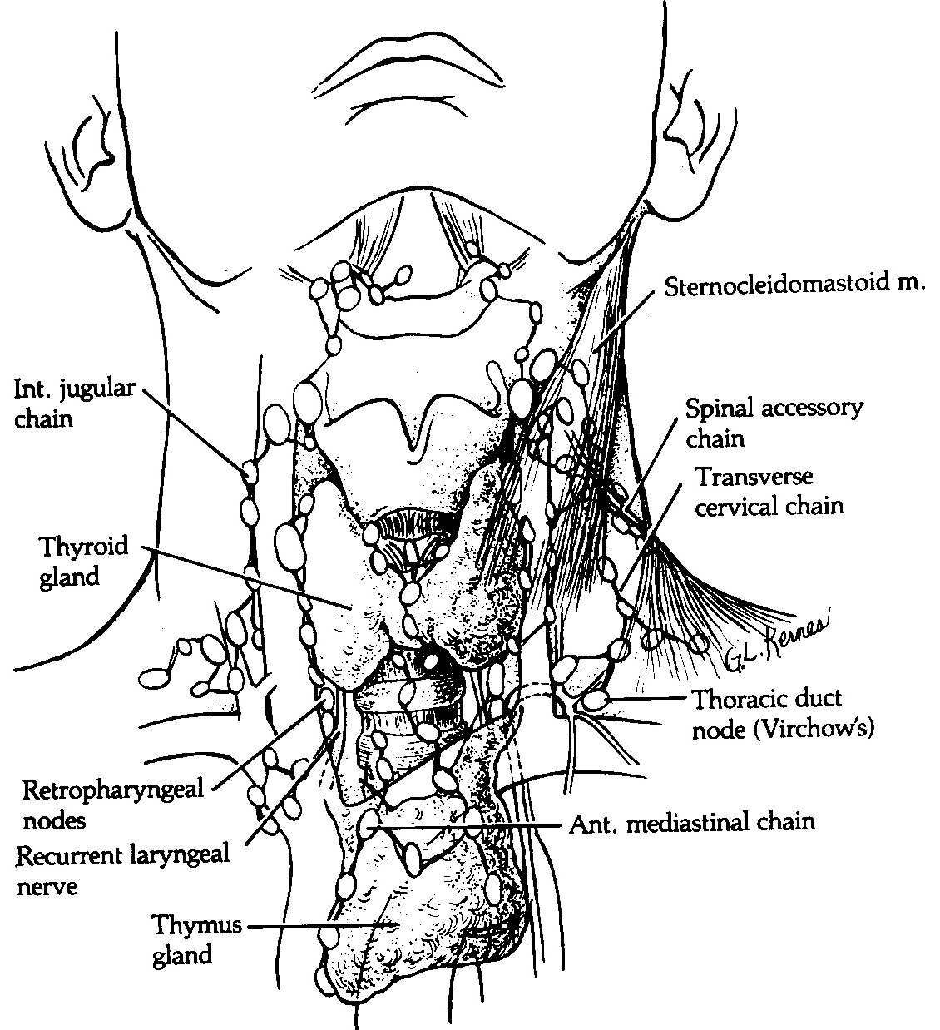
Macroanatomy of the thyroid gland

Slide 3
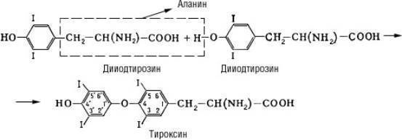
Thyroid hormones
– Synthesis and secretion of them is regulated by the thyroid-stimulating hormone (TSH) of the pituitary gland, and the formation of tetraiodothyronine and TSH is regulated by the principle of negative feedback.
Thyroxine - 3,5,31,51-tetraiodothyronine
is produced by follicles of the thyroid gland. Synthesized by iodination of the amino acid tyrosine and oxidative condensation of 2 diiodotyrosine molecules with the elimination of alanine.

Slide 4
Thyroid hormones
Thyroxine -
Increases the intensity of basal metabolism and thereby increases heat production, affects the growth and differentiation of tissues. Introduction to the body of thyroxin after a day causes an increase in basal metabolism (which is accompanied by increased oxygen consumption), increased heart rate, increased excitability of the nervous system.
In high concentrations, thyroxin causes an uncoupling of oxidative phosphorylation. As a result, the energy of the electron flow into the respiratory chains is not stored in the form of energy-rich compounds (ATP, etc.), but is released as heat. The effect of thyroxin on the enzymes of oxidative phosphorylation is explained by its ability to bind the metal ions necessary for the activity of these enzymes.
Секретируется в кровь в значительно меньших количествах, чем тироксин, но оказывает более быстрое действие на обмен веществ, так как менее прочно связан со специфическими белками плазмы и потому легче проникает в тканевую жидкость и клетки.
Недостаточная продукция этих гормонов щитовидной железой приводит к развитию клинической картины гипотиреоза или микседемы. Это заболевание может возникнуть в результате оперативного удаления щитовидной железы или лечения радиоактивным йодом в связи с гипертиреозом, а также тиреоидита. В части случаев недостаточная продукция тиреоидных гормонов связана с нарушением функции гипофиза, секретирующего тиреотропный гормон, и (или) гипоталамуса, выделяющего соответствующий рилизинг-фактор.

Slide 5
Thyroid hormones
It is secreted into the blood in much smaller quantities than the thyroxine, but has a more rapid effect on metabolism, since it is less tightly bound to specific plasma proteins and therefore easier to penetrate into the tissue fluid and cells.
Insufficient production of these hormones by the thyroid leads to the development of a clinical picture of hypothyroidism or myxedema. This disease can occur as a result of prompt removal of the thyroid gland or treatment with radioactive iodine due to hyperthyroidism, as well as thyroiditis. In some cases, insufficient production of thyroid hormones is associated with impaired function of the pituitary gland secreting the thyroid-stimulating hormone, and (or) the hypothalamus releasing the corresponding releasing factor.

Slide 6

Thyroid hormones
Triiodothyronine
Triiodothyronine - 3, 5, 3'-triiodothyronine,
is formed in the follicles of the thyroid gland during oxidative condensation of monoiodothyrosine and diiodotyrosine molecules. Like thyroxine, it has a diverse effect on the body, its growth, differentiation and metabolism.
It is secreted into the blood in much smaller quantities than the thyroxine, but it has a more rapid effect on metabolism, since it is less tightly bound to specific plasma proteins and therefore easier to penetrate into the tissue fluid and cells.

Slide 7
Thyroid hormones
Insufficient production of these hormones by the thyroid leads to the development of a clinical picture
hypothyroidism or myxedema.
This disease can occur as a result of prompt removal of the thyroid gland or treatment with radioactive iodine due to hyperthyroidism, as well as thyroiditis.
In some cases, insufficient production of thyroid hormones is associated with impaired function of the pituitary gland secreting the thyroid-stimulating hormone, and (or) the hypothalamus releasing the corresponding releasing factor.

Slide 8
Thyroid hormones
The determination in the blood of the radioimmune method of thyroid hormones, as well as the hormones of the pituitary gland, the hypothalamus -
is becoming more common in clinical practice and allows not only to diagnose hypothyroidism, but also to clarify its origin.
Thyroid hormones include:
levothyroxine (or thyroxine, or tetraiodothyronine T4)
lyotyronine (or triiodothyronine T3).
Thyroid hormones accumulate in the thyroid gland in the form of thyroglobulin, from which, as a result of hydrolysis, they are released and enter the bloodstream.
About 30% of T4 in peripheral tissues
goes to T3.

Slide 9
Thyroid hormones
The transformation of hormones in the liver leads to a loss of activity.
When entering the blood, T3 and T4 actively bind to the plasma protein.
Therefore, it is necessary to make corrections to the clinical evaluation of the data obtained when determining the iodine bound to the protein in plasma and the total concentration of thyroid hormones.
Lytryronin is approximately 5 times more biologically active than levothyroxine. The once-administered dose (20-25 μg) gives the maximum effect after 24 hours, the effect of the drug gradually decreases during the week (T1 / 2 is 2 days).
A single dose of thyroxin can achieve maximum effect after 10 days, its effect lasts for 2-3 weeks (T1 / 2 equals 7 days).

Slide 10
Thyroid hormones
The hypophyseal-thyroid function is evaluated by determining the concentrations of T3, T4 and thyrotropin-thyrotropic hormone (TSH) in the plasma, and also by the ability of the pituitary to respond to the introduction of a releasing hormone stimulating TSH. The results of these definitions are more informative than tests based on measuring the absorption of radioactive iodine by the thyroid gland. The intake of drugs containing iodine, salicylates and pyrazolones, leads to a decrease in the absorption of radioactive iodine. The introduction of lyotiron (120 mcg/day) inhibits the secretion of TSH. In a healthy person, a decrease in the TSH content leads to a decrease in the uptake of radioactive iodine. With hyperthyroidism, this is not observed, since the thyroid gland is often not controlled by a thyroid-stimulating hormone. The administration of thyrotropin-releasing hormone allows to diagnose hypothyroidism, which depends on the decrease in thyroid function, pituitary gland and hypothalamus.

Slide 11
Thyroid hormones
Indications for the appointment of thyroid hormones is the need for replacement therapy for thyroid insufficiency in the form of myxedema and cretinism.
The need for this hormone is stable.
Thyreoidin,
containing levothyroxine and lyotyronine -
are obtained from dried nonfat thyroid glands of cattle. The initial dose of the drug can be 0.06-0.1 g / day,
then it is constantly increased until the symptoms of the disease are eliminated, achieving an increase in the pulse, lowering cholesterolemia,
after that they switch to a maintenance dose.
In the treatment with levothyroxine, 100-200 mkg of the drug.

Slide 12
Thyroid hormones
Lyotyronin - triiodothyronine hydrochloride is a high-speed synthetic drug and is used for myxedematous coma and psychosis, less often for chronic hypothyroidism.
Along with the reception of thyroidin, which acts more slowly, every 8 hours, lyotyronine is administered, starting at 10 μg (up to 40 μg on the 1st day). The dose rises after 3 days with the subsequent transition to treatment with one thyroidin.
The effectiveness of 20 mkg of lyotyronine corresponds to 0.1 g of thyroidin.
Side effect of lyotyronin is associated with rapid intensification of basal metabolism. In this case, the aggravation of angina attacks, heart failure, atrial fibrillation may be provoked. In such cases, treatment with thyroidin should be interrupted and a week later started at a lower dose.

Slide 13
Thyroid hormones
Thyreocomb is a combined preparation containing lyotyronine (10 mkg), levothyroxine (70 mkg) and potassium iodide (150 mkg).
Apply for hypothyroidism and thyroiditis. Treatment is long, starting with 1 tablet a day, gradually increasing the dose to 2 tablets 3 times a day.
Thyreotome -
produced in tablets containing 40 mg of lyotyronine and 120 mkg of levothyroxine, is a highly effective drug for the treatment of severe hypothyroidism.
In hypothyroid coma, it is advisable to administer high doses of levothyroxine (400-500 mkg), 10-25 mkg of lyotyronine intravenously or through a probe 100-200 mkg 2 times per day.
Thyroid drugs are combined with glucocorticoids (100-300 mg hydrocortisone).

Slide 14
Antithyroid drugs
Hyperthyroidism - associated with increased thyroid function and thyroid hormone levels in the blood.
Characterized by:
- an increase in the thyroid gland,
- increased metabolism,
- tachycardia,
- changes in the heart,
- eyelids, the so-called eye symptoms,
- hypocholesterolemia.
The cause of hyperthyroidism are most often Basedova disease - diffuse toxic goiter, toxic multinodular goiter, adenoma of the thyroid gland. Significantly less often, hyperthyroidism can be associated with subacute thyroiditis and some other causes.

Slide 15
Antithyroid drugs
Hyperthyroidism -
There are drugs that cause the development of hyperthyroidism as a side effect with long-term admission:
- PASK,
- fenylbutazone,
- cobalt compounds,
- sulfonylurea,
- lithium,
- cordaron

Slide 16
Antithyroid drugs
Antithyroid drugs include:
- inorganic iodides,
- the thiourea derivatives that block the synthesis of T4,
- radioactive iodine, which destroys cells that synthesize thyroxine
Iodides -
in hyperthyroidism, the introduction of a significant amount of iodine inhibits the release of hormones and leads to the reverse development of the gland. The mechanism of this effect is not completely clear, since moderate doses of iodine are necessary in the norm for the synthesis of thyroid hormones. Large doses of iodides are used to prepare patients for resection of the thyroid gland and for thyroid crises.

Slide 17
Antithyroid drugs
Potassium iodide
in a dose of 60 mg orally gives some effect in 1-2 days, as much as 10-14 days.
Widely distributed Lugol solution - 5% aqueous solution of iodine with 10% potassium iodide. Take inside 0.5 ml every 12 hours.
Residents of areas where endemic goiter is common, it is recommended to take iodine preparations periodically.
Iodides are also used as an expectorant, usually added to the appropriate medicines.
Organic compounds of iodine are widely used as contrast agents in the radiographic study of kidneys, gall bladder, angiography, bronchography.

Slide 18
Antithyroid drugs
The tolerability of iodine preparations varies widely.
Symptoms of iodism are manifested:
- metallic taste in the mouth,
- excess salivation,
- lacrimation,
- productive cough,
- diarrhea,
- various rashes.
A small hyperfunction of the thyroid gland can develop with prolonged intake of iodides as expectorants.
The introduction of iodine preparations in contrast studies limits the possibility of using radioiodine for diagnostic purposes.

Slide 19
Antithyroid drugs
Thiourea preparations
carbimazole, mercazolyl - (T1 / 2 is 6 hours)
reduce the formation of thyroid hormones
by inhibiting the incorporation of iodine into tyrosine by suppressing the corresponding oxidase.
With sufficient dosage, these drugs lead to the activity of the pituitary gland TSH, which is accompanied by some hyperplasia of the thyroid gland.
Propylthiouracil also inhibits peripheral transformations of T4 and T3. Mercazolil (metimazol, tarazol) is in many respects similar to propylthiouracil, but it significantly exceeds its effectiveness.

Slide 20
Antithyroid drugs
Thiourea preparations
Mercazolil and carbimazole (tablets of 5 mg) are prescribed, starting with 10 mg three times a day; the maintenance dose is 5-10 mg / day.
Propylthiouracil (tablets of 50 mg) take 100 mg 3 times a day. The maintenance dose is 50-150 mg. It is possible to take the drug once in a daily dose.
Clinical improvement occurs in a week, and the full effect - in most cases within 4-8 weeks. After that, they switch to a maintenance dose.
Evaluate the effect of the drug:
to improve the patient's health,
increase in body weight,
reduction of pulse.
Evaluation of the effect of these drugs is difficult with the simultaneous administration of adrenoblockers.

Slide 21
Antithyroid drugs
Thiourea preparations
Side effects of thiourea drugs are manifested:
- allergic reactions, especially rashes on the skin,
- lymphadenopathy,
- leukopenia up to agranulocytosis,
- aplastic anemia.
Changes in blood are most likely during treatment with large doses of drugs. In this case agranulocytosis can develop very acutely. Antithyroid drugs should not be administered during lactation, as they accumulate in milk, during pregnancy they should be consumed with caution and in minimal doses.

Slide 22
Antithyroid drugs
Potassium perchlorate
violates the active absorption of iodine by the thyroid gland and thus interferes with the synthesis of hormones, less often it is prescribed for diagnostic purposes. Because it can cause aplastic anemia, for the treatment of hyperthyroidism is practically not used.
Propranolol - to reduce tachycardia.
With thyroid crisis:
- injected into the vein propranolol - 5 mg,
- iodides (potassium iodide 1-2 g per day inside),
- symptomatic means for correction of heart failure and hyperpyrexia.
- hydrocortisone,
- at a psychosis - chlorpromazine.

Slide 23
Antithyroid drugs
Radioactive iodine (131I), taken internally, accumulates in the thyroid gland. In connection with b-radiation, which penetrates 0.5 mm into the tissue, it has a therapeutic effect on the thyroid gland, without damaging the surrounding tissues, in particular the parathyroid glands. The half-life of 131I is 8 days. It is used to treat hyperthyroidism, sometimes in combination with surgery, in particular for thyroid cancer, the metastases of which may decrease with 131I therapy.
In hyperthyroidism, the effect after administration of a single dose of 131I is observed within 1-3 months. During the first year after treatment, 15% of patients have signs of hypothyroidism, in the future the number of such patients increases, and after this, patients should be constantly monitored by radioiodine.

Slide 24
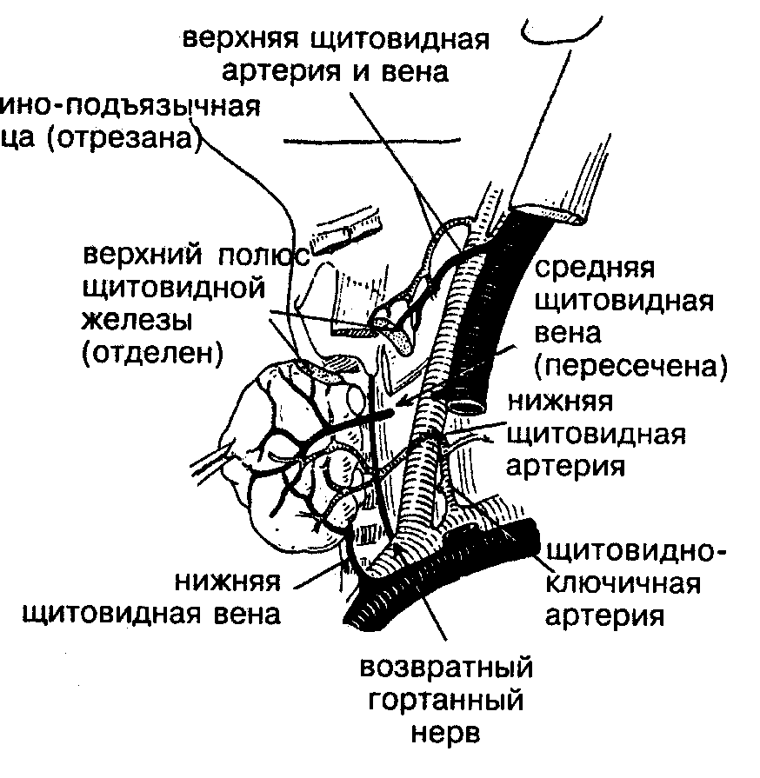
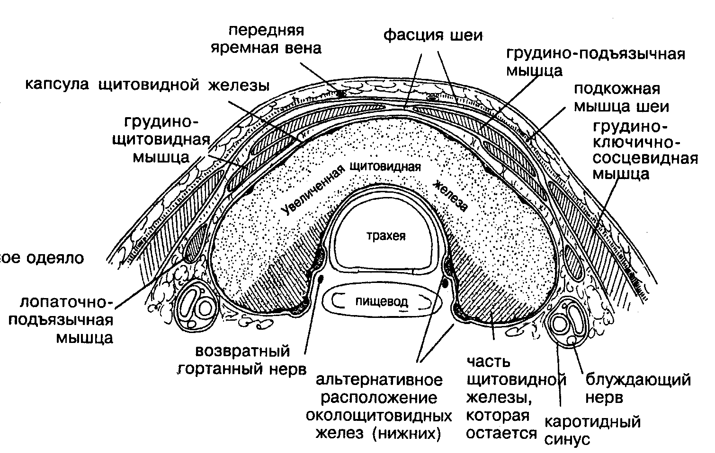
Фасции шеи. Кровоснабжение щитовидной железы.

Slide 25
Hormones synthesized by thyroid cells.
1) hormones - tetraiodothyronine (thyroxine, T4); triiodothyronine (T3), reversible triiodothyronine (p-T3), diiodotyrosine (DIT) and monoiodothyrosine (MIT);
2) protein compounds - thyroglobulins.
The precursor of T3 and T4 is the amino acid L-tyrosine.

Slide 26
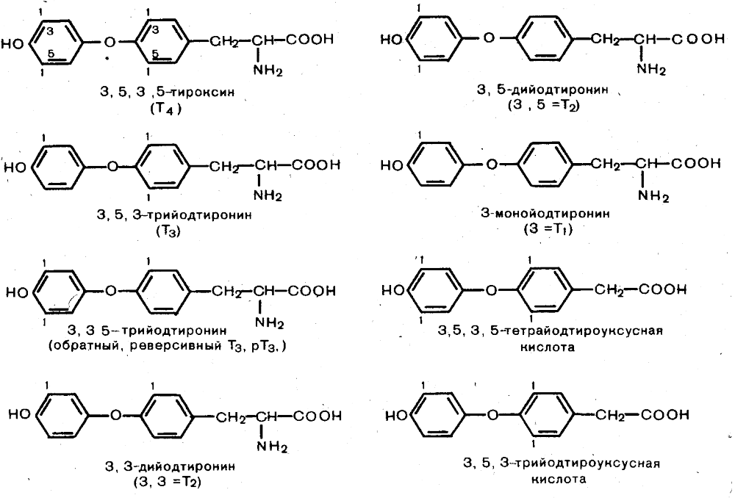
Химическая структура тиреоидных гормонов

Slide 27
Function of iodine-containing hormones:
1.Activate the processes of energy production, accelerate the catabolism of proteins, fats and carbohydrates (increases basal metabolism and consumption of O2, stimulates protein synthesis and activity of Na *, K *, ATPase)
2. Increase glycogenolysis (blood sugar level rises)
3. Strengthen the effect of catecholamines (increased heart rate and cardiac output, there is nervousness, irritability, muscle tremor and muscle malnutrition occurs)

Slide 28
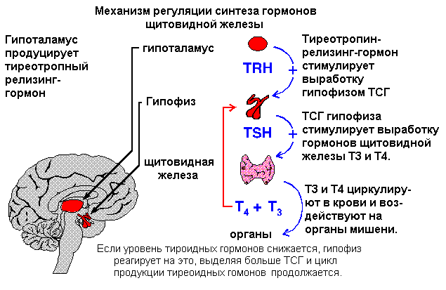
The mechanism of regulation of the synthesis of thyroid hormones

Slide 29
The main symptoms that characterize hypothyroidism of the thyroid gland.
Apathy and drowsiness
Memory loss
Chilliness and poor tolerance of cold
Weight gain with reduced appetite
Pain in the muscles
Swelling of the face and extremities
Hair loss, brittle nails

Slide 30
The main symptoms characterizing hyperthyroidism of the thyroid gland.
Tearfulness and irritability
Feeling of heat and poor heat tolerance
Decreased body weight with increased appetite
Sweating, palpitation, diarrhea.
Tachycardia, tremors, eye simtomy and goiter.

Slide 31
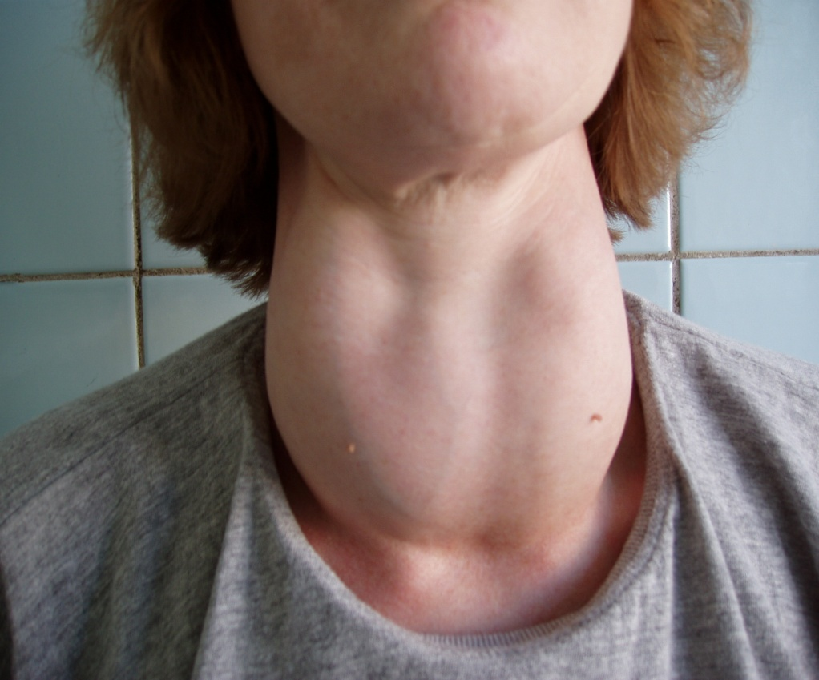
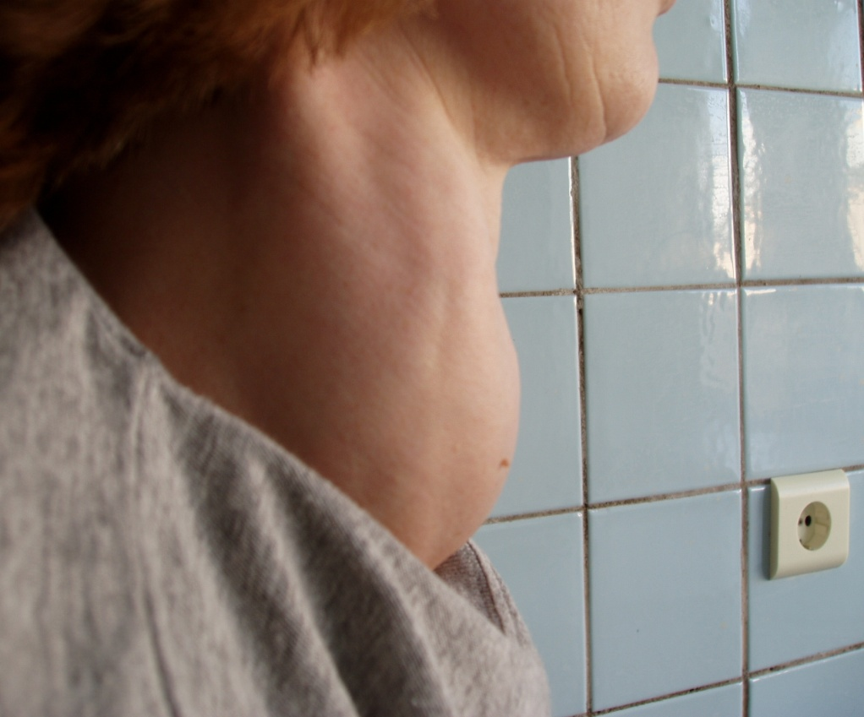
Diagnosis of thyroid diseases
Examination and palpation

Slide 32
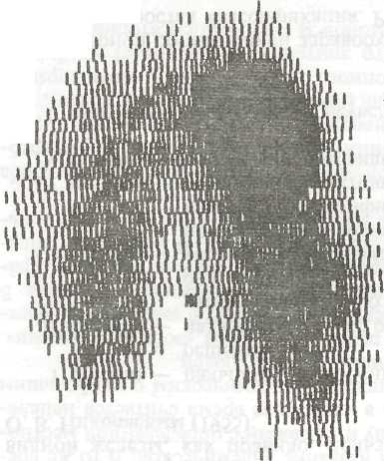
Radioisotope scanning (scintigraphy of the thyroid gland) (Iodine-131, preferably iodine-123 and technetium-99)

Slide 33
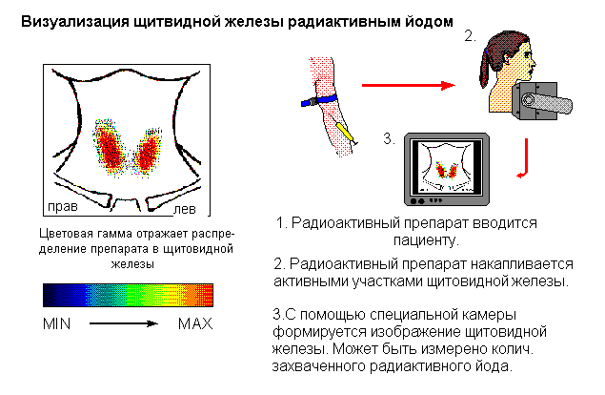
Радиоизотопное исследование щитовидной железы

Slide 34
Ultrasound examination (size, volume of shares, ehostrukture).
X-ray examination - soft tissue renintegronia and CT scan of the cervical trachea (displacement, narrowing of the trachea and esophagus, retrosternal goiter).
A biopsy of the thyroid gland (fine-needle, trepan-biopsy) under the supervision of ultrasound.

Slide 35
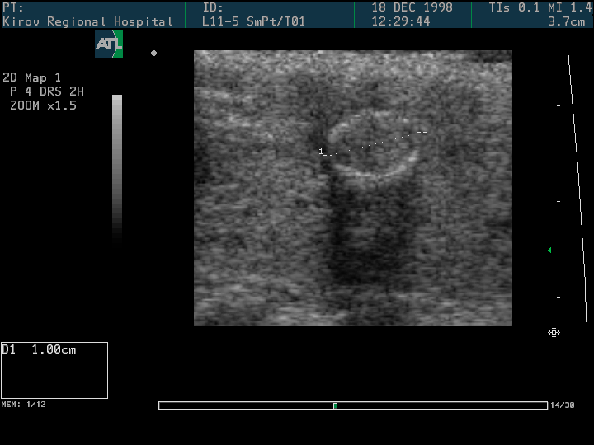
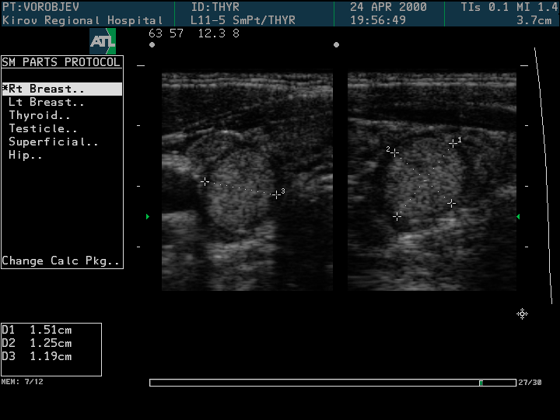
Ultrasound of the thyroid gland

Slide 36
Research of functional activity of thyroid gland
Main markers:
total and free thyroxine (T4)
total and free triiodothyronine (T3)
thyroid-stimulating hormone of the pituitary (TSH)
With latent diseases, special functional tests (stimulating test with tyroliberin, a sample of inhibition using triiodothyronine)
Achieving the last years is more sensitive non-isotopic technologies of hormone immunoassay

Slide 37
Classification of diseases of thyroid gland
I. Congenital abnormalities: a) aplasia and hypoplasia (with hypothyroidism or myxedema);
b) ectopia of the gland tissue (aberrant forms of goiter)
c) non-healing of the lingual-thyroid duct (median cysts and fistula of the neck)
II. Endemic goiter: a) 0, I, II st. enlargement
b) in shape: diffuse, nodular, mixed
c) Functional manifestations: euthyroid, hyperthyroid, hypothyroid
III. Sporadic goiter with division according to the same parameters as the endemic

Slide 38
Classification (continued)
IV. Diffuse toxic goiter with severity division of forms:
a) light, b) medium, c) heavy.
V. Hypothyroidism with severity division:
a) light, b) medium, c) heavy (myxedema).
VI. Inflammatory diseases of the thyroid gland:
a) acute thyroiditis and struma;
b) subacute thyroiditis (de Kervena);
c) chronic thyroiditis (fibroid Ridel, lymphomatous Hashimoto);
d) specific (tuberculosis, syphilis), fungal and parasitic
VII. Damage to the gland: a) open, b) closed.
VIII. Malignant tumors.

Slide 39
Goiter
A goiter is usually called an enlargement of the thyroid gland due to the growth of its tissue, not associated with inflammation, hemorrhage or malignant growth.
The appearance of goiter is a compensatory-adaptive reaction of the organism to specific features of the environment.

Slide 40
Classification of thyroid enlargement
WHO
0 level - no goiter
I level - the size is larger than the distal phalanx of the big toe, the craw is palpated, but not visible
II level - the struma is palpated and visible
Ultrasound: the volume of the thyroid gland in women is more than 18 ml, and in men more than 25 ml - the goiter is diagnosed

Slide 41
Endemic goiter - etiology and pathogenesis
The main reason - iodine deficiency. Consumption of less than 150-300 mcg per day leads to a decrease in the production of thyroid hormones.
The principle of feedback causes an increase in secretion of TSH.
Stimulated proliferation of thyroid epithelium (to ensure the necessary level of secretion of thyroid hormones).
Compensatory increases the mass of thyroid.

Slide 42
Morphology
Three forms of endemic goiter: diffuse, nodular (adenomatous) and mixed
Histologically - diffuse micro- or macrofollicular goiter
Colloidal Vascular

Slide 43
Clinic
Determined by:
Functional state of the thyroid gland
The size of the goiter
Localization
(There is no correlation between the size of goiter and the degree of functional changes)

Slide 44
With a significant deficiency of iodine hypothyroidism appears (the disease develops gradually)
Complaints:
Lethargy, drowsiness, apathy, slowness,
chilliness, memory weakness, constipation
On examination:
"Puffiness" of a face with poor facial expressions
Edema on the body and limbs
Bradycardia, lowering of blood pressure
Oppression of factors of nonspecific protection
(Hypothyroidism in early childhood can lead to a decrease in mental development up to cretinism)

Slide 45
Diagnostics
Living in areas of iodine deficiency
At a primary hypothyrosis level TTG it is raised
The content of T3 and T4 is reduced
The test with tyroliberin is positive.

Slide 46
Treatment
Methods of treatment depend on the size, morphological changes and functional state of the thyroid
Diffuse goiter - conservative treatment (thyroidin, triiodothyronine)
Operative treatment:
Nodal and mixed goiter (large size, violation of the function of neighboring organs) - hemithyroidectomy
Multinodular or mixed goiter - subtotal resection of the thyroid gland

Slide 47
Sporadic goiter
The etiology is not definitively established (separation of sporadic and endemic conditional)
It is assumed:
1. A number of genetic factors leads to
deficit of TG
2. Promotes food rich in strumogens-
thiocyanates (cabbage, turnip, soy, etc.) -
decreases iodine content and synthesis of TG
Lack of TG includes the same mechanism of development of thyroid hyperplasia as in endemic goiter

Slide 48
Diagnostics
Enlarged thyroid (node presence)
Palpation data
Puncture in nodular goiter
Additionally
Functional state (T3, T4, TTG)
If n / n can not be detected
location in a typical place
or is noted for its unusual growth - ultrasound,
CT, isotope study

Slide 49
Treatment
The principles of treatment of sporadic goiter do not differ from the principles of treatment of endemic goiter
The maximum remains unchanged thyroid tissue

Slide 50
Syndrome of thyrotoxicosis
The term of thyrotoxicosis refers to persistent hyperfunction of the thyroid gland associated with hyperproduction of thyroid hormones (T4 and T3) and endogenous intoxication.
Causes of thyrotoxicosis
1. Diffuse toxic goiter, as one of the
manifestations of Graves' disease (Basedov goiter)
(1835 - the disease is described by Graves, 1821 - Peri; 1840 - Karl Basedov)
2. Toxic adenoma of the thyroid gland is Plumper's disease.
3. Multi-nodular toxic goiter (Graves' disease) is a multi-system, autoimmune disease that proceeds according to the type of delayed type hypersensitivity.

Slide 51
Diffuse toxic goiter
Occurs everywhere
It affects mainly women (the ratio of women and men is 10: 1)
Age from 20 to 50 years
Autoimmune disease (occurs in persons with a congenital immune defect - an inherited special recessive gene)
At the heart of the disease is a defect of T-suppressors
Causes: infection, insolation, severe emotional stress

Slide 52
T-helpers stimulate B cells, produce thyroid stimulating antibodies (TSaB) With excess cortisol, control of T-suppressors is impaired
TSaB "sit down" on receptors, the iron becomes controlled by antibodies
Stimulates the growth of the gland
Generates more T3 and T4

Slide 53
Clinic
- The clinical picture of diffuse toxic goiter is diverse
- It is determined by the severity of thyrotoxicosis
Classical Basedov triad include: exophthalmos, tachycardia, goiter

Slide 54
Degrees of severity of thyrotoxicosis
Easy form:
moderate weight loss (by 10-15%)
--Nervous excitability
--Pulse is not more than 100 per 1min without disturbing the rhythm and function of other organs and systems
--The basic exchange does not exceed
+ 30%
--Some decrease in efficiency

Slide 55
Thyrotoxicosis of medium severity
Weight loss is more significant
Increased nervous excitability (slight irritability, tearfulness)
Tachycardia up to 100-120 per 1 minute
Short-term rhythm disturbances
Increased systolic blood pressure
Changes in carbohydrate metabolism
Gastrointestinal disorders (frequent loose stools)
The basic exchange is increased to + 60%.
Significant decrease in efficiency

Slide 56
Heavy (visceropathic) form of thyrotoxicosis
Abruptly increased nervous excitability
Significant weight loss up to cachexia
Tachycardia more than 120 per 1 min, atrial fibrillation
Heart failure
The basic exchange is exceeded to + 60%
Manifest changes in the cardiovascular and nervous systems
Total loss of efficiency

Slide 57
The main clinical manifestations of thyrotoxicosis
Complaints about: a feeling of heat (a lot of heat is generated)
Sweating, skin hot, wet
Feeling of inner trembling, trembling of the hands (typical is a small tremor of outstretched hands, eyelids with closed eyes)
Fussiness, anxiety, fast speech, irritability, touchiness, tearfulness, bad sleep

Slide 58
Changes in the cardiovascular system
Tachycardia
Increased systolic and decreased diastolic blood pressure
Left ventricular hypertrophy
Atrial fibrillation
Eye symptoms: exophthalmos, Stelvag, Dalrymple, Kraus, Gref, Koher, Mobius symptoms (defeat retrobulbary fiber)

Slide 59
Criteria for diagnosis of "diffuse toxic goiter"
1. High level of thyroid hormones and normal or reduced content of thyrotropin in the blood
2. The presence of thyroid-stimulating antibodies and antibodies to thyroglobulin and the microsomal fraction of the thyroid gland in the blood
3. Diffuse enlargement of the thyroid gland, determined by palpation
4. Increase in volume and diffuse decrease in echogenicity of thyroid tissue with ultrasound

