Slide 1

Principles
of clinico-pharmaceutical
approach to the selection of medicines
for the treatment of peptic ulcer
and gastroesophageal reflux disease

Slide 2

DIGESTION
Digestion is the process of mechanical processing of food in the digestive canal,
its enzymatic cleavage into simpler nutrients that can be absorbed into the blood.
The main substances that make up the products are proteins, fats, carbohydrates, vitamins, mineral salts and water
Functions of the digestive system:
motor (mixing, grinding, moving along the digestive tract of food)
secretory (synthesis and secretion of digestive juices)
suction (ensuring the transfer of nutrients from the intestine to the blood and lymph)

Slide 3
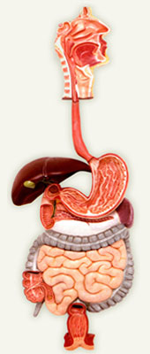
Anatomy of the digestive tract
The digestive system consists of :
- the digestive canal
- digestive glands
Parotid
salivary gland
Salivary
glands
Pharynx
Esophagus
Liver
Stomach
Gallbladder
Pancreas
Duodenum
Jejunum
Descending
colonic
intestine
Ascendant
colonic
intestine
Cecum
Rectum

Slide 4
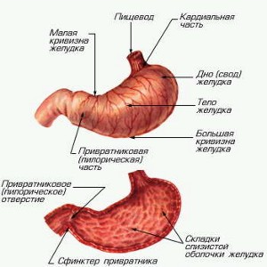
ANATOMY AND PHYSIOLOGY OF THE STOMACH
Stomach –
sacciform expansion of the digestive tract
it distinguishes :
cardial (fundus) part, consisting of the bottom, the body and the actual cardiac area
pyloric (antral) part, which includes the actual antral region, pylorus and pyloric canal
In its walls are the glands :
1. Secreting gastric juice, which contains the enzyme pepsin, splitting proteins to polypeptides
2. Secreting acid, creating an acidic environment in the stomach and depressing microorganisms trapped in the stomach
3. Secreting mucus, which protects the walls of the stomach from the action of enzymes and hydrochloric acid

Slide 5
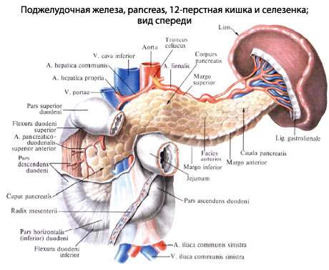
Physiology of the duodenum
Further, the food in the form of a semi-liquid slurry is pushed in portions into the duodenum
The duodenum has a length of 25-30 cm.
It opens the ducts of the pancreas and liver.
The pancreas produces:
- hormones (insulin, etc., entering the blood);
- digestive enzymes involved in the subsequent digestion of food.
Under the influence of the enzyme trypsin there is a splitting of proteins to amino acids. Other enzymes are involved in the cleavage of nucleic acids, carbohydrates and fats.

Slide 6
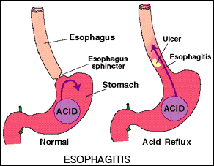
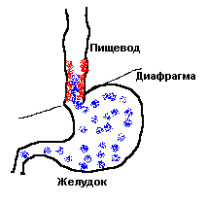


Diseases of the digestive tract
Diseases of the digestive system are divided into :
Diseases of the mouth
Diseases of the esophagus
- esophagitis - inflammation
of mucosa of the esophagus
- tumors of the esophagus
Diseases of the stomach
- gastritis - inflammation of the gastric mucosa:
-- acute
-- chronic
- peptic ulcer - chronic stomach disease - ulceration
of the mucous membrane of the stomach or duodenum
- stomach cancer, etc.
Bowel diseases –
- enteritis - inflammation of the small intestine,
- colitis - inflammation of the large intestine
- enterocolitis - simultaneous defeat of the small and large intestine

Slide 7
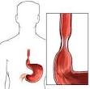
Symptomatology of diseases of the esophagus
Dysphagia — swallowing act violation
Pain
in inflammatory diseases of the esophagus
in burns
in esophagus cancer
usually the pain is observed:
- all over the esophagus
- increases during swallowing
- is preserved and at rest
- irradiation of pain in the interscapular space
Esophageal vomiting
- is associated with food stagnation in the esophagus
- occurs without prior nausea
- without the participation of the musculature of the stomach and abdominal press.
- vomit consist of unboiled food, they do not contain either hydrochloric acid or pepsin
Regurgitation—
return part of the taken food back to the oral cavity -
at neurotics or at a spasm of cardiac department of a stomach

Slide 8
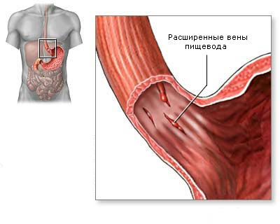
Symptomatology of diseases of the esophagus
Salivation
Heartburn (pirosis)
a peculiar, painful, burning sensation behind the sternum, which
occurs as a result of the throwing of gastric contents into the lower part of the esophagus through the gaping cardiac part, which can lead to the development of reflux esophagitis
Esophageal hemorrhage
from varicose veins with:
cirrhosis of the liver or with a sub-hepatic portal block
neoplastic lesion of the esophagus
hernia of the esophageal opening of the diaphragm
as a result of severe vomiting - tearing of the mucous membrane and this can also lead to bleeding
(Mallory-Weiss Syndrome)

Slide 9
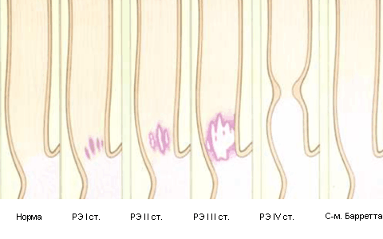
Symptomatology of diseases of the esophagus

Slide 10
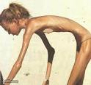
Symptomatology of stomach diseases
Dyspeptic syndrome - combines symptoms: a taste perversion, belching, heartburn, nausea and vomiting
Appetite is a very important factor regulating food intake
Disturbance of appetite is observed:
with many diseases of the digestive tract
central origin, i.e. these changes occur under the influence of impulses coming from the central nervous system - with neuroses, psychoses and with organic lesions of the brain
Perversion of taste - unpleasant taste in the mouth or dullness of taste sensations - with acute and chronic gastritis
When dulling sensations, as a rule, a lined tongue is found - which is formed as a result of swelling, death of the epithelium
Change in appetite
Anorexia - a complete loss of appetite
with acute gastritis
with gastric cancer
Decreased appetite - with chronic gastritis
Increased appetite - when hypersecretion of gastric juice often experience a frequent need for food, frequent intake of food reduces in these cases painful sensations

Slide 11



Symptomatology of stomach diseases
Perversion of appetite - selective attitude to food
For example, with chronic gastritis, with stomach cancer –
patients often note an aversion to meat, to fatty foods
Reinforced thirst (polydipsia)
at a hypersecretion - there is a dilution of the acidic gastric contents
when vomiting - is caused by dehydration of the body
Belching (eructatio - belching with air, regurgitatio-burping food):
belching with air - a sudden, and sometimes audible, exit through the mouth of air that has accumulated in the stomach or esophagus
burping food - mouth in the mouth of a small part of the gastric contents:
with the smell of "rotten eggs" (hydrogen sulphide) - indicates the far-gone decay of albuminous substances, such an eructation in the morning, on an empty stomach,
with stenosis of the pylorus,
with the expansion of the stomach,
with gastric cancer
belching sour - with hypersecretion, with peptic ulcer disease
belching bitter taste - when thrown into the stomach bile from the duodenum
burping with rancid oil - with reduced acidity
or complete absence of hydrochloric acid

Slide 12


Symptomatology of stomach diseases
Heartburn (pirosis) - a kind of feeling of heat and burning in the lower part of the esophagus, which is associated with regurgitation of the contents of the stomach into the esophagus
Observed:
-at high acidity of gastric juice
-can be with normal or even reduced secretion
Nausea is an unpleasant sensation (pressure) in the pit of the stomach, followed by:
sensation of faintness,
dizziness,
drooling,
cold extremities,
pallor of the skin,
a drop in blood pressure,
sometimes even a semi-fainting condition
Observed:
-with liver and kidney diseases
-helminthic invasion, during pregnancy, may be of central origin, with CNS involvement

Slide 13
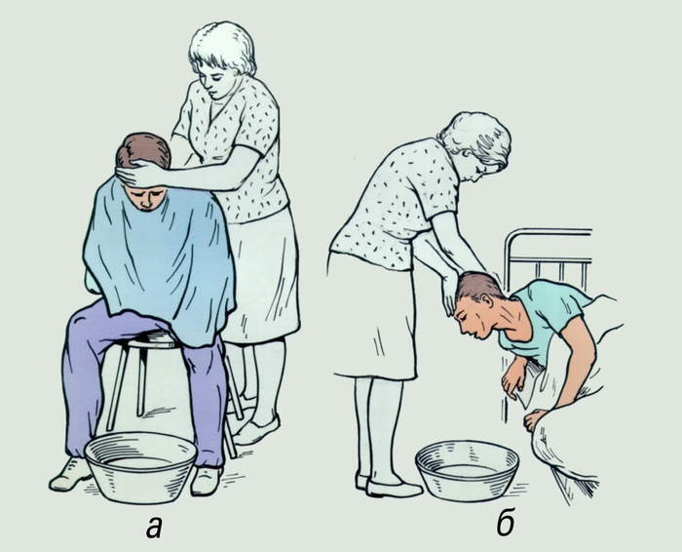
Symptomatology of stomach diseases
Vomiting (vomitus, emesis)
This is an involuntary trembling of the contents of the stomach through the mouth.
1. Vomiting of nervous origin - characteristic: persistence; lack of relief after vomiting; appearance without nausea
2. Reflex vomiting - occurs due to irritation - the root of the tongue, soft palate and pharynx, surface of the peritoneum, etc.
There are the following vomiting of gastric character :
- vomiting from irritation of the gastric mucosa:
=chemical substances (acids, alkalis, arsenic, etc.)
=medicinal substances (digitalis, aspirin)
=consumption of poor-quality food
- vomiting due to organic stenosis of the pylorus:
=late in the evening or at night,
=vomitous putrefactive or sour taste
=after vomiting, the patient usually notes the relief and reduction of pain
а
b
Help the patient with vomiting:
а — in the patient's sitting position
b — in the patient’s lying position

Slide 14
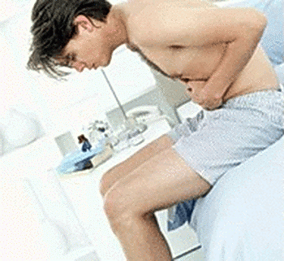
Symptomatology of stomach diseases
Vomiting
When diagnosing vomiting, you need to consider:
- vomiting time
- number of vomit
- reaction - pH
- character of impurities
Vomiting in the morning on an empty stomach -
- with alcoholic gastritis and hypersecretion
- when gastric juice is accumulated in the stomach
Vomiting in 5-10 minutes after eating -
- with ulcers and carcinoma of the stomach
with neurosis
Vomiting 2-3 hours after eating
in the midst of digestion is characteristic of:
gastritis, ulcers, stomach cancer
Vomiting 4-6 hours after eating
with pylorus or duodenal ulcer
with atony of the stomach
Vomiting after 6-12 hours or more after a meal
on the eve of a meal eaten by a pyloric stenosis

Slide 15

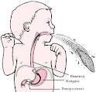
Symptomatology of stomach diseases
Vomiting
Vomiting of bile (v. felliosus) –in the vomit, bile is present
when the canal of the pylorus is gaping, due to achilliness or narrowing of the duodenum
Vomiting hysterical (v. hystericus) —
arising as a manifestation of hysteria
Faeces vomiting (copremesis) — vomit has a fecal odor or admixture of stool; observed:
- with intestinal obstruction
- in the presence of an entero-gastric fistula
Vomiting "coffee grounds" or bloody –
vomit have a black-brown color
Vomiting bloody (haematemesis, v. cruentus) –
with blood or an admixture of blood to the vomit
occurs with gastric bleeding
Brain vomiting (v. cerebralis) — paroxysmal, arising regardless of food intake in patients with organic lesion of the central nervous system
Vomiting indomitable (hyperemesis) — persistently repeated several times a day, incl. and at night:
- with severe forms of infectious diseases
- poisoning
- toxicosis of pregnant women

Slide 16
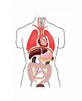

Symptomatology of stomach diseases
Pain syndrome
Distinguish: periodic pain and persistent (constant) pain
Periodic pain may be early pain that occurs 30 minutes
to 3 hours after eating -
characteristic of peptic ulcer disease
2. Periodic pains hungry and nocturnal (late pains) -
- with constant hypersecretion
- are burning
- are very strong
- appear on an empty stomach and especially at night
("Night pain"), subsided after eating
Constant pains are observed:
with an ulcer complicated by perigastritis or
periduodenitis
- with gastric cancer
The pain can be irradiated in the back, the scapula, into the lower part of the interscapular space.
Localization of pain, their irradiation allow us to judge the involvement of certain digestive organs in the pathological process.

Slide 17
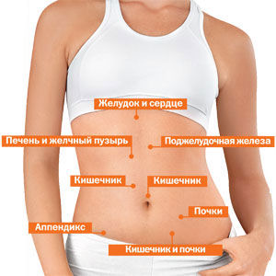
Symptomatology of stomach diseases
Stomach and heart
PAIN SYNDROME
Liver and gallbladder
Pancreas
Intestine
Intestine
Kidneys
Appendix
Intestine and kidneys

Slide 18
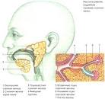


Methods of GIT research
Inspection of the oral cavity
-Determine the presence of odor (putrefactive ammonia, apples,
alcohol, etc.).
-Determine the condition of the mucosa of oral cavity, gums,
palate, tonsils, tongue, teeth.
Examination of the abdomen
- determine the shape of the abdomen in a standing position;
-determine the shape of the abdomen in the lying position on the back
(drawn, stuck out);
- to determine the presence or absence of asymmetry in the abdomen
- identify the involvement of the abdomen in the act of breathing;
- assess the condition of the skin;
- assess the condition of the navel and the presence of a venous vascular pattern.
Superficial palpation of the abdomen
-determine the presence of a common or limited soreness of the abdominal wall;
-to reveal the tension of the abdominal wall, the presence of hernial protrusions;
-to reveal superficially located tumors and enlarged organs (liver, spleen).

Slide 19
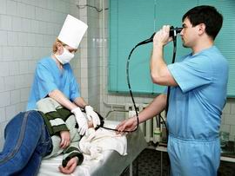
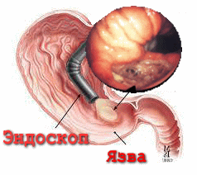
Instrumental methods
of GIT research
Endoscopic examination of the gastrointestinal tract.
Endoscopy is a direct examination of the internal surface of the cavity or tubular organs (esophagus, stomach, duodenum, large intestine) with the help of special instruments – endoscopes.
Endoscopy is used for:
research of the esophagus (esophagoscopy)
stomach (gastroscopy)
12 duodenal ulcer (duodenoscopy)
rectum and sigmoid intestines (sigmoidoscopy)
the entire colon (colonoscopy)
Investigation of the upper sections of the gastrointestinal tract - esophagus, stomach, duodenum (esophagogastroduodenoscopy, FGDS) - is usually carried out simultaneously

Slide 20
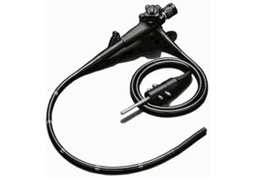
Instrumental methods
of GIT research
During endoscopy:
Doctor can take the material from the surface of the
mucosa shell for cytological analysis
(i.e., studying the shape and structure of tissue cells)
Doctor can take pieces of tissue for histological
and histochemical research (biopsy)
Doctor can photograph the areas of interest to document the identified changes
Doctor can record on a VCR
to trace the dynamics of pathological processes or healing of the resulting disorders in repeated endoscopic studies (for example, the development of polyps, the course of scarring of stomach ulcers, etc.)
Endoscopy is often performed with a therapeutic purpose:
-A small polyps is removed through the endoscope
-stop bleeding
-cauterize, glue, medicate ulcers, erosion
-conduct laser therapy, etc.
The most accurate instrumental research
perform with a video camera

Slide 21
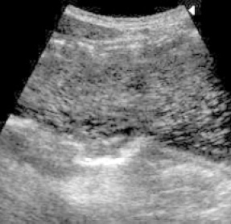
Instrumental methods
of GIT research
Ultrasound of the stomach with contrasting -
this study of the stomach in the process of its
filling 400-500 ml. boiled water
It allows to detect:
tumors
stomach ulcer
motor function impairment
hernia of the esophageal opening of the diaphragm
casting of the contents of the duodenum into the stomach
throwing the contents of the stomach into the esophagus
The method has low informativeness in the diagnosis of gastritis and duodenal ulcer.
Very effective in childhood.
The study includes 3 inspections:
on an empty stomach,
after filling the stomach with water (the patient drinks water directly during the study)
in 20 minutes. to assess the degree of emptying.
It is carried out on an empty stomach, it is not allowed to eat for 6 hours.
before the study, drink 2 hours before the study

Slide 22
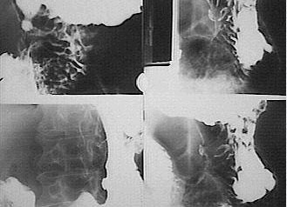
Instrumental methods
of GIT research
X-ray examination
esophagus, stomach and intestines -
allows to specify:
form of these organs
their position
tone
peristalsis
condition of mucosal relief
This method plays an important role in the diagnosis:
peptic ulcer disease
tumors of the gastrointestinal tract
anomalies in the development of cholelithiasis
complications (stenosis of the stomach, penetration of the ulcer, varicose veins of the esophagus, dolichosigma, megacolon, etc.)
also assess the nature of functional (motor-evacuation) disorders

Slide 23
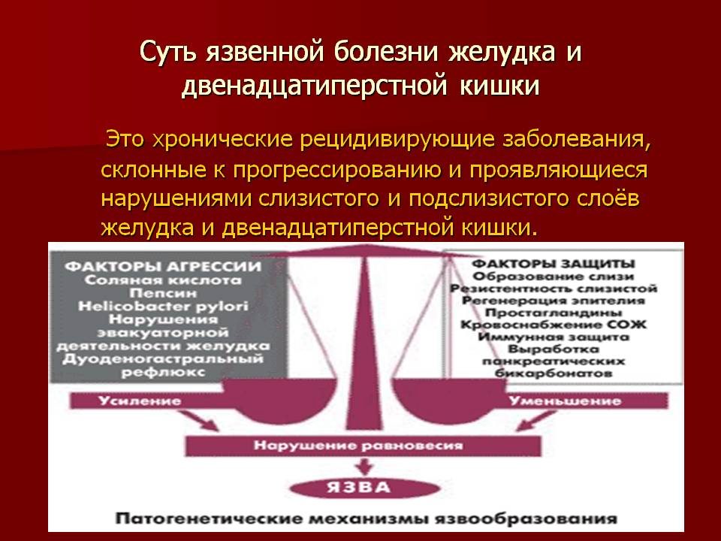
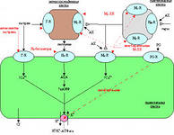
ULCER DISEASE

Slide 24
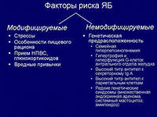
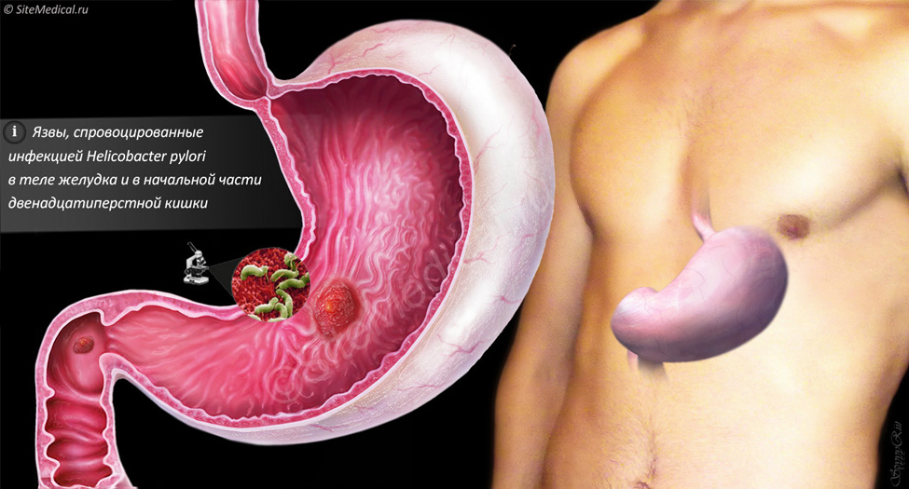
ЯБ

Slide 25
ЯБ

Slide 26
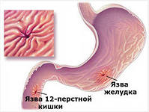
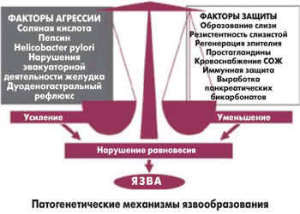
Классификация ЛС, применяемых при ЯБ
I. ЛВ, снижающие секрецию HCl
1. Это хронические рецидивирующие заболевания, склонные к прогрессированию и проявляющиеся нарушениями слизистого и подслизистого слоёв желудка и двенадцатиперстной кишки

Slide 27
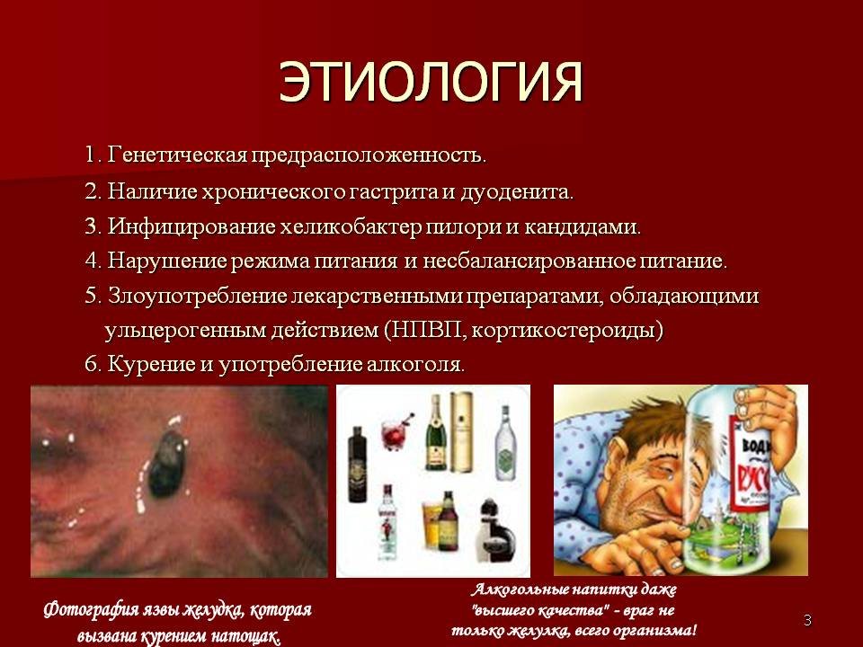
ЭТИОЛОГИЯ ЯБ

Slide 28
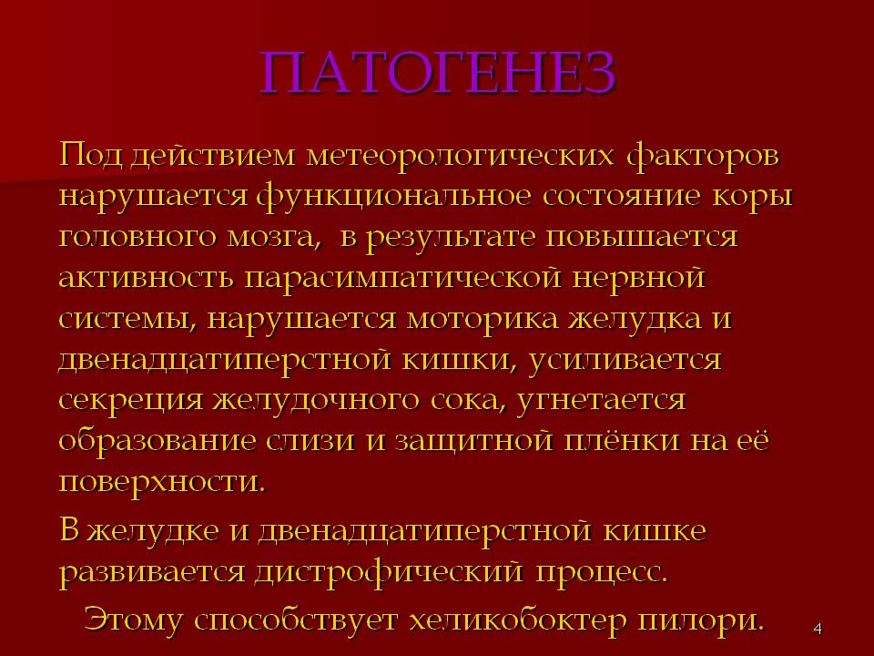
ЛВ, применяемые при ЯБ
ПАТОГЕНЕЗ ЯБ

Slide 29
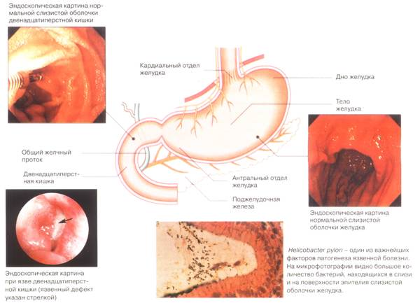
ЛВ, применяемые при ЯБ
ПАТОГЕНЕЗ ЯБ

Slide 30
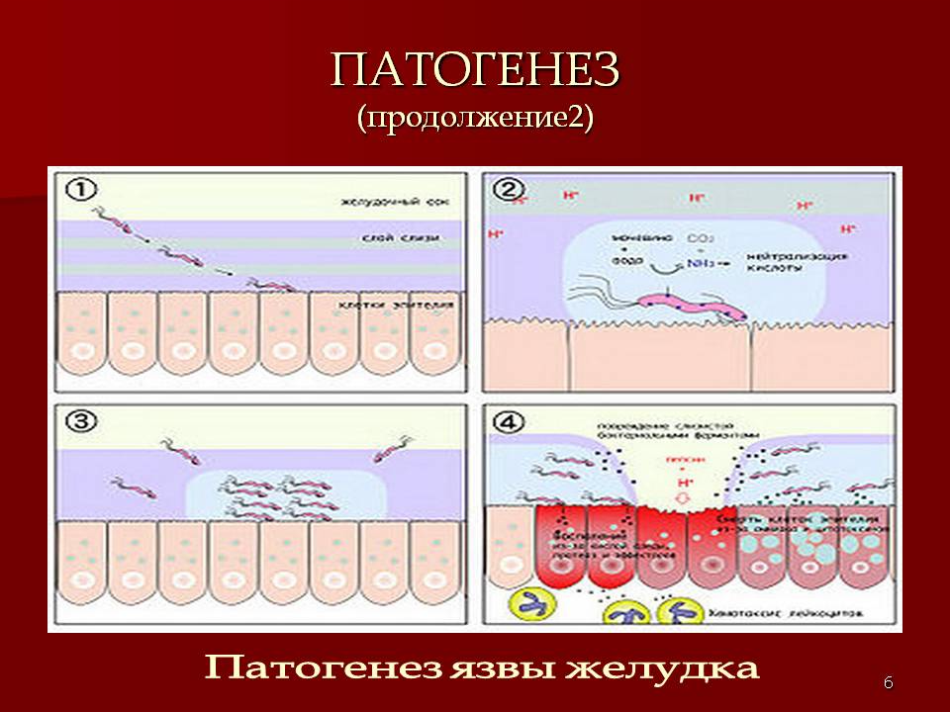
ЛВ, применяемые при ЯБ

Slide 31
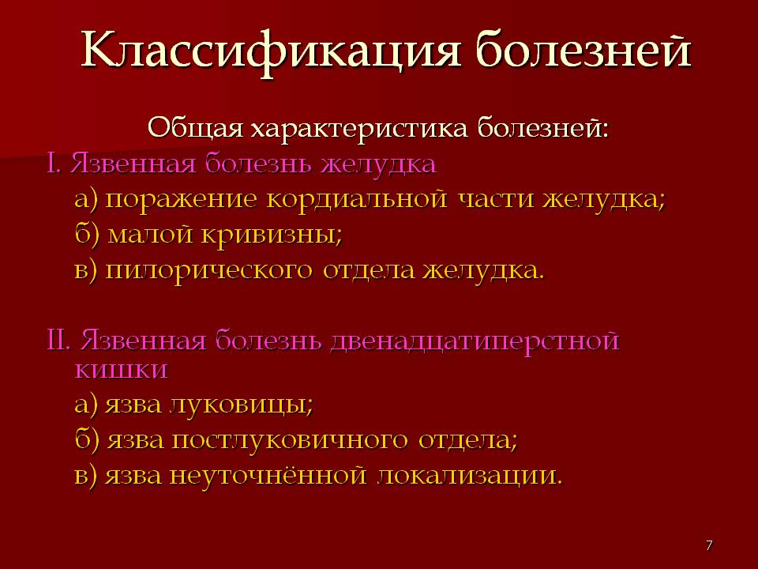
ЛВ, применяемые при ЯБ

Slide 32
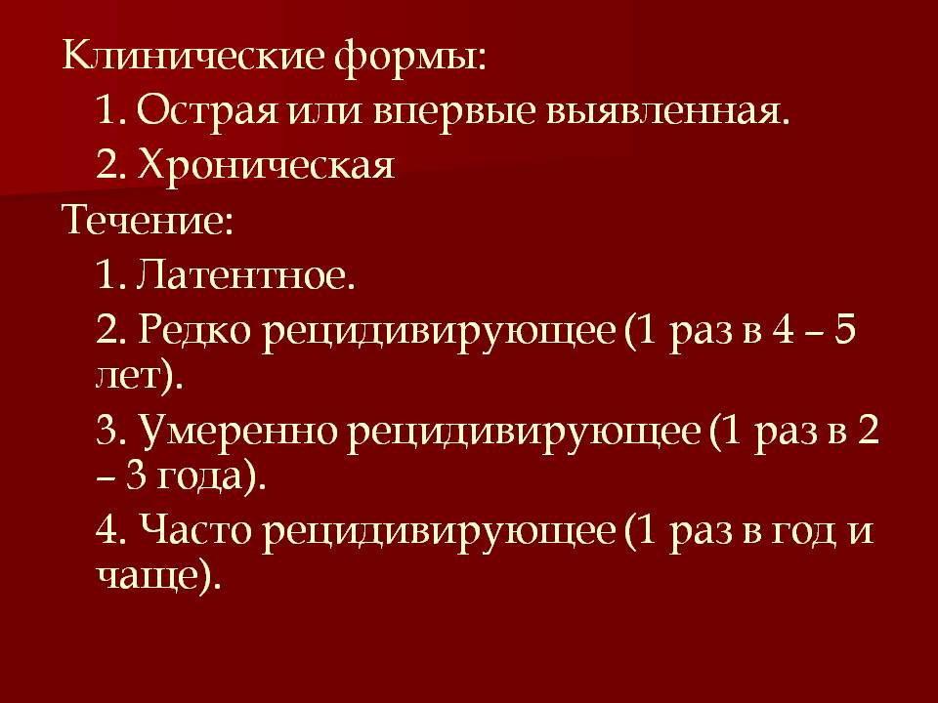
ЛВ, применяемые при ЯБ

Slide 33
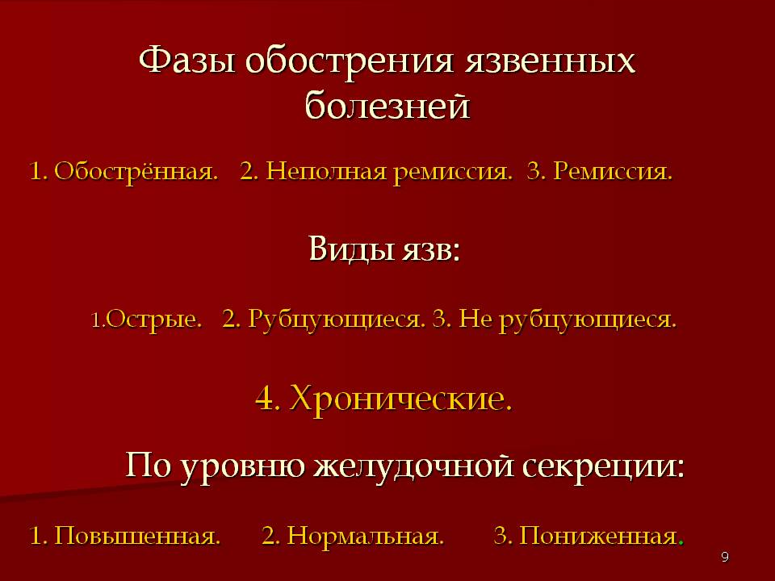
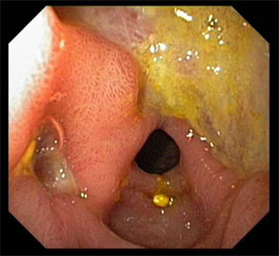
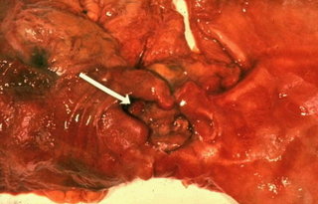

Slide 34
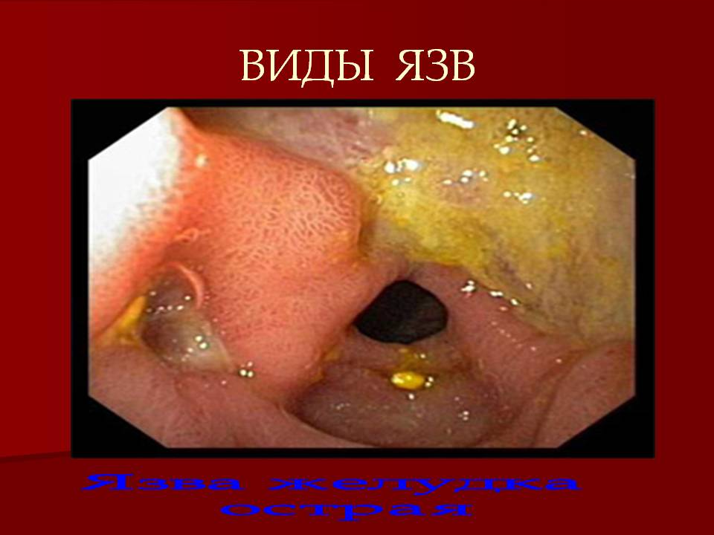

Slide 35
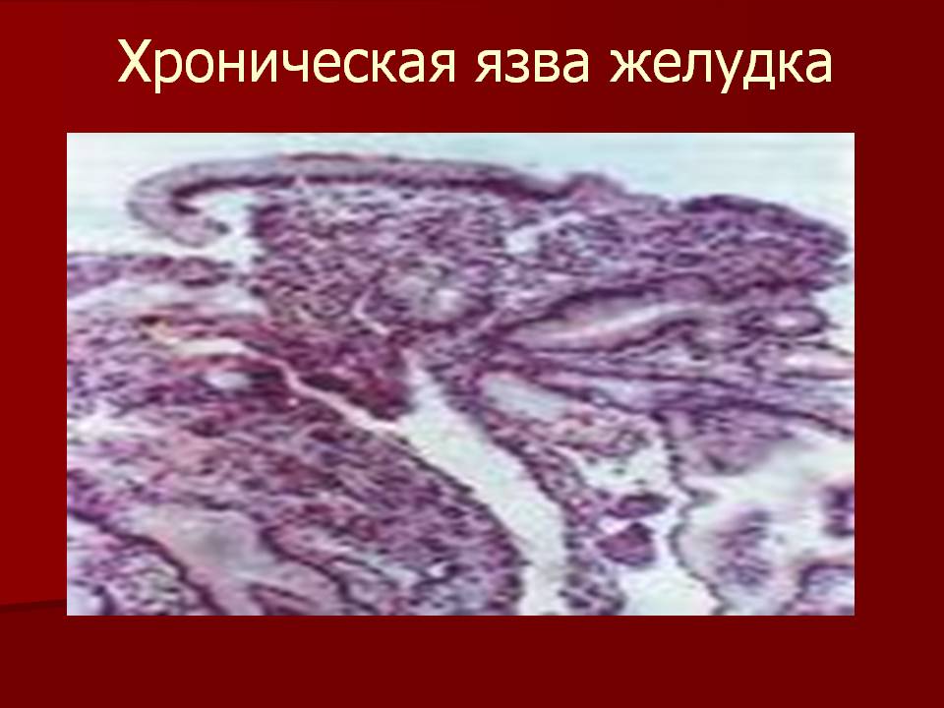
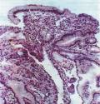
ЛВ, применяемые при ЯБ

Slide 36
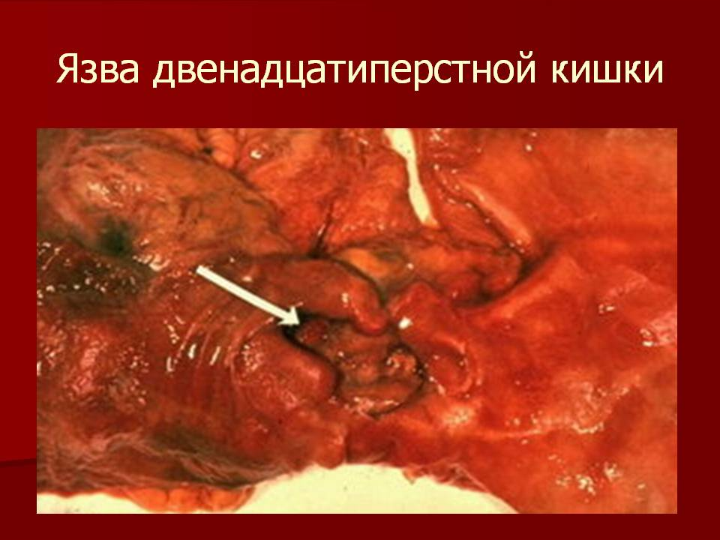
ЛВ, применяемые при ЯБ

Slide 37
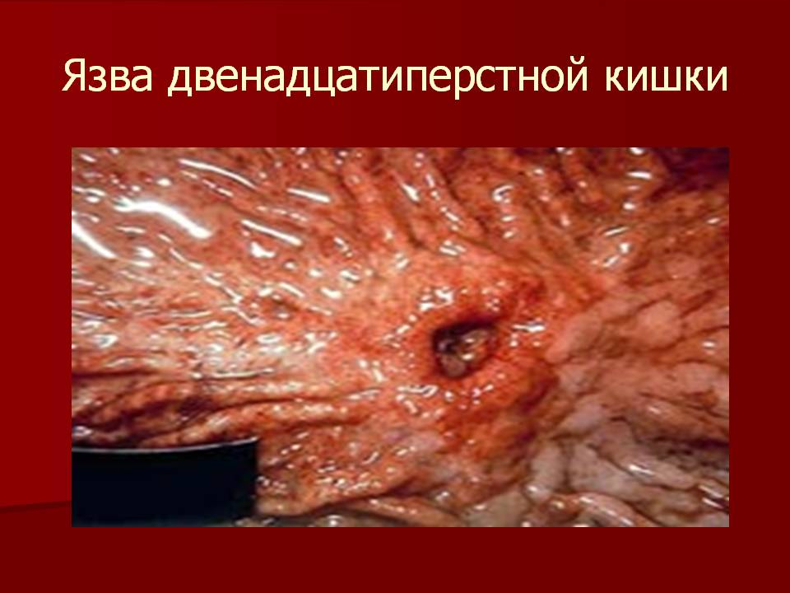

Slide 38
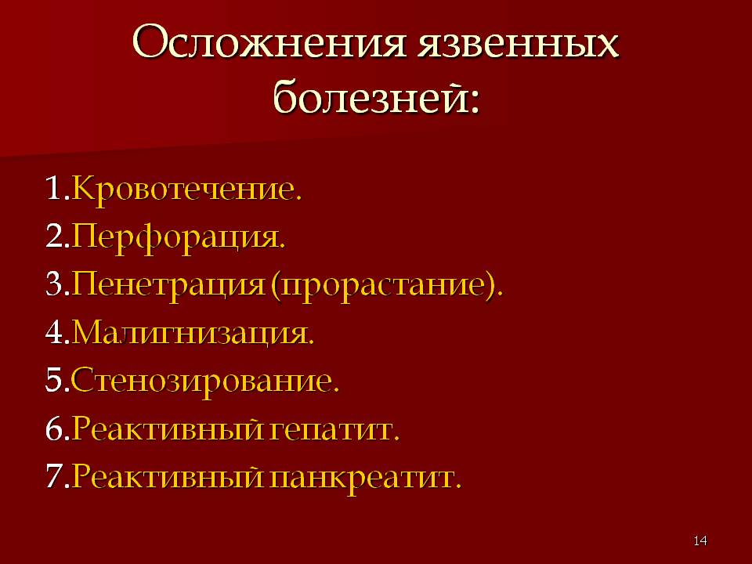
ЛВ, применяемые при ЯБ

Slide 39
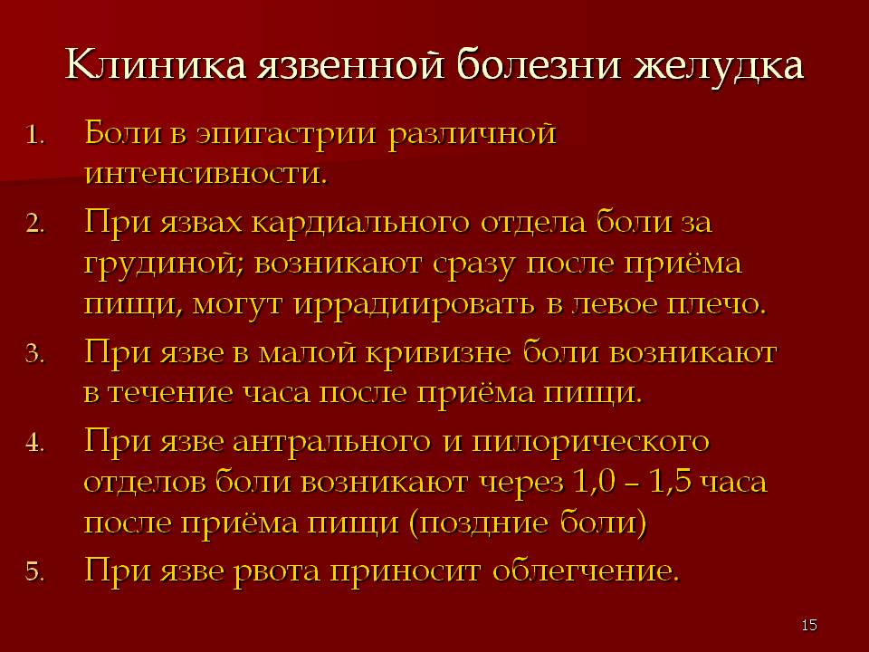
ЛВ, применяемые при ЯБ

Slide 40
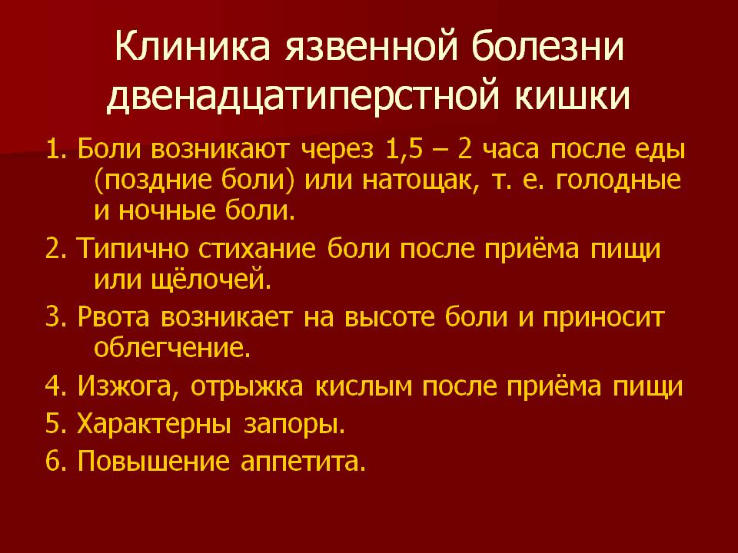
ЛВ, применяемые при ЯБ

Slide 41
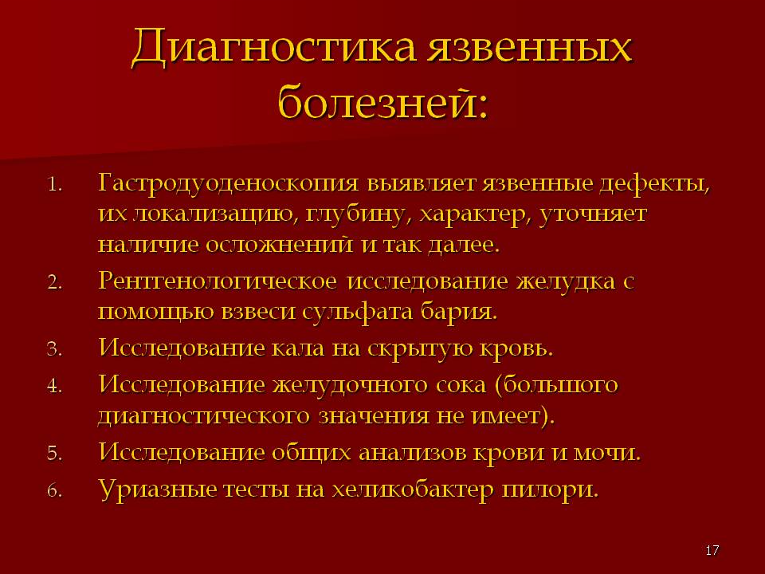

Slide 42
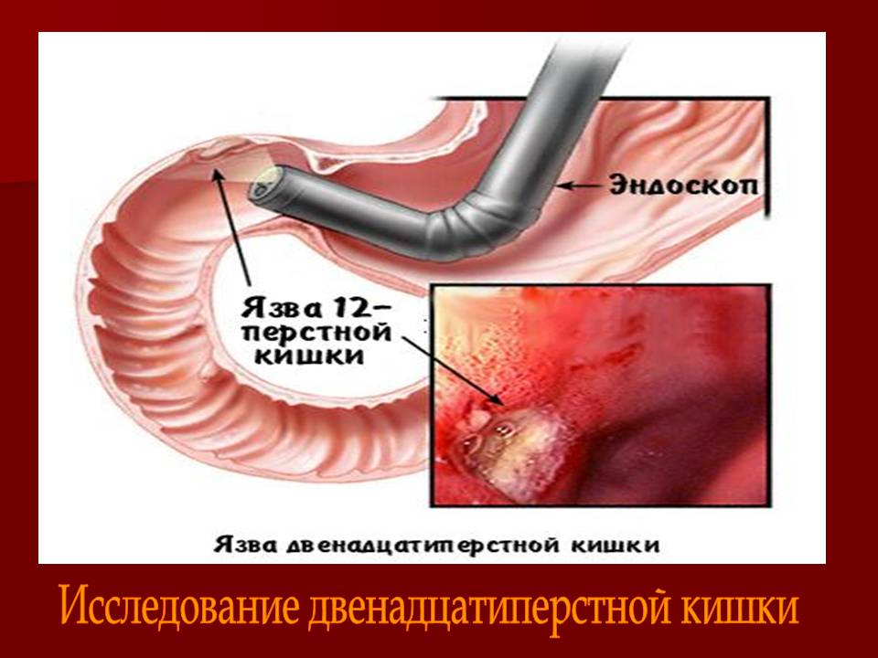
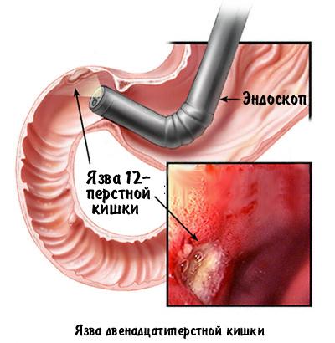
ЛВ, применяемые при ЯБ

Slide 43
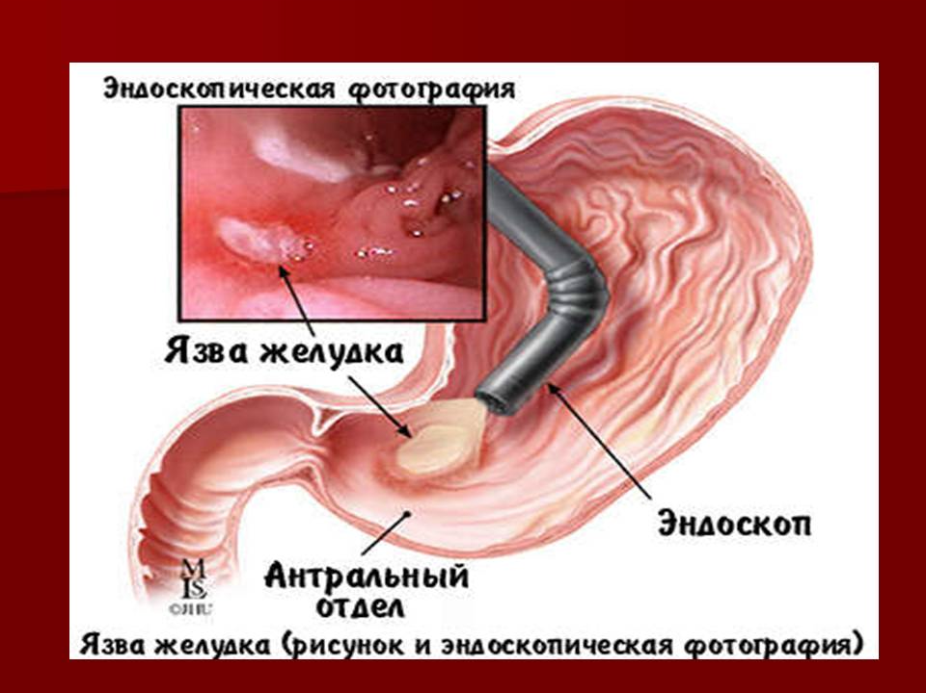
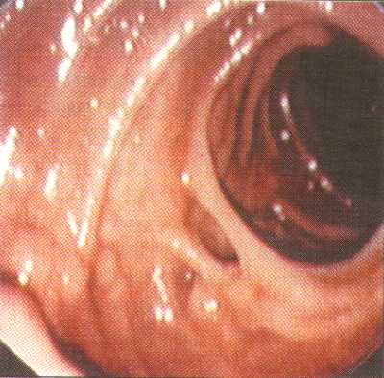
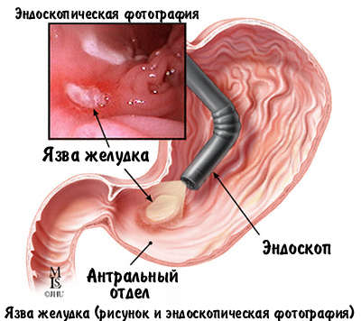
ЛВ, применяемые при ЯБ

Slide 44
ЛВ, применяемые при ЯБ

Slide 45
ЛВ, применяемые при ЯБ

Slide 46
ЛВ, применяемые при ЯБ

Slide 47
ЛВ, применяемые при ЯБ

Slide 48
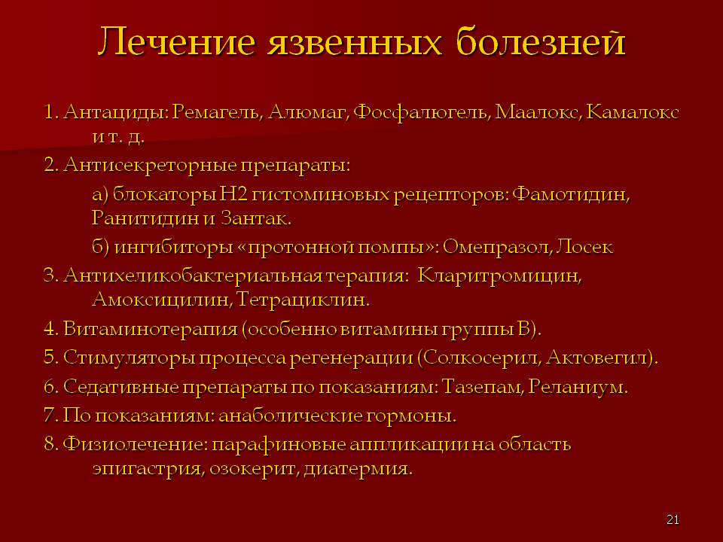

ЛВ, применяемые при ЯБ

Slide 49

ЛВ, применяемые при ЯБ

Slide 50


Классификация ЛС, применяемых при ЯБ
гастропротекторы
1. механическая защита
сукралфат
висмута трикалия динитрат
2. повышение защитной
функции слизистой
карбеноксолон
мизопростол
средства, оказывающие
бактерицидное действие
на H.Pylori
метронидазол
тетрациклин
амоксициллин
кларитромицин
висмута трикалия динитрат

Slide 51





Классификация ЛС, применяемых при ЯБ

Slide 52
Классификация ЛС, применяемых при ЯБ

