Slide 1
Pharmacoeconomics as a science, its purpose and objectives.
Basic pharmacoeconomic categories.
Lecture 1

Slide 2
The aim of this lecture
is to provide an overview of the issues and theory which lie at the heart of
Pharmacoeconomics
and to show how these can be applied in practice to decisions about drug therapy.

Slide 3
Contents of the Lecture:
1. Pharmacoeconomics: A brief History
2. Definition of terms and basic methodology of pharmacoeconomic evaluation of drug therapies
3. Types of pharmacoeconomic evaluation
4. Cost models and Cost effectiveness analysis
5. Principles of Bottom up cost models

Slide 4

Practitioners, patients, and health providers face a question:
How does one decide which are the best medicines to use within restricted budgets?
Pharmacoeconomics is the field of study that evaluates the behavior or welfare of individuals, relevant to the use of pharmaceutical products, services, and programs.

Slide 5
Why do we need Pharmacoeconomics?
Health care funders (governments, social security funds, insurance companies) are struggling to meet their rising costs.
They make many efforts to contain drug costs, by price negotiation, patient co-payments or
dedicated drug budgets.
The aim is to identify what is most efficient, so that the greatest amount of benefit can be bought for a given amount of money or resources.

Slide 6
The aim of pharmacoeconomics:
to compare the economics
of different pharmaceutical products or
to compare drug therapy to other treatments.
Pharmacoeconomics is a branch of health economics that particularly considers drug therapy.
It is of particular interest to pharmaceutical companies who in developing a new drug and after the traditional hurdles
of efficacy, safety and tolerability must now jump over a fourth hurdle of cost effectiveness.

Slide 7

Pharmacoeconomics
Phocus
cost (inputs),
consequences
(outcomes)

Slide 8
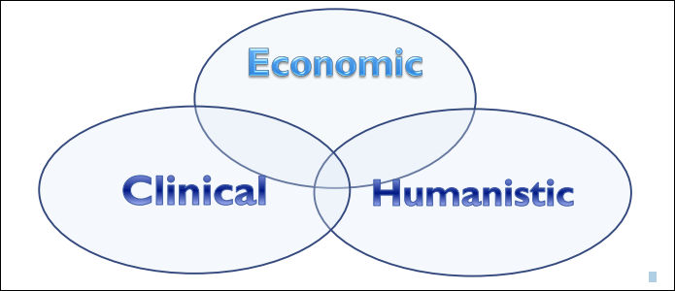
Pharmacoeconomics
ECHO Model:
Economic, Clinical, and Humanistic Outcomes

Slide 9

Pharmacoeconomics
is often referred to as
“health economics”
or “health outcomes research”

Slide 10
Principal reasons of pharmacoeconomics development
New medical technologies
Increasing of attention to the safety of
medicines
The legislative requirements to the clinical
researches, production, analysis of quality,
realization of medicines

Slide 11
Objects of pharmacoeconomics researches
efficiency of
medicines
safety of medicines
quality of life
results of medical
treatment
consumption of
medicines
necessity of medicines
development of new
medicines
expenses on medicines

Slide 12
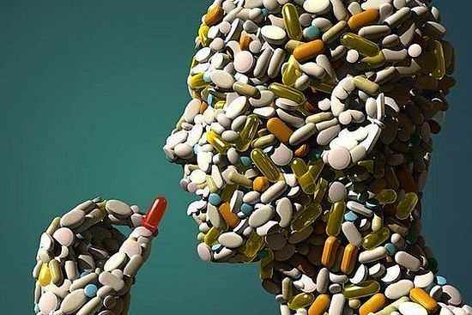
The main task of pharmacoeconomical analyses
Efficiency
Safety
Quality of life
Expenses
for the rational use of the health care system finances

Slide 13
Basic concepts and terminology
Efficiency is a key concept
in pharmacoeconomics, i.e. how to buy the greatest amount of benefit for a given resource use.
Despite some problems, pharmacoeconomic evaluations of drug therapy are increasingly important in decision making.

Slide 14
Basic concepts and terminology
Benefits
The benefits we expect from an intervention might be measured in:
“Natural” units - e.g. years of life saved, strokes prevented, peptic ulcers healed etc.
B. “Utility” units - utility is an economist’s word for satisfaction, or sense of well being, and is an attempt to evaluate the quality of a state of health, and not just its quantity.

Slide 15
Basic concepts and terminology
Utility estimates can be obtained through direct measurement
(using techniques such as time trade off or standard gambles, or by imputing them from the literature or expert opinion ).
They are often informed by measures of quality of life in different disease states

Slide 16
Basic concepts and terminology
The Quality Adjusted Life Year (QALY)
QALY is one widely used measure, which attempts to integrate both quality and the quantity of life.
Broadly, it assumes that if a treatment increases one’s life expectancy by 2 years, but causes adverse effects or inconvenience, such that one’s quality of life or utility are decreased by 25%, the net gain is 2 x 0.75 = 1.5 QALYs.

Slide 17


Pharmacoeconomic tecniques include
Cost-minimization
Cost-effectiveness
Cost-utility
Cost-benefit
Cost of illness
Sensitive analysis
and any other economic analytic technique that provides valuable information to health care decision makers for the allocation of scarce resources.

Slide 18

Pharmacoeconomic tools
vitally important in analyzing the potential value for individual patients and the public.

Slide 19
Pharmacoeconomics helps to:
Reduce the overall costs of the treatment by utilizing more efficient modes of therapy.
Reduce the unnecessary use of emergency rooms and medical facilities.
Reduce the rate of hospitalization attributable to or affected by the improper use of drugs.
Contribute to better use of health manpower by utilizing automation, telemedicine and technicians.
Decrease the incidence and intensity of iatrogenic disease, such as adverse drug reactions.
By improved monitoring and assessment of drug therapy outcomes, practitioners an provide early detection of therapy failure and provide cost-effective prescribing.

Slide 20


The international society for pharmacoeconomics and outcomes research (ISPOR)
The ISPOR promotes the science of
pharmacoeconomics (health economics) and outcomes research and facilitates the translation of this research into useful information for healthcare decision-makers to increase the efficiency, effectiveness, and fairness of
health care to improve health.

Slide 21
Questions
1. What does mean Pharmacoeconomics?
2. What is the main task of pharmacoeconomical analyses?
3. What are the types of benefits?
4. What is ISPOR?

