Slide 1
Odessa National Medical University
Faculty of Pharmacy
Department of Drug Technology
“Regulatory documentation in the production of GLZ”
Senior Lecturer, PhD Zamkovaya A.V.
Odessa -2020

Slide 2
Regulatory and technical documentation
in the manufacture of medicines
MU 64-04-002-2002 "Manufacture of medicines. documentation »
Documents
STATE
REGULATION
(State, departmental,
sectoral)
-federal laws
-resolutions and decisions
government of the Russian Federation and subjects of the Russian Federation
-GOST, OST, MU and RD industries
ДОКУМЕНТИ ПІДПРИЄМСТВА

Slide 3
ENTERPRISE DOCUMENTS
1. "Information about the enterprise"
(Site master file)
2. Quality policy
3. Pharmaceutical articles (or other ND)
4. Regulations of all drugs
1 level
JV (enterprise standard) /
SOP (standard operating room
procedure)
2. Specifications and dossiers for all drugs
3. Passports
4. Filled forms
5. Plans, programs
2 level
3 level
1. Production dossier
2. Reports
3. Completed forms

Slide 4
Technological terminology
Raw materials -source material that goes to mass processing and has a cost.
Raw materials (master, specialist) = basic substance + impurities
The main organic raw material: the most expensive, taken without excess, in the reaction is recorded first.
Products - are formed at the entrance to the process of matter.
For reaction: target product and by-product.
In technology: intermediate product, waste, losses. Intermediate product (semi-finished product, semi-finished product) - a product that has undergone partial industrial processing.
Excipients are substances that do not participate in the chemical transformation, but are used in the separation of reaction mixtures or purification of the product and raw materials from impurities (adsorbents, filter materials, etc.)
Waste - impurities and residues of raw materials, used auxiliary materials, by-products that have partially or completely lost their quality and no longer meet the standards.

Slide 5
Factors determining the choice of synthesis scheme:
the number of stages of synthesis and their duration;
yields and selectivity by stages;
patent purity of the synthesis method;
manufacturability of the process;
comparative quality of products obtained by different methods and their stability during storage; environmental characteristics of the process (toxicity, explosion and fire hazard of the substances used, the composition of wastewater and emissions into the atmosphere); availability and cost of all types of raw materials;
issues of mechanization and automation of the process;
approximate assessment of the possible hardware design of the process, wear (corrosion) of the equipment in the expected operating conditions;
taking into account the possibilities of the intended place of implementation on an industrial scale of the developed synthesis.

Slide 6
Types of schemes at the pharmaceutical enterprise Before to start technological calculations it is necessary to have a clear idea of ​​system and its structure
Forms of structure representation
verbal
(Verbal)
description
In text
documents
graphic
schemes
functional
(technological
scheme)
operator
structural
hardware

Slide 7

General technological scheme of obtaining drugs
Preparatory work (auxiliary work)
equipment preparation
preparation of premises
staff training
Air preparation, etc.
Technological process (stages of the main technological process)
preparation of raw materials
Preparation of the mass for tableting
Others, according to a given technology
Packing, marking, shipment
preparation of containers
Packing, etc.

Slide 8
Symbols of stages indices
"BP" - stages of ancillary work;
"TP" - stages of the main technological process;
"PO" - stages of processing of used waste;
"OBO" - stages of waste disposal;
"OBV" - stages of neutralization of technological and ventilation emissions into the atmosphere;
"UMO" - stages of packaging, labeling, shipment of the finished product.

Slide 9
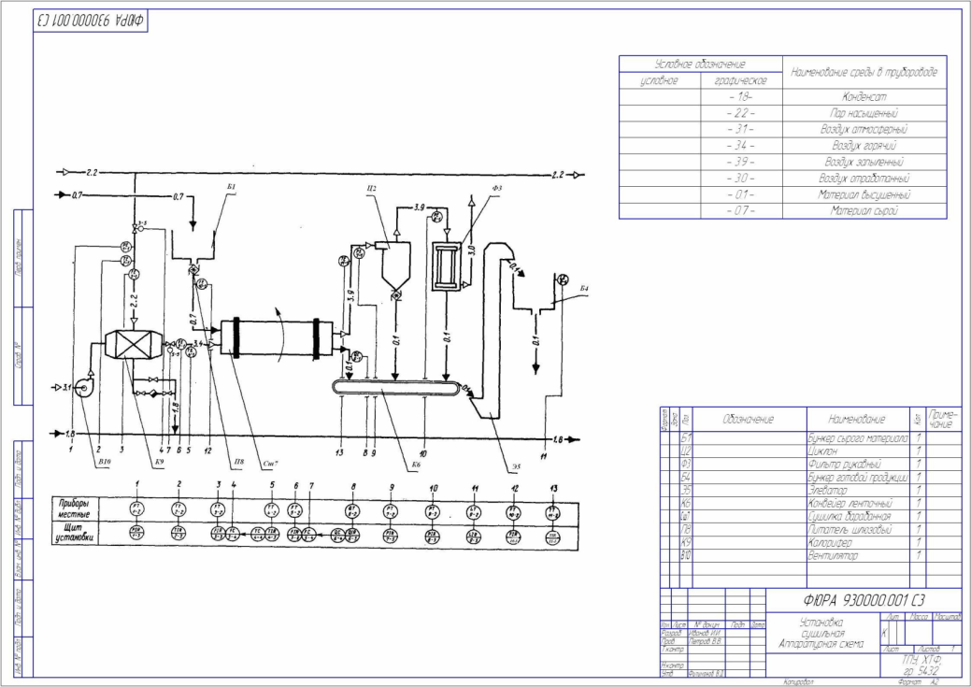
Algorithm for hardware circuit development
Fundamental (preliminary selection of main and auxiliary equipment as objects for further calculation, equipping the scheme with material and energy resources, means of automation and control).
Complex of technochemical calculations (quantity of raw materials and waste, type and basic parameters of devices, their quantity, consumption of all types of energy).
Completion (refinement) of the hardware scheme taking into account the calculated data.

Slide 10
Basic requirements for drawing up the hardware scheme
The location of equipment units on the diagram must correspond to the sequence of the technological process, regardless of the location of equipment in the production premises;
The diagram shows the level of equipment placement;
All items of equipment are numbered in the course of the technological process. This numbering must be strictly adhered to in the equipment specification and explanatory note.
The scheme must show a workable design of the installation, which ensures the optimal course of the technological process and its safety;

Slide 11
The drawing does not show the power supply schemes of installations and pipelines with factory-wide energy carriers (water, steam, compressed air, refrigerants, etc.), but the symbols indicate the supply of devices with energy carriers, places of their input and output;
If in production there are several identical technological lines (parallel threads) or several identical devices (installations) performing the same type of work, the drawing shows only one technological line or device, and their number is specified in the specification to the drawing;
When choosing the equipment it is necessary to use as much as possible standard installations, reactors, their equipment and only if necessary to include in the scheme the unique non-standard equipment.

Slide 12
Thank you for listening!!!

