Slide 1
Odessa National Medical University
Faculty of Pharmacy
Department of Drug Technology
On the topic of:
" Requirements for sterile products.
Determination of the main indicators of the quality of ampoule glass. "
Senior Lecturer, PhD Zamkovaya A.V.
Odessa -2020

Slide 2
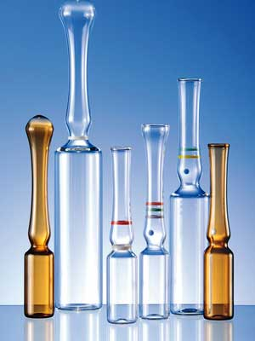
Ampoules as containers for injection solutions
Ampoules are glass vessels of various capacities (1; 2; 3; 5; 10; 20 and 50 ml) and forms, consisting of an expanded part - a body (bullet), where medicinal substances are placed (in solution or other state) and 1- 2 capillaries (“stems”) that serve to fill and empty ampoules. Capillaries can be straight or pinched.

Slide 3
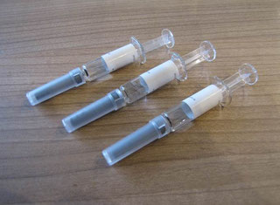
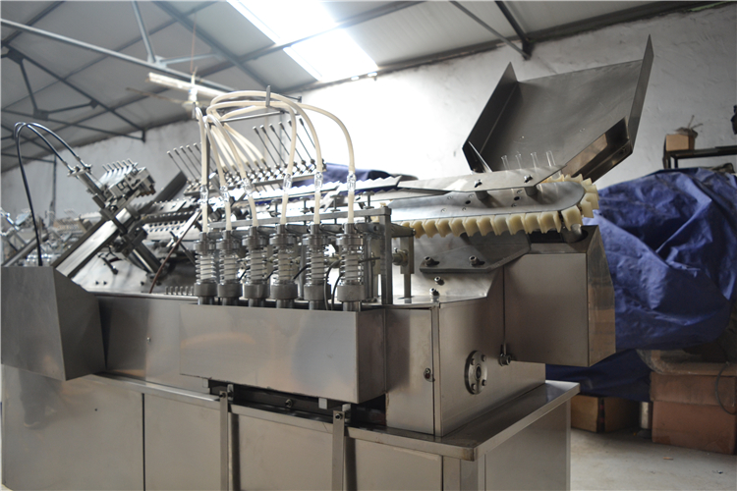
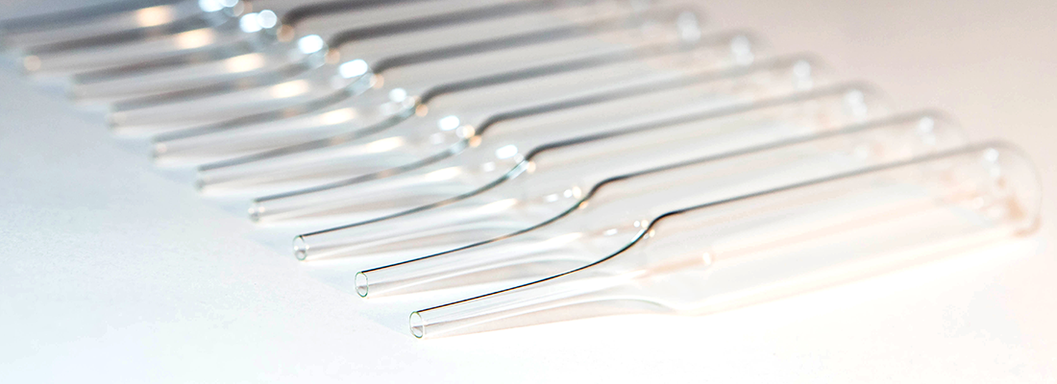
Vacuum ampoules:
VPO - vacuum filling with clamping, open;
VO - vacuum filling without pinching, open.
Ampoules for syringe filling:
IP-V - syringe filling, open;
IP-S - open-ended syringe filling; C - paired; G - for glycerin.

Slide 4
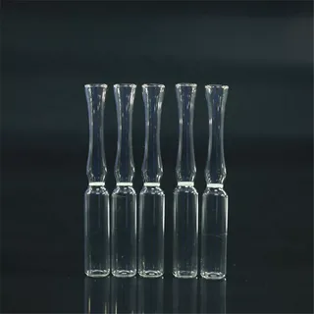
Ampoules must correspond to the shape and geometrical dimensions specified in the NTD and the set of technical documentation approved in the prescribed manner.
The deviation from the roundness of the ampoules, determined by the difference between two mutually perpendicular diameters, should not exceed the maximum deviations per diameter.
Ampoules are usually made from colorless glass, sometimes from yellow and very rarely from colored glass. Usually, ampoules with a flat bottom are made, although for technological reasons the bottom of the ampoule should be concave inward. This ensures the stability of the ampoule and precipitates in this "groove" the glass fragments formed during opening. The bottom should ensure the stability of the empty ampoule with the cut off stem on a horizontal plane. The concavity of the bottom of the ampoules is not more than 2.0 mm.
In our country, ampoules of syringe and vacuum filling with various markings are produced.

Slide 5
Water resistance
Three samples from 300 g of crushed glass with a mass of 11.0 g each are defatted with ethanol and acetone and dried at temperature. 140 ° C. Three accurate weighed portions of 10.0 g room. in flasks with 50 ml freshly boiled distilled water with ref. The pH value is 5.5. The autoclavier was also closed. 30 min at temp. 121 ° C (0.10-0.11 MPa). After cooling, they are titrated with 0.02 M solution of hydrochloric acid in the presence of methyl red until the color of the solution changes from yellow to orange. Glass water content X (ml / g) calc. by f-le: X = (V1-V2) / m
where V1 is the volume of hydrochloric acid solution consumed for titration of the test solution, ml; V2 is the average volume of hydrochloric acid solution, red for titration of each of the 2 control experiments, ml; m - glass mass, g.

Slide 6
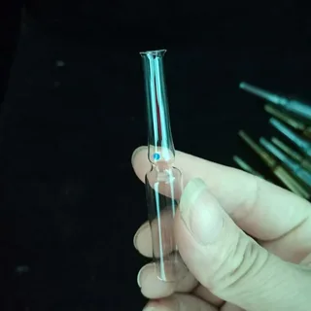
Alkali resistance
The method is based on the impact on glass samples of area. 0.10-0.15 dm2 of a mixture of equal volumes of 0.5 M solution of sodium carbonate and 0.1 M solution of sodium bicarbonate when boiling. in tech. 3 hours Before testing and after exposure to alkaline solutions, the samples are washed and dried. at temp. 140 ° C to DC masses and weigh. Alkalinity of glass X (mg / dm2) is calculated by f-ule: X = (m-m1) / S. where m is the mass of the sample before processing, mg; m1 - mass of sample after exposure to alkalis, mg; S - surface area. sample, dm2.

Slide 7
Residual stresses
The sharper the cooling, the more it means. the temperature difference inside the glass, the greater the tensile forces in the surface and compression forces in the inner layers of the ampoule walls. With rapid heating of the ampoules, on the contrary, outside. layers of walls arose. compression forces, and in the internal - tensile forces. The resistance of glass to compression is many times higher than its tensile strength. Poet. ampoules, like a friend. glass products that are more heat-resistant when heated quickly than when cooled quickly. The stresses remaining in the glass after cooling are called residual; if stress. disappear, then their called temporary. Residual stresses and determine the thermal stability of the ampoule. Residual stresses Determine the polarized-optical method using a polariscope-polarimeter PKS-125, PKS-250 and PKS-500. This method is based on the difference in the path of the beams in the test piece if it has a residual voltage. Beam path difference A (nm) calcd. by f-le: ∆ = λ ∙ φ / 180 = 3φ, where λ - with a green filter (540 nm); φ - angle of rotation of the analyzer limb, deg. To relieve residual stress. glass products were annealed.

Slide 8
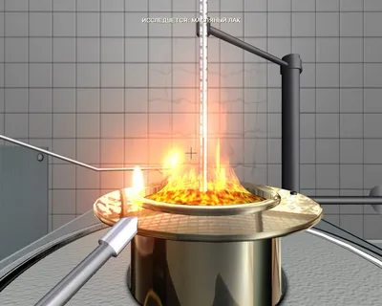
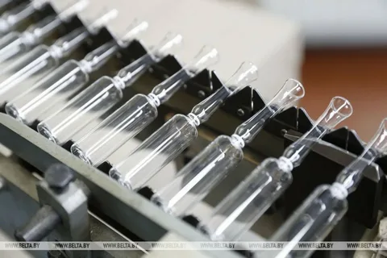
Thermal resistance
Ampoules must have thermal. Persistence, i.e. not destruction. with sharp fluctuations in temperature. (during sterilization). 50 ampoules are kept at tempera. 18 ° C for 30 min, then room. in a drying oven for not <15 minutes at a temperature specified. in GOST. After that, the ampoules are immersed. into the water with tempera. 20 ± 1 ° С and soak. not <1 min. Heat resistant d. B. not <98% of the ampoules taken for inspection.

Slide 9
Chemical resistance
For the assessment of chem. resistance of ampoule glass is used different. determination methods: using diff. acid-base indicators (by color change), using a pH meter (by pH shift); gravimetric methods (by the amount of leached components from suspended glass samples in contact with water), etc. As control samples, purified water is usually performed and various. special solutions of medicinal substances in contact with the glass of ampoules during the manufacture of injection solutions and their storage. Official md determined by the chemical resistance of ampoule glass - md determined using a pH meter. Ampoules, twice hot washed. water, rinse twice with demineralized water. and fill. purified water having a pH of 6.0 ± 2.0 and temp. 20 ± 5 ° С up to nominal capacity. Sealed sterilization ampoules. in an autoclave at 0.10-0.11 MPa (120 ± 1 ° C) in flow. 30 min. Then the ampoules are cooled to temperature. 20 ± 5 ° С, check them for tightness. and open the capillaries. Using a pH meter, determine the shift in the pH of the water extracted from the ampoules in relation to the pH ref. water. Of the other known substances, the simplicity of the definition of the chemical resistance of ampoule glass using the acid-base indicator phenolphthalein differs in simplicity. Ampoules are filled with water for injection with the addition of 1 drop of 1% phenolphthalein solution for every 2 ml of water, sealed and sterilized at 120 ° C for 30 minutes. Ampoules in which water is after sterilization. not stained, belong to class 1. The contents of the colored ampoules are titrated with 0.01N solution of hydrochloric acid, the amount of which is determined by the chemical. resistance of ampoule glass. If the titration before discoloration of the solution is consumed. <0.05 ml - ampoules belong to class 2,> 0.05 ml - ampoules are considered unusable. for storage of injection solutions.

Slide 10
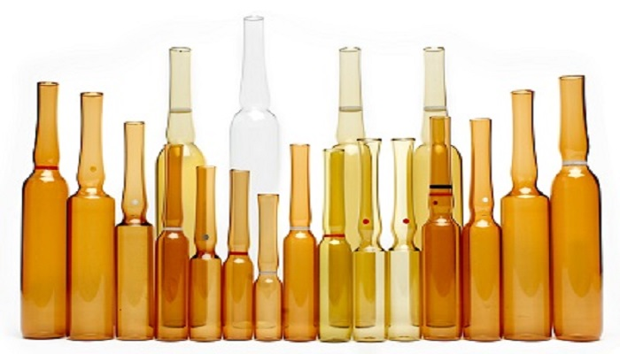
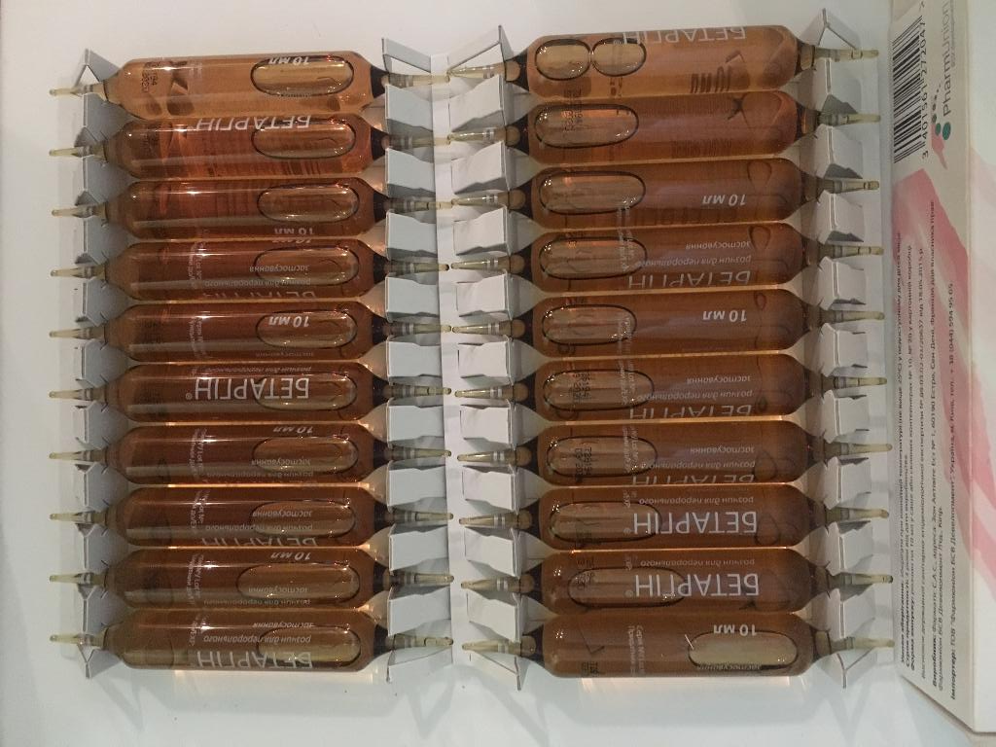
Light-protective properties
These properties are tested in ampoules made from neutral. light-protective glass by measuring the light transmission in the region of the spectrum from 290 to 450 nm. From cylindrical parts of the ampoule cut out the sample, rinse it thoroughly, wipe it, dry it. and room. parallel to the slit of the SFD-2 spectrophotometer.

Slide 11
Thanks for attention!!!

