Slide 1
Odessa National Medical University
Faculty of Pharmacy
Department of Drug Technology
On the topic of:
"Industrial production of injection solutions "
Senior Lecturer, PhD Zamkovaya A.V.
Odessa -2020

Slide 2
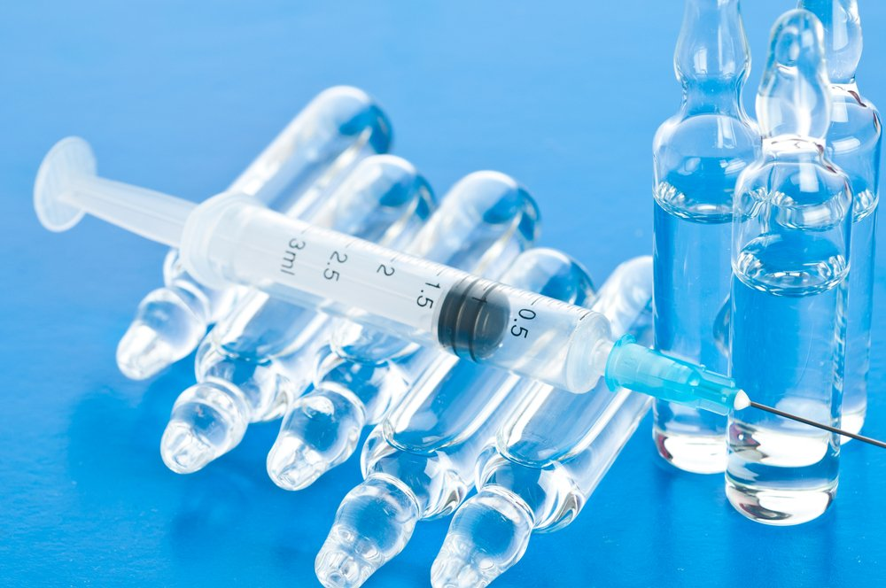
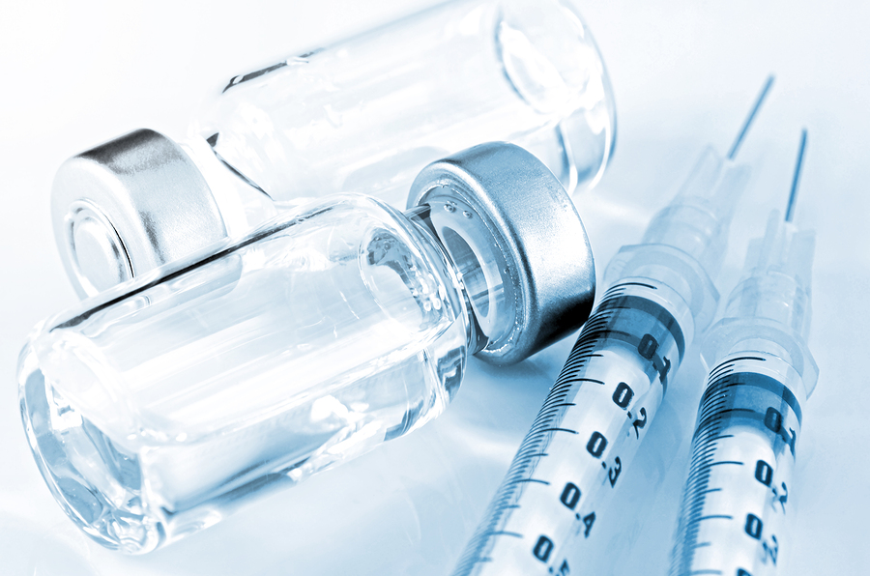
Medicines for parenteral use
Medicines for parenteral use include sterile aqueous and non-aqueous solutions, suspensions, emulsions and dry solids (powders, porous masses, tablets), which are dissolved in a sterile solvent immediately before administration. Solutions for parenteral administration with a volume of 100 ml or more are infusion solutions.
Medicines for parenteral use are prepared under conditions that maximally prevent contamination of the finished product by microorganisms and foreign substances.
For the preparation of medicines for parenteral use, drugs, excipients and solvents that are approved for medical use are used.

Slide 3
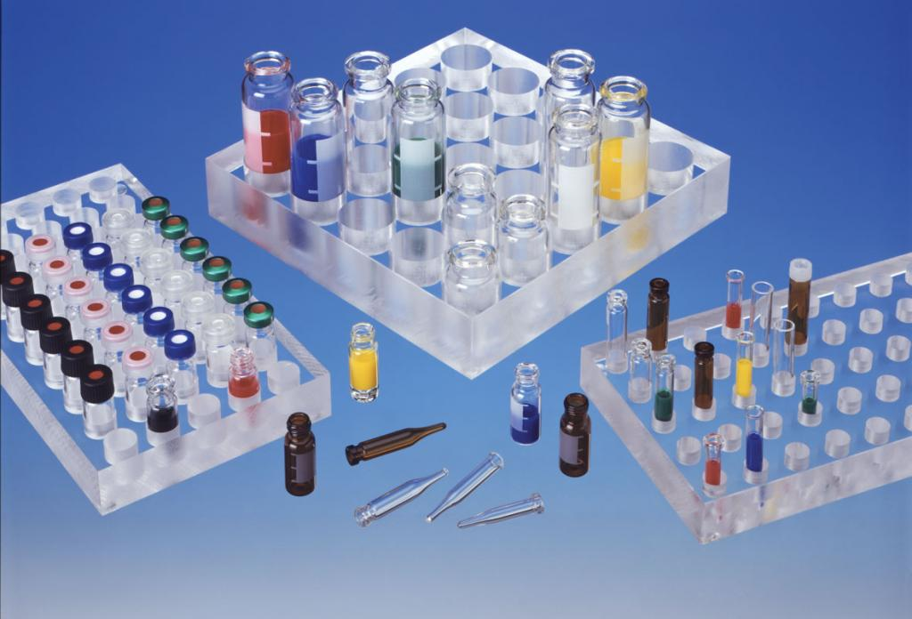
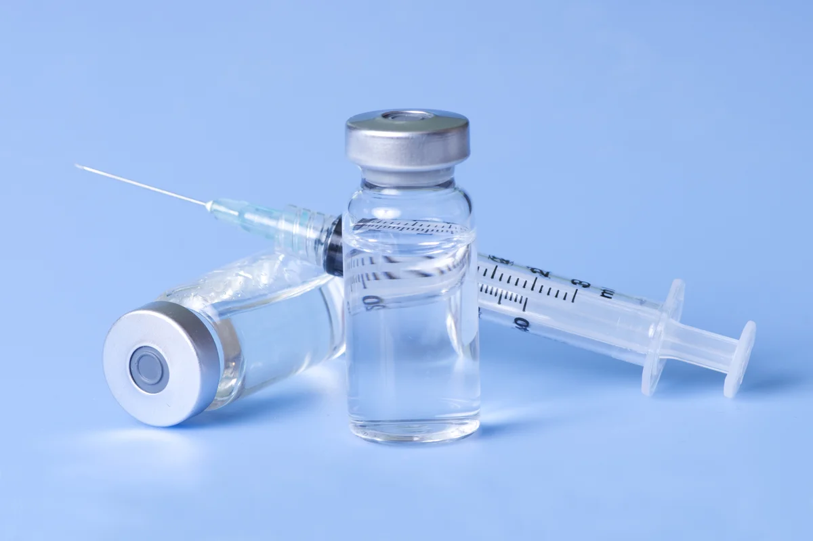
Medicines for parenteral use must be sterile, practically free from visible mechanical impurities, withstand tests for pyrogenicity and toxicity in accordance with the requirements of private articles. Injection solutions can be isotonic, isohydric and isoionic in accordance with the requirements of private articles.

Slide 4
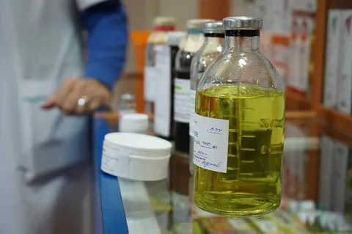
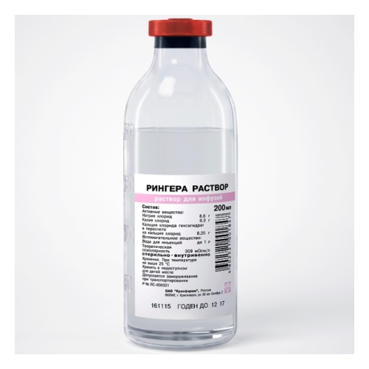
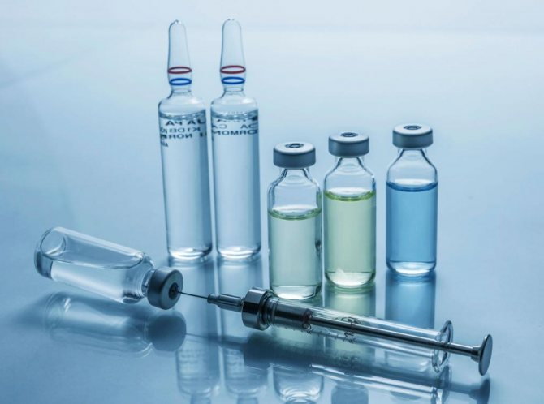
Solvents
Water for injection, fatty oils, ethyl oleate are used as solvents. Ethyl alcohol, glycerin, propylene glycol, polyethylene oxide 400, benzyl benzoate, benzyl alcohol and other solvents can be used as part of the complex solvent.

Slide 5
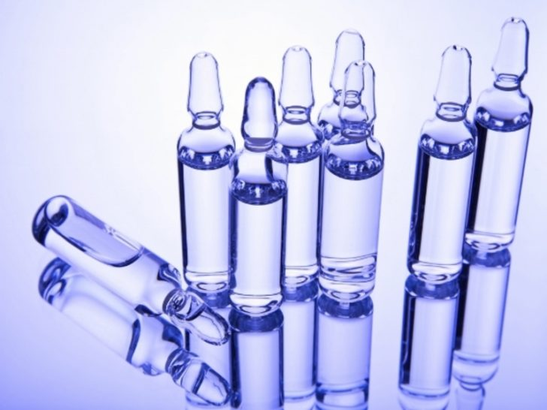
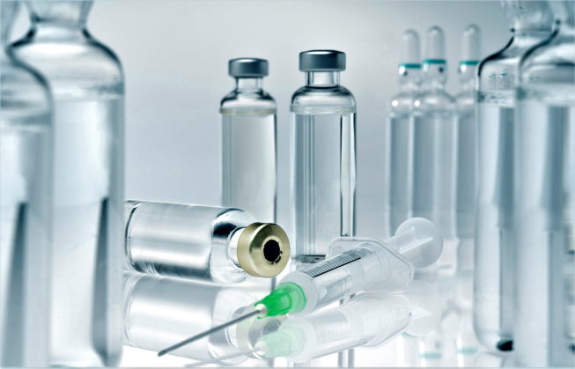
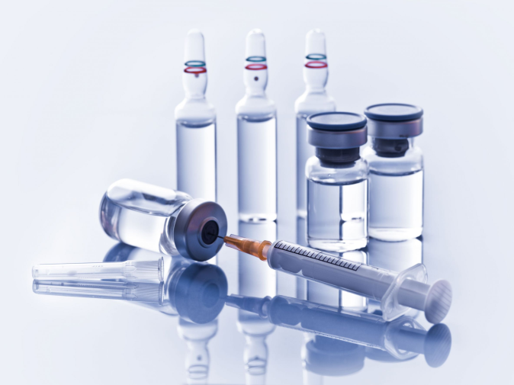
Excipients
In the manufacture of medicines for parenteral use, preservatives, antioxidants, stabilizers, emulsifiers, solubilizers and other auxiliary substances specified in private articles can be added.
As auxiliary substances used ascorbic, hydrochloric, tartaric, citric, acetic acids, sodium carbonate, sodium bicarbonate, sodium hydroxide, sodium or potassium sulfite, bisulfite or metabisulfite, sodium thiosulfate, sodium citrate, sodium phosphate mono- and disubstituted, sodium chloride, methyl ester of hydroxybenzoic acid, propyl ester of hydroxybenzoic acid, rongalite, disodium salt of ethylenediaminetetraacetic acid, polyvinyl alcohol, chlorobutanol, cresol, phenol, etc.

Slide 6
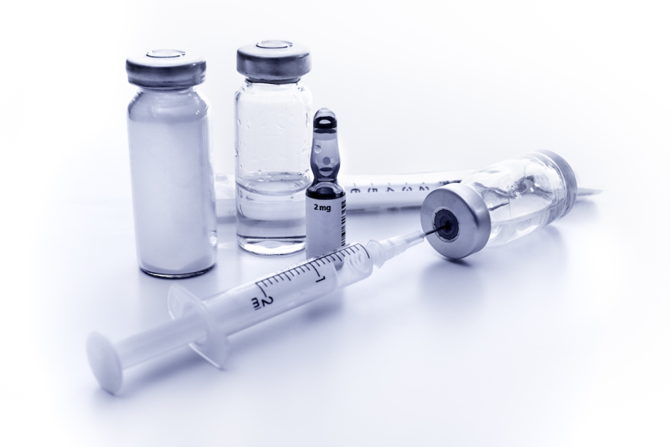
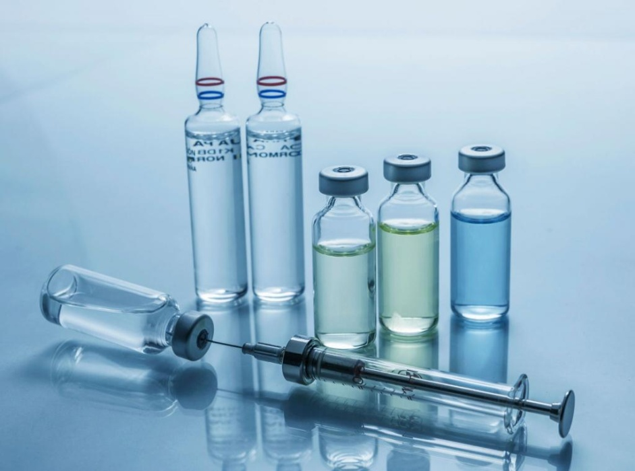
The amount of added excipients, unless otherwise indicated in private articles, should not exceed the following concentrations: for substances like chlorobutanol, cresol, phenol,
up to 0.5%; sulfurous anhydride or equivalent amounts of sulfite, bisulfite or metabisulfite of potassium or sodium - up to 0.2%.
Preservatives are used in multi-dose drugs for parenteral use, as well as in single-dose drugs in accordance with the requirements of private articles.
Medicines for intracavitary, intracardiac, intraocular or other injections with access to cerebrospinal fluid, as well as for a single dose exceeding 15 ml, should not contain preservatives.

Slide 7
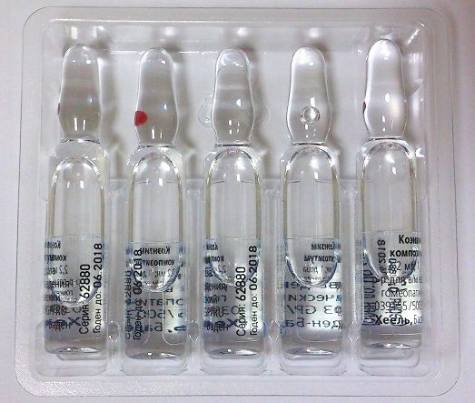
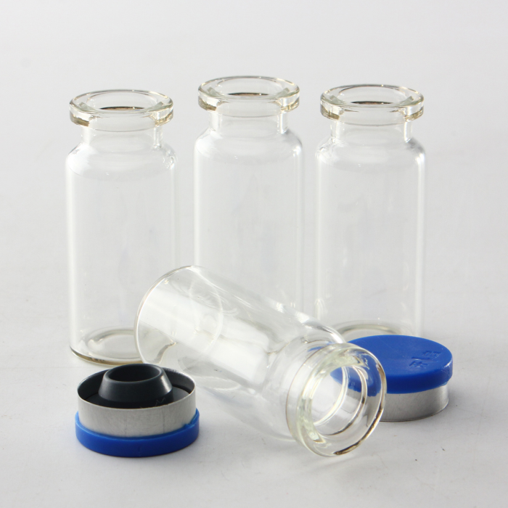
Vessels and closures
Vessels and closures must ensure tightness, be indifferent to the content, maintain its stability during sterilization, storage and transportation. The brands of glass and other closures (rubber, plastic) must be indicated in private articles. The vessels are made of materials that do not obstruct the visual control of the contents.
The cork material must be strong and resilient enough to allow the collection of the contents without removing the cork and separating its particles and sealing the vessel after removing the needle.

Slide 8
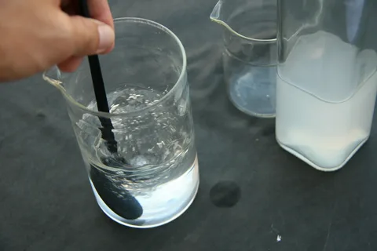
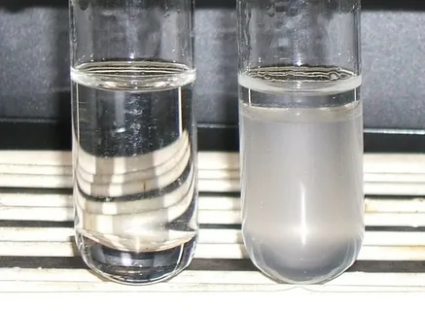
Transparency
Solutions should be clear compared to water for injection or an appropriate solvent, unless otherwise indicated in private articles.

Slide 9
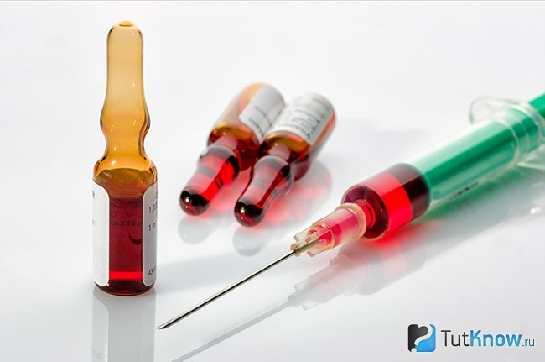
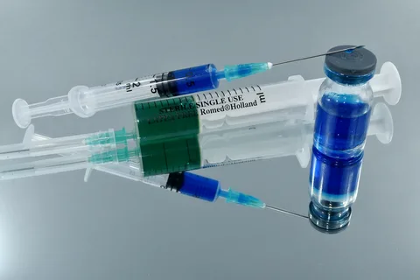
Coloration
The color of drugs for parenteral use is determined by comparison with color standards in accordance with the article "Determination of the color of liquids" or the instructions of private articles.

Slide 10
The volume of injection solutions
Nominal ny volume, ml | filling volume, ml | Number of vessels for control filling, pcs.
non-viscous solutions | viscous solutions
1,0 | 1,10 | 1,15 | 20
2,0 | 2,15 | 2,25 | 20
5,0 | 5,30 | 5,50 | 20
10,0 | 10,50 | 10,70 | 10
20,0 | 20,60 | 20,90 | 10
50,0 | 51,0 | 51,50 | 5
More 50 | 2% more nominal | 3% more nominal
The volume of injection solutions in the vessels must be greater than the nominal.
In vessels with a capacity of up to 50 ml, the filling is checked with a calibrated syringe, in vessels with a capacity of 50 ml or more - with a calibrated cylinder at a temperature of (20 ± 2) ° C.

Slide 11
Deviation of the mass of the contents of one vessel
The deviation of the average mass of the contents of 20 containers shall not exceed ± 5% of the nominal quantity indicated in the particular articles.
For sterile dry medicinal products for injections and suspensions with a container content weight of 0.05 g or less, a dosage uniformity test is performed. The contents of 10 vessels are tested separately according to the quantitative methods specified in the private articles. The content of the active substance should not deviate from the nominal by more than ± 15%. If in no more than one vessel the deviation exceeds ± 15% but not more than ± 25%, an additional test is carried out in 20 vessels. Deviations of the content of the active substance of more than ± 15% should not be in any of the 20 vessels.

Slide 12
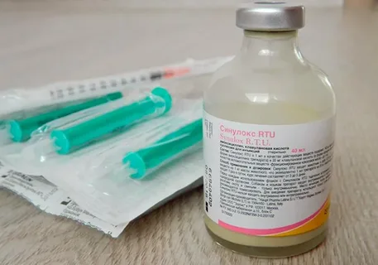
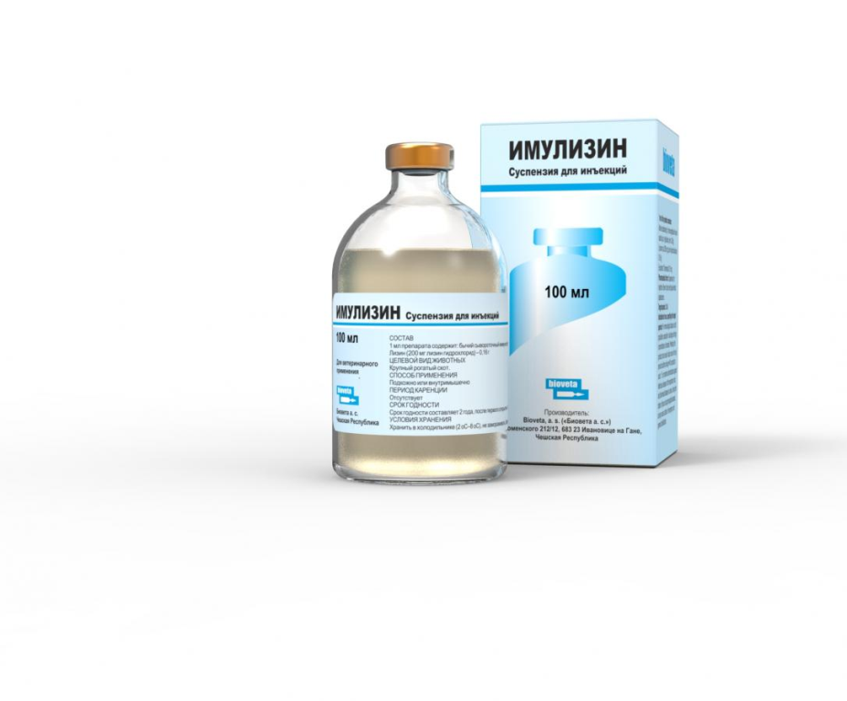
Suspensions
Suspensions for parenteral use after shaking should not separate for at least 5 minutes, unless otherwise indicated in private articles. The suspension should pass freely into the syringe through the # 000 needle, unless otherwise indicated in private articles. The suspensions are not injected into the blood and lymph vessels and the spinal canal; emulsions are not injected into the spinal canal.

Slide 13
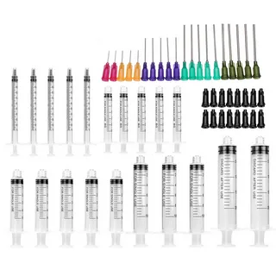
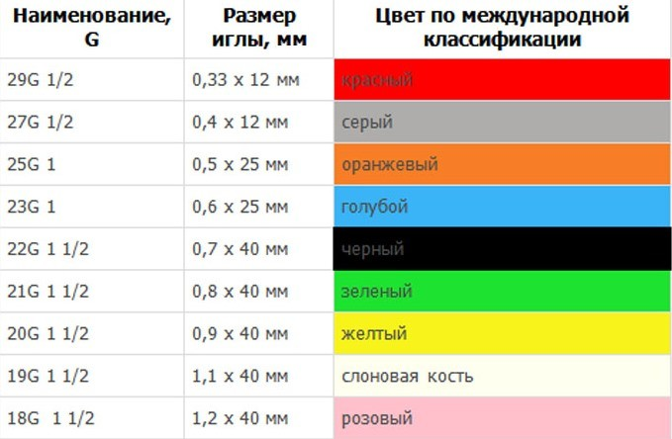
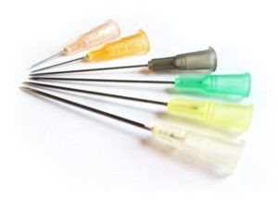
Marking
Each ampoule (vessel) indicates the name of the drug, its concentration or activity, volume or weight, and the batch number.

Slide 14
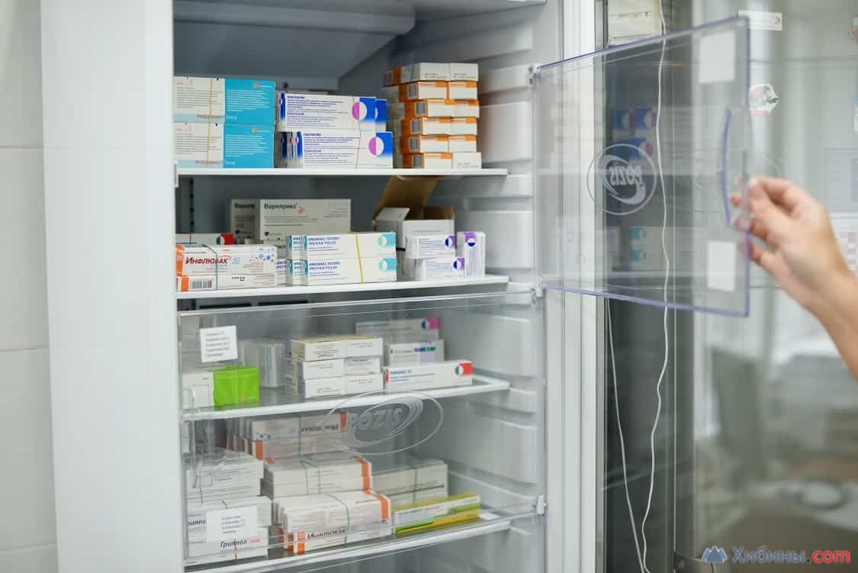
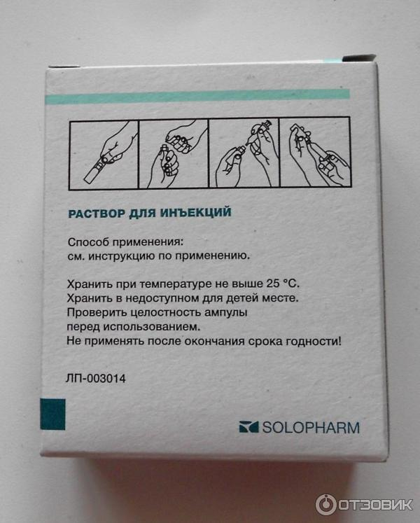
Storage
In packaging that ensures the stability of the drug during the expiration date specified in the private articles

Slide 15
Thanks for attention!!!

