Slide 1
Odessa National Medical University
Faculty of Pharmacy
Department of Drug Technology
"Industrial production of infusion solutions "
Senior Lecturer, PhD Zamkovaya A.V.
Odessa -2020

Slide 2
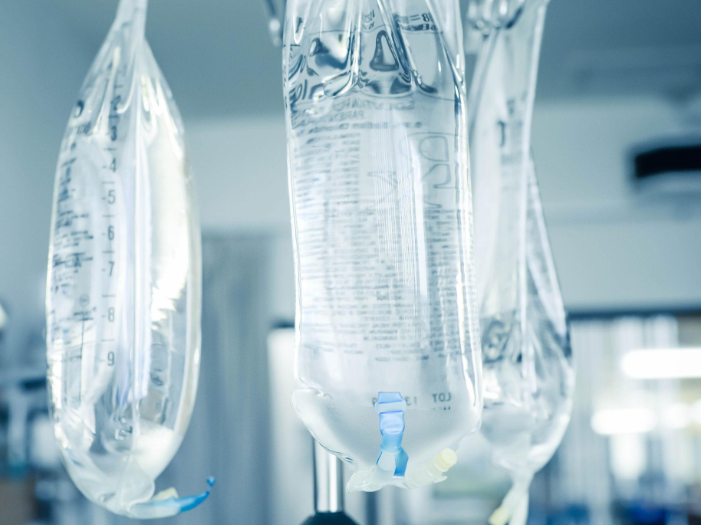
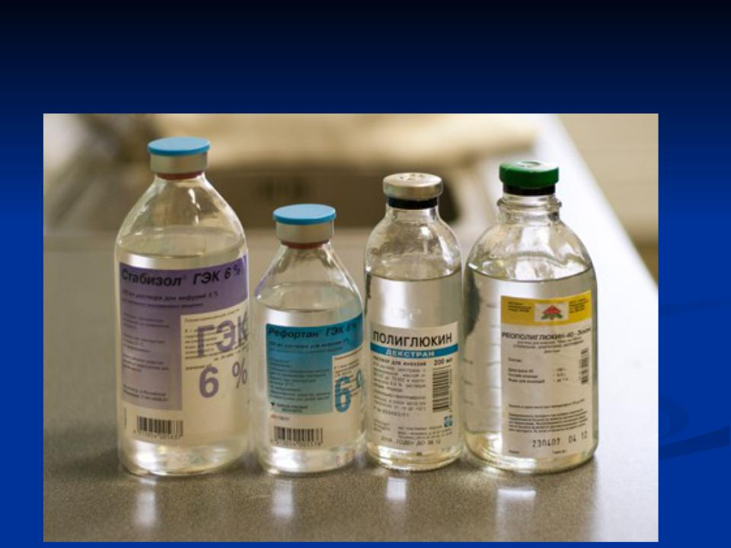
Infusion dosage forms
Infusion solutions are the most complex group of injectable dosage forms. These include the so-called physiological solutions, which, in terms of the composition of solutes, are capable of supporting the vital activity of cells and organs without causing significant changes in the physiological balance in the body. Solutions with properties as close as possible to human blood plasma are called blood-substituting fluids.
In various pathological conditions, accompanied by blood loss, shock, disturbance of the water-electrolyte and acid-base state of the body, it becomes necessary to introduce significant volumes of infusion solutions into the bloodstream.

Slide 3
Depending on the function performed when introduced into the body, infusion solutions are divided into 6 groups:
Hemodynamic or anti-shock drugs. Designed to treat shock of various origins, replenish circulating blood volume and restore hemodynamic disorders. This group includes - polyglucin, rheopolyglucin, gelatinol, reogluman, etc. Often ethanol, bromides, barbiturates, narcotic substances that normalize excitement and inhibition of the central nervous system are added to anti-shock solutions; glucose, which activates the body's oxidation-reduction processes.
Detoxification solutions. Many diseases and pathological conditions are accompanied by intoxication of the body (infectious diseases, extensive burns, renal and liver failure, poisoning with various poisonous substances, etc.). For their treatment, targeted detoxification solutions are needed, the components of which must bind to toxins and be quickly excreted from the body. Such compounds include polyvinylpyrrolidone, polyvinyl alcohol, hemodez, polydesis neohemodesis, gluconeodesis, enterodesis, etc.
Regulators of water-salt balance and acid-base balance. Such solutions correct the blood composition in case of dehydration caused by diarrhea, with cerebral edema, toxicosis, etc. These include saline injection solutions of 0.9% and 10% sodium chloride solutions, Ringer and Ringer-Locke solutions, Petrov's liquid, 4.5-8.4% sodium bicarbonate solutions, 0.3-0.6% potassium chloride solution and etc.

Slide 4
4. Preparations for parenteral nutrition. They serve to provide the body's energy resources, the delivery of nutrients to organs and tissues, especially after surgical interventions, in the coma of the patient, when he cannot eat naturally, etc. Representatives of this group are glucose solution 40%, casein hydrolyzate, aminopeptide, aminocrovin, fibrinosol, lipostabil, lipidin, lipofundin, introlipid, aminophosphatide, etc.
5. Solutions with oxygen transfer function. They are designed to restore the respiratory function of the blood; they include perfluorocarbon compounds. This group of infusion drugs is under study and development.
6. Solutions of complex action or polyfunctional. These drugs with a wide range of action can combine several of the above functions.

Slide 5
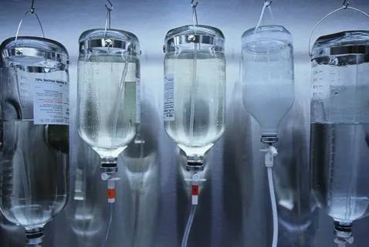
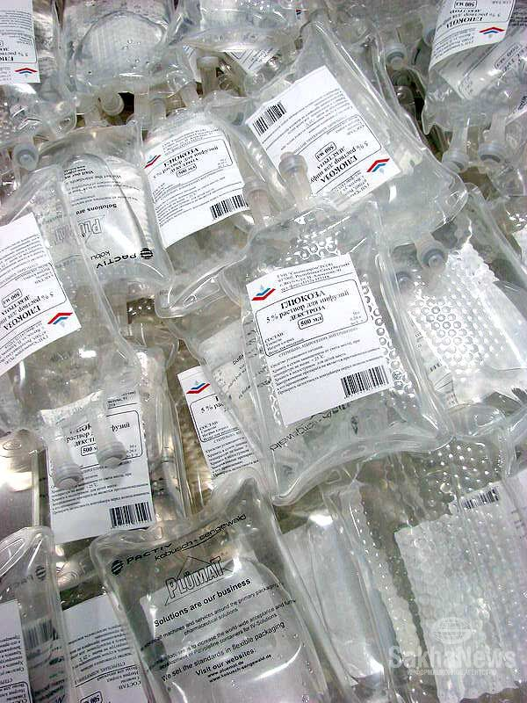
In addition to the general requirements for solutions for injections (apyrogenicity, sterility, stability, absence of mechanical impurities), specific requirements are also imposed on plasma-substituting drugs. When introduced into the bloodstream, infusion solutions must fulfill their functional purpose, while being completely excreted from the body, without cumulating. They should not damage tissues or disrupt the functions of individual organs. Due to the large injected volumes, blood substituting drugs should not be toxic, not cause sensitization of the body with repeated injections, not irritate the vascular wall and not cause embolism. Their physical and chemical properties must be constant.

Slide 6
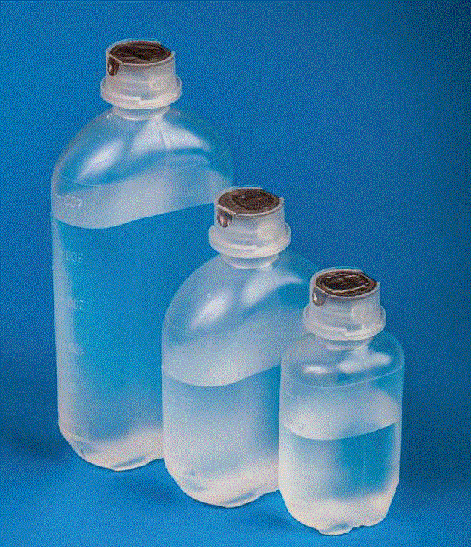
Many infusion solutions must be isotonic, isoionic, isohydric. Their viscosity should correspond to the viscosity of blood plasma.
Isotonicity - the ability of solutions to have an osmotic pressure equal to the osmotic pressure of body fluids (blood plasma, lacrimal fluid, lymph, etc.).
Isoionicity is the property of injection solutions to contain certain ions in the ratio and quantities typical of blood serum. Therefore, the composition of infusion solutions includes ions K +, Ca2 +, Mg2 +, Na +, Cl - SO42–, PO43–, etc. At present, plasma-substituting solutions are produced, which contain up to 40 microelements that play an important physiological role.
Isohydricity - the ability to maintain a constant concentration of hydrogen ions, equal to the pH of blood plasma. In blood, this constancy is achieved by the presence of buffers (reaction regulators) in the form of carbonate and phosphate systems, as well as protein systems, which are ampholytes by nature and, depending on the pH of the medium, can retain both hydrogen and hydroxyl ions. These systems take upon themselves to regulate all influences aimed at changing the reaction of the environment. The isohydricity of saline solutions is achieved by the introduction of sodium bicarbonate, sodium hydrogen phosphate and sodium acetate.

Slide 7
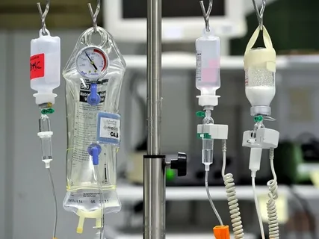
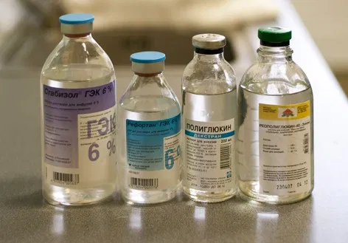
Physiological constants of some blood parameters: normal blood pH value is 7.36 - 7.47; viscosity 0.0015 - 0.0016 Ns / m2. The osmotic pressure of blood plasma is kept at 72.52 · 104 N / m2 (Pa) or 7.4 atm. The temperature of blood serum depression is 0.52 ° C.
When using infusion solutions, there is often a need for their prolonged circulation when injected into the bloodstream. For this purpose, substances are added that increase the viscosity of solutions, bringing it closer to the viscosity of human blood plasma: products of protein origin and high-polymer compounds. Of the synthetic IUDs, dextran is most often used, and gelatin is classified as natural.

Slide 8
Emulsions and suspensions for injection
Currently, a significant number of suspensions and emulsions for injection are used in medical practice.
Suspensions are prepared under aseptic conditions by dispersing the sterile drug substance in sterile filtered solvent. To improve the quality of the resulting product, in some cases, ultrasonic exposure is used, which promotes additional grinding and dispersion of the drug in a solvent, and on the other hand, makes the drug form sterile. Under these conditions, the particle size decreases to 1-3 microns, and such suspensions and emulsions can be suitable for administration into the bloodstream. To increase stability in the technology for the production of suspensions and emulsions, co-solvents, stabilizers, emulsifiers and preservatives are used.
Emulsions for parenteral nutrition. Therapeutic parenteral nutrition is used in cases where due to illness or injury, food intake in a natural way is impossible or limited. The intake of nutrients in the body during parenteral nutrition is provided by intravenous administration of drugs specially designed for this purpose.
An extremely important task of parenteral nutrition - replenishment of protein needs - is carried out by the introduction of nitrogen-containing preparations produced in the form of protein hydrolysates or solutions of synthetic mixtures of crystalline amino acids. The introduction of these drugs allows you to make up for nitrogen losses.

Slide 9
The general energy needs of the body during parenteral nutrition are covered by the introduction of energy preparations (solutions of glucose, other carbohydrates, polyhydric alcohols), among which fat emulsions for intravenous administration occupy an important place. Preparations of emulsified fats for parenteral nutrition, in comparison with protein and carbohydrate ones, have the highest energy value, which facilitates the preparation of parenteral diets without increasing the physiologically permissible amounts of injected fluid, which is observed with the introduction of solutions containing carbohydrates.
The value of fat emulsions in parenteral nutrition is not limited by their energy value. The vegetable fats and phospholipids included in these preparations contain a significant amount of essential polyunsaturated fatty acids (linoleic, linolenic, arachidic), which play an extremely important role in metabolic processes, constitute permanent structural elements of cell membranes (membrane lipids) and are precursors of tissue hormones - prostaglandins ... The composition of vegetable emulsifying fats includes fat-soluble vitamins A, D, E, K. Fat emulsions, in connection with the above, are currently considered as sources of essential lipids for the body and as irreplaceable components of parenteral nutrition.
The particle size of dispersed oil in emulsions is many times smaller than the diameter of erythrocytes (7-8 microns). The bulk of the particles in fat emulsions have a size of 0.5 - 1.0 μm, i.e. corresponds to the size of blood chylomicrons.

Slide 10
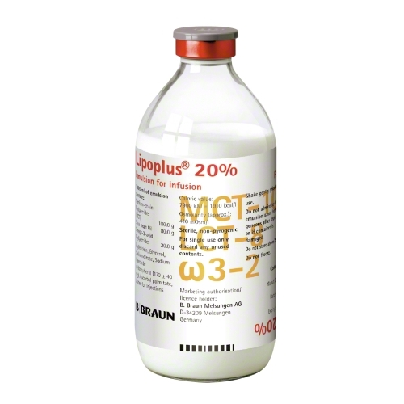
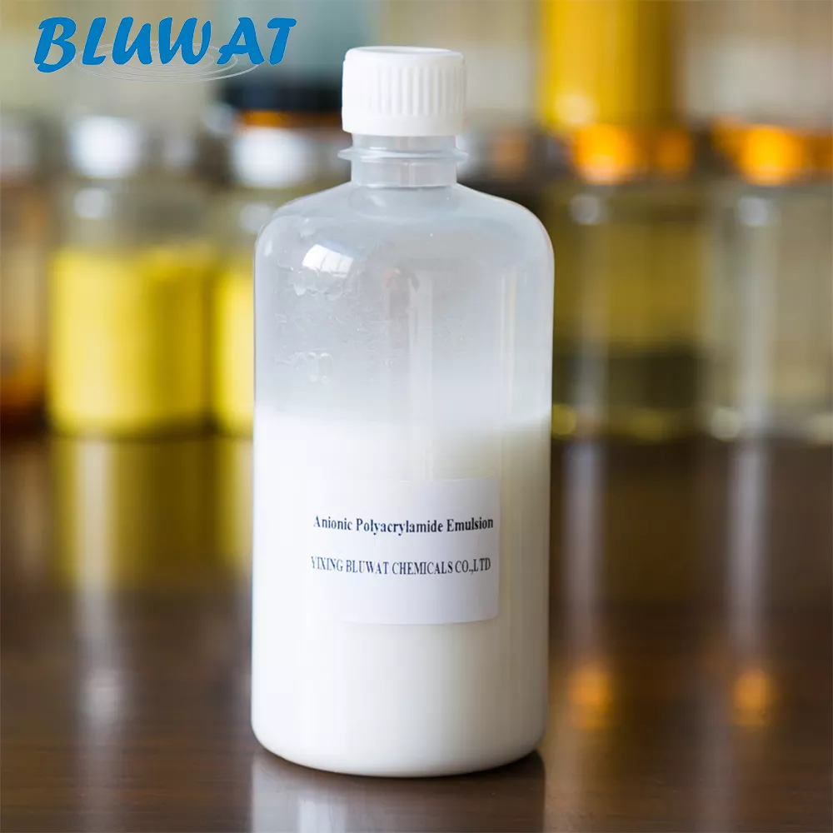
Antihemolytic emulsions
Studies of egg yolk phosphatidylethanolamine (PE) have shown that it is capable of delaying erythrocyte hemolysis. Creation of a lipid emulsion on its basis allows to prevent specific immune hemolysis of erythrocytes. However, the drugs created to date delay hemolysis by only 40-60%. The drugs containing at least 60-65% of phosphatidylethanolamine have the highest effect.
Fat emulsions created on its basis strengthen the erythrocyte membrane, inactivate blood serum complement and delay hemolysis by 95-100%. One of the drugs in this group of fat emulsions is "Aminophosphatide", which contains up to 3% phospholipids, including: 60-65% phosphatidylethanolamine, 20-30% phosphatidylcholine, 10-20% sphingomyelin and cerebroside. The drug is pyrogen-free, harmless and is used intravenously in the treatment of hemolytic phenomena of various etiologies.

Slide 11
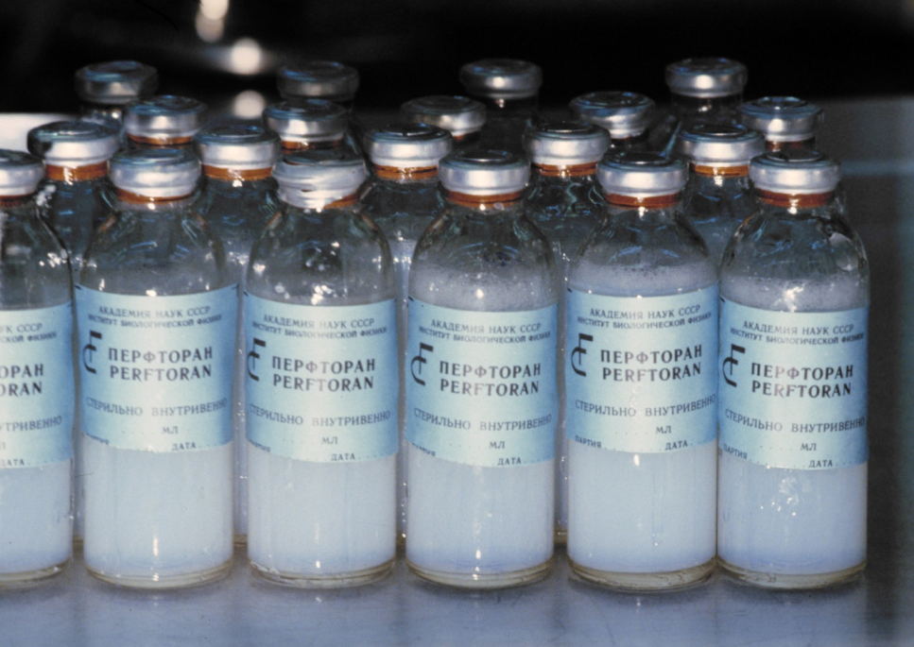
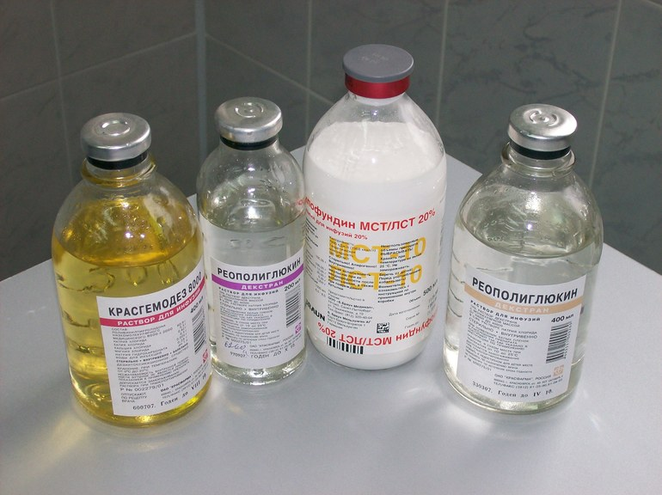
Emulsions for blood replacement
Emulsions based on fluorocarbon compounds have become widespread, the use of which is intended for the transfer of oxygen in the body. The role of a stabilizer in them is played by phospholipids isolated from various natural sources. The use of lipid emulsifiers depends on their biological activity, structure and fatty acid composition of the lipid. The optimal emulsifier of this group of drugs is considered to be a phospholipid containing 20% ​​phosphatylideethanolamine, 60% phosphatidylcholine and 20% cholesterol. Such an emulsifier with high emulsifying activity is obtained from egg yolk. It is an alcoholic solution of a lipid containing 18-21% phosphatilideethanolamine, 15-18% cholesterol, 47-55% phosphatidylcholine, the rest is sphingomyelin and lysophosphatidylcholine.

Slide 12
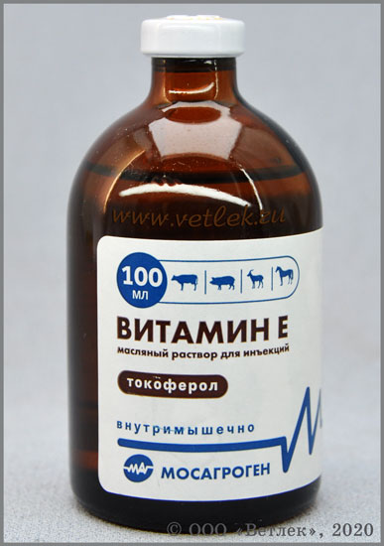
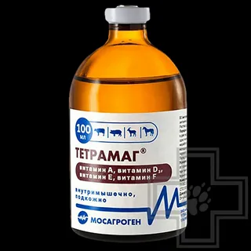
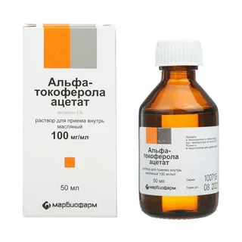
The nomenclature of oil solutions for injections is represented by a 20% solution of camphor in oil, a 0.5% solution of deoxycorticosterone acetate, 1% and 5% solution of temtosterone propionate and other hormones, and a number of anticancer drugs for injections.

Slide 13
Thanks for attention!!!

