Slide 1
Odessa National Medical University
Faculty of Pharmacy
Department of Drug Technology
Industrial production of ophthalmic, ear and nasal dosage forms
Senior Lecturer, PhD Zamkovaya A.V.
Odessa -2020

Slide 2
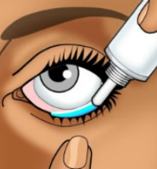
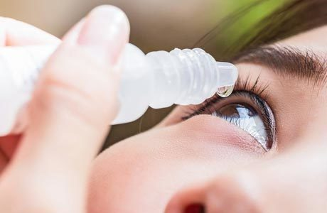
Ophthalmic dosage forms are sterile liquid, soft or solid dosage forms intended for topical application (on the eyeball and / or conjunctiva), injection and implantation into the tissues of the eye.

Slide 3
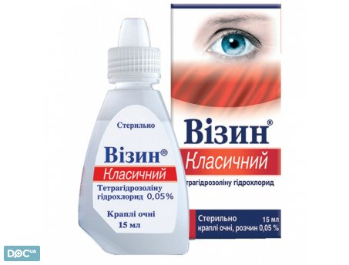
Eye drops are liquid dosage forms that are aqueous or oily solutions, as well as the finest suspensions of drugs intended for instillation into the eye.
The poor quality of eye drops and their contamination by microorganisms can cause serious consequences up to loss of vision. Therefore, eye drops are subject to the requirements for injectable solutions:
sterility
stability
absence of mechanical impurities
isotonicity
in some cases - prolonged action
Eye drops are prescribed in small quantities (5-10 ml) with the calculation of their use for a short time.

Slide 4
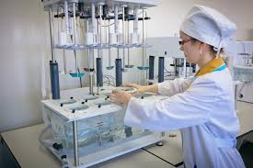
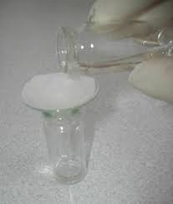
EYE DROPS TECHNOLOGY
Eye drops are prepared by mass-volume method in aseptic conditions, followed by sterilization of solutions of thermostable substances
In the production of eye drops use sterile solvents: purified water or water for injections, isotonic buffer solutions, oils and others.
When preparing eye drops in small quantities, there are significant losses of the substance: due to its adsorption on the filter materials (up to 4.7%,) due to the dilution of the initial solutions when filtering them through water-washed paper filters.

Slide 5
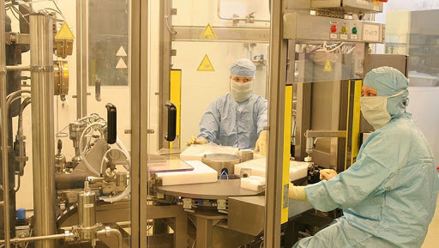
In order to minimize the loss of drug in the preparation of eye drops use 2 methods.
1. The drug substance, well soluble in water, is dissolved in part (half the amount) of solvent and the solution is filtered into a vial for release through a folded filter and cotton wool washed with sterile water for injections, and then the filter is washed with the remaining solvent
2. In cases where half the amount of solvent is not enough to dissolve the drug, then the substance is dissolved in the prescribed amount of solvent and filtered into a measuring cylinder through a dry filter and cotton wool, and the missing amount of water is added through the same filter and cotton wool to the required volume.

Slide 6

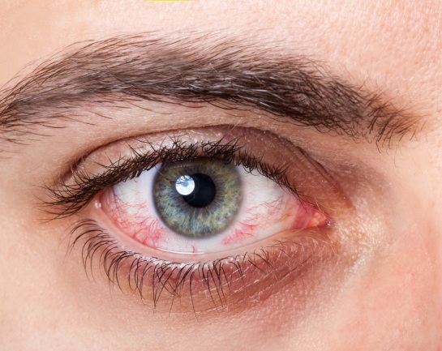
All eye drops should be isotonic to avoid instillation of discomfort (itching, burning, pain, tearing, redness of the mucous membranes).
Eye drops are isotonic regardless of the doctor's instructions. Isotoning agents: sodium chloride, sodium nitrate, sodium sulfate.
Sodium sulfate or sodium nitrate is used in cases where sodium chloride reacts chemically with the drug:
Solutions of silver nitrate isotonizing sodium nitrate.
Solutions of zinc sulfate isotonizing sodium sulfate.
Calculations per 10 ml: 0.09 - (drug sample * isotonic equivalent)
Calculations per 5 ml: 0.045 - (drug sample * isotonic equivalent)

Slide 7
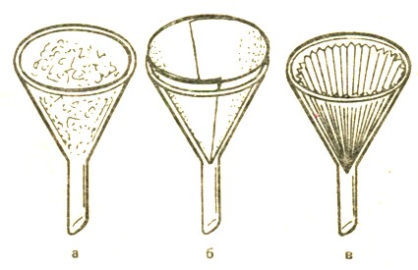
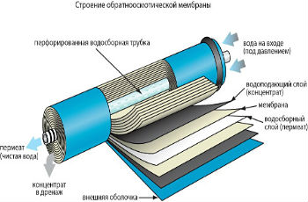
ABSENCE OF MECHANICAL IMPURITIES
All eye drops, except for emulsions and the finest suspensions, should be carefully filtered.
For filtering use:
folded paper filters, under which a lump of long-fiber wool is placed in the mouth of the funnel
glass filters №3 and №4 (pore size 20-30 μm)
membrane - with simultaneous mechanical sterilization (in the preparation of eye drops in large quantities)

Slide 8
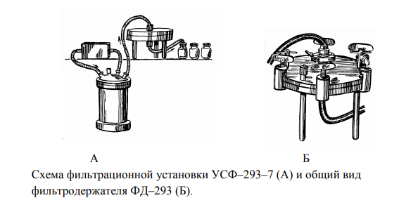
At serial preparation of eye drops in drugstores it is expedient to use devices for their filtering with the subsequent packing.

Slide 9
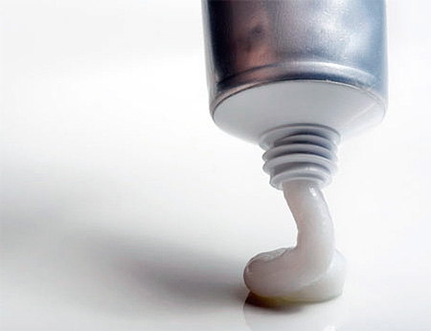
EYE SOFT MEDICINES
are homogeneous sterile ointments, creams or gels intended for application to the conjunctiva
REQUIREMENTS for eye ointments:
sterility
stability
Uniform distribution of drugs in the ointment
No irritation and sticking of the eyelids
Uniform distribution on the mucous membrane of the eye with the formation
Maximum dispersion of drugs

Slide 10
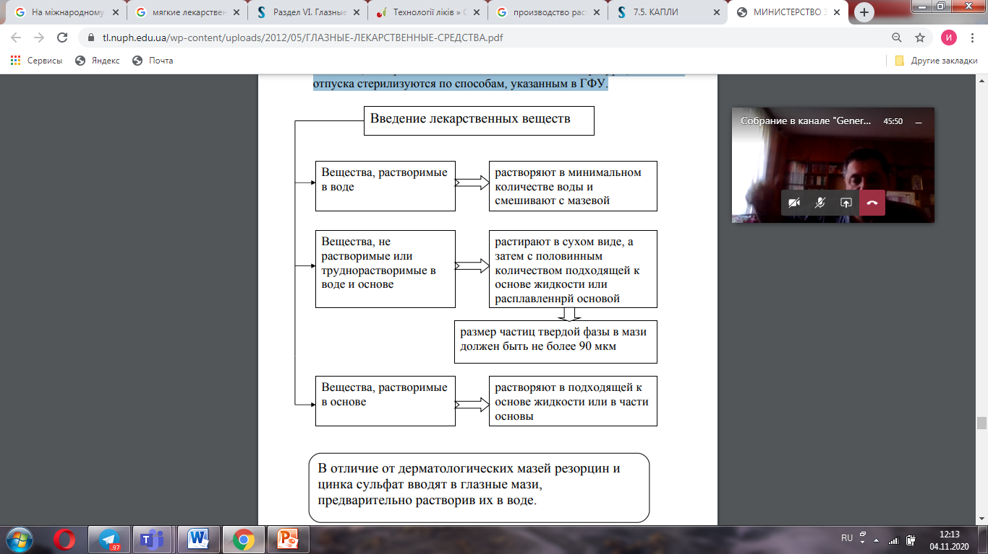
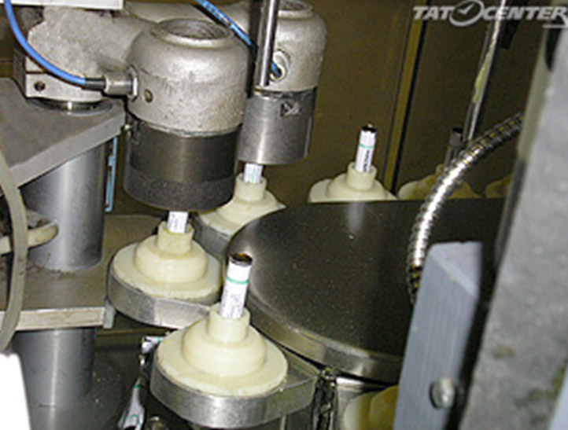
EYE OINTMENT TECHNOLOGY
Eye ointments should be prepared under aseptic conditions. All auxiliary materials, ointment bases, drugs that can withstand the effects of high temperatures, vacation jars are sterilized according to the methods specified in the SPU.

Slide 11
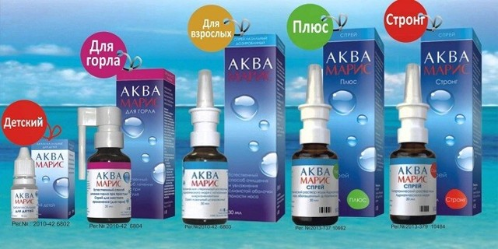
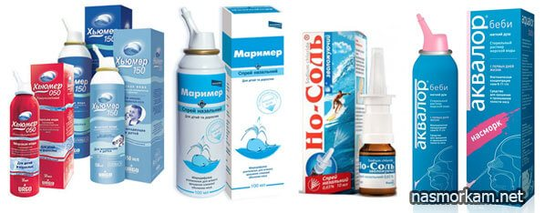
Nasal drops and liquid aerosols
are solutions, emulsions or suspensions intended for instillation or injection into the nasal cavity to obtain a general or local effect
Nasal preparations intended for use in severe injuries of the nose or before surgery must be sterile. Nasal lavage is an isotonic solution designed to clean the nasal passages in case of damage to the nose, or before surgery

Slide 12
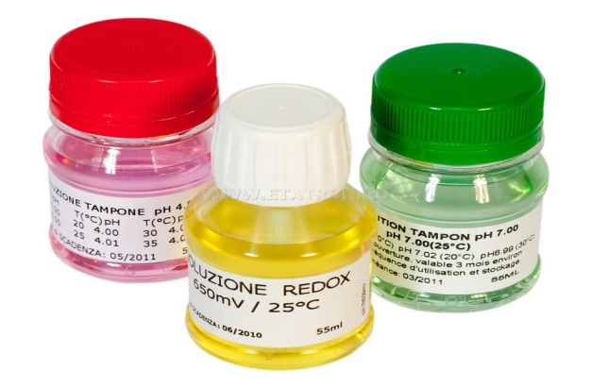
In the production of nasal drops, buffer solutions are used to increase the chemical stability of the active substances and reduce the feeling of discomfort associated with the osmolarity of the solution.
Most often used:
borovo-boratny
citrate
phosphate buffers
Most often used for prolongation of gelatin, polyvinylpyrrolidone (PVP), metelcellulose, sodium carboxymethylcellulose, polyethylene glycol, polyvinyl alcohol, acrylic acid derivatives, etc.
It is important when using nasal drops to prolong the action of drugs, which prevents the rapid outflow of drops and provides a long-term constant concentration of BAS at the therapeutic level.

Slide 13
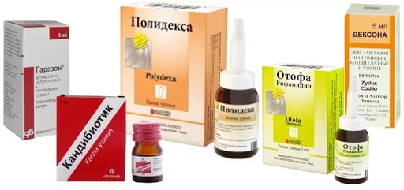
Ear drops and aerosols
Ear drops, rinses and aerosols are solutions, emulsions or suspensions intended for instillation, spraying into the ear canal or for rinsing the ear without dangerous pressure on the eardrum.
Ear preparations, as a rule, are not subject to strict requirements for compliance with physiological parameters of body fluids, with the exception of ear washes, because the epithelium of the outer ear is quite resistant to irritation.

Slide 14
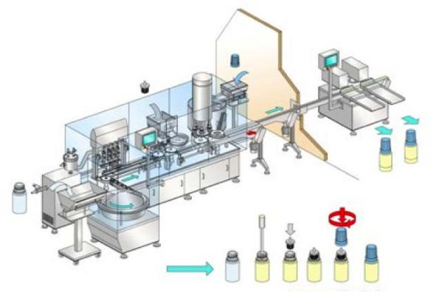
The technology of preparation of ear drops depends on the properties of drugs and solvent, it may not differ significantly from the general methods of production of solutions.
Ear, as well as nasal drops, representing solutions are usually monitored for the following quality indicators: description, identification, transparency,
color, color, pH (except for the above and oil solutions), concomitant impurities, the volume of the container, microbiological purity or sterility, quantitative content.

Slide 15
References
https://tl.nuph.edu.ua/wp-content/uploads/2012/05/%D0%93%D0%9B%D0%90%D0%97%D0%9D%D0%AB%D0%95-%D0%9B%D0%95%D0%9A%D0%90%D0%A0%D0%A1%D0%A2%D0%92%D0%95%D0%9D%D0%9D%D0%AB%D0%95-%D0%A1%D0%A0%D0%95%D0%94%D0%A1%D0%A2%D0%92%D0%90.pdf
https://studfile.net/preview/6761345/page:56/
https://studfile.net/preview/6761345/page:57/
https://info.odmu.edu.ua/chair/drugs/fileinfo/195/101763

Slide 16
Thank you !

