Slide 1
Powders. Fees. Grinding, mixing and dosing of solid materials in pharmaceutical production
St. teacher Ph.D. Zamkovaya AV.

Slide 2
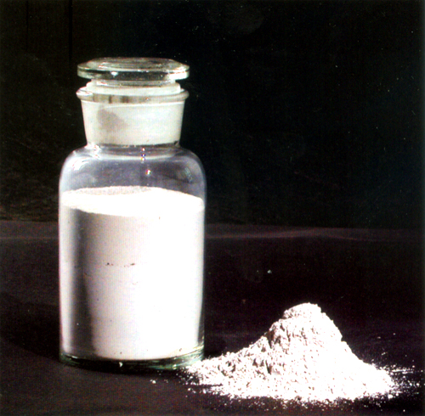
Powder - solid dosage form for internal and external use, consisting of one or more crushed substances having the property of flowability

Slide 3

METHODS OF PRESCRIPTION OF POWDER
Distributive
The prescription indicates the amount of substances per dose and the number of doses (the method used most often).
Separate
The prescription indicates the amount of drugs for all powders and indicates the number of doses into which the total weight must be divided.

Slide 4
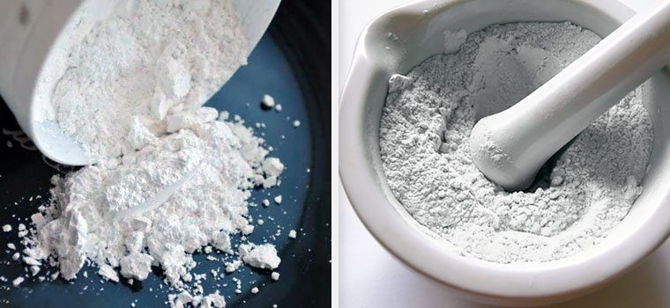
BASIC REQUIREMENTS FOR POWDER
The optimal degree of grinding of all components of the powder (dispersion)
Looseness
Dosage accuracy
Invariance (stability) of substances during storage
Homogeneity of the content of the active substance per unit of dosed drug (according to the GF of Ukraine)
For some - sterility (wound powder, for newborns)

Slide 5
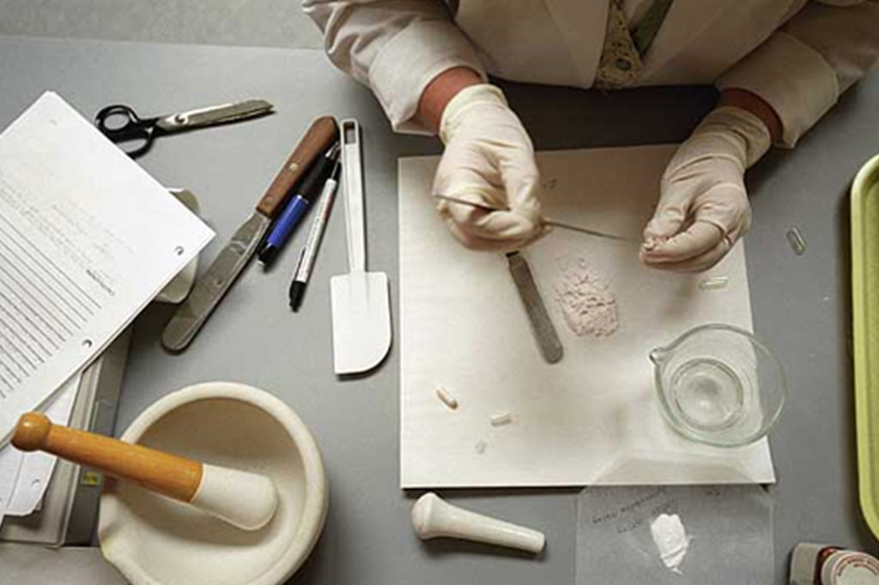
TECHNOLOGICAL SCHEME OF MANUFACTURE OF COMPLEX POWDER
Sanitary training of personnel, workplace and equipment
Selection of auxiliary and packaging material, utensils
Carrying out the necessary calculations
Weighing BP -1, BP-5, BP-20 drug substances
Grinding of drug substance Sifting (in factory production)
Mixing of medicinal substances
Dosage of mass
Packaging
Registration for vacation
Report on the preparation of the drug
Quality assessment

Slide 6
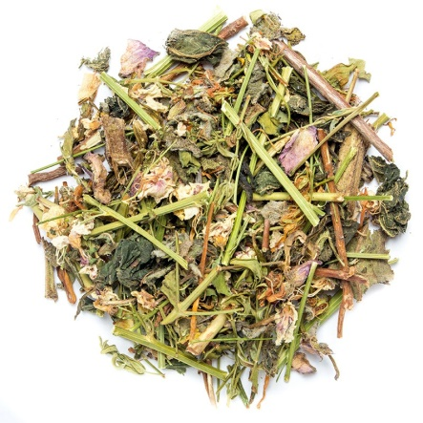

Fees - a mixture of chopped or coarsely chopped plant medicinal raw materials (except for plants containing potent substances), to which are sometimes added salts, essential oils or other substances.
Fees are classified into dosed and underdosed. Dosage fees can be divided into ordinary, pressed and instant teas.
The composition of the fees can be simple or complex. Simple consist of one type of medicinal plant raw materials, complex - of several plants and others

Slide 7
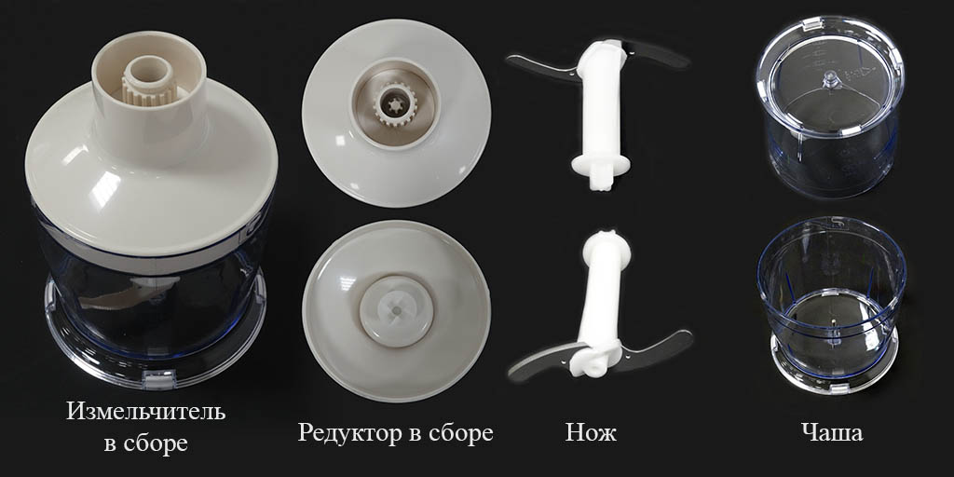
Preparation of the meeting consists of the following stages:
- Grinding
- Screening
-Mix
- Packaging
Grinding. For better extraction of active substances, vegetable raw materials that are part of the fees are almost always crushed. Raw materials are ground separately, depending on the structure and type. Leaves, grass, bark, roots and rhizomes are cut on grass - and root cutters. The roots and rhizomes are then crushed on roll or other mills. Fruits, seeds and leathery leaves (bearberry, cranberry or eucalyptus) are crushed with the help of various mills. Flowers, except lime blossom. Must have the following particle sizes: leaves and herbs - 4-6 mm, stems, bark and roots - Hmm, fruits and seeds - 0.5 mm, smoking fees - 3 mm, fees for baths - 2 mm.

Slide 8
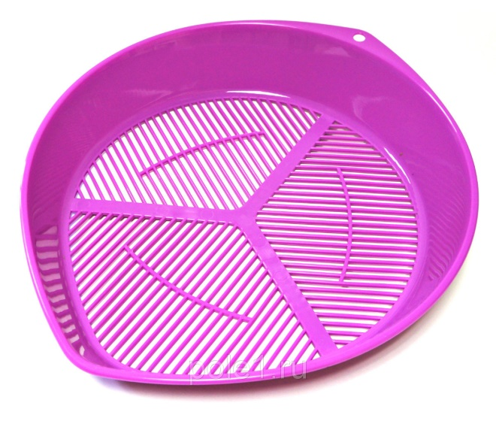

Screening. After grinding, the fees must be cleaned of dust by sieving through a sieve № 32 with a hole size of 0.2 mm.
Mix. Components:
the assembly is mixed in mixers with a rotating body. Obtaining a homogeneous composition of the mixture presents certain difficulties, as the individual particles of the collection have different size, shape, weight and therefore can flake. If the collection includes essential oils or salts, they are pre-dissolved: essential oils in ethanol, salts - in water; the resulting solutions are sprayed on one of the components or the entire collection. In cases of application of aqueous solutions moistened

Slide 9
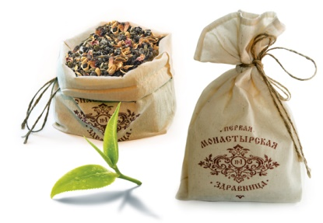
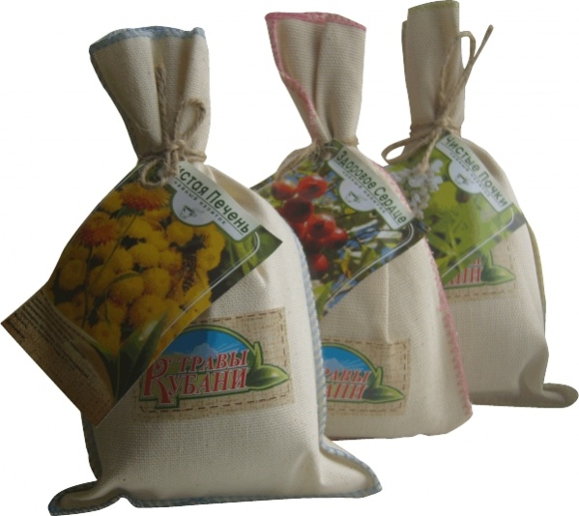
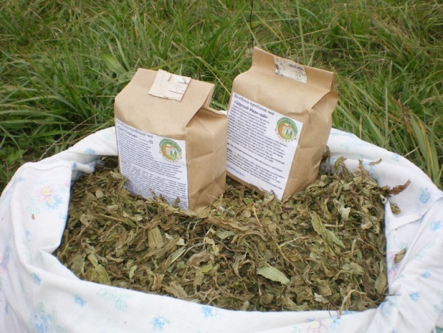
Packing fees.
Fees are released in cardboard boxes lined with parchment paper, or in a double paper bag of 50,100,150 and 200 m. The label indicates the composition of the collection and the mandatory use

Slide 10
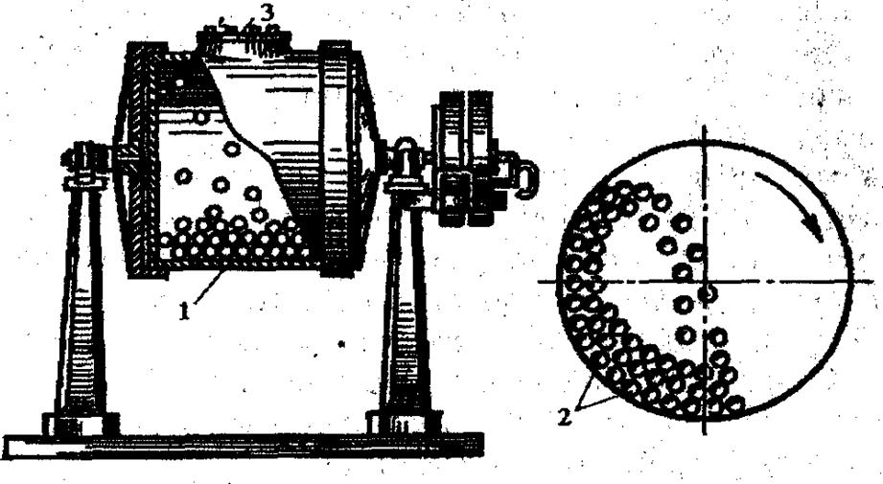
Grinding— the process of reducing the size of pieces (particles) of solid materials by mechanical action. It is widely used in the pharmaceutical industry for various purposes. Grinding can be an auxiliary process used to ensure dissolution, extraction, drying, etc. The latter proceed faster and more fully, the more surfaces involved in them solids. The crushed material in this case plays the role of a semi-finished product, as used by the company to obtain solutions, tinctures, extracts, tablets, etc. Grinding can be the main process used to obtain finished dosage forms with a certain degree of dispersion (fees, powders). In this case, obtaining a crushed product consists of several successive technological operations: grinding material, sieve separation, mixing.

Slide 11
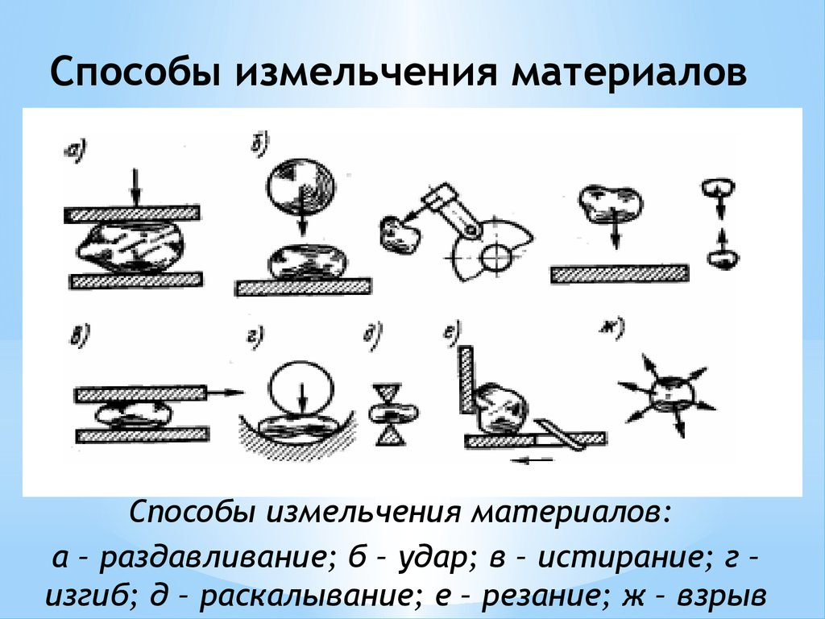

Slide 12
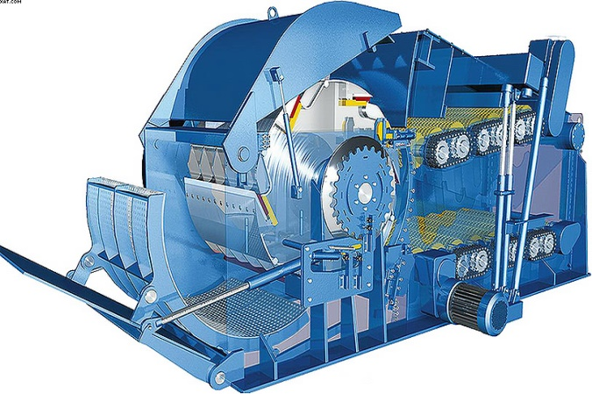
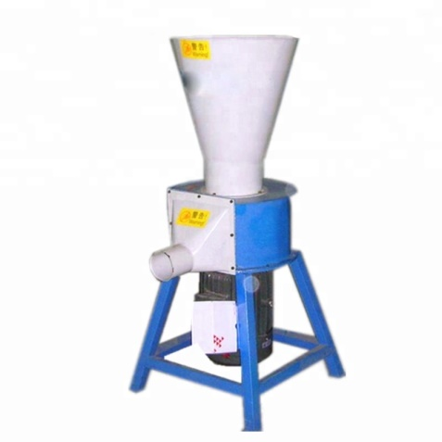
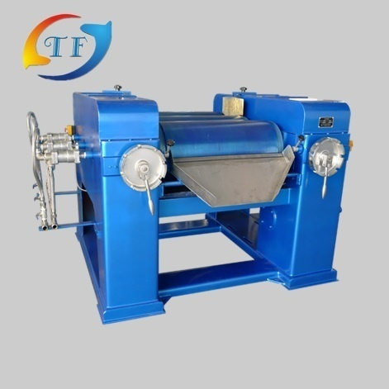
Grinding machines can be classified on various grounds:
the degree of grinding of the material that can be achieved with the help of machines (for medium and fine grinding)
mills (for fine and colloidal grinding);
Method of grinding
cutting machines
abrasive
crushing
drums
shock-abrasives, etc

Slide 13
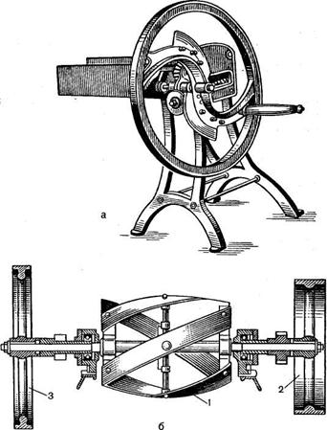
Cutting machines
Used for grinding dried herbal medicinal raw materials, which is cut to a particle size of 2-8 mm (to obtain fees or production of extraction drugs) using grass - and root cutters. The working tool of cutting machines is a knife or a system of knives that perform reciprocating or rotational movement. In some cases, the machine has two knife systems. One knife in these systems moves, the others are mounted stationary.

Slide 14
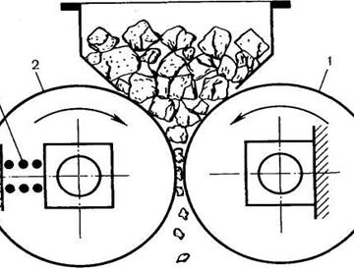
Crushing machines
The roll crusher (Fig.) Consists of two parallel cylindrical rolls, which, rotating towards each other, grind the material mainly by crushing. The rollers are placed on bearings in the housing, and the roller (1) rotates in a fixed, and the roller (2) - in sliding bearings, which are held in a given position (depending on the required width of the gap) by means of a spring (3). When a piece of material of excessive hardness of a spring gets to it in a crusher, the mobile roll departs from the motionless and the piece falls out of a crusher, thus the possibility of its breakage is eliminated.

Slide 15
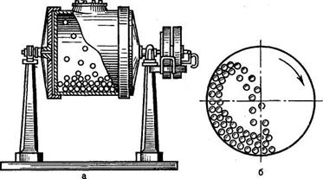
Drum mills
The material is crushed inside the rotating body (drum) under the influence of grinding bodies. Depending on the type of grinding bodies, there are ball and rod mills. Depending on the shape of the drum and the ratio of its length to the diameter d, there are short (l / d = - 1.5-2.0), pipe (// d = 3.0-6.0), cylindrical-horse-ethical mills (the drum has the form of two truncated cones, the wide bases of which are connected by a cylindrical part)

Slide 16
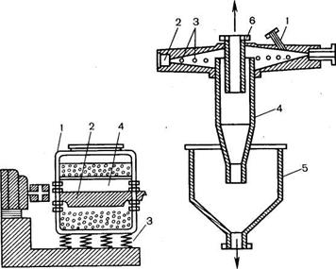
Vibrating mills
The cylindrical body of the mill (1) is about 80% of the volume filled with grinding bodies - balls, sometimes rods (2). A vibrator (4) is installed inside the housing. This is a shaft with an unbalance or an eccentric mechanism, which during the operation of the mill makes 1500- 3000 oscillations per minute at an amplitude of 2-4 mm. At the same time grind bodies and the crushed material are put in intensive motion. Particles of material, vibrating in the suspended layer, are crushed under the influence of frequent collisions with grinding and abrasive bodies. To prevent vibration of the floor, the mill housing is mounted on springs (3)

Slide 17
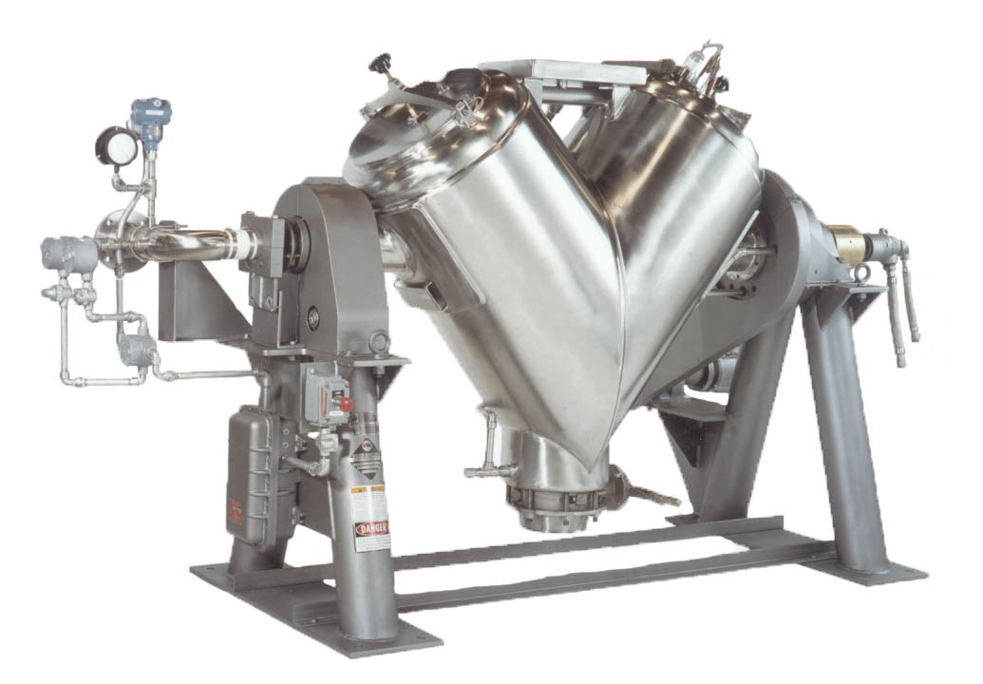
Mix
a process in which several separate powdered components after thorough mixing and uniform distribution of each of them in a mixed volume of material, form a homogeneous mixture. Obtaining a homogeneous mixture is very important to ensure the requirement of uniform distribution of drugs in the volume of the finished dosage form. Especially increasing requirements for the quality of mixing for drugs with a potent substance, the content of which in one dose is less than 5 mg.

Slide 18
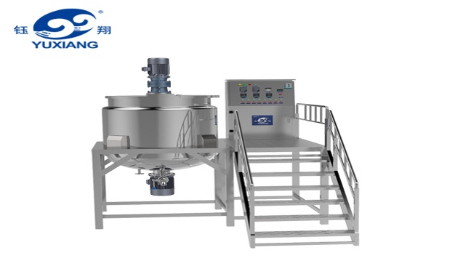
Mixing
-devices in which bulk materials are mixed with each other and with liquids are called mixers.
Mixers are classified:
by the nature of the mixing process (convective or diffusion)
design feature (drum mixers with rotating body and worm-blade)
method of influencing the mixture (gravitational, centrifugal)
the nature of the mixing process (periodic or continuous) and other features.
By the nature of the process taking place in the domestic chemical and pharmaceutical industry, the most common are mixers of periodic action, which, depending on the type of working body are divided into mixers:
with rotating case
worm-lobed
pseudo-liquid bulk material
centrifugal action with a rotating cone.

Slide 19
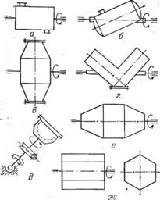
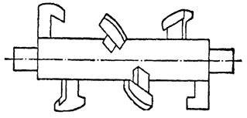
Mixers with rotating housing
Blade (screw) mixer

Slide 20
Dosage of solid materials
The dispenser used in the installation as a device for uniform supply of materials from the hoppers to the transporting or processing machines and devices is usually called a feeder.
There is a feeder:
1) Gateway
2) Plunger
3) Plate

Slide 21
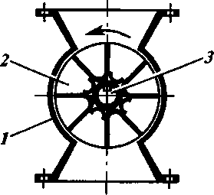
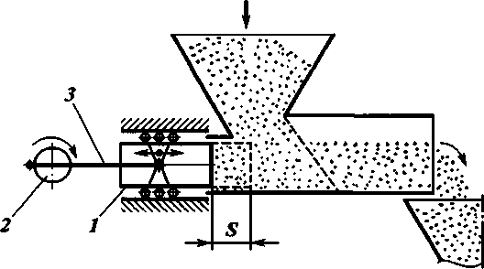
1) Gateway feeder -
is intended for giving of well loose powdery and granular materials
2) Plunger feeder
consists of a conical loading hopper, a horizontal cone for moving the dosing material and a plunger 1 connected to the eccentric 2 by means of a rod 3. When rotating the eccentric plunger moves a distance S, displacing a portion of the dosing material from the housing

Slide 22
Thank you for attention

