Slide 1
Tablet dosage forms
Senior lecturer Ph.D. Zamkovaya A.V.

Slide 2
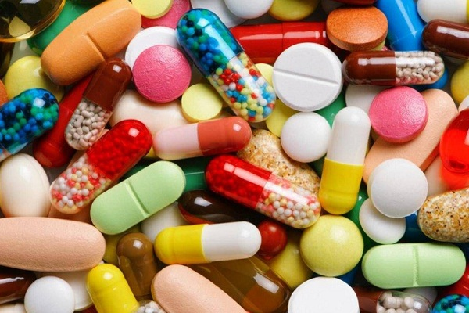
Tablets - definition
Tablets (Tabulate, Latin tabula - board, tabulate - board, tile) is a solid dosage form containing one dose of one or more active substances, obtained by pressing a certain volume of particles. The tablets are intended for oral administration. Some tablets are swallowed whole, some are pre-chewed, others are dissolved or dispersed in water before use, or left in the mouth where the active ingredient is released.

Slide 3
Characteristics of tablets
Tablets as a dosage form are widely used throughout the world. Today, tablet preparations account for more than three-quarters of the total volume of finished medicines.
The positive qualities of the tablets provide:
- the proper level of mechanization at the main stages and operations, ensures high productivity, cleanliness and hygiene of the production of these dosage forms;
- the accuracy of dosage of medicinal substances included in the tablet;
- the portability of tablets, provides the convenience of their dispensing, storage and transportation;
- long-term integrity of medicinal substances in a compressed state;
- for substances that are not sufficiently stable - the possibility of applying protective shells
- the ability to mask unpleasant organoleptic properties (taste, smell, color), which is achieved by applying coatings;
- a combination of medicinal properties that are incompatible in physical and chemical properties in other dosage forms;
- localization of the action of the drug in a certain part of the gastrointestinal tract by applying membranes that are soluble in an acidic or alkaline environment;
- prolongation of the action of medicinal substances (by applying certain coatings, using special technology and the composition of the core tablets)
- regulation of the sequential absorption of several medicinal substances from the tablet at certain intervals (multilayer tablets)
- prevention of errors when dispensing and taking medications due to the application of appropriate inscriptions on the surface of the tablets.

Slide 4
However, pills have some disadvantages:
- the effect of drugs in tablets develops relatively slowly;
- the pill cannot be administered with vomiting and unconsciousness;
- during storage, the tablets can become cemented, and the decomposition time increases;
- the tablets may contain excipients that have no therapeutic value, and sometimes cause some side effects (for example, talc irritates the gastric mucosa)
- certain drugs (for example sodium or potassium bromide) form highly concentrated solutions in the dissolution zone, which can cause severe irritation of the mucous membranes (this drawback is eliminated by dissolving the tablets in an appropriate amount of water);
- not all patients, especially children, can easily swallow tablets.

Slide 5
Classification of tablets
According to the method of production in industrial conditions, two classes of tablets are distinguished:
1. Pressed, which are obtained by compressing medicinal powders on tablet machines with different productivity. This method is basic.
2. Formable, or trituration tablets, which are obtained by forming a tablet mass. Trituration tablets contain small doses of drugs and fillers: their weight can be up to 0.05 g
Tablets are also classified by design feature:
1. By composition: simple (one-component) and complex (multicomponent).
2. By the structure of the structure: frame, single-layer and multi-layer (at least two layers), with or without coating.
3. The coating of tablets is classified into pelleted, film-coated and compressed.

Slide 6
The forms of tablets produced by the chemical-pharmaceutical industry are very diverse: cylinders, balls, cubes, triangles, quadrangles, etc. The most common is a flat-cylindrical shape with a bevel and a biconvex shape, easy to swallow. In addition, tablet punches and dies are simpler and easier to install on tablet machines.
The size of the tablets ranges from 3 to 25 mm in diameter. Pills larger than 25 mm in diameter are called briquettes. The most common are tablets with a diameter of 4 to I 2 mm. Tablets with a diameter of more than 9 mm have one or two notches applied perpendicularly and allow you to divide the tablet into two or four parts and thus vary the dosage of the drug.
The mass of the tablets is mainly 0.05-0.8 g and is determined by the dosage of the medicinal substance and the amount of helped substances in their composition.

Slide 7
Depending on the purpose and method of administration, tablets are divided into the following groups:
Oriblettae - tablets, taken orally. Medicinal substances are absorbed by the mucous membrane of the stomach or intestines. These tablets are taken orally with water. The peroral group of tablets is the main one.
Resoriblettae - tablets, used subliveally; medicinal substances are absorbed by the oral mucosa.
Implantabulettae - aseptic tablets are used for implantation. Designed for delayed absorption of medicinal substances in order to prolong the therapeutic effect.
Injectabulettae - aseptic tablets are used to obtain injection solutions of medicinal substances.
Solublettae - tablets are used to prepare solutions for various pharmaceutical purposes.
Dulciblettae bacilli, boli, uretratoria, vagitoria - pressed urethral, ​​vaginal and rectal dosage forms.

Slide 8
Auxillary substanses
Auxiliary substances in the production of tablets are intended to provide the tabletted mass with the necessary technological properties, ensuring the accuracy of dosage, mechanical strength, disintegration ability and stability of the tablets during storage.
Excipients used in the industrial production of tablets are divided into groups depending on their purpose.
Auxiliary substances include the following requirements: they must be chemically indifferent; should not negatively affect the patient's body, as well as the quality of the tablets during their manufacture, transportation and storage.

Slide 9
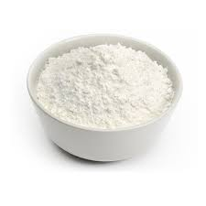
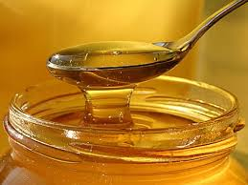
Fillers (diluents) are added to obtain a specific tablet weight. With a small dosage of a medicinal substance (usually 0.01-0.001 g) or when tabletting potent, poisonous and other substances, it can be used to regulate some technological parameters (strength, disintegration ability, etc.). Fillers determine the technological properties of the mass for tabletting and the physicomechanical properties of the finished tablets.
Binders. The particles of most medicinal substances have little adhesion to each other, therefore, when tabletting them, high pressure must be applied, which is often the reason for untimely wear of the tablet press tool and the production of low-quality tablets. To achieve the required adhesion force at a relatively low pressure, binders are added to the tableted substances. By filling the interparticle space, they increase the contact surface of the particles and their ability to cohesion.
Крахмал
Сахарный сироп

Slide 10
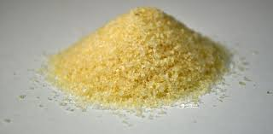
Loosening agents. When medicinal substances are pressed, the porosity is sharply reduced, and thereby the penetration of the liquid into the tablet becomes difficult. To improve disintegration or dissolution, disintegrating agents are used, which provide mechanical destruction of the tablets in a liquid medium, which is necessary for the speedy release of the active substance.
Disintegrants are also added to tablets if the drug is insoluble in water or if the tablet is capable of cementing during storage. When using a mixture of sodium bicarbonate with citric or tartaric acid as a disintegrant, it is necessary to take into account their interaction in a humid environment, and therefore, correctly choose the order of their introduction during wet granulation into a tablet mass.
In general, all disintegrating substances ensure the destruction of tablets into small particles when they come into contact with a liquid, as a result of which there is a sharp increase in the total surface of the particles, and promotes the release and absorption of active substances.
Желатин

Slide 11
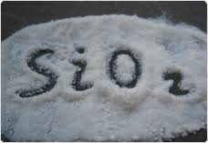
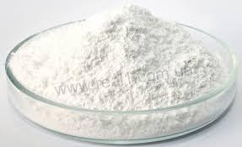
Antifriction substances. One of the problems of tablet production is to obtain good flowability of the granulate in feeding devices (funnels, hoppers). The resulting granules or powders have a rough surface; this makes it difficult to suck them from the feed hopper into the matrix slots. In addition, the granules can adhere to the walls of the die and punches as a result of friction, develops in the contact zones of the particles with the press tool of the tablet machine.
To remove or reduce these undesirable phenomena, antifriction substances are used, represented by a group of sliding and lubricating agents.
Sliding substances, adsorbed on the surface of particles (granules), eliminate or reduce their roughness and thereby increase their fluidity (flowability). Spherical particles have the highest sliding efficiency.
Talc
Aerosil

Slide 12
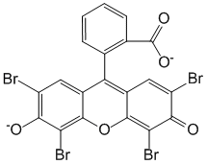
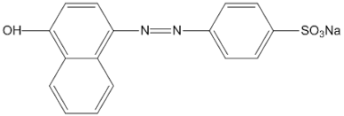
Lubricants make it easier to push the tablets out of the die. Otherwise, they are called anti-adhesive or anti-adhesive substances. They not only reduce friction at the contact areas, but significantly facilitate the deformation of the particles due to the adsorptive decrease in their strength.
Dyes are introduced into tablets primarily for the purpose of providing them with a presentation, designating a therapeutic group of medicinal substances, for example, hypnotics, poisonous. In addition, some dyes are stabilizers for photosensitive drugs.
Tropeolin
Eosin

Slide 13
Technological process for the production of tablets
Direct compression - is a combination of various technological measures that make it possible to improve the main technological properties of the tabletted material: flowability and compressibility, and to obtain tablets from it, bypassing the granulation stage.
Today tableting without granulation is carried out:
1) with the addition of excipients that improve the technological properties of the material;
2) forced feeding of the tabletted material from the charging hopper of the tabletting machine into the matrix; ,
3) with preliminary directional crystallization of pressed substances
The technology for making tablets is that the drugs are thoroughly mixed with the required amount of excipients and pressed on tablet machines. The disadvantages of this method are the possibility of delamination of the tablet mass, changing the dosage when pressing with a small amount of active substances and using high pressure. Some of these disadvantages are minimized by forced-feed tableting, compressed into a die.

Slide 14
Granulation
Granulation is a purposeful enlargement of particles, that is, the process of converting a powdery material into grains of a certain size.
Currently existing granulation methods are divided into the following main types:
1) dry granulation or grinding granulation;
2) moisture granulation, or push-through granulation;
3) structural granulation.
Dry granulation method. It consists in mixing the powders and moistening them with solutions of adhesives in enameled mixers, followed by drying in a lumpy mass. Then the mass is turned into a coarse powder using rollers or an Excelsior mill. Grinding granulation is used when the moistened material reacts with the material during wiping.
In some cases, if medicinal substances decompose in the presence of water, and during drying enter into chemical interaction reactions or undergo physical changes (melting, softening, color change), they are subjected to briquetting. For this purpose, briquettes are pressed from the powder on special briquetting presses with large matrices (25-50 mm) under high pressure.
The resulting briquettes are crushed on rollers or an Excelsior mill, fractionated using sieves and pressed on tablet machines to tablets of a given weight and diameter. Briquetting granulation can also be used when the drug substance has good compressibility and does not require additional particle bonding with adhesives.

Slide 15
Wet granulation method.
Granulation or wiping of a wet mass is carried out to compact the powder and obtain uniform grains - granules with good flowability.
Powders with poor flowability and insufficient adhesion between particles are subjected to this granulation process.
In both cases, a sticky solution is added to the mass, which improves the adhesion between the particles.
The wet granulation stage includes the following operations:
1) mixing powders;
2) mixing of powders with a solution of binders and mixing;
3) wet mass granulation;
4) drying wet granules;
5) processing of dry granules.

Slide 16
Structural granulation
There are three types of structural granulation - fluid bed pan granulation and spray drying granulation.
For granulation in a coating pan, a mixture of powders is loaded while the kettle rotates, the resulting granules are moistened and dried.
Spray-drying granulation is used for thermolabile substances. First, a suspension is prepared from auxiliary substances. It is sprayed in a spray dryer at a temperature of 150-200 ° C, and the granules are mixed with active ingredients.
Fluid bed granulation. Granules obtained in a fluidized bed are distinguished by significant strength and better flowability, which is a consequence of a more regular geometric shape of the granules, close to spherical. In this case, softer and more porous agglomerates are formed than when receiving granules by wet granulation, where large agglomerates are formed, which are subject to further grinding.
The formation and growth of granules in a fluidized bed occurs due to two physical processes: pelletization during wetting and adhesion with subsequent agglomeration. The quality of the granules and their fractional composition depend on many factors that determine the course of the process, the main of which are the speed of the fluidizing gas, the composition and the feed rate of the granular liquid; temperature in the layer.

Slide 17
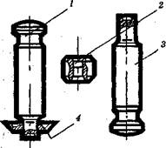
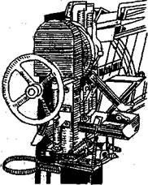
Equipment
Pressing on tablet machines is carried out with a press tool consisting of a matrix and two punches.
The main types of tablet machines are eccentric, or percussion, and rotary.
Draw frames are skid and intermediate (shoe).

Slide 18
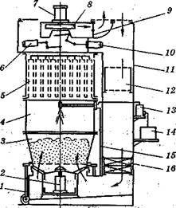
Schematic diagram of the apparatus with a fluidized bed for granulating tablet mixtures (SG-30):
1 - cart;
2 - pneumatic cylinder for receiving the reservoir preparation;
3 - product tank;
4 - shell of the sprayer;
5 - shell of bag filters;
6 - shaking off device;
7 - safety valve;
8 - fan;
9 - gate;
10 - damper control mechanism;
11 - case;
12 - air filter;
13 - dosing pump;
14 - capacity for granular fluid;
15 - compressed air that is sprayed;
16 - steam heater.

Slide 19
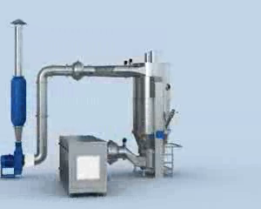
SG-60 Apparatus with fluidized bed for granulation of tablet mixtures

Slide 20
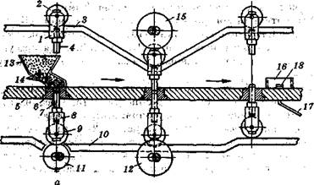
The scheme of movement of punches in a multi-matrix rotary machine:
1 - slider; 2 roller; 3 - top color; 4 - upper punch; 5 - table top; 6 - matrix 7 - lower punch; 8 - lower slider; 9,11,12,15 - rollers; 10 - lower copier; 13 - bunkers; 14 - mixers in bunkers; 16 - knife for dropping tablets; 17 - lot; 18 - tablet.

Slide 21
Thank you for attention!

