Slide 1
Micropreparations

Slide 2
Hialinosis of veselles

Slide 3
Skin in Addison’s disease

Slide 4
Nutmeg liver

Slide 5
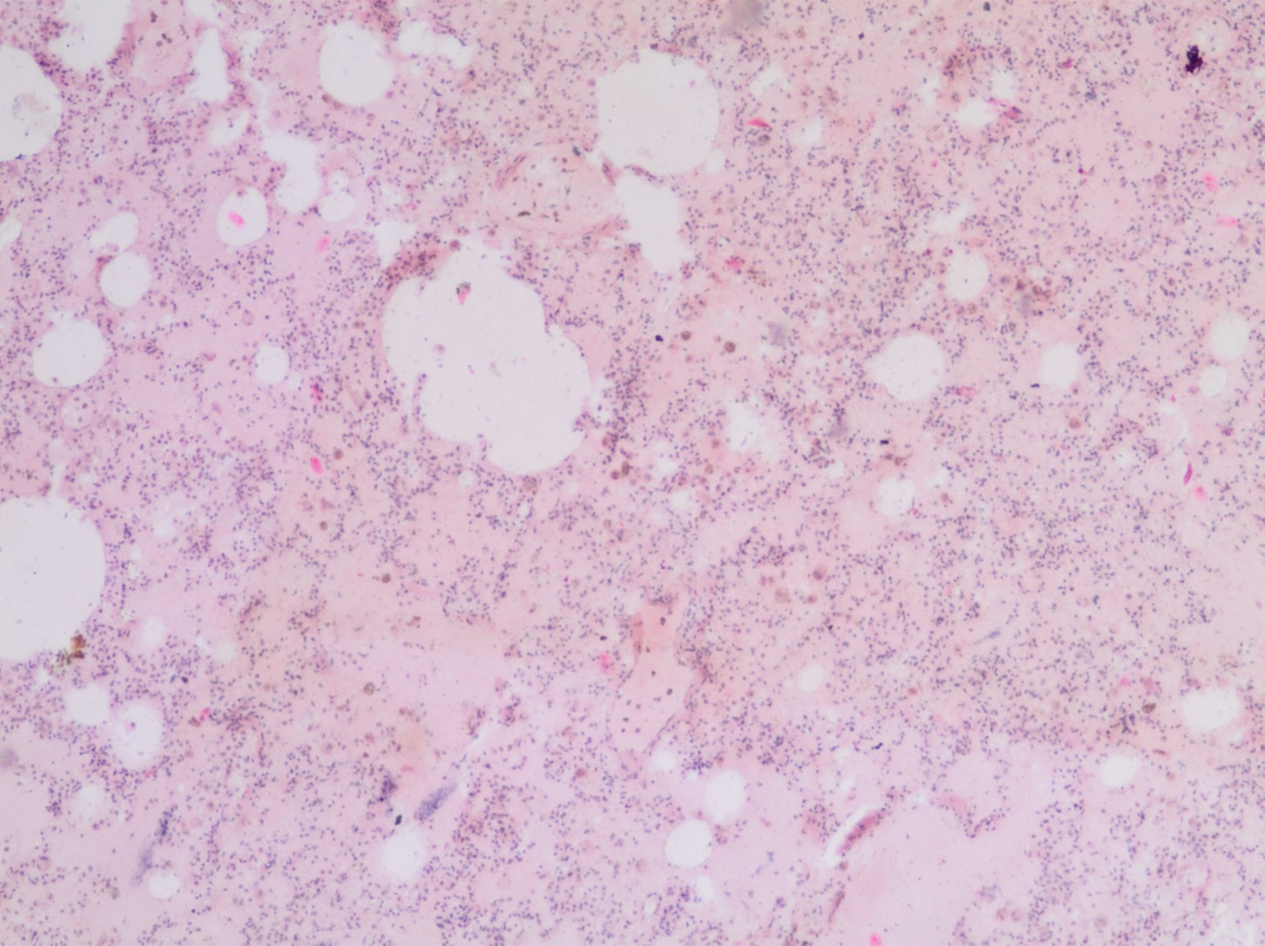
Edema of lung

Slide 6
Phlegmon

Slide 7
Actinomycosis

Slide 8
Cavernous hemangioma of liver

Slide 9
Melanoma

Slide 10
Atherosclerosis of the heart coronary arteries

Slide 11
Emphysema of lungs

Slide 12
Phlegmonous-ulceric appendicitis

Slide 13
Miliary tuberculosis of lungs

Slide 14
Deep caries of tooth

Slide 15
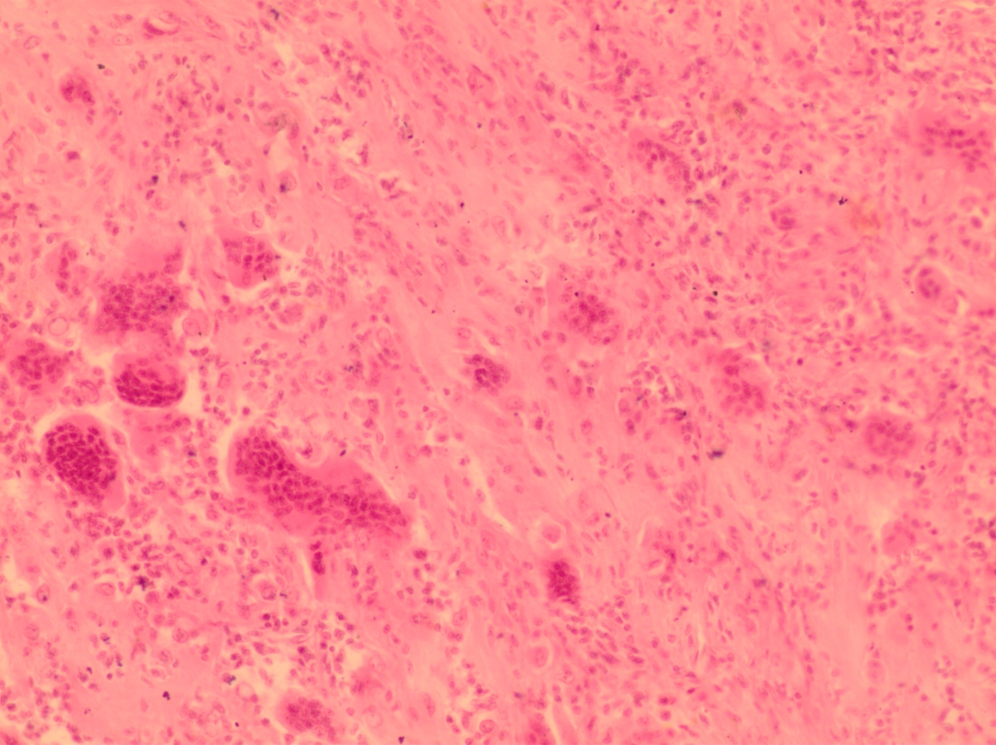
Gigant-cell epulis

