Slide 1
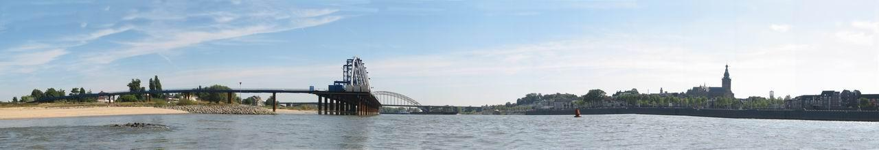
Cross- border e-Radiology

Slide 2
Why go digital and why radiology?
Data set of an imaging dept. largest in hospital
All imaging digital anyway, also dictation
Costly proces of archiving and transporting films
Work flow re-engineering the real issue
Affects the whole hospital
Thus: a template for cross-border approach

Slide 3
UMC St. Radboud
User
information
administration
hospitals
Specialists
Genral practioners
LAN
WAN
Information
distribution
& presentation
In-huis distributie
Telemedicine
A
A
Electr.pat. Record
HIS
Clinical
information
management
B
B
RIS
LIS
PIS
Admin
A
Cardiology
Pathology
Laboratores
Dispenseray
Administration
Radiology
Information
generators
B
...
Modalities/equipment
data

Slide 4
EU teleradiology initiative
Radiology is a service industry
Accessibility of information independent of location! Sparsely populated areas eg. (both radiologists shortage and small hospitals)
Secondary readings for general rads
Tertiary ‘second opinion’ reads

Slide 5
So what is important:
Effect of ‘digitalization’ on
1. Space
2. Personnel
3. Finances
4. Legal issues

Slide 6
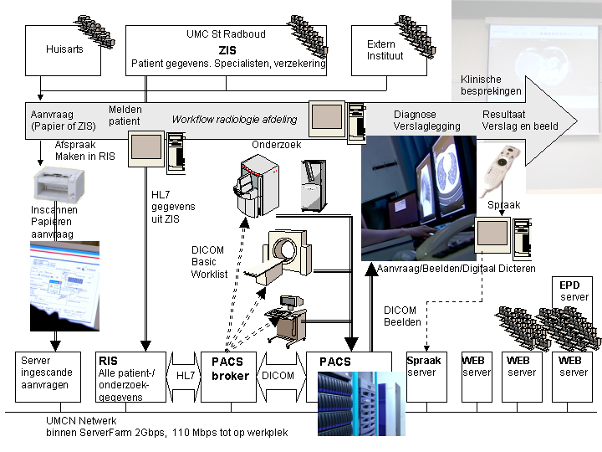
x

Slide 7
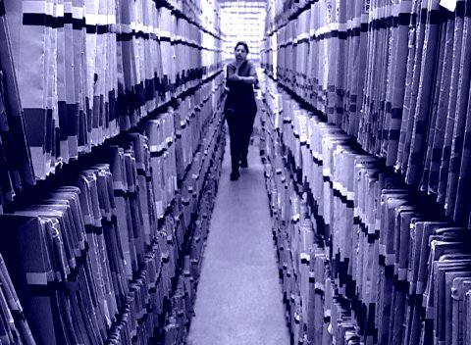
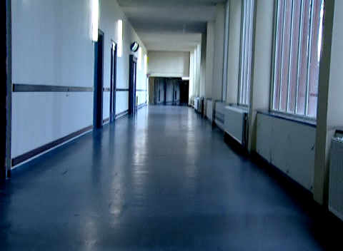
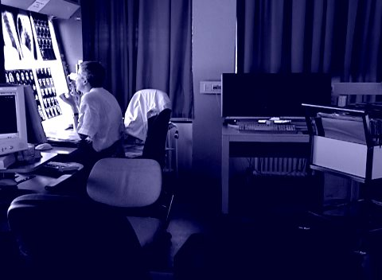
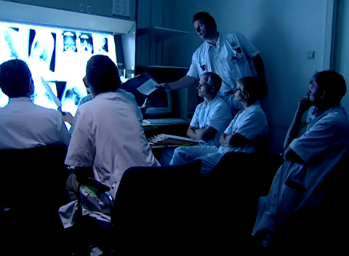
Space= exit film

Slide 8
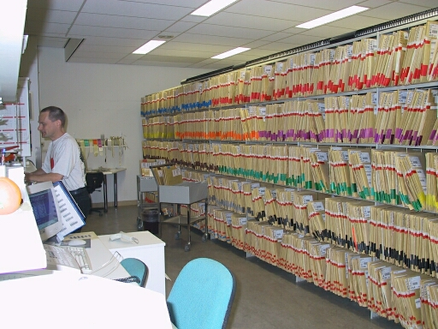
Area=$’s
300 sq. Meter@ euro 1.000:
Valuable budget tool

Slide 9

Workflow re-engineering leads to team effort:
Quicker image generation
Quicker archiving
Quicker reporting
Scanning of request forms
Consequences:
  Faster communication with clinicians/patients
  Results used to be 2 days, now 2 minutes a problem!
  Cave: Achievement of today, baseline of tomorrow
  Thus: get entire clinical team to buy into the concept.

Slide 10
ICT profile changes
More in-house ICT knowledge/experience/ presence needed
Technical and ICT issues interrelated
Weakest link issues
Upgrade moments more complex} web-based applications are the exception!
Quality control issues
  Workstations: luminescence etc.
  Image quality
  Uptime and response time issues

Slide 11
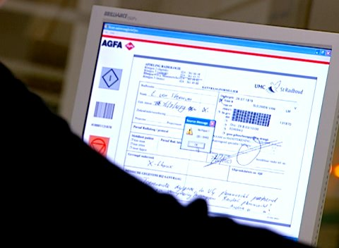
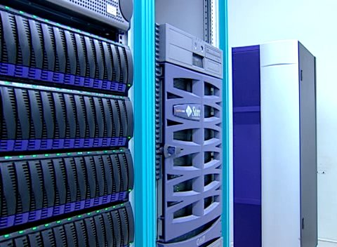
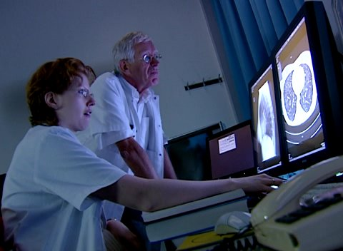
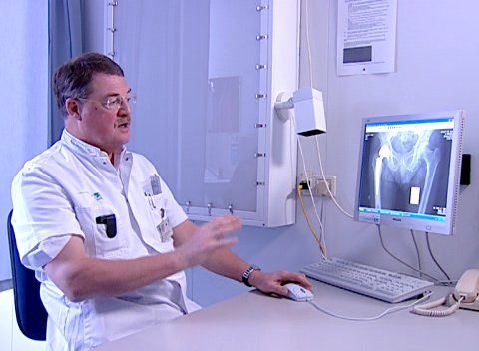
Infrastructure maintenance!!

Slide 12
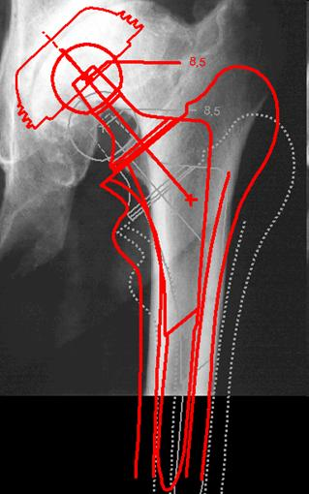
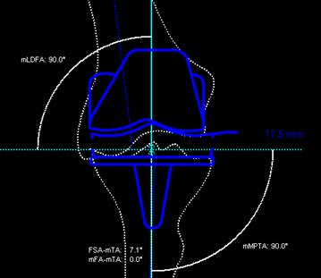
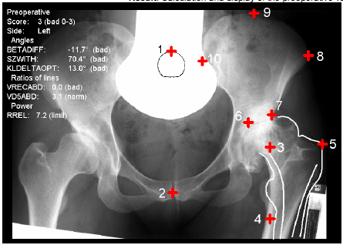
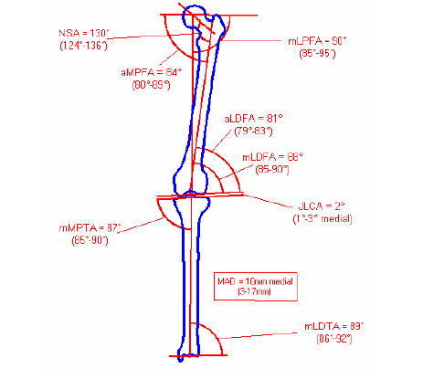
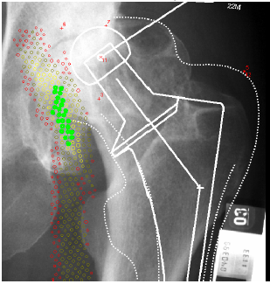
advanced applications: costly but have become standard practice

Slide 13
Finances:
Everybody talks ROI, rubbish!
but, the $’s make a good story
- pure facts of costs
- ‘virtual’ and real savings

Slide 14
$’s:
Annual cost (private hospital belgium)
Conventional Phosphor Filmless
    Image distribution €415.229 €268.878 € 23.328
    Image processing € 31.316 € 102.717 €410.016
    Personnel €1.098.440 €1.098.440 €923.807
    Total €1.544.986 €1.470.036 €1.357.153
    NICE, but not the ENTIRE story!
-

Slide 15
$’s and sense:
No more film: -euro 555.000/yr
Decrease FTE’s: -euro 245.000
New ‘digital’ FTE’s: +euro 95.000
Increased production 11%/yr
Continued production <people
Fewer rooms/# modalities conventional

Slide 16
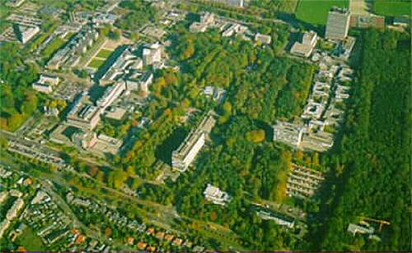
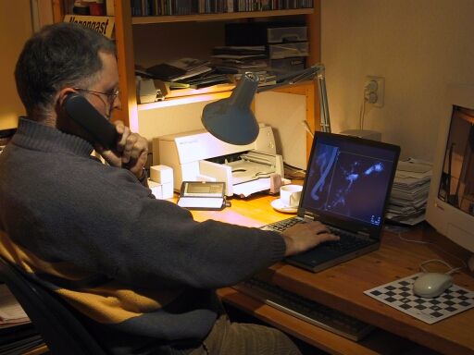
Teleconsulting
From home or elsewhere:
Infrastucture:
Citrix (server based computing)
VPN ( Virtual Private Network)

Slide 17
Disadvantages of e-radiology
Variable levels of training/maintaining competence in Europe
Variable judicial practices/standards
Multiple languages
Loss of ‘clinical component’ (McCall)
Security of data

Slide 18
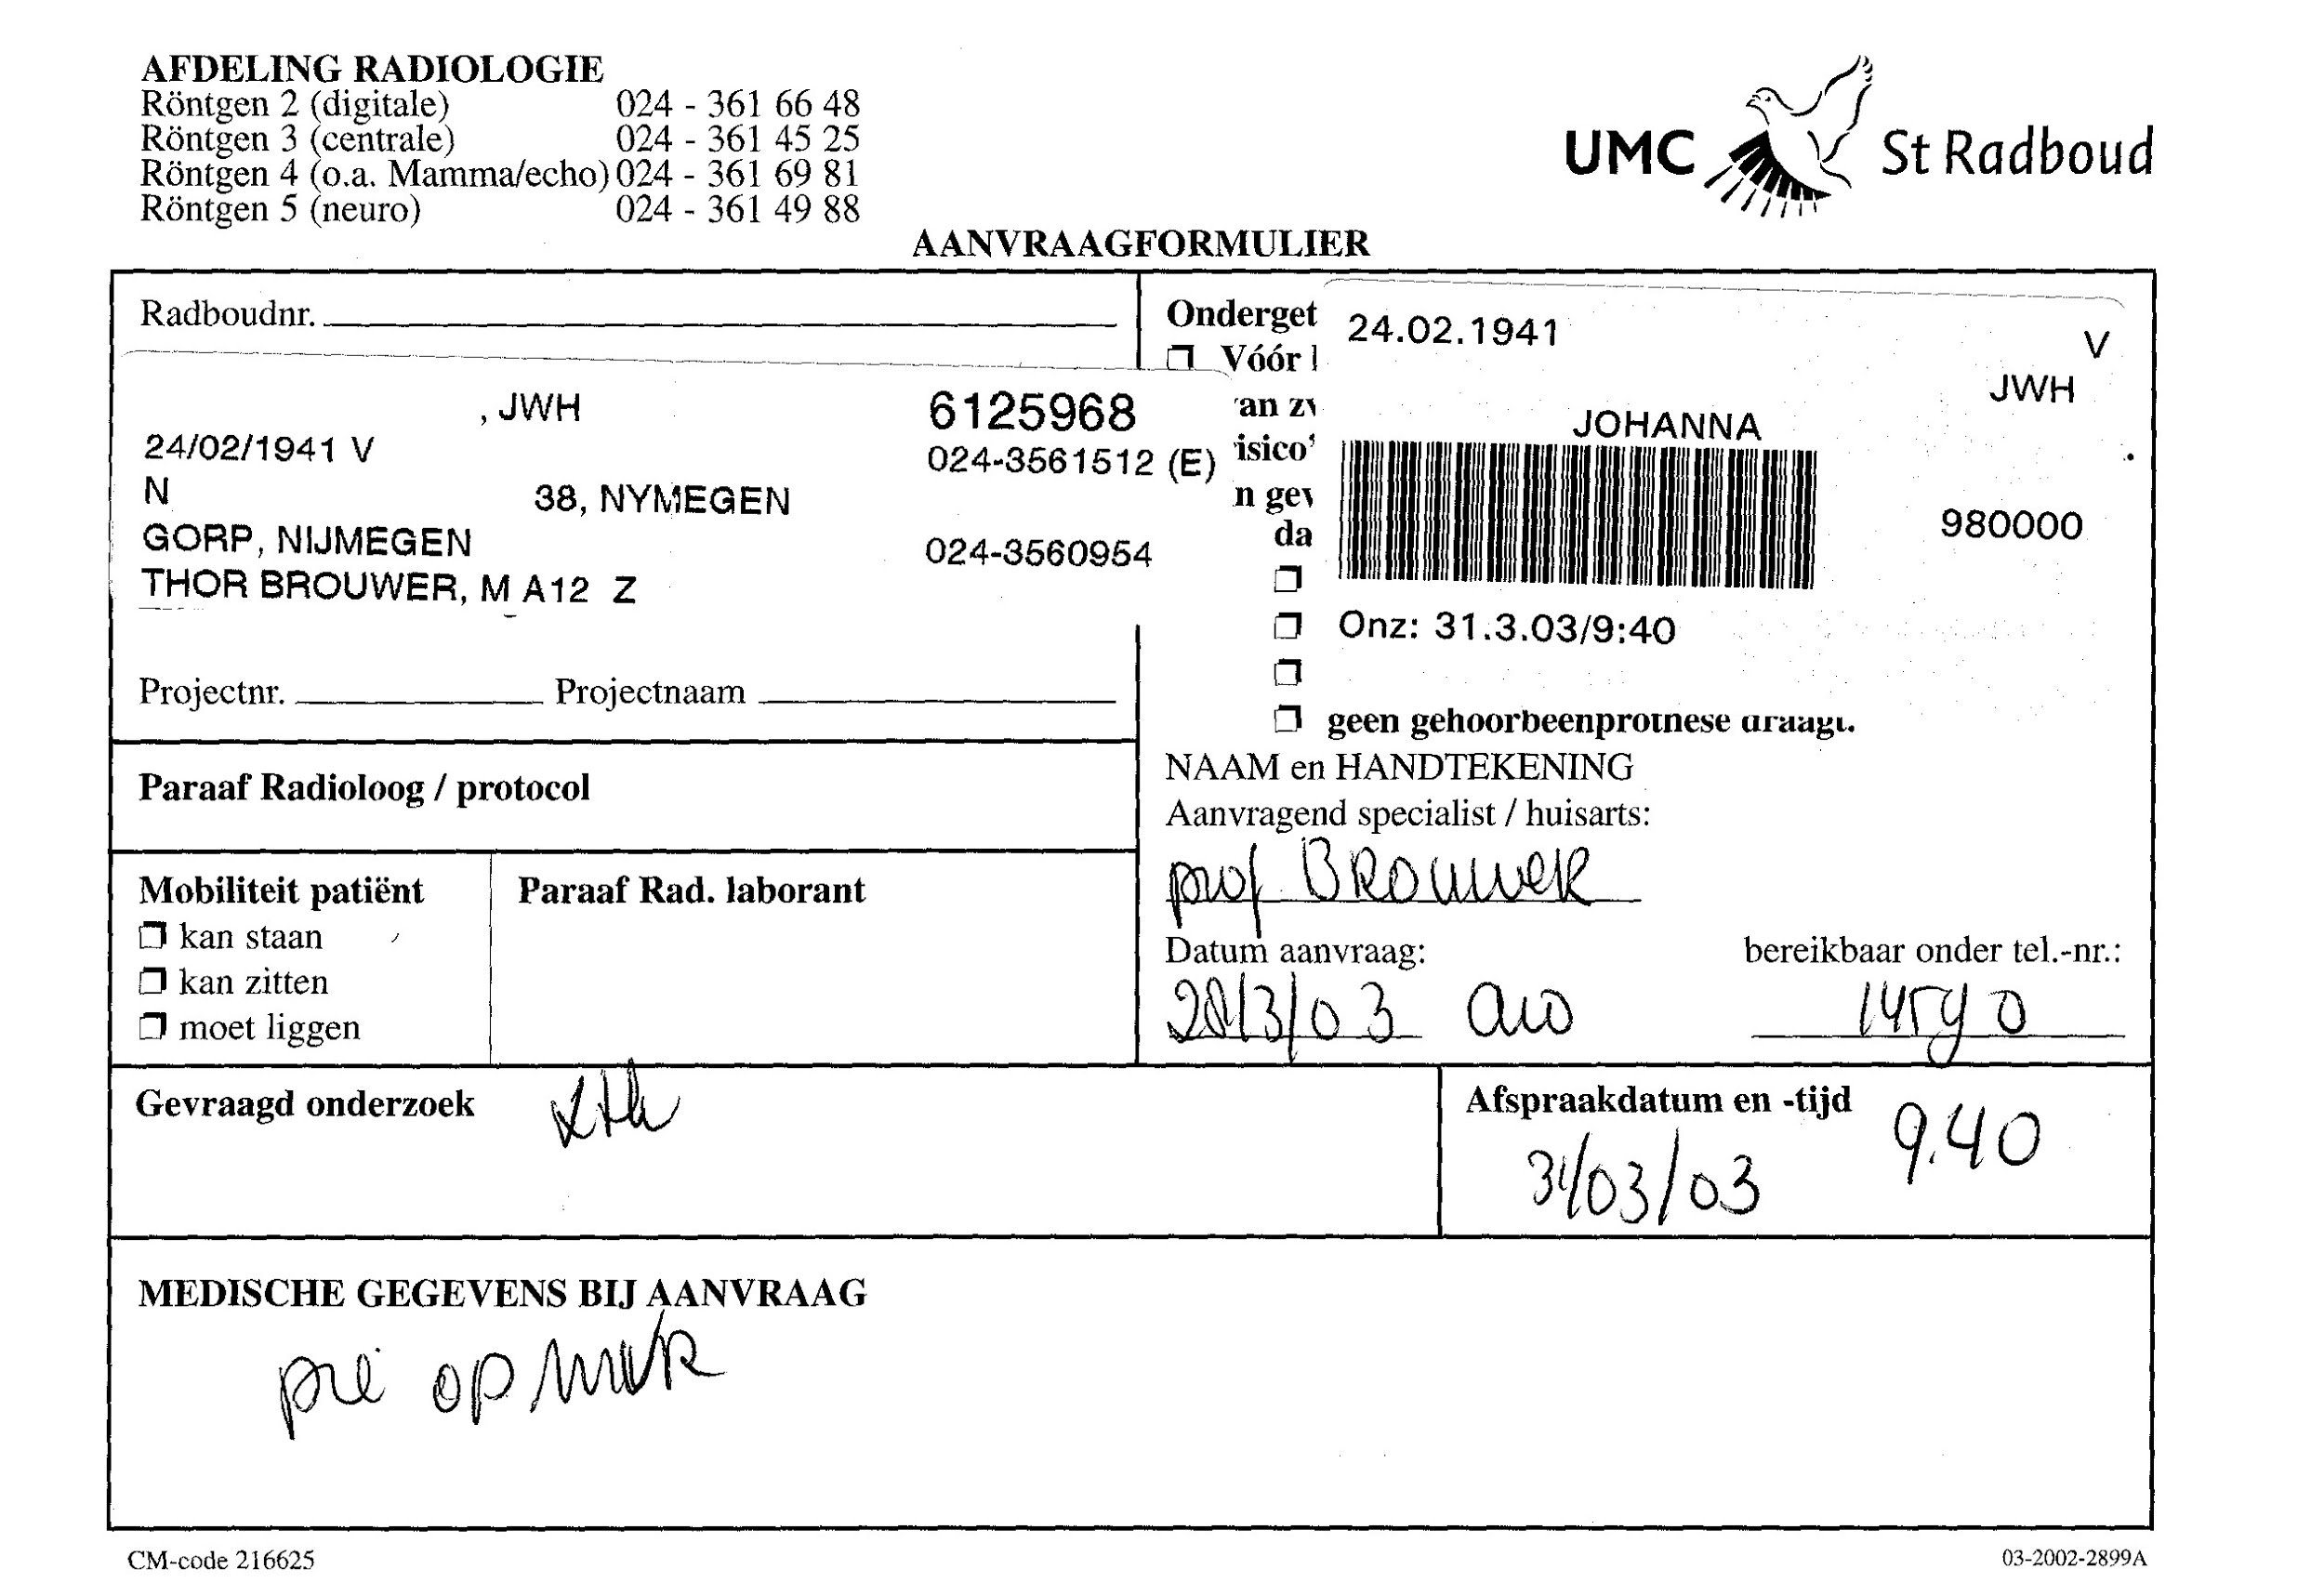
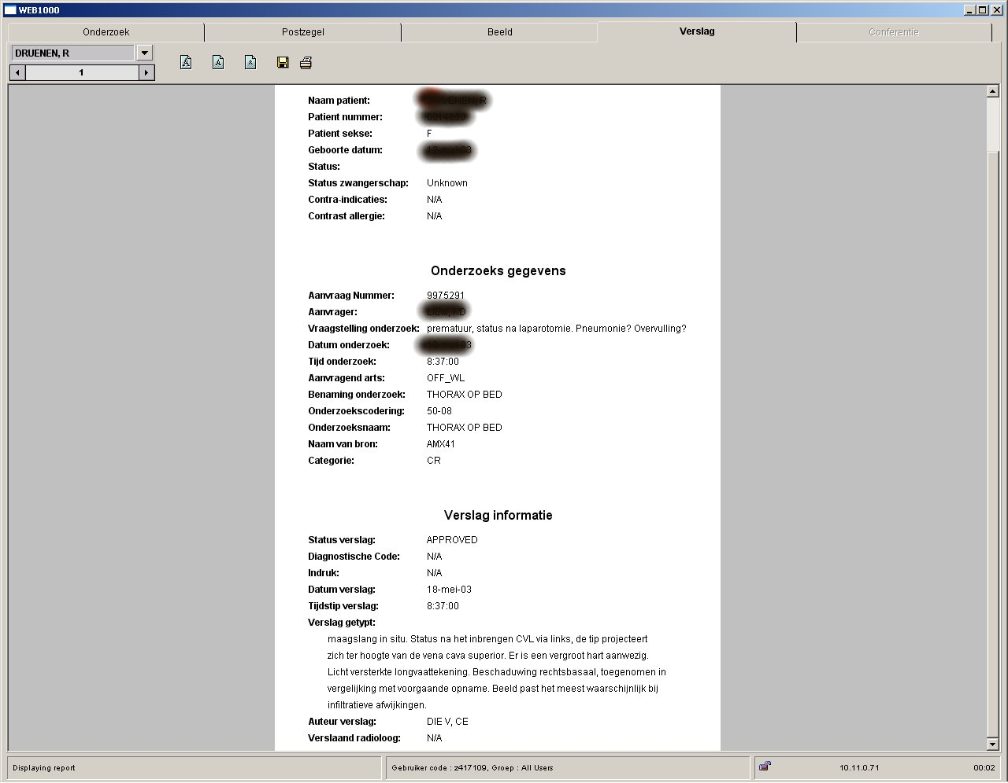
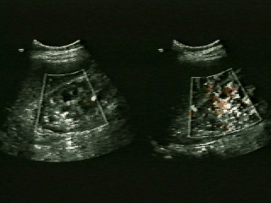
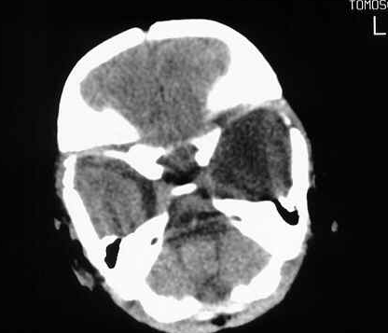
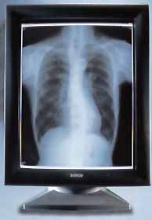
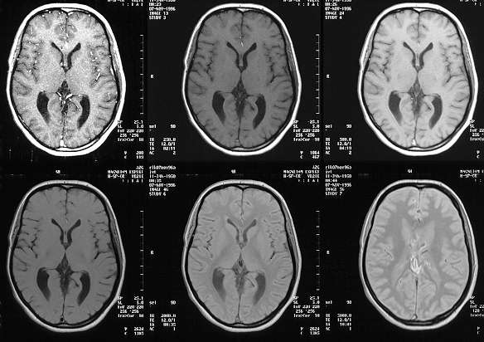
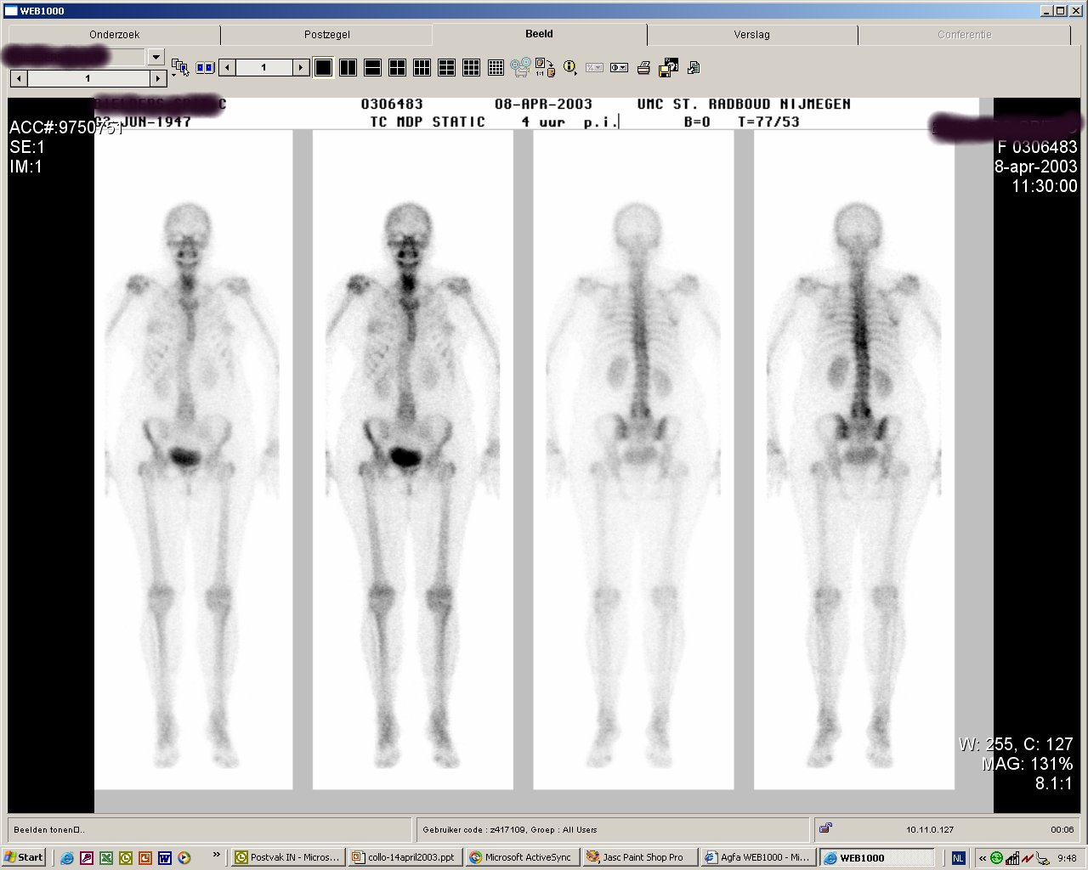
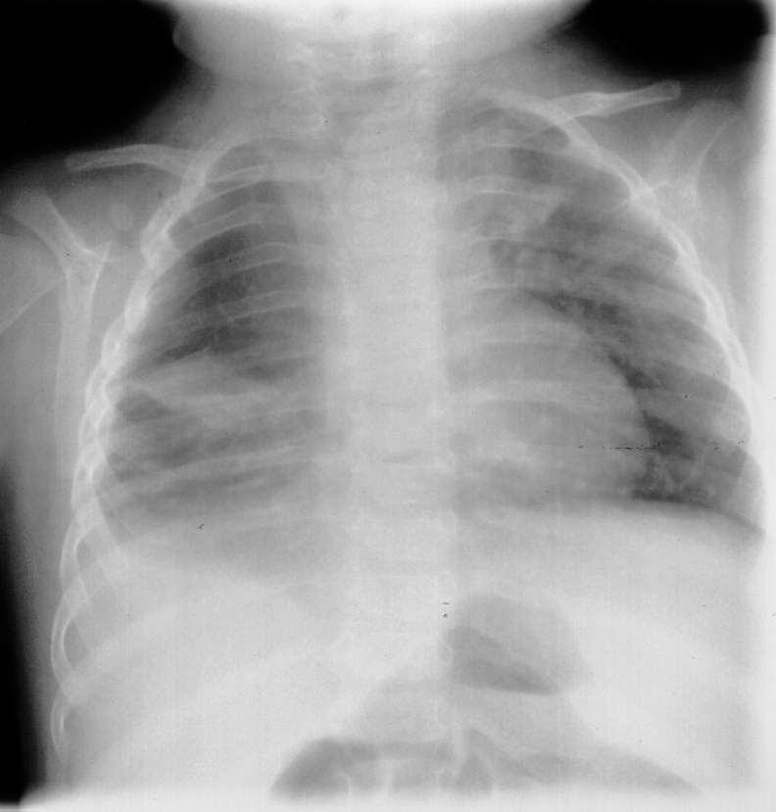
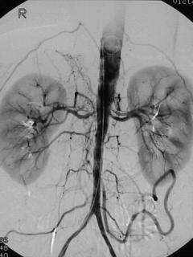
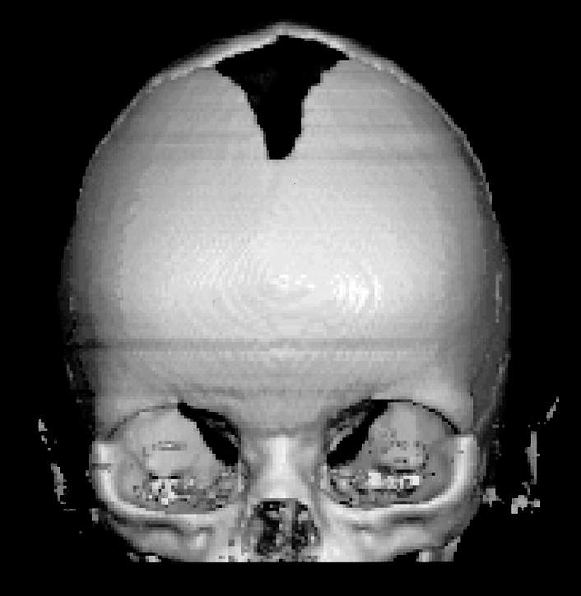

Slide 19
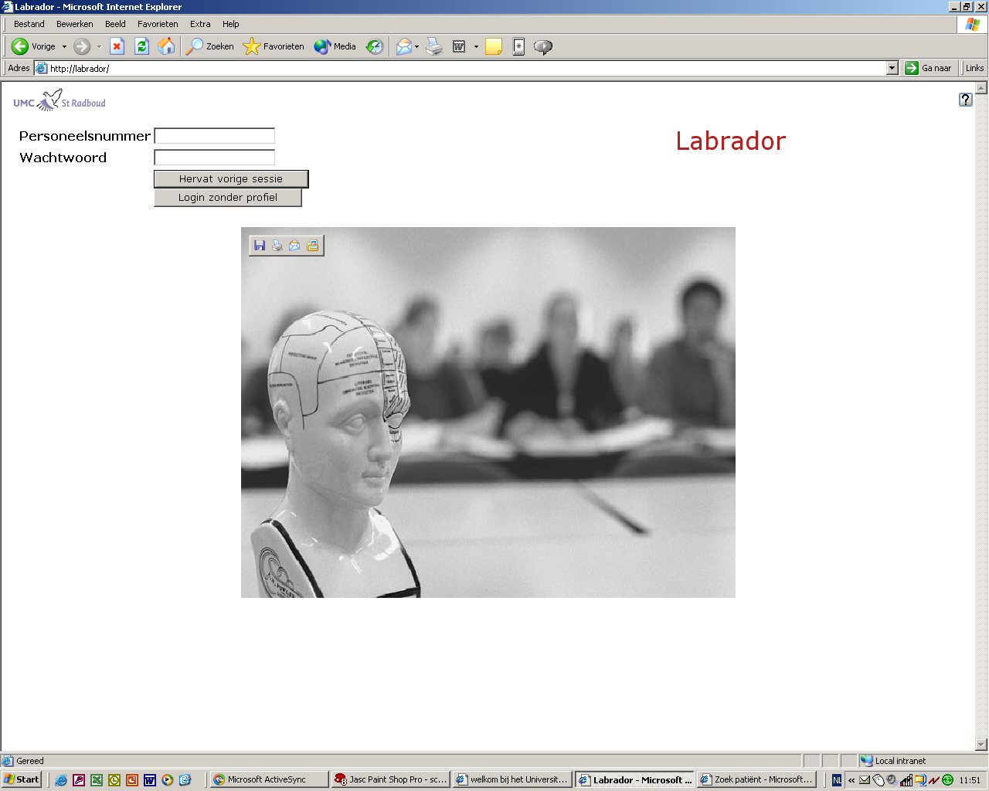
Next step: EPR
DRG registration
Radiology images and reports
NucMed images and reports
Laboratory results
PA results
Outpatient scheduling
Patient arrival indication
KEY: DATA FLOW!
“Labrador”

Slide 20
