Slide 1
ODESSA NATIONAL MEDICAL UNIVERSITY
DEPARTMENT OF ORAL AND MAXILLOFACIAL SURGERY
Lecture 1 «Anesthesia in oral surgery. Local and general anesthesia. Indications and contraindications for anesthesia, premedication principles. Complication of local and general anesthesia, treatment and prevention. Cardiopulmonary resuscitation. »
Year 3
Professor Anatoliy G. Gulyuk

Slide 2
Visiting a dentist is traditionally associated with inescapable pain and fear of it. This tendency is still alive, in spite of a centuries-old tradition of anesthesia and its modern opportunities.

Slide 3
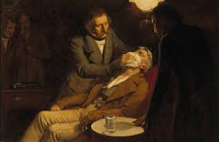

Slide 4
A pioneer in local anesthesia in dentistry was a Russian dentist V. Anrep, who in 1879 used cocaine not only for applicational, but also for injectional anesthesia, which turned out to be not absolutely safe for the organism. With discovery and introduction of Novocain in 1904 by a German scientist Eichhorn, a new era of solving tasks of painless surgery began. During nearly 100 years this anesthetic was a model for developing new medications now counting more than 100 items. A great role in developing and founding methods of local anesthesia was played by A.V. Vishnevsky, M.D. Dubov, S.N. Vaisblat, S.F. Grishchuk, P.A. Egorov etc.

Slide 5
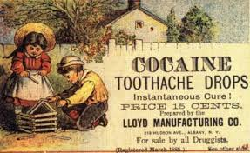

Slide 6
Local anesthesia is defined as reversible breach of conductivity of impulses along nervous fibers, achieved by physical, chemical, of physico-chemical methods aimed at elimination of pain in the region of planned invasion not accompanied by loss of consciousness.

Slide 7
Physical methods, restrictedly used in maxillofacial surgery, include local cooling of a limited region of the tissue. It is achieved by using ice, liquid C02-dry ice mixture or quickly evaporating chemical agent, namely chlorethyl.

Slide 8
To chemico-physical methods can be referred electro-, electromagnetic, laser and audioanalgesia, when electric current, radiation or sound waves cause respective biochemical processes in tissues. In this category falls achieving anesthesia by means of acupuncture.

Slide 9
For local anesthesia now more than 100 agents are introduced which mainly fall. into, two chemical groups — derivatives of benzoic acid - main representative being Novocain, and amid acid which is more common today - lidocaine, xylocaine, ultracaine etc, non-containing or containing vasoconstrictors, to increase duration of anesthesia.

Slide 10
According to methods of application of local anesthesia, there are two ways depending on using an anesthetic.
1. application of it onto the surface of the skin, mucosa, wound or ulcer surface, i.e. applicational anesthesia
2. injection of the solution of anesthetic into tissues: subcutaneously, into subcutaneous cellulose, muscles, into aponeurotic spaces and submucal capsule, into cellulous spaces, subperiosteously, intraosseously, peri- and endoneurally, i.e. injectional (infiltrational) anesthesia.

Slide 11
Applicational anesthesia is rarely used in surgery, mainly to eliminate painful irritation in open burning wounds, erosions, ulcers of mucosa, often as aerosols containing trimecaine (2% solution) etc. Sometimes applicational anesthesia is used for analgesia; of mucosa prior to injection (perylene-ultra, xylonor).

Slide 12
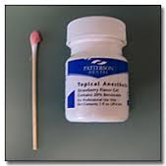

Slide 13
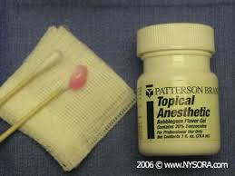

Slide 14
Injectional (infiltrational) anesthesia is the main method of local anesthesia in surgery on the face, jaws, oral cavity and other regions of the human body.

Slide 15
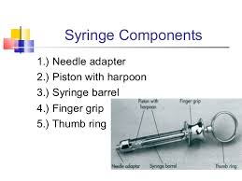

Slide 16
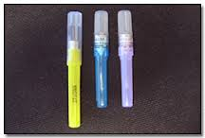

Slide 17


Slide 18
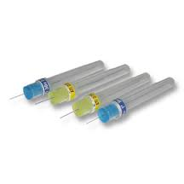

Slide 19
Another option to achieve anesthesia is introducing an anesthetic directly to the nerve stem or nerve plexus innervating particular area, namely conductional or regional anesthesia. Depending on the area of introducing an anesthetic, central anesthesia, predominantly near the place of exit of the nerve stem from the cranial cavity, and peripheral conductional anesthesia in areas innervating certain nerve conductors are differentiated.

Slide 20
At the same time, peripheral conductional anesthesia is widely used for surgery in the oral cavity, especially for extraction of mandibular molars and premolars.

Slide 21
SELECTION OF A LOCAL ANESTHETIC

Slide 22
With so many local anesthetic combinations available for injection, it becomes difficult to select an ideal drug for a given patient. Many dentists deal with this by simply using one local anesthetic for all procedures, regardless of their duration.

Slide 23
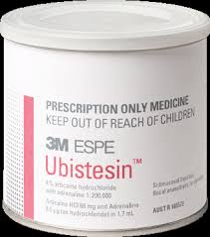

Slide 24
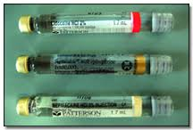

Slide 25
A first approach to the selection of a local anesthetic for a patient includes a consideration of the length of time for which pain control Is required. Table 4-5 lists the commonly used anesthetics according to their usual duration of anesthesia. The average, expected duration of pulpal and soft tissue anesthesia is listed. Again, take note, these numbers are approximations, and the actual duration of clinical anesthesia may be somewhat longer or shorter than indicated.

Slide 26
A second consideration in the selection of a local anesthetic must be the requirement for pain control following treatment. Long-duration anesthetics can be administered when postoperative pain is thought to be a factor. Drugs providing a shorter duration of soft tissue anesthesia can be used for nontraumatic procedures

Slide 27
A third factor is the need for hemostasis during the procedure. Anesthetic solutions containing epinephrine in a 1:50,000 or 1:100.000 dilution is recommended, via local infiltration, when hamostasis is considered necessary.
A fourth factor in the selection of a local anesthetic involves the physical status of the patient. Table 4-6 lists contraindications for local anesthetics based on this criterion.

Slide 28
Absolute contraindications require that the offending drug(s) not he administered to the patient under any condition. The risk that a life-threatening situation will arise is increased. One absolute contraindication to local anesthetic administration exists: documented reproducible allergy. Fortunately this is an extremely rare occurrence, although the incidence of alleged local anesthetic allergy is quite high.

Slide 29
In cases of a relative contraindication it is preferable to avoid administration of the drug in question because of an increased risk that an adverse response will develop. An alternative drug that is not contraindicated is recommended.

Slide 30
Infiltrational, local anesthesia in maxilla: infraorbital anesthesia (extraoral and intraoral technique), incisal anesthesia (extraoral and intraoral technique). Possible complications and prevention in children and adults

Slide 31
There are several general methods of obtaining pain control with local anesthetics. The site of deposition of the drug relative to the area of operative intervention determines the type of injection administered. Three major types of local anesthetic injection can be differentiated—local infiltration, field block, and nerve block.

Slide 32
Local infiltration Small terminal nerve endings in the area of the dental treatment are flooded with local anesthetic solution. Incision (or treatment) is then made into the same area in which the solution has been deposited . An example of local infiltration would be the administration of a local anesthetic into an interproximal papilla prior to root planing

Slide 33
Field block Local anesthetic solution is deposited near the larger terminal nerve branches so the anesthetized area will be circumscribed, to prevent the passage of impulses from the tooth to the central nervous system (CNS). Incision (or treatment) is then made into an area away from the site of injection of the anesthetic . Maxillary injections administered above the apex of the- tooth to be treated arc properly termed field blocks (although common usage identifies them as infiltration or supraperiosteal).

Slide 34
Nerve block Local anesthetic is deposited close to a main nerve trunk, usually at a distance from the site of operative intervention . Posterior superior alveolar. inferior alveolar, and nasopalatine injections are examples of nerve blocks

Slide 35
MAXILLARY INJECTION TECHNIQUES

Slide 36
A number of injection techniques are available to aid in providing clinically adequate anesthesia of the teeth and soft and hard tissues in the maxilla. Selection of the specific technique to be used is determined, in large part, by the nature of the treatment to be provided. The available techniques are as follows:

Slide 37
Supraperiosteal (infiltration), recommended for limited treatment protocols
Periodontal ligament (PDL, intraligamentary) Injection, recommended as an adjunct to other techniques or for limited treatment protocols
Intraseptal injection, recommended primarily for periodontal surgical techniques

Slide 38
Intraosseous injection, rccommended for single teeth (primarily mandibular molars) when other techniques have failed
Posterior superior alveolar nerve block, recom¬mended for management of several molar teeth in one quadrant
Middle superior alveolar nerve block, recommend¬ed for management of premolars in one quadrant
Anterior superior alveolar (infraorbital) nerve block, recommended for management of anterior teeth in one quadrant

Slide 39
Maxillary (second division) nеrve block, recommended for extensive buccal, palatal, and pulpal management in one quadrant
Greater (anterior) palatine nerve block, recommended for palatal soft and osseous tissue treatment distal to the canine in one quadrant
Nasopalatine nerve block, recommended for palatal soft and osseous tissue management from canine to canine bilaterally

Slide 40
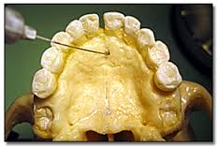

Slide 41
Supraperiosteal Injection
Indications
Pulpal anesthesia of the maxillary teeth when treatment is limited to one or two teeth
Soft tissue anesthesia when indicated for surgical procedures in a circumscribed area
Contraindications
Infection or acute inflammation in the area of injection.
Dense bone covering the apices of teeth can be determined only by trial and error;

Slide 42
Technique
1. A 25- or 27-gauge short needle recommended
2. Area of insertion: height of the mucobuccal fold above the apex of the tooth to be anesthetized
3. Target area: apical region of the tooth to be anesthetized

Slide 43
Anterior Superior Alveolar Nerve Block (Infraorbital Nerve Block)
The anterior superior alveolar (ASA) nerve block does not enjoy the popularity of the PSA block, primarily because there is a general lack of experience with this highly successful and extremely safe technique. It provides profound pulpal and buccal soft tissue anesthesia from the maxillary central incisor through the premolars in about 72% of patients.

Slide 44
Used in place of supraperiosteal injections, the ASA nerve block requires a smaller volume of local anesthetic solution to achieve equivalent anesthesia—0.9 to 1.2 ml versus 3.0 ml lor supraperiosteal injections of the same teeth.
Fortunately this fear is unfounded. Adherence to the following protocol will produce a high success rate devoid of complications and adverse side effects

Slide 45
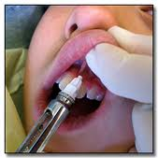

Slide 46
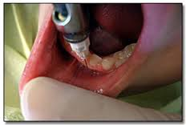

Slide 47
Serves anesthetized
Anterior superior alveolar
Middle superior alveolar
Infraorbital nerve
Inferior palpebral
lateral nasal
Superior labial

Slide 48
Areas anesthetized
Pulps of the maxillary central incisor through the canine on the injected side In about 72% of patients, pulps of the maxillary pre- molars and mesiobuccal root of the first molar
Buccal (labial) periodontium and bone of these same teeth
lower eyelid, lateral aspect of the nose, upper lip

Slide 49
Indications
Dental procedures involving more than two maxillary' teeth and their overlying buccal tissues
Inflammation or infection (which contraindicates supraperiosteal injection); if a cellulitis is present, the maxillary nerve block may be indicated in lieu of the infraorbital nerve block
When supraperiosteal injections have been ineffective because of dense cortical bone

Slide 50
Contraindications
Discrete treatment areas (one or two teeth only— supraperiosteal preferred)
Hemostasis of localized areas, when desirable, cannot be adequately achieved with this injection; local infiltration into the treatment area is indicated

Slide 51
Technique
A 25-gauge long needle recommended, though the 25-gauge short may also be used, especially for children and smaller adults
Area of insertion: height of the mucobuccal fold directly over first premolar
Note: The needle may be inserted into the height of the mucobuccal fold over any tooth from the second premolar anteriorly to the central incisor. The ensuing path of penetration is to the target area, the infraorbital foramen. The first premolar usually provides the shortest route to this target area.

Slide 52
Target area: infraorbital foramen (below the infraorbital notch)
Landmarks
- Mucobuccal fold
- Infraorbital notch
- Infraorbital foramen

Slide 53
Serves anesthetized
Anterior superior alveolar
Middle superior alveolar
Infraorbital nerve
Inferior palpebral
lateral nasal
Superior labial

Slide 54
Areas anesthetized
Pulps of the maxillary central incisor through the canine on the injected side
In about 72% of patients, pulps of the maxillary pre- molars and mesiobuccal root of the first molar
Buccal (labial) periodontium and bone of these same teeth
lower eyelid, lateral aspect of the nose, upper lip

Slide 55
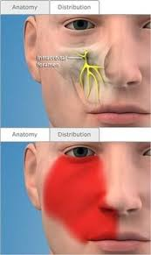

Slide 56
Indications
Dental procedures involving more than two maxillary' teeth and their overlying buccal tissues
Inflammation or infection (which contraindicates supraperiosteal injection); if a cellulitis is present, the maxillary nerve block may be indicated in lieu of the infraorbital nerve block
When supraperiosteal injections have been ineffective because of dense cortical bone

Slide 57
Contraindications
Discrete treatment areas (one or two teeth only— supraperiosteal preferred)
Hemostasis of localized areas, when desirable, cannot be adequately achieved with this injection; local infiltration into the treatment area is indicated

Slide 58
Local anesthesia in maxilla: tuberal (extraoral and intraoral technique), palatinal anesthesia: indications, complications and their treatment in children and adults

Slide 59
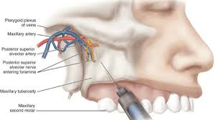

Slide 60
Posterior Superior Alveolar Nerve Block
The posterior superior alveolar (PSA) nerve block is a commonly used dental nerve block. Although it is a highly successful technique (> 90%), there are several issues to weigh when considering its use. These include the extent of anesthesia produced and the potential for hematoma formation

Slide 61
Other common names Tuberosity block, zygomatic block
Nerves anesthetized Posterior superior alveolar and branches

Slide 62
Areas anesthetized
Pulps of the maxillary third, second, and first molars (entire tooth = 72%; mesiobuccal root of the maxil¬lary first molar not anesthetized = 28%)
Buccal periodontium and bone overlying these teeth

Slide 63
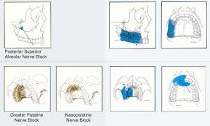

Slide 64
Indications
Treatment involving two or more maxillary molars. When supraperiosteal injection is contraindicated (e.g., with infection or acute inflammation)
When supraperiosteal injection has proved ineffective

Slide 65
Contraindication
When the risk of hemorrhage is too great—as with a hemophiliac—in which case a supraperiosteal or PDL injection is recommended

Slide 66
Complications
Hematoma
• This is commonly produced by inserting the needle too far posteriorly into the pterygoid plexus of veins. Additionally, the maxillary artery may be perforated. I 'sc of a short needle minimizes the risk of pterygoid plexus puncture.
• A visible hematoma develops within several minutes, usually noted in the buccal tissues of the mandibular region.
- There is no easily accessible area to which pressure can be applied to stop the hemorrhage.
- Bleeding continues until the pressure of the extravascular blood is equal to or greater than that of intravascular blood.

Slide 67
PALATAL ANESTHESIA
Anesthesia of the hard palate is necessary for dental procedures involving manipulation of palatal soft or hard tissues.

Slide 68
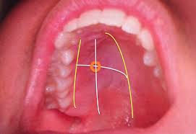

Slide 69
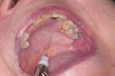

Slide 70
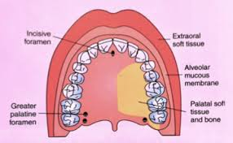

Slide 71
Greater Palatine Nerve Block
The greater palatine nerve block is quite useful during dental procedures involving the palatal soft tissues distal to the canine. Minimum volumes of solution (0.45 to 0.6 ml) provide profound hard and soft tissue anesthesia. Although potentially traumatic, the greater palatine nerve block is less so than the nasopalatine nerve block because the tissues surrounding the greater palatine foramen are better able to accommodate the volume of solution deposited.
Other common name- Anterior palatine nerve block

Slide 72
Nerve anesthetized Greater palatine
Areas anesthetized The posterior portion of the hard palate and its overlying soft tissues, anteriorly as far as the first premolar and medially to the midline

Slide 73
Indications
When palatal soft tissue anesthesia is required for restorative therapy on more than two teeth (e.g.. with subgingival restorations and insertion of matrix bands subgingivally)
For pain control during periodontal or oral surgical procedures involving the palatal soft and hard tissues

Slide 74
Contraindications
Inflammation or infection at the injection site
Smaller areas of therapy (one or two teeth)

Slide 75
Technique
A 27-gauge short needle recommended (though the 2S-gauge short may also be used)
Area of insertion: soft tissue slightly anterior to the greater palatine foramen
Target area: greater (anterior) palatine nerve as it passes anteriorly between the soft tissues and bone of the hard palate
Landmarks: greater palatine foramen and junction of the maxillary alveolar process and palatine bone
Path of insertion: advance the syringe from the opposite sick of the mouth at a right angle to the target area.

Slide 76
Local anesthesia in mandible.
Akinosi closed-mouth mandibular block. Mandibular nerve block: the Gow-Gates technique). Possible complications: treatment and prevention in adults and children. The central methods of nerve block anesthesia (at oval foramen) in mandible and surrounding tissues

Slide 77
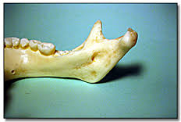

Slide 78
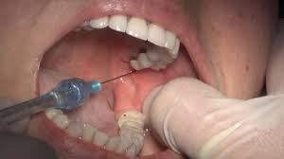

Slide 79
Successful pulpal anesthesia of mandibular teeth is quite a bit more difficult to achieve on a consistently reliable basis. Success rates of 80% to 85% for the inferior alveolar nerve block, the most frequently administered mandibular injection, attest to this fact.

Slide 80
Reasons for these lower success rates include the greater density of the buccal alveolar plate (which precludes supraperiosteal injection), limited accessibility to the inferior alveolar nerve, and the wide variation in anatomy. Although an 80% rate of success does not seem particularly low, consider that one out of every five patients will require reinjection to achieve clinically adequate anesthesia.

Slide 81
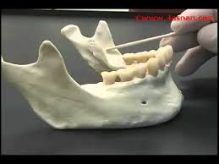

Slide 82
The success rate of the inferior alveolar nerve block is lower than for most other (maxillary) nerve blocks, because of anatomical considerations in the mandible (primarily the density of bone), the administrator must accurately deposit local anesthetic solution to within 1 mm of the target nerve.

Slide 83
Inferior alveolar nerve anesthesia , also known as the inferior alveolar nerve block or IANB, is a technique for dental anesthesia, used to cause numbness to the areas of the face innervated by the inferior alveolar nerve; namely, the lower lip and the teeth and gingiva of the mandible. This procedure attempts to anaesthetise the inferior alveolar nerve prior to it entering the mandibular foramen.

Slide 84
