Slide 1
ODESSA NATIONAL MEDICAL UNIVERSITY
DEPARTMENT OF ORAL AND MAXILLOFACIAL SURGERY
Lecture # 13 «Impacted and/or dystopic lower third molars extraction. Technique. Possible complications and their prevention»
Year 3 Stomatological faculty

Slide 2
Extraction of the impacted
lower third molar

Slide 3
Position of the tooth &nd its
line of withdrawal

Slide 4
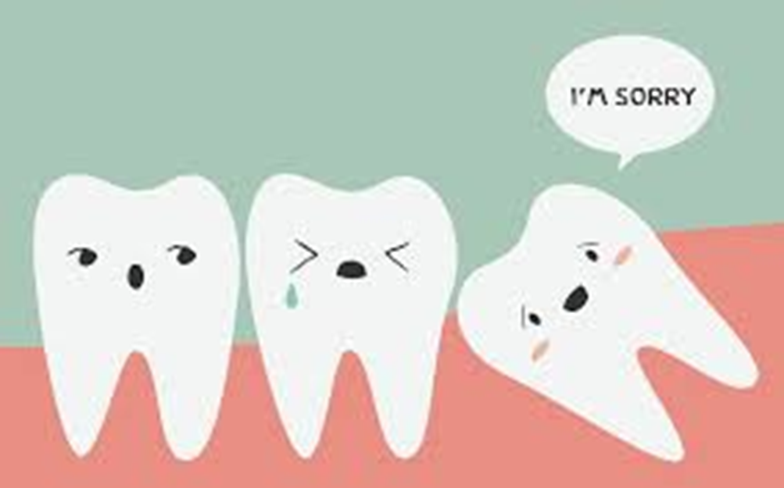

Slide 5
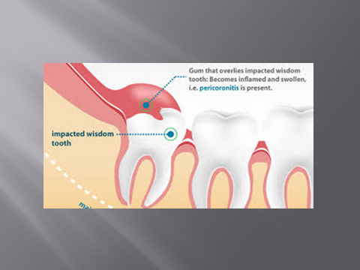

Slide 6
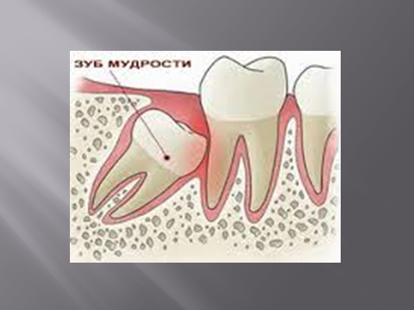

Slide 7
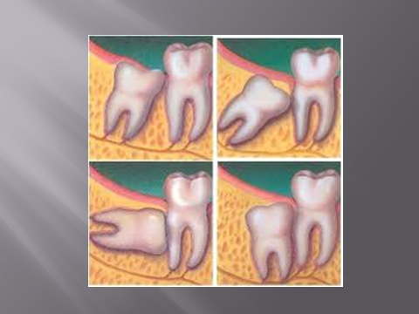

Slide 8
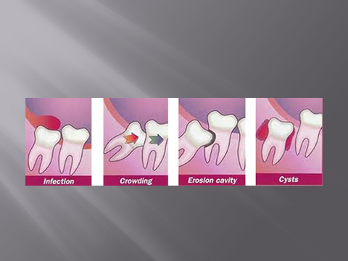

Slide 9
The position of the unerupted lower third molar may be vertical, horizontal, mesioangular or distoangular. The crown usually lies nearer the lingual than the buccal plate. Occasionally it is inverted or lies across the mandible, with the crown facing either bucally or lingually. Very rarely it is found in the ascending ramus or at the lower border of the mandible.

Slide 10
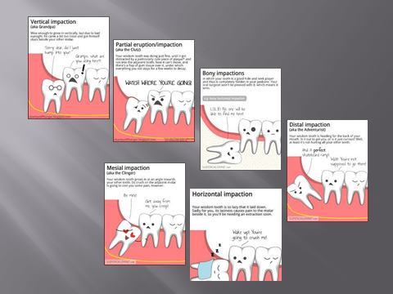

Slide 11
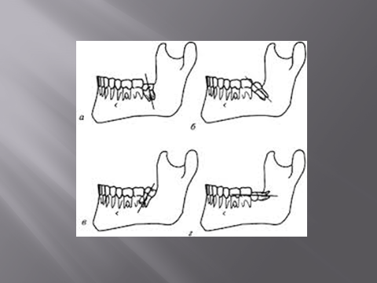

Slide 12
The natural line of the tooth can only be determined by a study of radiographs showing the form of the roots which may be fused, divergent, straight or curved to favour or prevent extraction of the tooth.

Slide 13
The difficulty of the extraction is increased if access is difficult. This may occur if the mouth is small, where the space between the anterior border of the mandible and the distal aspect of the second molar is narrow or when the tooth is deeply buried in bone.

Slide 14
Obstacles to extraction

Slide 15
Bone
All or part of the crown may be covered by bone. How deeply the tooth is buried is calculated by measuring the vertical distance from the cervical margin of the second molar to the mesial cervical margin of the tooth except in distoangular impactions where the distal cervical margin is used.

Slide 16
Where this distance over 4mm the tooth should be regarded as deeply buried. Vertically placed buried teeth may only need bone to be removed from over the whole of the occlusal and buccal surfaces of the crown for them to be elevated up and out with a elevator applied to the buccal aspect of the root.

Slide 17
They must, however, be distinguished from the tooth that is distally impacted against the bone of the ascending ramus. These are the most difficult of all impacted third molars to extract.

Slide 18
They should always be approached with great caution, especially where they are deeply placed, lie far back in the ascending ramus, or the roots have a distal curvature.

Slide 19
Where the roots are curved distally this may still prove difficult until further bone has been cut to free them distally, or the roots are sectioned again. If the roots are separate vertical division is often useful.

Slide 20
The inferior dental neurovascular bandle
This may be damaged by direct trauma from burs or elevators, or indirectly when the tooth is elevated or rotated as the root can crush or tear the neurovascular bundle.

Slide 21
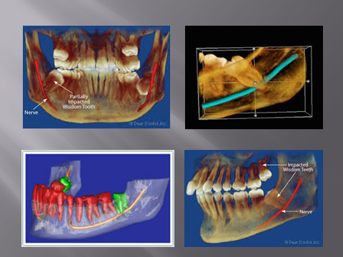

Slide 22
The relationship of roots, particularly of the lower third molar, to the inferior dental canal may be deduced from radiographs. It may clearly lie below the roots or appear to cross them. In the latter relationship it is probably grooving the roots if the radiolucent band of the canal is seen to cross them above their apices

Slide 23
Where the root is deeply notched the white lines, representing the cortical plates lining the canal, converge, are diverted or are interrupted. This is a warning that heavy or repeated elevation may compress the nerve
against bone to cause hypoaesthesia or paraesthesia.

Slide 24
Impaction against a tooth
The third molar may impact against the second molar either in the mesioanglar or in the horizontal position. The impaction may be overcome in one of three ways.

Slide 25
Extraction of the second molar can be justified by gross caries or periodontal disease.It is often advised where the third molar is heavily impacted against the distal root of the second molar without any apparent intervening alveolar, bone.

Slide 26
Operative technique

Slide 27
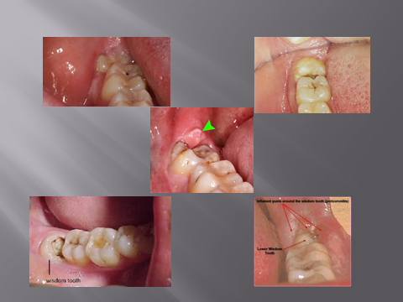

Slide 28
The flap
The incision for partly erupted third molars is commenced in the distal part of the gingival crevice and carried buccally round the crown of the tooth to just behind the crown of the second molar (where the tooth is buried the incision starts on the alveolar crest, distal to the second molar).

Slide 29
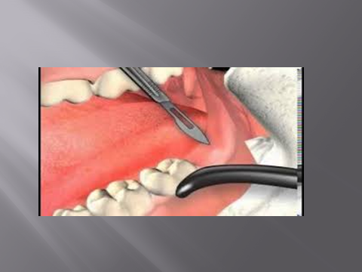

Slide 30
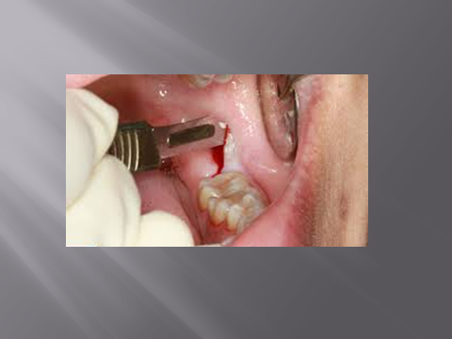

Slide 31
The envelope flap
The incision is carried forward in the gingival crevice of the second and first molar teeth and relieved distal to the third molar towards the external oblique ridge. Initially the flap is raised along the gingival margin with a suitable fine instrument .

Slide 32
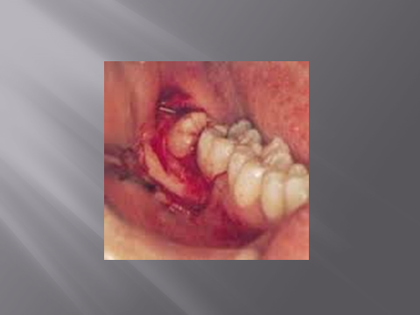

Slide 33
Bone removal
With the improvement in high speed drills incorporating water delivery systems bone removal is now almost universally achieved using burs. Bone can quickly be removed by grinding using a tungsten carbide rosehead bur.

Slide 34
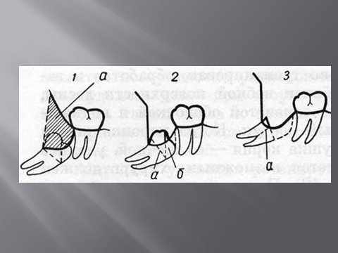

Slide 35
Debridement
The wound must be cleansed of debris and the follicle of the tooth removed by grasping it firmly in tissue forceps and drawing it gently off the bone. Where it is attached to the flap, this may be gently dissected off with a Mitchell's trimmer, but great care should be taken on the lingual side as the lingual nerve may be inadvertently damaged.

Slide 36
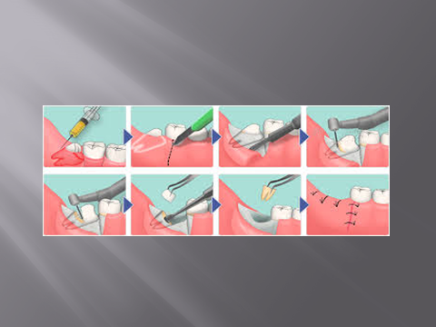

Slide 37
Closure
One suture in the distal part of the incision, over the external oblique ridge, is usually sufficient to hold the flap in position. Primary closure of the wound edges can protect the socket and improve the chances of uneventful healing but the flap should not be placed under tension to achieve this as it will tend to break down.

Slide 38
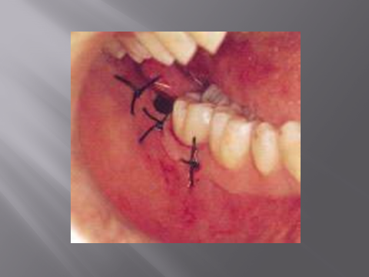

Slide 39
THE END

