Slide 1
LECTURE STUDY GUIDE
Subject «Oral and maxillofacial surgery»
Lecture № 12 «The management of impacted teeth. Incidence, Etiology, Evaluation, Surgical Treatment.»
Year 3 Stomatological faculty
Prof. Gulyuk A.G.

Slide 2
The management of impacted teeth is a basic component of most oral and maxillofacial surgery practices. Although the majority of impacted teeth are third molars, any other tooth may be impacted.

Slide 3
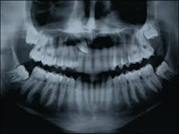

Slide 4
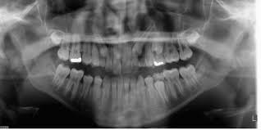

Slide 5
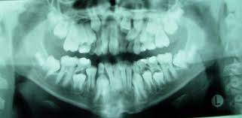

Slide 6
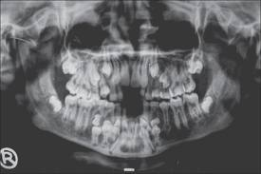

Slide 7
The usual care for impacted third molars is removal; however, the care for impacted teeth other than third molars may include exposure (with or without attachment of an orthodontic bracket), uprighting, transplantation, or removal. These teeth often pose challenges in treatment planning and surgical care.

Slide 8
Incidence

Slide 9
The incidence of impacted permanent teeth has been addressed in several studies. Grover and Lorton examined 5,000 army recruits and found a high frequency of impacted teeth. Although maxillary and mandibular third molars were the teeth most commonly impacted, 212 teeth excluding third and fourth molars were impacted.

Slide 10
Thilander and Myrberg examined more than 6,000 Swedish school children and found a 5.4% prevalence of impacted teeth excluding third molars. In an evaluation of 3,874 full-mouth radiographs, Dachi and Howell found the incidence of impacted canines in the maxilla to be 0.92% and of other non–third molar teeth to be 0.38%.

Slide 11
In a study of middle-aged and older Swedish women, Grondahl found approximately 25 non–third molar impacted teeth in 1,418 women evaluated. Again, the canine tooth was the most frequent non–third molar impaction identified, followed by premolars and second molars.

Slide 12
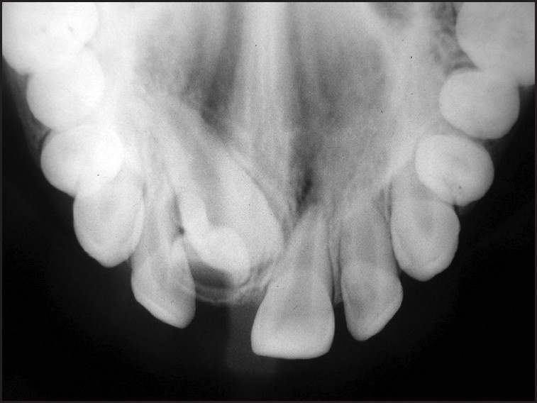

Slide 13
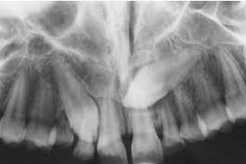

Slide 14
The next most likely teeth to be impacted are mandibular bicuspids, followed by maxillary bicuspids and second molars.
Impactions of first molars and incisors are relatively uncommon.

Slide 15
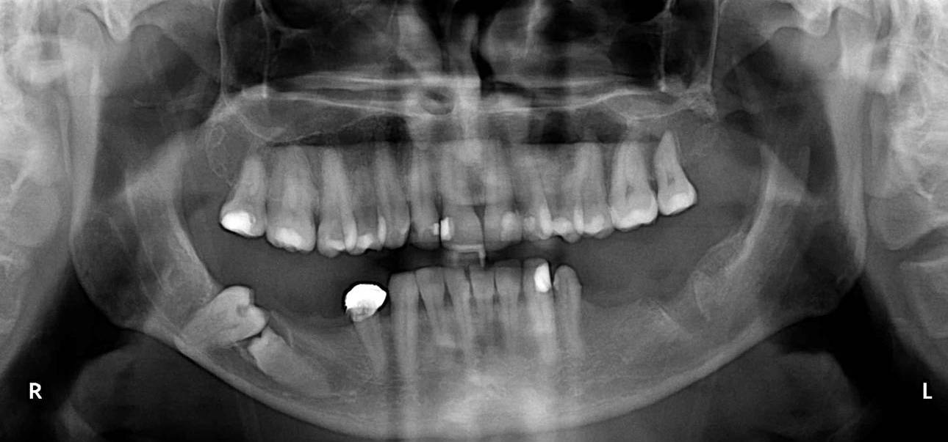

Slide 16
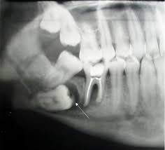

Slide 17
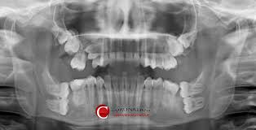

Slide 18
Etiology

Slide 19
The definition of an impacted tooth is a tooth that can not, or will not, erupt into its normal functioning positions, and is, therefore, pathologic and requires treatment. Causes of impacted permanent teeth include systemic and local factors. Impaction of teeth in the hereditary syndrome of cleidocranial dysplasia is more properly termed primary retention.

Slide 20
Endocrine deficiencies (hypothyroidism and hypopituitarism), febrile diseases, Down syndrome, and irradiation are other systemic factors that may influence impaction of permanent teeth. In all of these systemic conditions, multiple teeth are generally involved

Slide 21
More commonly local factors are the cause of permanent tooth impaction. These factors include prolonged deciduous tooth retention, malposed tooth germs, arch-length deficiency, supernumerary teeth, odontogenic tumors abnormal eruption path, and cleft lip and palate.

Slide 22
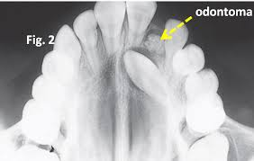

Slide 23
Evaluation

Slide 24
Clinical diagnosis of impacted permanent teeth is straightforward, involving clinical inspection that discloses the absence of the tooth in its normal position combined with the radiographic assessment showing the unerupted position of the tooth.

Slide 25
Radiographic assessment of the impacted teeth is important in the preparation for surgical or orthodontic treatment.
Standard radiographic techniques may be used to localize the unerupted teeth. These include the tube shift method, buccal object rule, and periapical occlusal method.

Slide 26
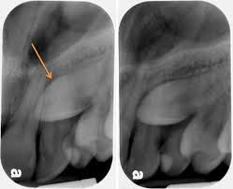
tube shift method

Slide 27
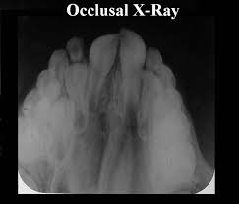

Slide 28
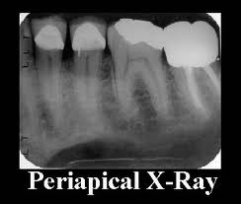

Slide 29
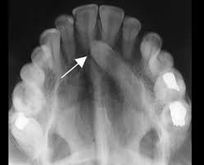

Slide 30
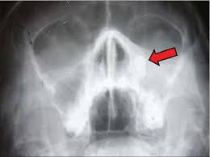

Slide 31
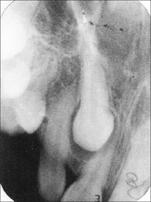

Slide 32
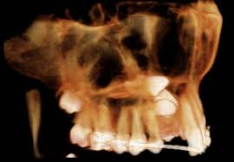

Slide 33
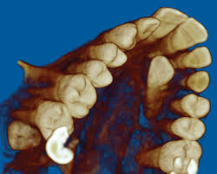

Slide 34
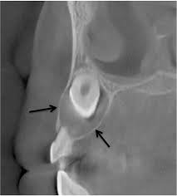

Slide 35
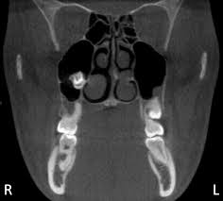

Slide 36
The tube shift method uses two periapical radiographs, shifting the tube horizontally between exposures. If the unerupted tooth moves in the same direction in which the tube is shifted, it is localized on the lingual or palatal side. A facial or buccally located tooth moves in the opposite direction to the tube shift.

Slide 37
The periapical occlusal method uses the periapical radiograph taken with a standard technique and an occlusal radiograph to give two different views of the impacted tooth. Panoramic films can be used to assess maxillary canine position.

Slide 38
Surgical Treatment

Slide 39
Treatment of impacted permanent teeth must be based on clinical and radiographic evaluation as well as a determination of future risks.

Slide 40
Clearly, teeth that are symptomatic, have caused infection in the surrounding tissues, or have radiographic evidence of development of changes (cyst formation, resorption of adjacent teeth, or root resorption of the impacted teeth) require surgical treatment.

Slide 41
Treatment of the asymptomatic tooth must take into account many factors, including age, specific prevalence of pathologic conditions, severity of potential pathology associated with impacted teeth, progression of untreated conditions, frequency and severity of potential complications of treatment, potential patient discomfort and inconvenience associated with either treatment or nontreatment, and economic consequences of treatment.

Slide 42
Methods of treatment of impacted permanent teeth include orthodontic assistance through surgical exposure with or without attachment of the tooth, surgical uprighting, transplantation, and surgical removal.

Slide 43
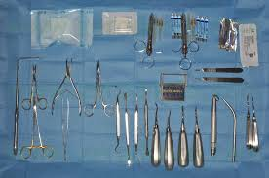

Slide 44
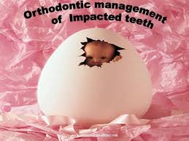

Slide 45
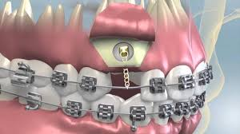

Slide 46
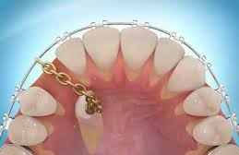

Slide 47
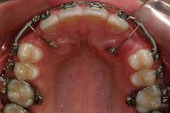

Slide 48
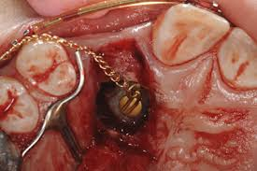

Slide 49
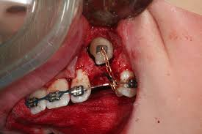

Slide 50
Removal

Slide 51
Surgical removal of impacted permanent teeth may be performed when other methods of treatment are unavailable. Basic surgical principles of radiographic assessment and careful surgical technique must be followed.

Slide 52
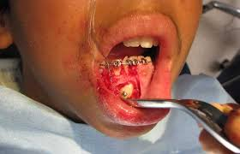

Slide 53
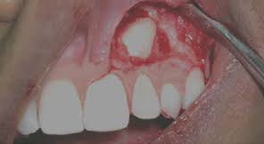

Slide 54
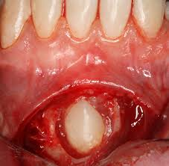

Slide 55
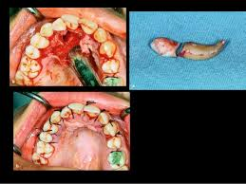

Slide 56
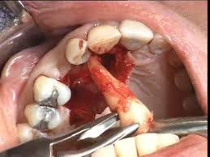

Slide 57
Conservation of bone through conservative exposure and removal with sectioning of the tooth should be considered. Impacted canines should be approached from the surface of the maxilla with which they are most closely associated.

Slide 58
Labially impacted canines are frequently removed with an elevator technique, but palatal canines generally require removal of the crown followed by sectioning of the root.
Impacted maxillary bicuspids may be removed much like canines.

Slide 59
Mandibular bicuspids are generally approached from the labial surface of the mandible. Care must be taken to preserve the integrity of the mental nerve when the impacted tooth is nearby

Slide 60
Impacted teeth other than third molars are relatively common findings. Much can be done to preserve these teeth and allow their functional positioning within the dental arch. Surgical exposure with or without orthodontic guidance, surgical uprighting, and transplantation of teeth are valuable techniques that can be mastered by oral and maxillofacial surgeons.

