Slide 1

Basics of Radiation imaging semiotics of organs in the abdominal area of the body. Radiation imaging semiotics of pathologies of the Gastro-Intestinal tract(GIT) diseases.
ODESSA NATIONAL MEDICAL UNIVERSITY
Department of Radiation Diagnostics, Therapy and Oncology
As. Elena Kabachynskaya
Odessa National Medical University
Department of Radiation Diagnostics, Therapy and Oncology
Odessa – 2021

Slide 2
CONTENTS
Imaging modalities:
Plain X-ray abdomen
Contrast studies
Ultrasound
Computed Tomography & Magnetic Resonance Imaging
Angiography & Interventional radiology
Others: ERCP, PTC, intra-op & T-tube cholangiogram, Radionuclide imaging – IDA, Meckel’s and GIT bleed.
Quiz and summary.

Slide 3
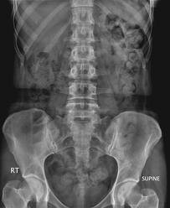
X-ray Abdomen
The most common plain radiograph of the abdomen is an anteroposterior (AP) view with the patient in the supine position.
The AP view of the abdomen is also called a KUB film because it includes the kidneys, ureters and bladder.
When acute abdominal disease is suspected clinically, an erect film of the abdomen and a posteroanterior (PA) view of the chest are also required.

Slide 4
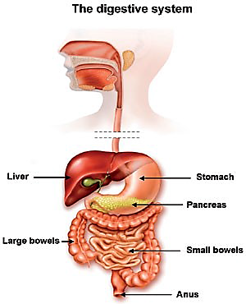
Digestive System
The digestive system consist of:
1. Oral Cavity
2. Pharynx
3. Oesophagus (muscular tube 25cms long extending fromC6 to T11)
4. Stomach
5. Small Intestine
6. Large Intestine

Slide 5
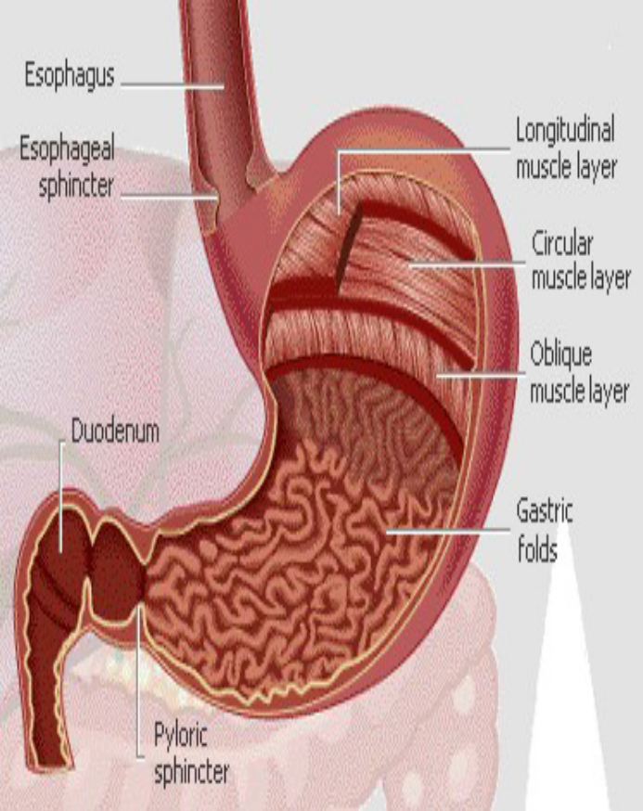
Gross Anatomy of the Stomach
1. Lesser curvature
2. Greater curvature
3. Cardia - end under the heart
4. Fundus - bulge above the esophageal opening
5. Body - largest region
6. Pylorus - J curve, inferior end, terminates in
7. Pyloric sphincter and superior end terminates in
8. Cardiac sphincter
9. Rugae – highly extendable interior folds

Slide 6
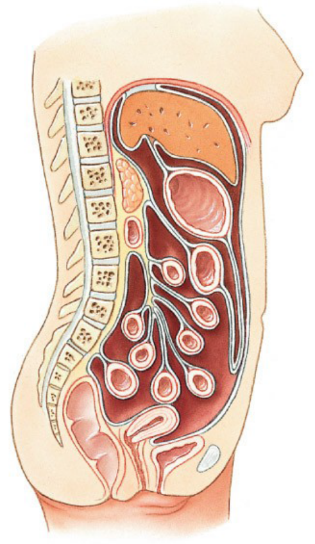
Membrranes
Peritoneum - generic serous membrane in
abdominal cavity
Mesenteries - double sheets of peritoneum,
surrounding and suspending portions of the digestive organs
• Greater omentum - "fatty apron", hangs anteriorly from stomach, double layer encloses fat
• Lesser omentum - between stomach and liver
• Mesentery proper - suspends and wraps the small intestine
• Mesocolon - suspends and wraps the colon, parts are:
1. transverse mesocolon
2. sigmoid mesocolon

Slide 7
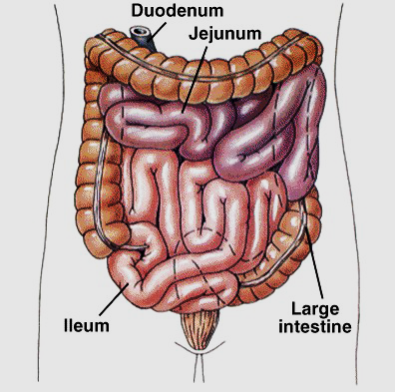
Regions of Small Intestine
SI is longest part of dig. tube
• Duodenum (short, 12 inches)
– fixed shape & position
– Mixing bowl for chyme
• Jejunum (2.5 m long)
– Most of digestion
• Ileum (longest at 3.5 m)
– Most of absorption, ends in
• Ileocecal valve – slit valve into large intestine (colon)

Slide 8
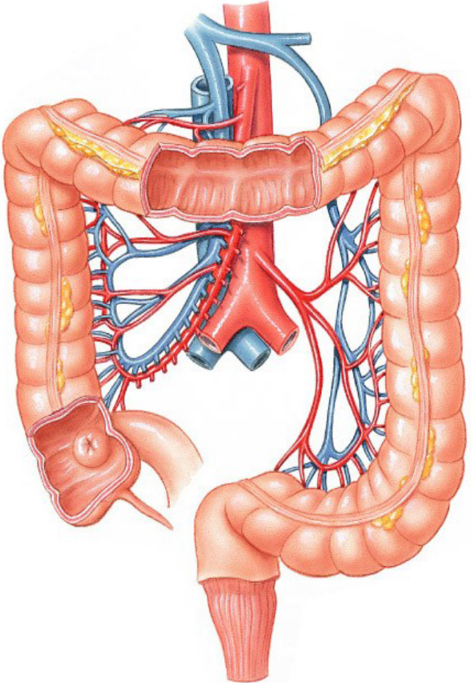
Regions of Large Intestine
Cecum - pocket at proximal end with
Appendix
Collon:
Ascending colon - on right, between
cecum and right colic flexure;
Transverse colon - horizontal portion;
Descending colon - left side, between
left colic flexure end;
Sigmoid colon - S bend near terminal
end.
Rectum – terminal end is anal canal - ending at the anus -
which has internal involuntary sphincter and external voluntary sphincter

Slide 9
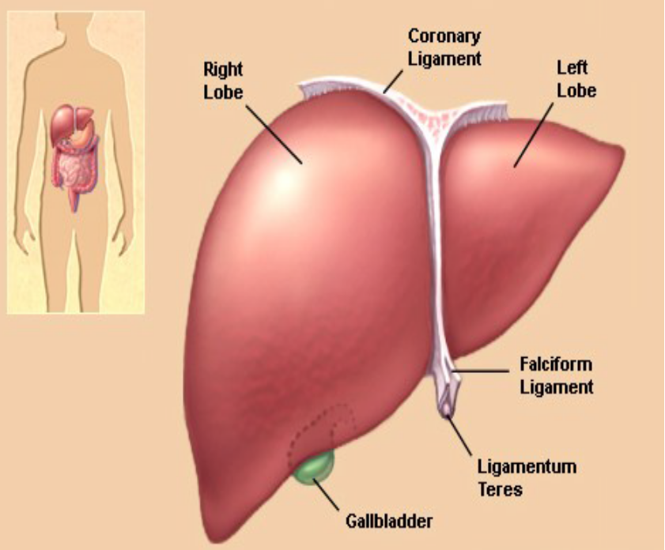
Abdomen Anatomy-Liver
Liver - largest gland in the
body, present in RUQ. Two
major lobes two minor
lobes.
Falciform ligament separates larger Rt lobe from Lt lobe, small quadrate lobe lies inferior to Rt lobe and posterior to quadrate lobe lies caudate lobe

Slide 10
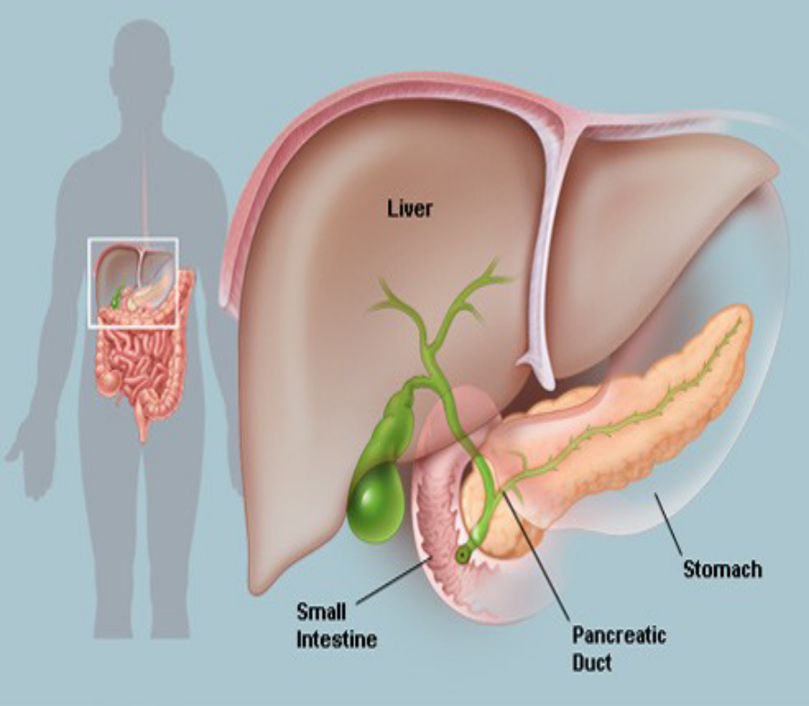
Abdomen Anatomy-CBD
Extrahepatic biliary apparatus
Rt and Lt hepatic duct from right
and left lobe of liver unite to form
common hepatic duct.
Gallbladder – pear shaped, 7 – 10cm
long. Has three parts, fundus is
distal and middle part is body
continues proximally as cystic duct.
Common bile duct – formed by
union of cystic duct and common
hepatic duct. It joins with pancreatic duct and opens into second part of duodenum at duodenal papilla

Slide 11
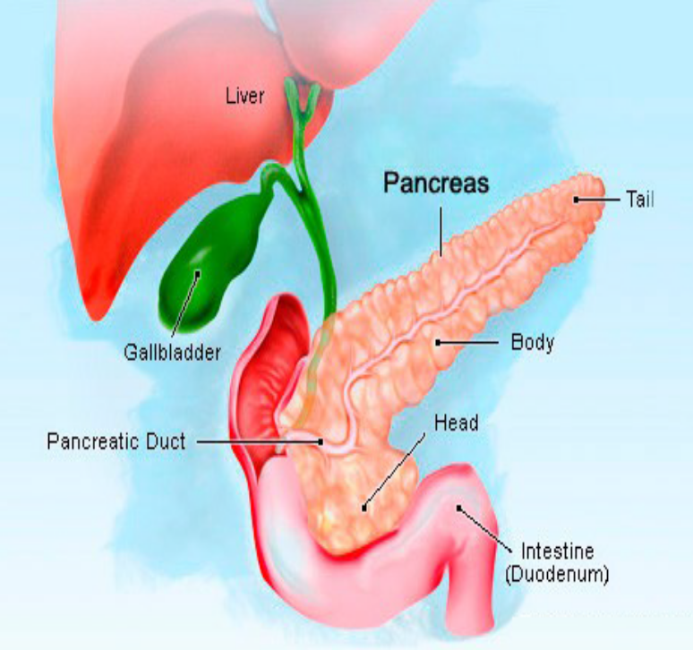
Abdomen Anatomy-Pancreas
Pancreas is transversely placed between L1 and L2. It has three parts head, body and tail.
It is partly exocrine and partly endocrine.
Endocrine part secretes insulin and glucagon.
Exocrine part secretes pancreatic juice.
The pancreatic duct opens in to second part of duodenum.

Slide 12
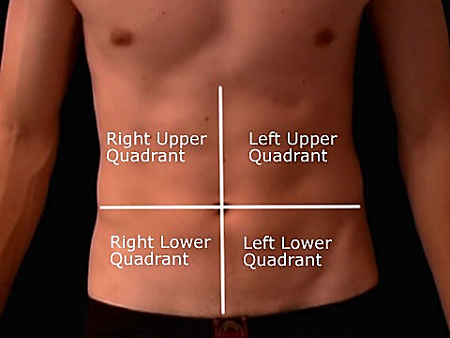
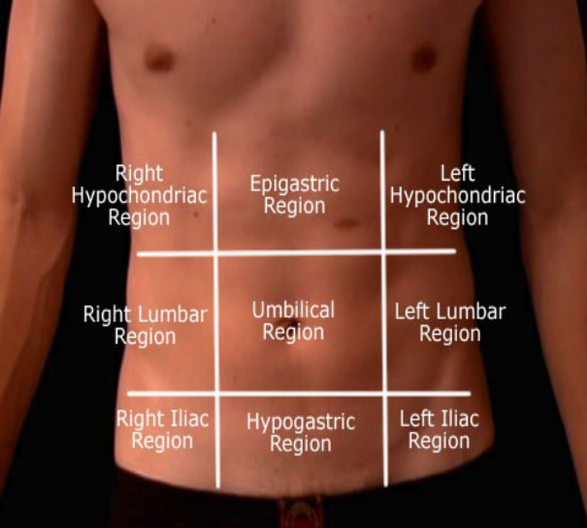
Surface Anatomy-Quadrants & Regions
Upper transverse plane.
Lower transverse plane.
Sagittal planes at right angles to transverse planes divide the abdomen into four quadrants and nine regions.

Slide 13
Plain X-ray abdomen
Remember the five basic densities on X-rays:
Gas -> Black
Fat -> Dark grey
Soft tissue/fluid -> Light grey
Bone/calcification -> White
Metal -> Intense white

Slide 14
Indications:
Bowel obstruction
Perforation
Renal pathology
Acute abdomen
Foreign body localization
Toxic megacolon
Aortic aneurysm
Control or preliminary films for contrast studies
Detection of calcification or abnormal gas collection

Slide 15
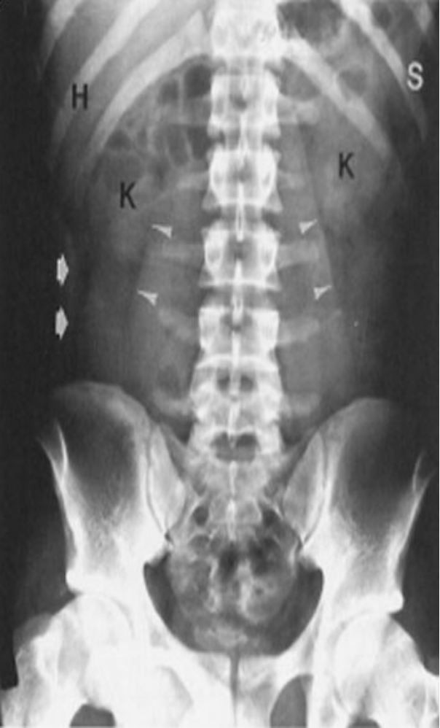
Abdomen - plain film Anatomy
A Normal plain film of the abdomen. The lower margins of the posterior portion of the liver, the hepatic angle (H), and the lower part of the spleen
(S) are delineated by a fat shadow. Both kidneys (K) and the psoas muscle
shadows (arrowheads) are outlined by a fat shadow. The properitoneal fat stripe is also shown bilaterally (arrows).

Slide 16
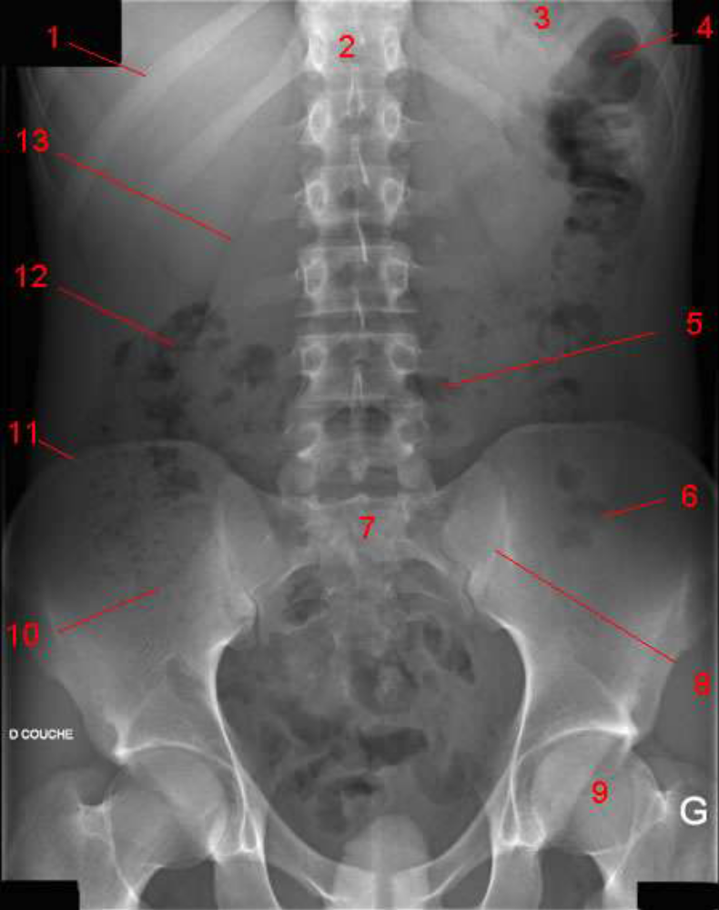
1. 11th rib.
2. Vertebral body (TH 12).
3. Gas in stomach.
4. Gas in colon (splenic flexure).
5. Gas in transverse colon.
6. Gas in sigmoid.
7. Sacrum.
8. Sacroiliac joint.
9. Femoral head.
10. Gas in cecum
11. Iliac crest.
12. Gas in colon (hepatic flexure).
13. Psoas margin.

Slide 17
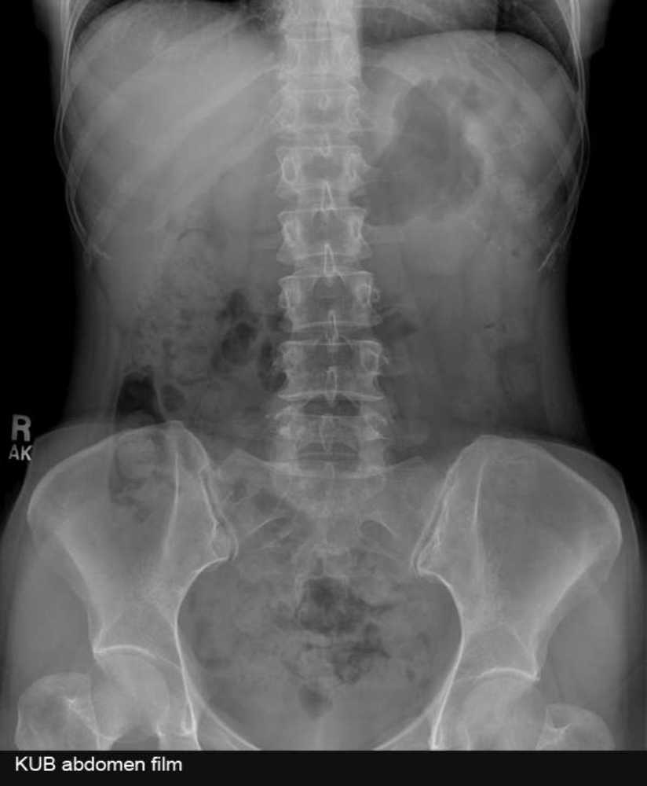
Normal stomach
If the stomach contains air it may be visible in
the left upper quadrant of the abdomen. The
lowest part of the stomach crosses the
midline.

Slide 18
Look at the diagram
Are they raised or flattened?
Are the costophrenic angles clear?
Is there any free intra-abdominal air(better to be judged if erect or decubitus)?

Slide 19
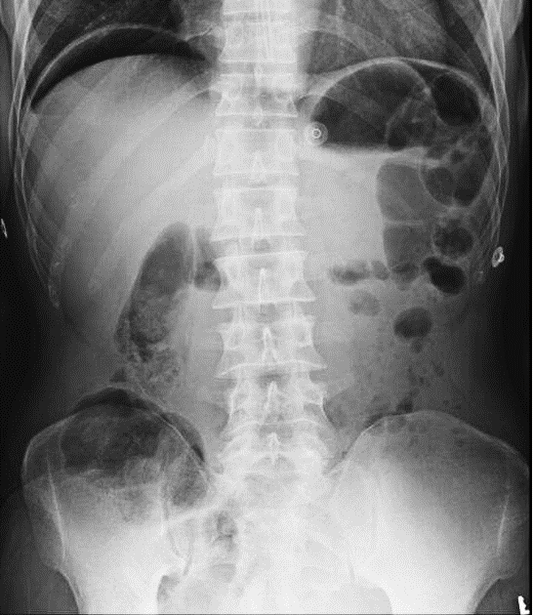
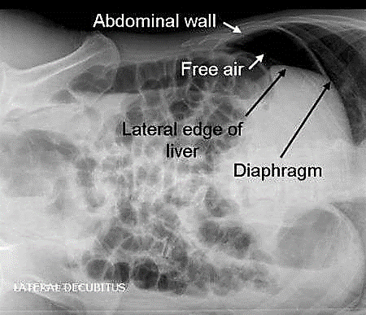
An X-ray erect abdomen reveals crescentric gas under right diaphragm in keeping with a visceral perforation.
Lateral decubitus view of an abdominal X-ray exhibiting
free intra-abdominal air between the liver, right
hemidiaphragm and lateral abdominal wall.

Slide 20
Look at the liver
The liver lies in the right upper quadrant (RUQ) and is seen as a bland area of grey on an abdominal X-ray.
Is it enlarged?
Is it shrunk?
Is it displaced?
Are there any signs for a Chilaiditi's syndrome
(interposition of the colon between the right
hemidiaphragm and the colon)?
Are there any calcifications?

Slide 21
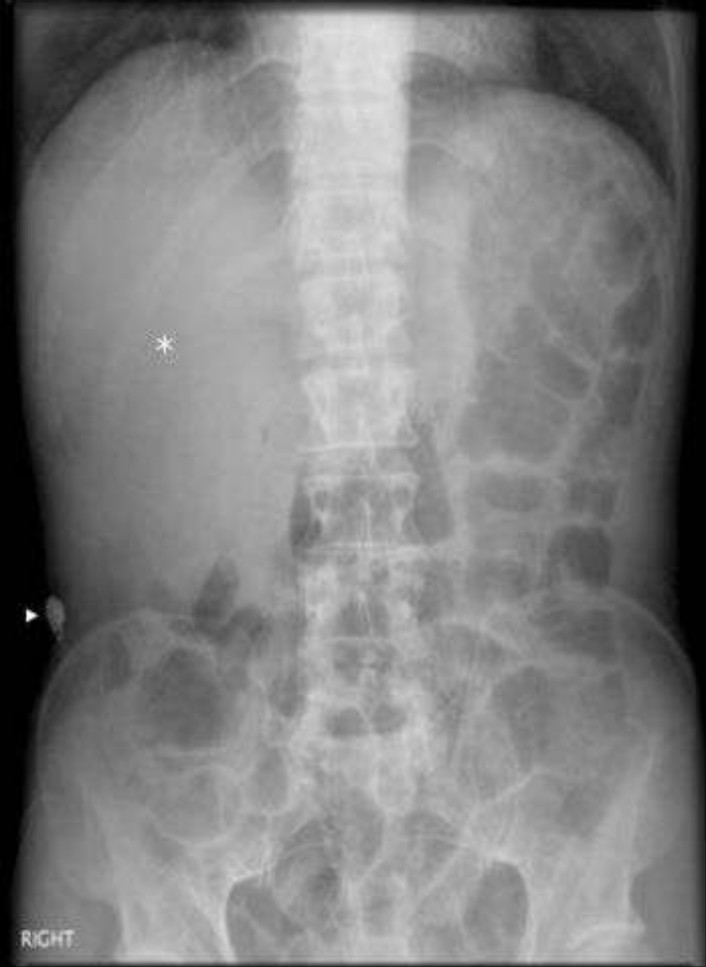
Abdominal X-ray showing an enlarged liver (*) displacing
the ascending and transverse colon downward. Note the
metallic artefact (arrowhead) consistent with a zipper.

Slide 22
Look at the spleen
The spleen lies in the left upper quadrant
(LUQ)immediately superior to the left kidney.
Is it enlarged?
Is it shrunk?
Has it been removed?
Are there any calcifications?

Slide 23
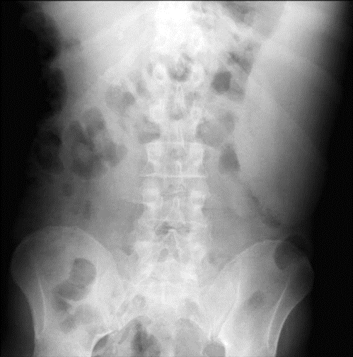
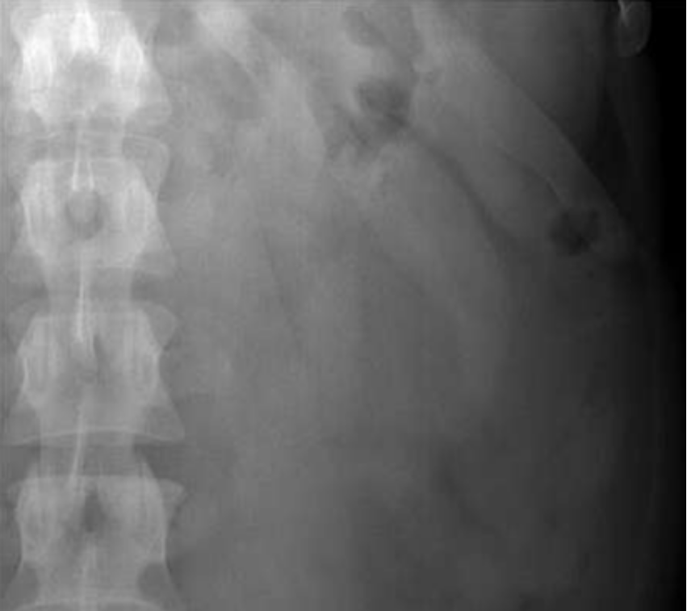
X-ray of abdomen showing enlarged spleen

Slide 24
Psoas muscles
Psoas edges on abdominal X-ray
The psoas muscles arise from the transverse
processes of the lumbar vertebrae and
combine with the iliacus muscles attaches to
the lesser trochanter of the femur.
An abdominal X-ray often demonstrates the
lateral edge of the psoas muscles as a near
straight line.

Slide 25
Look for the bowel gas pattern
Where are the bowel loops located (central vs. peripheral)?
Is there too much intraluminal gas?
What is the distribution of the gas in the abdomen?
What is the intraluminal caliber of the smalland large bowel?
Are there any dilatations of the small and/or large bowel?
Identify any air-fluid levels?

Slide 26
Small bowel identified by:
Central position in the abdomen
Valvulae conniventes - mucosal folds that cross
the full width of the bowel
Large bowel, normal large bowel may be identified by:
Peripheral position in the abdomen (the
transverse and sigmoid colon occupy very
variable positions)
Haustra
Contains faeces

Slide 27
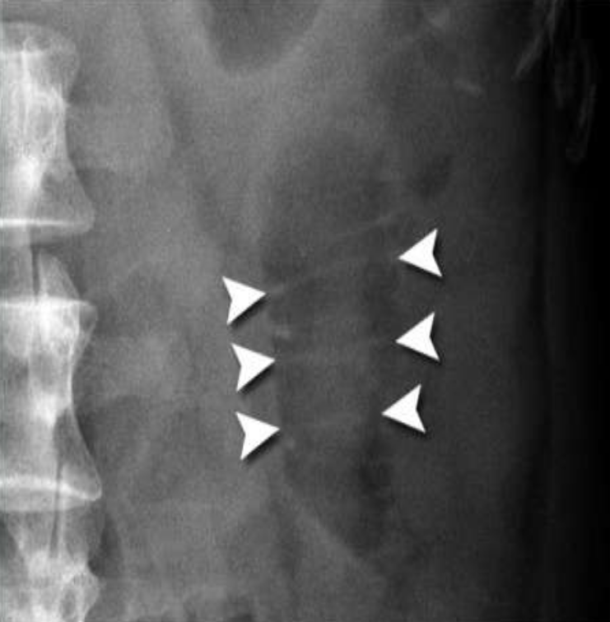
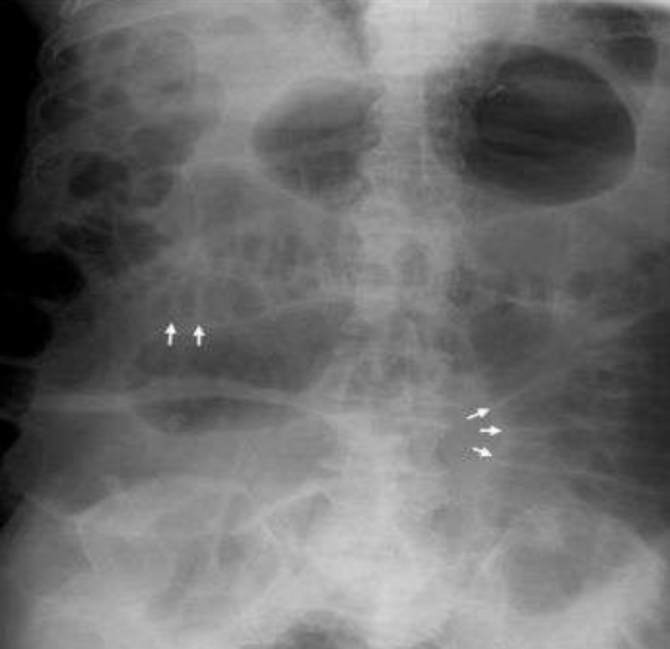
Usually they become visible when the small bowel is more distended, in particular the jejunum.

Slide 28
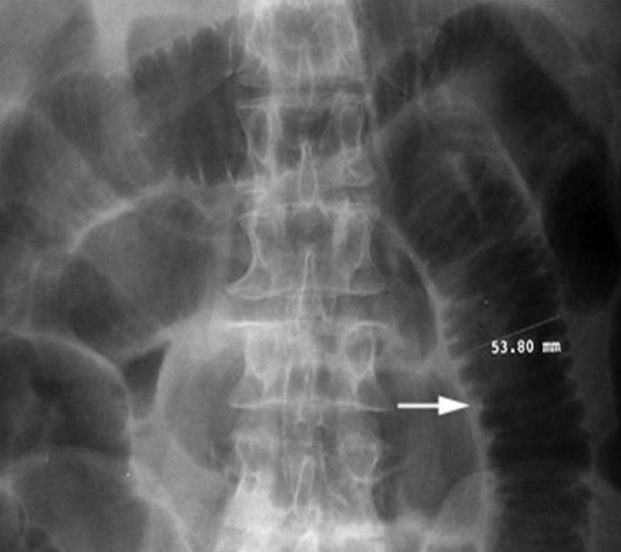
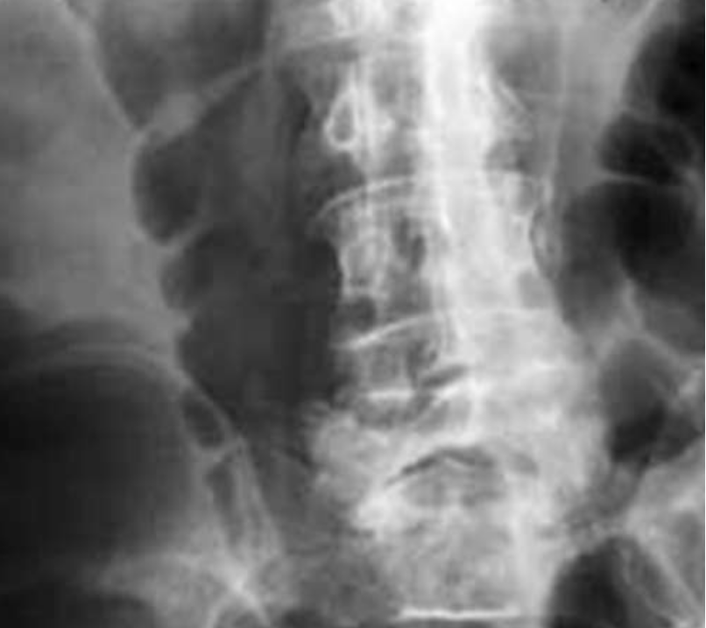
Compare
Small bowel
Large bowel
Valvulae conniventes
Haustra

Slide 29
Contrast studies
Barium swallow
Barium meal
Barium follow-through
Barium enema

Slide 30
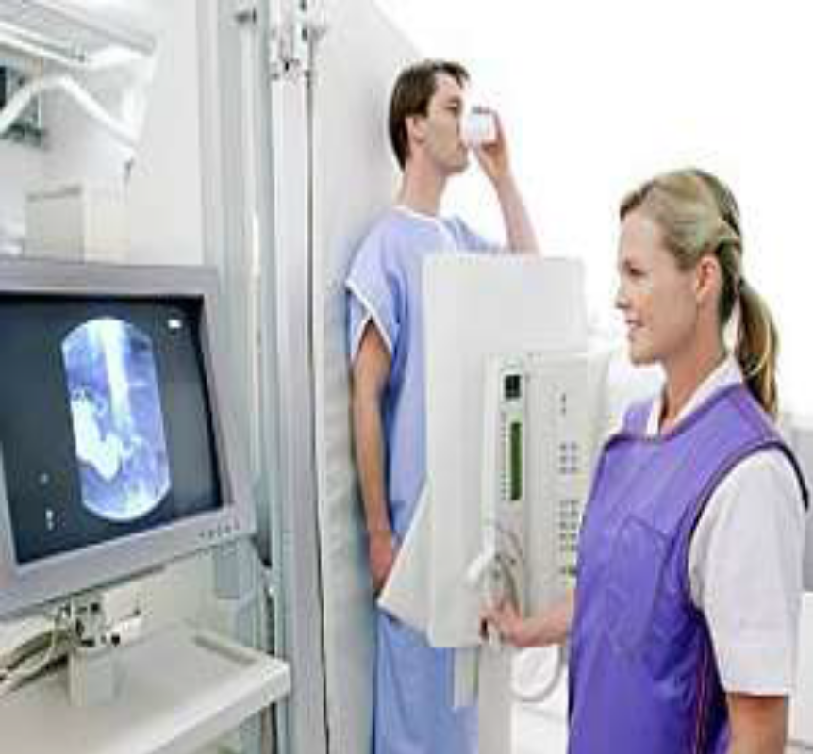
Administering a contrast agent modifies the image to give more information. Typical ones are barium, an inert particulate contrast used in GI tract evaluation and Iodine, a water soluble agent which can be injected into the
vascular tree.

Slide 31
Barium swallow
It is a medical imaging procedure used to
examine upper gastrointestinal tract, which
include the esophagus and to a lesser extent
the stomach.
The contrast used is barium sulfate.

Slide 32
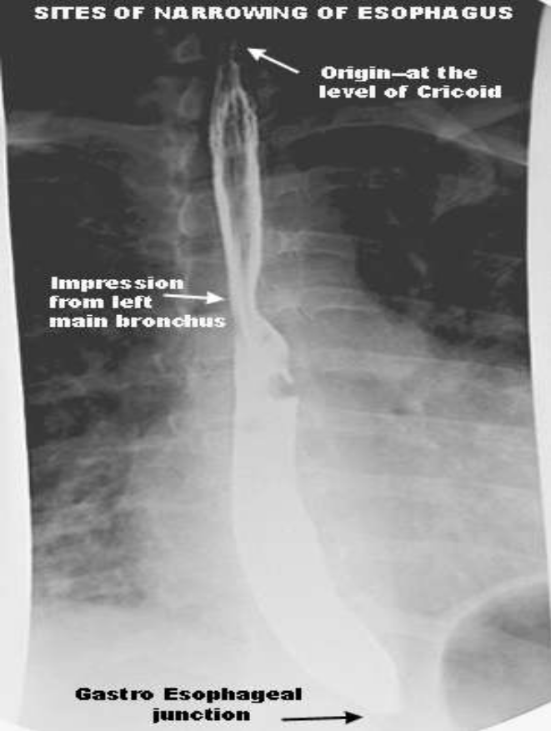
Esophageal Constriction
Superiorly: level of Cricoid
cartilage, juncture with pharynx
Middle: crossed by aorta and left main bronchi
Inferiorly: diaphragmatic
sphincter
normal sites of
narrowing of Esophagus

Slide 33
Cervical esophagus bordered anteriorly by trachea,
posteriorly by vertebral column and laterally by carotid sheath and thyroid gland.
Thoracic esophagus anteriorly lies the trachea, right
pulmonary artery, left main bronchus diaphragm.
Posteriorly it rest on vertebral column and closely
related to thoracic duct, azygus & hemiazygus vein.
Abdominal eshophagus its right border is continuous
with lesser curvature & left border is demarcated from fundus by esophagogastric angle of implantation(angle of His).

Slide 34
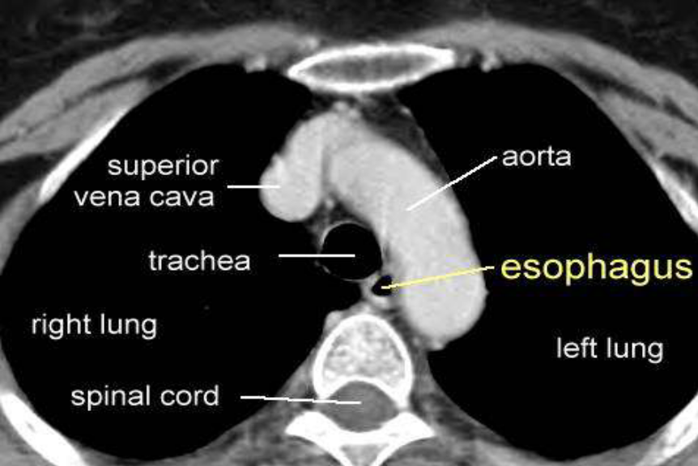
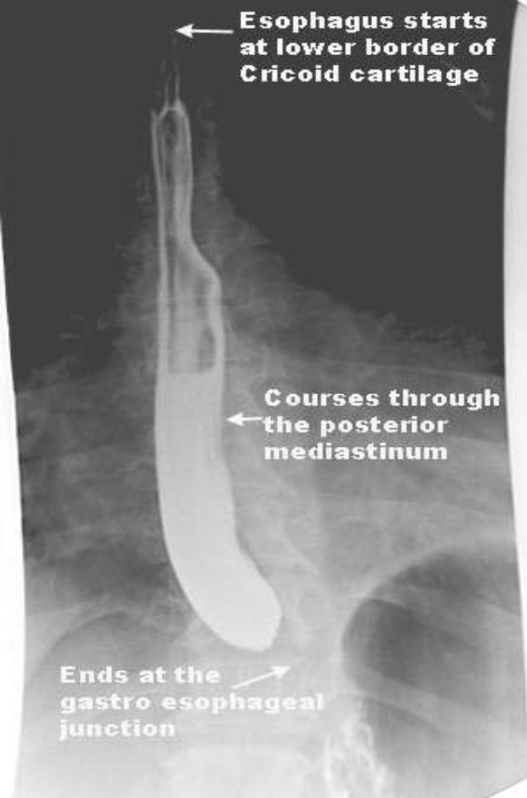
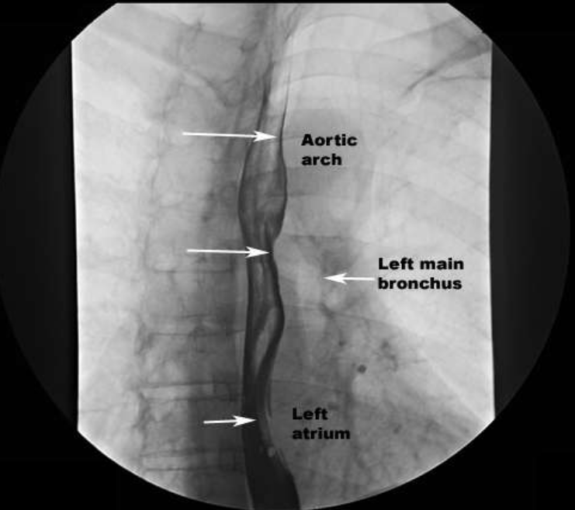
normal impressions in the Esophagus

Slide 35
Barium meal
In a barium meal test, X-ray images are taken of the stomach and the beginning of
duodenum.

Slide 36
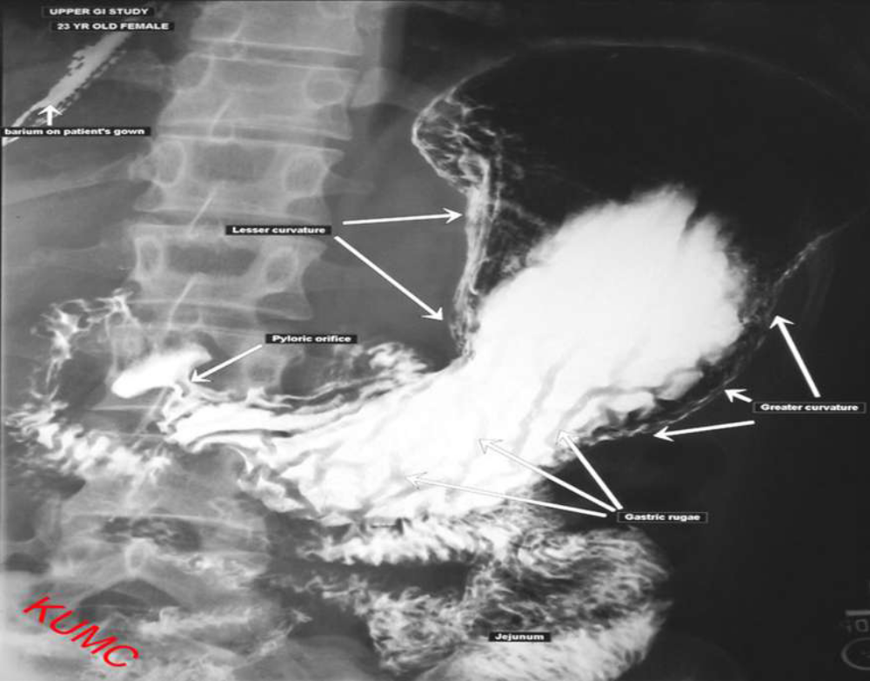

Slide 37
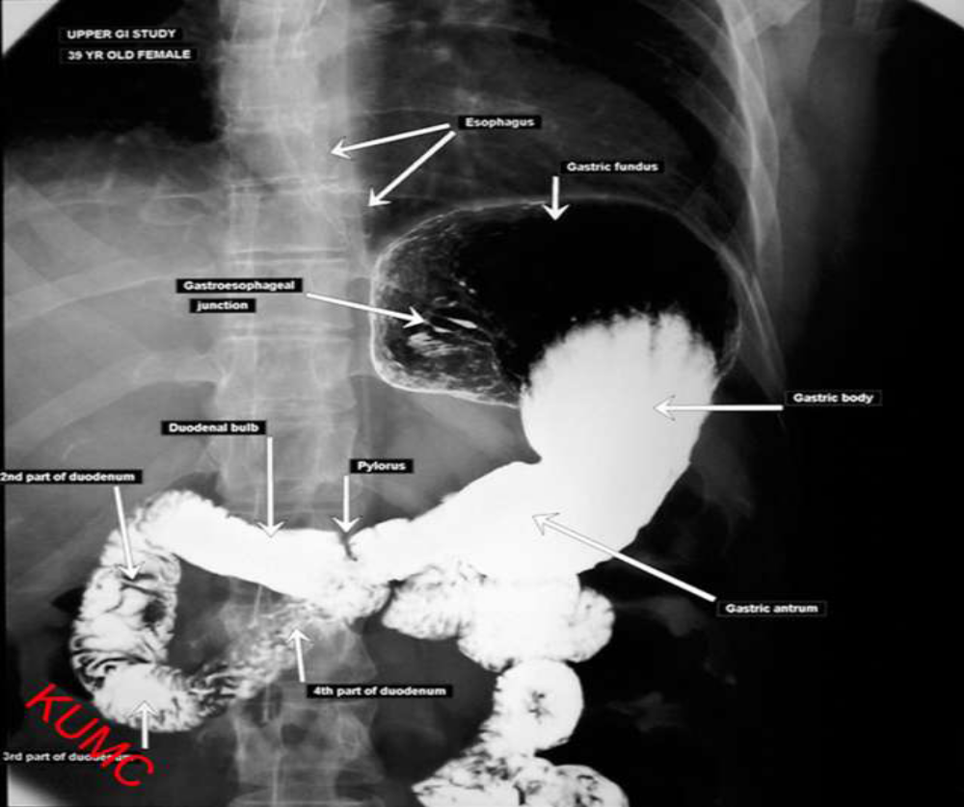

Slide 38
Barium enema
SINGLE CONTRAST STUDY
The colon is filled with barium, which outlines the intestine and reveals large abnormalities.
DOUBLE CONTRAST with AIR
The colon is first filled with barium then the barium is drained out, leaving only a thin layer of barium on the wall of the colon.
The colon is then filled with air. This provides a detailed view of the inner surface of the colon, making it easier to see narrowed areas (strictures), diverticula, or inflammation.

Slide 39
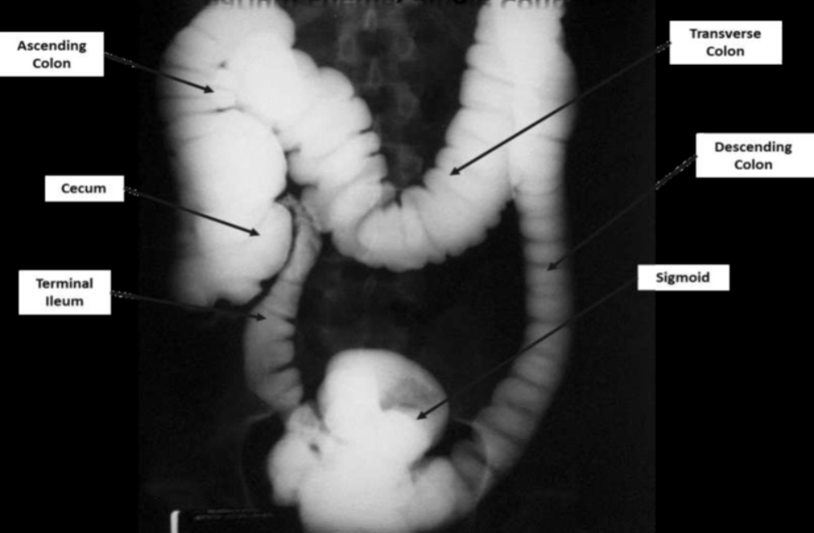
Barium enema, Single contrast

Slide 40
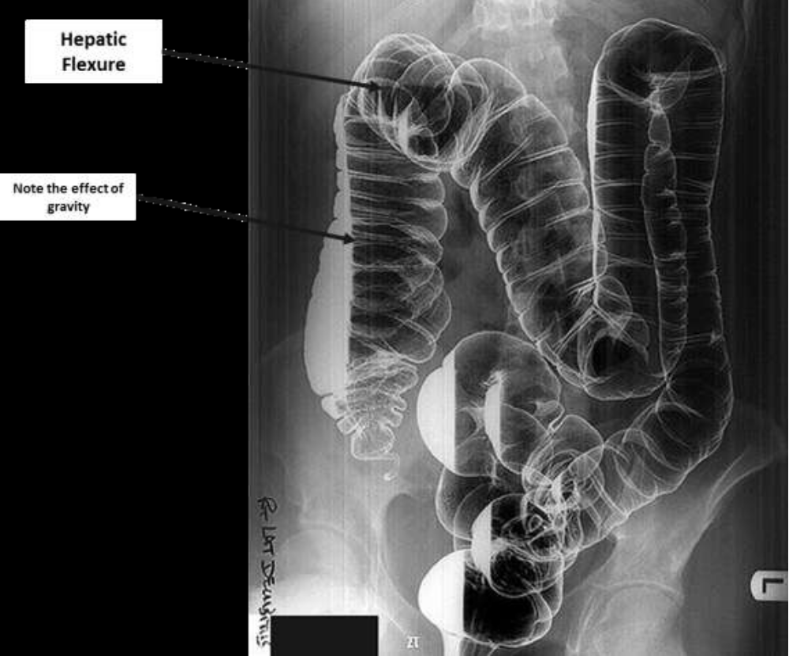
Barium enema, Double contrast

Slide 41
Ultrasound
General considerations
preparation
normal anatomy: solid organs + biliary tree + vessels + lymph nodes.
echogenicity: pancreas, liver, spleen, kidney, hyper hypo
appearances of various tissues:
fat = hyper;
fluid = hypo with posterior acoustic enhancement;
calculi/ bone = hyper with post ac shadowing;
gas = shadowing.

Slide 42
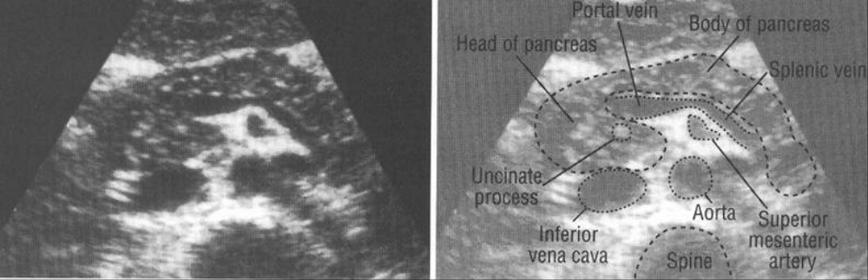
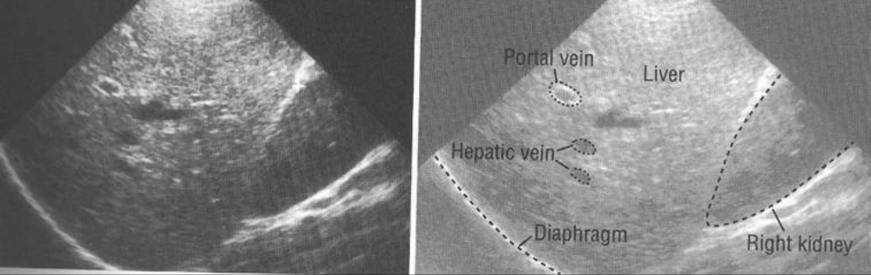
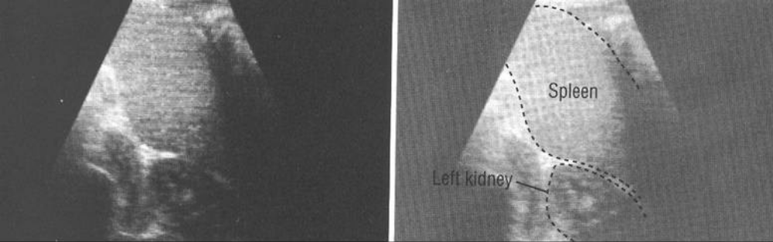
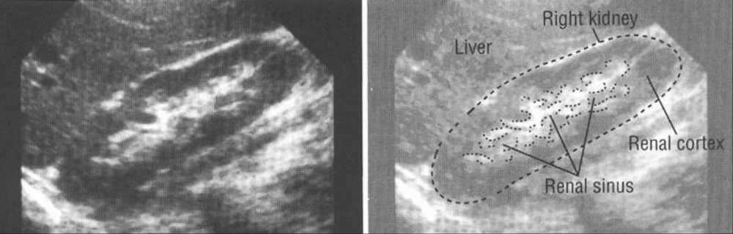
Normal
Pancreas
Liver
Spleen
Kidney

Slide 43
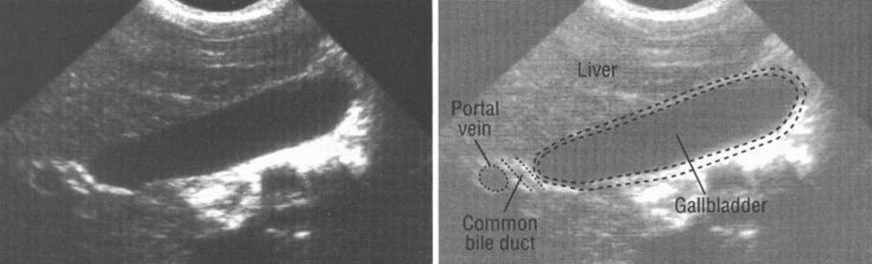
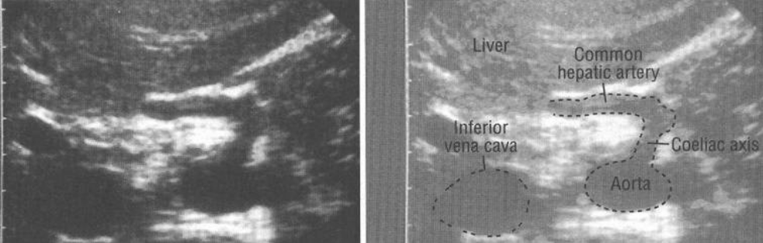
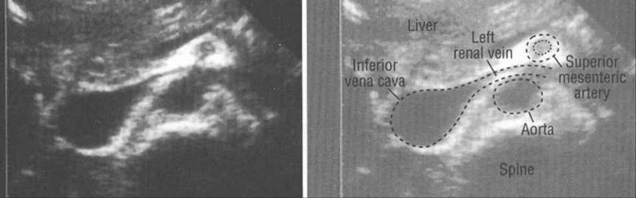
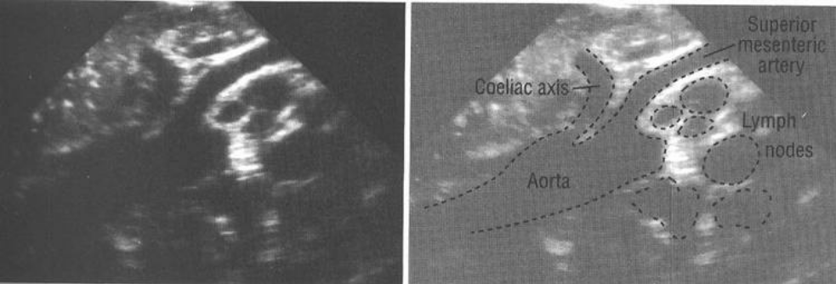
Normal
Gallbladder
Aorta
&
IVC
Lymph nodes

Slide 44
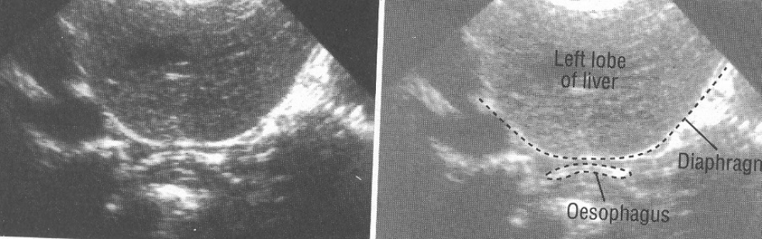
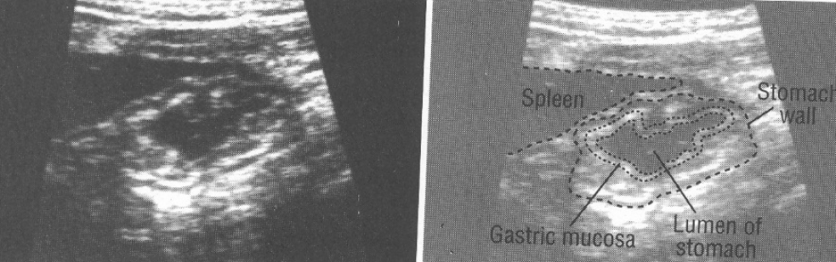
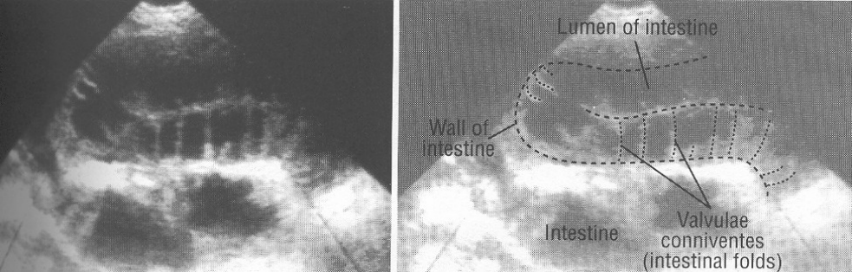
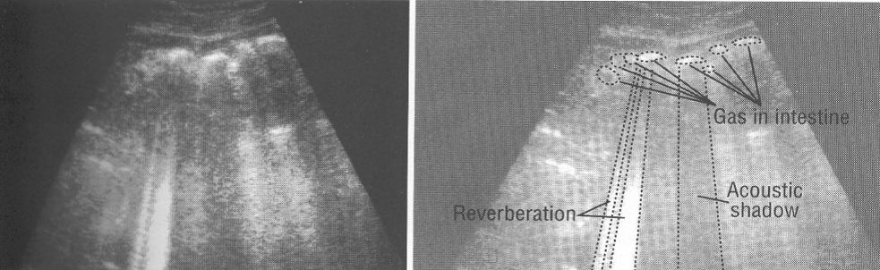
Normal
Oesophagus
Stomach
Small bowel
Gas in bowel

Slide 45
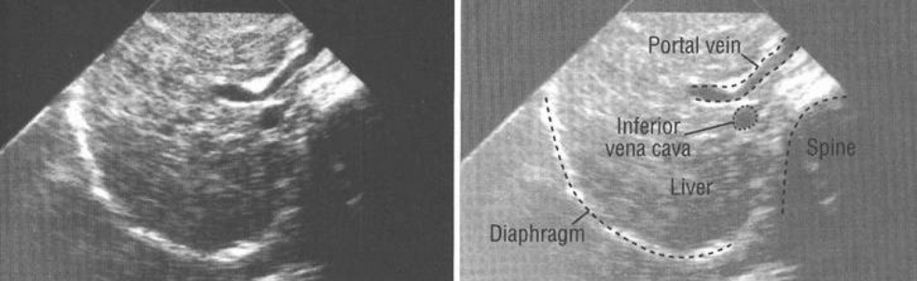
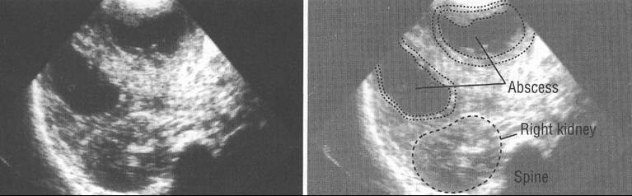
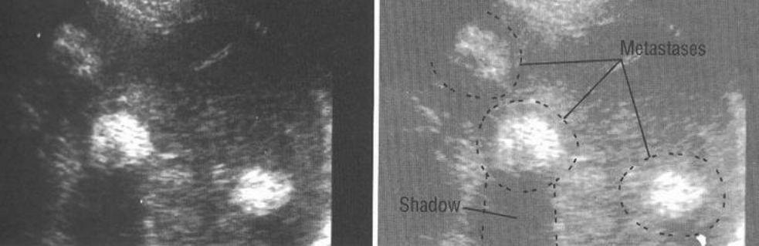
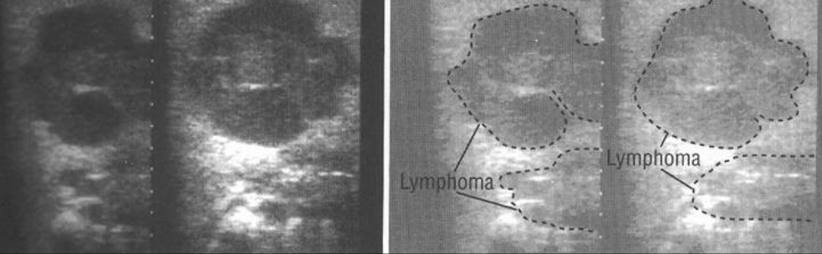
Pathology
Cirrhosis
Abscesses
Metastases
Lymphoma

Slide 46
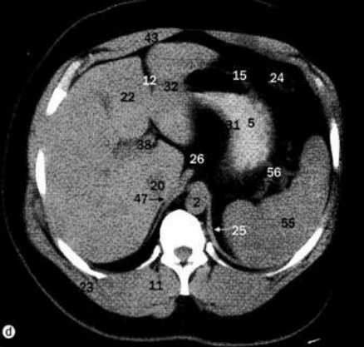
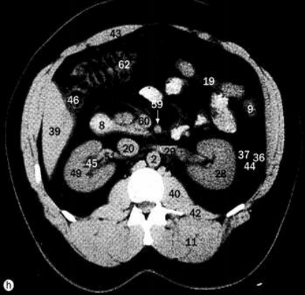


Computed Tomography & Magnetic Resonance Imaging
General considerations
Differences between CT and MRI.
Windowing in CT and sequences in MRI.
Various densities in CT and intensities in MRI.
CT
MRI
T2W
T1W

Slide 47



Pathology
Hepatic cysts
T1W
CT
MRI
T2W

Slide 48



Haemangioma
Contrasted CT
T2W MRI
Pancreatic Cancer
Postoperative
3 months later
6 months later

Slide 49
Angiography & Interventional radiology
Types:
Flush aortogram
Inferior vena cavogram / SVCgram
Selective: (according to vessels) hepatic artery, renal, spleen, pancreas, coeliac axis, SMA, IMA, uterine artery.
May include intervention:
chemoembolization, coil/glue embolization,
stenting.
Indications:
tumour / haemangioma, bleeding, pre-op … etc

Slide 50


Multifocal Hepatoma
Arterial phase
Late phase
Post-embolisation
Angioma

Slide 51



Other imaging methods
Endoscopic retrograde cholangio-pancreatogram
Stone
Percutaneous transhepatic cholangiogram
Stone

Slide 52
The main radiological syndromes of diseases of the alimentary canal
Organ dislocation syndrome (change in its usual location)
Syndrome of pathological changes in the relief of the mucous membrane
Alimentary canal dilatation syndrome:
- diffuse expansion;
  - limited (local) expansion.
  Narrowing of the alimentary canal syndrome:
  - diffuse narrowing;
  - limited (local) narrowing.
  Syndrome of motor dysfunction of the alimentary canal

Slide 53

Organ dislocation syndrome
normal position of the esophagus
displacement of the esophagus
protrusion of part of the stomach through the esophageal opening of the diaphragm into the chest cavity

Slide 54

Violation of position

Slide 55

Syndrome of pathological changes in the relief of the mucous membrane
normal relief
folds of the mucous membrane bypass the pathological formation
contrasting spot on the relief - "relief niche"
mucosal folds are infiltrated and destroyed

Slide 56

Filling defect

Slide 57

Alimentary canal dilatation syndrome
limited (niche)
limited (diverticulum)
diffuse
normal (tight filling)

Slide 58

Expansion of the lumen

Slide 59

Narrowing of the alimentary canal syndrome
limited with organ deformation (in this example, the duodenal bulb is deformed)
normal (tight filling)
limited with suprastenotic expansion
limited with filling defect
diffuse

Slide 60

Narrowing of the lumen

Slide 61
The displacement of the esophagus occurs:
with pressure on him of enlarged lymph nodes, tumors or cysts of the mediastinum;
with atelectasis, cirrhosis of the lung and with large accumulations of fluid in the pleural cavity (together with the mediastinal organs).
Displacement of the stomach and intestines occurs:
with an increase in the liver and spleen;
under pressure from a large tumor or cyst that has developed in the abdomen;
when part of the stomach passes through the esophageal opening of the diaphragm into the chest cavity (the formation of a hernia of the esophageal opening).

Slide 62
Syndrome of pathological changes in the relief of the mucous membrane
Thickening folds:
with hypertrophy;
with inflammatory swelling of the mucous membrane.
Spreading the folds - with a small tumor.
Disappearance of relief and breakage of folds - with infiltration of the mucous membrane by a cancerous tumor.

Slide 63


Barium depot (niche)

Slide 64

Change in the relief of the mucous membrane

Slide 65

Change in the relief of the mucous membrane

Slide 66


Menetrie's disease (fold hypertrophy)

Slide 67

Atrophic gastritis (absence of folds in the vault)

Slide 68


Convergence folds

Slide 69


Localized thickening of the bowel wall (inflammatory infiltrate)

Slide 70
Alimentary canal dilatation syndrome
Diffuse enlargement of the esophagus, stomach or intestine - usually the manifestation of paresis of this part of the alimentary canal.
Limited expansion of the alimentary canal:
- expansion with an ulcer;
- expansion with diverticulum;
- suprastenotic expansion (with prolonged
stenosis).

Slide 71
Limited expansion of the alimentary canal
The symptom of «niche»:
when the contrast agent penetrates beyond the contour of the organ shadow ("contour niche");
when a "spot" appears on the relief (folds) of the mucous membrane ("relief niche").
The difference between a diverticulum and a «niche»:
all layers of the intestinal wall are represented in the diverticulum;
has a narrower place at the base - "neck";
has the correct rounded shape;
it includes normal folds of the mucous membrane.

Slide 72

Niche with malignant gastric ulcer

Slide 73

Multiple relief niches for erosive and ulcerative gastritis

Slide 74


Zenker's diverticulum

Slide 75


Traction esophageal diverticulum

Slide 76
Diffuse narrowing (decrease in the lumen of the organ)
Observed:
with chronic inflammation in the colon or small intestine;
with cicatricial stenosis of the esophagus or stomach after a chemical burn with caustic liquids (alkali, acid);
with advanced fibroplastic stomach cancer.

Slide 77



Limited narrowing with filling defect (marginal and circular)

Slide 78

Limited narrowing with circular filling defect (carcinoma) and intestinal diverticula

Slide 79


Limited narrowing and displacement of the esophagus (swelling)

Slide 80

Limited narrowing of the esophagus (very rarely arteria lusoria can go between the trachea and the esophagus)

Slide 81


Limited narrowing of the esophagus (achalasia)

Slide 82
Limited constriction:
Spasm - a transient circular narrowing of short length with smooth, clear contours (esophageal spasm, cardiospasm, pyloric spasm);
Tumor lesion (in the opening - the unevenness of the contour of the organ, as it increases - a filling defect).

Slide 83

Limited narrowing (stricture due to chemical burn)

Slide 84

Limited narrowing (inflammatory stricture)

Slide 85
THANK YOU
FOR YOUR ATTENTION!

