Slide 1
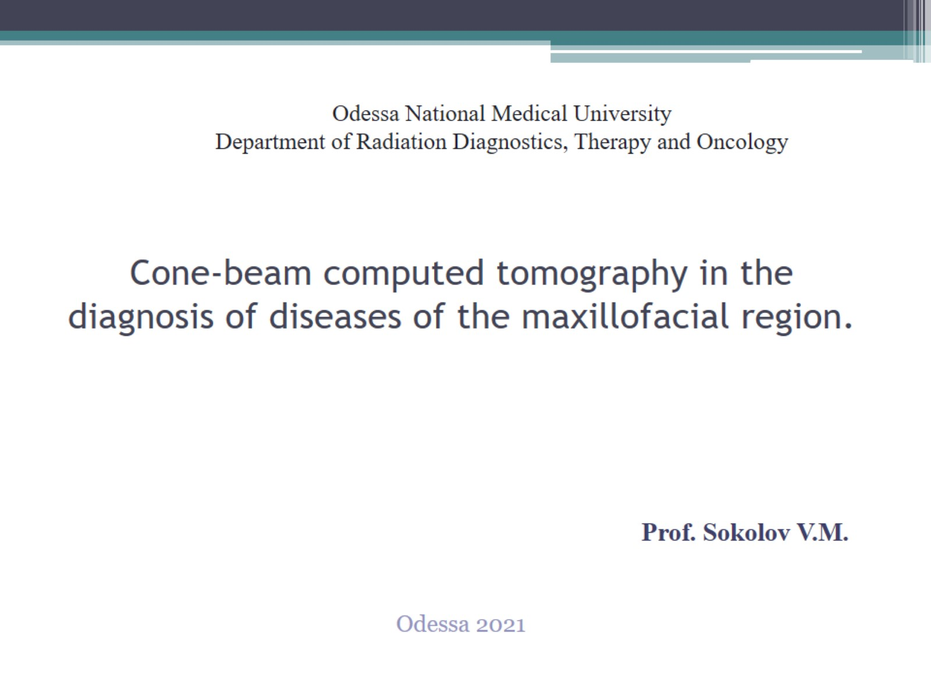
Cone-beam computed tomography in the diagnosis of diseases of the maxillofacial region.

Slide 2
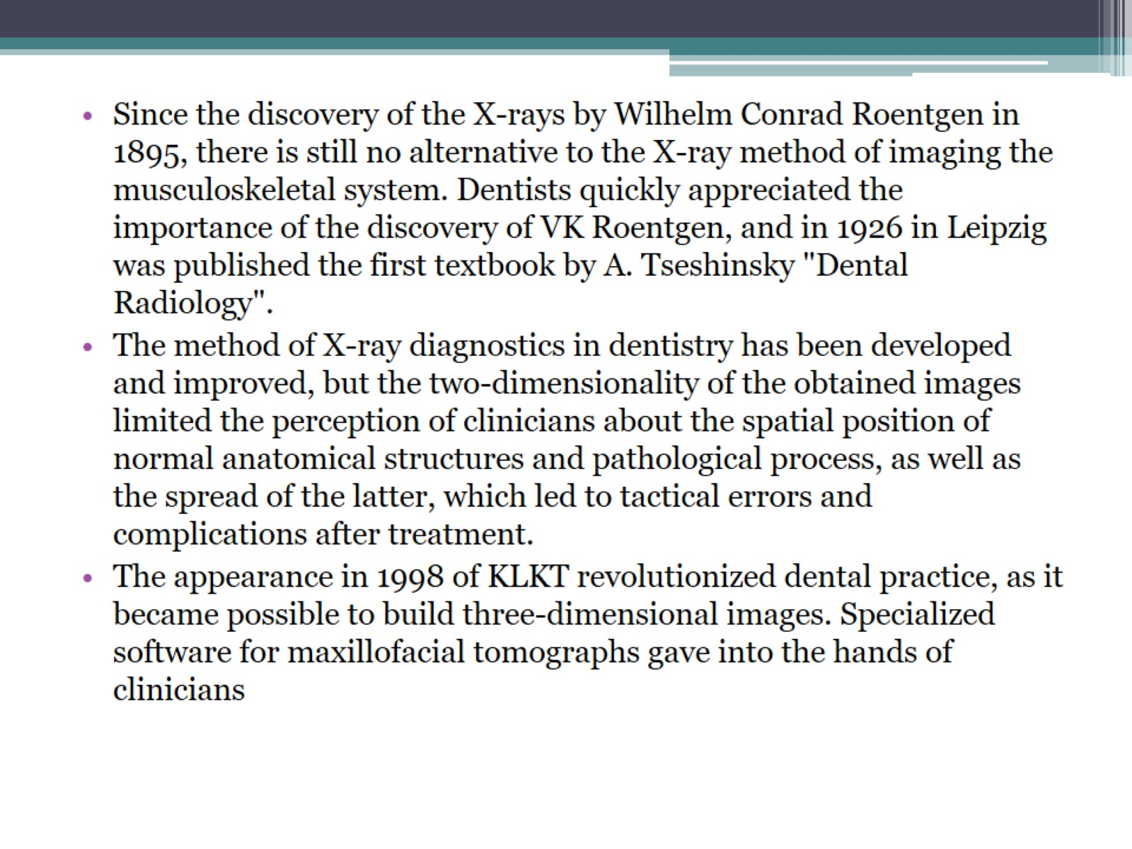

Slide 3
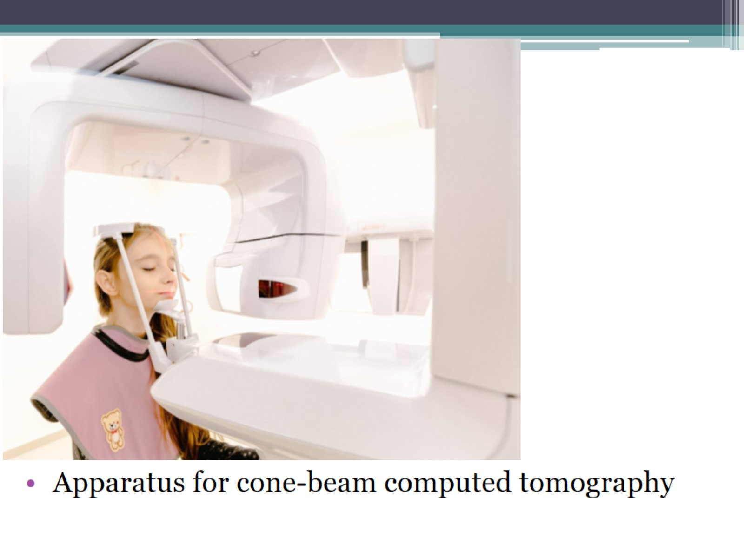

Slide 4
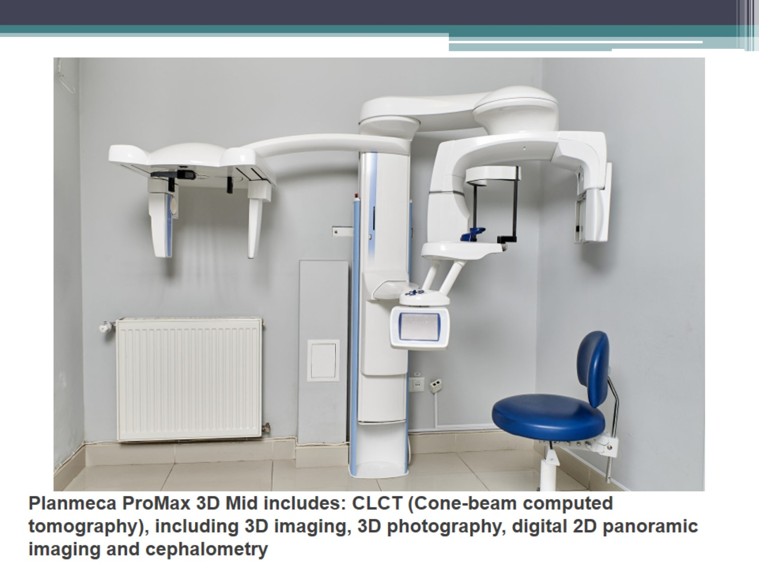

Slide 5
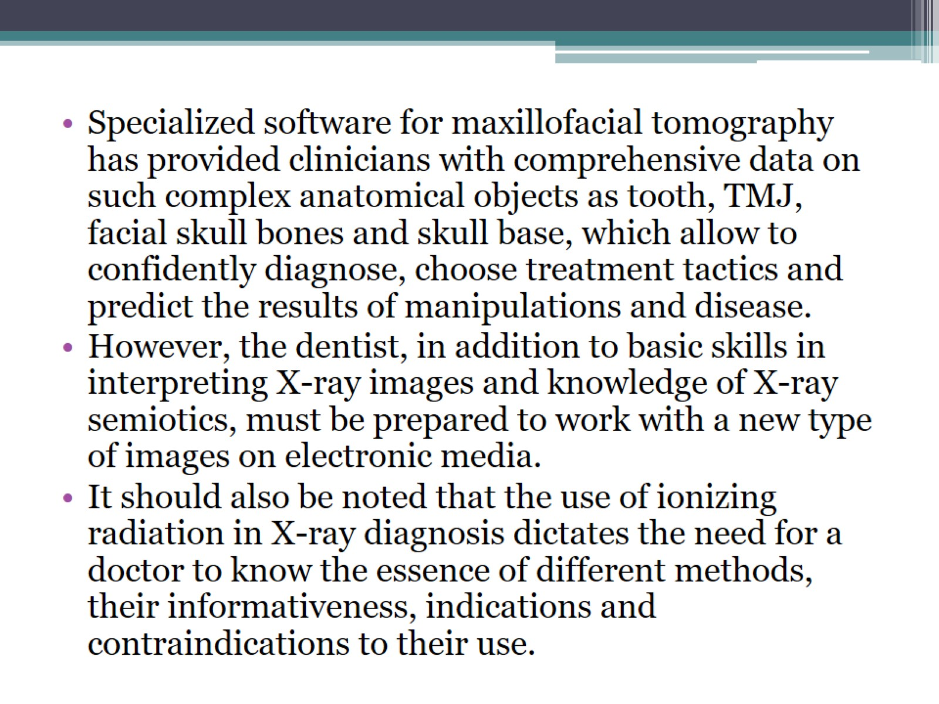

Slide 6
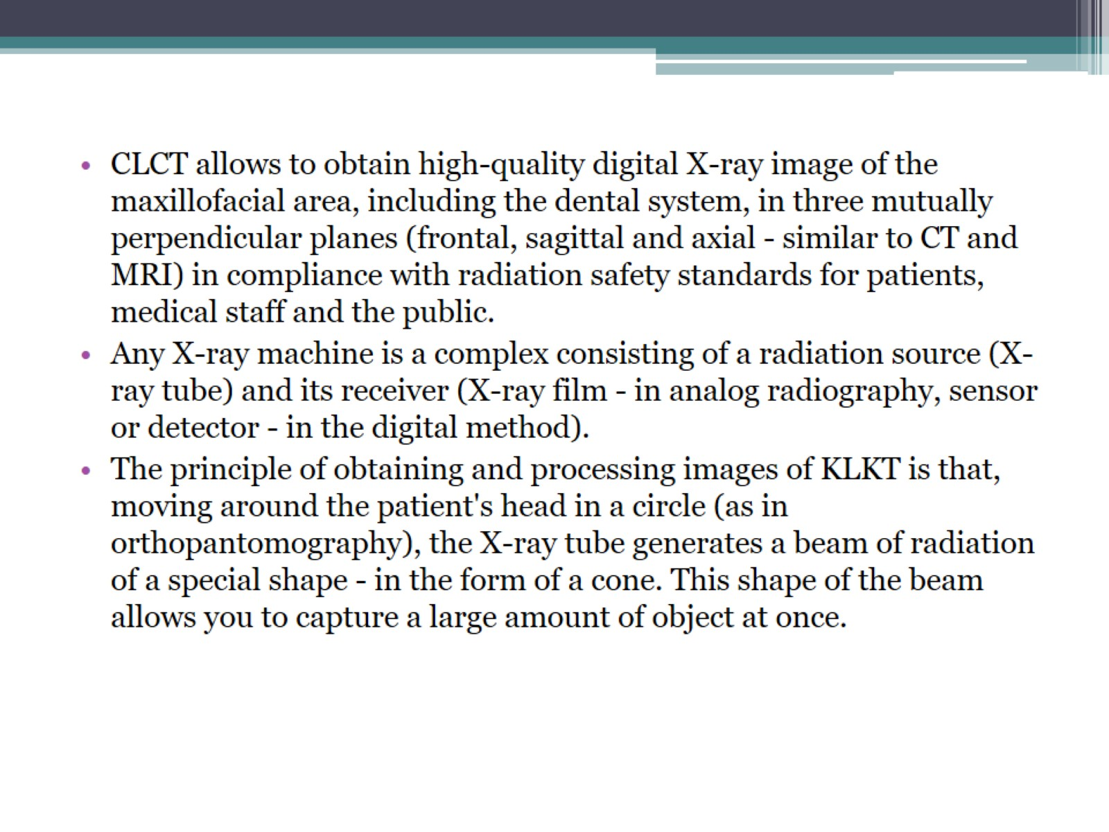

Slide 7
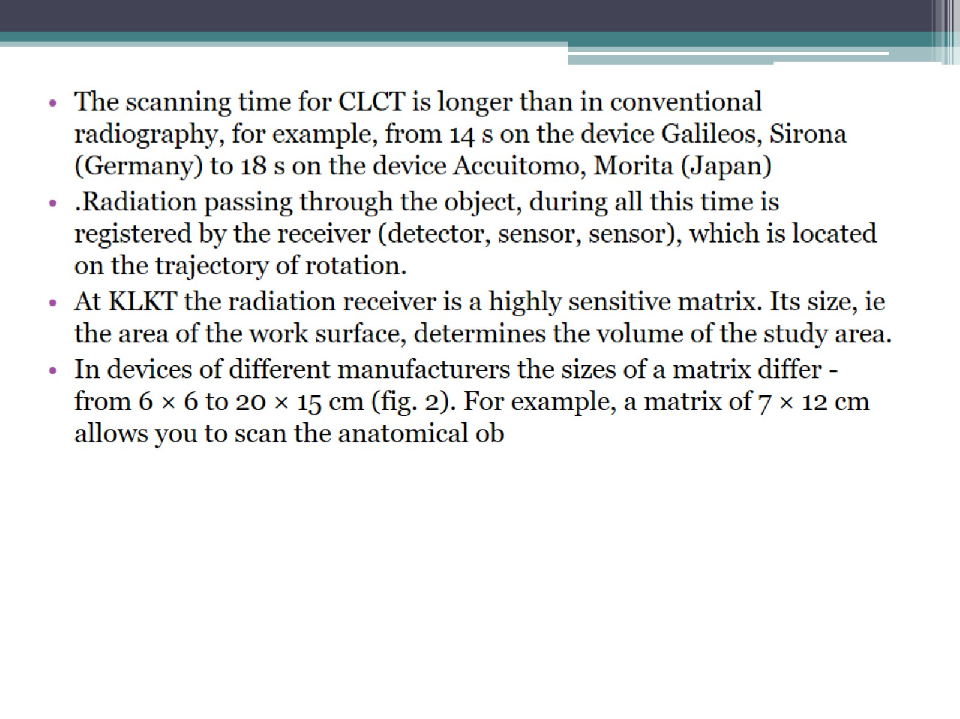

Slide 8
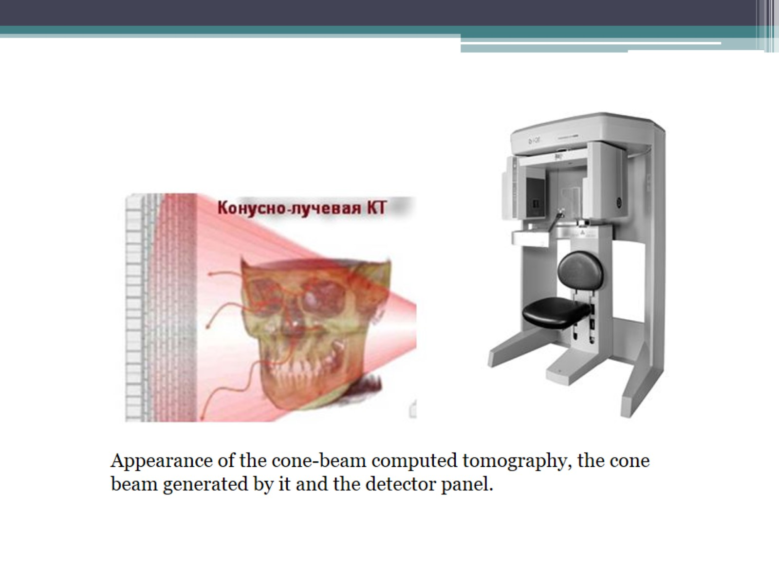

Slide 9
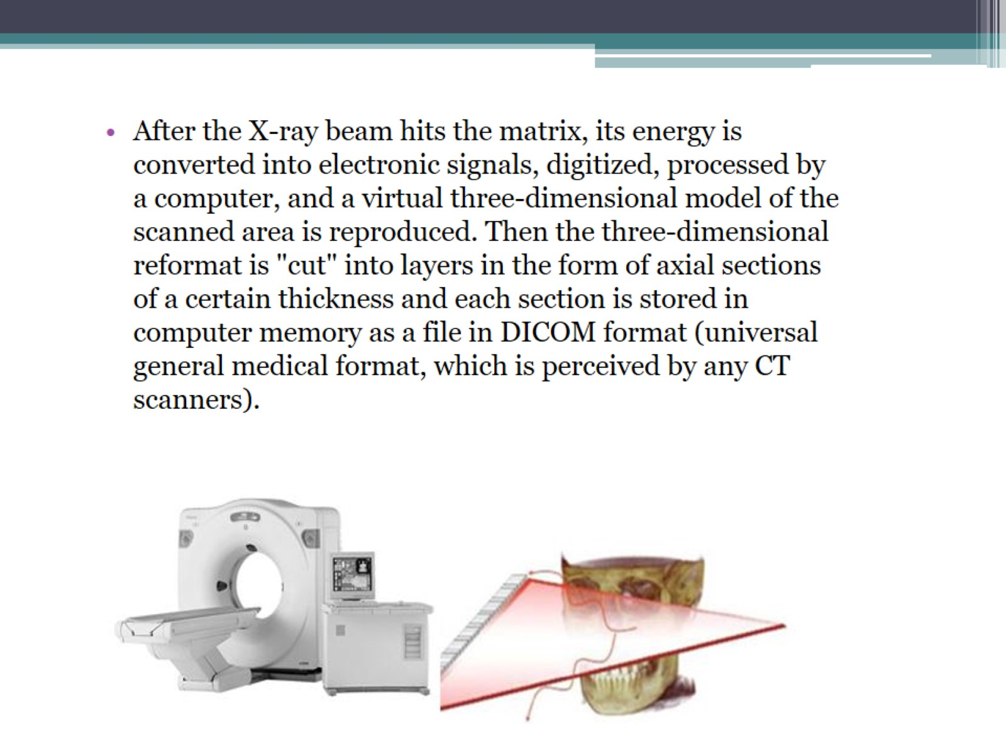

Slide 10
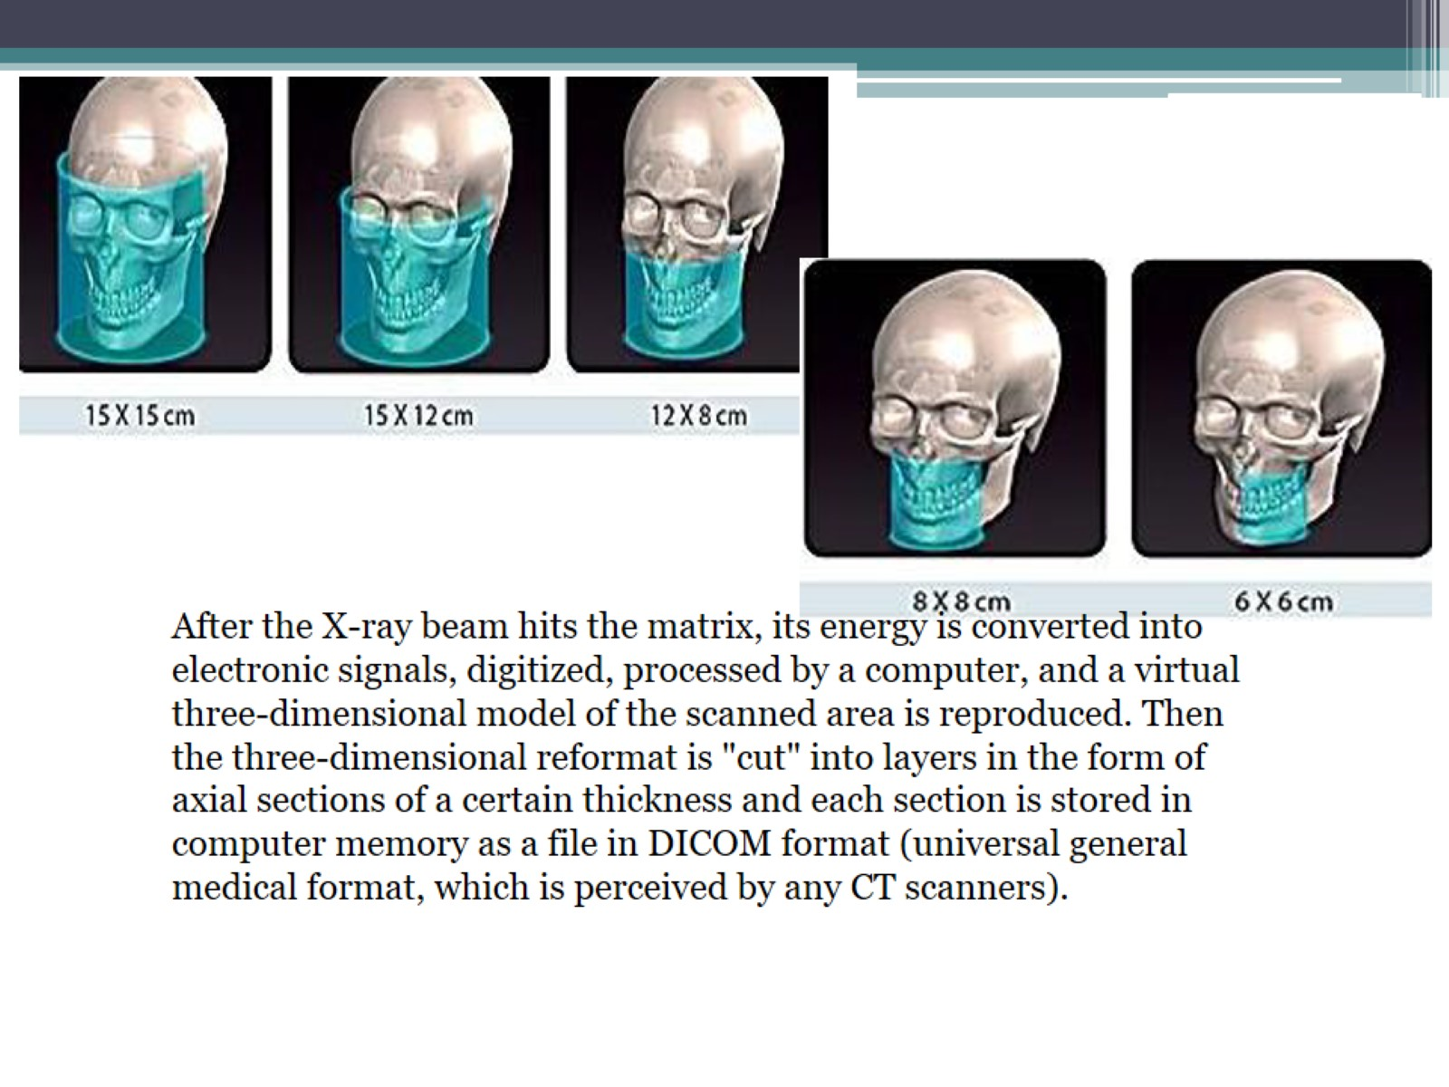

Slide 11
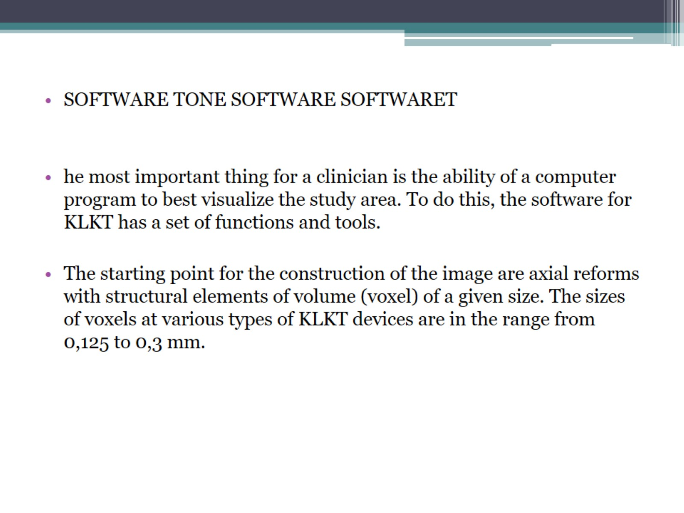

Slide 12
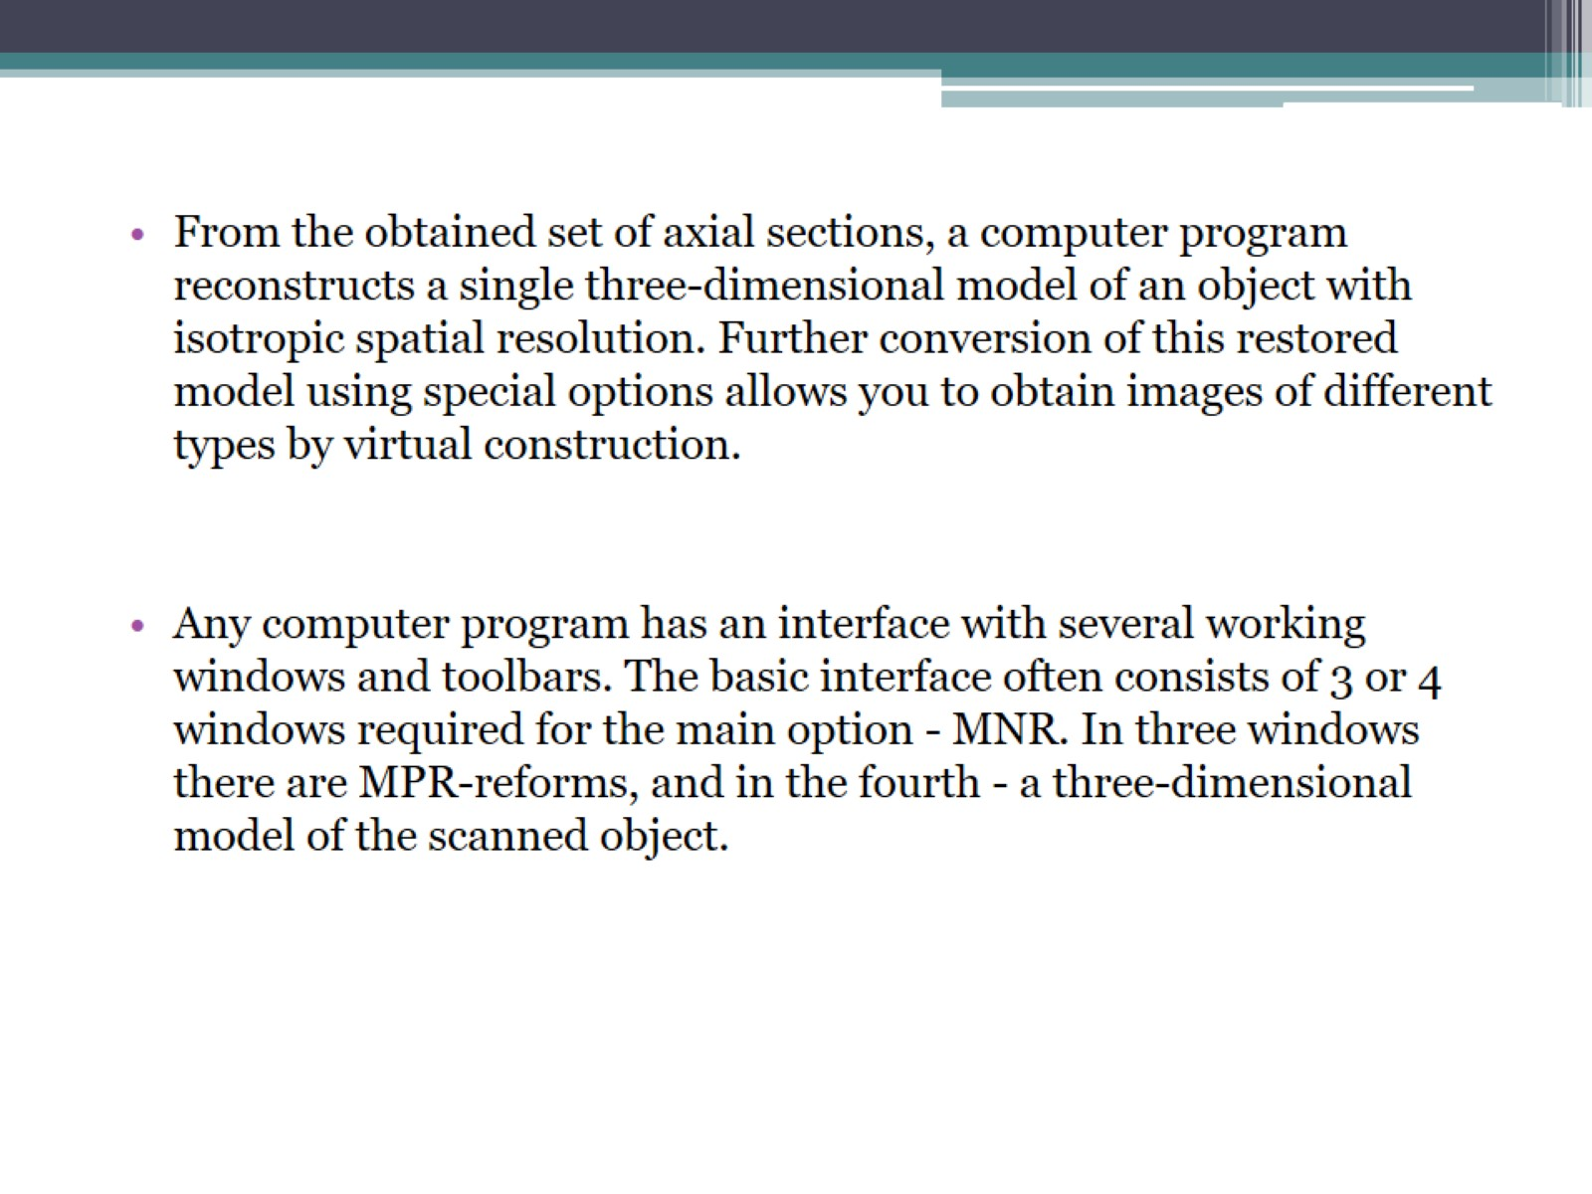

Slide 13
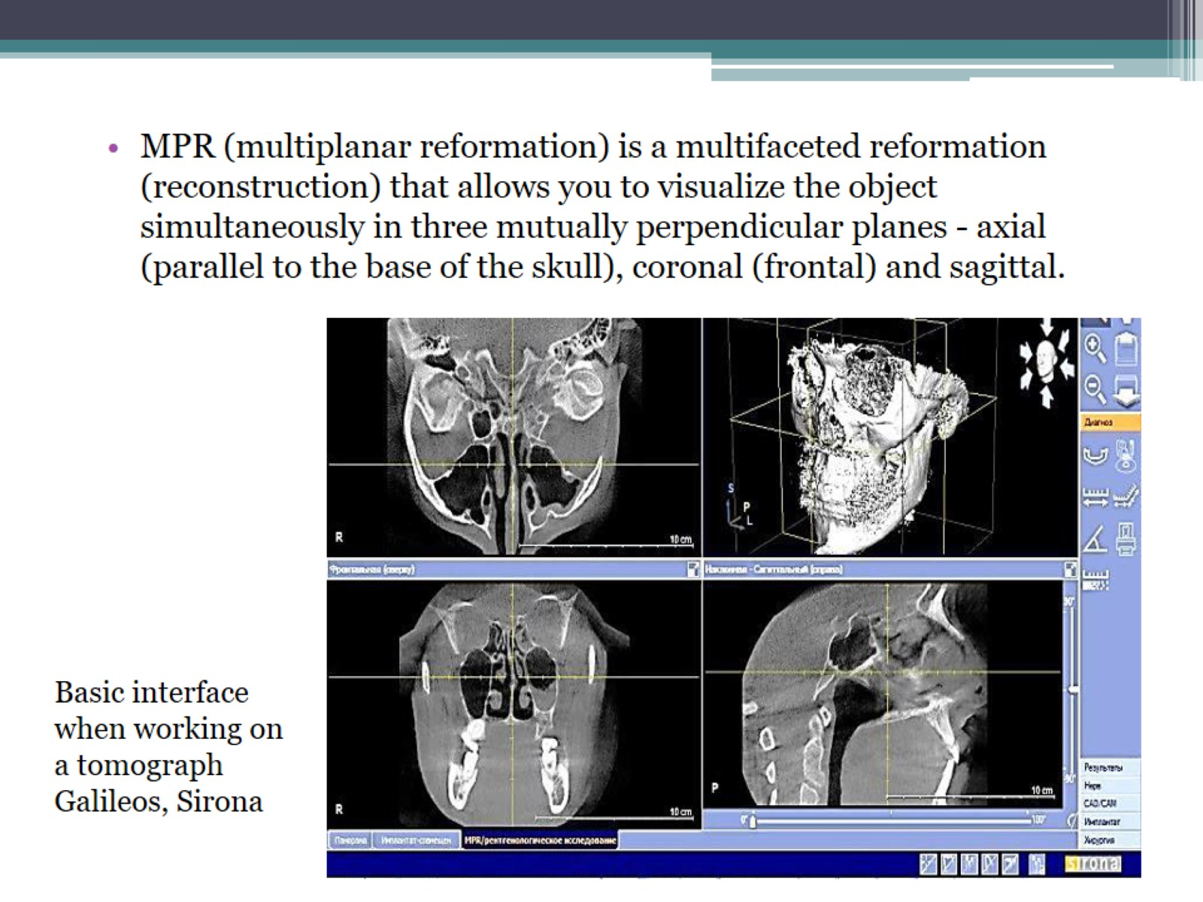

Slide 14
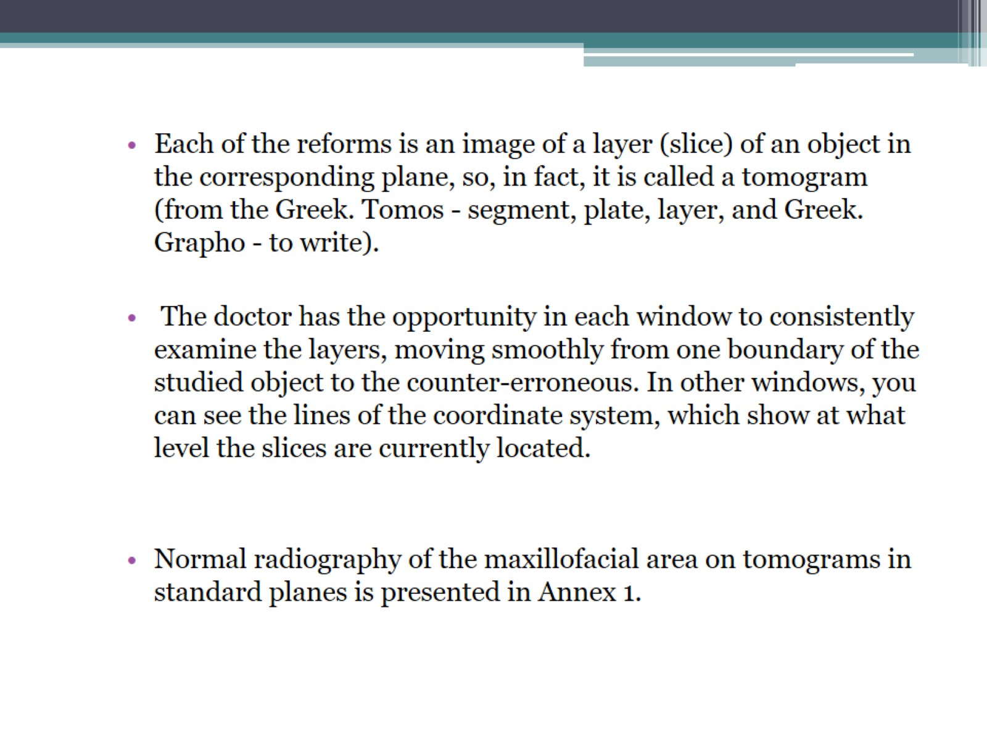

Slide 15
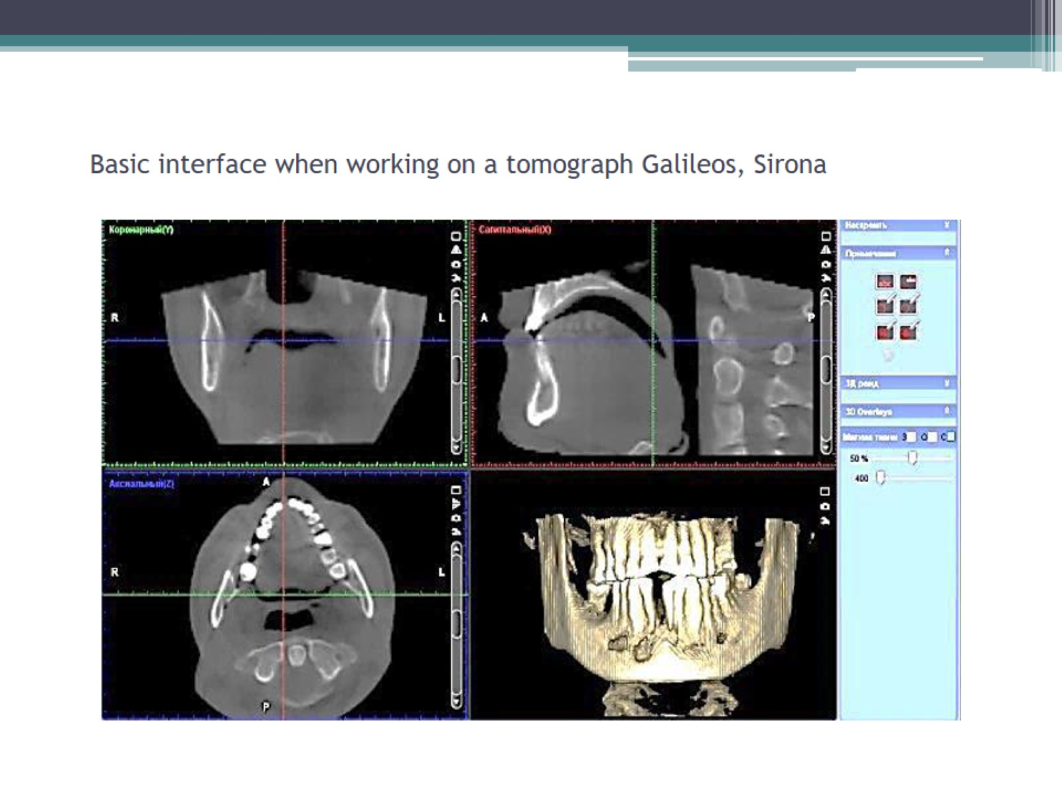
Basic interface when working on a tomograph Galileos, Sirona

Slide 16
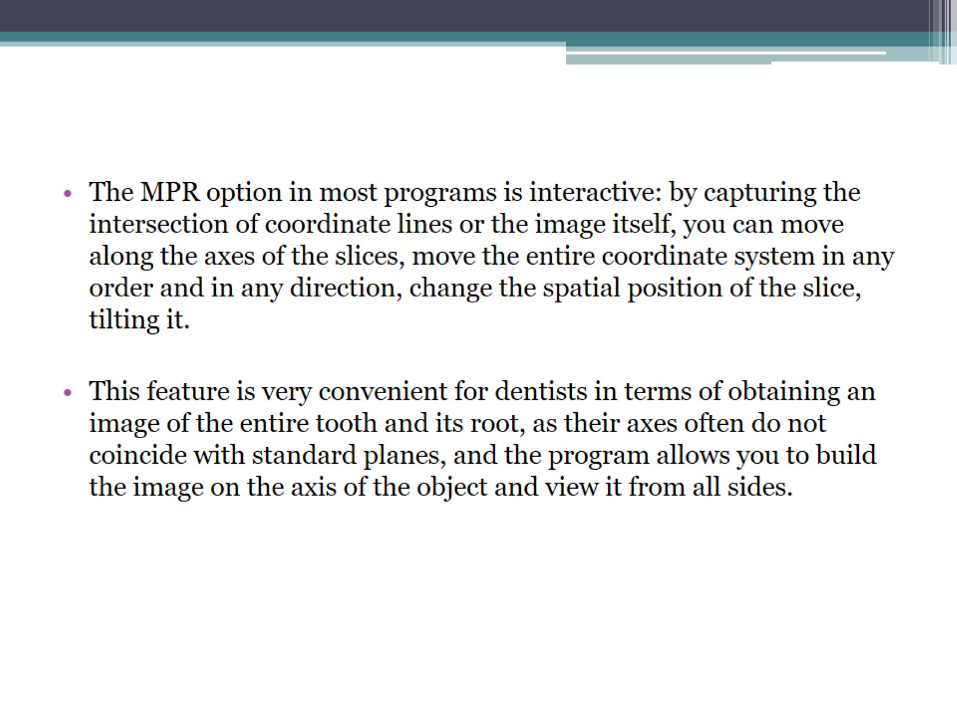

Slide 17
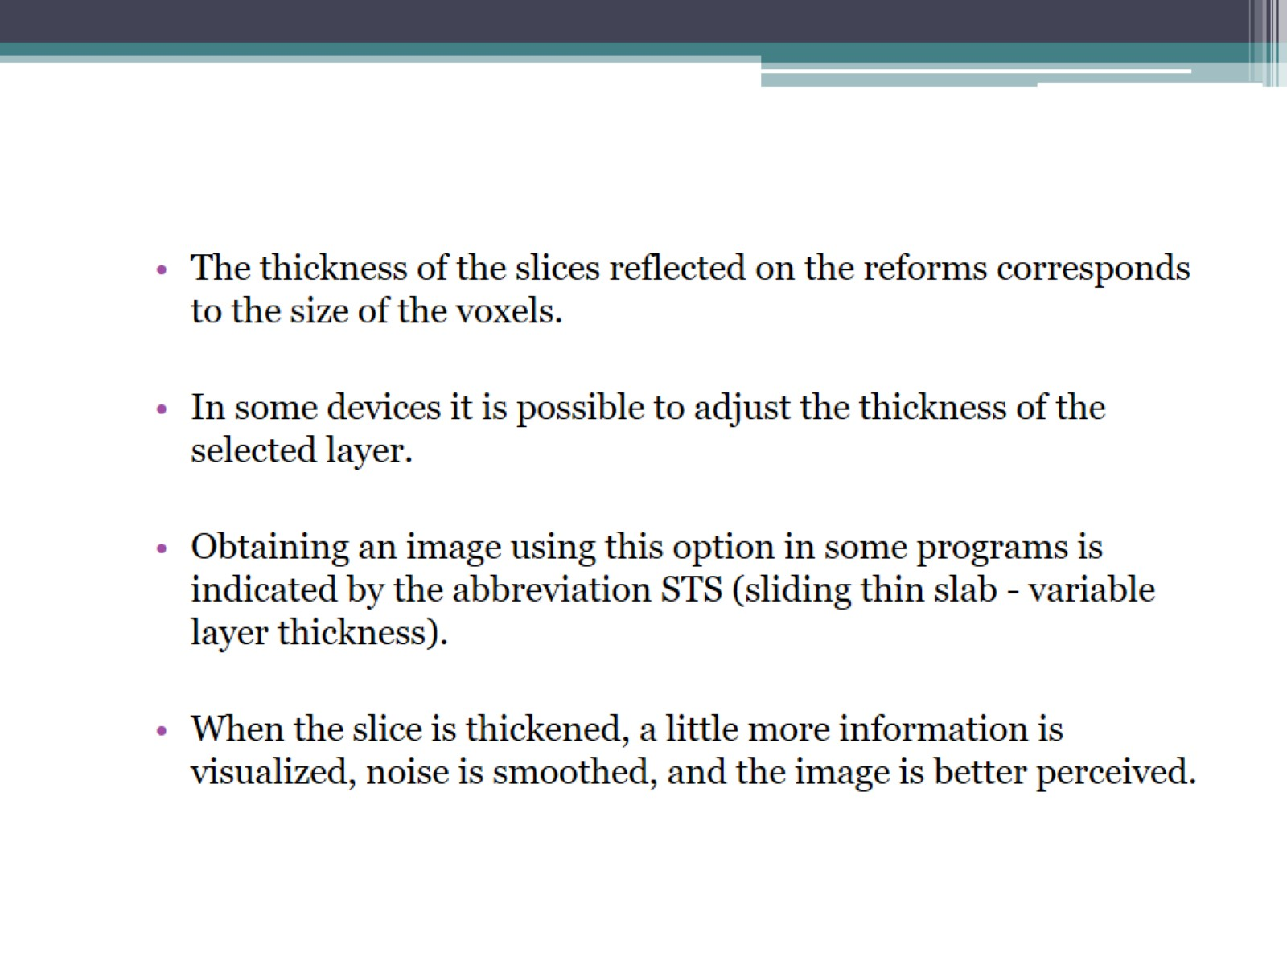

Slide 18
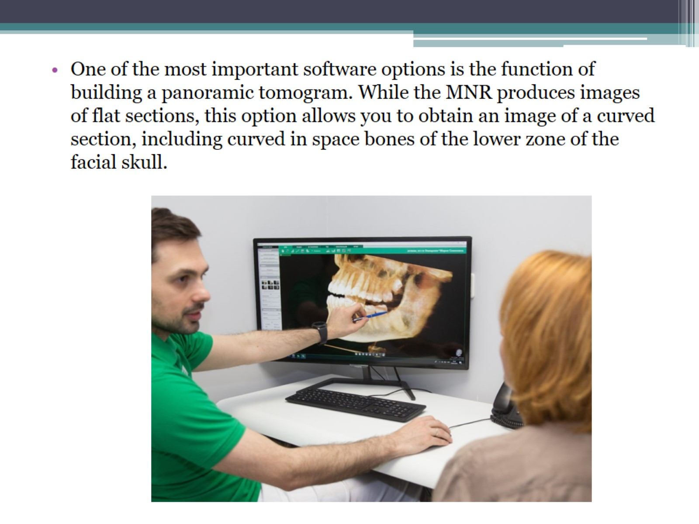

Slide 19
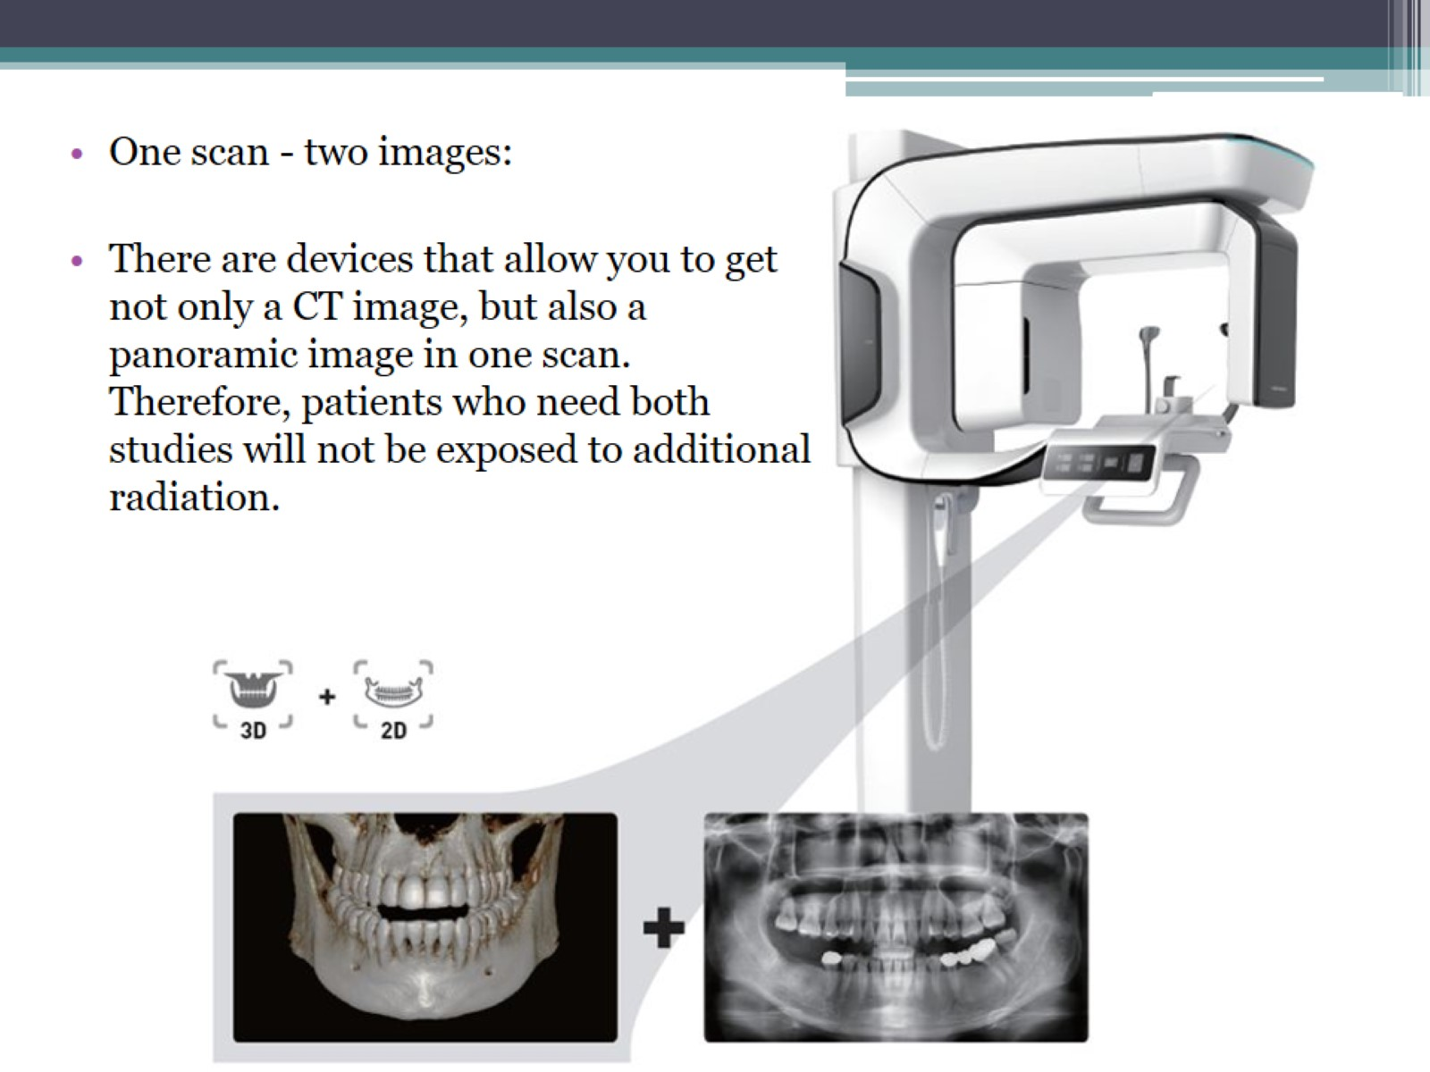

Slide 20
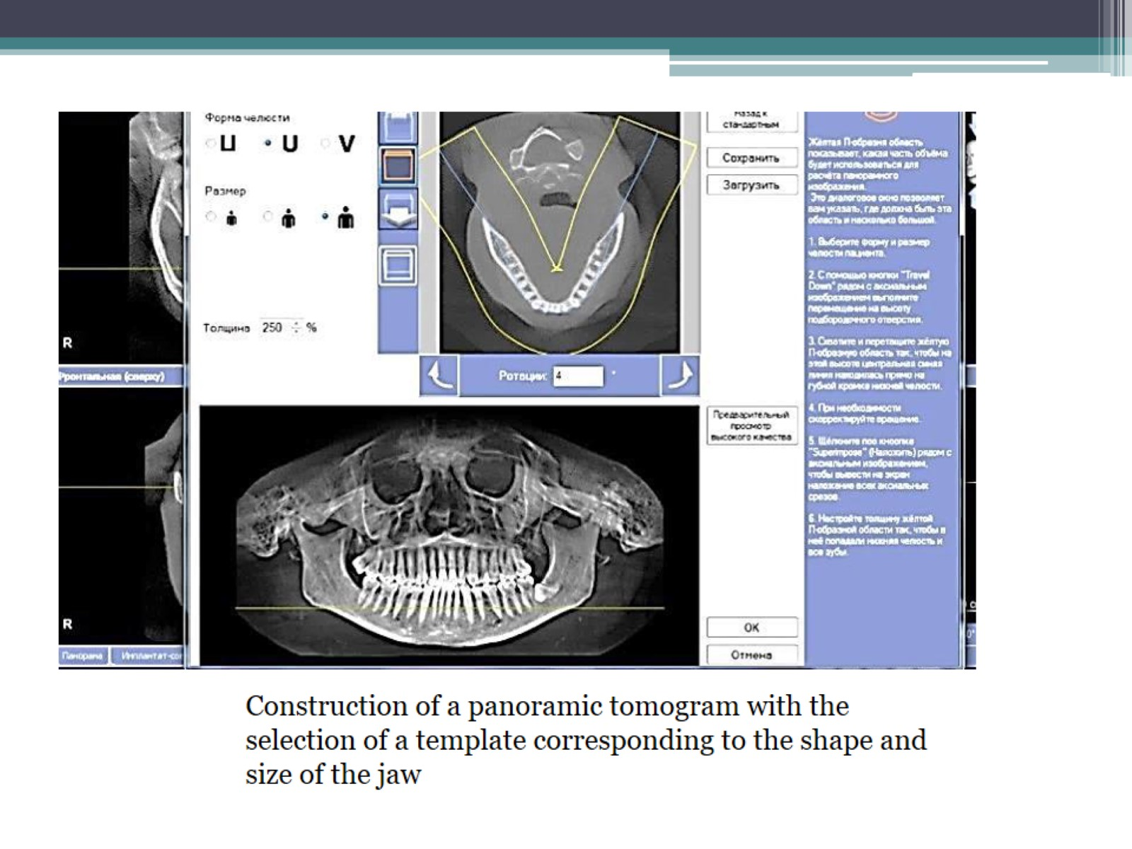

Slide 21
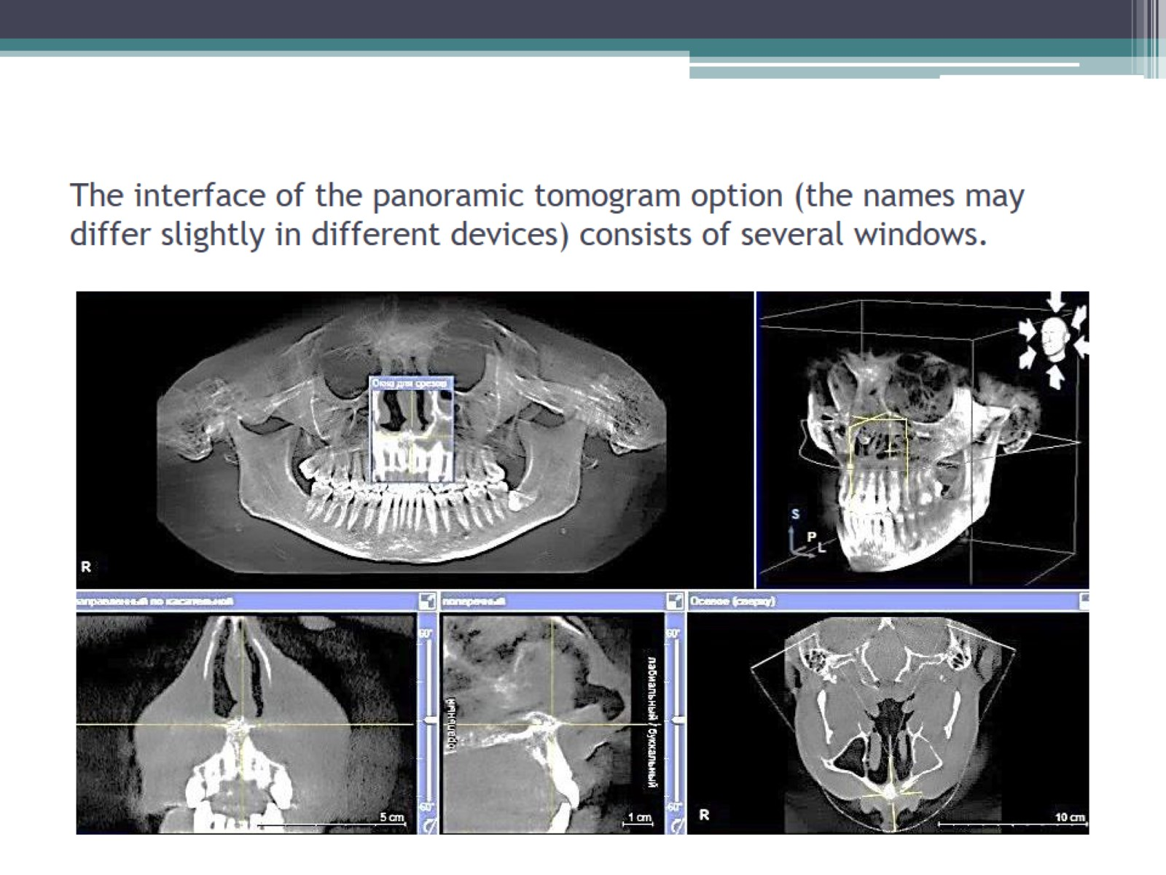
The interface of the panoramic tomogram option (the names may differ slightly in different devices) consists of several windows.

Slide 22
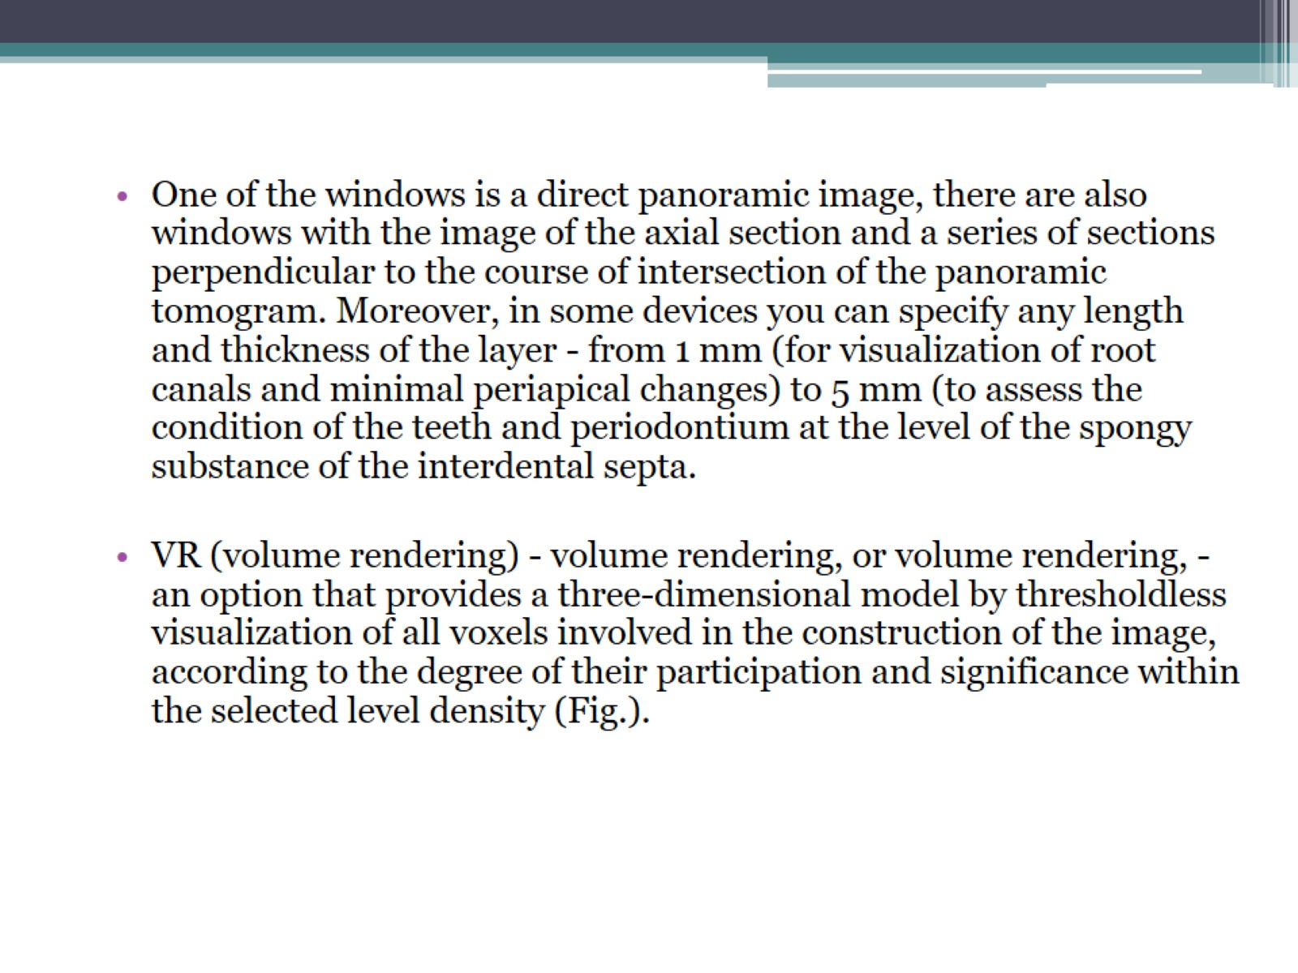

Slide 23
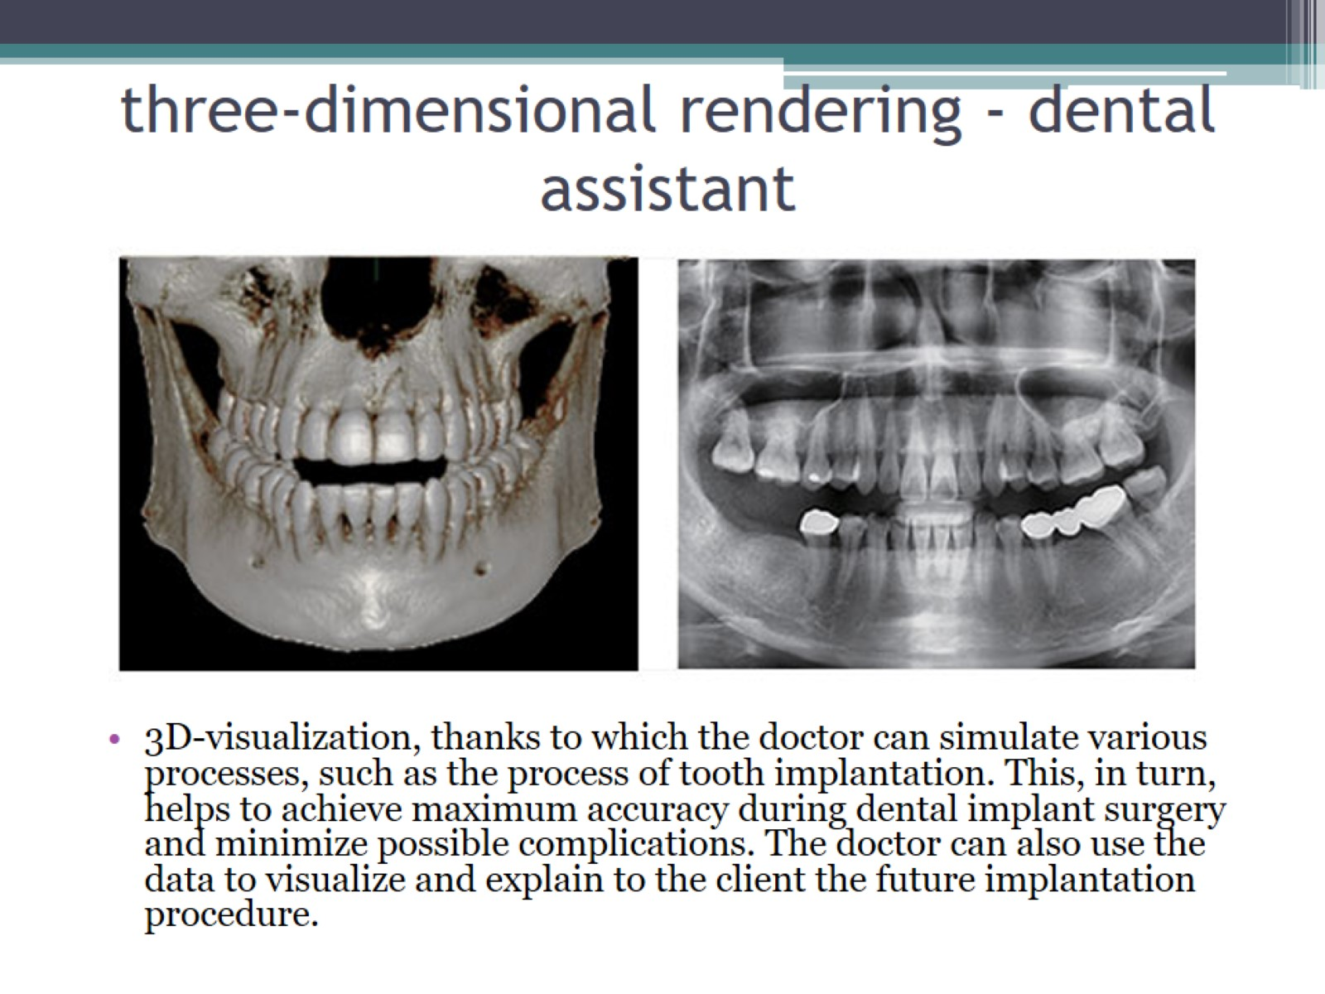
three-dimensional rendering - dental assistant

Slide 24
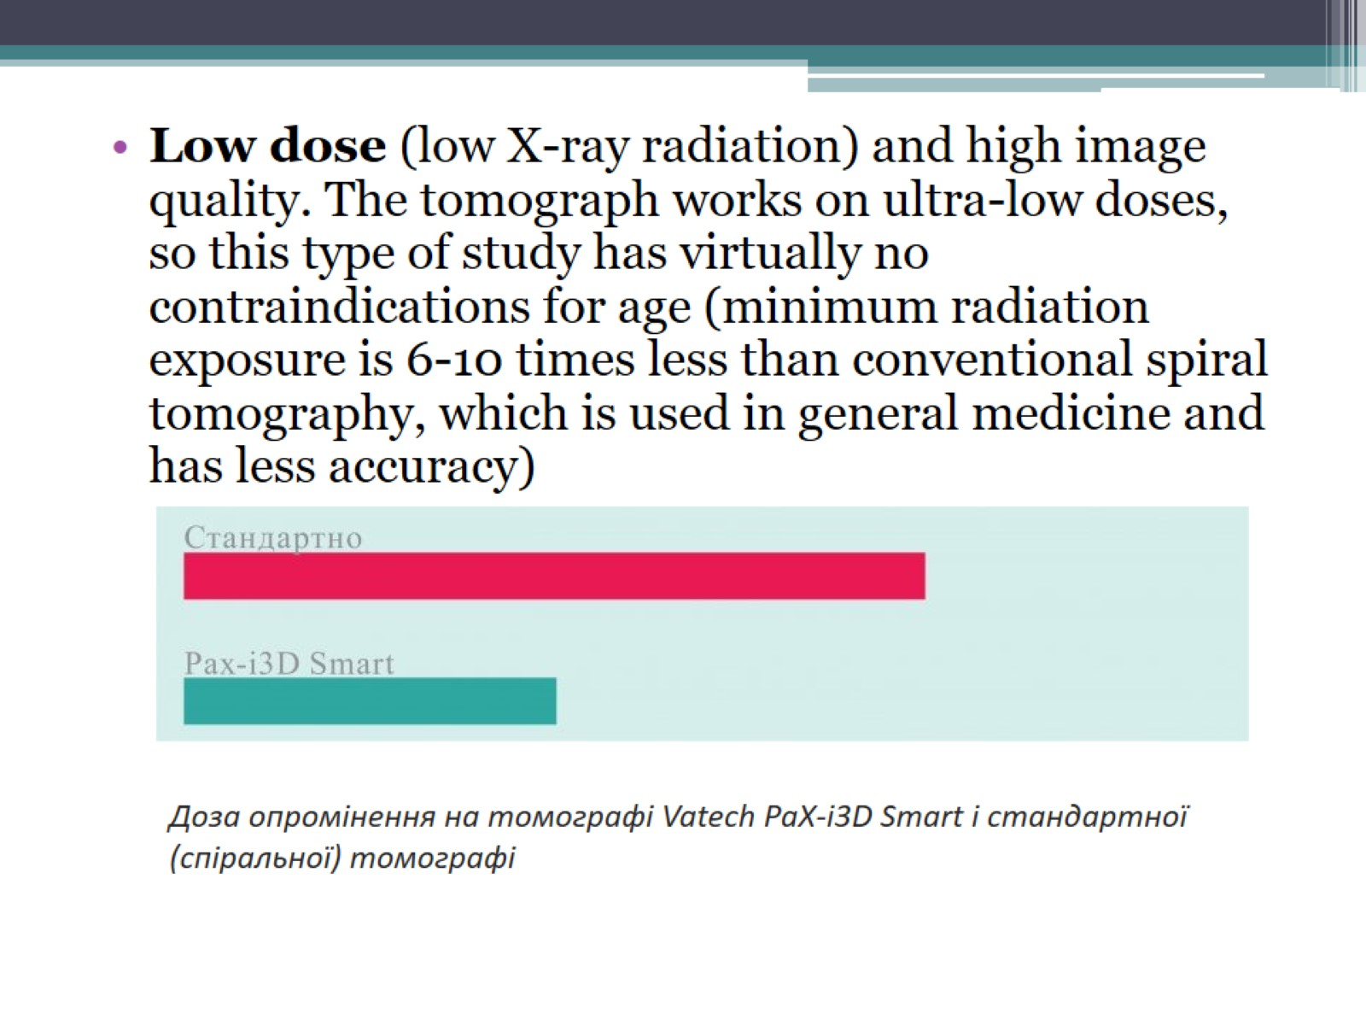

Slide 25
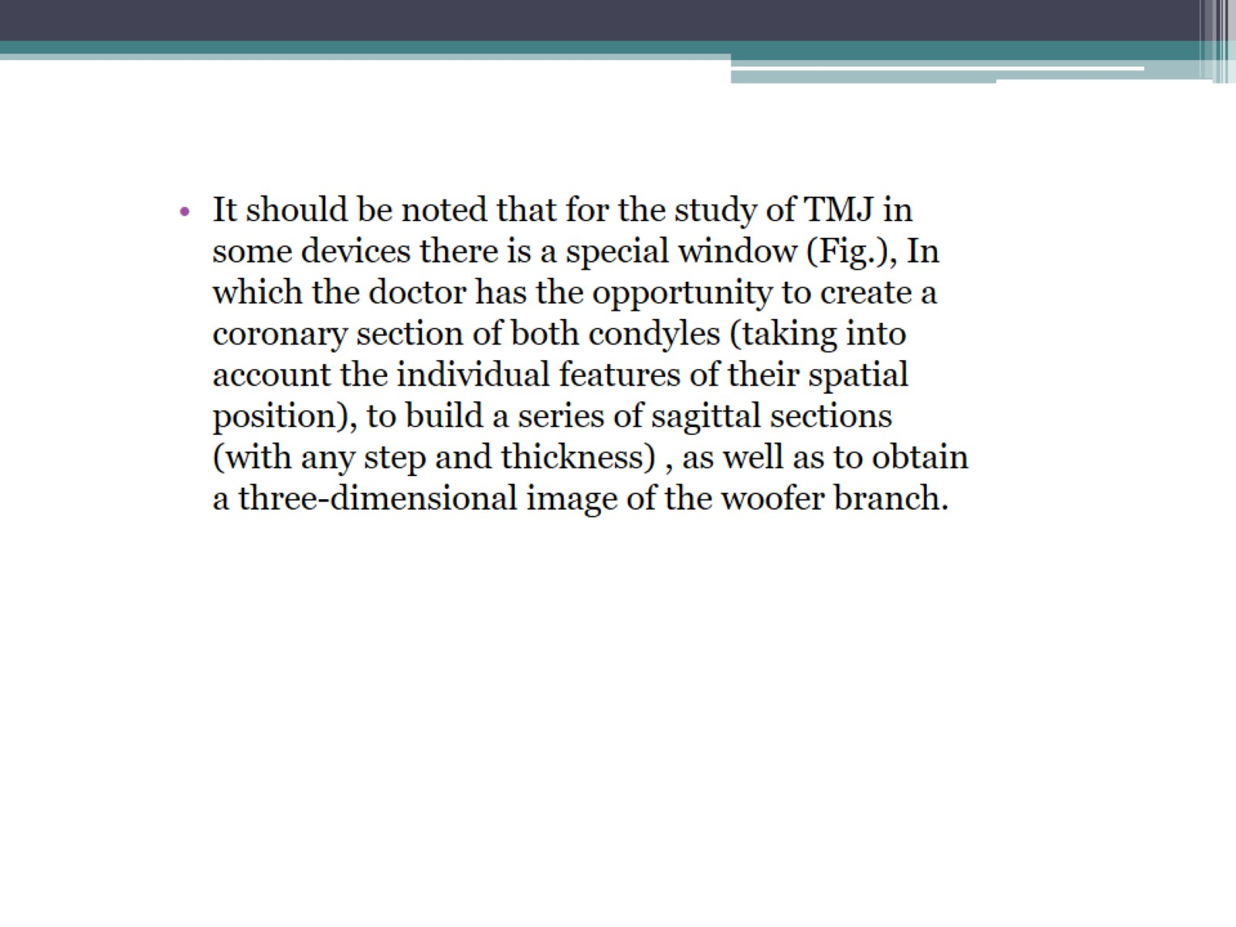

Slide 26
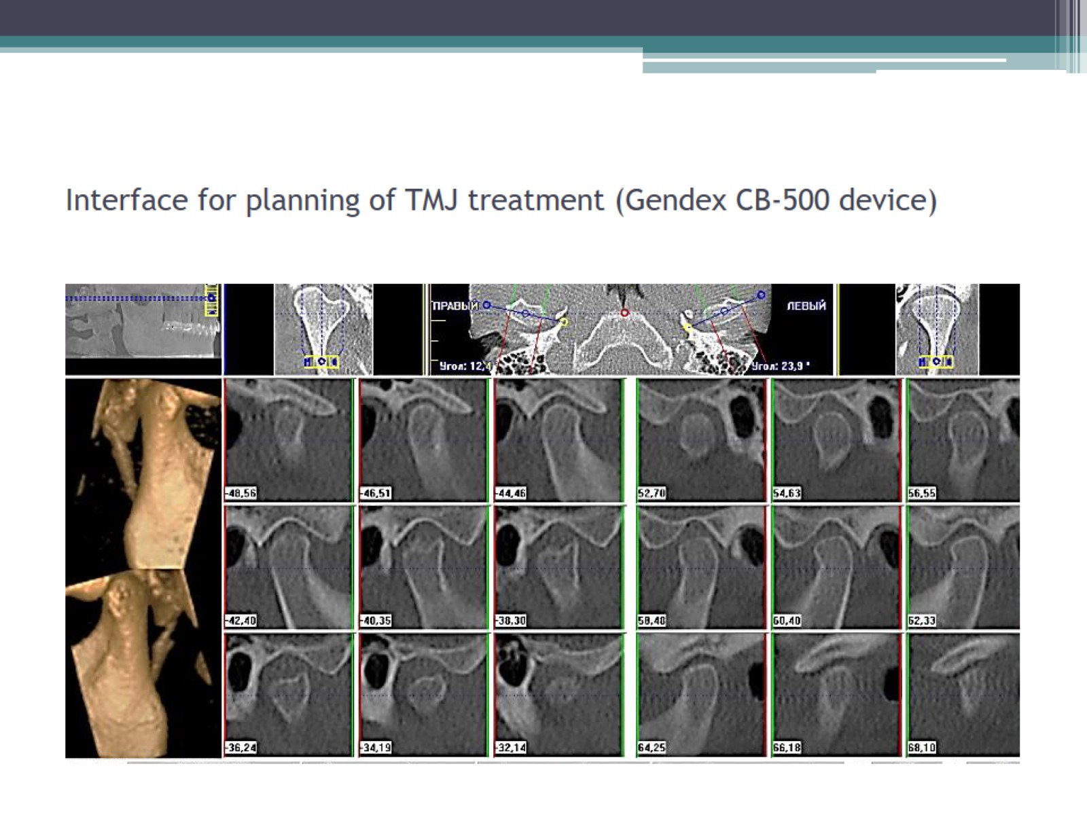
Interface for planning of TMJ treatment (Gendex CB-500 device)

Slide 27
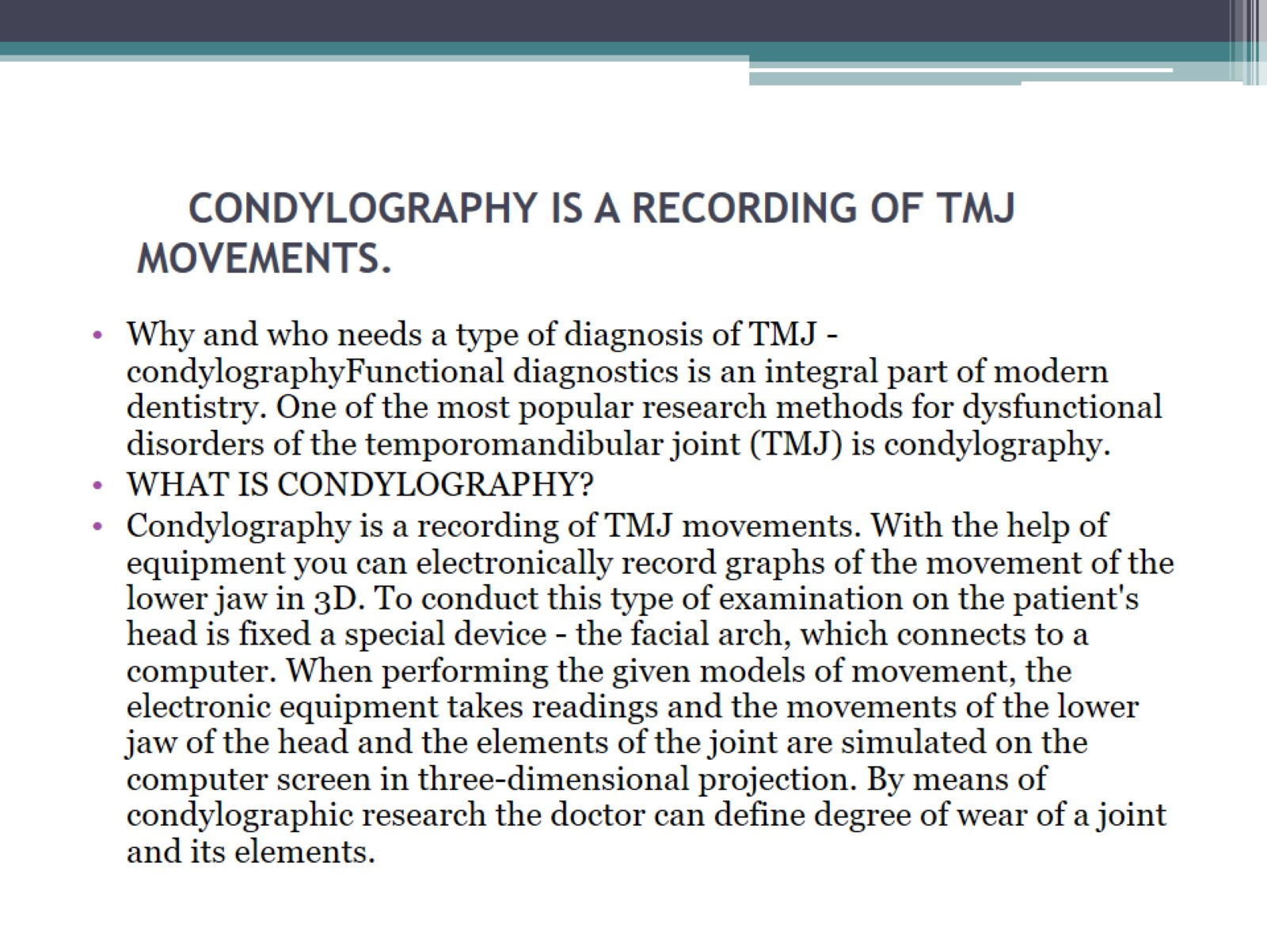
CONDYLOGRAPHY is a recording of TMJ movements.

Slide 28
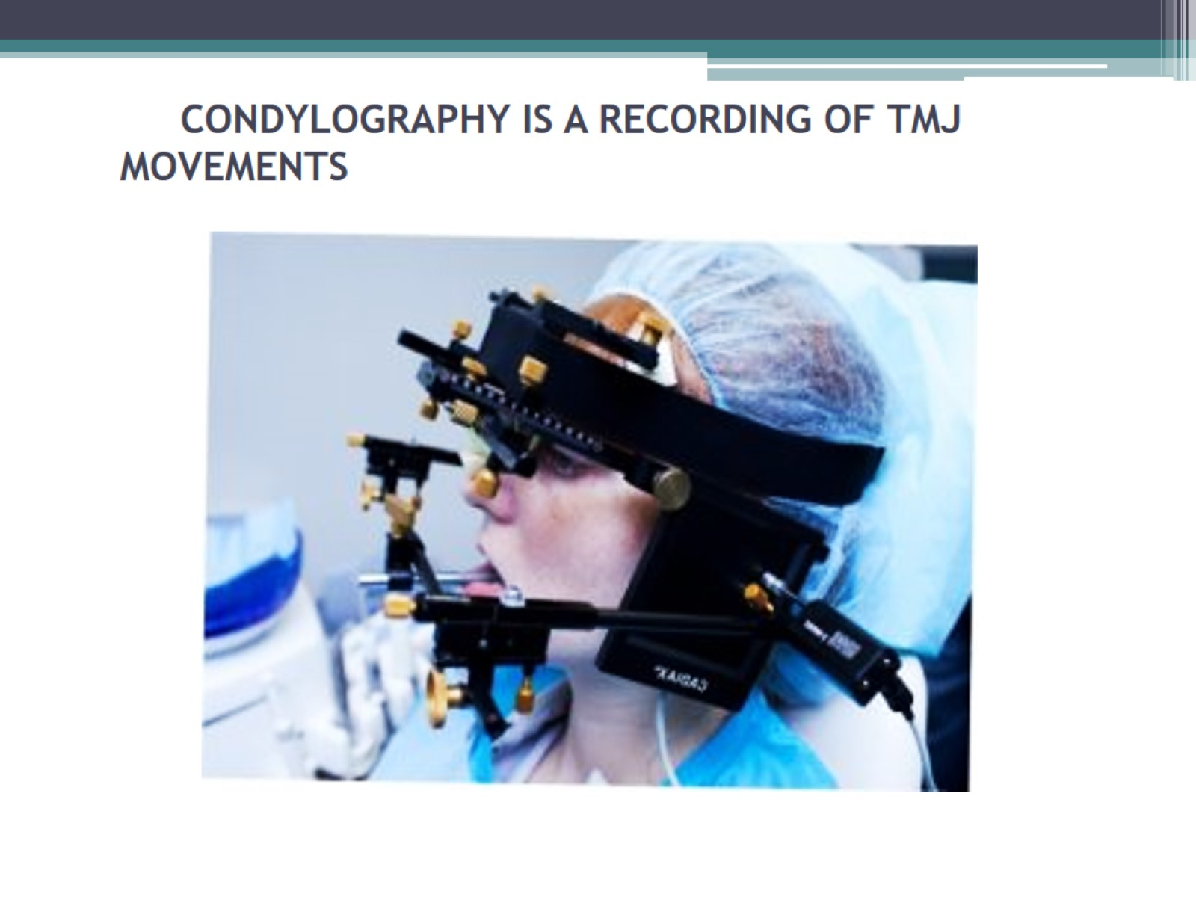
CONDYLOGRAPHY is a recording of TMJ movements

Slide 29
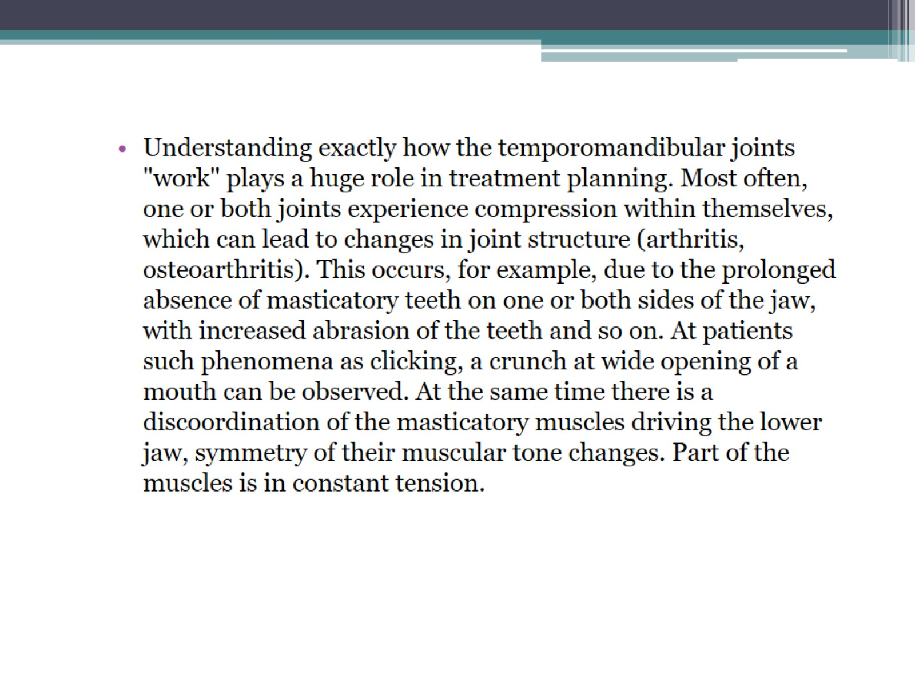

Slide 30
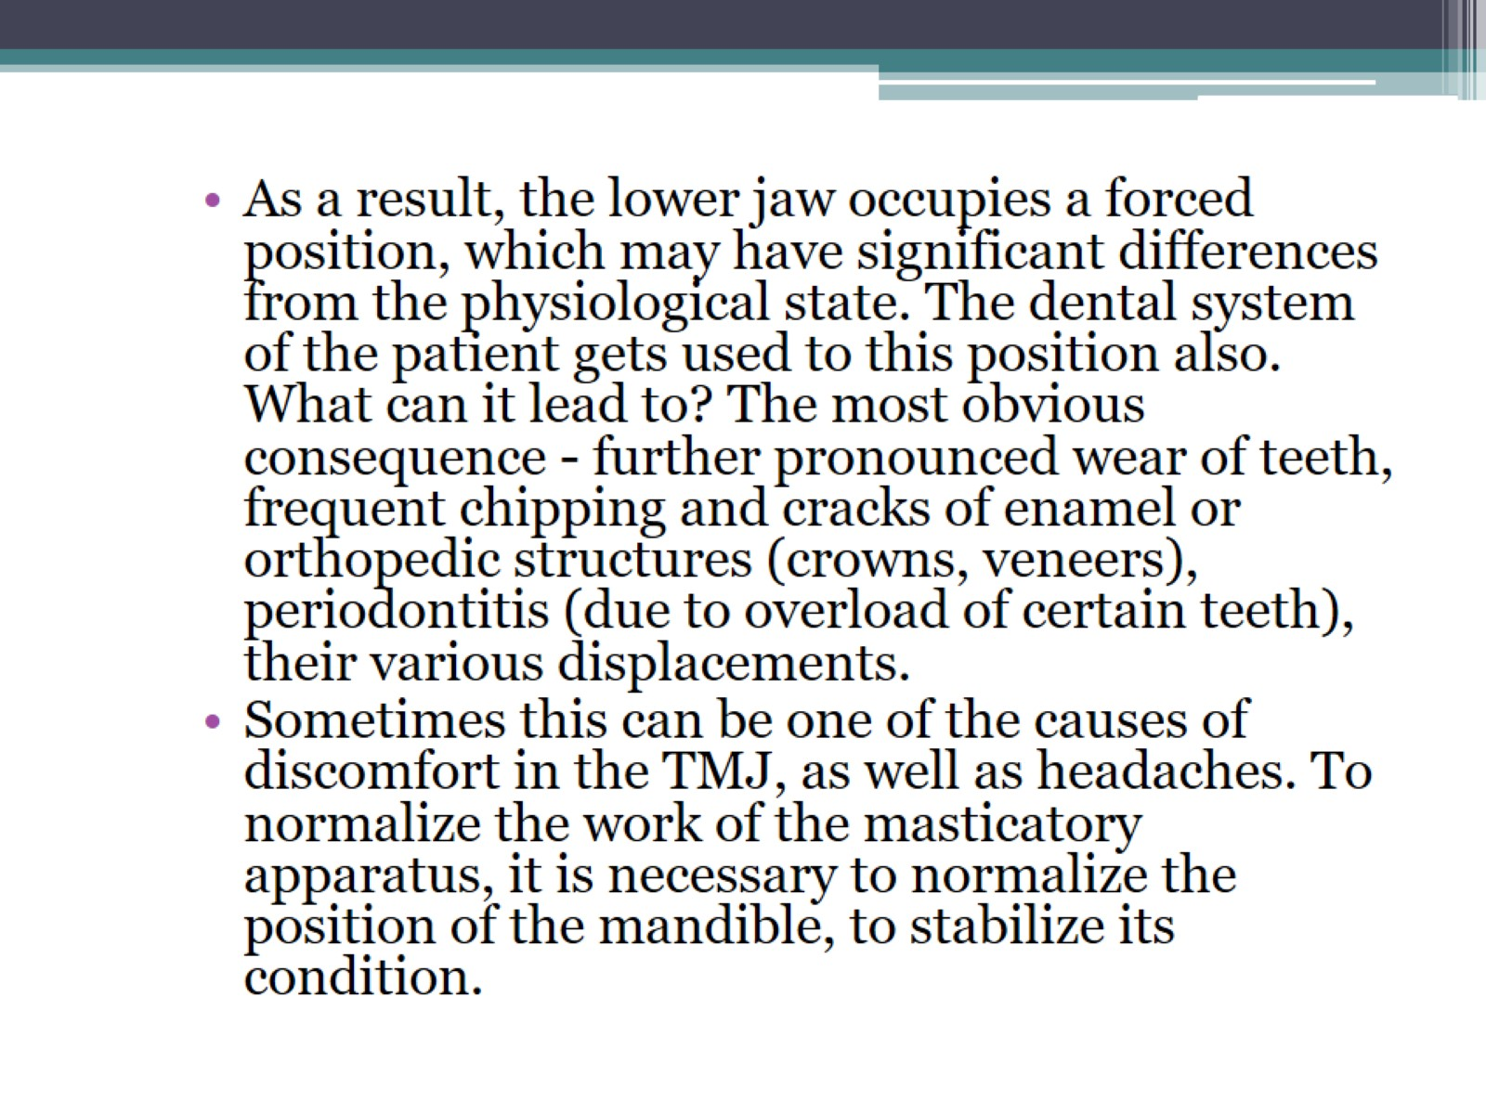

Slide 31
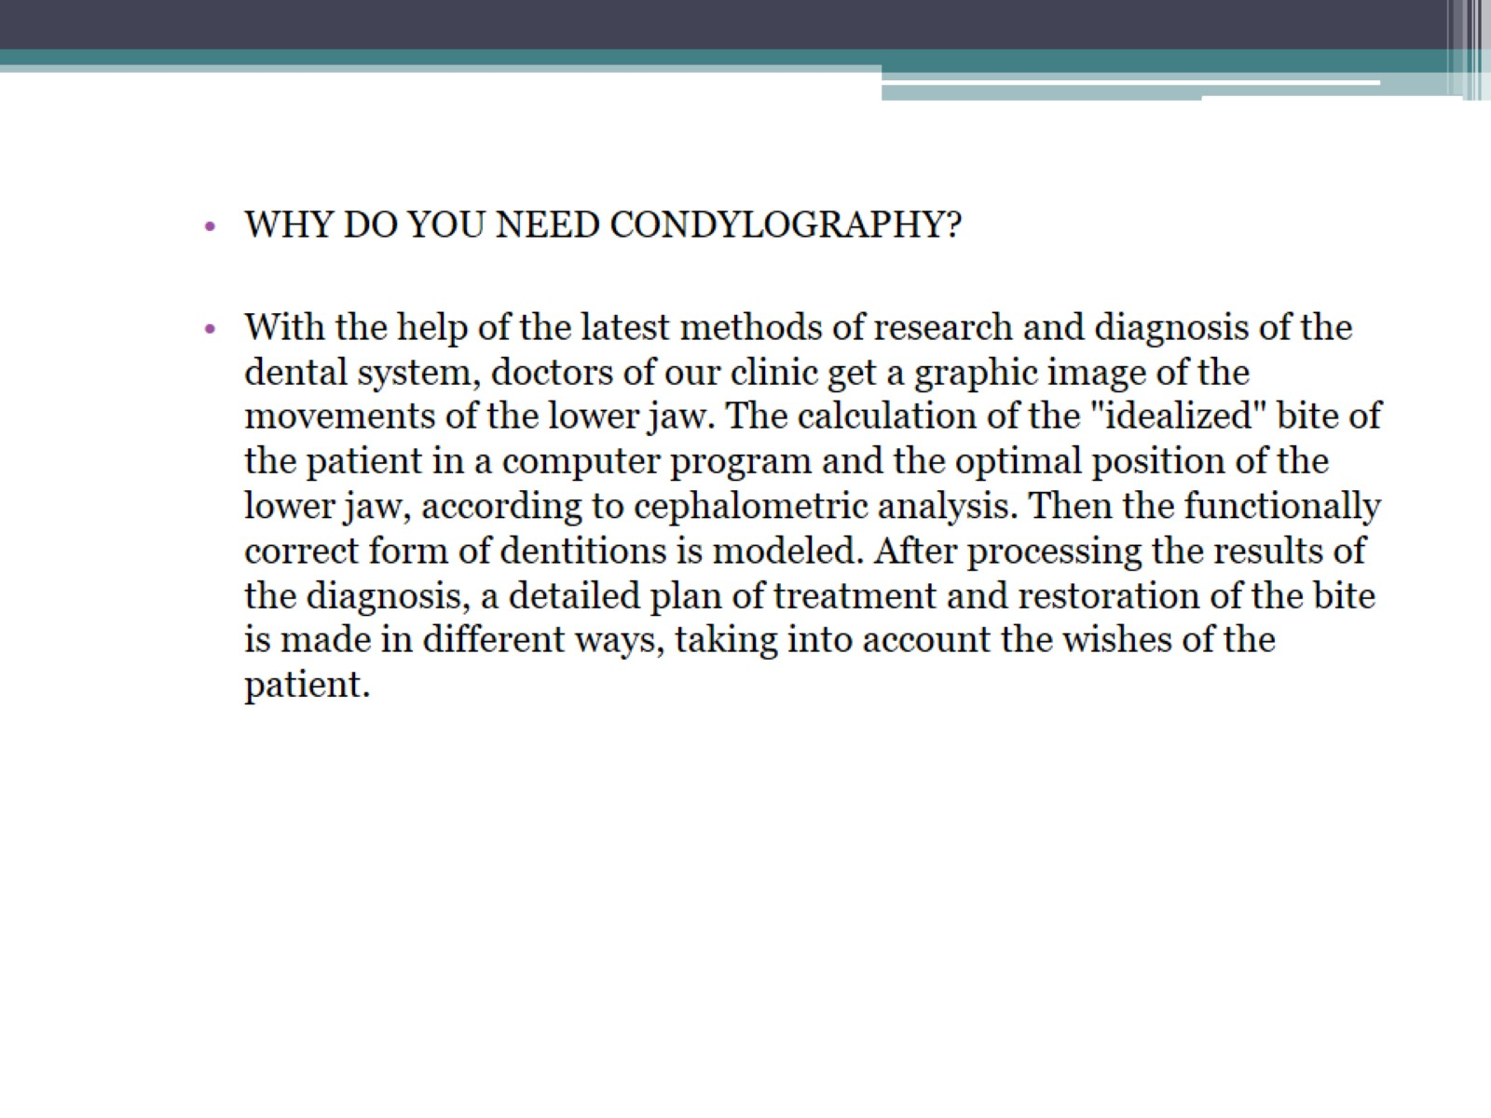

Slide 32
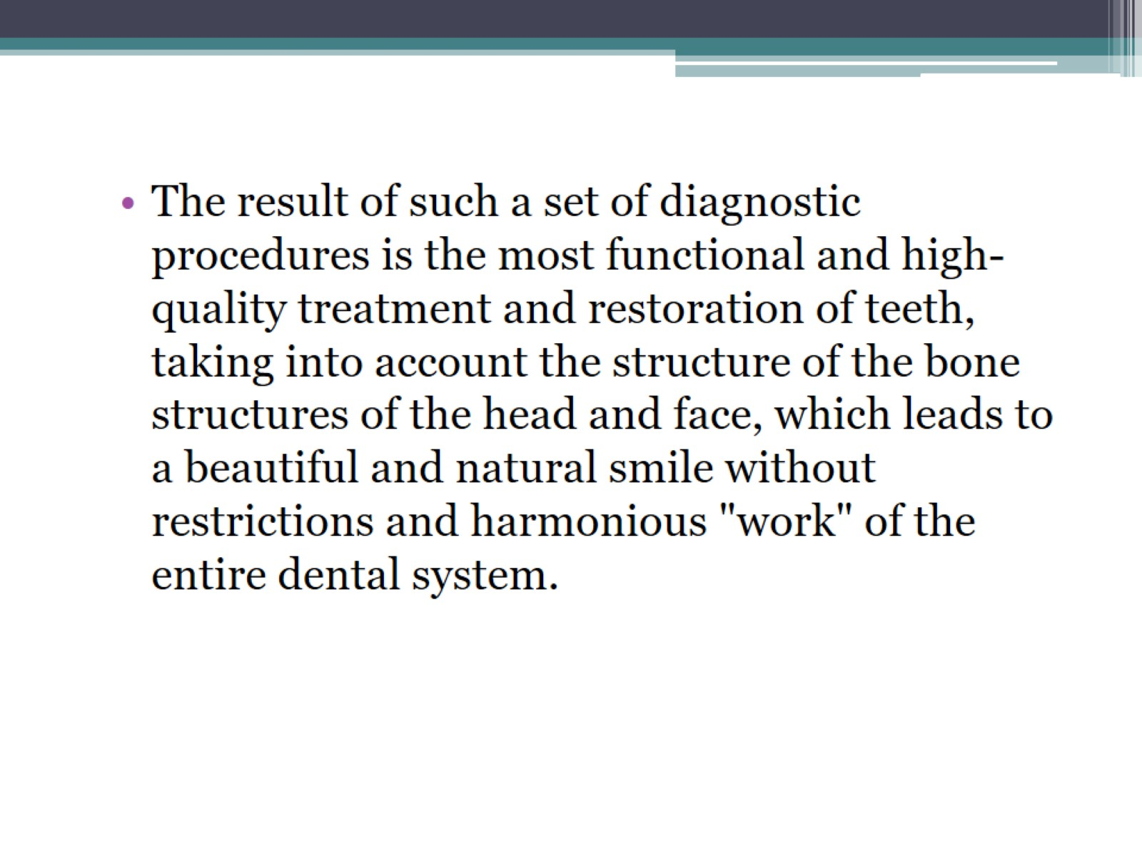

Slide 33
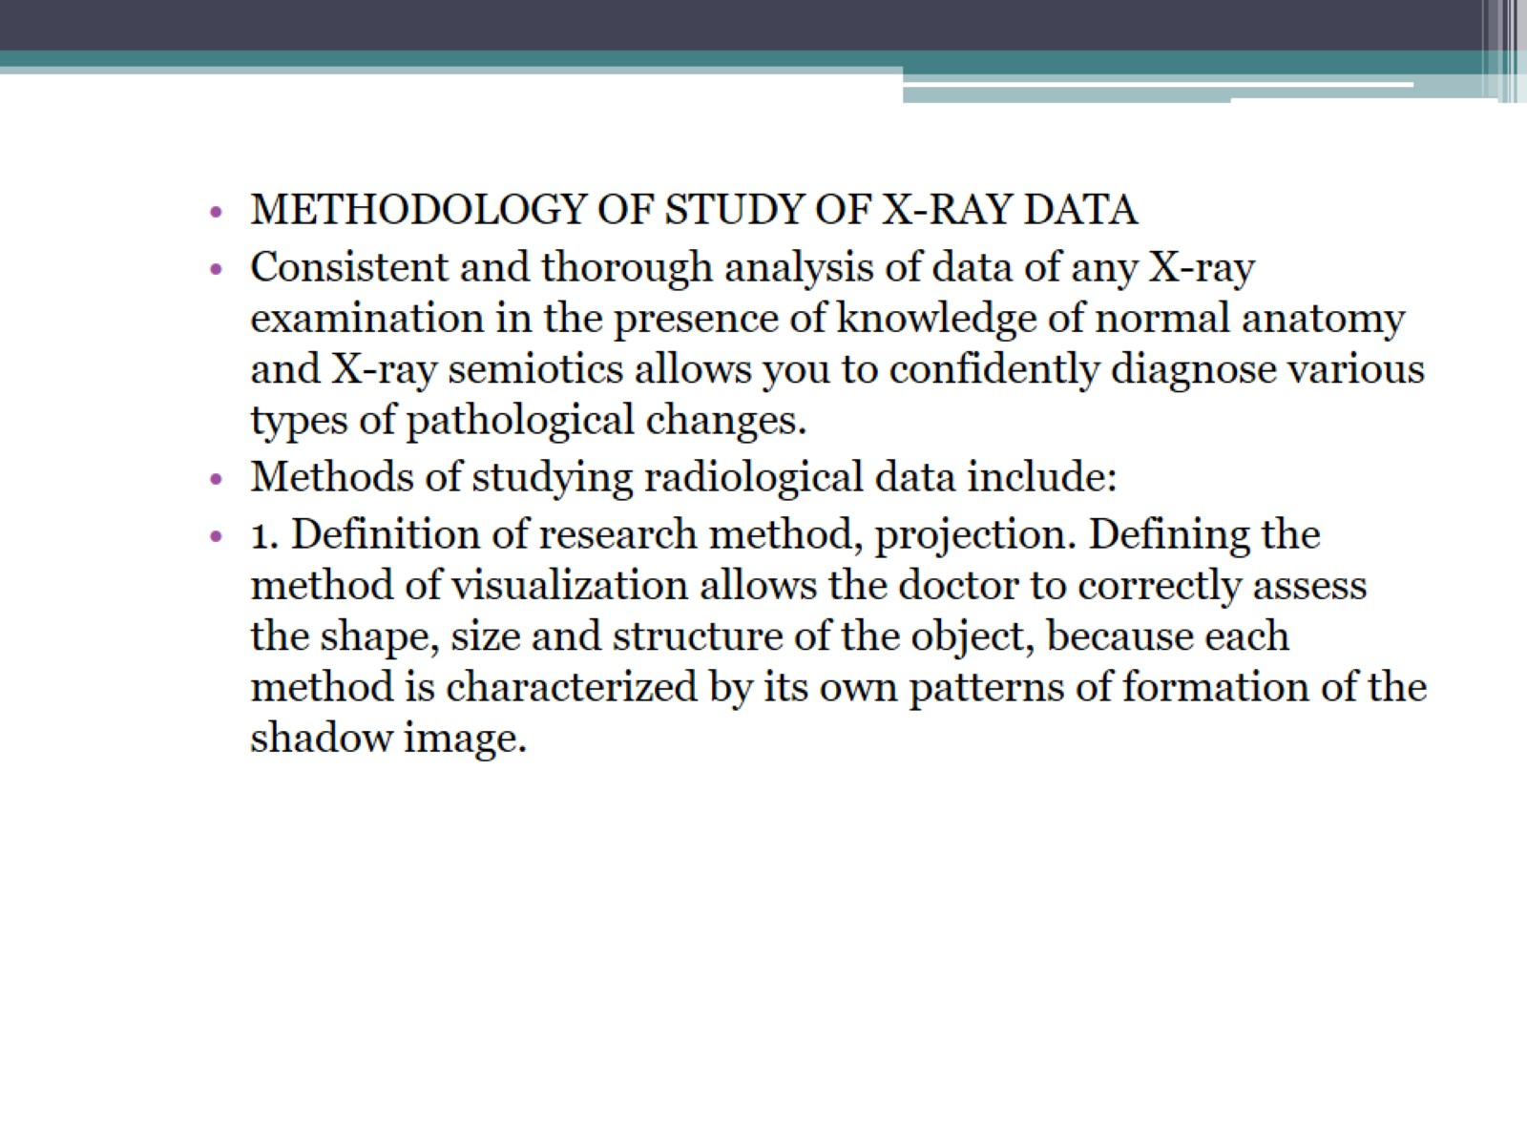

Slide 34
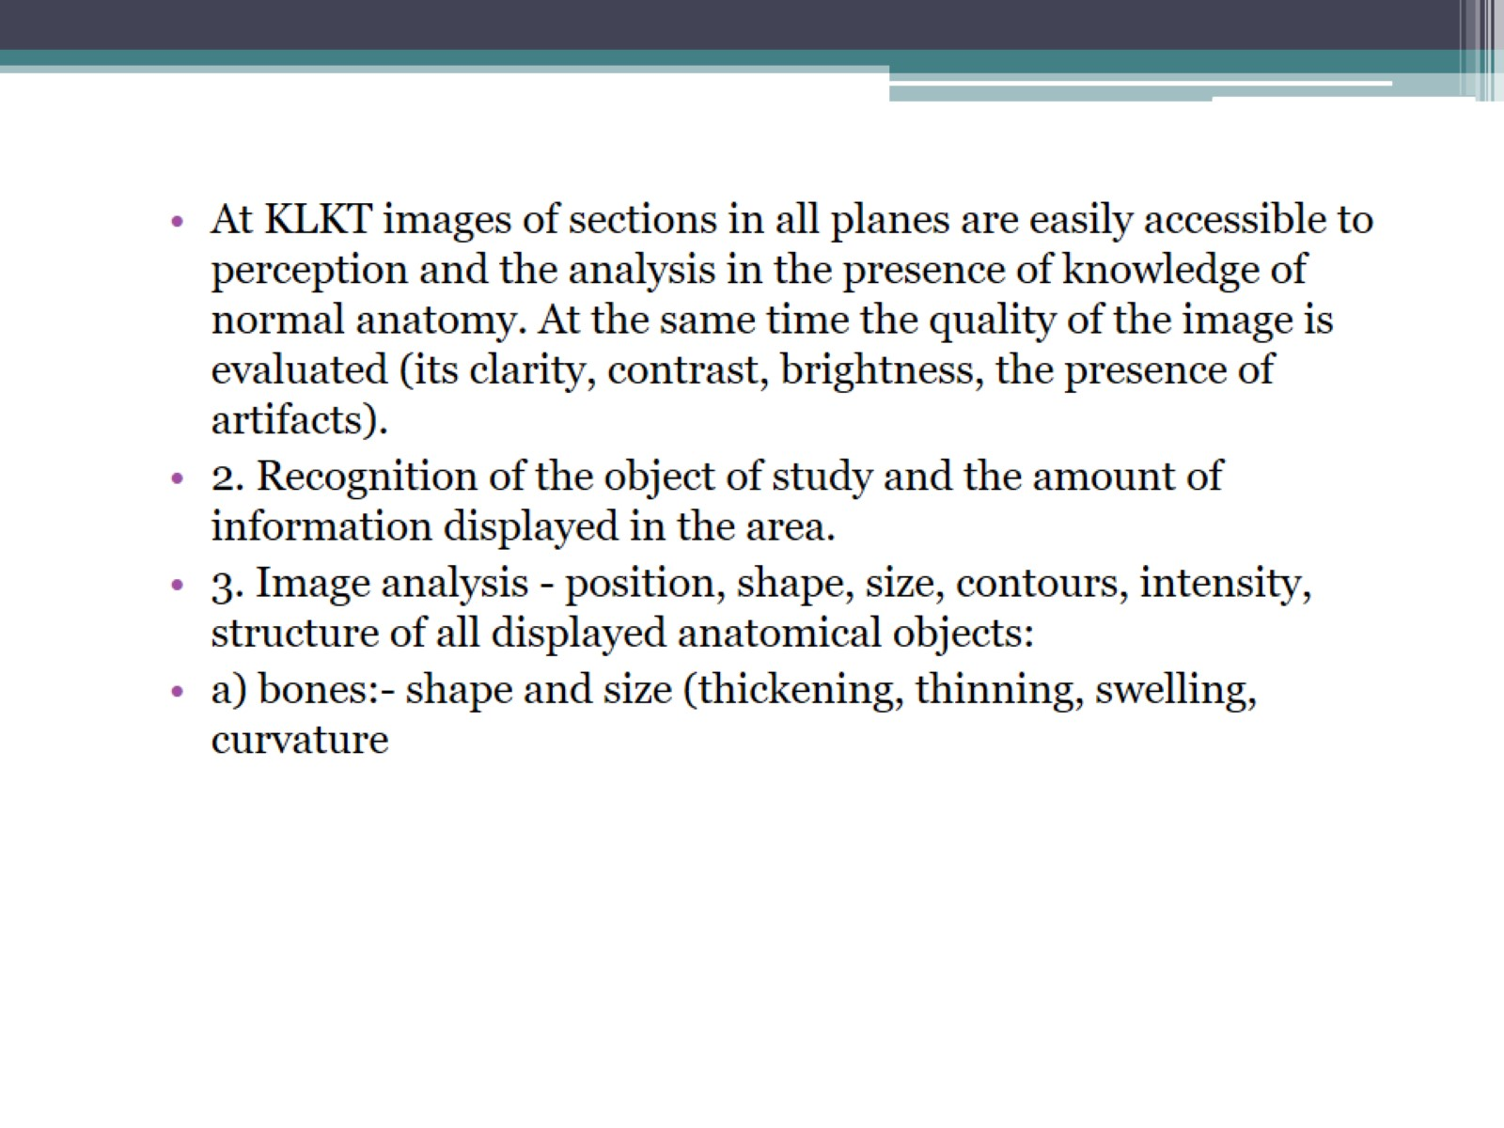

Slide 35
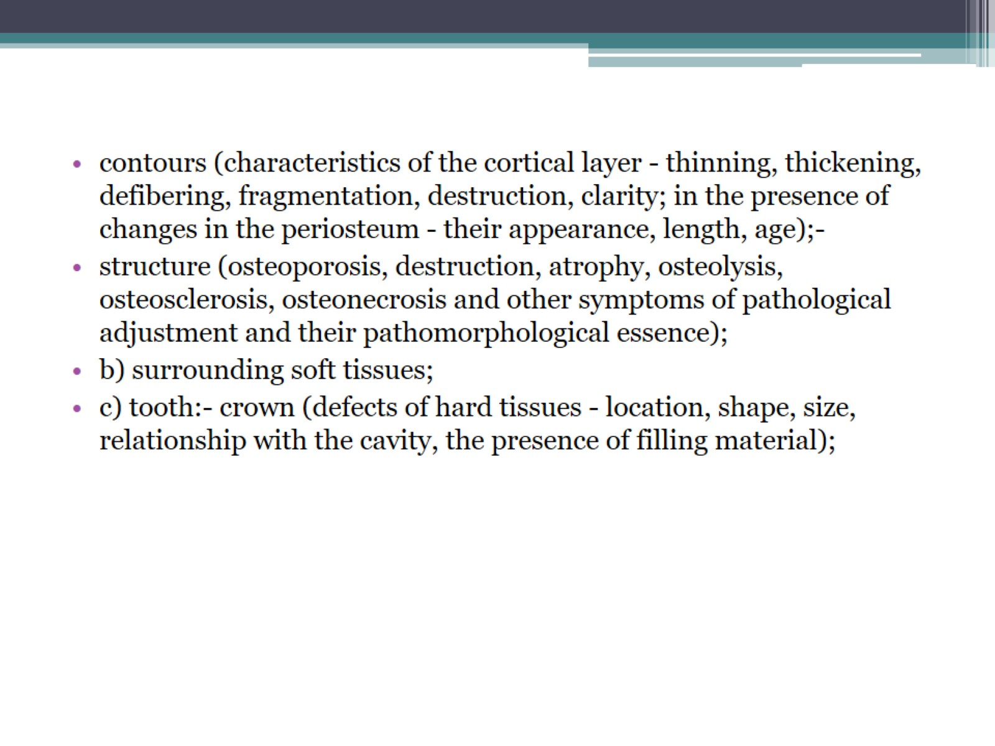

Slide 36
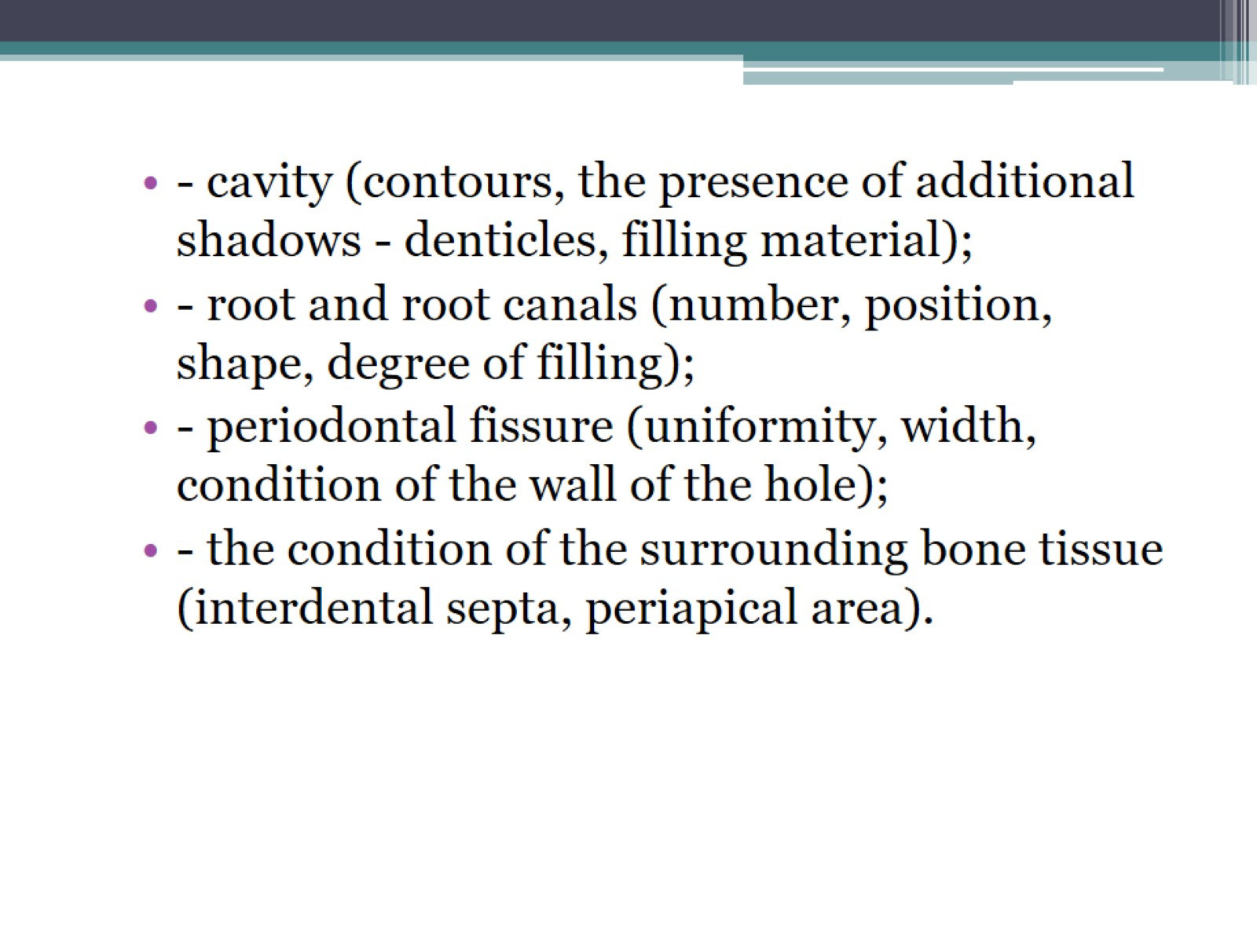

Slide 37
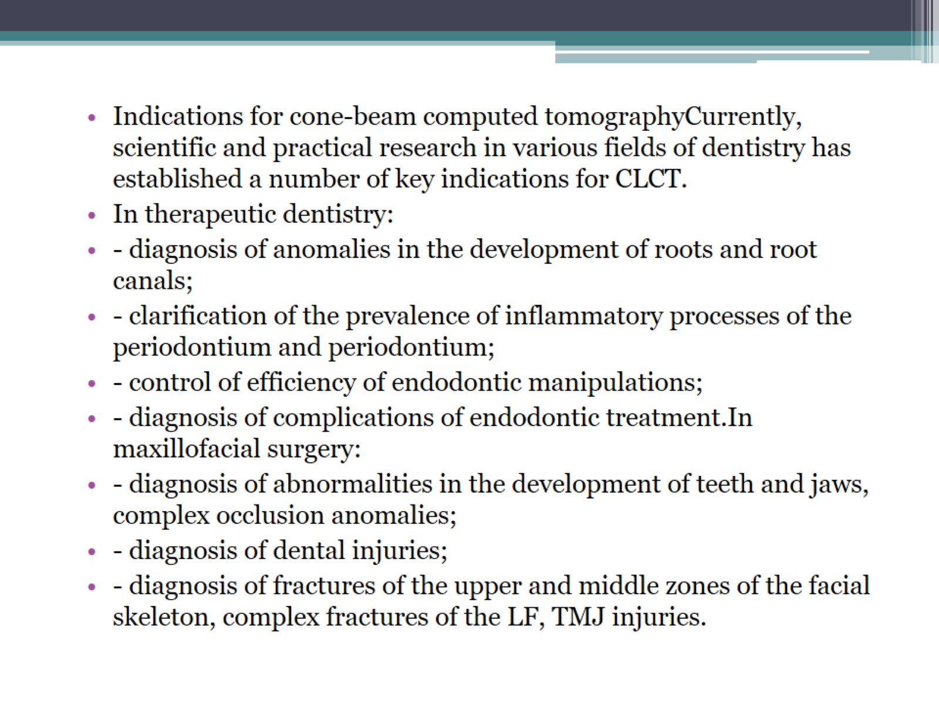

Slide 38
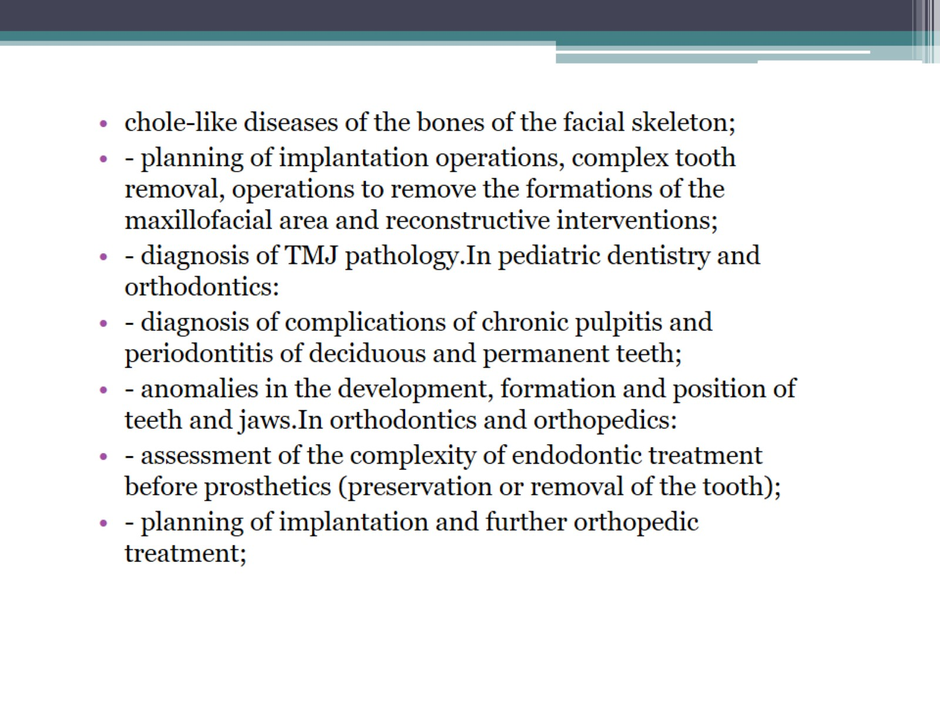

Slide 39
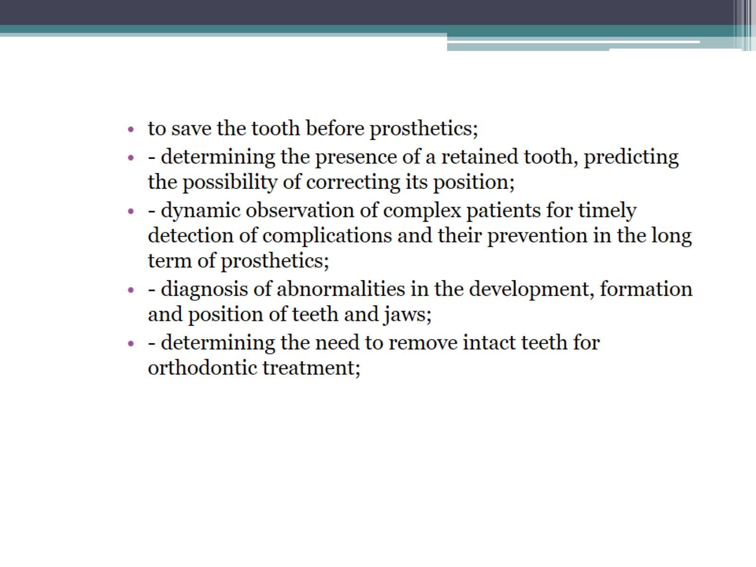

Slide 40
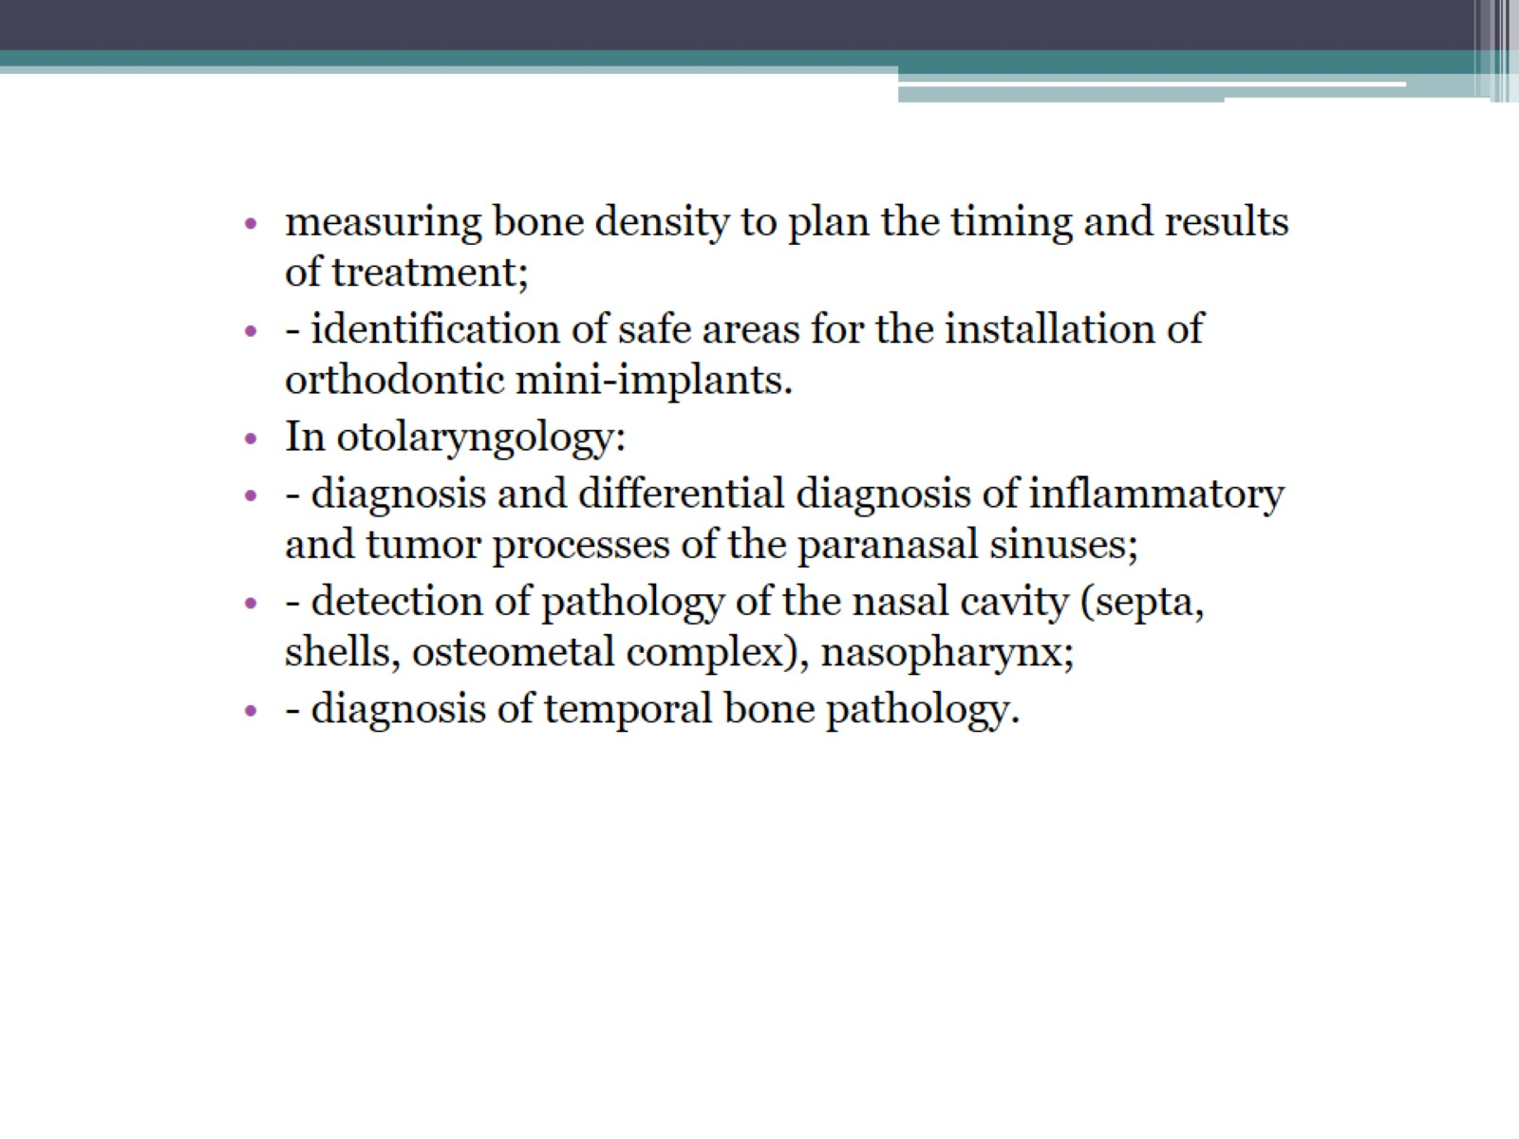

Slide 41
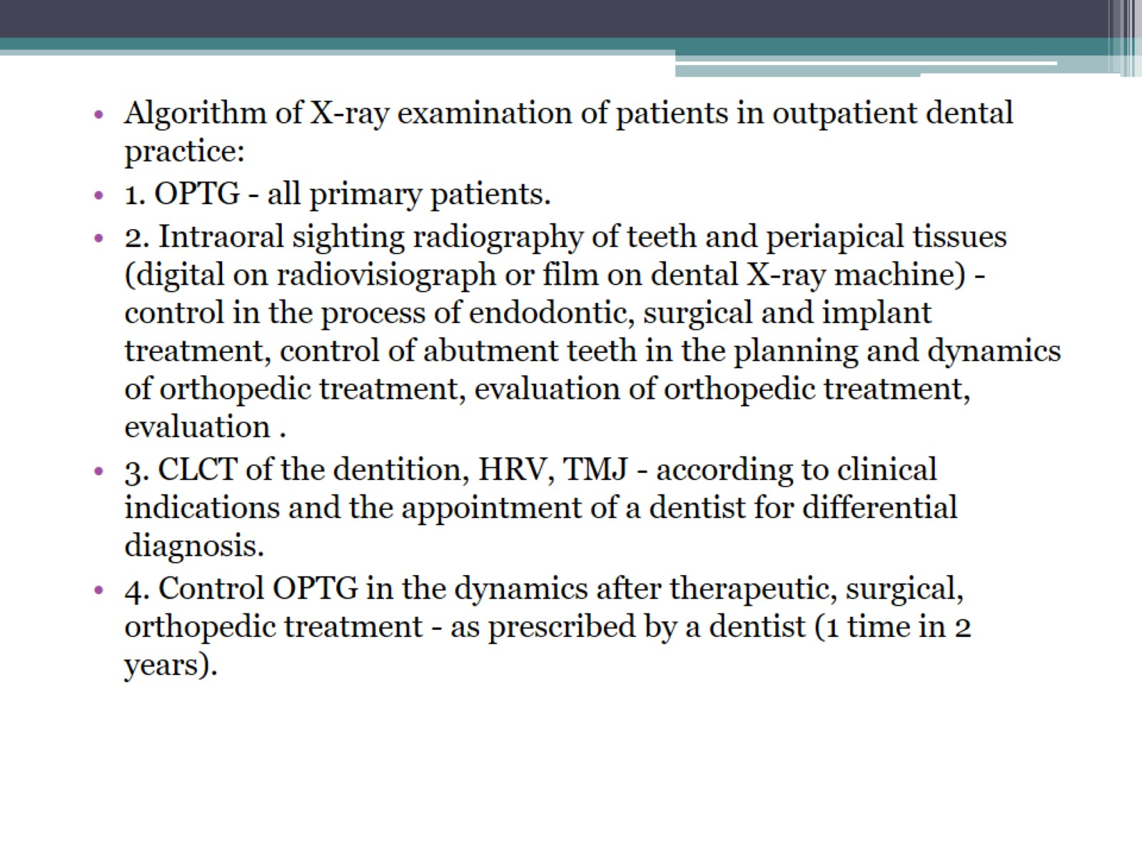

Slide 42
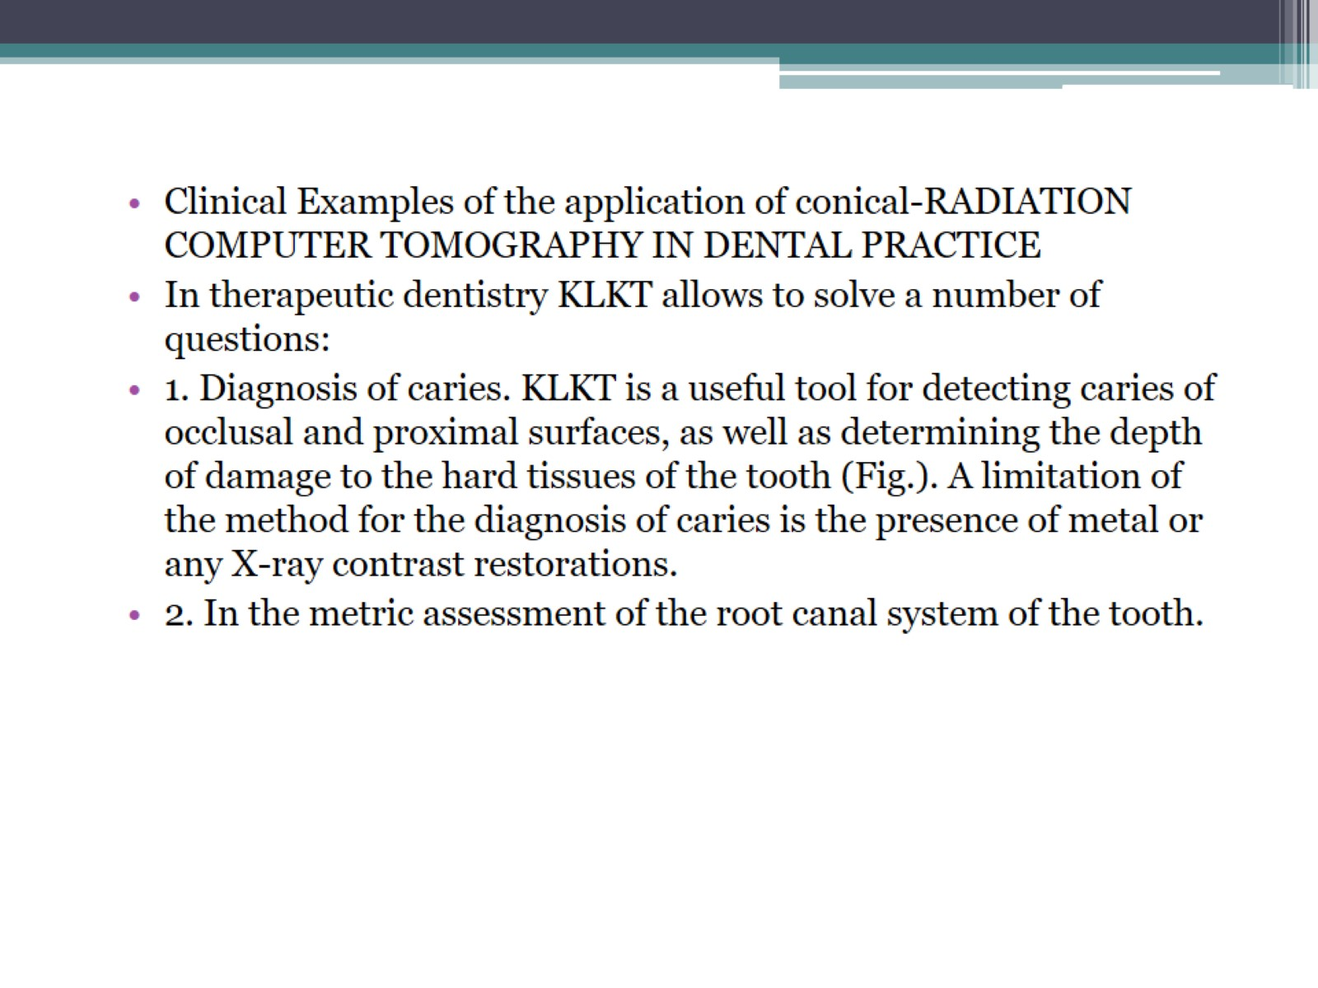

Slide 43
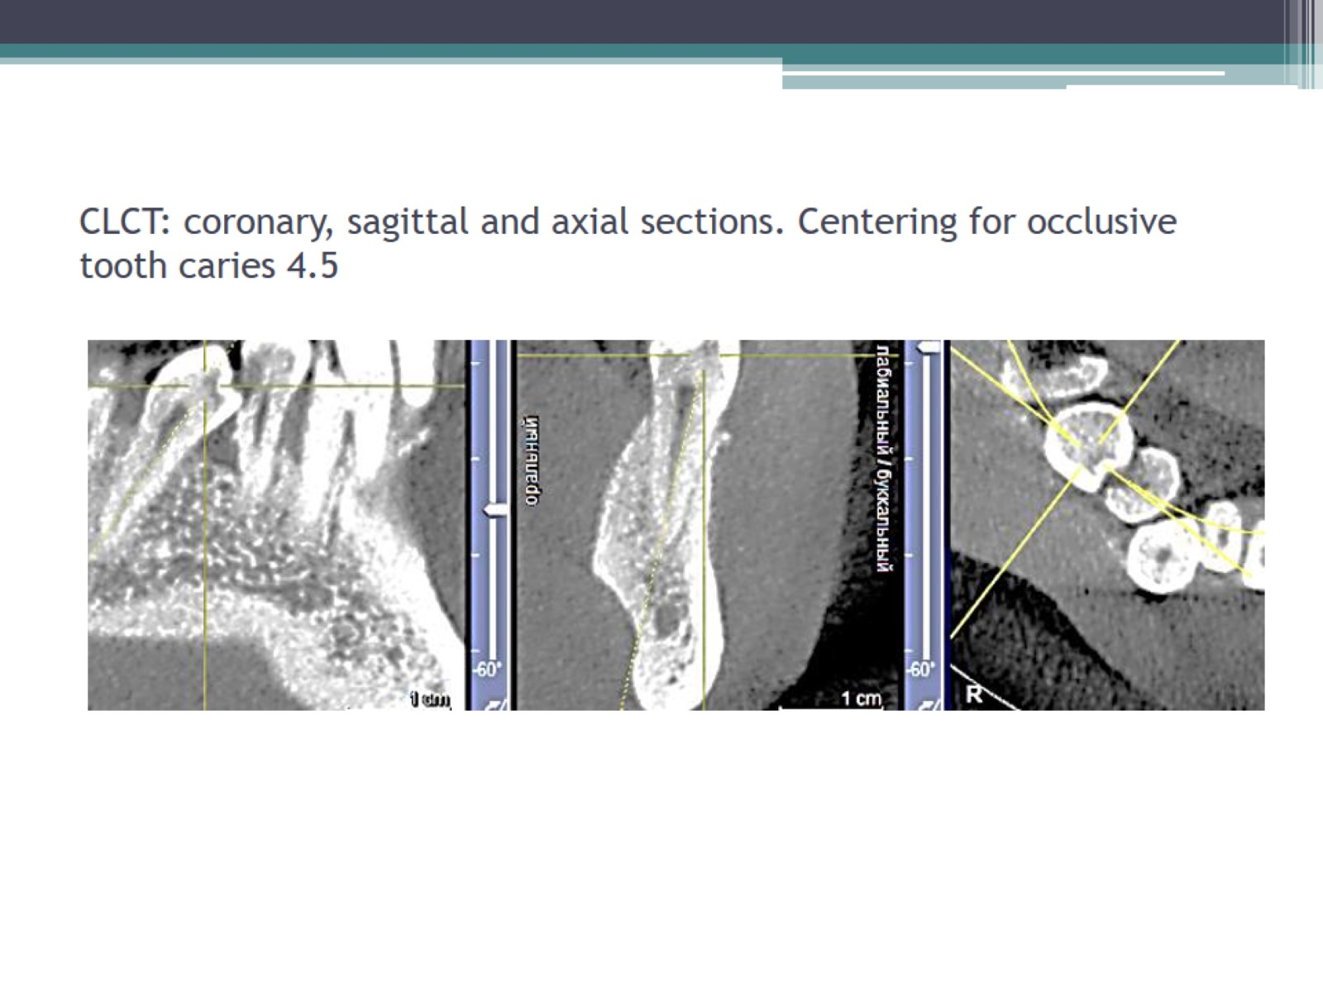
CLCT: coronary, sagittal and axial sections. Centering for occlusive tooth caries 4.5

Slide 44
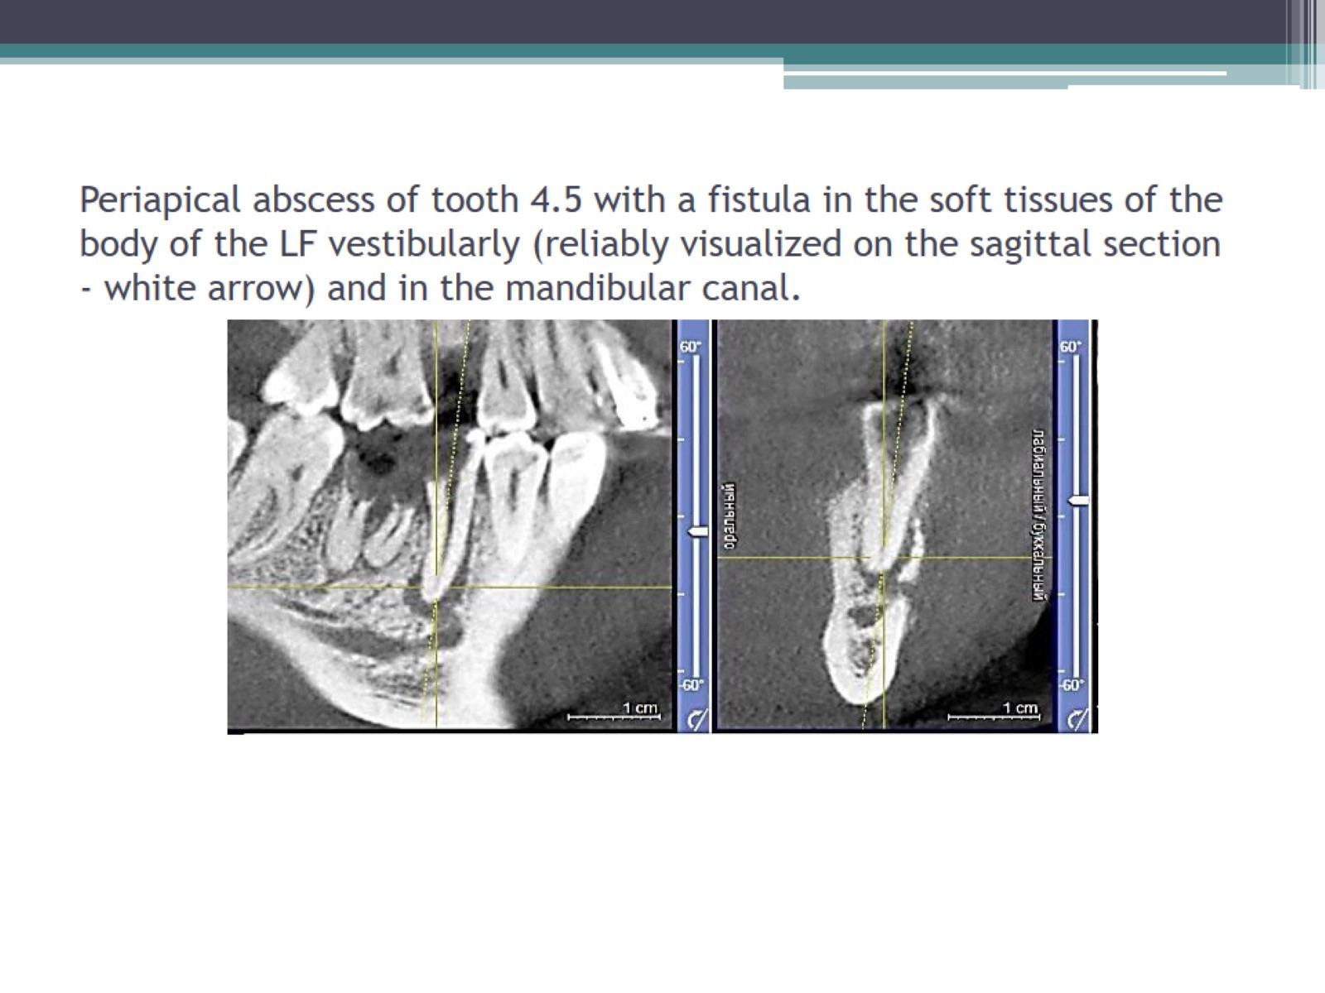
Periapical abscess of tooth 4.5 with a fistula in the soft tissues of the body of the LF vestibularly (reliably visualized on the sagittal section - white arrow) and in the mandibular canal.

Slide 45
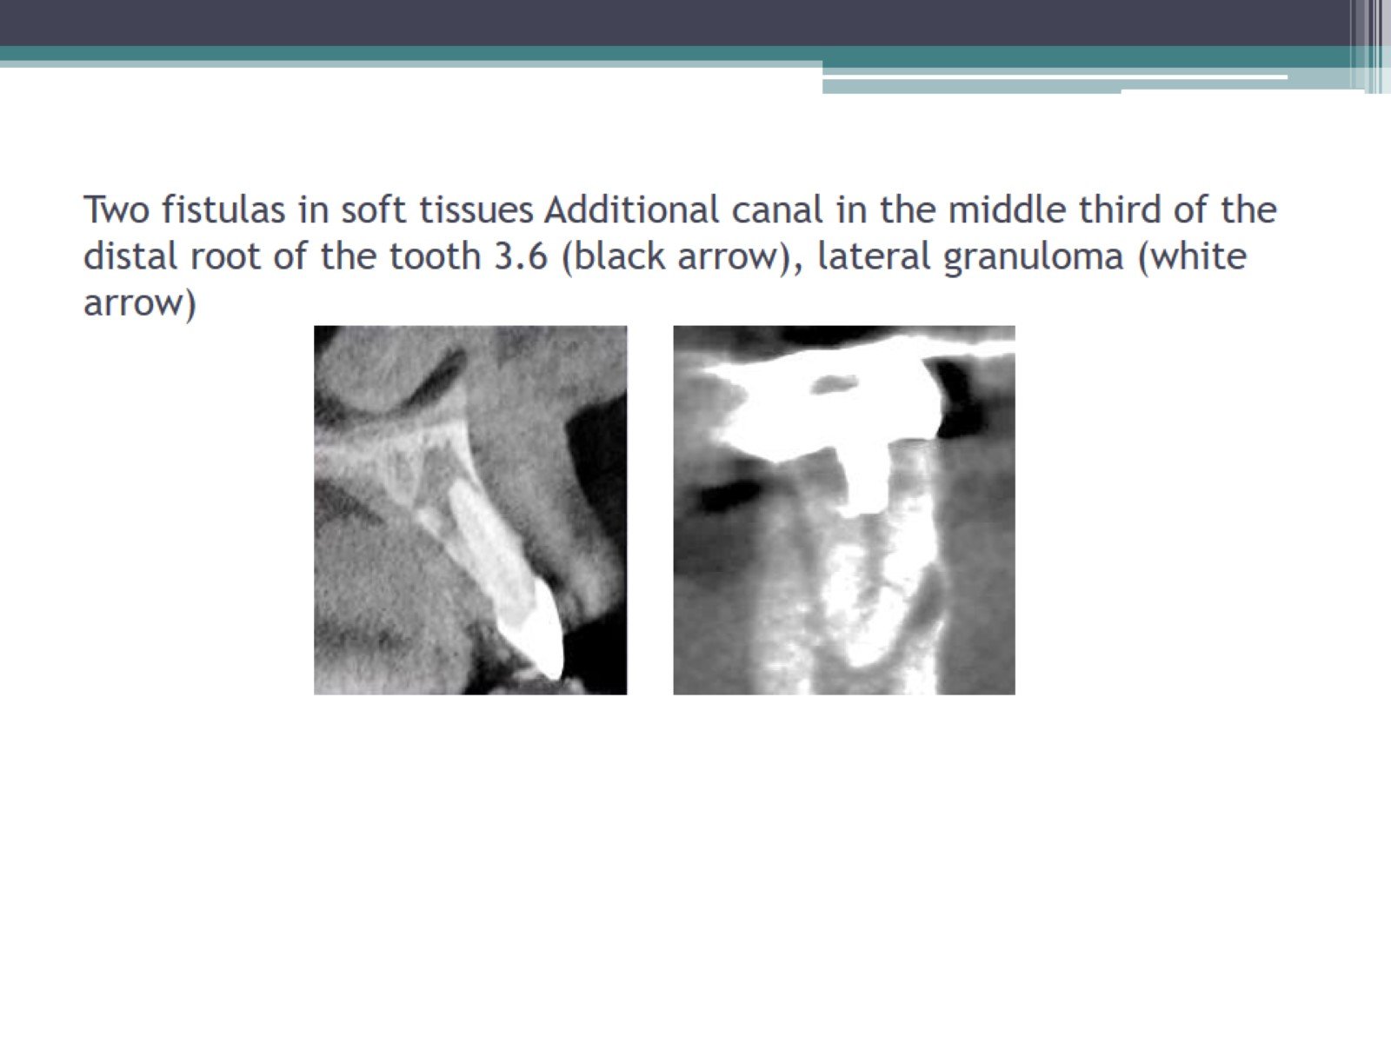
Two fistulas in soft tissues Additional canal in the middle third of the distal root of the tooth 3.6 (black arrow), lateral granuloma (white arrow)

Slide 46
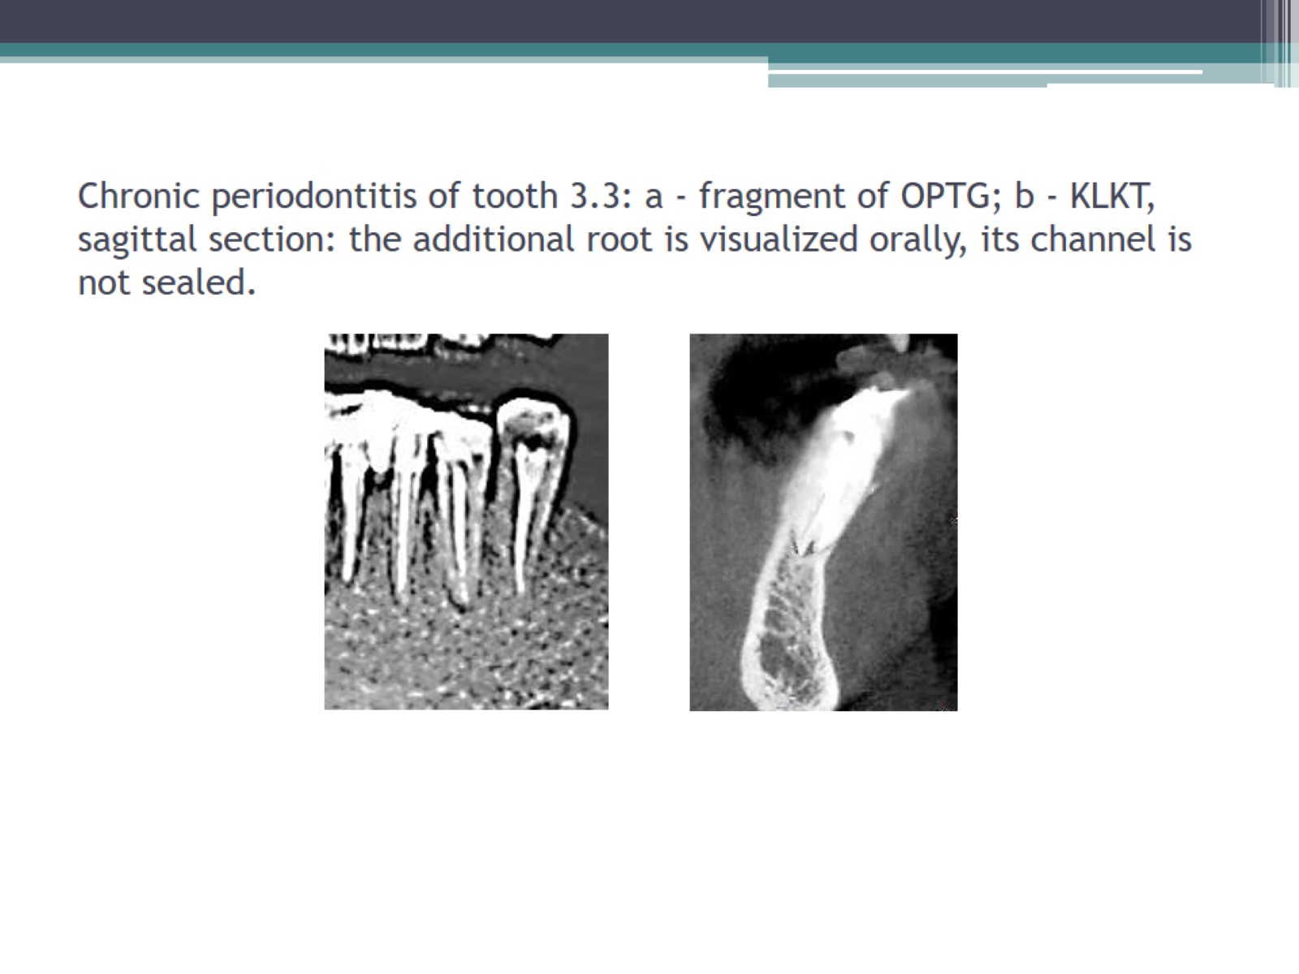
Chronic periodontitis of tooth 3.3: a - fragment of OPTG; b - KLKT, sagittal section: the additional root is visualized orally, its channel is not sealed.

Slide 47
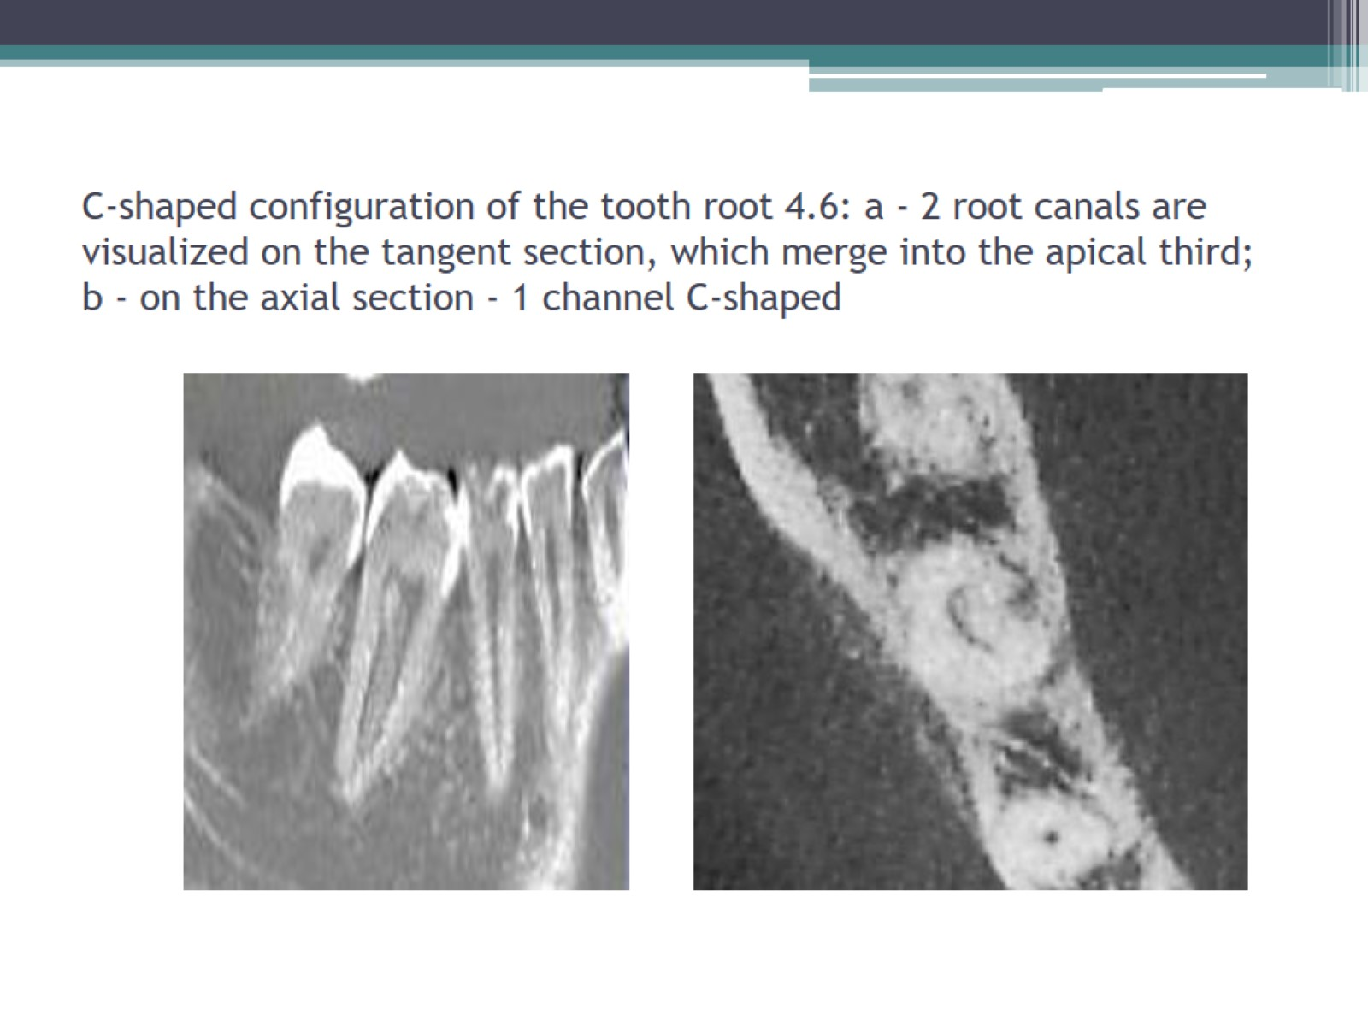
C-shaped configuration of the tooth root 4.6: a - 2 root canals are visualized on the tangent section, which merge into the apical third; b - on the axial section - 1 channel C-shaped

Slide 48
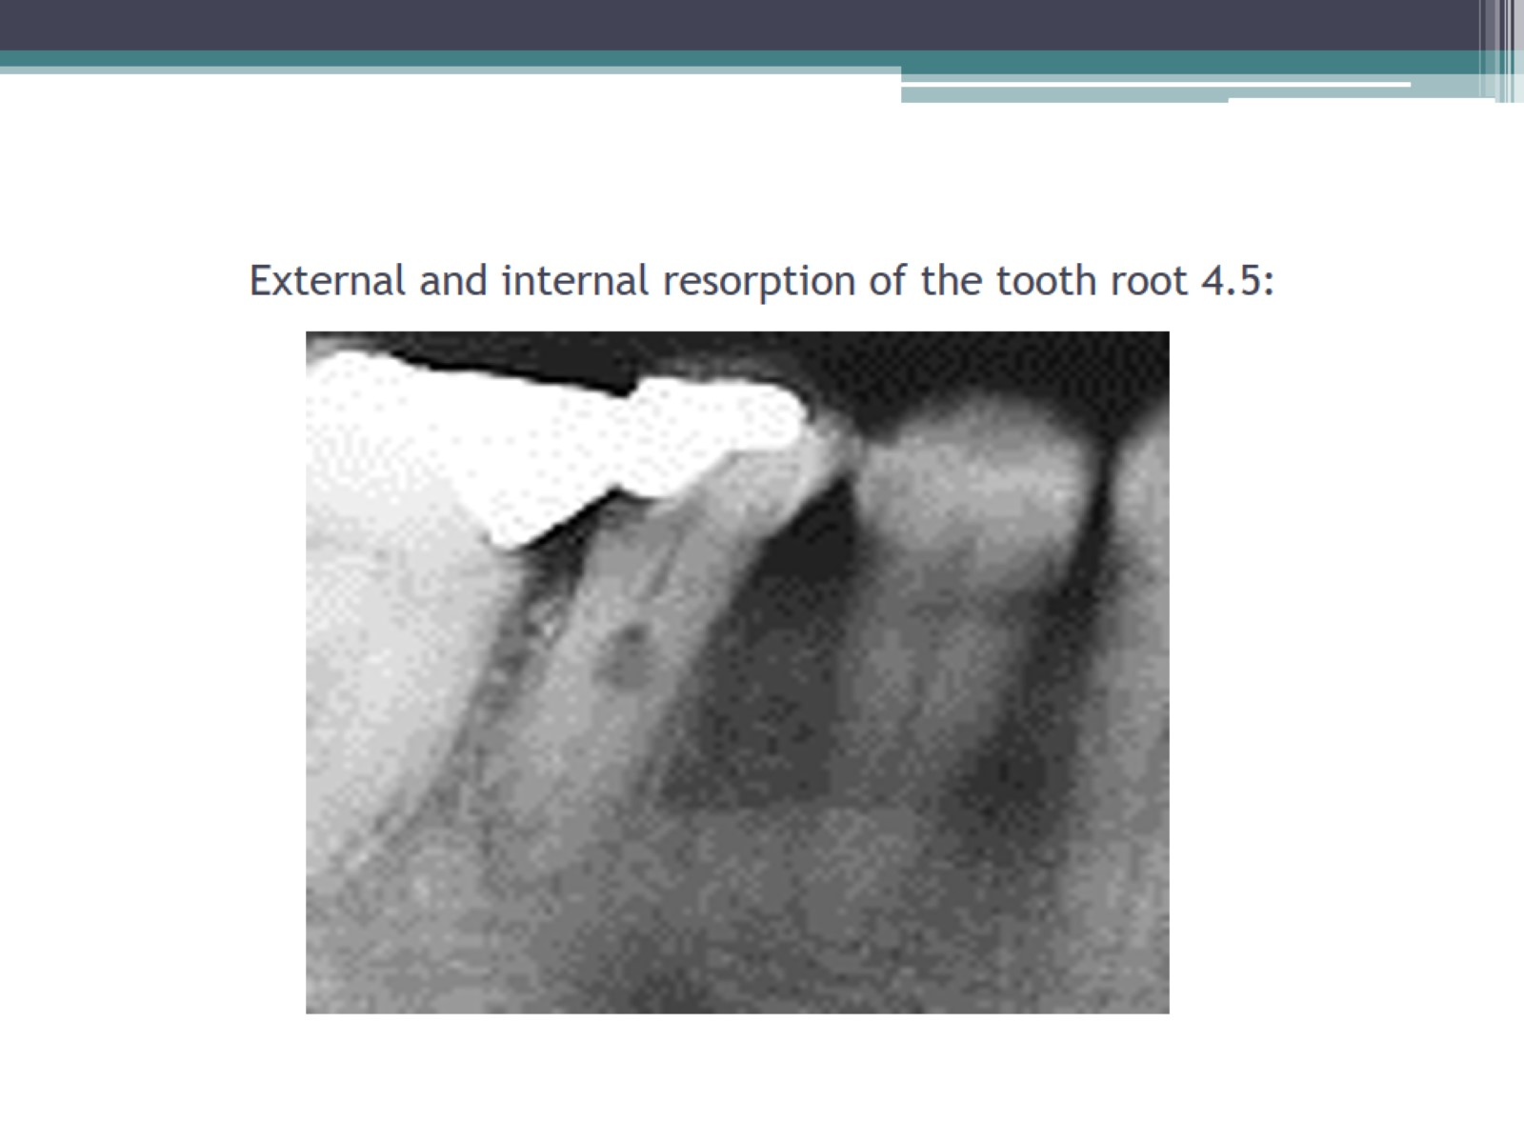
External and internal resorption of the tooth root 4.5:

Slide 49
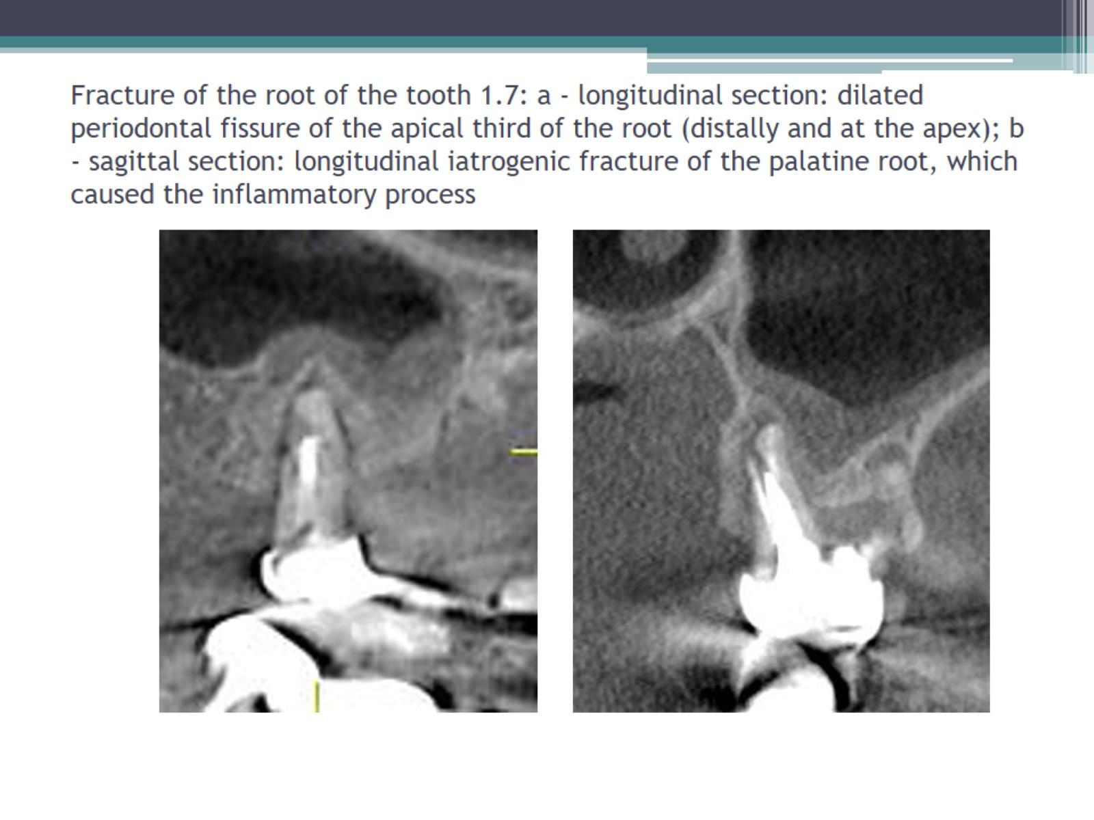
Fracture of the root of the tooth 1.7: a - longitudinal section: dilated periodontal fissure of the apical third of the root (distally and at the apex); b - sagittal section: longitudinal iatrogenic fracture of the palatine root, which caused the inflammatory process

Slide 50
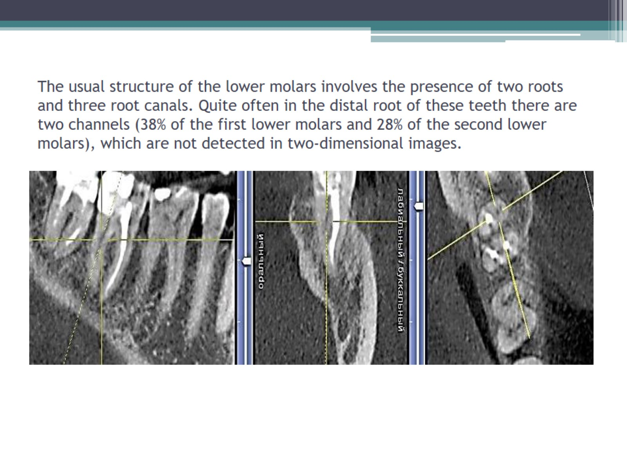
The usual structure of the lower molars involves the presence of two roots and three root canals. Quite often in the distal root of these teeth there are two channels (38% of the first lower molars and 28% of the second lower molars), which are not detected in two-dimensional images.

Slide 51

Removal of filling material for the apex of the distal root of the tooth 3.7: on the coronary section - in the mandibular canal, on the sagittal - reliably does not penetrate into the lumen of the channel.

Slide 52


Slide 53

Denticle at the mouth of the distal root canal of tooth 4.7 (intersection of coordinate axes

Slide 54

Application in periodontology. Performing 2D radiography can lead to incorrect assessment of the degree of destruction of bone tissue due to errors due to the projection overlap and, as a result, to inaccuracies in determining reliable anatomical landmarks. Only 3D-visualization allows you to make sections perpendicular to the axis of the dental arch and accurately measure bone defects on the vestibular and oral sides (dehiscence, fenestration) (drawings).

Slide 55

Resorption of the walls of the alveoli of the tooth 3.5 orally and distally by 2/3 of the root length, vestibular and mesial - by 1/2

Slide 56

Chronic periodontitis of tooth 4.6 (furcation lesions). Chronic periodontitis of both roots.

Slide 57

Apical granuloma of tooth 2.2 with a fistula in the soft tissues of the RF vestibular

Slide 58

Preparation of dental implant surgery and evaluation of its effectiveness. Identification of optimal access and study of anatomical features of RF for sinus lifting operations.

Slide 59

Preparation of dental implant surgery and evaluation of its effectiveness. Identification of optimal access and study of anatomical features of RF for sinus lifting operations.

Slide 60

Tracing "of the mandibular canals, virtual implant planning

Slide 61

. Root cyst of the frontal part of the woofer (including the roots of the teeth 3.2-4.1, with thin and exploding cortical plates vestibularly and lingually), the threat of pathological fracture

Slide 62

Search for retained and dystopian teeth and planning the operation of their removal overcomplete incisors-microdentia, dystopia (rotation of 180 °), eruption into cavities

Slide 63

Acute arthritis of the left TMJ - local osteoporosis and usurpation of the cortical plate.

Slide 64

Bilateral recurrent dislocation

Slide 65

apical granuloma (red arrow), squeezing the lower wall of the HPV; distal-buccal canal - uneven filling to the apical third.

Slide 66


Slide 67

Chronic hyperplastic maxillary sinusitis, hyperplasia of the lower nasal concha, conha bullosa of the middle nasal concha

Slide 68

Volumetric computed tomography (CT) of the paranasal sinuses, an objective radiological method that allows you to get a reliable picture of the condition of the paranasal sinuses and structures of the nasal cavity.

Slide 69


Slide 70


Slide 71

CLCT in otorhinolaryngology

Slide 72


Slide 73


Slide 74


Slide 75


Slide 76


