Slide 1

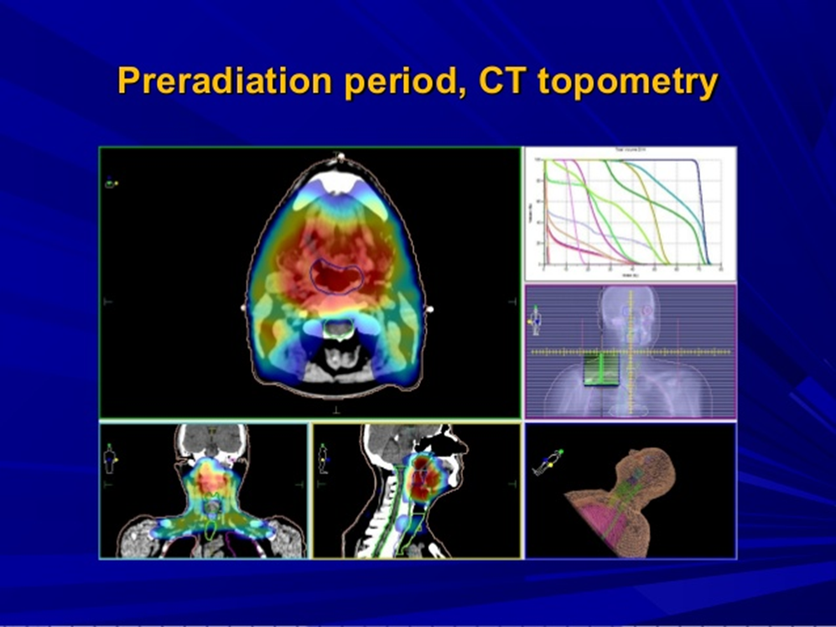
Principles and methods of Radiation Therapy
Department of Radiation Diagnostics, Therapy and Radiation Medicine, ONMedU Kovtun A.V.

Slide 2
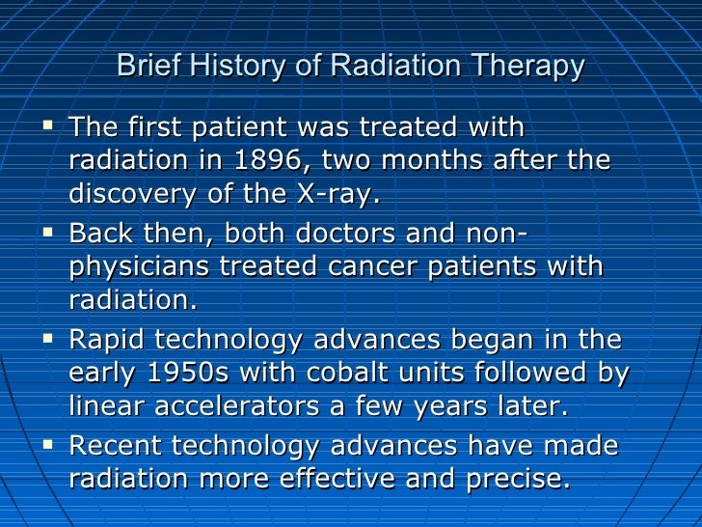
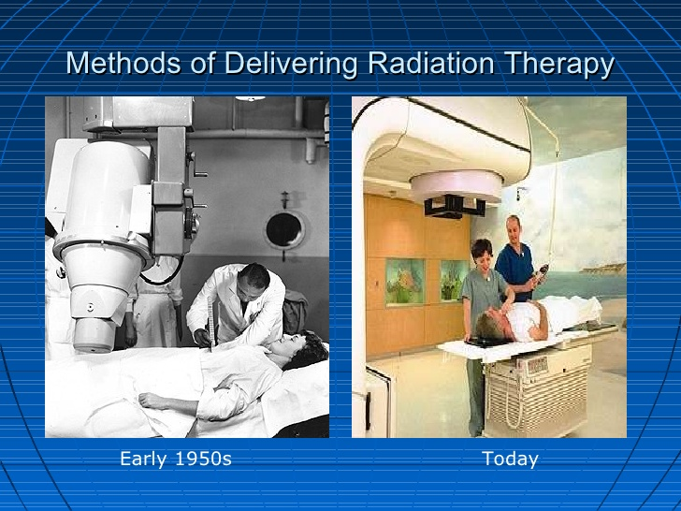
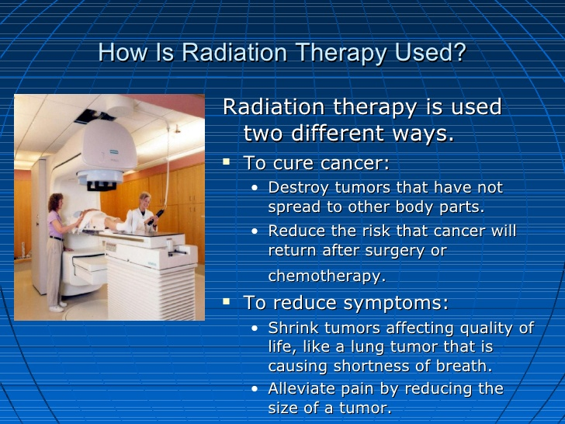
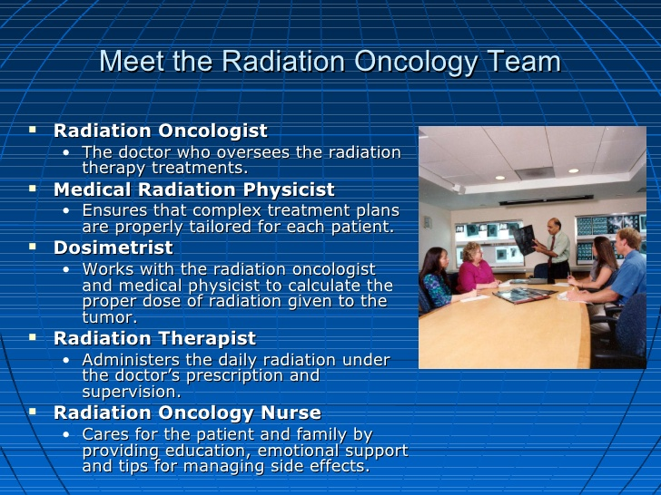

Slide 3
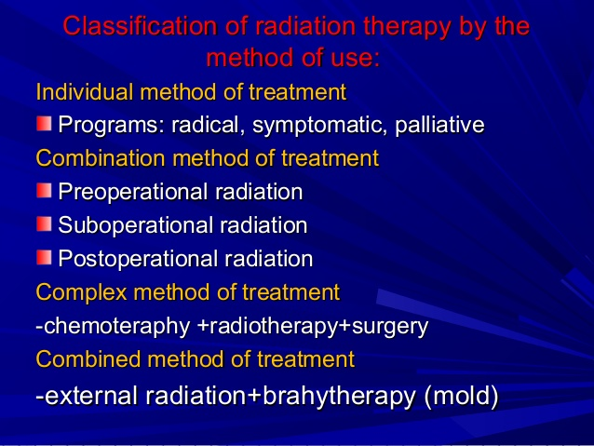
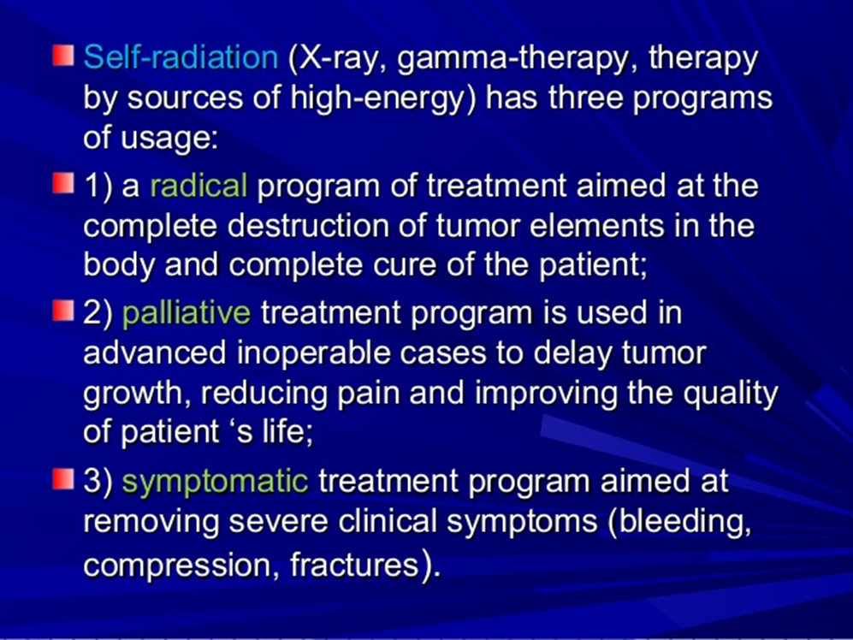

Slide 4
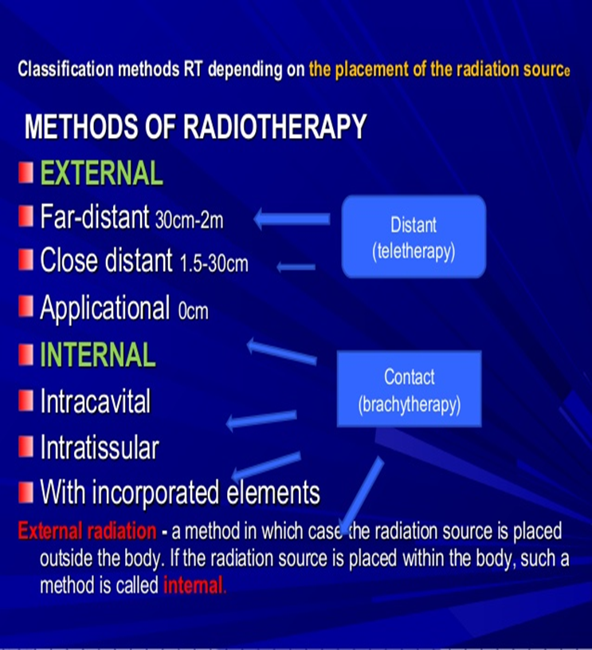
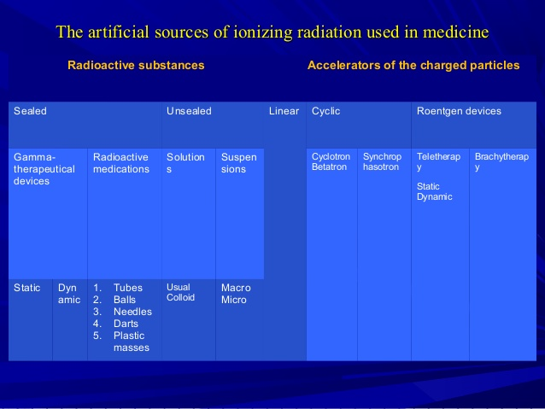
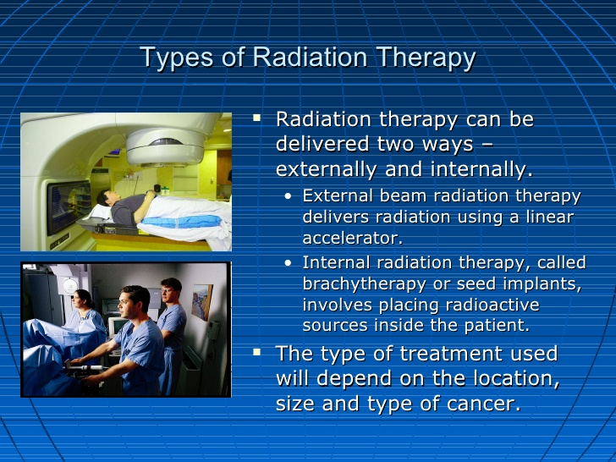
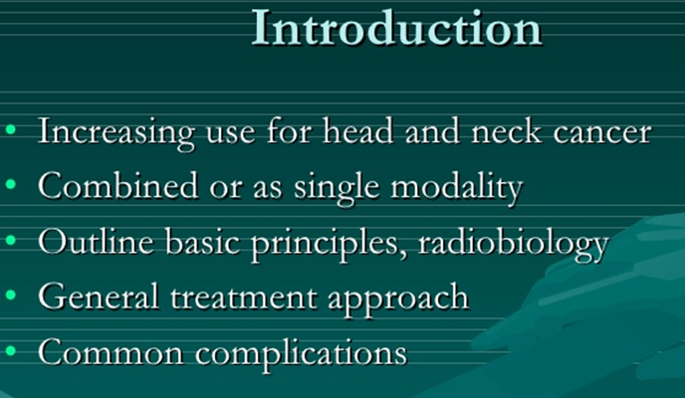

Slide 5
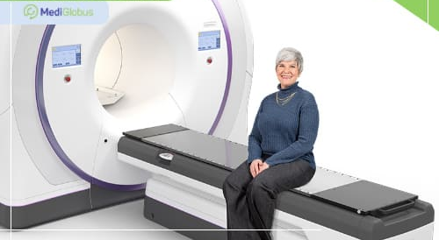
Radiation therapy with 3D planning is the most common and versatile type of radiation therapy. Before starting treatment, a CT scan of the body is done. Sometimes an additional MRI or PET scan is required. Based on these imaging techniques, doctors determine the exact location of the tumor and plan treatment. During treatment, the tumor will be irradiated with several beams at different angles. The device will wrap around the patient who needs to lie still. This allows you to accurately select the treatment for the shape and size of the tumor, as well as reduce damage to healthy tissues.
3DCRT therapy is used for the following types of cancer: - Brain cancer; - Head and neck cancer; - Lungs' cancer; - Breast cancer; - Liver cancer; - Prostate cancer

Slide 6
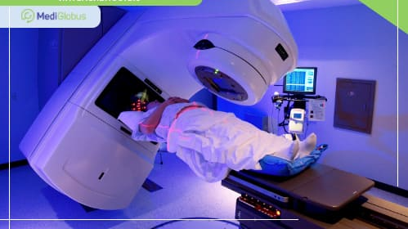
MODULATED INTENSITY RADIOTHERAPY (IMRT)
During IMRT therapy, a 3D model of the patient's body is created based on CT and MRI images. With the help of computer programs, the trajectory and intensity of the beam movement are calculated. During the treatment, several intensely modulated fields are formed that irradiate the cancer from several directions. IMRT therapy uses a device called Linac.
Most often, IMRT is used to treat the following types of cancer: prostate; breasts; head and neck; lungs; brain; digestive tract; lymphomas; sarcomas; uterus and ovaries; some types of pediatric tumors.

Slide 7
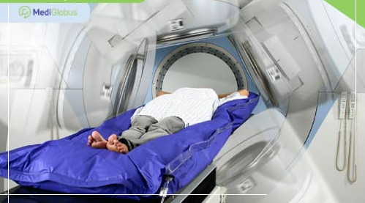
VOLUME-MODULATED IRRADIATION (VMAT)
Volume modulated therapy is a modern radiation therapy technique that delivers a dose of radiation continuously while rotating the treatment device 360 ​​degrees. This technique accurately modulates the radiation dose to the tumor while minimizing damage to the organs surrounding the tumor. Volume Modulated Therapy is also known as RapidArc.
VMAT therapy is used to treat tumors located close to sensitive organs: Head and neck cancer; Brain cancer; Prostate cancer; Liver cancer; Pancreas cancer; Stomach cancer; Lungs' cancer.

Slide 8
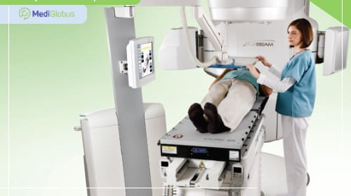
RADIOTHERAPY WITH VISUAL CONTROL (IGRT)
IGRT therapy is often given in combination with other types of radiation therapy. She uses rapid X-rays before, during or after the radiation to pinpoint the location of the tumor. This data is used to fine tune the hardware. The computer program built into the device adjusts to the rhythm and depth of breathing of each patient, which also reduces the level of unwanted irradiation of healthy tissues.
The equipment for taking pictures is installed in the device itself. The resulting images are compared with MRI, CT, or PET scans taken at the time of diagnosis. IGRT therapy is most often used in relation to tumors located in mobile areas of the body: Lung cancer; Prostate cancer; Head and neck cancer.

Slide 9
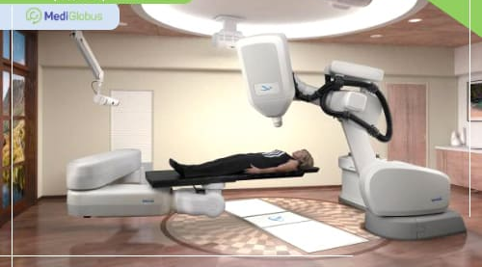
STEREOTAXIC RADIOTHERAPY (SRS / SRT)
Stereotactic radiotherapy is used to treat brain tumors. It is an attractive alternative to neurosurgery as it allows the patient to be cured without any incisions or anesthesia. When using this procedure, radioactive radiation is concentrated on the neoplasm, and damage to healthy tissues is minimized. If the tumor is removed in one session, the procedure is called radiosurgery (SRS); if several sessions are needed, this is stereotaxic radiotherapy (SRT). SRS is used primarily in the treatment of small brain masses, both benign and malignant. It can also be used to remove metastases.

Slide 10
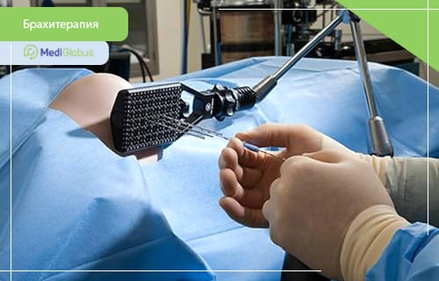
Brachytherapy is a type of radiation therapy in which a radiation source is placed inside the body, directly into the tumor. This allows for the safe use of higher doses of radiation than with external radiation therapy. This procedure requires surgery. In foreign clinics, minimally invasive methods are preferred, since they are less traumatic and easier to tolerate by patients. Its features depend on the organ in which the radiation source is placed. The substance is transported in a special protective capsule, so it does not irradiate internal organs on the way to the tumor.
Brachytherapy is used for such oncologies:
Prostate cancer; Gynecological cancer; Lungs' cancer; Esophageal carcinoma; Skin cancer; Soft tissue cancer.

Slide 11
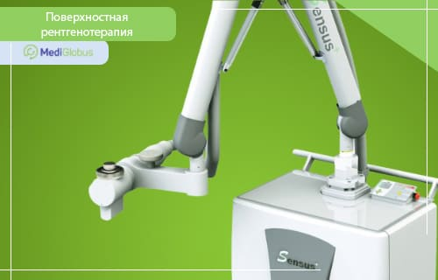
SURFACE X-RAY THERAPY (SXRT)
Superficial X-ray therapy uses rays that do not penetrate deep into the tissues of the body. Therefore, it is used in the treatment of skin cancer, for example: Basal cell carcinoma; Squamous cell carcinoma; Kaposi's sarcomas; Non-melanoma skin cancer; Keloid scars. During the procedure, the boundaries of the tumor are drawn on the skin with a pencil in order to make it easier to adjust the equipment. A thin lead coating is also made with a slot at the site of formation to protect nearby tissues. SXRT therapy is recommended in cases where Mohs surgery is not possible or recommended. These cases include: Patients over 70; Patients with serious concomitant diseases; Taking anticoagulants or antiplatelet agents; The location of the tumor in areas that are unfavorable for surgery, such as the eyelids or the wings of the nose.

Slide 12
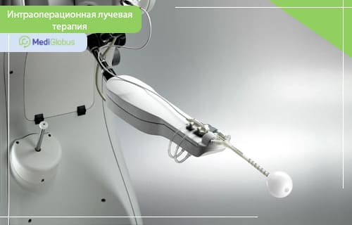
INTRAOPERATIVE RADIOTHERAPY (IORT) Intraoperative radiation therapy is performed during an operation to remove a tumor. The advantage of intraoperative therapy is that it is performed in one session instead of a long course of radiotherapy. IORT therapy is only used in some older patients with stage 0-2 breast cancer. Irradiation is carried out after removal of the tumor using a special apparatus. The procedure takes about 10 minutes. The effectiveness of intraoperative radiation therapy is the same as that of traditional radiation therapy, but the number of side effects is significantly less due to the shorter duration of the procedure.

Slide 13
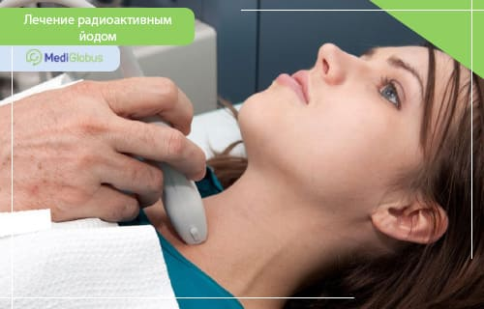
RADIOACTIVE IODINE TREATMENT
Radioactive iodine therapy is used in the treatment of thyroid cancer. The method is effective because iodine is actively absorbed by this particular organ. The procedure is prescribed to patients after surgery to remove the thyroid gland, provided that the patient has tissue remnants. The procedure is performed 4 weeks after the operation. Radioactive iodine is used in the form of capsules or, in rare cases, a liquid solution. Treatment with radioactive iodine is associated with minimal side effects, but requires strict adherence to safety rules. How to behave before, during and after treatment, the attending physician will tell you more specifically.

Slide 14
SUMMARY
There are various options for radiotherapy that are used depending on the type of oncology, the size and location of the tumor, and the patient's condition. Types of radiation therapy for prostate cancer: external beam radiation therapy, 3D-CRT, IMRT, stereotactic radiation therapy, brachytherapy, etc. Types of radiation therapy for breast cancer: external beam radiation therapy, brachytherapy, intraoperative radiation therapy, IMRT, 3DCRT.
Radiation therapy with three-dimensional planning - tumor irradiation based on the construction of a 3D-model of an organ from CT and MRI images.
IMRT and RapidArc use machines that can wrap around the patient to accurately irradiate the tumor from different angles.
During IGRT therapy, intermediate body images are taken to more accurately direct the treatment beam. Stereotactic radiosurgery is used to treat head and brain tumors.
Brachytherapy - placing a radiation source inside the body, next to the tumor.
SXRT is used to treat certain types of skin cancer as an alternative to surgery. IORT is performed during breast cancer surgery instead of a long course of radiation therapy.

Slide 15
Radiation therapy - is one of the sections of medical radiology, which is examining the use of ionizing radiation for the treatment of various human diseases.
Radiation for the treatment of various human diseases.
International classification of malignant tumors in the International classification of malignant tumors in the system TNM, which is used in oncology reflects the state system TNM, which is used in oncology reflects the state of the primary tumor and its regional and distant of the primary tumor and its regional and distant metastases (T - tumor, N - nodules, M - metastasis).
This allows you to choose the tactics of treatment of cancer patients. In modern oncology main methods of treatment of patients with malignant tumors is surgical treatment of patients with malignant tumors is surgical and radiation, and the combination of these methods and radiation, and the combination of these methods greatly improves treatment outcomes. On the greatly improves treatment outcomes. On the effectiveness of radiation therapy in the treatment of effectiveness of radiation therapy in the treatment of inoperable cases ranked first place inoperable cases ranked first place.

Slide 16
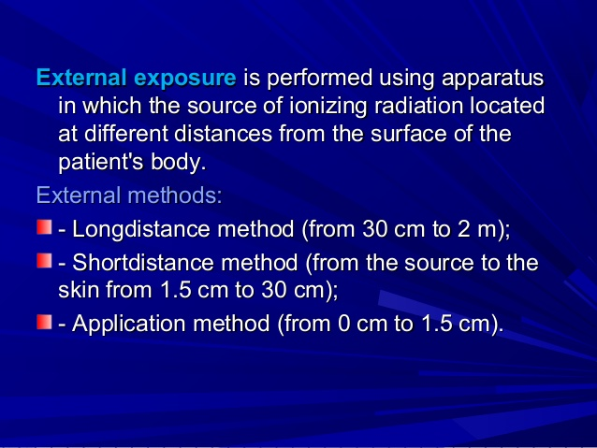
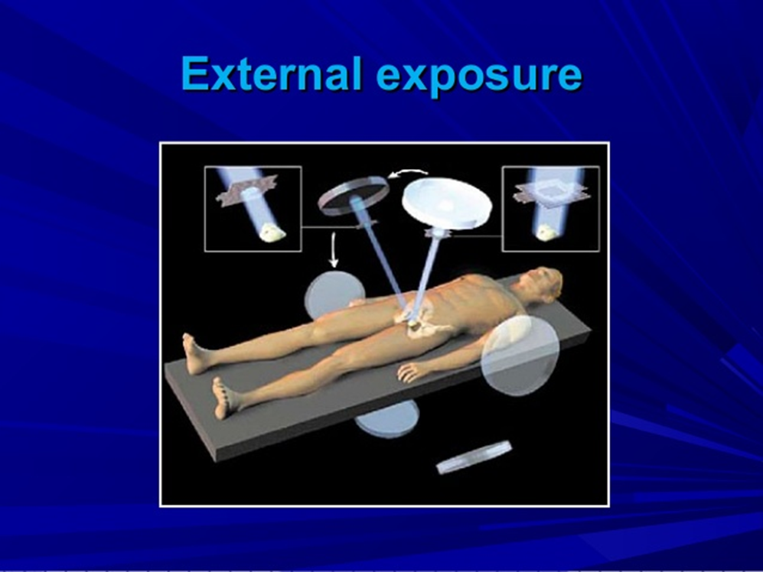
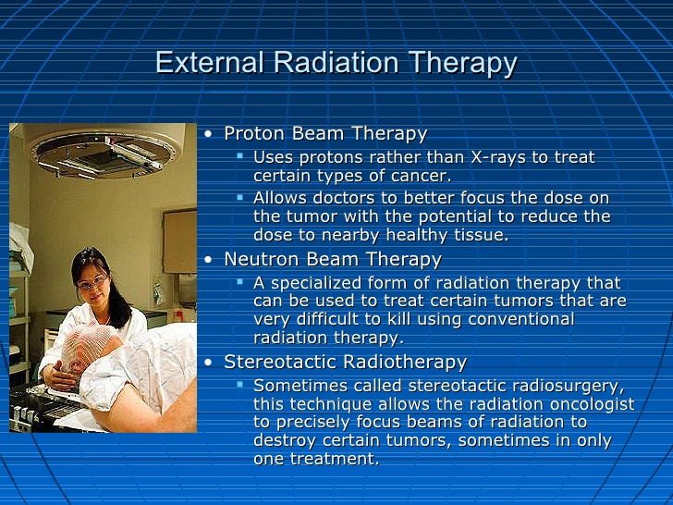
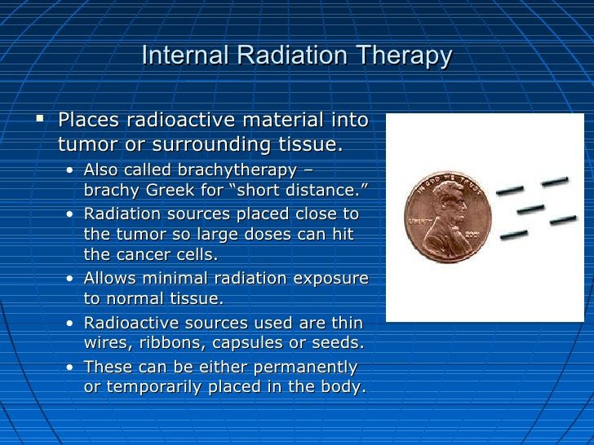

Slide 17
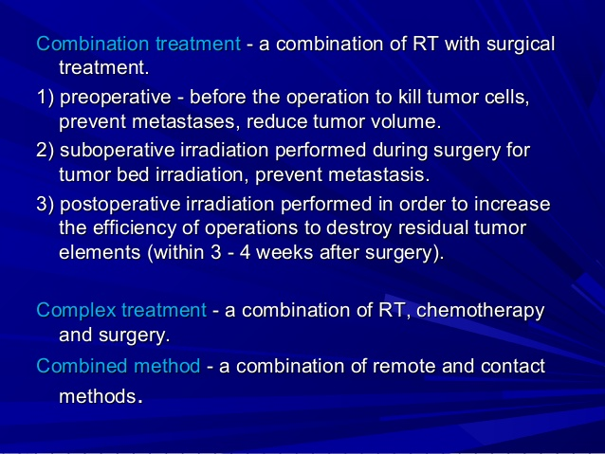
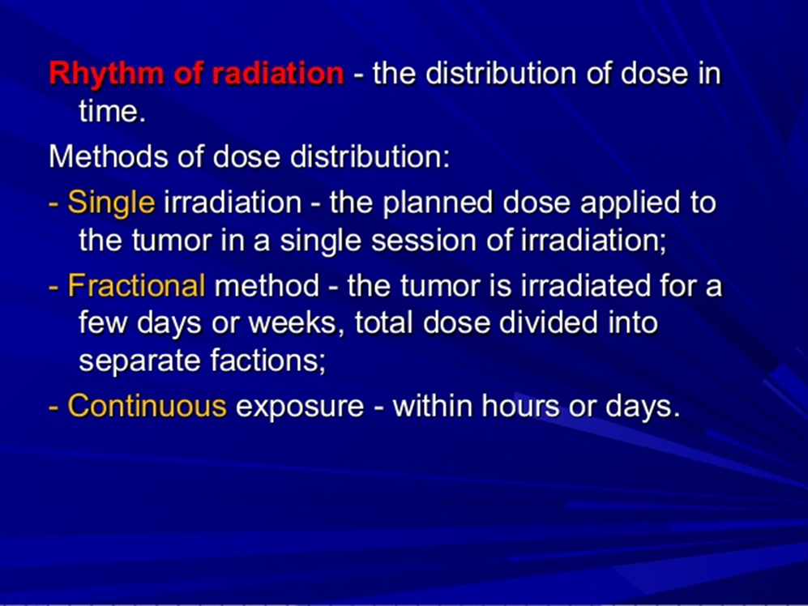

Slide 18
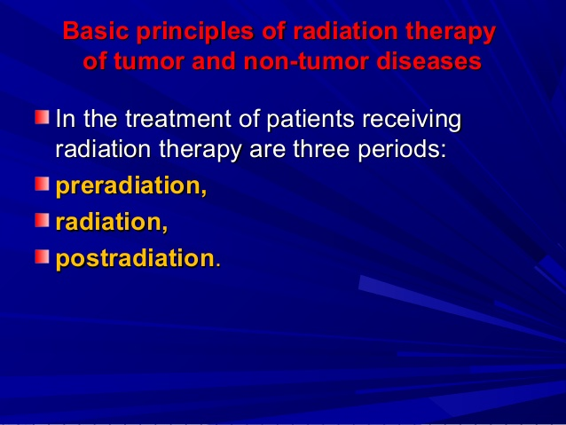
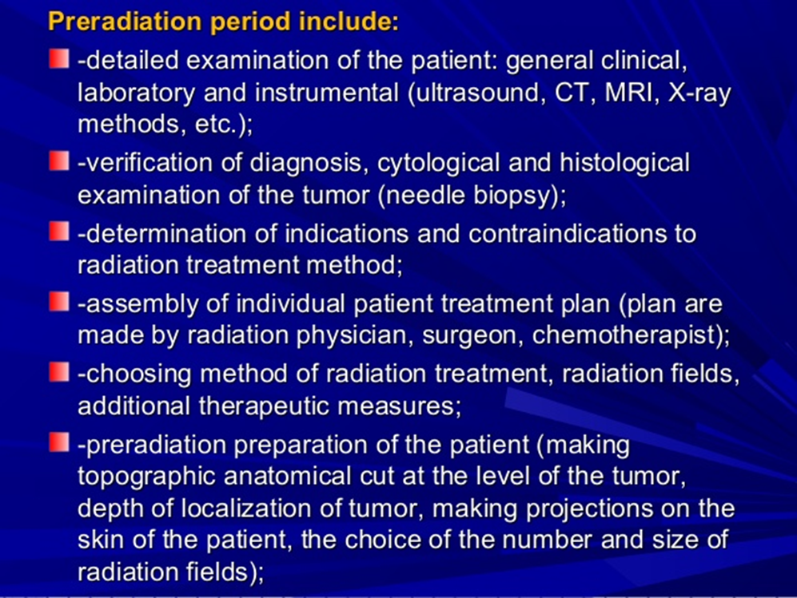

Slide 19
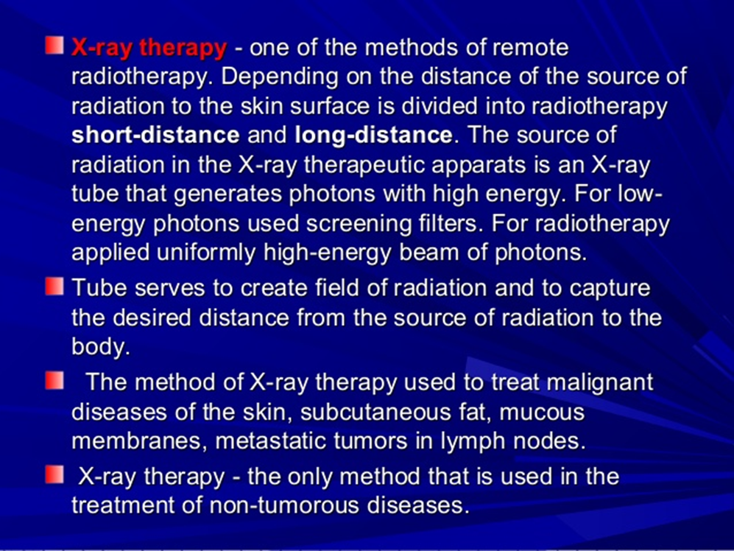
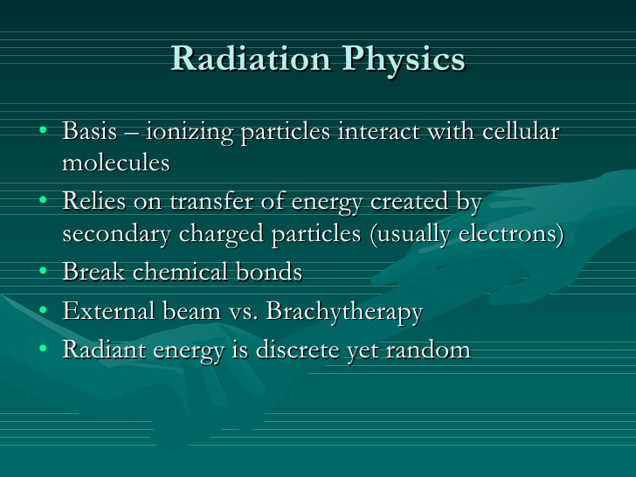
The main goal of radiation therapy is to determine the optimal dose of radiation to determine the optimal dose of radiation to the pathological focus with minimal the pathological focus with minimal damage to normal tissues located in the damage to normal tissues located in the area of exposure​​area of exposure.

Slide 20
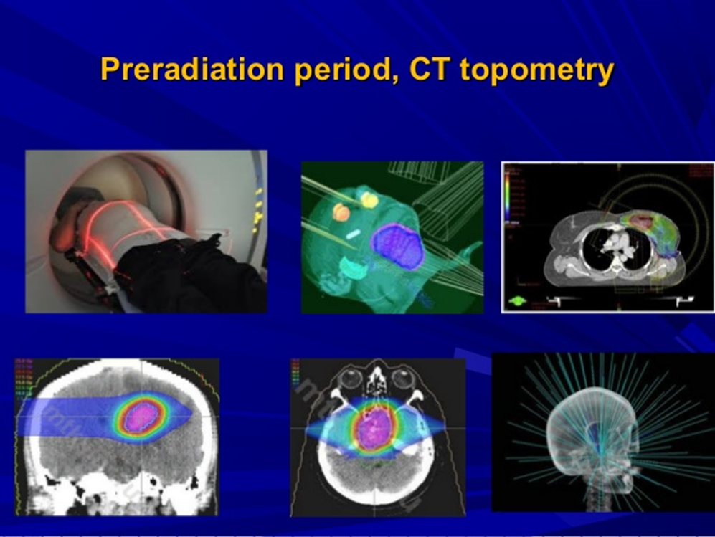
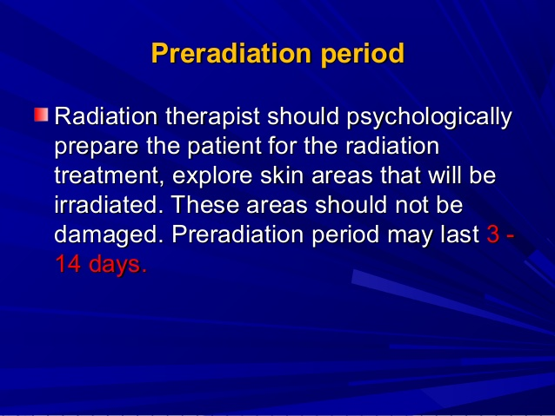
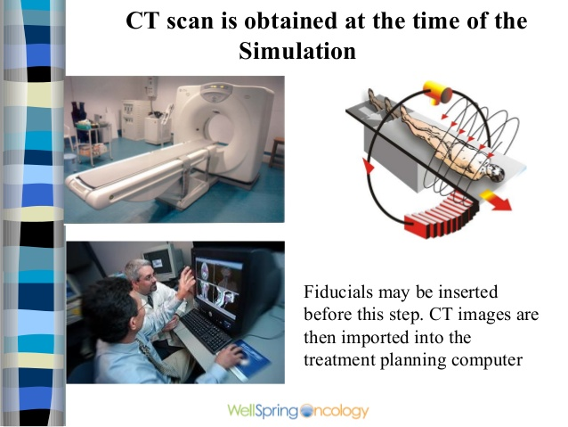

Slide 21
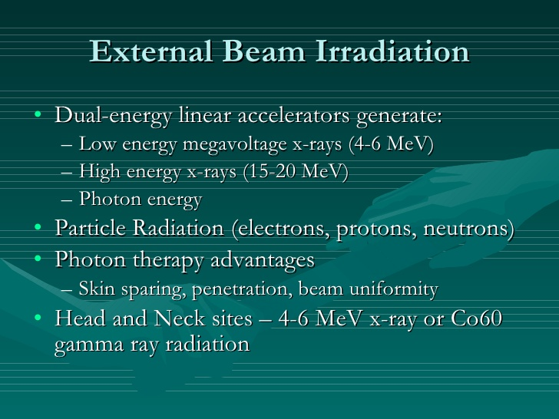
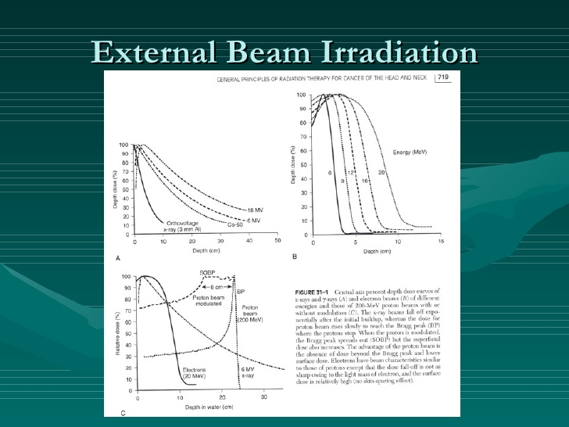
The main principles of radiotherapy:
- Radiotherapy appointed strictly on the in dications;
- The absence of contraindications;
- Selection of the optimal dose of radiation;
- Minimal exposure to surrounding normal;
Course of radiotherapy must be the shortest and most radical;
Radiotherapy should be accompanied by therapeutic measures aimed at improving the therapeutic measures aimed at improving the body's defense power;

Slide 22
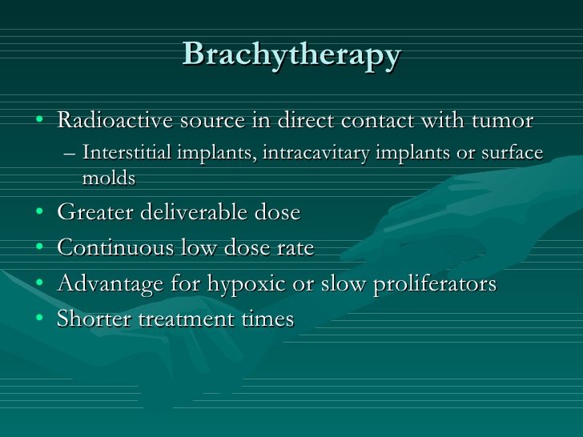
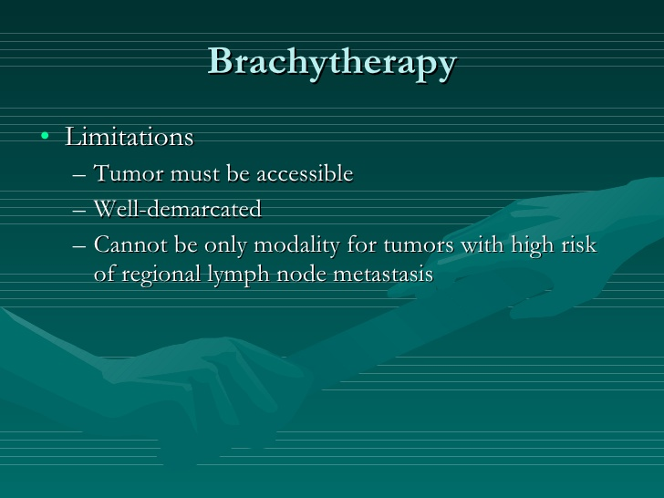
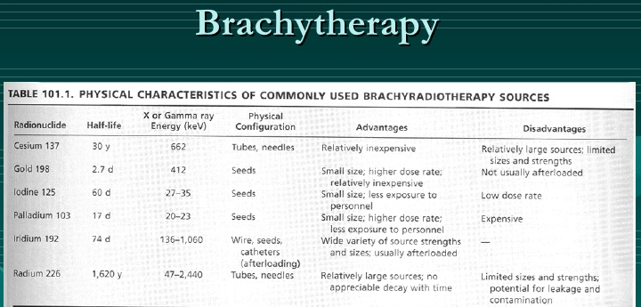

Slide 23
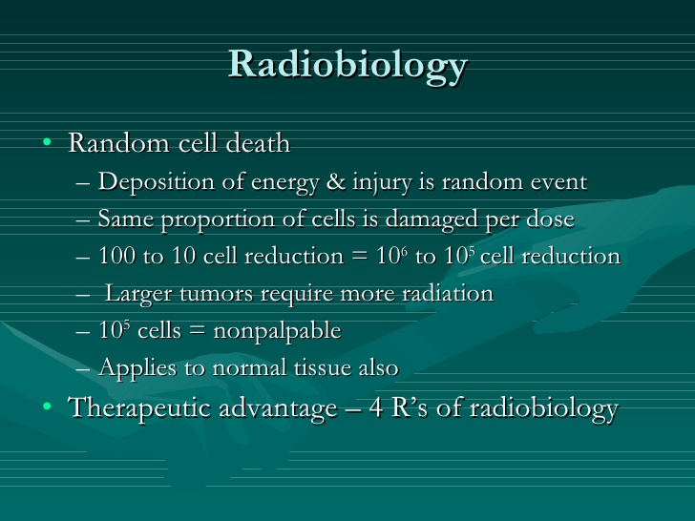
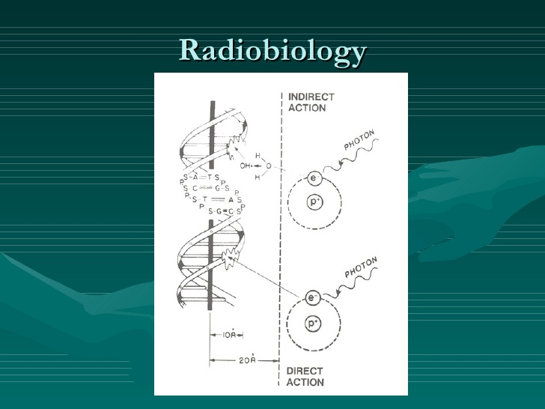
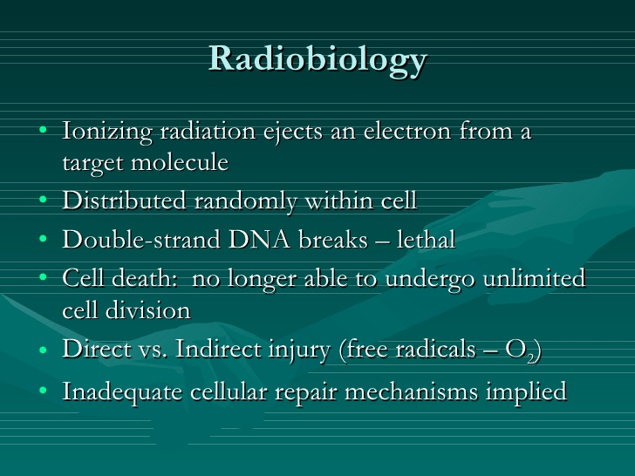

Slide 24
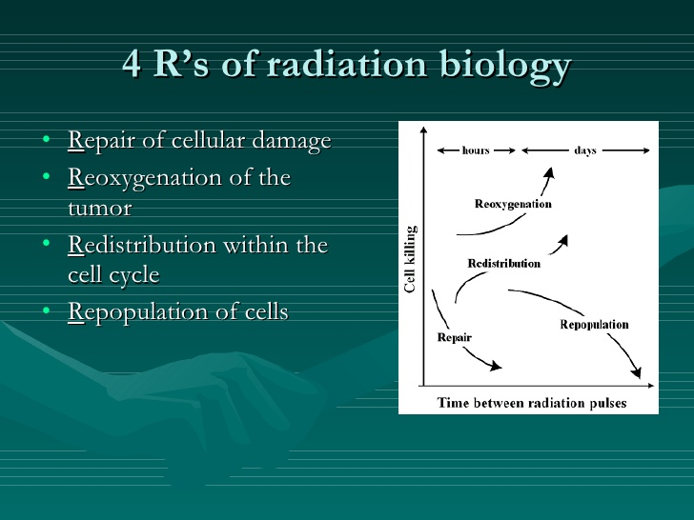
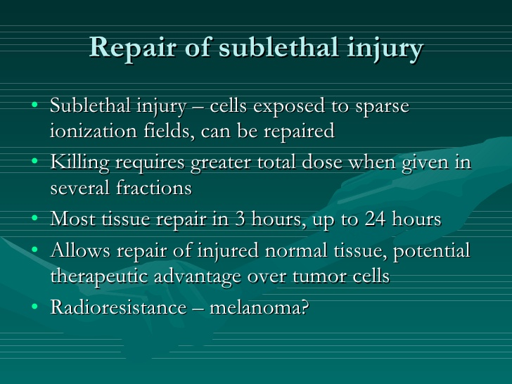

Slide 25
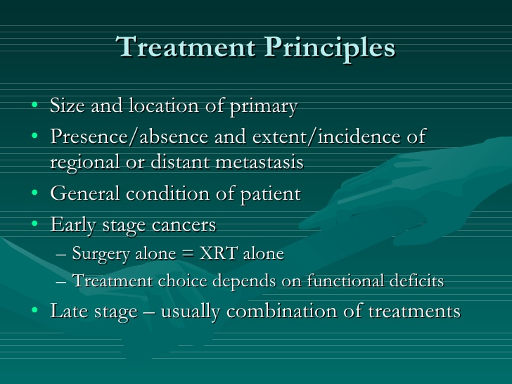
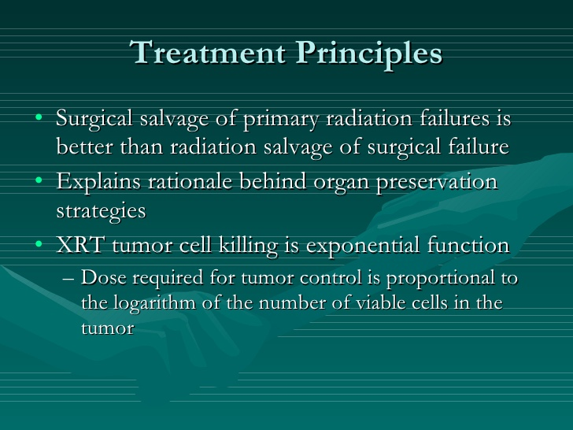

Slide 26
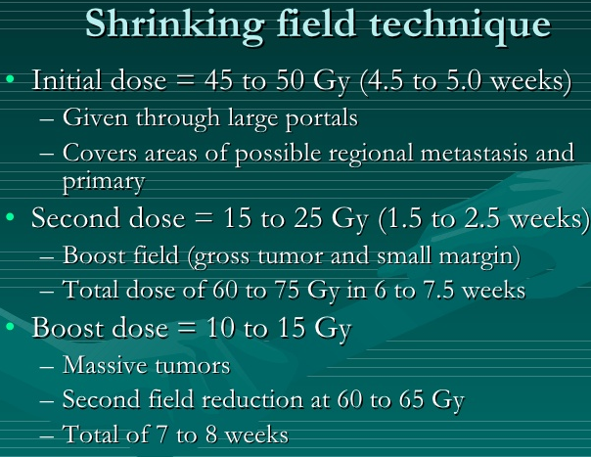
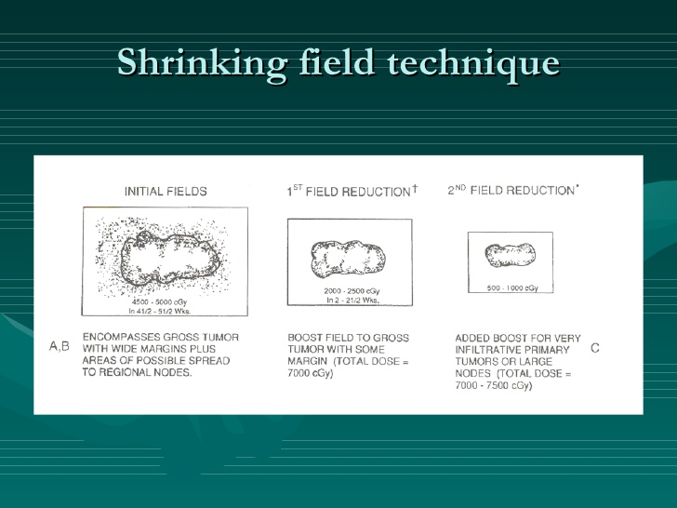

Slide 27
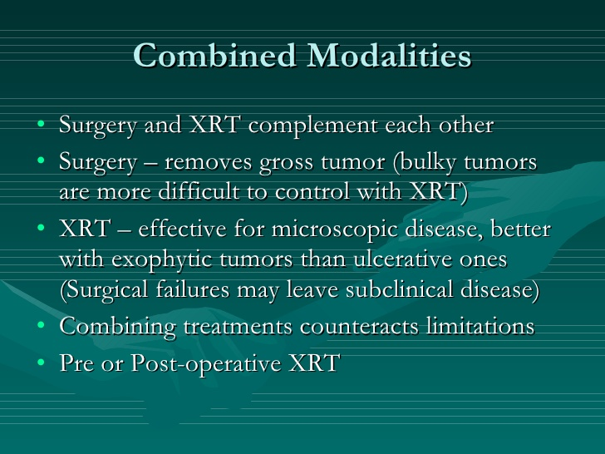
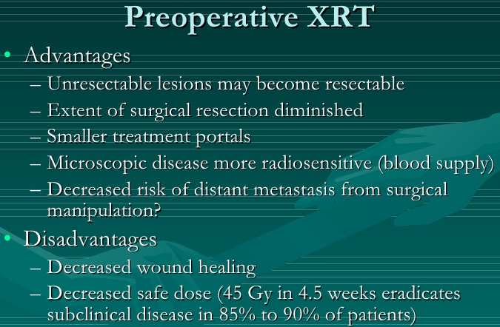

Slide 28
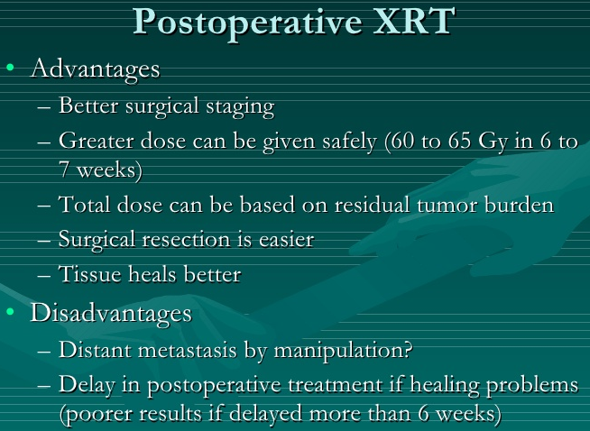


Slide 29




Slide 30







Slide 31



Slide 32



Slide 33



Slide 34


Thank you for attention!

