Slide 1
Ministry of health of Ukraine
Odessa National Medical University
Department of Robotic and Endoscopic Surgery
Simulation medicine cycle simulation medicine cycle
Topic 1
Basic life support

Slide 2
BASIC LIFE SUPPORT

Slide 3
WHAT IS BASIC LIFE SUPPORT ?
It’s a sequence of procedures performed to restore the circulation of oxygenated blood after a sudden respiratory or cardiac arrest.
Chest compressions and pulmonary ventillations can be done by anyone who knows how to do it , ANYWHERE,IMMEDIATELY WITHOUT ANY EQUIPMENT!!
AIRWAY
BREATHING
CIRCULATION

Slide 4


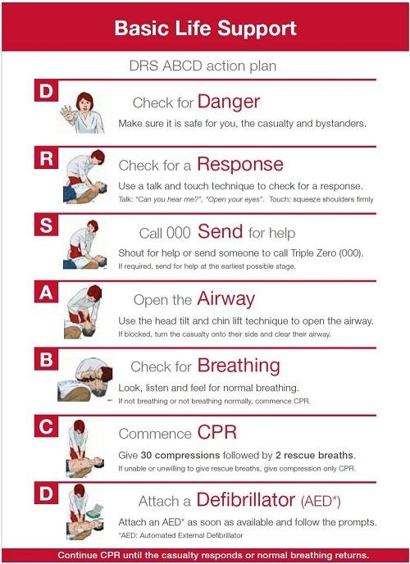

Slide 5

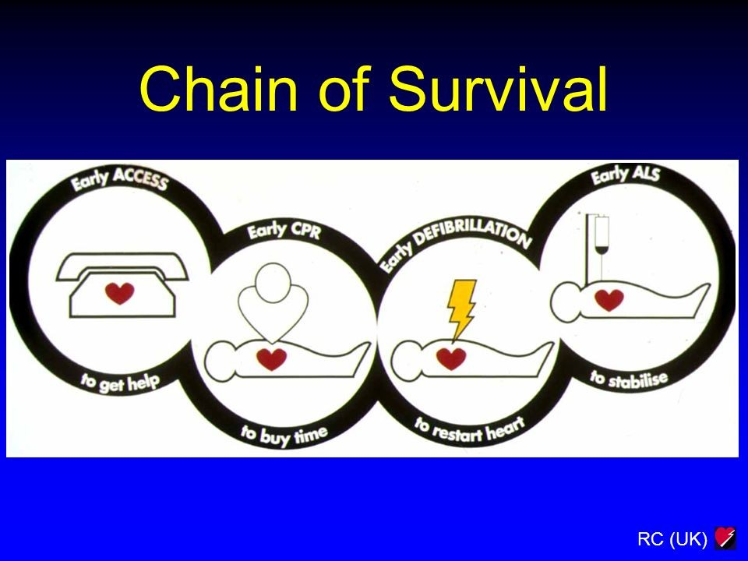

Slide 6
STEPS TO PERFORM ON BLS (BASIC LIFE SUPPORT
)
APPROACH SAFELY
CHECK RESPONSE
SHOUT FOR HELP+CALL 122
OPEN AIRWAY+CHECK BREATHING (PULSE IF YOU KNOW HOW TO DO IT)
CHEST COMPRESSIONS 30
2RESCUE BREATHING

Slide 7
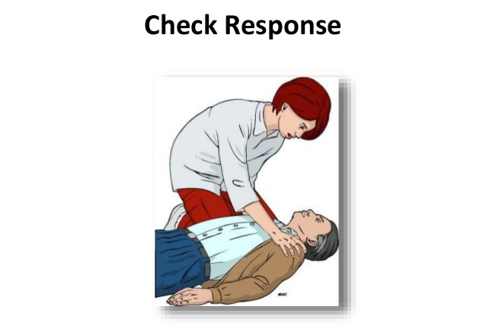
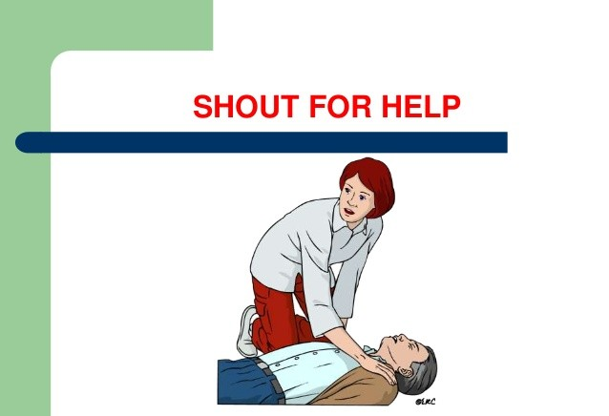
FOR CHECKING RESPONSIVENESS
Shake shoulders gently and ask hey do you here me,? are you alright ?
If he or she responds leave them and find out what is wrong , reasses regulary, until the emergency comes.
AND SHOUT ANYBODY FOR FURTHER HELP !!

Slide 8
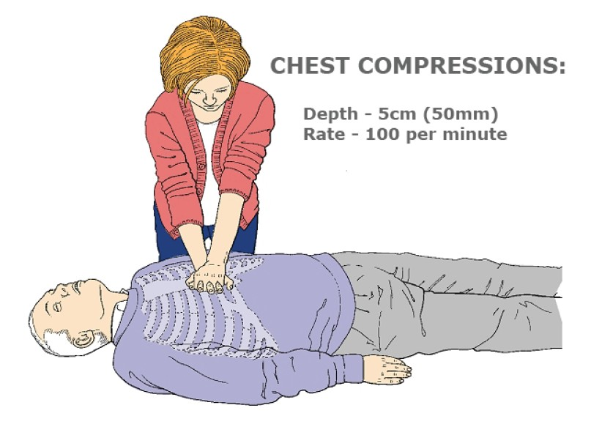
30 CHEST COMPRESSIONS :
By placing the heel of 1 hand in the centre of chest,
Place other hand on top,interlock the fingers
Compress the chest at the rate 100 b/m , depth till 5cm there should be equal compression and relaxation ratio.
Change CPR operator in every 2 min and keep an eye on the patient.

Slide 9


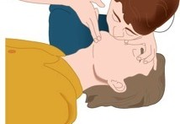
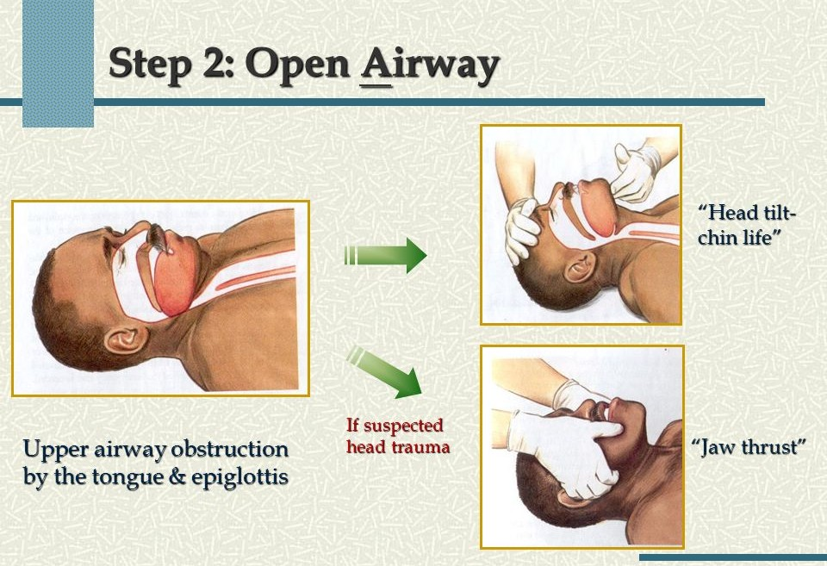

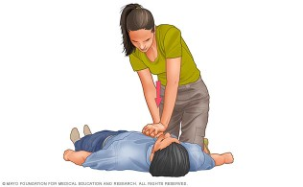
OPEN AIRWAY BY TRIPLE MANEUVER HEAD TILT+CHIN LIFT+JAW THRUST
Check for breathing ,lOOK ,LISTEN ,AND FEEL NORMAL BREATHING ,SEE chest movements .
RESCUE BREATHING :
Pinch nose, take normal breath place lips over mouth ,blow until the chest rises ,take 1 sec ,allow chest to fall,and repeat again.
CONTINUE CPR

Slide 10
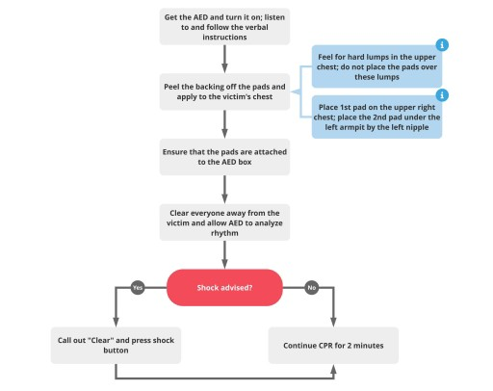

Slide 11
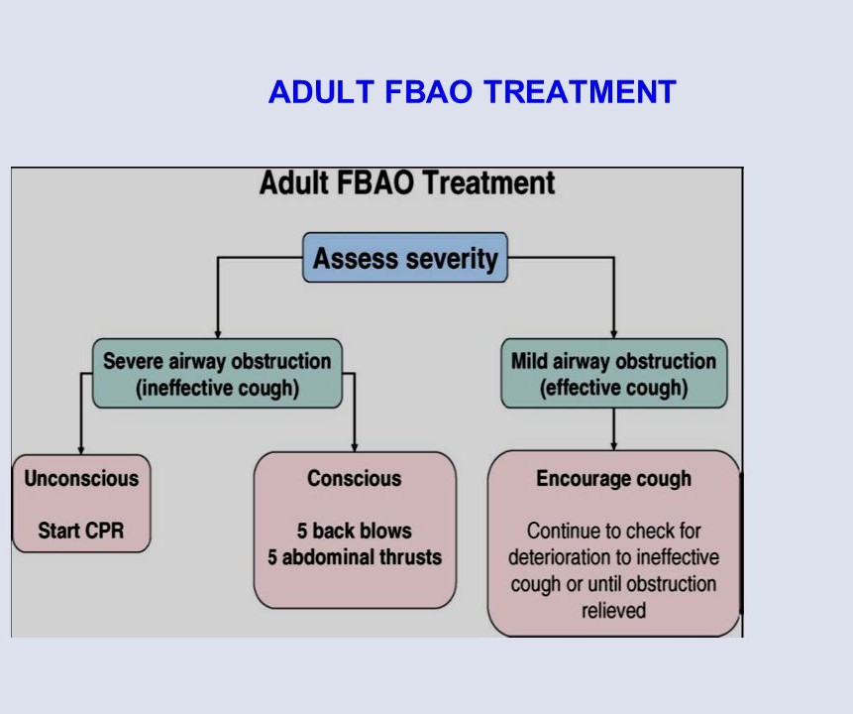
FOR FOREIGN BODY AIRWAY OBSTRUCTION REMOVAL

