Slide 1
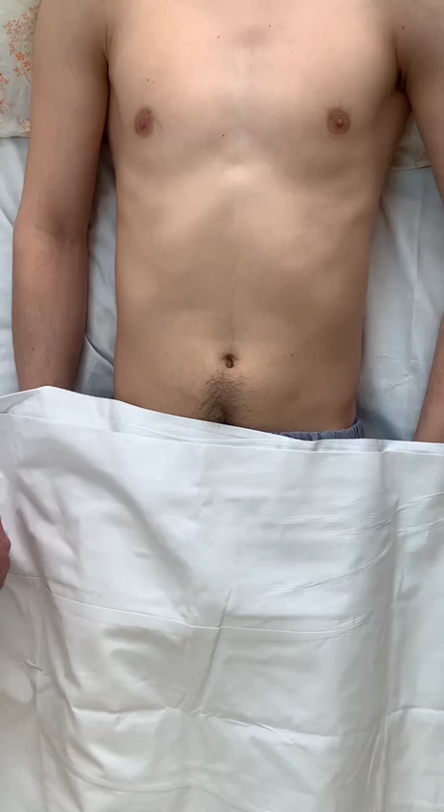
Kocher sign
Subjective symptom.
The patient complains that the pain was previously in the epigastric region or in the umbilical region, and then shifted to the right iliac region.
The pathogenesis is explained by the peculiarity of the innervation of the digestive organs. The first to activate a large nerve trunk (Pl. Caeliacus, projection - epigastric region, umbilical region), and then the pain is displaced more locally.

Slide 2
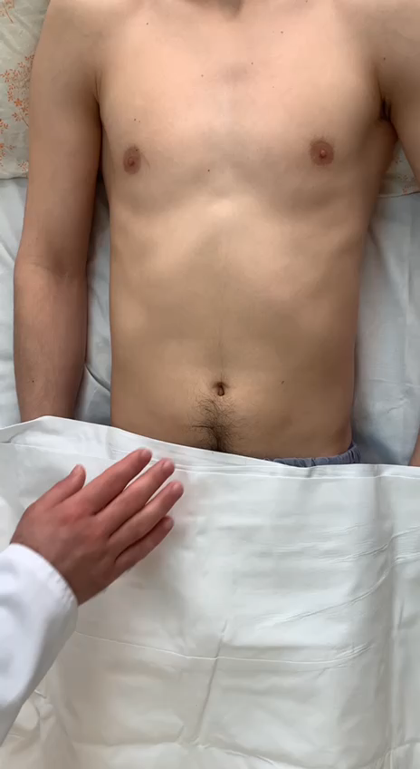
Kushnirenko sign
Subjective symptom.
The patient complains that during coughing, pain appears / intensifies in right ileac region.
The pathogenesis is explained by an increase in pressure in the abdominal cavity and tension of the peritoneum during coughing.

Slide 3
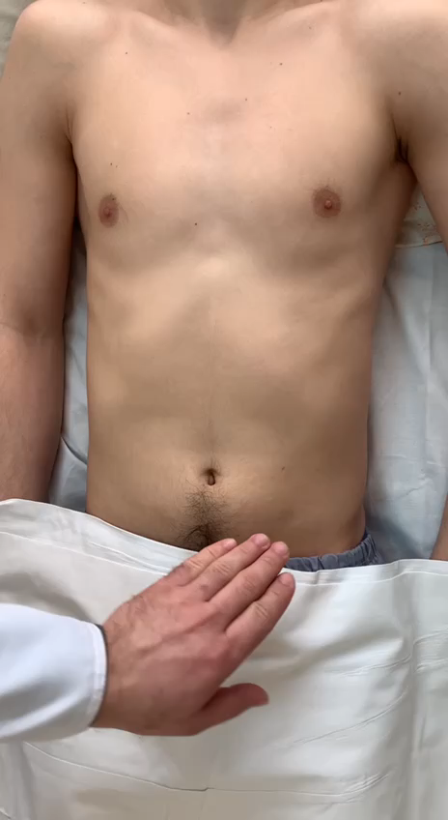
Rovsing sign
Objective symptom.
The sigmoid colon is fixed in the left ileum with the left hand. With the right hand the examiner is making pushing movements towards the descending colon. The patient notes the appearance / intensification of pain in the right iliac region.
The pathogenesis is explained by the migration of gases from the distal colon to the base of the appendix, increasing the pressure in its lumen, which leads to an increase / appearance of pain syndrome.

Slide 4
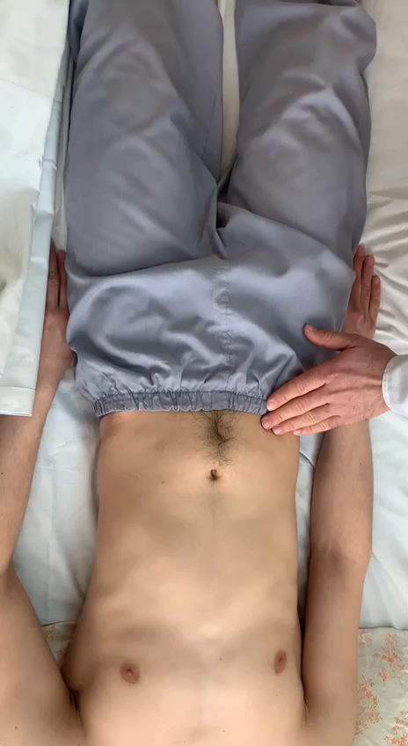
Obraztsov sign
Objective symptom.
Simultaneous palpation of the right iliac region and flexion of the right hip causes an increase / appearance of pain in the right iliac region
The pathogenesis is explained by the localization of the appendix retroperitoneally retrocecally, when it is closely adjacent to m. Ileopsoas, causing superficial myositis of it. Movements in the inflamed muscle lead to the appearance of pain in the projection of the appendix on the one hand, and on the other, when the muscle contracts, its own fascia rubs against the serous membrane of the appendix, which also causes pain syndrome.

Slide 5
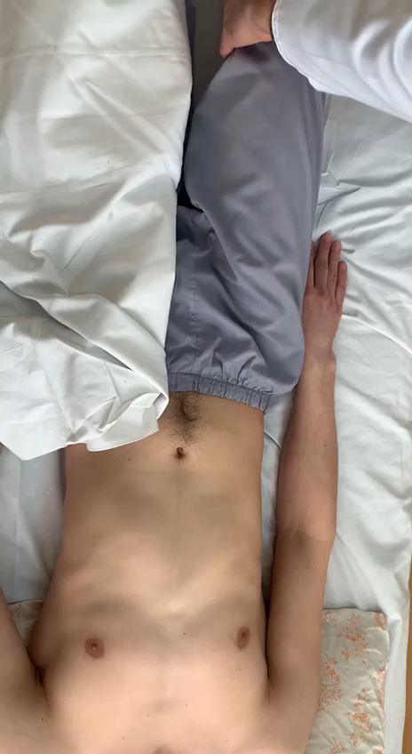
Coup sign
Objective symptom.
Increase / appearance of pain in the right iliac region during rotation of the right hip.
The pathogenesis is explained by the same mechanisms as that of Obraztsov sign. In this case m.obturatorius participates.

Slide 6
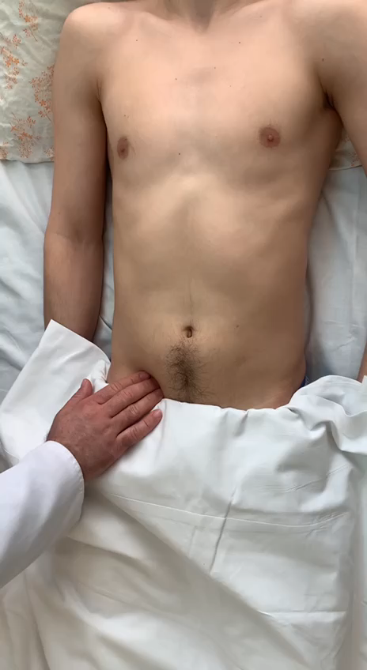
Blumberg sign
Objective symptom.
The appearance / intensification of pain with slow immersion of the palm and one-part sharp abduction of the fingers.
The pathogenesis of SM is caused, on the one hand, by the occurrence of vibrations of the peritoneum during such a test of sign, and on the other, due to the "adhesion" of the parietal peritoneum to the inflamed serous membrane.

Slide 7
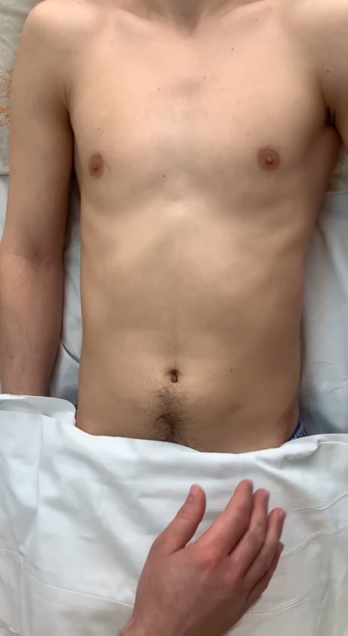
Razdolsky sign
Objective symptom.
The appearance / intensification of pain with weak tapping on the anterior abdominal wall.
Pathogenesis of sign - see Shchetkin-Blumberg sign

Slide 8
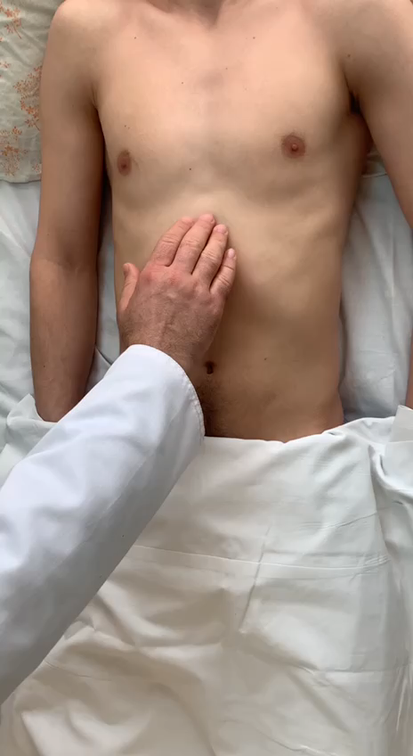
Voskresensky sign
Objective symptom.
The appearance / intensification of pain during sliding movements from the epigastric region to the right iliac region.
Pathogenesis of sign - see Shchetkin-Blumberg sign

Slide 9
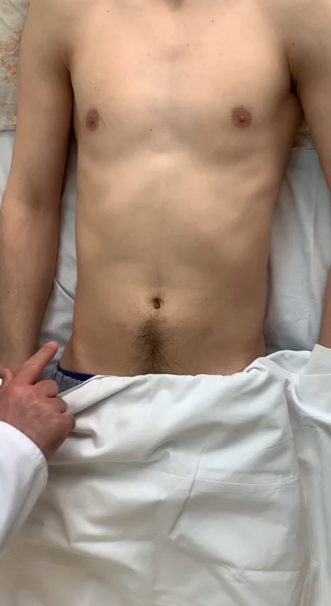
McBurney point and sign
McBurney Point. Located on the border of the outer and middle third of the line drawn between the umbillicus and the right anterior superior iliac spine
McBurney's access is made through the point of the same name so that the upper third of the cut is located above the point, and the remaining two thirds - below the point.

Slide 10
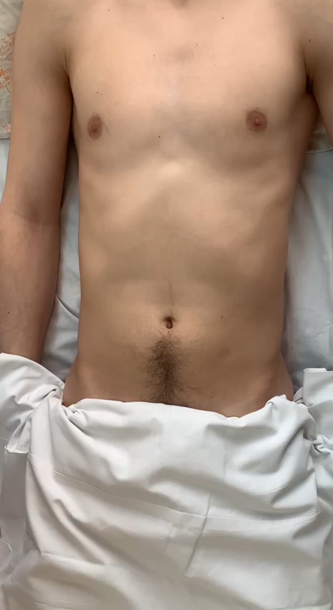
LeNander point and surgical access
LeNander point. Located at the intersection of the outer and middle third of the linea bispinatum and the outer pararectal line on the right
LeNander's access is made through the point of the same name so that the upper half of the cut is located above the point, and the remaining half - below the point.

Slide 11
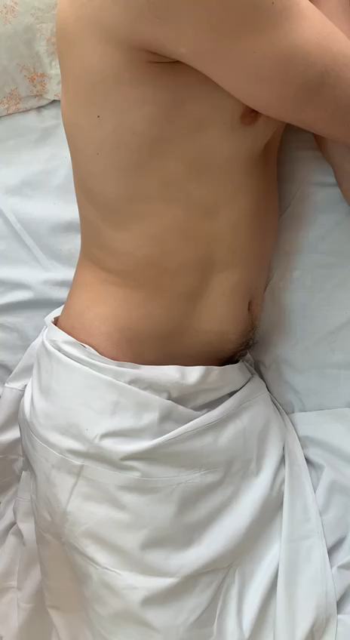
Sitkovsky and Bartomier-Michelson sign
Objective symptoms.
They are checked in a patient who is lying on his left side.
S-m Sitkovsky - the appearance / intensification of pain in the position on the left side.
S. Bartomier-Michelson - the appearance / intensification of pain on palpation of the right iliac region in the position on the left side.
The pathogenesis is due to the anatomical features of the organs in the right ileal region, - the cecum with the appendix are fixed by ligaments in the right ileal region, are inactive. In the position on the left side, due to the force of gravity, the appendix with its mesentery is stretched, which increases the pain syndrome. (Sitkovsky); in this position, the previously located loops of the small intestine and the greater omentum are displaced to the left, making the appendix more accessible to palpation. (Bartomier-Michelson)

Slide 12
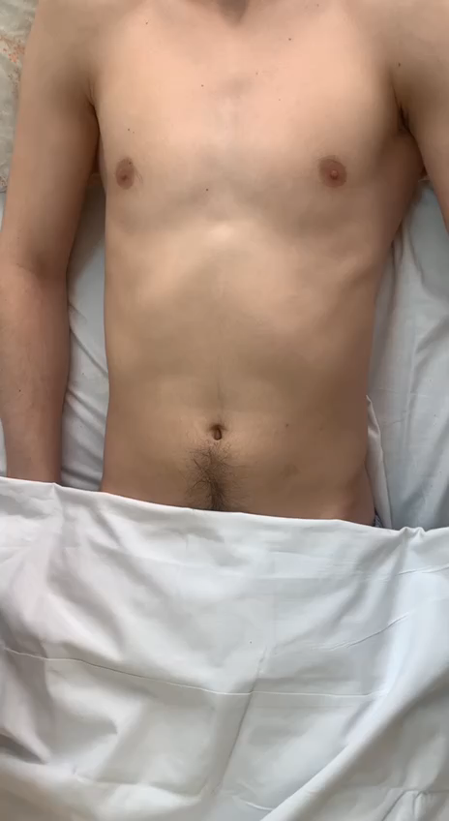
Ker point and sign
Subjective symptom.
Ker point - a point at the intersection of the edge of the right costal arch with the outer edge of the right rectus abdominis muscle
Ker sign- the appearance / intensification of pain on palpation at the point of Ker.
The pathogenesis is due to the closest location of the gallbladder to the anterior abdominal wall at this point.

Slide 13

Orthner sign
Objective symptom
Orthner - the appearance / intensification of pain when tapping with the edge of the palm along the right costal arch
The pathogenesis is caused by irritation of the peritoneum in the right hypochondrium and the serous membrane of the gallbladder when tapping along the costal arch

Slide 14

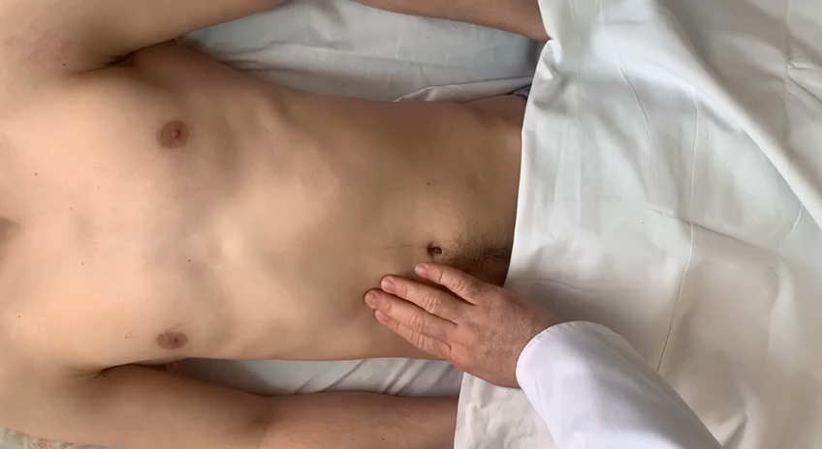
Murphy sign
Objective symptom
Murphy sign- the appearance / intensification of pain with deep palpation in the right hypochondrium
The pathogenesis is caused by irritation of the peritoneum in the right hypochondrium and the serous membrane of the gallbladder with deep palpation of the gallbladder

Slide 15
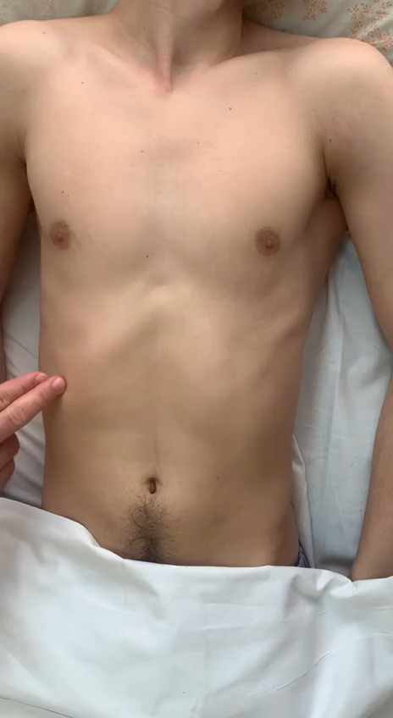
Mussi sign
Objective symptom
Mussi - the appearance / intensification of pain of palpation between the legs of the sternocleidomastoid muscle
Pathogenesis due to possible irritation of the phrenic nerve in acute cholecystitis / subphrenic abscesses

Slide 16
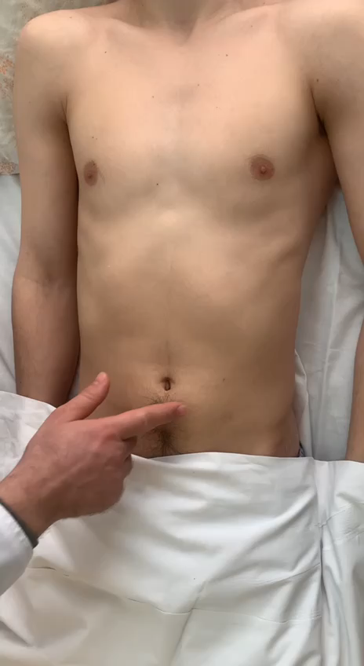
Culen and Gray-Turner signs
Objective symptoms
Culen sign- the appearance of petechiae and ecchymosis in the umbilical region
Gray-Turner sign - the appearance of petechiae and ecchymosis in the lateral areas of the abdomen
The pathogenesis is due to capillarotoxicosis and activation of the kallikrein-kinin system as a result of hyperproteasemia in acute pancreatitis.

Slide 17
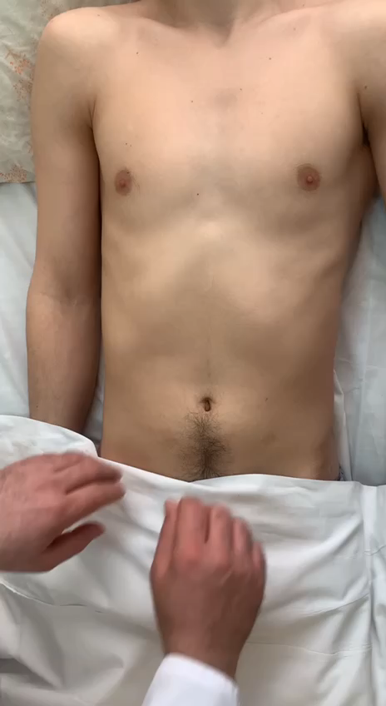
Kerte sign
Objective symptom
Kerte sign- palpable painful infiltrate occupying the epigastric region

Slide 18
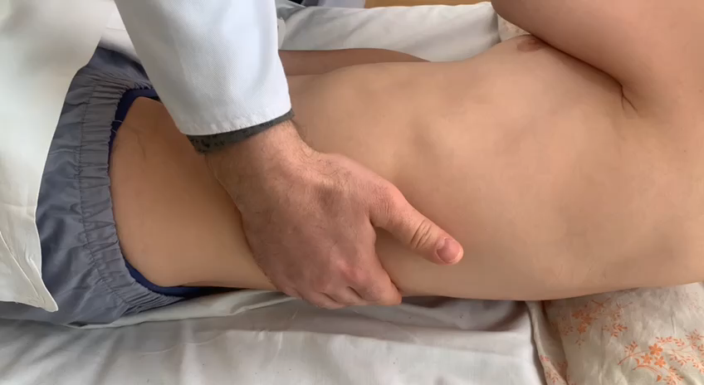
Mayot-Robson sign
Objective symptom
S. Mayot-Robson - the appearance of pain on palpation in the left costal-vertebral angle
The pathogenesis is due to the close fit of the tail and body of the pancreas to the muscles at this point

Slide 19
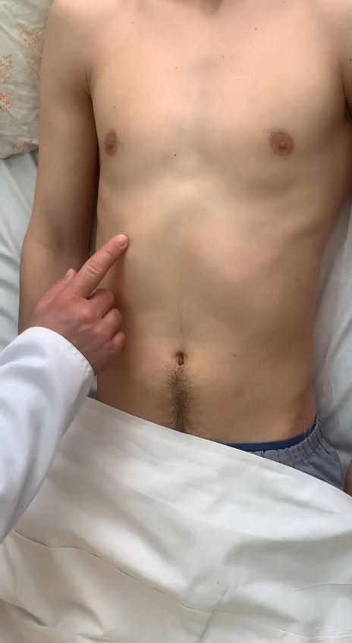
Courvoisier sign
Objective symptom
Courvoisier sign - palpable painless gallbladder in the right hypochondrium
The pathogenesis is due to the lack of evacuation of bile from the bladder as a consequence of the block of the underlying biliary tract (tumor of the head of the pancreas, tumor of the ducts, tumor of the papilla duodeni)

