Slide 1
"Expert systems and modeling in biology and medicine"
Lecture 5

Slide 2
Software
Software is the programs and applications that tell the computer what to do and how to look.
Computer programmers write the codes/instructions that make-up software applications/programs.
HTML is a type of computer programming language that allows programmers to make web pages.
The next 2 slides show what HTML codes look like and the web page the codes produce.

Slide 3
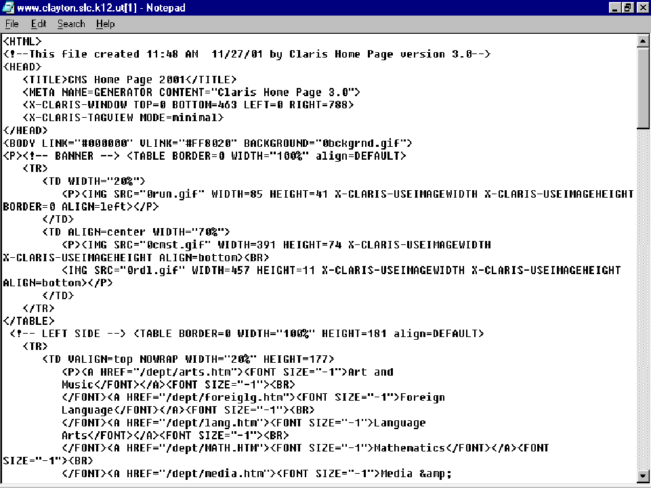

Slide 4
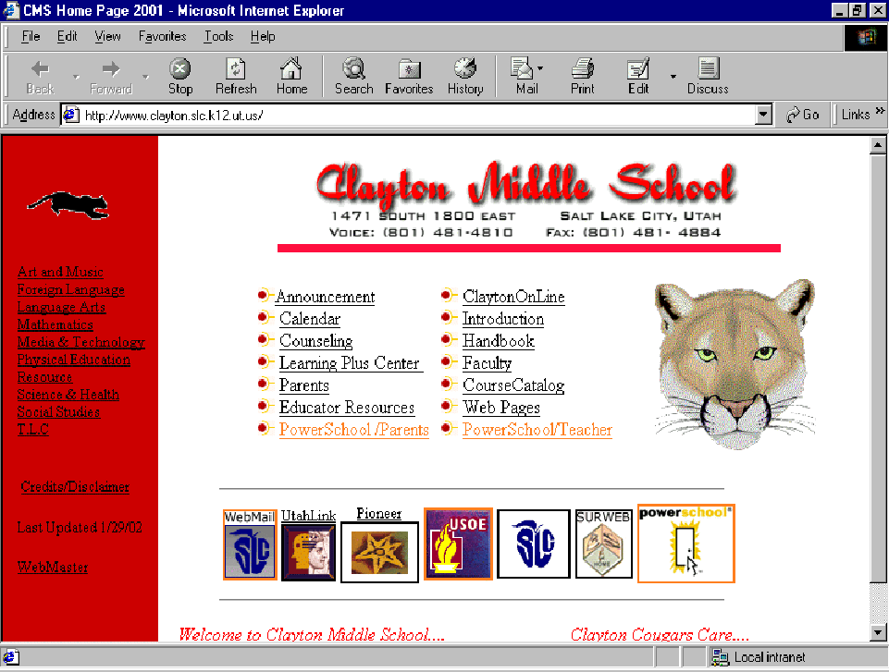

Slide 5


Two Types of Software
Application Software
Operating System Software

Slide 6
Operating System Software
Directs all the activities and sets all the rules for how the hardware and software will work together.
Examples would be:
DOS, Windows 95, 98, ME, NT, XP, Vista, Windows 7
Unix, Linux,
MAC system OS 6,7,8,9,10

Slide 7
Command Line Operating Systems
DOS is an example of a command line operating system.
On the next slide, Notice that there are no:
Icons (pictures)
Colors
Mouse Pointer
Buttons
You have to memorize commands in order to use this text based operating system.

Slide 8
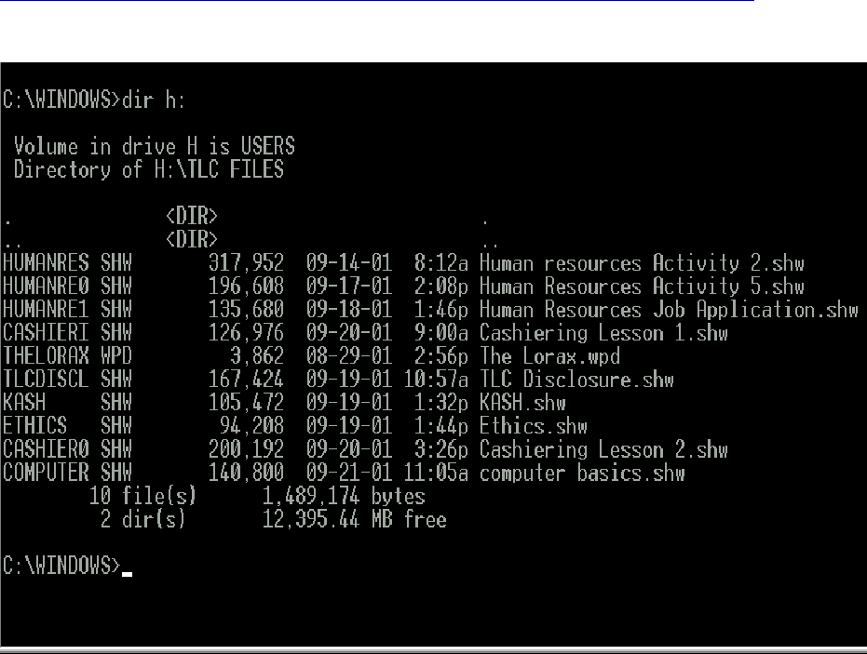

Slide 9
Operating Systems: GUI
GUI stands for Graphical User Interface
Uses pictures (icons) to represent files, folders, disk drives, modems, printers, etc.
GUI’s were created to make using a computer easier, more interesting, non-threatening to inexperienced users.
A mouse allows users to point at something and click to make it work. With command line you have to have all of the commands to make your programs work.
Here is an example of a GUI

Slide 10
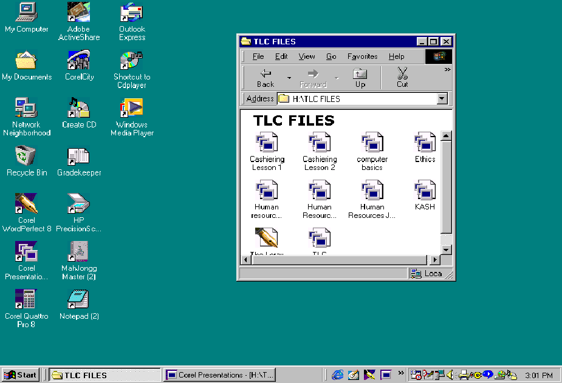

Slide 11
Application Software
Programs that work with operating system software to help the computer to do specific types of work.

Slide 12
Application Software
There are six basic types of application software...

Slide 13
Application Software
1. Business software: word processors, spreadsheets, and database programs.
2. Communication software: allows computers to communicate with other computers: fax software, Novell NetWare, AOL, Modem Software.
3. Graphics software: software that allows users to create and manipulate graphics...Photoshop, Print Shop, etc.

Slide 14
Application Software
4. Education and Reference software: Programs that help teach new material and ideas, and programs that can be used to find information...Encarta, Worldbook Encyclopedia, Jumpstart Kindergarten, MicroType.
5. Entertainment and Leisure software...Warcraft, Age of Empires, Barbie Design Center, Mrs. Pacman, Solitair
6. Integrated software: Combines several types of software into one program or package...Quicken (Spreadsheet/data base/communications/reference) or Print Shop (Graphics/Word processor).

Slide 15




Software

Slide 16
_{Knowledge Systems Architecture}
Brand new advances in information processing technology,
applied mathematics and cybernetics are associated with the creation
of special man-machine systems that are intended for accumulation
and processing of formalized knowledge needed to solve complex
practical problems. Such systems are called knowledge based
systems; the discipline that deals with research, development and
application of such systems is known as knowledge engineering.
Knowledge based systems provide opportunities for solving important problems in various fields of science and technology that was previously available only for people with great experience and intuition. This was made possible by advances in artificial intelligence. The most important practical results of these studies, which seriously affected the development of applied knowledge systems, include the development of methods for knowledge representation and inference (decision making) and research in databases. In general, knowledge systems represent a new qualitative stage in the evolution of information processing systems.
Knowledge reflects our idea of the object domain and expresses a system of concepts, relationships and dependencies between concepts. Examples of concepts: electrical conductor, number; examples of relations between concepts is resistance, amperage and voltage; example of dependence - Ohm’s law.

Slide 17
If you want to transfer some amount of computer knowledge, firstly objects are presented, then relations, which establish the necessary links between the objects and processes that determine creation, destruction, transformation and other types of behavior objects.
Knowledge consists of data objects, relationships and processes. Objects can represent the character of data structures, relationships - lists of properties, processes implemented by computer programs.
As noted in section 1, knowledge can be divided into procedural and declarative.
Procedural knowledge is knowledge relating to the procedures of data processing, methods of inference. This knowledge is represented as a sequence of actions that must be made and a sequence of goals that must be achieved.

Slide 18
Declarative knowledge is coming into the system from experts
and includes facts or axioms and rules relating to these facts. For the declarative form of knowledge base organization, descriptions of objects and their semantic relationships are stored with no information about how data can be used. The procedural form of knowledge is based on the description of domain using procedures in any language (like LISP).
Advantages and disadvantages are characteristic of both procedural and declarative knowledge representation methods. The best approach is to consider problems simultaneously from two positions, because it takes advantage of both of these.
_{Human Computer Interaction}
Before developing a computerized knowledge system it is necessary to answer the question whether computers can make the same decision as an experienced expert (physician) using the same data and knowledge and logical procedures for their processing. In other words, if people can use scientific knowledge and clinical experience for a conclusion, how can we teach computers to use the same knowledge to
arrive at a similar conclusion? To answer this question we first have to figure out what is different between the structure of knowledge in the human brain and the structure of knowledge in the computer. How should knowledge or data be structured in the computer so they can be used to make decisions similar to those taken by a doctor when prescribing treatment? Unfortunately, the key problem here is that we do not know how people keep and use knowledge, we do not know what model is used by the human brain to solve problems.

Slide 19
In database theory such concepts as a data model and its scheme hold a special role. The scheme of a data model is a semantic model of presenting knowledge about data.
The development of data banks (DB) goes towards improving procedures for information retrieval in complex structures. Unlike DB, information that is stored in knowledge models is internally structured not due to tabular forms and documents, but due to using the relations between the observed facts on the control object. In knowledge models relations are defined, fixed outside of semantics and are the same data as the source.
Tracing the evolution of data, we can note several features that distinguish data from knowledge. Firstly, there is observed a lack of orientation data on some specific interpretation and the availability

Slide 20
of special meta-procedures (its necessity is induced by knowledge
itself). Secondly, there is the possibility of internal interpretation.
This data should be provided with attributes, thus they will have
defined semantics. The next step on the path to knowledge is
introduction of relations over such units of information as generic,
temporal, etc. Thirdly, there is the assumption of some recursive
relations with other units of information. In general, differences
between data and knowledge have no clear boundaries.
Thus we can note at least three characteristics of knowledge
_{that distinguish it from data:}
- knowledge can be interpreted;
- links that distinguish knowledge: element-class, class-
subclass, type-subtype, situation-subsituation;
- presence of situational relations that determine situational
_{knowledge compatibility.}
Analyzing these concepts one can argue that the question of
knowledge nature, its classification and systematization is controversial.
The development of computer technology opens new possibilities
of knowledge processing. However, it is necessary to highlight and
present knowledge in the forms in which it is used by the computer.

Slide 21
The core of every knowledge system is a knowledge base (KB)
and inference engine, which are linked to methods of problematic
knowledge representation, processes of obtaining new knowledge
through plausible reasoning. It is the choice of methods of knowledge
representation and gaining that determines the architecture of
knowledge system and in practice takes the form of an appropriate
DB organization and the scheme of output mechanism control.
_{Expert Systems in Medicine}
Recently one finds medical expert systems among the most
dynamically developed knowledge systems. Computer programs are usually designed to solve an exactly

Slide 22
defined number of problems. To expand or change it somehow the
user needs to make relevant changes in the program. But this
improvement requires much time; there is always possibility of
additional errors. Development of artificial intelligence (software
that can simulate some features of human thinking) led to emergence
of a new class of software capable of learning and accumulating
new useful information. This class includes systems based on the
use of knowledge - knowledge-based systems (intelligent systems,
knowledge systems). Older literature uses the term expert systems
because such systems use knowledge acquired from experts, and can
solve problems using the means that to some degree has similarities
to expert reasoning. The peculiarity of this system is the division
into a database that includes medical history, a knowledge base
about the industry, and the inference mechanism. In general,
intelligent system assumes that there is a program of learning
that will be used to build and maintain the knowledge base. Such
a system may also include an explanation module, which helps to
explain its recommendations to users. Expert systems are widely
used in medicine for decision support in solving various problems
of diagnosis, prognosis, treatment, management, training, etc.

Slide 23
_{Artificial Intelligence}
Of course, scientists do not fully know how the human
brain works. Only a few mechanisms were found and now we
are trying to simulate them in artificial intelligence systems.
The term intelligence comes from the Latin intellectus, which
means understanding. Therefore, AI (artificial intelligence) can
be regarded as a property of automatic systems to take certain
features of human intelligence, for example, select and make
better decisions based on prior experience, and rational analysis of
_{external influences.}
The heart of human activity is thinking. The result to which you tend is a goal whose achievement is aimed by cognitive processes of your brain.
Our everyday activities are a sequence of such goals. Each step towards the main goal is part of the sequence. The brain is always focused on the goal (purpose), and no matter physical or intellectual work it performs.
The human brain is a warehouse of a huge amount of data.
People are constantly gaining new knowledge and apply them to

Slide 24
Artificial intelligence is divided into two main areas:
- pragmatic - it concerns work aimed to create programs that
solve logical problems, recognize patterns, classify data, etc.;
- bionic - it develops systems that solve problems by analogy
_{with the human brain.}

Slide 25
The term expert system is naturally associated with the term expert. Expert is a highly qualified, competent professional in some domain that solves problems by using their experience and knowledge. You can identify the following problems that are solved by experts:
- diagnosis - identifying causes of disease or malfunction of technical systems and making recommendations for their elimination;
classification - construction of a hierarchy of concepts or objects, finding a place for a given object or concept in this hierarchy;
prediction - prediction of behavior of an organism, a technical or any other system based on its current status;
planning - making a plan (program) of action for solving a _{problem;}
control - controlling complex systems and making operational _{decisions.}

Slide 26
_{Knowledge Base}
The heart of each ES is the knowledge base. The knowledge base contains both data (information, facts, and statements) about data domain and the rules by means of which these data are used for decision making. In the knowledge base the information concerning professional knowledge in the given field is stored in the form of a structured model of the data domain. Information is classified, synthesized, estimated in respect of its consistency; certain informational units are joined together by various types of links. Languages designed for description of any data domain are called knowledge representation languages.
Data domain description with the use of certain symbol systems
is called knowledge formalization. Knowledge formalization neans its representation in the form of somehow arranged lata that reflect the regularities existing in the specified data lomain. In that way knowledge is described in the form of formal models. In database theory data model means formalism aimed at description of data structure, their dependencies, requirements they should meet.

Slide 27
_{Examples of Expert Systems}
Expert systems are most widely used in diagnosis, not only medical but also technical and economic. Blood infections. Great influence on the development of expert systems was exerted back in 1970 at Stanford University by the system MYCIN, which is now considered classic. This system diagnoses bacterial infection of the blood and makes recommendations for therapy. The knowledge base of MYCIN is hundreds of rules such as IF-THEN that is probabilistic, used to make the right decisions when the data is false. The system has reasoning explainer.
Pharmacokinetics. Pharmacokinetic model allows introducing and quantifying different phases of the exchange product (absorption, distribution, transformation into active and inactive metabolites, excretion). Measurement of biological parameters of the patient and consultation with an expert system allow to individually adjust drug dosage. The clinical use of this method is especially important when using drugs with a narrow therapeutic
window (the optimal dosing interval is small, there is a high risk of failure or overdose).
Therapeutics. The most famous examples of diagnostic expert systems are INTERNIST, CADUCESS, and QMR-system developed at the University of Pittsburgh. The INTERNIST system covers approximately 80 % of therapy and uses basically information about 4500 symptoms and syndromes, 600 diseases. Each disease is described with about 80 symptoms. Given the symptoms presented by the patient, the system identifies different diagnostic hypotheses. Studies have shown that the diagnoses made by the system are equal to the work of an expert. Practical use of the system is complicated by a large amount of time required to work with it.
Chemotherapy. The system ONCOCIN developed by Stanford Oncology Clinic helps with chemotherapy of cancer patients. It helps to choose treatment protocols that can be applied to patients, to determine the dose of chemotherapy and control the course of treatment.

