Slide 1
Information Technology
Information Technology. Basic concepts and definitions
Lesson № 1

Slide 2
What is Information Technology?
The study of information, protocols and algorithms for idealized and real automata.
- automaton: “self moving” – in our context, self “deciding” or autonomous mechanism with bounded resouces (time and space)
- information: knowledge represented in a form suitable for transmission, manipulation, etc.
- protocol: rules for exchanging information without problems
- algorithm: an unambiguous, finite description in simple steps or actions

Slide 3
The concept of information is ambiguous, therefore, consider the summary of the interpretation:
* In the "cybernetic" sense, the concept of information is widely used in the control signal system, which is transmitted over communication lines.
* In the "philosophical" sense, information is closely related to concepts such as interaction, reflection.
* In the "probable" sense, information is understood as information about objects and phenomena of the environment, their parameters, properties and state, which reduce the existing degree of uncertainty and incompleteness of knowledge.
* In the "usual" sense, the word information is used as a synonym for intuitive words: information, meaning, message, awareness.
* For a person, this information, knowledge, messages, a person perceives from the surrounding world with the help of the senses (sight, hearing, taste) ", smell, touch)").

Slide 4
In nature, information exists in various forms:
• Human speech.
• Texts, numbers.
• Light or sound signals.
• Electrical or nerve impulses.
• Gestures, facial expressions.
• Smells or tastes.
• Genetic inheritance
• Other forms.

Slide 5
Classification by presentation
• Continuous information. A quantity characterizing a process continuous in time.
• Discrete information. A sequence of characters that characterizes a discontinuous value that changes.
information properties
• Objectivity. Doesn't depend on circumstances or someone's thought.
• Credibility. Reflects the true state of affairs.
• Completeness. Has enough information to understand and make a decision.
• Relevance. It is essential when working in a constantly changing environment.
• Value (usefulness. Significance). Provides a solution to the task, it is necessary in order to make the right decisions.
• Clarity (clarity). Expressed language, comprehensible.

Slide 6
Basic data operations
... Data collection. Accumulation of information in order to ensure sufficient completeness for decision-making.
... Data formalization. Bringing data from different sources to the same form to make them comparable (which can be measured the same to any degree; wide world) and increase the level of availability.
... Filtering data. Filtering out "unnecessary" data that are not important for decision making. After filtering, the reliability and adequacy of the data should increase.
... Sorting data. Data ordering according to a given criterion for the purpose of ease of use and increasing the availability of information.
... Data archiving. Organization of data storage in a convenient and easily accessible form. This is necessary to reduce the economic costs of data storage and increase the overall reliability of the information process} 'as a whole.
... Data protection. A set of measures aimed at preventing data loss, reproduction and modification.
... Transporting data. Reception and transmission of data between remote participants in the information process) ".
... Data transformation. Transfer of data from one form to another or from one structure to another.

Slide 7
The main properties of information technology are:
• Feasibility.
• Availability of components and their structure.
• Interaction with the external environment.
• Integrity.
• Development in time.
Feasibility. The main goal of the implementation of information technology is to increase the efficiency of production based on the use of modern computers for distributed information processing, distributed databases, various information computer networks by ensuring the circulation and transformation of information.
Components. These are the functional units of information circulation and processing.
Structure. Internal organization that reflects component relationships
Interaction with the external environment. Interaction of information technology with control objects, systems, software and hardware automation.
Integrity .. Information technology is a holistic system that is able to solve problems using the capabilities of its components.
Implementation (development) in time Ensuring the dynamism of the development of information technology, its modification, changing the structure, adding new components.

Slide 8
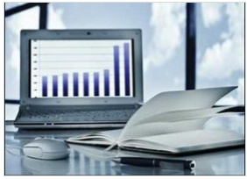
Computer Fundamentals ─ Applications
In this chapter, we will discuss the application of computers in various fields.
Business A computer has high speed of calculation, diligence, accuracy, reliability, or versatility which has made it an integrated part in all business organizations. Computer is used in business organizations for:
• Payroll calculations
• Budgeting
• Sales analysis
• Financial forecasting
• Managing employee database
• Maintenance of stocks, etc.

Slide 9
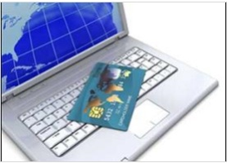
Banking
Today, banking is almost totally dependent on computers. Banks provide the following facilities:
• Online accounting facility, which includes checking current balance, making deposits and overdrafts, checking interest charges, shares, and trustee records.
• ATM machines which are completely automated are making it even easier for customers to deal with banks

Slide 10
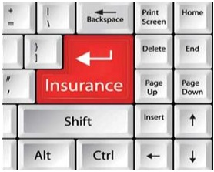
Insurance
Insurance companies are keeping all records upto-date with the help of computers. Insurance companies, finance houses, and stock broking firms are widely using computers for their concerns. Insurance companies are maintaining a database of all clients with information showing:
• Procedure to continue with policies
• Starting date of the policies
• Next due installment of a policy
• Maturity date
• Interests due
• Survival benefits
• Bonus

Slide 11
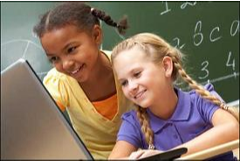
Education
The computer helps in providing a lot of facilities in the education system.
• The computer provides a tool in the education system known as CBE (Computer Based Education).
• CBE involves control, delivery, and evaluation of learning.
• Computer education is rapidly increasing the graph of number of computer students.
• There are a number of methods in which educational institutions can use a computer to educate the students.
• It is used to prepare a database about performance of a student and analysis is carried out on this basis.

Slide 12

Healthcare
Computers have become an important part in hospitals, labs, and dispensaries. They are being used in hospitals to keep the record of patients and medicines. It is also used in scanning and diagnosing different diseases. ECG, EEG, ultrasounds and CT scans, etc. are also done by computerized machines. Following are some major fields of health care in which computers are used.
• Diagnostic System - Computers are used to collect data and identify the cause of illness.
• Lab-diagnostic System - All tests can be done and the reports are prepared by computer.
• Patient Monitoring System - These are used to check the patient's signs for abnormality such as in Cardiac Arrest, ECG, etc.
• Pharma Information System - Computer is used to check drug labels, expiry dates, harmful side effects, etc.
• Surgery - Nowadays, computers are also used in performing surgery.

Slide 13
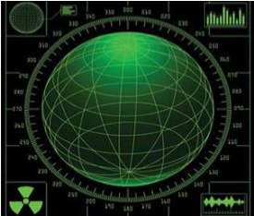
Military
Computers are largely used in defence. Modern tanks, missiles, weapons, etc. Military also employs computerized control systems. Some military areas where a computer has been used are:
• Missile Control
• Military Communication
• Military Operation and Planning
• Smart Weapons

Slide 14
Thank you for attention!

