Slide 1
Information Technology
Basic concepts of information coding. Number systems
Lecture 2

Slide 2
To automate work with data belonging to different types, it is important to bring them to a single form. To do this, as a rule: use an encoding, that is, representations of data of one type through data of another type.
• Natural human speech is a system for coding ideas and concepts for expressing thoughts through speech.
• ABC is a system for encoding language components using graphic symbols.
• In various branches of technology, science and culture, other means of coding are used: mathematical expressions; telegraph alphabet, nautical alphabet, alphabet for the blind, sign language and the like.
Coding (German Kodieren):
Coding (informatics) - the operation of replacing the text data code; replacing plain text data with abbreviated conventions; translation of any information; expressed by means of natural language, in a sequence of conventional symbols, signals according to certain rules; what is called code.
Character encoding is a table, each character from a certain set is assigned a sequence of bytes.
Coding (programming) is the process of writing program code in the selected programming language.
Coding (telecommunications) - converting any information into a sequence of pulses that have the property of self-synchronization for transmission over telecommunications channels.

Slide 3
Binary code
Computer science has its own coding system, called binary code (digital code). It uses only 2 characters "0" and "1" (binary digits).
The information contained in this form is technically easy to simulate. For example, in the form of electrical impulses (there is an impulse - "1", there is no impulse, - "0") or on an optical disk (a transparent section - the ray is reflected - "1", a dark section - the ray is absorbed - "0"),
All information stored and processed by computer technology, regardless of its type (numbers, text, graphics, sound, video), presented in binary code.
The amount of information that is required to store such a character ("0" or "1") is called a bit (bit from the abbreviation of the English words Binar digit).
One bit can encode two values: 0 or 1 (neither or so, false or true, there is no pulse or there is a pulse).
Four values ​​can be encoded with two bits: 00, 01, 10,11.
Three bits encode eight values: 000, 001, 010, 011, 100, 101, PO, 111.
By increasing the number of bits (sometimes called digits) for encoding, the number of values ​​you can encode doubles. Therefore, the number of values ​​is calculated by the formula:
N = 2m,
Where, N is the number of independent values ​​that can be encoded,
m - bit width of binary encoding.

Slide 4
Units of information
The basic unit of information is a bit that takes the value "0" or "1".
To encode characters familiar to humans in computer science, 8 bits are used, with which you can encode 28 = 256 values.
A standard set of 256 characters was developed, called ASCII (American Standard Code for Information Interchange - American Standard Code for Information Interchange). The ASCII code was developed in America, but it is used all over the world, taking into account the national alphabets.
• 128 characters are reserved for letters of the Latin alphabet, numbers, mathematical and other symbols.
• 128 characters are reserved for letters of national alphabets, specific characters.
The amount of information allocated to store one ASCII character is called a byte.
Byte (Byte) is the smallest unit of measure of data, it consists of 8 bits.

Slide 5
Number systems
A number system is a way of writing numbers using a given set of special characters - numbers.
Number systems can be divided into
• non-positional number system.
• Positional number systems.
Non-positional number system
In a non-positional numeral system, the value of each digit in an arbitrary place in a sequence of digits denotes the recording of the number does not change. In a non-positional system, each character in a record, regardless of place, means the same number.
A well-known example of a non-positional number system is the Roman system, in which the letters of the Latin alphabet play the role of numbers:
And - one; C - one hundred; And - n fifty; M - one thousand; V-n five; X - ten; O-n "five hundred;
For example, 324 = _{СССХХУ}
The Roman system lacks the concept of "0". A non-positional number system is inconvenient and difficult for performing arithmetic operations and writing numbers.

Slide 6
Octal number system
Binary Octal
Code code
000 0
001 1
010 2
011 3
100 4
101 5
110 6
111 7
For a computer, binary representation is very convenient and efficient, but for programmers and hardware or software developers, such notation is extremely inconvenient.
To shorten the lengthy binary code entries, it was decided to replace a sequence of three binary digits with one decimal digit. Since iterating over all combinations of three binary digits provides 8 values ​​(23 = 8), this code is called octal and uses only 8 digits (from "0" to "7").

Slide 7
_{Hexadecimal number system}
Subsequently, the grouping of four binary characters and the designation of such a group by one digit were applied in a similar way. Since iterating over all combinations of four binary digits provides 16 values ​​(24 = 16), therefore such a code is called hexadecimal and it uses 10 decimal digits (from "0" to "9") and additional digits denoted by the first letters of the Latin alphabet ("A "," B "," C "," B "," P "," E ").
When debugging programs and in other situations in programming, you need to convert numbers from one number system to another. Therefore, the rules of translation from various number systems have been developed. Translation rules
Translation from the second to the eighth and sixteenth systems
If the base of the new number system is equal to some power of the binary number system (8 = 23, 16 = 24), then the translation algorithm is very simple:
It is necessary to group from right to left binary digits (from the end of the number) in an amount equal to the exponent and replace this group of digits with the corresponding digit of the new number system (if there are not enough digits in the group, then you can supplement the number with zeros on the left).

Slide 8
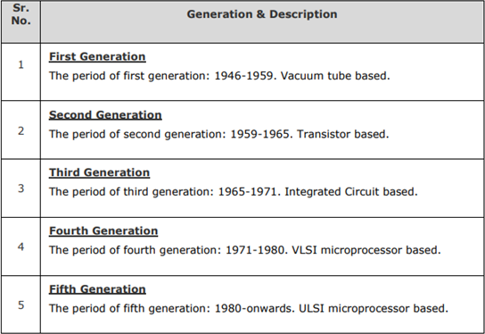
Computer Fundamentals ─ Generations
Following are the main five generations of computers.

Slide 9
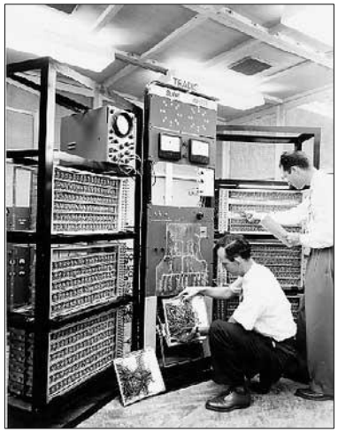
First GenerationComputers
The period of first generation was from 1946-1959. The computers of first generation used vacuum tubes as the basic components for memory and circuitry for CPU (Central Processing Unit). These tubes, like electric bulbs, produced a lot of heat and the installations used to fuse frequently. Therefore, they were very expensive and only large organizations were able to afford it.
In this generation, mainly batch processing operating system was used. Punch cards, paper tape, and magnetic tape was used as input and output devices. The computers in this generation used machine code as the programming language.

Slide 10
The main features of the first generation are:
• Vacuum tube technology
• Unreliable
• Supported machine language only
• Very costly
• Generated a lot of heat
• Slow input and output devices
• Huge size
• Need of AC
• Non-portable
• Consumed a lot of electricity
Some computers of this generation were:
• ENIAC • EDVAC • UNIVAC • IBM-701 • IBM-650

Slide 11
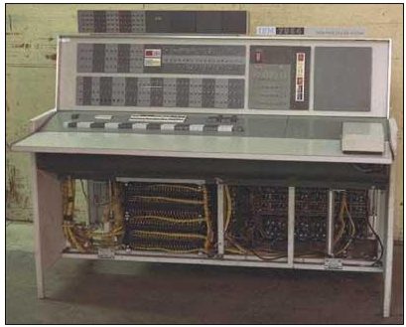
Second Generation Computers
The period of second generation was from 1959-1965. In this generation, transistors were used that were cheaper, consumed less power, more compact in size, more reliable and faster than the first generation machines made of vacuum tubes. In this generation, magnetic cores were used as the primary memory and magnetic tape and magnetic disks as secondary storage devices. In this generation, assembly language and high-level programming languages like FORTRAN, COBOL were used. The computers used batch processing and multiprogramming operating system.

Slide 12
The main features of second generation are:
• Use of transistors
• Reliable in comparison to first generation computers
• Smaller size as compared to first generation computers
• Generated less heat as compared to first generation computers
• Consumed less electricity as compared to first generation computers
• Faster than first generation computers
• Still very costly
• AC required
• Supported machine and assembly languages
Some computers of this generation were:
• IBM 1620 • IBM 7094 • CDC 1604 • CDC 3600 • UNIVAC 1108

Slide 13
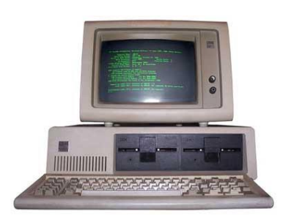
Third GenerationComputers
The period of third generation was from 1965-1971. The computers of third generation used Integrated Circuits (ICs) in place of transistors. A single IC has many transistors, resistors, and capacitors along with the associated circuitry. The IC was invented by Jack Kilby. This development made computers smaller in size, reliable, and efficient. In this generation remote processing, time-sharing, multi-programming operating system were used. High-level languages (FORTRAN-II TO IV, COBOL, PASCAL PL/1, BASIC, ALGOL-68 etc.) were used during this generation.

Slide 14
The main features of third generation are:
• IC used
• More reliable in comparison to previous two generations
• Smaller size
• Generated less heat
• Faster
• Lesser maintenance
• Costly
• AC required
• Consumed lesser electricity
• Supported high-level language
Some computers of this generation were:
• IBM-360 series • Honeywell-6000 series • PDP (Personal Data Processor) • IBM-370/168 • TDC-316

Slide 15
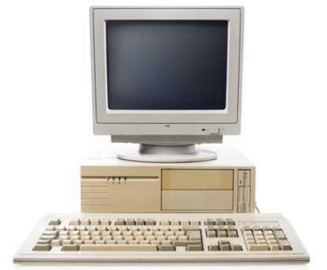
Fourth GenerationComputers
The period of fourth generation was from 1971-1980. Computers of fourth generation used Very Large Scale Integrated (VLSI) circuits. VLSI circuits having about 5000 transistors and 18 other circuit elements with their associated circuits on a single chip made it possible to have microcomputers of fourth generation. Fourth generation computers became more powerful, compact, reliable, and affordable. As a result, it gave rise to Personal Computer (PC) revolution. In this generation, time sharing, real time networks, distributed operating system were used. All the high-level languages like C, C++, DBASE etc., were used in this generation.

Slide 16
The main features of fourth generation are:
• VLSI technology used
• Very cheap
• Portable and reliable
• Use of PCs
• Very small size
• Pipeline processing
• No AC required
• Concept of internet was introduced
• Great developments in the fields of networks
• Computers became easily available
Some computers of this generation were:
• DEC 10 19 • STAR 1000 • PDP 11 • CRAY-1(Super Computer)
• CRAY-X-MP(Super Computer)

Slide 17
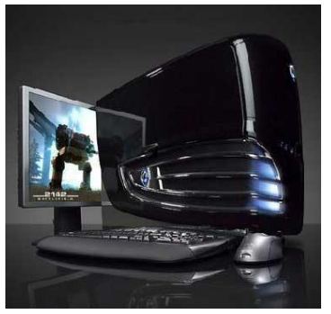
Fifth Generation Computers
The period of fifth generation is 1980-till date. In the fifth generation, VLSI technology became ULSI (Ultra Large Scale Integration) technology, resulting in the production of microprocessor chips having ten million electronic components. This generation is based on parallel processing hardware and AI (Artificial Intelligence) software. AI is an emerging branch in computer science, which interprets the means and method of making computers think like human beings. All the high-level languages like C and C++, Java, .Net etc., are used in this generation.

Slide 18
AI includes: • Robotics • Neural Networks • Game Playing • Development of expert systems to make decisions in real-life situations • Natural language understanding and generation
The main features of fifth generation are: 20
• ULSI technology
• Development of true artificial intelligence
• Development of Natural language processing
• Advancement in Parallel Processing
• Advancement in Superconductor technology
• More user-friendly interfaces with multimedia features
• Availability of very powerful and compact computers at cheaper rates
Some computer types of this generation are:
• Desktop • Laptop • NoteBook • UltraBook • ChromeBook

