Slide 1
Lecture 3
Basics of computer networks

Slide 2
Fundamentals of Computer Networking
It's hard to imagine life without computers these days. Computers are needed in manufacturing, offices, banks, educational institutions and at home. They opened a new stage in the life and development of human civilization. However, for efficient processing and transmission of information, it is important to integrate computers with each other.
The first experiments to create computer networks were carried out in 1965 by researcher Larry Robertson (Massachusetts Institute of Technology). Since then, humanity has been developing and improving the ability to combine computers into computer networks.
The overview of computer networks can be divided into 2 large classes:
... Local area networks LAN {Local Area Network).
... Global, remote networks WAN (Wide Area Network).
local area networks
Local networks are the unification of a different number of computers by a single cable system; they are located at a relatively small distance between themselves (from 10 m to 100 km). Created within the same premises, organization or area.

Slide 3
Today, wireless local area networks are popular, where terrestrial channels (radio, infrared and ultrashort waves) are used as a unifying medium.
LAN capabilities
- Data exchange and collective data processing.
- Sharing programs.
- Sharing printers and hard drives.
: To create local networks you need
Equip computers with network cards.
Connect computers with cables through which data transfer occurs.
Install and configure the corresponding software on computers.

Slide 4




simple. The easiest way to combine. They are used for a small number of computers (2-3) located in the same room or at a short distance (2-5 m). Cables connect either to the output of network cards or to USB ports (then network cards are not required).
tire. Computers are connected to one channel at the ends of which there are stubs. Such a combination is simple, economical, aie not entirely reliable and fast.
Star. All computers are connected to a central device, which can be either a computer or a special device (swith). The interconnection is reliable, high-speed, but more expensive due to the large number of cables and the central device.
Ring. Combining computers in a circle. The cost of the network is low, the information after sending it reaches the sender, allows you to control its safety. But the speed and reliability of such a combination is somewhat low.

Slide 5
Global networks
They are divided into regional and international. Regional are created in certain areas, city, state, and international provide communication with any computer in the world. Communication in global networks is provided through telephone or satellite communication lines; for this, the computer must be equipped with a modem. This connection is called remote access, and user computers are called subscribers.
The functioning of global networks is supported by special computers of the provider company. They are called servers and are used for administrative purposes only. Administrators keep records of subscribers, provide each of them with their own address, check the status of the network, expand or narrow the network.
For the simultaneous connection of a large number of users, the server has special means - a multi-line telephone or multi-port network cards. On the other hand, it is connected to other servers via high quality dedicated lines - backbones.
Providers provide services on a contractual basis, focusing on the user's work time or the amount of data transferred. When concluding a contract, the provider provides the user with all the attributes necessary for work - phone numbers, identifiers, passwords). Protective functions from the flow of unnecessary information are carried out by a program installed on the server and called a firewall.

Slide 6
Popular Internet Services
-. Web service. Internet Information Service. The basic concept of the service is hyperlinks, which are contained in the text of the page and allow the user to travel both within a particular site and to go to other sites. The client for the Web service is a browser.
- Web forums,
- Blogs.
- Wiki projects (Wikipedia).
- Internet shops,
- Internet auctions,
- Internet advertising,
- Social networks,
- Multiplayer games.

Slide 7
1. Communication services
1. Email. Email service. Allows users around the world to exchange text messages in which you can attach various files. The client program can be either a browser or specialized mail clients.
2. Instant messaging services, instant messengers, Internet chats. Designed for communication of many participants in real time. Mostly chats are intended for entertainment, dating, serious issues are usually not discussed here. The client is a browser.
3. Search engines
4. News and mailing services
The user chooses a topic and subscribes to a cycle of articles (mailings), which will be sent to him with a certain frequency.
RSS technologists. News service from selected sites. Instant display of any new arrivals, news feed.

Slide 8
5. File services
RTR servers. File transfer service. Allows you to emulate the file structure of a remote computer on your own computer and work with it as with a local directory, for example, download files from the PTP server to your computer and vice versa. The client program can be a browser, file manager, or a specialized RTP client.
- File hosting
- File sharing networks
6. Broadcasting services
Internet radio. A service that allows you to listen to hundreds of radio stations broadcasting on the Internet. There is a possibility to select radio stations, taking into account the language and subject of broadcasting (for example, news). Music radio stations can be filtered by music style (popular, classical or retro music). The number of radio stations on the Internet is constantly growing.
Internet television. A service that allows you to receive many television channels.
7. Services of remote access.
Provides client access to another remote computer and provides the ability to work on it as if it were on your own
8. Electronic payment systems
There are many services on the Internet and their list is constantly growing. The main concern of developers is to ensure the reliability and usability of the corresponding service.

Slide 9
Computer Basics
There are many types of computers including:

Slide 10
Types of Computers
Supercomputers...are used to process very large amounts of information including processing information to predict hurricanes, satellite images and navigation, and process military war scenarios.
Mainframes...are used by government and businesses to process very large amounts of information.
Mini-Computers...are similar to mainframes...they are used by business and government to process large amounts of information.
Personal Computers (PC)…

Slide 11
Types of Computers
Personal Computers (Continued)
Personal Computers...also known as PC’s...are smaller and less powerful than the others. They are used in homes, schools, and small businesses.

Slide 12
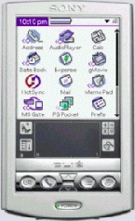
Types of Computers
There are 3 main types of PCs
Desktop
Portable (Notebook/Laptop)
When portable (notebook/laptop) computers were first created they were HUGE. They weighed around 100 lbs., and were carried in a large luggage suitcase. The creators of the portable (notebook/laptop) computer dreamed that one day it would be the size a notebook or pocket dictionary. With today’s technology, we have been able to accomplish this goal and more..
Hand-Held

Slide 13


Networks
A network is a group of computers that share information and hardware.
The computers are connected together using copper phone wires, fiber optic cables, or radio waves.
Our computers are on a network here at school...Look under the table and see the blue wires that connect your computer to the network.
The internet is many networks around the world that are all connected together to make 1 huge network.

Slide 14
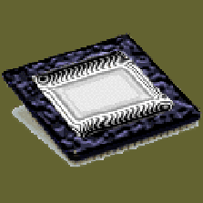
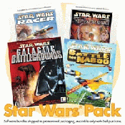
Parts of a Computer
There are two basic parts that make up a computer...
Hardware
Software

Slide 15
Hardware
Hardware is basically anything that you can touch with your fingers.
Computer Case
CPU (central processing unit...Pentium chip)
Monitor
Keyboard & Mouse
Disk Drive, Zip Drive, CD-ROM, DVD,
Hard Drive
Memory (RAM)
Speakers
Printer

Slide 16
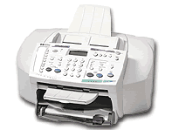
Hardware (Continued)
There are three types/categories of hardware
1. Input Devices
2. Output Devices
3. Storage Devices

Slide 17
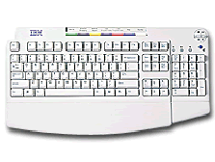
Input Devices
Input basically means getting data into the computer to be processed.
Keyboard, Mouse,
Trackball, Touch Pad
Light Pen, Laser Scanner,
Pointing Stick
Touch Screen,
Bar Code Reader, Scanner
Microphone, Joystick

Slide 18
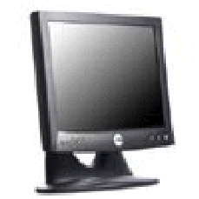
Output Devices
Output basically means getting data out of the computer.
Monitor
Printer
Speakers
Headphones
Modem
Fax

